Slide 1

Verification: Testbenches in Combinational Design
IAX 0600 Digital Systems Design
Alexander Sudnitson
Tallinn University of Technology

Slide 2
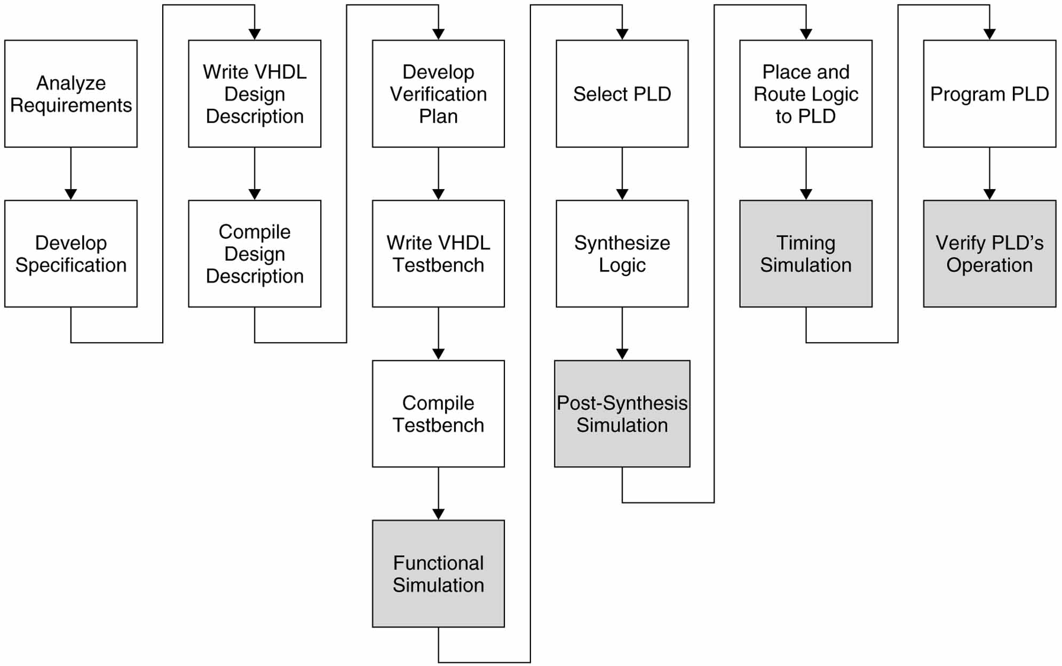
VHDL / PLD (FPGA) Design Flow
In our course
PLD ⬄ FPGA

Slide 3
Design verification
We want to verify that our design is correct before the target FPGA (PLD) is programmed. The process performed to accomplish this is design verification.
An advantage of using VHDL is that the is written in the same language as the design description. Since a testbench is not synthesized, it can be written using any of the constructs and features of VHDL.
There are two basic things that we need to verify
One is that our design achieves its intended functionality.
The other is that our design, after being synthesized and mapped to the target PLD, will meet its timing requirements.

Slide 4
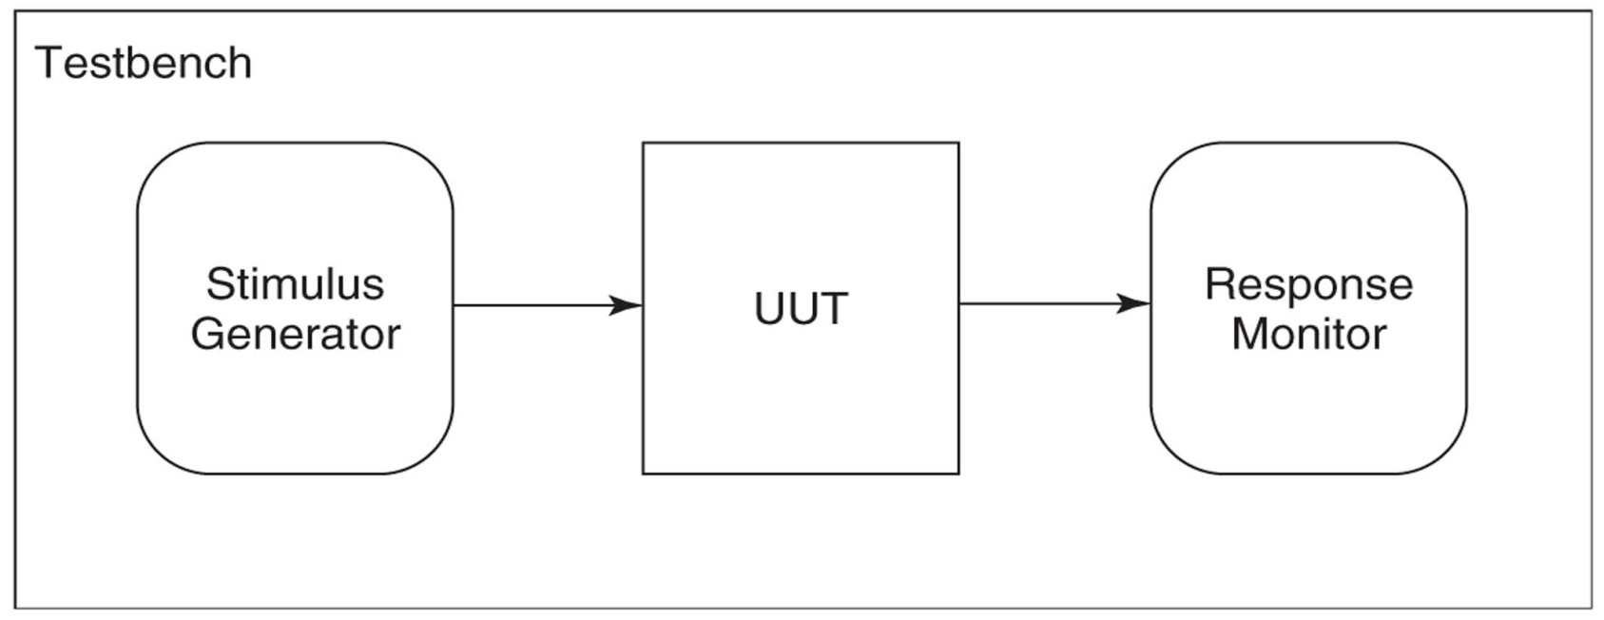
Typical constituents of a simple testbench
UUT (Unit Under Test)
For a functional verification, the design description is the UUT.
For a timing verification, the VHDL timing model generated by the place-and-route tool is the UUT.
Stimulus generator. For combinational designs, only combinations of the values of ‘0’ and ‘1’ , or sequences of combinations are applied.
Response monitor. In response to each stimulus, the UUT output values must be checked to verify that they are identical to the expected.

Slide 5
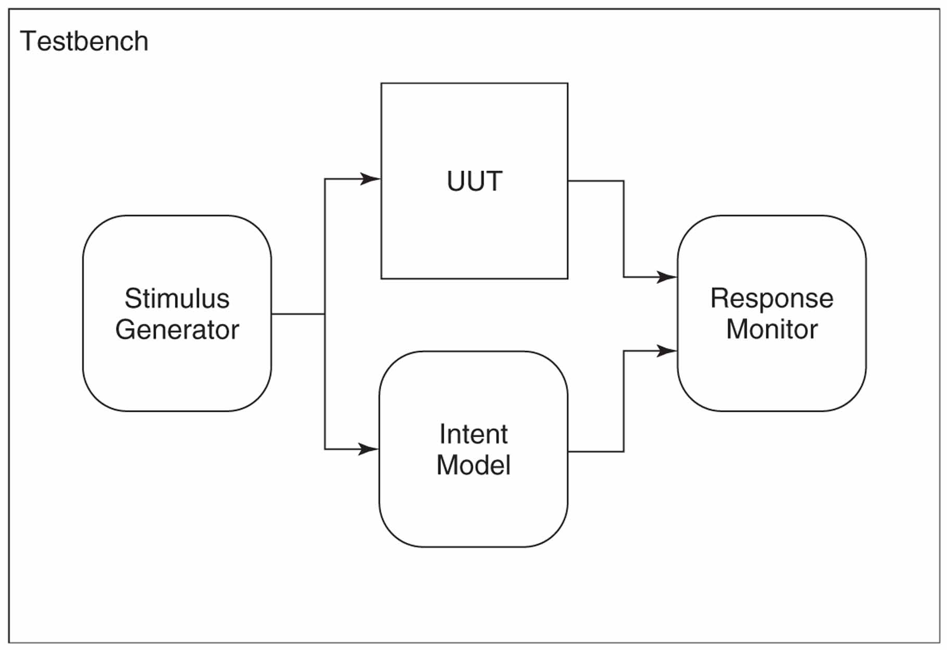
Self-checking testbench
The intent model models the expected UUT response to the stimulus. It is also referred to as the golden model. Using an intent model, the response monitor simply compares the UUT’s output with that of the intent model, for each stimulus applied.

Slide 6
Testbench development
The stimulus must not contain any metalogical or high-impedance values. Logical values ‘L’ and ‘H’ are replaced by ‘0’ and ‘1’, respectively. As a result, only combinations of the values ‘0’ and ‘1’ are applied as stimulus.
Determine the intent of the design from its specification.
Determine a strategy for verification of the design.
Determine the stimulus needed to achieve the design verification.
Create a model that represents the intent of the design.
Create the stimulus generator.
Evaluate the adequacy of the verification.

Slide 7
What is actually being verified?
Our determination of the intent of system from its natural language specification is our personal interpretation of that specification.
Ideally, the final testbench for a design is developed and written by persons other than those who wrote the design description.
Since a combinational design’s outputs at any time are a function only of its inputs at that time, the order in which input combinations are applied does not affect the verification results. For a combinational design, an exhaustive verification requires the application, in any order, for a UUT with n inputs 2^{n} possible input combinations.
In contrast, exhaustive verification of a sequential design requires that every possible sequence of input combinations be applied to the UUT (exhaustive verification is impractical).

Slide 8
Testbench using projected waveforms
The simplest testbench don’t include code for a response monitor or an intent model. They just apply stimulus to the UUT. We must the visually verify UUT output values by inspecting waveforms using the simulator’s waveform editor.
Signals are projected waveforms (a signal has a current value, and future scheduled values). Two simple ways of generating a stimulus are:
Using a projected signal assignment
Using a process with wait statements

Slide 9
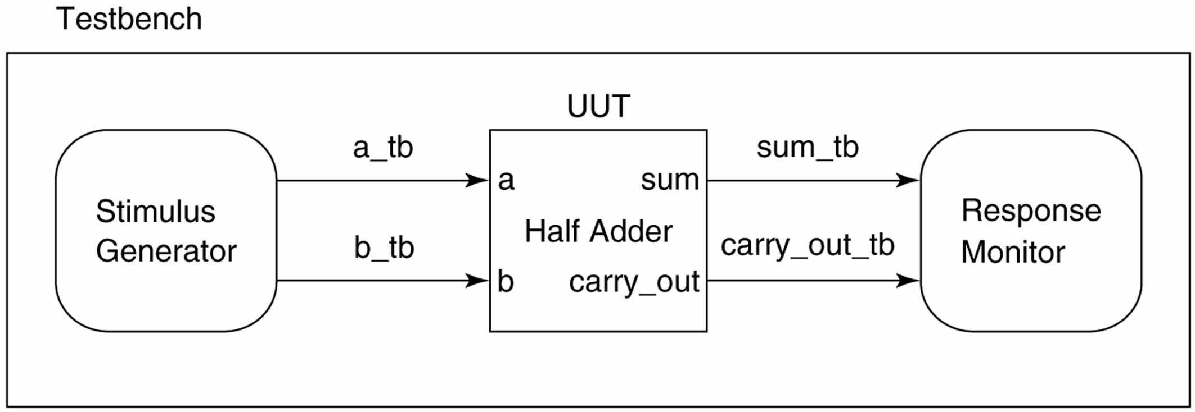
Testbench using projected waveforms
In order to simulate the operation of a UUT using a testbench, we must actually simulate a testbench, since the UUT is simply a component in the testbench.

Slide 10
Testbench of a half adder
library ieee ; use ieee.std_logic_1164.all ;
entity testbench is --testbench entity has no ports
end testbench ;
architecture waveform of testbench is
-- stimulus signals
signal a_tb, b_tb : std_logic ;
signal sum_tb, carry_out_tb : std_logic ;
begin
-- UUT port map; the label uut as name is not significant
UUT : entity half_adder port map ( a => a_tb, b => b_tb,
sum => sum_tb, carry_out => carry_out_tb ) ;
-- generating stimulus values
a_tb <= '0', '1' after 40 ns ;
b_tb <= '0', '1' after 20 ns, '0' after 40 ns, '1' after 60 ns ;
end waveform ;

Slide 11
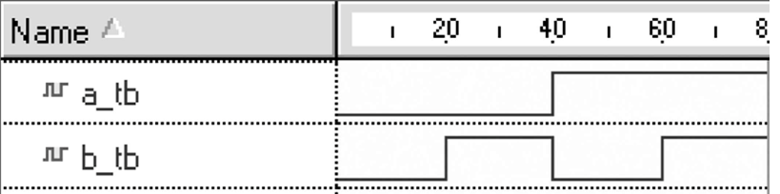
Statement with multiple waveform elements
a_tb <= '0', '1' after 40 ns ;
b_tb <= '0', '1' after 20 ns, '0' after 40 ns, '1' after 60 ns ;
The optional after clause specifies when its associated value should become the new value of a signal.
Transactions in the signal assignment statement must be in ascending order with respect to time.
After clauses are not synthesizable.

Slide 12
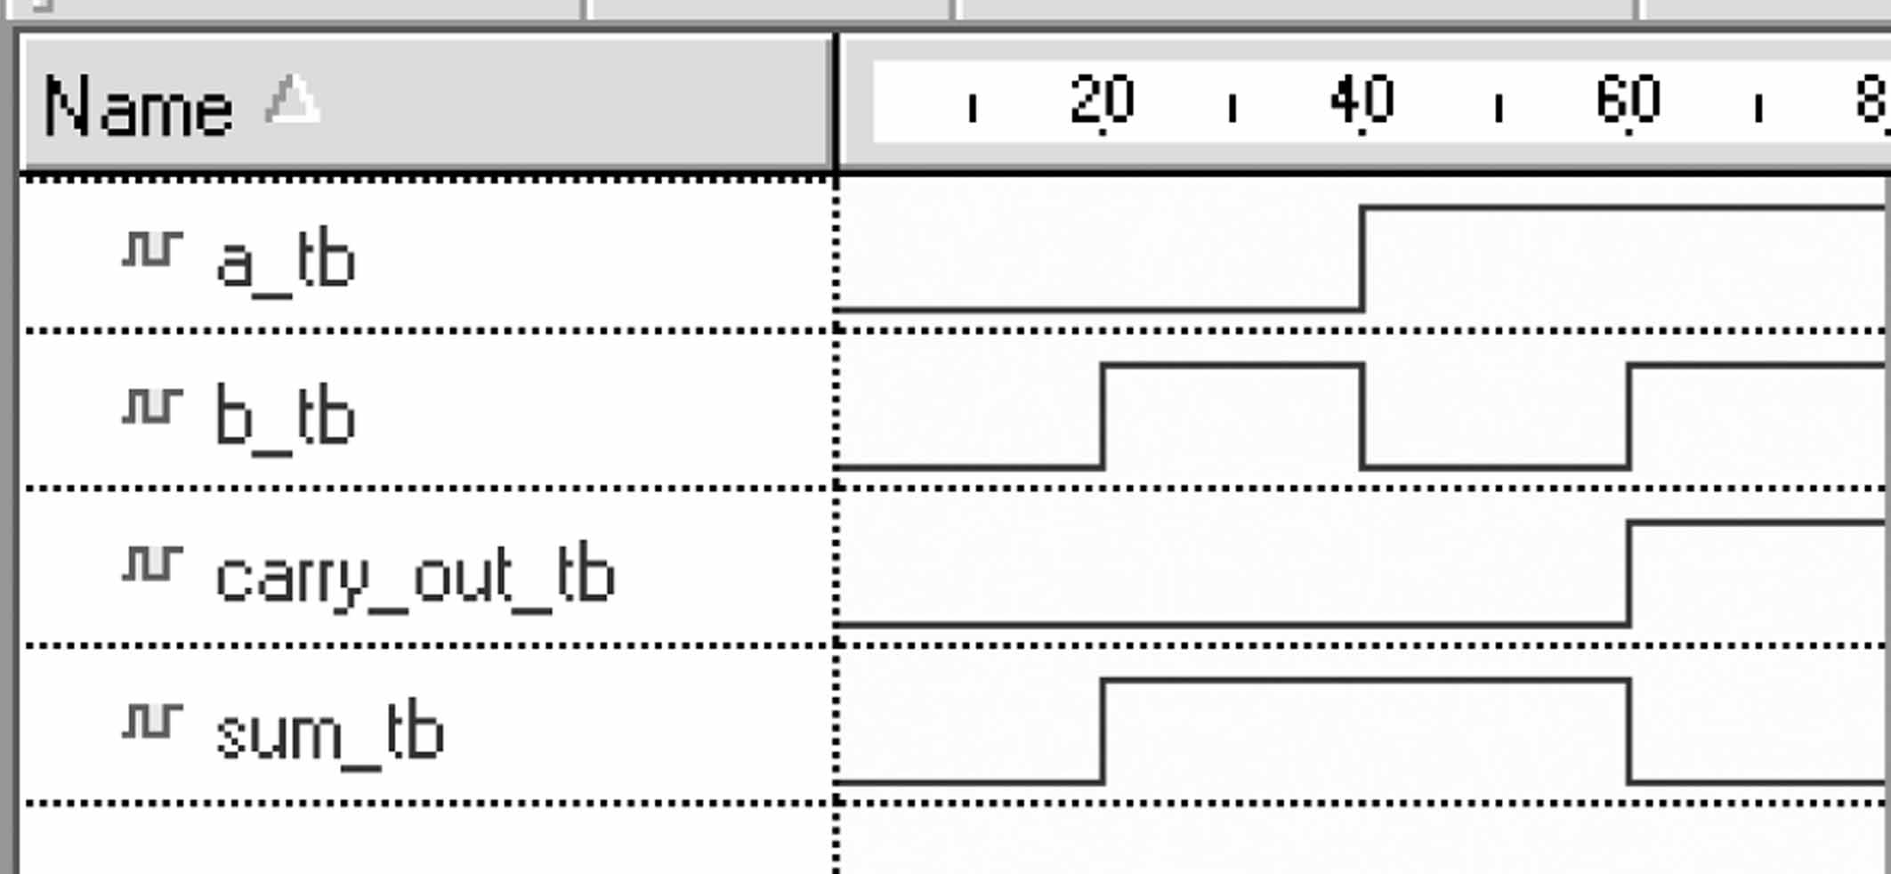
Timing waveform from example simulation
If the entity testbench is simulated for 80 ns, the waveforms shown above are produced.
There are no statements in this testbench to stop the simulation; we can either set the maximum simulator time limit prior to starting the simulation, or let the simulator run until there are no further stimulus changes to process.

Slide 13
Physical types
Physical types are numeric types used to represent real-world physical quantities such as time, frequency, voltage, and current.
type time is range implementation_defined
units
fs; -- femtosecond
ps = 1000 fs; --picosecond
ns = 1000 ps; --nanosecond
us = 1000 ns; --microsecond
ms = 1000 us; --millisecond
sec = 1000 ms; --second
min = 60 sec; --minute
hr = 60 min; --hour
end units ;
Type time is the only predefined physical type. It is used extensively to specify delays. Type time is declared in package STANDARD.

Slide 14
Single process testbench
A single process testbench includes a process that applies a stimulus to the UUT, waits an appropriate length of time, and then checks the UUT outputs. The wait between applying each stimulus results in waveform being generated. The functionality of the stimulus generator and response monitor are provided by the single process.
A single process testbench has two concurrent statements in its architecture body:
One instantiates the UUT.
The other is the process that applies the stimulus and verifies the UUT output values
Since the UUT instantiation and the process are both concurrent statements, either one can appear first in the architecture body (however, instantiation of the UUT first is the more common practice).

Slide 15
Testbench for a half adder (architecture)-1
architecture waveform of testbench is
-- Declare local signals to assign values to and to observe
signal a_tb, b_tb : std_logic ; sum_tb, carry_out_tb : std_logic ;
begin
-- Create an instance of the circuit to be tested
uut: entity half_adder port map ( a => a_tb, b => b_tb,
sum => sum_tb, carry_out => carry_out_tb ) ;
-- Define a process to apply input stimulus and verify outputs
tb : process
constant period: time := 20 ns ;
begin --Apply every posiible input combination
a_tb <= '0' ; b_tb <= '0' ;
wait for period ;
assert ((sum_tb = '0' and (carry_out_tb = '0'))
report "test failed for input combination 00" severity error ;

Slide 16
Testbench for a half adder (architecture)-2
a_tb <= '0' ; b_tb <= '1' ;
wait for period ;
assert ((sum_tb = '1' and (carry_out_tb = '0'))
report "test failed for input combination 01" severity error ;
a_tb <= '1' ; b_tb <= '0' ;
wait for period ;
assert ((sum_tb = '1' and (carry_out_tb = '0'))
report "test failed for input combination 10" severity error ;
a_tb <= '1' ; b_tb <= '1' ;
wait for period ;
assert ((sum_tb = '0' and (carry_out_tb = '1'))
report "test failed for input combination 11" severity error ;
wait ; -- indefinitely suspend process (is important)
end process ;
end ;

Slide 17
Wait statements in a testbench
The use of a wait statement to produce a delay between the application of each stimulus, and the use of an assertion statement to automatically verify the UUT’s response, is common practice.
There are three reasons why the wait statement is required (for our example):
the signal assignment can not take effect until after process suspends
waiting for a time interval allows the new input values to appear in the simulator waveforms for this time period
the wait statements allow this same testbench to be used later, without modification, for timing simulation (after design being synthesized and mapped).

Slide 18
Wait statements
A process with no wait statement (or sensitivity list) executes its statements in sequence, starting at the first statement. After the last statement in the process is executed, the process immediatelly continues executution at the first statement, forming an infinite loop. As a result, the process never suspends.
A wait statement suspends and resumes execution of the process containing the statement.
Std 1076.6 2004 supports synthesis of all wait statements, except wait for statements.
Std 1076.6 1999 only allowed wait until statement per process for synthesis.

Slide 19
Wait statements
If only one, or none, of the optional clauses is included, four forms result:
wait on sensitivity_list;
wait until boolean_expression;
wait for time expression;
wait;
When an event occures on any one of signals of sensitivity list (or in the boolean expression), the process resumes execution.

Slide 20
Assertion statements in a testbench
Use of assertion statements eliminate the need to visually inspect timing waveforms.
In half_adder example the condition in the assertion statement requires that:
((sum_tb = '0' and (carry_out_tb = '0'))
If this condition is true, the next message in the process is executed (without any message). If it is false, the message
"test failed for input combination 00“
is generated and severity level error is assigned.
The message aids debugging by making it clear for which input combination the failure occurred.

Slide 21
Assertion and report statements
An assertion statement checks whether a specified a specified condition (the assertion) is true. If it is not true, a message is displayed. This approach can eliminate the need to visually inspect simulator waveforms.
A severity level indicates the degree to which an assertion violation affects operation of the system and what actions the simulator must take. Type severity_level is predefined in package STANDARD as:
type severity_level is (note, warning, error, failure);
In addition to the report clause in an assertion statement, there is a separate statement called a report statement (look LRM). A report statement displays a message every time it is executed. Whenever executed, a report statement always generates the message associated with the report expression.

Slide 22
Severity levels
Note is simply used to display informative messages during a simulation
Warning is used to indicate an unusual situation where the simulation can continue but may produce unusual results
Error is used to indicate a situation where corrective action should be taken
Failure is used to indicate a situation that should never arise
If severity clause is omitted, the default level is error

Slide 23
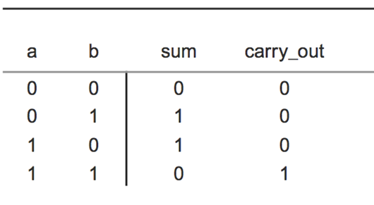
Table Lookup
A simple way to describe a combinational system is to use a table lookup. For a system with a single output the table is represented as a constant vector. For a system with multiple outputs an array of constant vectors is used. For any input combination we can then determine the output by simply looking it up in the table.
index
0
1
2
3

Slide 24
Records
A record is a composite type that consists of named elements that may be of different types. Elements in a record are selected by name, not by an index number. The value of
a record object is the composite value of its elements.
The entire value of a signal, variable, or constant record can be assigned to a signal or variable of the same record type using an assignment statement. When a single element of a record is to be selected for assignment to an object of the same element type or a value is to be assigned to a single element of a record, that element’s selected name is used. A selected name consists of a prefix and a suffix separated by a period. For an element of a record, the prefix is the record name and the suffix is the element name.

Slide 25
Records and lookup testbenches (testbench for half adder)
library ieee; use ieee.std_logic_1164.all;
entity testbench is
end testbench;
architecture table of testbench is
signal a : std_logic;
signal b : std_logic;
signal sum : std_logic;
signal carry_out : std_logic;
type test_vector is record
a : std_logic;
b : std_logic;
sum : std_logic;
carry_out : std_logic;
end record;
Stimulus signals
Observed signals
Declare record type

Slide 26
Records and lookup testbenches (testbench for half adder)
type test_vector_array is array (natural range <>) of test_vector;
constant test_vectors : test_vector_array := (
-- a, b, sum, carry_out
('0', '0', '0', '0'),
('0', '1', '1', '0'),
('1', '0', '1', '0'),
('1', '1', '0', '1'));
begin
UUT : entity half_adder
port map (a => a, b => b, sum => sum, carry_out => carry_out );

Slide 27
Records and lookup testbenches (testbench for half adder)
verify : process
begin
for i in test_vectors'range loop
a <= test_vectors(i).a;
b <= test_vectors(i).b;
wait for 20 ns;
assert (( sum = test_vectors(i).sum )
and (carry_out = test_vectors(i).carry_out))
report "test vector " & integer'image(i) & " failed"&
" for input a = " & std_logic'image(a)
& " and b = " & std_logic'image(b)
severity error;
end loop;
wait;
end process;
end table;
We use the predefined image attribute, integer'image(i), to convert the loop index to a string equal to the index value, so that the index of the specific test vector that failed can be displayed. The report statement will display the values of a_tb and b_tb at the time that the statement is executed.

Slide 28
Testbench that computes expected results
In previous testbenches, expected output values were predetermined for each input combination and included in the testbench as literals. Alternatively, a testbench can be written so that the expected output values are computed during the simulation. In a single process testbench, the same process is used to apply stimulus and compute and verify expected results.

Slide 29
Types UNSIGNED and SIGNED
Type std_logic is not defined as a numeric representation, no arithmetic operators are not defined for it in package STD_LOGIC_1164.
To avoid confusion separate types were created for numeric representation in package NUMERIC_STD:
type unsigned is array (natural range < >) of std_logic;
type signed is array (natural range <>) of std_logic;
Type signed is interpreted as a signed binary number in 2´s complement form. The leftmost element is the sign bit.

Slide 30
Context clause to use unsigned and signed
The type unsigned is defined in pakcage NUMERIC_STD.
LIBRARY ieee;
USE ieee.std_logic_1164.all;
USE ieee.numeric_std.all;

Slide 31
Type conversion
To make an assignment of the value of one type to one of the others, the type of the value being assigned must be converted to the target type.
For example, if signal x is declared as type std_logic_vector and signal y is declared as type unsigned, and they are of equal length, each of the following assignments is illegal:
x <= y ; --illegal assignment, type conflict
y <= x ; --illegal assignment, type conflict
However, appropriate type conversions allow the following assignments to be made:
x <= std_logic_vector (y) ; -- valid assignment
y <= unsigned (x) ; -- valid assignment

Slide 32
Testbench that computes expected results
library ieee ;
use ieee.std_logic_1164.all ;
use ieee.numeric_std.all ;
entity testbench is
end testbench ;
architecture behavior of testbench is
-- Declare signals to assign values to and to observe
signal a_tb, b_tb, sum_tb, carry_out_tb : std_logic ;
begin
-- Create an instance of the circuit to be tested
uut: entity half_adder port map ( a => a_tb, b => b_tb,
sum => sum_tb, carry_out => carry_out_tb ) ;

Slide 33
Testbench that computes expected results
-- Define a process to apply input stimulus and test outputs
tb : process
constant period: time := 20 ns ;
constant n : integer := 2 ;
begin --Apply every posiible input combination
for i in 0 to 2**n - 1 loop
(a_tb, b_tb) <= to_unsigned (i, n) ;
wait for period ;
assert ((sum_tb = (a_tb xor b_tb)) and (carry_out_tb = (a_tb and b_tb)))
report "test failed" severity error ;
end loop ;
wait ; -- indefinitely suspend process
end process ;
end ;

Slide 34
Using function to_unsigned
This function has two parameters. The first parameter is the integer to be converted. The second is the length of the returned unsigned vector. This vector’s element values are the binary equivalent of the integer value passed to the function.
In the statement (a_tb, b_tb) <= to_unsigned (i, n) ; the unsignet vector value returned by the to_unsigned function is assigned to an aggregare made up of the scalar input signals. Since each of these scalar inputs is type std_logic, the assignment is valid.

Slide 35
Typical FPGA design flow

Slide 36
Synthesizer
The objective of a synthesizer is to synthesize logic that behaves identically to the simulated behavior of the design description. A synthesizer translates a design description into a functionally equivalent gate-level logic implementation.
A synthesizer requires two inputs: the design description file and the specification of the target PLD
The synthesizer produces two output files:
A VHDL netlist – a design file that describes, in VHDL structural style, the connectivity of the optimized logic implemented using the target PLD’s primitives. The VHDL netlist is used as UUT model in a post-synthesis simulation.
A technology dependent gate-level netlist.
A netlist is a textual representation of the interconnections.

Slide 37
Synthesizer
Typically, a synthesizer performs three steps during synthesis:
Language synthesis: the design description is transformed into a representation based on Boolean equations.
Optimization: algorithms apply the rules of Boolean algebra to optimize the logic for area and /or speed. This optimizations are independent of the technology of the target PLD and produce a technology-independent netlist.
Technology mapping: the logic is mapped to the target PLD. This step corresponds to transforming the technology independent netlist to a technology dependent netlist.

Slide 38
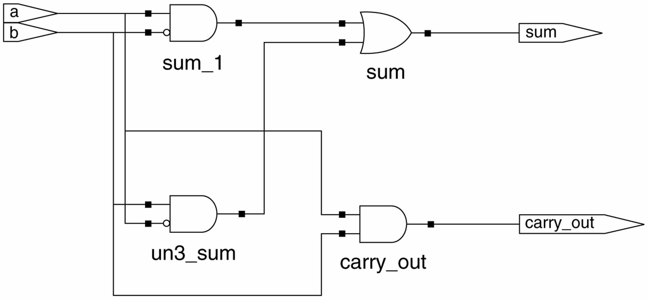
Half-adder after language synthesis step

Slide 39
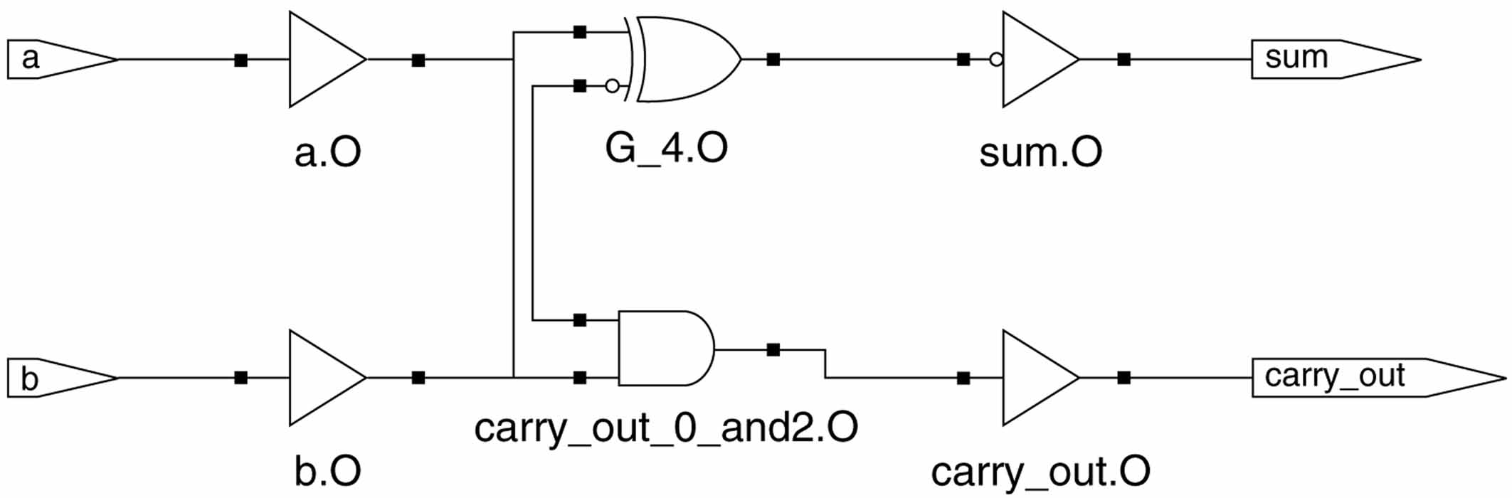
Technology dependent view of half-adder
22V10 SPLD was selected as the target PLD for half-adder design.

Slide 40
Post-synthesis (gate-level) simulation
Simulation of the VHDL netlist is called post-synthesis simulation, since it simulates the structural interconnection of the gates and flip-flops synthesized for a design.
The results from this simulation are compared with the results from the functional simulation of design description. These results should be the same.
If a timing simulation is to be performed, post-synthesis simulation may be skipped.

Slide 41
Place-and-route phase of design flow
A place-and-route (or fitter) tool is software used to automatically map or fit synthesized logic to a target PLD’s architecture.
The place operation selects and configures specific logic primitives in the PLD’s architecture for each logic primitive in the technology dependent netlist.
The route operation determines the path for each connection between a logic primitive and a pin of the PLD.
The place-and-route tool is usually obtained from PLD vendor.
A place-and-route tool uses as its inputs a technology dependent gate-level EDIF netlist and constraint information such as pin assignments for port signals and timing constraints.

Slide 42
Place-and-route phase of design flow
A technology dependent netlist describes the connectivity of the optimized logic using the target PLD’s logic primitives. These primitives are the logic elements available in the target PLD’s architecture.
The technology dependent netlist is in a format readable by the PLD vendor’s place-and-route tool. Typically, the EDIF netlist format is used.
EDIF ( Electronic Data Interchange Format ) is a format issued by the Electronic Industries Association, as EIE-548. Its purpose is to provide a standard format for transferring design information between EDA tools.

Slide 43
Place-and-route tool outputs
A chip report – which port signals are assigned to which PLD pins and how much of the PLD’s logic capacity is used.
A configuration file (programming file) – contains the interconnection and configuration data necessary to program the PLD. This file specifies exactly which programmable interconnects in the target PLD are to be programmed as connections and which are not.
A VHDL timing model – is a file containing a structural-stile VHDL program that describes the logic and timing of the synthesized logic mapped to the target PLD. This model includes information detailing the propagation delays of signals through the PLD.

Slide 44
Hazard and glitch
A hazard is an output glitch caused by the gate-level structure of a circuit and the propagation delays of its individual gates.
A static hazard occurs when a change in the input values to a combinational circuit causes an output to briefly change value when functionally it should have remained the same. This brief change (glitch) is caused by differences in propagation delays through different signal paths in the circuit.
A dynamic hazard occurs when a change in the input values to a combinational circuit causes an output to briefly change value multiple times when it should have changed value only once.

Slide 45
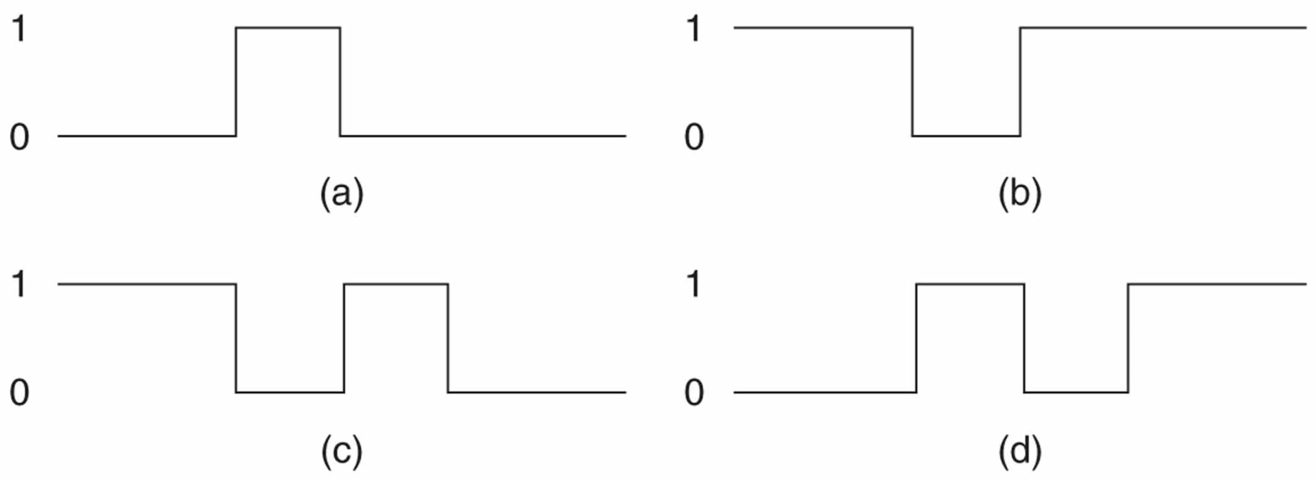
Hazard and glitch

Slide 46
Using assertion to verify timing
We must consider the possibility of hazards affecting the verification.
Look the next slide (this is modified listing ”Testbench that computes expected results”) :
In the process, the time between each application of stimulus is given by the constant period. The maximum allowed propagation delay, taken from the systems specification, is given by the constant tpd_spec.
After anew stimulus is applied, the process suspends for tpd_spec. When the process resumes, it uses an assertion statement to verify the UUT’s output values. The process then suspends for a time equal to
period – tpd_spec.

Slide 47
A description of trivial timing model
tb : process
constant tpd_spec : time := 11 ns ;
constant period: time := 20 ns ;
constant n : integer := 2 ;
begin
--Apply every posiible input combination
for i in 0 to 2**n - 1 loop
(a_tb, b_tb) <= to_unsigned (i, n) ;
-- Verify output values at specified time
wait for tpd_spec ;
assert ((sum_tb = (a_tb xor b_tb)) and (carry_out_tb = (a_tb and b_tb)))
report "test failed for a_tb = " & std_logic ' image (a_tb) & and b_tb = " & std_logic ' image (a_tb)
severity error ;

Slide 48
Process to verify logic and timing of model
-- Verify that outputs do not subsequently change
wait for period - tpd_spec ;
assert sum_tb ' quiet (period - tpd_spec) and (carry_out_tb ' quiet (period - tpd_spec)
report "propagation delay specification exceded" severity error ;
end loop ;
wait ;
end process ;
end ;

Slide 49
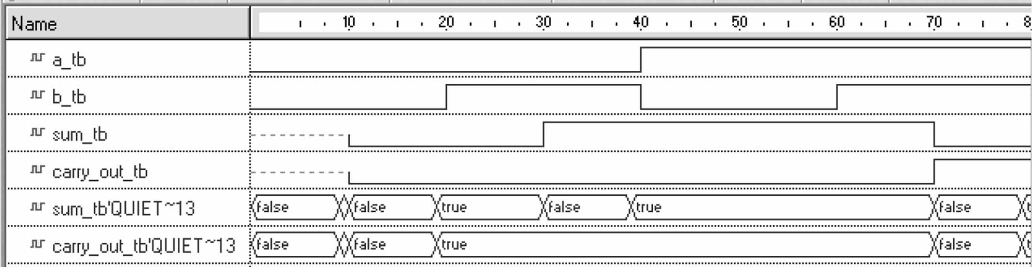
Timing waveforms
When the process (previous slide) again resumes, it verifies that the outputs have not changed since they were last verified. This is accomplished using the signal attribute quite.

Slide 50
Signal-related attributes
VHDL contains a number of predefined attributes which are related to signals :
attributes which define signals themselves
attributes which are functions to provide information about signals.
These attributes are signals themselves

Slide 51
Generics
The VHDL timing model uses a set of timing parameters to specify the propagation delays of the PLD’s primitive elements.
The timing parameter values are usually passed to the model using constants called generics.
Actual generic values are either defined directly in the timing model or specified in a separate file that is generated by the place-and-route tool.
If a separate file is used it usually specifies the generic timing values in a format called standard delay format (SDF).
A PLD’s timing is a function of both the propagation delays of its primitive elements and the specific delay paths that result when the synthesized logic is routed for the target PLD.

Slide 52
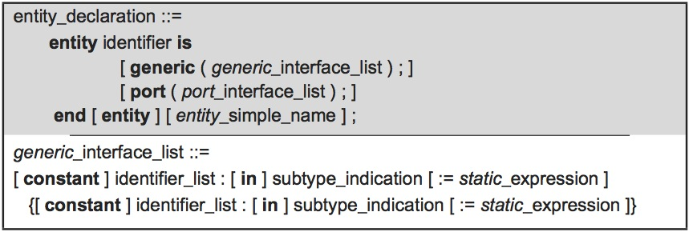
Entity declaration that includes generic
Generics are similar to constants, except their default values can be overridden from outside of the design entity in which they are declared. Default values can be overridden from outside of the design entity in either:
• The component instantiation statement that instantiates the design entity
• A configuration declaration.

Slide 53
Trivial timing model for half-adder
library ieee; use ieee.std_logic_1164. all;
entity half_adder is
generic (tpd : time := 10 ns);
port (a, b : in std_logic; sum, carry_out : out std_logic);
end half_adder;
architecture data_flow of half_adder is
begin
sum <= a xor b after tpd ;
carry_out <= a and b after tpd ;
end data_flow;

Slide 54
Remarks
Look previous slide:
For simplicity, this model uses concurrent signal assignment statements rather than component instantiation statements.
This mode has a single generic named tpd. It is used to specify the input to output delay.
The advantage of using generics is that we can use the same timing model for different speed grades of the same PLD by simply using the appropriate generic values.

Slide 55
Circuit’s behavior
The steady-state behavior of a circuit is the value of the
output after the inputs have been stable for a long time.
The transient behavior of a circuit is the value of the
output while (or soon after) the inputs change.
The glitch is a (often undesirable) short pulse produced
in the output during a transient phase.
If a circuit has the possibility of producing a glitch,
the circuit has a hazard.

Slide 56
Static-1 Hazard
A static-1 hazard is a set of two input combinations
X_{a} and X_{b} such that:
(i) X_{a} and X_{b} differ in only one input variable;
(ii) both X_{a} and X_{b} produce a 1 output;
but it is possible for a momentary 0 to appear in the output when the input transits from X_{a} to X_{b} or from X_{b} to X_{a}
i.e., a static-1 hazard is a possibility of a 0 glitch when we expect a steady 1 output.

Slide 57
Static-0 Hazard
A static-0 hazard is a set of two input combinations X_{a} and X_{b} such that:
(i) X_{a} and X_{b} differ in only one input variable;
(ii) both X_{a} and X_{b} produce a 0 output;
but it is possible for a momentary 1 to appear in the output when the input transits from X_{a} to X_{b} or from X_{b} to X_{a}
i.e., a static-0 is a possibility of a 1 glitch when we expect a steady 0 output.

Slide 58
Example
Does this circuit have a hazard?
If so, of what kind?
X
1
XZ’
0
→0
Z’
→1
1
Z
0
F
→1
1
→0 →1
1
YZ
1
Y
→0
The hazard occurs in the transition
from X,Y,Z = 111 to X,Y,Z = 110
Z
Z’
YZ
XZ’
F

Slide 59
Static Hazards in Karnaugh Maps
X
Z
F
Y
F = X•Z’ + Y•Z
X
How can we identify a static-1 hazard
in this Karnaugh map?
1
1
1
Z
1
1
1
Two adjacent 1’s that are not in the
same term cause a static-1 hazard.
Y

Slide 60
Hazard free design
X
Z
F
Y
F = X•Z’ + Y•Z
X
1
1
How can we eliminate the hazard?
Z
1
1
We can add one extra term to F.
F = X•Z’ + Y•Z + X•Y
Y
X•Y
Consensus Term

Slide 61
Hazard free design in Karnaugh Maps
X
Z
F
Y
X
F = X•Z’ + Y•Z
X
1
1
How can we eliminate the hazard?
Z
1
1
We can add one extra term to F.
X•Y
Y
F = X•Z’ + Y•Z + X•Y
Consensus Term

Slide 62
Hazard free design: another example
To avoid hazards: every par of adjacent 1s should be covered by a 1-term
W
W
1
1
1
1
1
1
1
1
1
1
1
1
1
1
1
1
1
1
Z
Z
1
1
1
1
1
1
1
1
1
Y
Y
1
1
1
1
1
1
1
1
1
X
X
F = W’•Z + X•Z’ + X’•W
F = W’•Z + X•Z’ + X’•W
1. Write minimal form for F
2. Identify static-1 hazards
3. Eliminate static-1 hazards

Slide 63
Hazard free design: another example
W
W
1
1
1
1
1
1
1
1
1
1
1
1
1
1
Z
Z
1
1
1
1
1
1
1
Y
Y
1
1
1
1
1
1
1
X
X
F = W’•Z + X•Z’ + X’•W
F = W’•Z + X•Z’ + X’•W + X•W’
1. Write minimal form for F
2. Identify static-1 hazards
3. Eliminate static-1 hazards

Slide 64
Hazard free design
W
W
1
1
1
1
1
1
1
1
1
1
1
1
1
1
Z
Z
1
1
1
1
1
1
Y
Y
1
1
1
1
1
1
1
1
X
X
F = W’•Z + X•Z’ + X’•W
F = W’•Z + X•Z’ + X’•W + X•W’ + W•Z’
1. Write minimal form for F
2. Identify static-1 hazards
3. Eliminate static-1 hazards

Slide 65
Hazard free design
W
W
1
1
1
1
1
1
1
1
1
1
1
1
1
1
Z
Z
1
1
1
1
1
1
1
1
Y
Y
1
1
1
1
1
1
X
X
F = W’•Z + X•Z’ + X’•W
F = W’•Z + X•Z’ + X’•W + X•W’ + W•Z’ + X’•Z
1. Write minimal form for F
2. Identify static-1 hazards
3. Eliminate static-1 hazards

Slide 66
Dynamic hazards
A dynamic hazard is the possibility of an output changing more than once as the result of a single
transition.
Dynamic hazards exist when there are multiple paths with different delays from the changing input to the changing output.
Dynamic hazards do not occur in properly designed
two level AND-OR or OR-AND circuits.
PS: A two level AND-OR or OR-AND circuit is
properly design if a variable and its complement are
never input to the same first level gate.

Slide 67
Dynamic hazard example
0
W
0
0
slow
X
0
0
Y
1
1
1
1
1
1
1
1
Z
slower

Slide 68
Dynamic hazard example
0
W
0
→1
0
→1
slow
X
0
0
→1
→0
Y
→0
1
1
→0
→1
1
→0
1
→0
→0
1
→0
1
1
1
Z
slower
A dynamic hazard occurs when
oscilation may occur when a single
transition is expected.

