Slide 1

Finite State Machines (part 1)
IAX 0600 Digital Systems Design
Alexander Sudnitson
Tallinn University of Technology

Slide 2
Sequential circuit and FSM
A sequential circuit is a circuit with memory. A Finite State Machine (FSM) is a mathematical model of the sequential circuit with discrete inputs, discrete outputs and a finite number of internal configurations or states. The state of a system completely summarizes the information concerning the past inputs to the system that is needed to determine its behavior on subsequent inputs. The FSM approach to sequential system design is a straightforward generic approach that allows any sequential system to be designed.
A sequential system may be either asynchronous or synchronous. An asynchronous sequential system has no clock and its state can change value as soon as any of its inputs changes value.
In asynchronous system, asynchronous actions are limited to the external reset used to force the synchronous system into an initial state at power on.

Slide 3
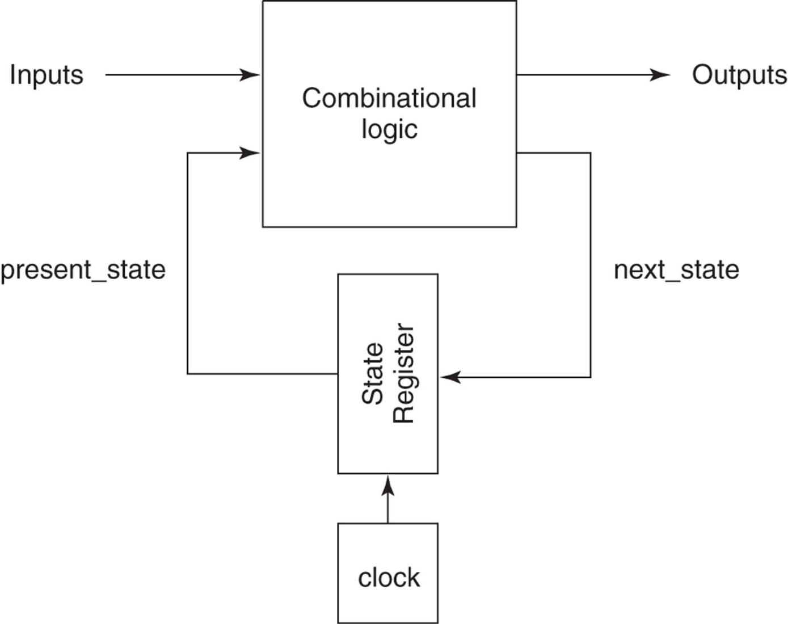
Synchronous FSM block diagram
In this course, a fully synchronous FSM is assumed.
A FSM’s inputs are sampled at each triggering clock edge.
The present state is stored as a binary value in the state register.

Slide 4
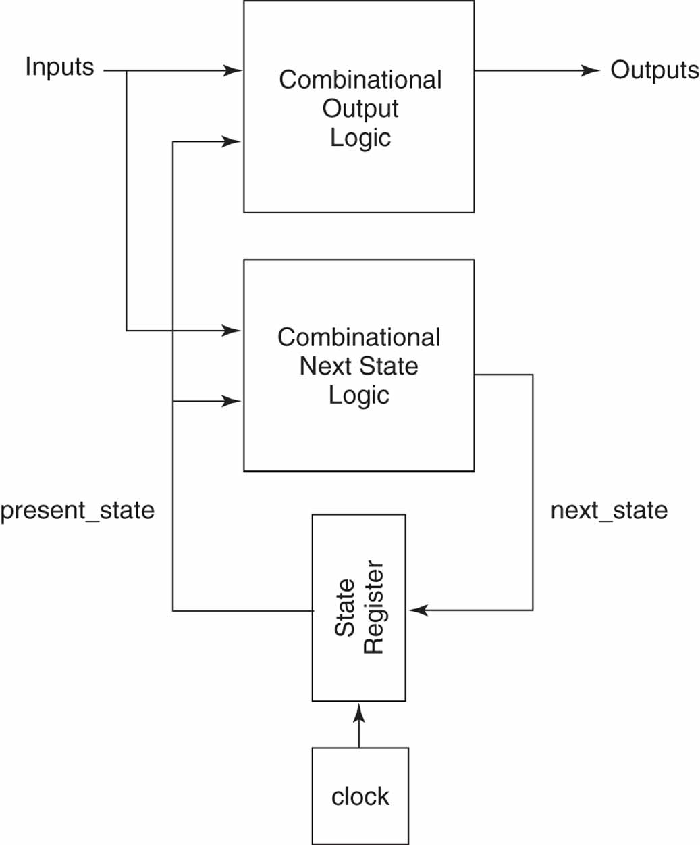
Next state and output logics
This diagram separates the combinational logic of the FSM into two
subsystems. One computes the FSM’s outputs from the inputs and present state.

Slide 5
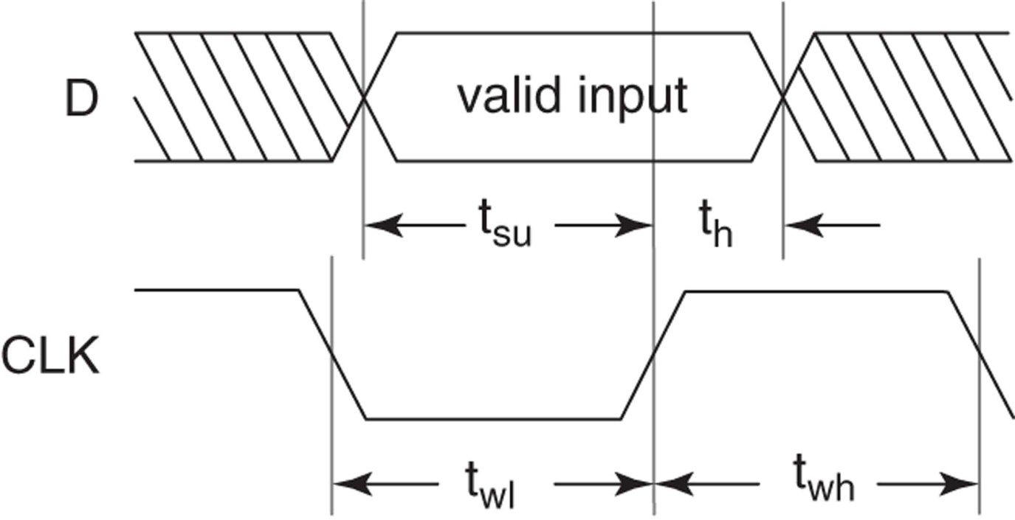
Timing requirements
Physical memory elements have timing requirements that must be met to ensure their proper operation. For example, input data to a D flipflop must be stable for a period of time (setup time, t_{su}) before a triggering clock edge and must remain stable for a period of time (hold time, t_{h}) after a triggering clock edge. There is also a minimum clock width requirement (clock width, t_{wh}) that must be met.

Slide 6
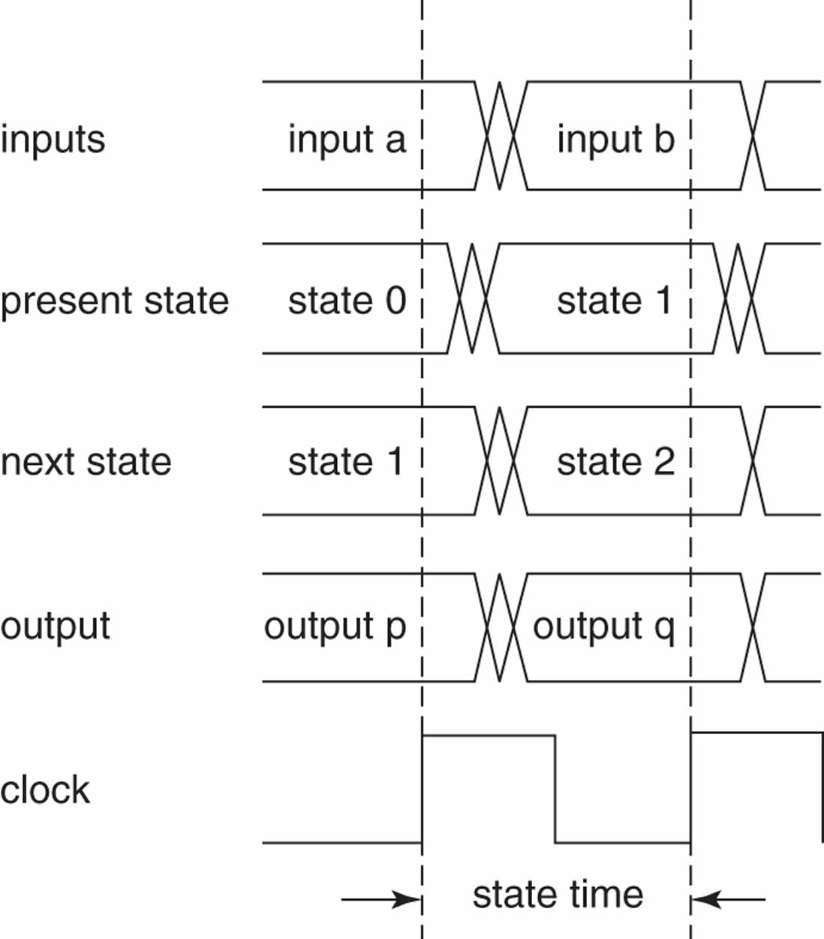
State time as defined by a FSM’s clock
Since a FSM’s outputs and next state are a function of its present state, they will be unstable for a short time after each triggering clock edge. This is caused by propagation delays through the flip-flops and the combinational logic that computes these values.
The present state, outputs, and next state are defined only during that portion of
the clock cycle where these signals are stable.

Slide 7
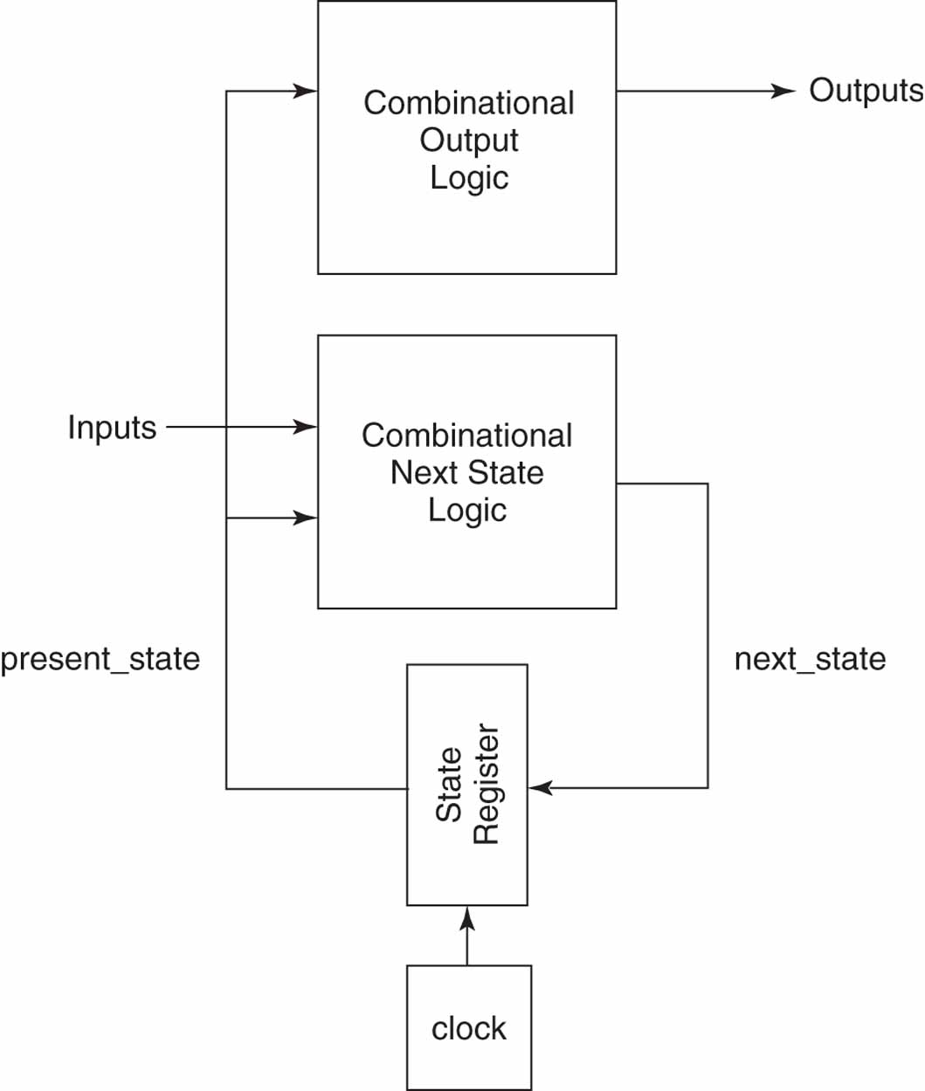
A Moore FSM
A Moore FSM’s output is a function of only its present state.

Slide 8
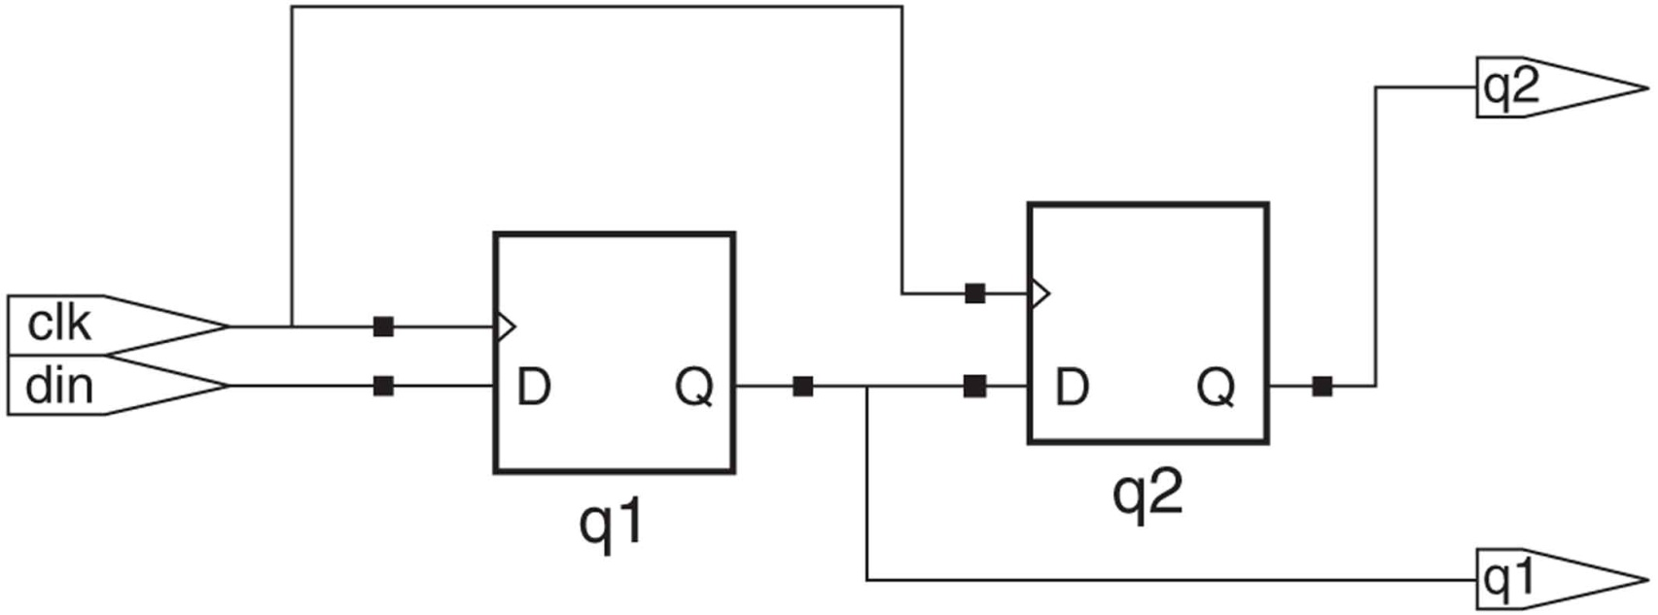
Synchronous input data
If the Q output of one flip-flop provides input data to a second flip-flop that uses the same clock signal, the input data to the second flip-flop is synchronous input data.
With synchronous input data and a sufficiently long clock period it is easy to ensure that a flip-flop’s setup time and hold time requirements are met.

Slide 9
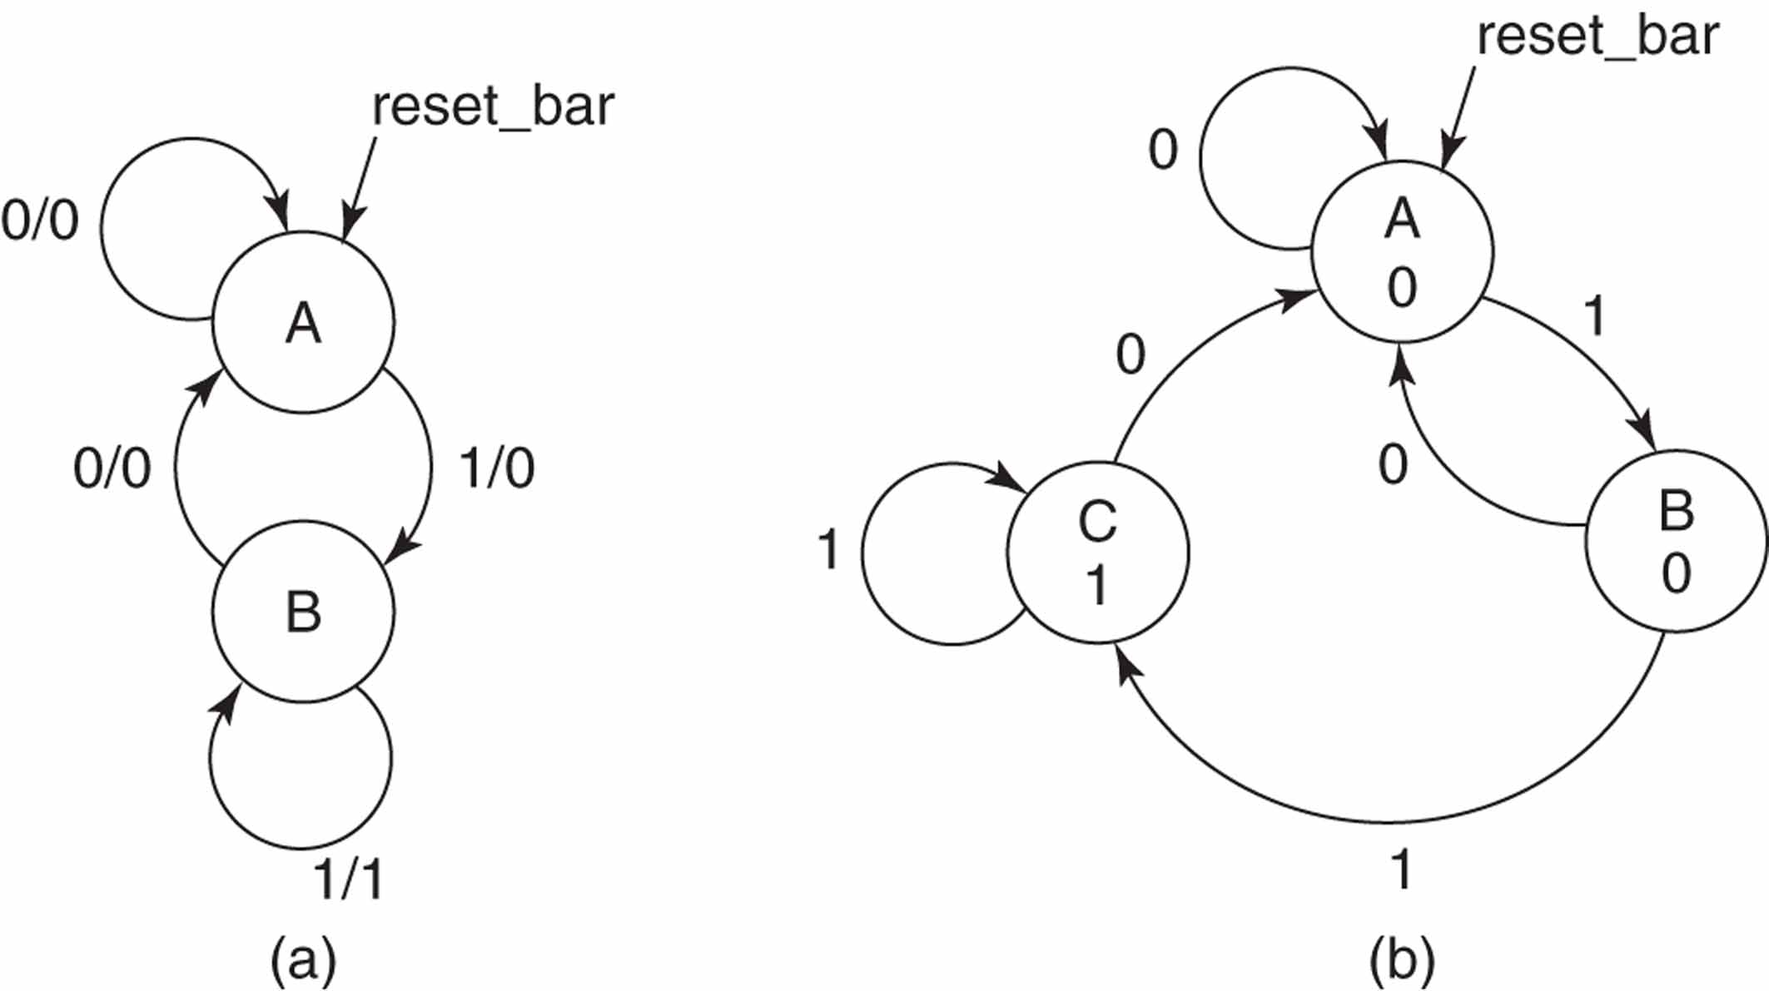
Mealy and Moore FSMs (state diagrams)
State diagrams of a (a) Mealy machine and (b) Moore machine.
A state diagram usually have a reset state. For simplicity, directed arcs representing transitions from every state to the reset state, in response to assertion of the reset input, are omitted from state diagrams.

Slide 10
Mealy or Moore decision
The State Transition Graph (STG) or state diagram of the Moore machine has the output associated with the states, while in the Mealy model, the outputs are associated with the edges.
A Moore machine may require more states than the corresponding Mealy machine.
Moore device isolates the outputs from the inputs
Mealy machine can respond one clock period earlier than the Moore machine to input changes, but noise on the input lines may be transferred to the outputs.

Slide 11
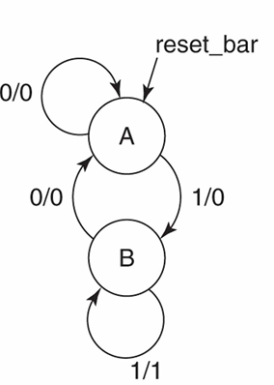
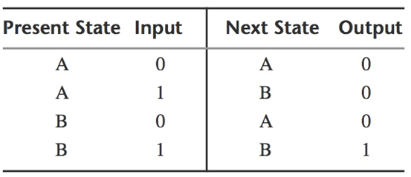
Diagrams and tables
The same information presented in a state diagram can be presented in a state/ output table.

Slide 12
VHDL description of FSM
Once a FSM’s state diagram has been created, its VHDL code can be written. There are many ways a FSM can be described in VHDL. One straightforward way is to code each block of diagram (excluding the clock) as a separate process. The result is a description consisting of three processes. One describes the state register. The other two describe the output combinational logic and the next state combinational logic.
In this template, states of the FSM are enumerated. In the declarative part of the architecture, type state is declared as an enumeration of state names. Two signals, present_state and next_state, are then declared of type state. When the FSM is synthesized, each enumerated state is converted to a unique binary code.

Slide 13
Three-process template -1-
library ieee; use ieee.std_logic_1164.all;
entity fsm_template is
<port_declarations>
end fsm_template;
architecture three_processes of fsm_template is
type state is (enumeration_of_state_names);
signal present_state, next_state : state;
begin
state_reg: process (clk)
begin
if rising_edge(clk) then
if reset_bar = '0' then
present_state <= <initial_state>;
else
present_state <= next_state;
end if;
end if;
end process;

Slide 14
Three-process template -2-
outputs: process (present_state, <inputs>);
begin
case present_state is
-- one case branch required for each state
when <state_value_i> =>
if <input_condition_1> then
-- assignments to outputs
elsif <input_condition_2> then
-- assignments to outputs
else
-- assignments to outputs;
end if;
...
-- default branch
when others =>
-- assignments to outputs
end case;
end process;

Slide 15
Three-process template -3-
nxt_state: process (present_state, <inputs>);
begin
case present_state is
when <state_value_i> =>
if <input_condition_1> then
-- assignment to next_state
elsif <input_condition_2> then
-- assignment to next_state
else
-- assignment to next_state
end if;
...
-- default branch
when others =>
-- assign initial_state to next_state
end case;
end process;
end three_processes;
one case branch required for each state

Slide 16
Two- and One-Process FSM Templates
The three-process FSM template has the advantage that from the coding perspective, that it is very readable and easy to modify and maintain.
However, it is certainly not the only template that we can use for an FSM.
One common variation is to use two processes and a set of conditional signal assignment statements.
Another FSM template variation uses one process to describe both the state register and next state logic, and uses conditional signal assignment statements for the output logic.
Finally, the entire FSM can be coded as a single process. This is the least readable of the approaches.
Regardless of the approach used, if the same FSM is described, the resulting synthesized logic is the same.

Slide 17
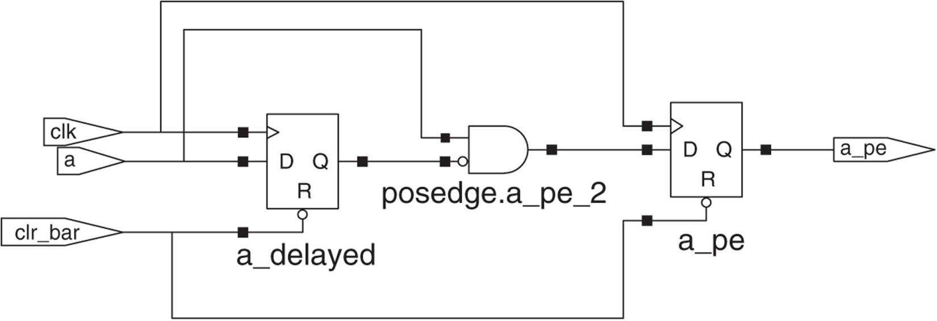
Detecting non–clock signal edges (not as a FSM design)
Often a design requires that some action be carried out when an event occurs on a signal other than the clock signal.
A synchronous edge detector generates a synchronous pulse of one clock duration whenever it detects the required edge of a specified signal.
The objective is to detect positive edges of signal a. To do this, a version of signal a delayed by one clock cycle, called a_delayed, is created. This is done by storing a in a flip-flop at each triggering clock edge.

Slide 18
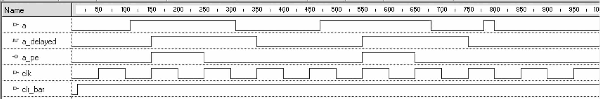
Detecting non–clock signal edges (not as a FSM design)
This edge detector system detects each positive edge of signal a, as long as the positive edge is not part of a narrow pulse that occurs between two adjacent triggering clock edges.
The narrow pulse that occurs just before 800 ns is missed because this pulse occurs between two triggering clock edges (one at 750 ns and the other at 850 ns).

Slide 19
Detecting non–clock signal edges (not as a FSM design)
entity posedge is
port (a : in std_logic; clr_bar : in std_logic; clk : in std_logic;
a_pe : out std_logic);
end posedge;
architecture behavioral of posedge is
signal a_delayed : std_logic;
begin
posedge: process (clr_bar, clk)
begin
if clr_bar = '0' then a_pe <= '0'; a_delayed <= '0';
elsif rising_edge (clk) then a_delayed <= a;
a_pe <= not a_delayed and a;
end if;
end process;
end behavioral;

Slide 20
A positive edge detector description -1-
library ieee;
use ieee.std_logic_1164.all;
entity pedgefsm is
port (
a : in std_logic;
clr_bar : in std_logic;
clk : in std_logic;
a_pe : out std_logic
);
end pedgefsm;
architecture moore_fsm of pedgefsm is
type state is (state_a, state_b, state_c);
signal present_state, next_state : state;
begin

Slide 21
A positive edge detector description -2-
state_reg: process (clk, clr_bar)
begin
if clr_bar = '0' then
present_state <= state_a;
elsif rising_edge(clk) then
present_state <= next_state;
end if;
end process;
outputs: process (present_state)
begin
case present_state is
when state_c => a_pe <= '1';
when others => a_pe <= '0';
end case;
end process;
The final branch of the case statement is a when others branch. In this template, the case expression present_state is an enumerated type. If all of the members of this type are not explicitly specified as choices in the previous branches, then the when others branch is required for syntactical correctness.

Slide 22
A positive edge detector description -3-
nxt_state: process (present_state, a)
begin
case present_state is
when state_a =>
if a = '0' then next_state <= state_b;
else next_state <= state_a;
end if;
when state_b =>
if a = '1' then next_state <= state_c;
else next_state <= state_b;
end if;
when others =>
if a = '0' then next_state <= state_b;
else next_state <= state_a;
end if;
end case;
end process;
end moore_fsm;

Slide 23
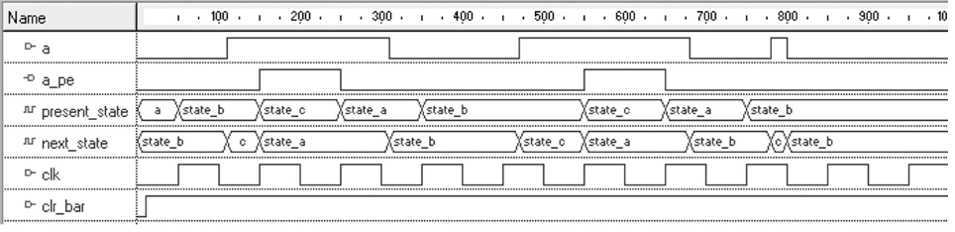
Waveforms for positive edge detectors Moore FSM
In our Moore FSM, a_pe is a 1 for the clock cycle immediately after a positive edge on a is detected. This is true because in a Moore FSM the output is a function of only the state, and our FSM remains in state_c for one clock cycle after a positive edge on a is detected

Slide 24
State diagram development
The three-process FSM template has the advantage that from the coding perspective, that it is very readable and easy to modify and maintain.
However, it is certainly not the only template that we can use for an FSM.
One common variation is to use two processes and a set of conditional signal assignment statements.
Another FSM template variation uses one process to describe both the state register and next state logic, and uses conditional signal assignment statements for the output logic.
Finally, the entire FSM can be coded as a single process. This is the least readable of the approaches.
Regardless of the approach used, if the same FSM is described, the resulting synthesized logic is the same.

Slide 25
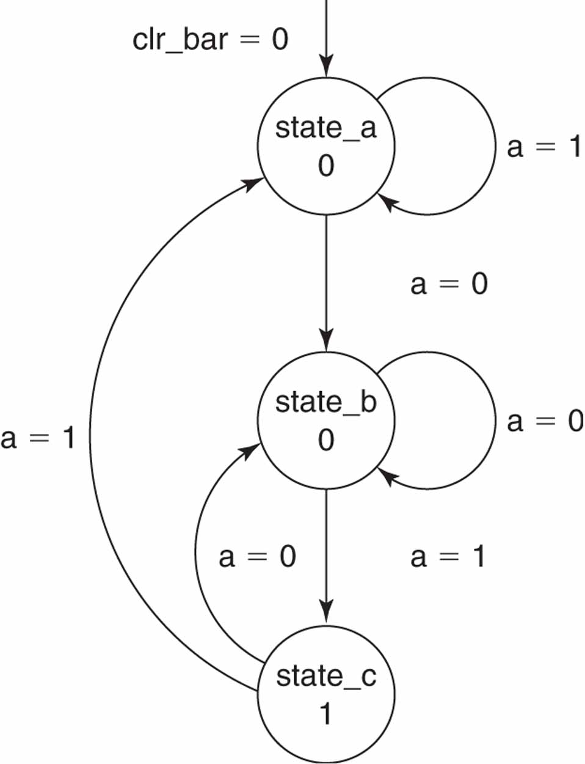
Moore FSM state diagram for a positive edge detector
present
state
output
(a_pe)
The synchronous edge detector generates a synchronous pulse of one clock duration whenever it detects the required edge (0 to 1 transition) on input a.
First we need a state (state_a) for the FSM to be placed in when it is reset by asserting clr_bar. Recall that the purpose of the positive edge detector is to detect a 0 to 1 transition on input a. There are two conditions that must be met to detect a 0 to 1 transition on a.
First, a must be 0 at a triggering clock edge.
Second, a must be 1 at the next triggering clock edge. The resulting Moore FSM has three states, represented abstractly as state_a, state_b, and state_c. It is clear from the state diagram that the output is 1 only in state_c.

Slide 26
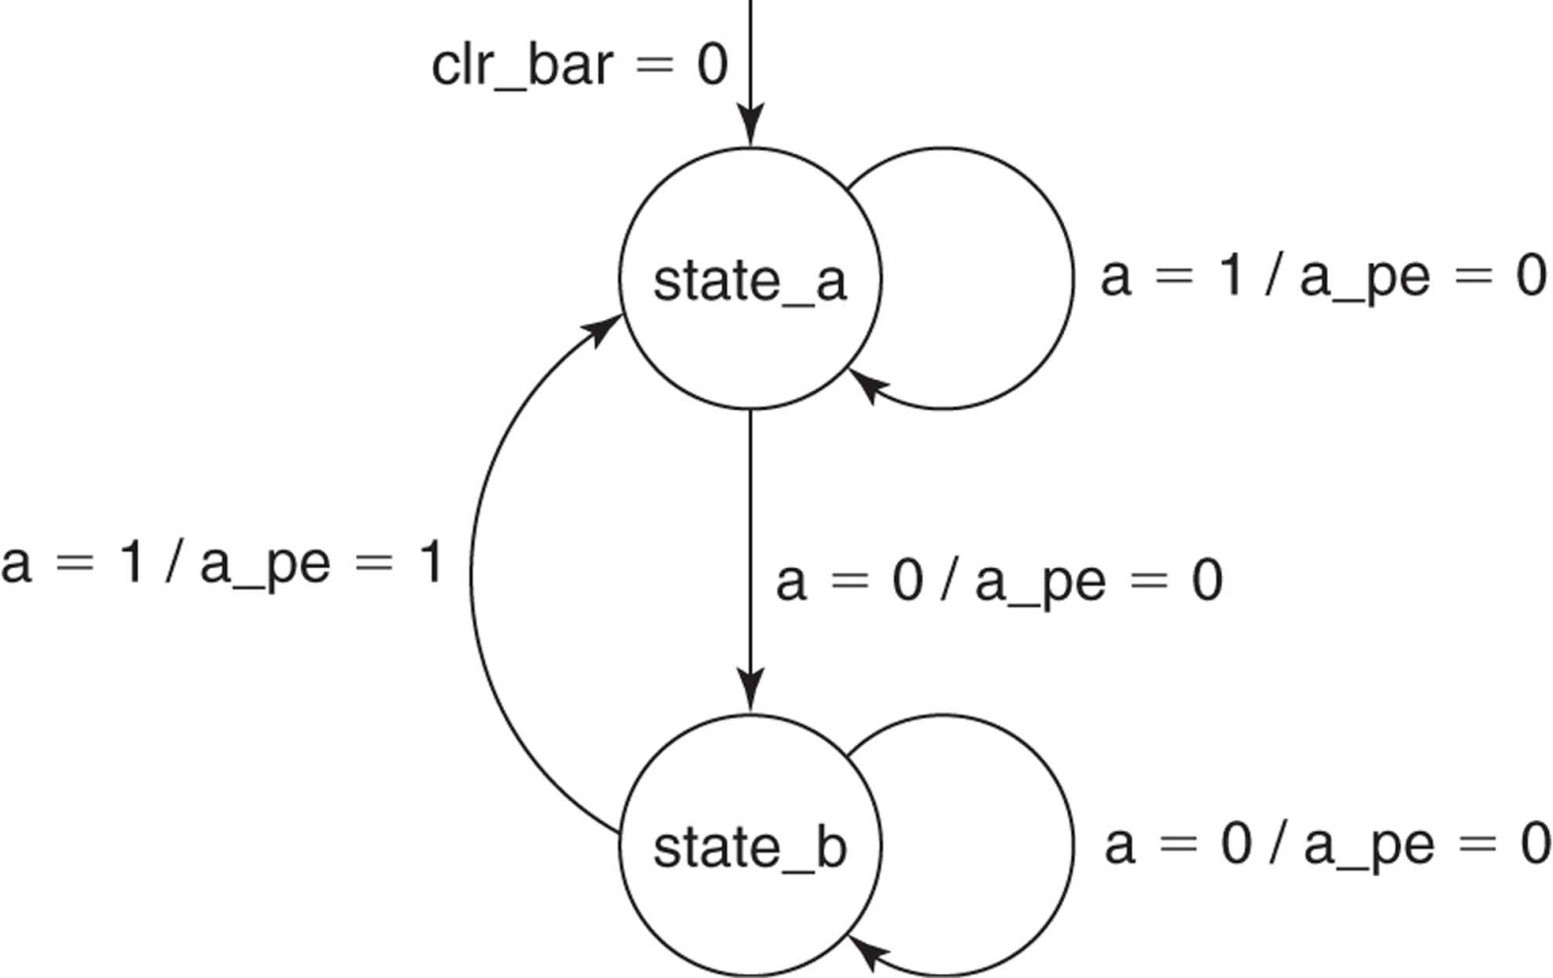
Mealy FSM state diagram for a positive edge detector

Slide 27
Mealy description -1-
library ieee;
use ieee.std_logic_1164.all;
entity pedgefsm is
port(
a : in std_logic;
clr_bar : in std_logic;
clk : in std_logic;
aposedge : out std_logic
);
end pedgefsm;
architecture mealy_fsm of pedgefsm is
type state is (state_a, state_b);
signal

Slide 28
Mealy description -2-
state_reg: process (clk, clr_bar)
begin
if clr_bar = '0' then present_state <= state_a;
elsif rising_edge(clk) then present_state <= next_state;
end if;
end process;
outputs: process (present_state, a)
begin
case present_state is
when state_a => aposedge <= '0';
when state_b =>
if a = '1' then aposedge <= '1';
else aposedge <= '0';
end if;
end case;
end process;

Slide 29
Mealy description -3-
nxt_state: process (present_state, a)
begin
case present_state is
when state_a =>
if a = '0' then next_state <= state_b;
else next_state <= state_a;
end if;
when state_b =>
if a = '1' then next_state <= state_a;
else next_state <= state_b;
end if;
end case;
end process;
end mealy_fsm;

Slide 30
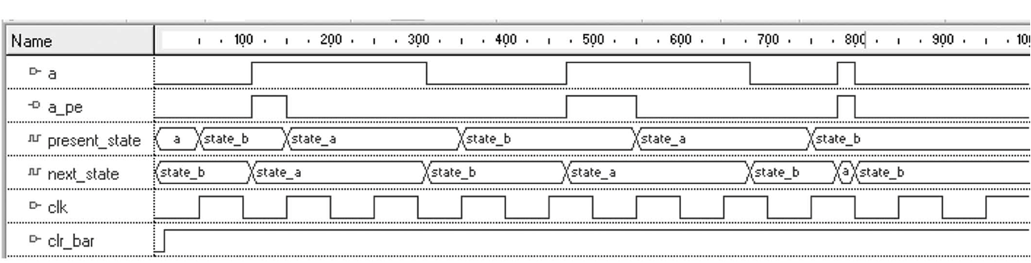
Waveform for Mealy FSM
The positive edge on a at 750 ns is detected, because output a_pe can change at any time a changes. Since a is an asynchronous input, output a_pe can be 1 for less than a clock period in the Mealy FSM.
If input a were synchronous (synchronized to clk), then its value could not change between triggering clock edges and a_pe, when asserted, would be 1 for a full clock period. Thus, if a were a synchronous input, the outputs of the Mealy and Moore FSMs would be identical.

