Slide 1

Exam
IAS 0600 Digital Systems Design
Alexander Sudnitson
Tallinn University of Technology

Slide 2
Dates
1. |  |  |  | 24.01.2019 14:00 |  | ICT-102
2. |  |  |  | 22.01.2019 14:00 |  | ICT-315
3. |  |  |  | 16.01.2019 14:00 |  | ICT-315
4. |  |  |  | 09.01.2019 14:00 |  | ICT-315
Labs (reports and defences) red line is 07.01.2019
(Dmitri presents me final reults).

Slide 3
Data Types
What is meant by strong typing in VHDL and why is it useful?
What is the relationship between std_ulogic and std_logic? Under what condition(s) would each be preferred as the type of a signal in a design description?
What is a subtype? What is a base type? Can a signal that is of a subtype be assigned to a signal that is of the base type of the subtype? Can a signal that is of a base type be assigned to a signal that is of a subtype of the base type? Under what condition will these kinds of assignments cause an error during a simulation?
What are the two composite types in VHDL and what are their similarities and differences?

Slide 4
Data Types
Given the following declarations:
signal a, b : std_logic_vector (3 downto 0);
signal p, q : std_logic_vector (7 downto 0);
Give the value of the signal after the following assignments:
a <= (2 => '1', 1 => '0', 0 => '0', 3 => '1’);
p <= (7|5|3 => '1', others => '0’);
b <= (others => '0’);
q <= (6 downto 4 => '0', others => '1');

Slide 5
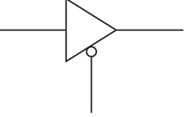
Data Types
a
b
Write three state buffer VHDL description
en
What means predefined data type.
Give definition of type Boolean.
BIT versus STD_LOGIC
Write context clause to use unsigned and signed types.
Give definition of type Boolean.
Conversion between Std_logic_vector, Unsigned and Signed (give an example)

Slide 6
Data Types
Given the following declarations:
constant m : unsigned := "1101";
constant p : signed := "1101";
constant i : integer := 145;
constant r : integer := —31;
constant q : integer := 19;
For the following assignment statements give the type, number of elements, and value of the target signal:
f <= to_unsigned(i, 8);
g <= to_signed(r,8);
h <= std_logic_vector(to_unsigned(q, 5));
j <= to_integer(m); k <= to_integer(p);

Slide 7
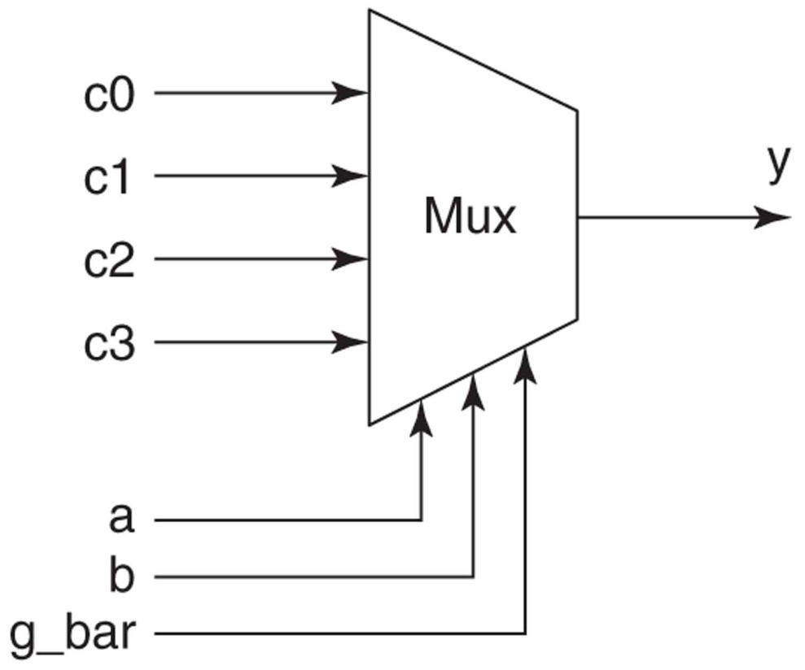
Coding styles
What coding styles do you know?
Which coding styles describe a behavior of the system?
Suppose, we would like to evaluate Boolean expression (that equivalent to aXORb)
c = a and not b or not a and b
Write correct VHDL assignment signal assignment statement using AND, OR, NOT operators
c <=
What kinds of concurrent signal assignment statements do you know?
Write VHDL description of such multiplexor

Slide 8
Coding styles
process (a, b)
begin
y <= a and b ;
end process;
For given process write equivalent process using WAIT ON statement.
Write two requirements for a process to synthesize a combinational system
Signals versus Variables
How to avoid unwonted latches
a
y0
y1
Write a VHDL description of 2-to-4 decoder using a case statement
y2
b
y3
g_bar

Slide 9
Coding styles
Positional and named association in a component instantiation statement
(give an example)
Two forms for a component instantiation statement
i1
AND
o
i2
i1
Compiled design entities
OR
o
i2
Give structural description using direct component instantiation and positional association
a
AND
k
b
y
AND
c
Give structural description using indirect component instantiation and named association
OR
m
d

Slide 10
Coding styles
Default binding rules of design entities to components
Three ways that binding can be accomplished
Configuration specification vs configuration declaration

Slide 11
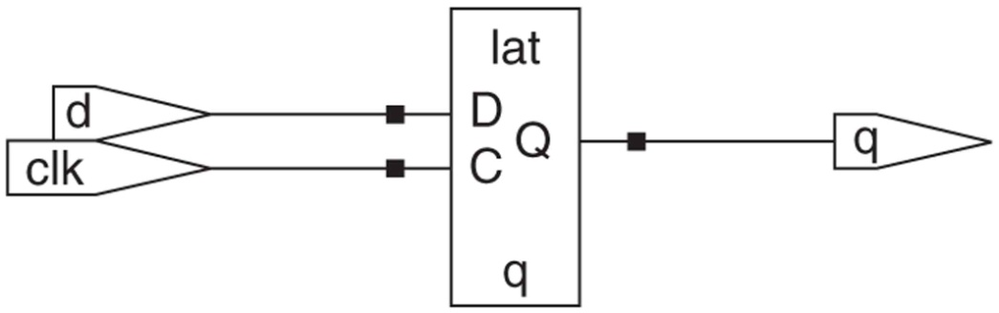
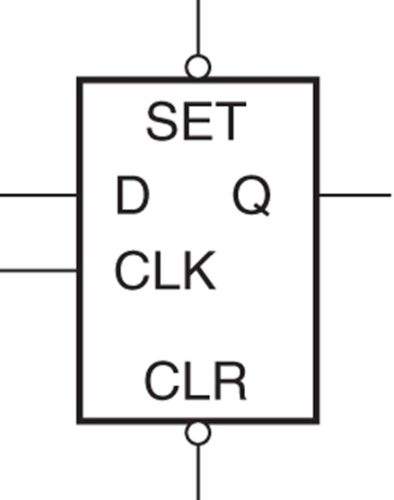
Sequential Systems and FSMs
Latch versus flip-flop
Explicit and implicit description of memory elements
Give VHDL description of this latch
Give VHDL description of D latch with asynchronous set and clear inputs

Slide 12
Sequential Systems and FSMs
Positive-edge-triggered D flip flop
Give expressions for a positive clock-edge condition
Give VHDL description of positive-edge-triggered D flip flop
Give VHDL description D flip-flop with asynchronous set and clear inputs
Give VHDL description D flip-flop with synchronous set and clear inputs

Slide 13
Sequential Systems and FSMs
Metastable event
Use of flip-flops versus latches
Mealy or Moore FSM decision
Briefly state, in terms of their functional operation, the differences between a combinational system and a sequential system. How is the past sequence of input values to a sequential system represented inside the system?

Slide 14
Subprograms
Kinds of subprograms in VHDL
What is the main difference subprograms in conventional programming languages and VHDL subprograms

