Slide 1

IAS 0600 Digital Systems Design
Structural style
Modular design and hierarchy
Part 2
Alexander Sudnitson
Tallinn University of Technology

Slide 2
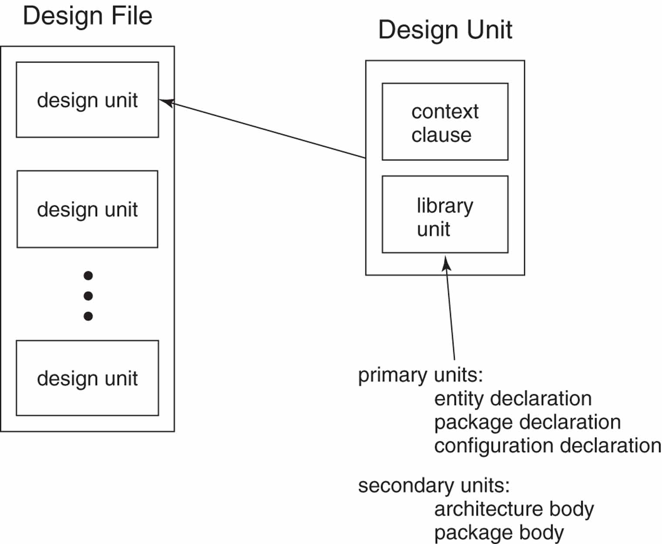
Design file and design units
A name made directly visible to a primary library unit by a context clause is automatically visible in any associated secondary library unit.

Slide 3
Design libraries
A simulator can only simulate programs that have been successfully compiled and stored in a library.
A design library is a logical storage area in the host computer environment for compiled design units (library units)
A design library is identified by its logical name.
There are two kinds of design libraries: working library and resource library

Slide 4
Design libraries
All VHDL compilers come with the library STD included. This built-in library is provided by standard IEEE Std 1076.
Library STD contains two packages: STANDARD and TEXTIO.
VHDL compilers also include the library IEEE.
This library contains packages defined by VHDL’s supporting standards, such as packages STD_LOGIC_1164.
Of course, we can write our own packages and place them in libraries that we create – user-defined libraries.
Third-party intellectual property provides sell libraries containing complex design entities that we can use as modules.
PLD vendor libraries
(Source code for the architecture bodies and package bodies is usually not provided)

Slide 5
Using library units
Implicit context clause:
Every library unit is assumed to be preceded by the implicit context clause
library std, work ;
use std.standard.all ;
Rules:
A primary unit whose name is referenced within a given design unit must be compiled prior to compiling the given design unit.
A primary unit must be compiled prior to compiling any associated secondary units.
User written packages and other design units can be precompiled and placed in a resource library. Design entities in a resource library can be used as modules by design entities in a design file. The appropriate context clauses for any resource libraries used must be included prior to each library unit in a design file.

Slide 6
Design file and design units
A design unit is a VHDL construct that can be construct that can be independently compiled and stored in a design library. Design units provide modularity for the design management of complex systems.
A design file is a source file containing one or more design units. A design file is the input to a VHDL compiler. Design units in a design file are compiled in the same order as their textual order in the file.
Using separate files allows separate compilation and verification of each design entity.

Slide 7
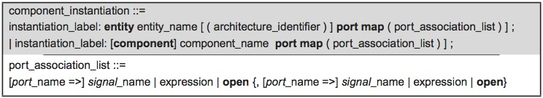
Direct and indirect instantiation
In a structural style description, component instantiation statements are used to create an instance of each design entity.
The syntax provides two forms for a component instantiation statement:
1) Direct instantiation of a design entity.
2) Indirect instantiation. Indirect instantiation instantiates a component, which serves as a placeholder for a design entity rather than directly instantiating a design entity. The binding of each component to an actual design entity is then accomplished using either default binding or an explicit binding indication.

Slide 8
Direct instantiation of design entities
Consider a following example. Assume that we have created separate design files for each of the following entity declarations and architecture bodies and compiled them into our working library in the order listed:
Entity and_2
Architecture dataflow of and_2
Architecture behavioral of and_2
Entity or_2
Architecture dataflow of or_2
We now want to use these entity in a structural style description of the simple combinational circuit (next slide)
The order of compilation

Slide 9
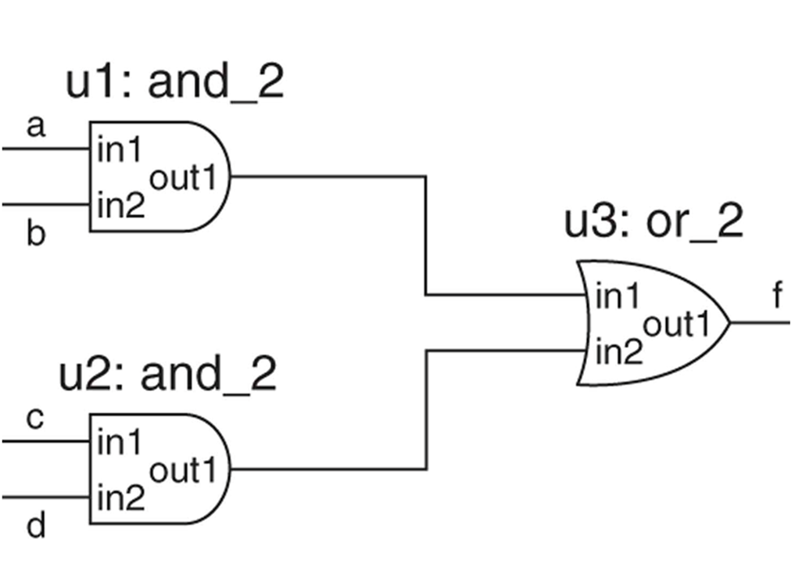
Logic diagram of an example circuit comb_ckt

Slide 10
Direct instantiation of design entities
Binding is the process of associating a design entity and, optionally, a specific architecture body with an instance of a component.
library ieee; use ieee.std_logic_1164. all ;
entity comb_ckt is
port (a, b, c, d : in std_logic; f : out std_logic) ;
end comb_ckt;
architecture structural_1 of comb_ckt is
signal s1 : std_logic ;
begin
u1 : entity and_2 port map (in1 => a, in2 => b, out1 => s1) ;
u2 : entity and_2 port map (in1 => c, in2 => d, out1 => s2) ;
u3 : entity or_2 port map (in1 => s1, in2 => s2, out1 => f) ;
end structural_1 ;

Slide 11
Default binding rules
The compiler can follow a set of default binding rules, defined in the LRM, to accomplish bindings. For example, by default compiler looks in the working library (work) for an entity declaration whose name and interface match those specified in the component instantiation statement. If, in the working library, there is more than one architecture body associated with that entity declaration, then the compiler uses the one most recently compiled.
For entity and_2 (previous slide), there are two possible architectures: dataflow and behavioral. Assuming that behavioral was the most recently compiled, instances u1 and u2 will both use that that architecture body.
If we want binding other than default binding, we can specify the desired architecture with the entity name in the component instantiation statement.
u1: entity and_2 (dataflow) port map (…);
u2: entity and_2 (behavioral) port map (…);
Specifying the library:
u1: entity work.and_2 (dataflow) port map (…);

Slide 12
Components and indirect instantiation
Indirect design entity instantiation uses a placeholder, called a component, to stand for the design entity in a component instantiation statement. Thus a component can be viewed as a virtual design entity.
Look next slide.
First, each component must be declared before it can be used.
Second, each instantiation statement is an instance of a component, not an instance of a design entity
A component declaration is placed in the declarative part of the architecture in which the component is used.
Alternatively, if a component is likely to be used in multiple designs, its declaration can be placed in a package in a library.

Slide 13
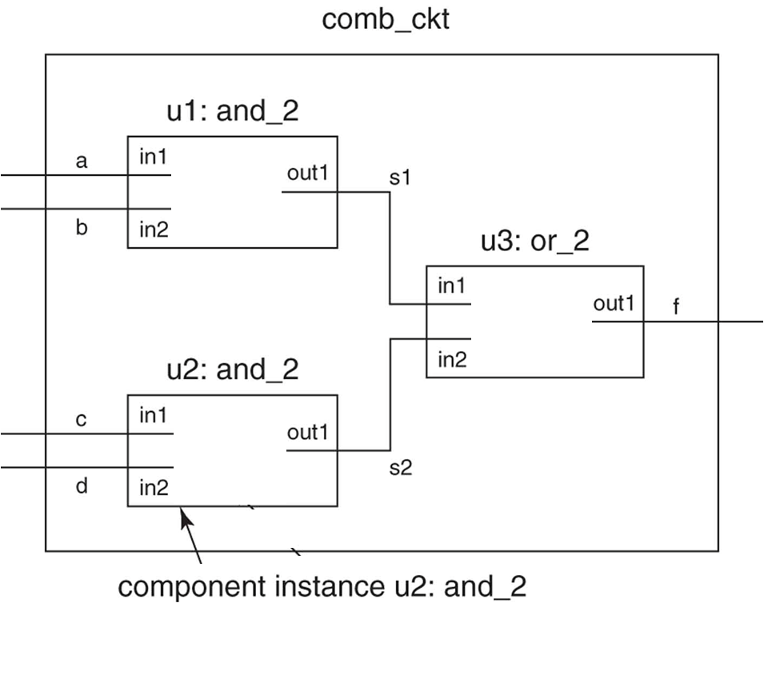
Interconnection of components

Slide 14
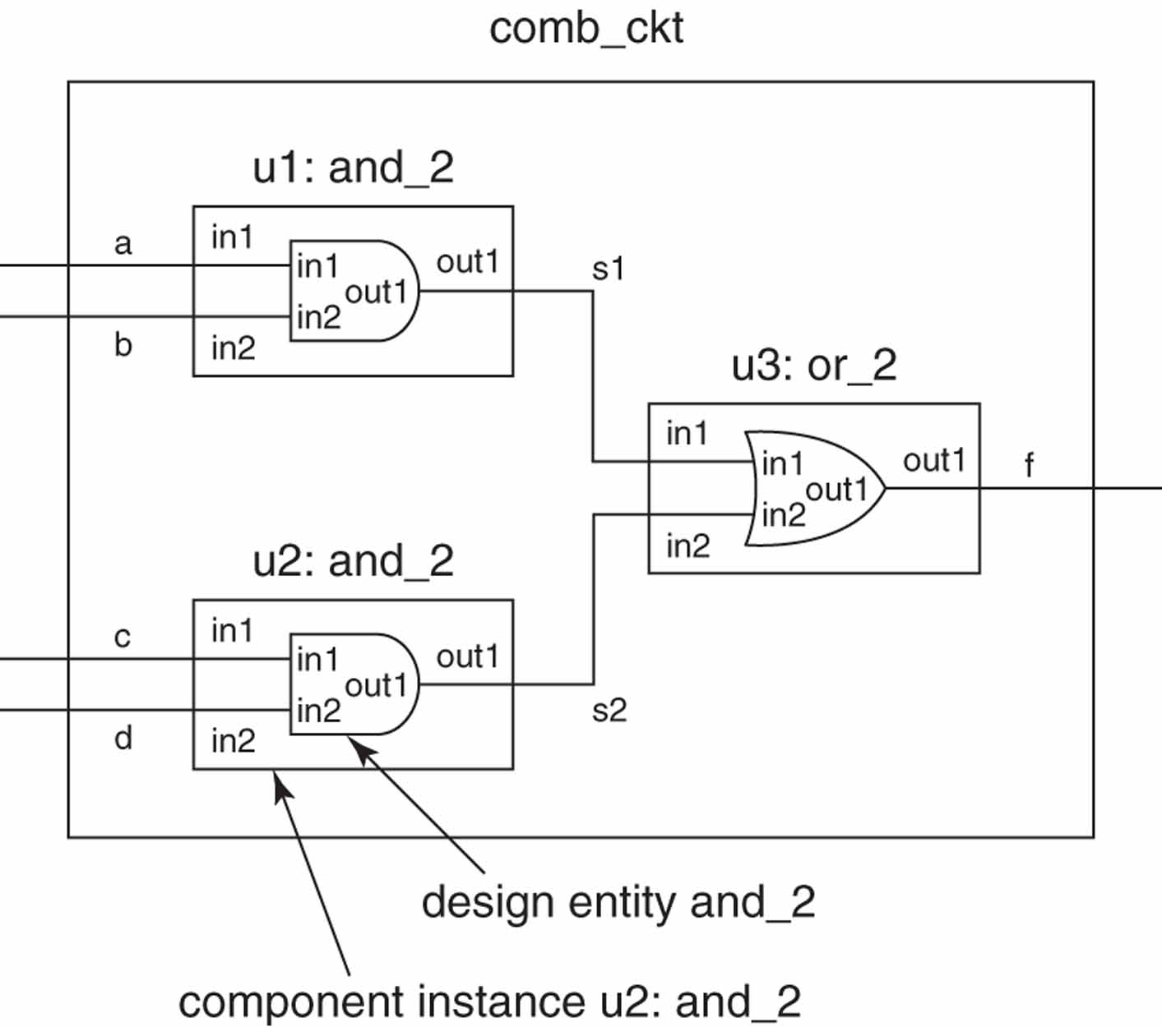
Interconnection of entities via components

Slide 15
Indirect instantiation of design entities -1-
library ieee; use ieee.std_logic_1164. all ;
entity comb_ckt is
port (a, b, c, d : in std_logic; f : out std_logic) ;
end comb_ckt;
architecture structural_2 of comb_ckt is
component and_2 is
port (in1, in2: in std_logic ; out1 : out std_logic) ;
end component ;
component or_2 is
port (in1, in2: in std_logic ; out1 : out std_logic) ;
end component ;

Slide 16
Indirect instantiation of design entities -2-
signal s1, s2 : std_logic ;
begin
u1 : component and_2 port map (in1 => a, in2 => b, out1 => s1) ;
u2 : component and_2 port map (in1 => c, in2 => d, out1 => s2) ;
u3 : component or_2 port map (in1 => s1, in2 => s2, out1 => f ) ;
end structural_2 ;

Slide 17
Default binding rules of design entities to components
VHDL’s default binding rules:
The compiler looks for the entity declaration and architecture body in the visible libraries.
The compiler first looks in the working library for an entity declaration with the same name as the component name and a matching interface.
Where more than one architecture is available for the entity declaration, the most recently compiled architecture is used.
If the entity declaration is not found in the working library, then the resource libraries are searched in order.
If a design is created so that components and their corresponding design entities have matching names and interfaces, then it is not necessary to use either configuration specifications nor configuration declarations.

Slide 18
Components and configuration specification
For components, there are three ways that binding can be accomplished:
Default binding
Configuration specification
Configuration declaration
In contrast to default binding, use of a configuration declaration or specification allows us to explicitly specify bindings.
Configuration specifications are place in the declarative part of the architecture in which the components are instantiated.
A configuration declaration is a design unit.
A configuration specification starts with a keyword for.

Slide 19
Components and configuration specification
library ieee; use ieee.std_logic_1164. all ;
entity comb_ckt is
port (a, b, c, d : in std_logic; f : out std_logic) ;
end comb_ckt;
architecture structural_3 of comb_ckt is
component and_2 is
port (in1, in2: in std_logic ; out1 : out std_logic) ;
end component ;
component or_2 is
port (in1, in2: in std_logic ; out1 : out std_logic) ;
end component ;

Slide 20
Components and configuration specification
signal s1, s2 : std_logic ;
-- configuration specifications
for u1 : and_2 use entity work.and_2 (dataflow) ;
for u2 : and_2 use entity work.and_2 (behavioral) ;
for u3 : or_2 use entity work.or_2 (dataflow) ;
begin
u1 : and_2 port map (in1 => a, in2 => b, out1 => s1) ;
u2 : and_2 port map (in1 => c, in2 => d, out1 => s2) ;
u3 : or_2 port map (in1 => s1, in2 => s2, out1 => f ) ;
end structural_3 ;

Slide 21
and_2 desig entity bound to component instance u3 or_2
Let us consider the following example. The configuration specification for u3 could be written as
for u3 : or_2 use entity work.and_2 (dataflow) ;
and no compilation error would occur. But, the function of the resulting combinationa circuit has been changed (the effect of using this configuration specificationis shown in next slide).

Slide 22
Port maps in configuration specification
For example, assume that we did not have a design entity or_2 to bind to component or_2, but we did have a three-input OR designentity in the library parts (full adder example). Assume that the entity declaration is
entity or_3 is
port (inp1, inp2, inp3 : in std_logic; outp1 : out std_logic) ;
end or_3;
We can change the configuration specification for u3 to
for u3 : or_2 use entity parts.or_3 (dataflow) ;
port map (inp1 => in1, inp2 => in2, inp3 => ´0´, outp1 => f) ;

Slide 23
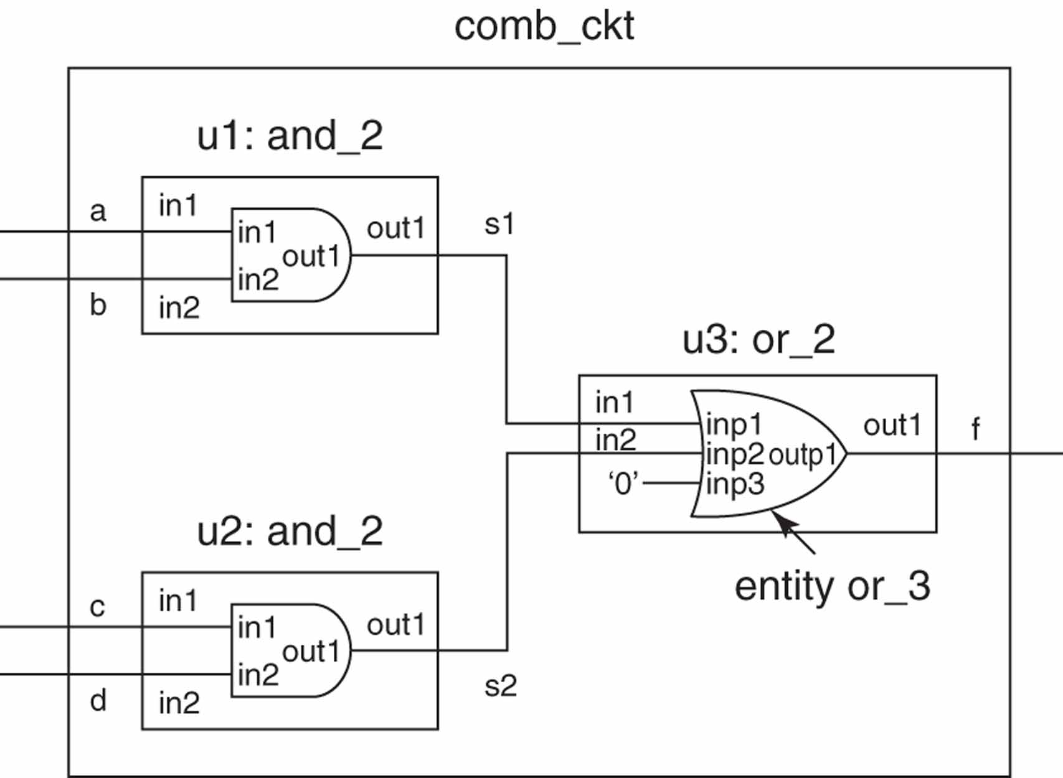
or_3 desig entity bound to u3:or_2
Port maps in configuration specification

Slide 24
Configuration declaration
Using configuration specifications is advantageous when we don’t intend to change our component-instance/design-entity bindings. Greater flexibility in specifying bindings can be achieved using a configuration declaration.
A configuration declaration is a design unit that allows bindings of architecture bodies to entity declarations, as well as bindings of components to design entities, to be specified.
Since a configuration declaration is a separate design unit, these bindings are specified outside of the architecture body.

Slide 25
Configuration declaration for comb_ckt
Configuration declaration specifying architecture dataflow.
configuration config1 of comb_ckt is
for dataflow --block configuration
end for;
end config1;
The simplest use of a configuration declaration is to specify the binding of an architecture to a design entity when the architecture is not structural. Suppose that we had a second architecture for comb_ckt that was a dataflow architecture named dataflow. We now have two different architectures for design entity comb_ckt. If we simulated comb_ckt, by default, the most recently compiled architecture would be used. Suppose that we wanted to simulate comb_ckt using the dataflow architecture and it was not the most recently compiled. We could create a configuration declaration to specify that architecture dataflow be used.

Slide 26
Configuration declaration for comb_ckt (component configurations) -1-
configuration config2 of comb_ckt is
for structural_2 -- block configuration
for u1 : and_2 -- component configuration
use entity work.and_2(dataflow);
end for;
for u2 : and_2 -- component configuration
use entity work.and_2(behavioral);
end for;
for u3 : or_2 -- component configuration
use entity work.or_2(dataflow);
end for;
end for;
end config2;
To write a configuration declaration for design entity comb_ckt that uses architecture structural_2 (slide 15-16), we must not only specify the architecture, but also the bindings of components in the architecture to design entities. This is accomplished using component configurations inside the configuration declaration.

Slide 27
Con. dec. for comb_ckt (component configurations) -2-
A component configuration inside of a component declaration allows us to configure the internal structure of the architecture of an entity to which a component is bound; a configuration specification does not allow this. The of a component configuration is like that of a configuration specification, except for the addition of the keywords end for.The architecture (slide 15-16) for structural_2 contained no configuration specifications, and its components were bound to design entities using default binding. Configuration declaration config2 explicitly configures this architecture to produce the same bindings that were produced using configuration specifications in slide 19-20.

Slide 28
Configuration declaration for a functional simulation of a half adder.
configuration functional_sim of testbench is
for behavior
for UUT : half_adder use entity work.half_adder(dataflow);
end for;
end for;
end functional_sim

Slide 29
Configuration for functional simulation
When we compile the half-adder description, we get the design entity half_ adder(dataflow). We can write a configuration declaration named functional_ sim for design entity testbench that binds the instance UUT of component half_adder to design entity half_adder(dataflow). We can then simulate configuration declaration functional_sim to perform a functional simulation. Note that, when using a configuration declaration to simulate the UUT, we are not actually simulating the testbench, but rather the configuration declaration for the testbench.

Slide 30
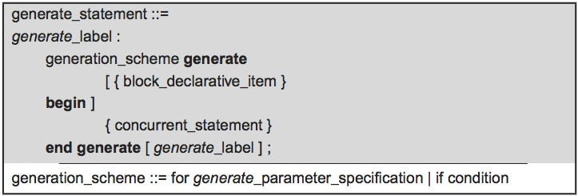
Generate statement
A generate statement is a concurrent statement that allows us to specify the replication of concurrent statements. If a concurrent statement that is to be replicated is a component instantiation statement, then we have a concise way of describing the repeated instantiation of a component.
Syntax for a generate statement

Slide 31
Generate statement (example)
entity d_ff_pe is
port (d, clk: in std_logic; q: out std_logic;
end d_ff_pe;
architecture behavioral of d_ff_pe is
begin
process (clk)
begin
if clk'event and clk = '1' then q <= d;
end if;
end process;
end behavioral;
Assume that we have compiled this D flip-flop description to the working library.

Slide 32
Serial-in parallel-out 4-bit right-shift register
A 4-bit shift register described using an iterative generate statement
entity is
port (si : in std_logic; clr_bar : in std_logic; clk : in std_logic;
qout : out std_logic_vector (3 downto 0));
end shift_reg_gen;
architecture structural of shift_reg_gen is
signal s: std_logic_vector (4 downto 0);
begin
stages: for i in 3 downto 0 generate
begin
stage: entity dff_stage port map (d => s(i + 1), clr_bar => clr_bar,
clk => clk, q => s(i));
end generate;
s(4) <= si;
qout <= s(3 downto 0);
end structural;

Slide 33
Serial-in parallel-out 4-bit right-shift register
A 4-bit shift register described using an iterative generate statement
The discrete range of the generate statement is from 3 down to 0. The component instantiation statement inside the generate statement generates the four instances of the D flip-flop.
The connection of the serial input si to the D input of the leftmost flip-flop is made by the concurrent statement
s(4) <= si;
which is outside of the generate statement. The connection of the D flip-flop outputs to the output port qout is made by the concurrent statement
qout <= s(3 downto 0);
which is also outside of the generate statement.

Slide 34
Alternative architecture body for the shift register
architecture structural2 of shift_reg_gen is
signal s: std_logic_vector(3 downto 0);
begin
stages: for i in 3 downto 0 generate
begin
lstage: if i = 3 generate
begin
stage: entity dff_stage port map (d => si,
clr_bar => clr_bar, clk => clk, q => s(3));
end generate;
ostages: if i /= 3 generate
begin
stage: entity dff_stage port map (d => s(i + 1),
clr_bar => clr_bar, clk => clk, q => s(i));
end generate;
end generate;
qout <= s(3 downto 0);
end structural2;

Slide 35
Alternative architecture body for the shift register
In the architecture body an iterative generate statement labeled stages sequences through the values of its generate parameter. Nested inside this generate statement are the two conditional generate statements.
The first conditional statement, labeled lstage, has the condition i = 3. When the generate parameter is equal to 3, this conditional generate statement produces the instantiation of the leftmost stage of the shift register.
The second conditional statement, labeled ostage, has the condition i/= 3. When the generate parameter is not equal to 3, this conditional generate statement produces the instantiation of the other three stages of the shift register.

Slide 36
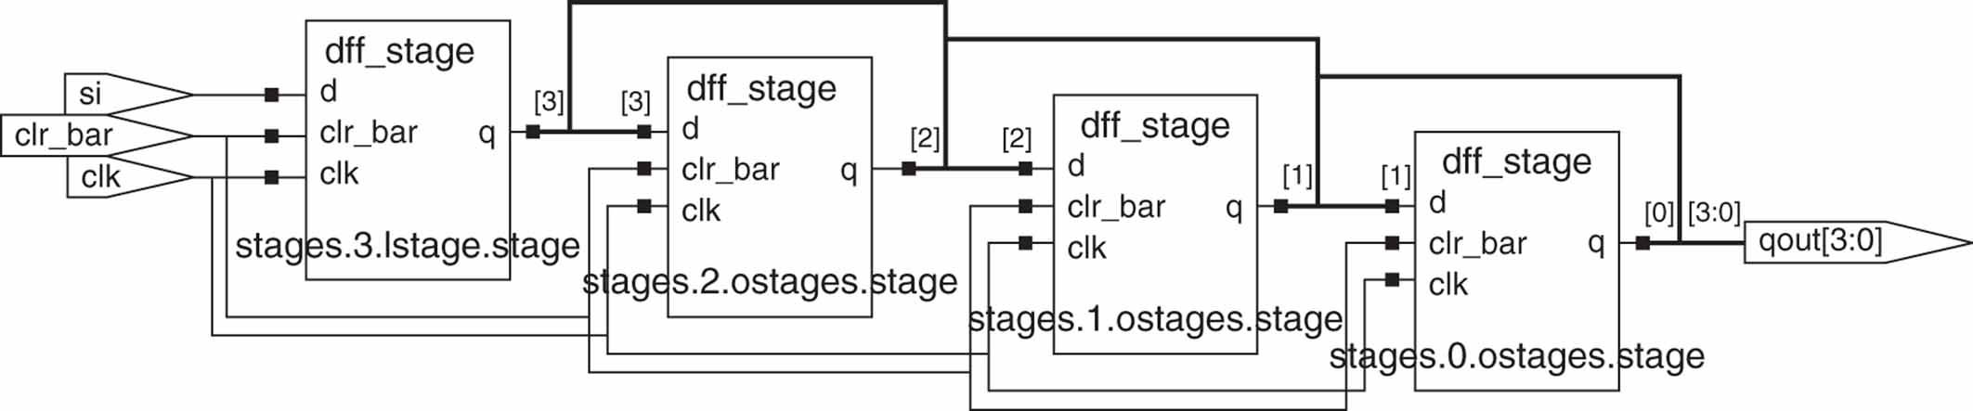
Serial-in parallel-out 4-bit right-shift register
Logic synthesized for 4-bit shift register

