Slide 1

Introduction to digital system design with VHDL
IAX 0600 Digital Systems Design
Alexander Sudnitson
Tallinn University of Technology

Slide 2
Digital System
A discrete system is a system in which signals have a finite number of discrete values.
(This contrasts with analog systems, in which signals have values from an infinite set).
Discrete
System
Inputs
Outputs
Any finite number of discrete values can be represented by a vector of signals with just two values. Such a signal, which takes only two values, is called a digital signal (or binary, or logic), and any device that processes digital signals is called a digital device (or system).

Slide 3
Design representation
Three different domains of description:
A behavioral or functional representation is one that looks at the design as a black box. A behavioral representation describes the functionality but not the implementation of a given design, defining the black box’s response to any combination of input values.
A structural representation is one that presents the black box as a set of components and their connections. It specifies the product’s implementation without explicit reference to its functionality.
A physical representation is one that specifies the physical characteristics of the black box.

Slide 4
General design process
The design process consists of obtaining an implementation that satisfies the specification of a system.
Behavior
(specification)
Analysis (verification)
Synthesis
Structure
(Implementation)
The synthesis consists of obtaining an structural description (implementation ) that satisfies the behavioral description (specification) of a system.

Slide 5
Levels of abstraction (this course area)
Behavior Description
Structural Description
Architectural (Algorithmic)
Algorithmic and computational models
Processor, Memory, Peripheral interface
Register-Transfer
Dataflow
Registers, Adders, Multipliers, etc.
Logic
Boolean equotions
Logic netlist, Schematic
Transformations
View
RTL is the ideal level of abstraction at which to design hardware given the state of the art of today's synthesis tools.

Slide 6
Transformations (this course area)
Behavior Description
Structural Description
High-level (behavioral) synthesis
Algorithmic level of abstraction
Register-transfer level of abstraction
RTL synthesis
Logic level of abstraction
Logic synthesis
View

Slide 7
Timing units at different levels
Behavior Description
Structural Description
Time Units
Computation Step
Algorithmic
Processor, Memory, Peripheral interface
Clock Cycle
Dataflow
Registers, Adders, Multipliers, etc.
Boolean equations
Delay
Logic netlist, Schematic
View

Slide 8
Example: HalfAdder
Behavior
Structure
a
b
Sum
Carry
a
Sum
0
0
0
0
HalfAdder
b
Carry
0
1
1
0
1
0
1
0
1
1
0
1
a
Sum
⊕
Sum = ~a&b ∨ a&~b = a ⊕ b
Carry = a & b
&
Carry
b

Slide 9
Example: HalfAdder Behavioral Description
Sum
Sum = ~a&b ∨ a&~b = a ⊕ b
Carry = a & b
a
HalfAdder
b
Carry
entity HalfAdder is
port(a, b: in BIT; Sum, Carry: out BIT);
end HalfAdder;
architecture RTL of HalfAdder is
begin
Sum <= a xor b;
Carry <= a and b;
end RTL;
This is data flow behavioral description

Slide 10
Brief History of VHDL
VHDL is an acronym for VHSIC (Very High Speed Integrated Circuit) Hardware Description Language.
VHDL is an industry standard hardware description language that is widely used for specifying, modeling, designing, an simulating digital systems.
VHDL has its origins in a research project funded in the early 1980s by the U.S. Department of Defense (DoD).
A modified version of the original VHDL became IEEE Std 1076-1987. “Std” is the IEEE’s abbreviation for “Standard.” The standard’s number is 1076. The number following the hyphen is the date that the standard was issued or revised.

Slide 11
VHDL for Synthesis (vs. for Simulation)
VHDL was originally developed as a language for describing digital systems for the purpose of documentation and simulation, but not for synthesis.
In 1999, the IEEE issued IEEE Std 1076.6-1999, IEEE Standard for VHDL Register Transfer Level (RTL) Synthesis. This standard described a subset of IEEE Std 1076 suitable for RTL synthesis. It also described the syntax and semantics of this subset with regard to synthesis. IEEE 1076.6 defines a subset of the language that is considered the official synthesis subset.
The last revision of this standard was issued in 2008 (IEEE 1076-2008).

Slide 12
VHDL for specification, simulation, and synthesis
Some VHDL constructs are not synthesizable. Therefore, it is possible to write a VHDL description that can be simulated, but not synthesized.
VHDL for Specification
VHDL for Simulation
VHDL for Synthesis

Slide 13
VHDL for simulation
The document that defines the precise syntax and simulation semantics of VHDL is the IEEE Standard VHDL Language Reference Manual (LRM). Revised versions of this standard are dated 1993, 2000, 2002, and 2008.
Testbenches are written to apply stimulus to a UUT and to verify the UUT’s output values during simulation. Testbenches are not synthesized. Accordingly, there are no constraints on which VHDL constructs we can use in a testbench.
They should be capable of being simulated on any IEEE Std 1076-1993 or later compliant VHDL simulator.

Slide 14
VHDL vs. Verilog
Government Developed | Commercially Developed
Ada based | C based
Strongly Type Cast | Mildly Type Cast
Difficult to learn | Easier to Learn
More Powerful | Less Powerful
Features of VHDL and Verilog:
technology/vendor independent
portable
reusable

Slide 15
VHDL/PLD design methodology
and design automation tools

Slide 16
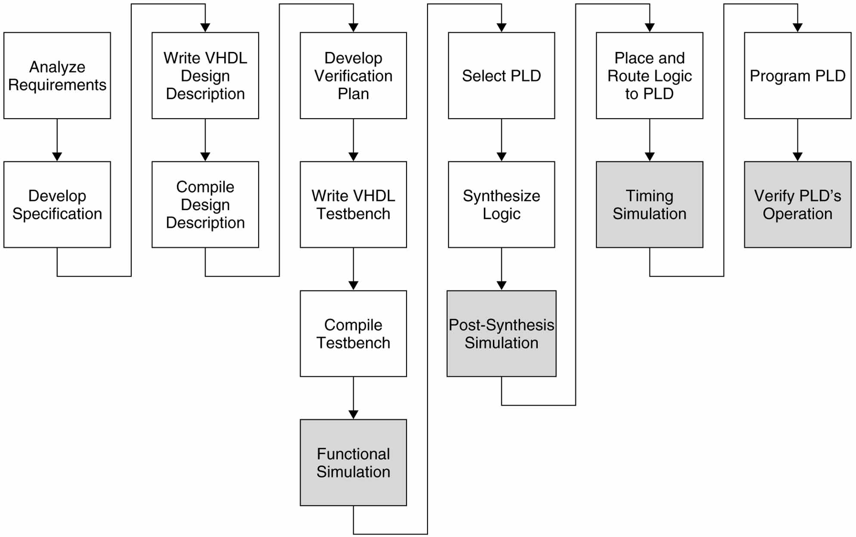
VHDL / PLD (FPGA) Design Flow
In our course
PLD ⬄ FPGA

Slide 17
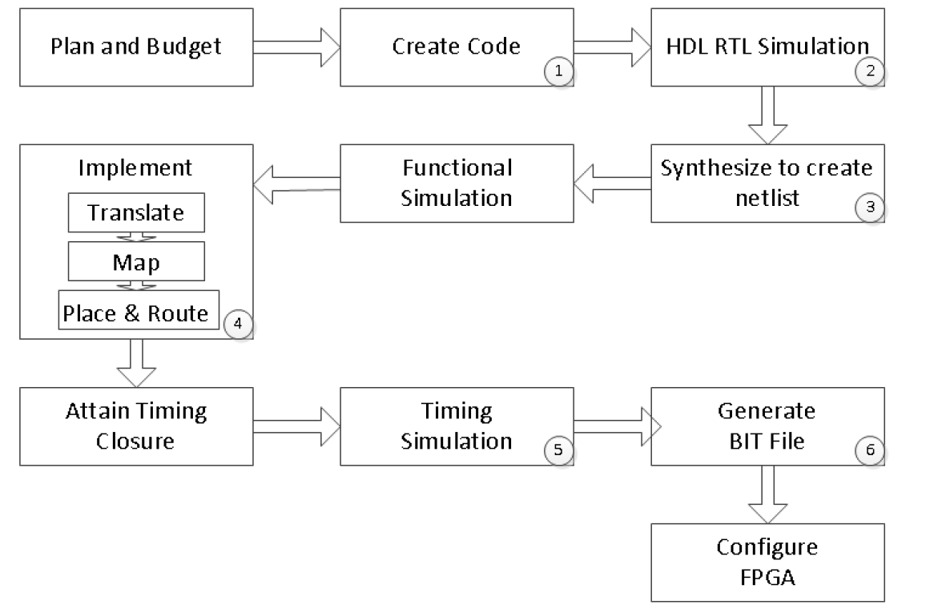
Vivado typical design flow

Slide 18
The VHDL/FPGA design methodology uses
VHDL to describe both the system being designed and the testbench used to verify the design
A software simulator tool to simulate the design to verify its functionality and timing
A software synthesis tool to create the logic described by the VHDL description
A software place-and-route tool to map the synthesized logic to the target PLD and to generate a timing model and a configuration file
A PLD to physically implement the design
Information in the configuration file to program the PLD

Slide 19
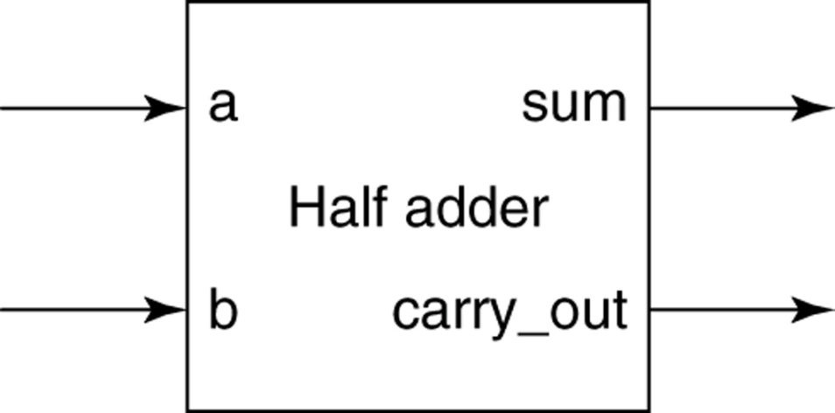
Requirements and Specification
A very brief requirements definition and specification for a half adder serve as very simple examples of these two phases. A natural language requirements definition for a half adder might be: “We need to be able to add two one-bit binary numbers.”
From this requirements definition we can write a natural language specification: “The circuit must add two binary inputs, producing two outputs. One output is the sum from the addition and the other is the carry.” A timing constraint that requires the addition to be completed in a specified time might be included in the specification. A block diagram, that shows the half-adder’s inputs and outputs might also be included.

Slide 20
Dataflow style half-adder description
library ieee;
use ieee.std_logic_1164. all;
entity half_adder is
port (a, b : in std_logic; sum, carry : out std_logic);
end half_adder;
architecture data_flow of half_adder is
begin
sum <= a xor b ; -- concurrent signal assignment
carry_out <= a and b ; -- concurrent signal assignment
end data_flow;
Signal assignment statement placed in the statement part of an architecture is a concurrent statement.

Slide 21
Context clause
library ieee;
use ieee.std_logic_1164. all;
A library clause is required when objects that are not predefined in the VHDL language, but are defined in a library, are used. This half-adder program uses a data type called std_logic for its input and output signals. This data type is defined in the package STD_LOGIC_1164 in the library ieee. The first statement in the program, starting with the keyword library, names the library (in our case, it is ieee).
A package is a collection of commonly used data type declarations and/or subprograms. The statement starting with the keyword use is a use clause that specifies which package in the ieee library is to be made available to this program (ieee.std_logic_1164).

Slide 22
Design Entity
entity half_adder is
port (a, b : in std_logic; sum, carry_out : out std_logic);
end half_adder;
architecture data_flow of half_adder is
begin
sum <= a xor b ;
carry_out <= a and b ;
end data_flow;
The simplest VHDL design descriptions consist of a single design entity. A design entity can represent all or a portion of a design. A design entity has well-defined inputs and outputs and performs a well-defined function. A design entity consists of two parts, an entity declaration and an architecture body. These two parts can be placed in the same file or they can be placed in separate files.

Slide 23
Type std_logic
Type std_logic provides nine different values to represent a logic signal. This allows a more detailed representation of a logic signal’s state than does type bit. Both types include the values '0' and '1'. Type std_logic is discussed in detail later.
Now we will only be using the '0' and '1' values from std_logic’s nine possible values.

Slide 24
BIT versus STD_LOGIC
BIT type can only have a value of ‘0’ or ‘1’
STD_LOGIC can have nine values
'U',‘0’,’1’,’X’,’Z’,’W’,’L’,’H’,’-’
Useful mainly for simulation
‘0’,’1’, and ‘Z’ are synthesizable

Slide 25
State and strength properties of std_ulogic
Value | Meaning
'U' | Uninitialized
‘X’ | Forcing (Strong driven) Unknown
‘0’ | Forcing (Strong driven) 0
‘1’ | Forcing (Strong driven) 1
‘Z’ | High Impedance
‘W’ | Weak (Weakly driven) Unknown
‘L’ | Weak (Weakly driven) 0. Models a pull down.
‘H’ | Weak (Weakly driven) 1. Models a pull up.
‘-’ | Don't Care

Slide 26
Design description compilation
VHDL compilers are sometimes called analyzers. The term “analyze” means to check a design file for syntax and static semantic errors before it is simulated. This term is sometimes used instead of the term “compile,” because compiling typically means to generate executable object code. In contrast, code generation for VHDL was initially associated only with simulation.
Syntax errors are violations of the language grammar.
Semantic errors are violations of the meaning of the language.
Static semantic errors are errors in meaning that can be detected by a compiler before a simulation is performed.
Dynamic semantic errors can only be detected during simulation.

Slide 27
Verification
Verification is the process used to demonstrate the correctness of a design. We verify that our design description meets its functional and timing specifications before the target PLD is programmed. Generally speaking, verification using simulation can show the existence of errors in a design, but cannot prove that a design is correct. The process of verification often consumes a significant percentage of the total design effort.

Slide 28
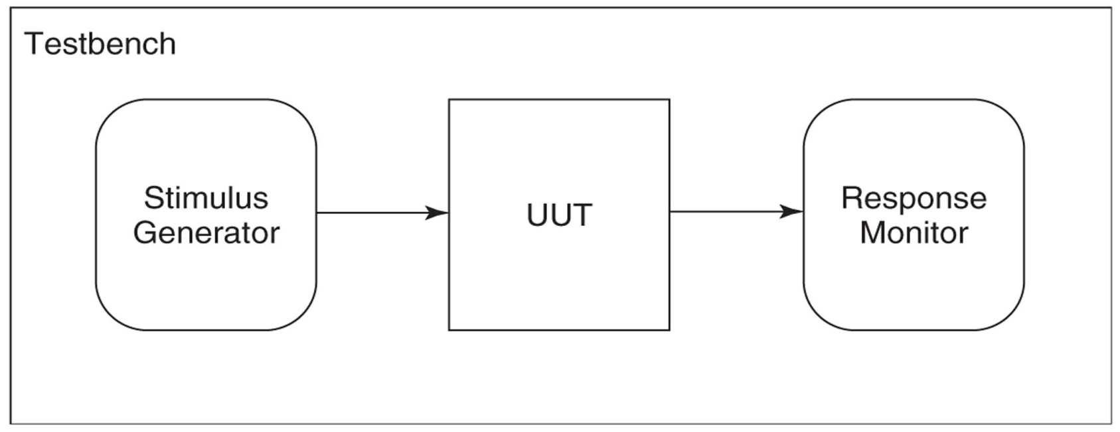
Typical constituents of a simple testbench
UUT (Unit Under Test)
Stimulus generator. For combinational designs, only combinations of the values of ‘0’ and ‘1’ , or sequences of combinations are applied.
Response monitor. In response to each stimulus, the UUT output values must be checked to verify that they are identical to the expected.

Slide 29
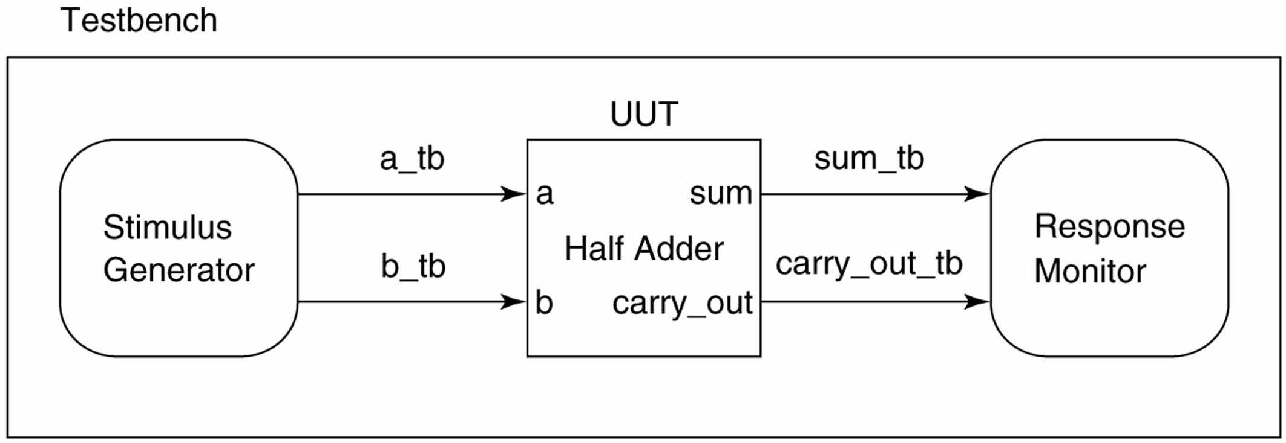
Testbench using projected waveforms
In order to simulate the operation of a UUT using a testbench, we must actually simulate a testbench, since the UUT is simply a component in the testbench.

Slide 30
Testbench of a half adder
library ieee ; use ieee.std_logic_1164.all ;
entity testbench is --testbench entity has no ports
end testbench ;
architecture waveform of testbench is
-- stimulus signals
signal a_tb, b_tb : std_logic ;
signal sum_tb, carry_out_tb : std_logic ;
begin
-- UUT port map; the label uut as name is not significant
UUT : entity half_adder port map ( a => a_tb, b => b_tb,
sum => sum_tb, carry_out => carry_out_tb ) ;
-- generating stimulus values
a_tb <= '0', '1' after 40 ns ;
b_tb <= '0', '1' after 20 ns, '0' after 40 ns, '1' after 60 ns ;
end waveform ;

Slide 31
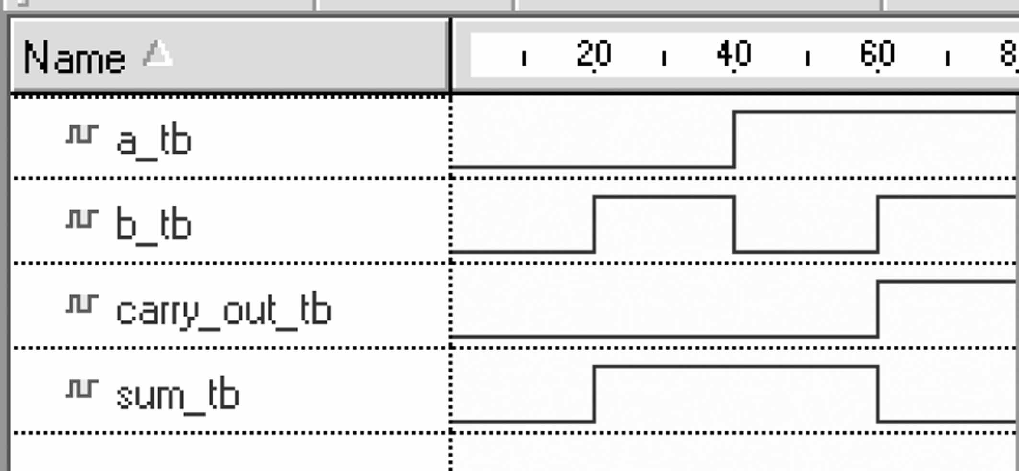
Timing waveform from example simulation
The signals displayed are those used to connect the UUT to the testbench. Because this is a functional simulation, the waveforms do not show any delay from an input change to a corresponding output change. That is, as soon as a UUT input changes, its outputs respond instantaneously.

Slide 32
Synthesizer
The objective of a synthesizer is to synthesize logic that behaves identically to the simulated behavior of the design description. In effect, a synthesizer translates a design description into a functionally equivalent gate-level logic implementation.
A synthesizer generates the required Boolean equations. It automatically carries out logic and state minimization and stores the simplified Boolean equations in an intermediate form. The output of the synthesizer is a gate-level logic description.
A gate-level logic implementation is sometimes referred to as a register transfer level (RTL) implementation. This level describes the logic in terms of registers and the Boolean equations for the combinational logic between the registers. Of course, for a combinational system there are no registers and the RTL logic consists only of combinational logic.

Slide 33
Register Transfer Level (RTL) Design Description
…
Combinational
Logic
Combinational
Logic
Registers

Slide 34
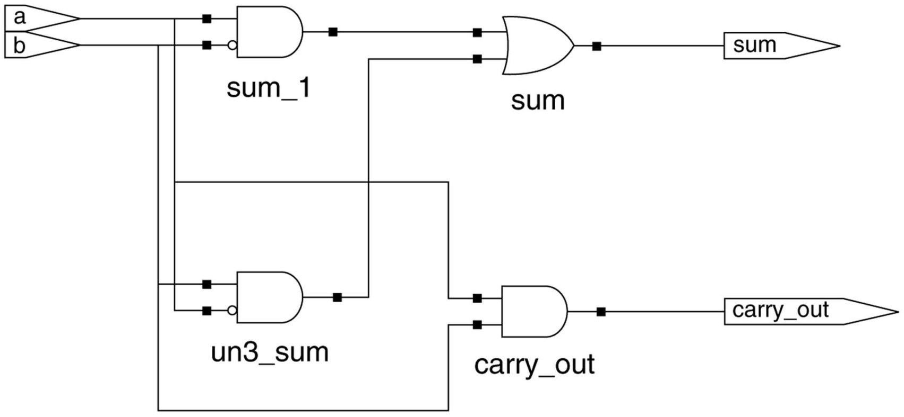
Half-adder synthesized logic
The synthesizer produces two output files: a VHDL netlist and a technology dependent gate-level netlist.
A netlist is a textual representation of the interconnection of logic elements.

Slide 35
Place-and-route
A place-and-route (or fitter) tool is software used to automatically map or fit synthesized logic to a target PLD’s architecture. The place operation selects and configures specific logic primitives in the PLD’s architecture for each logic primitive in the technology dependent netlist.
The route operation determines the path for each connection between two logic primitives and each connection between a logic primitive and a pin of the PLD. The place-and-route tool is usually obtained from the PLD (FPGA) vendor.

Slide 36
Place-and-route tool outputs
A place-and-route tool generally produces three outputs: a chip report, a configuration file, and a VHDL timing model.
The chip report documents which port signals are assigned to which PLD pins and how much of the PLD’s logic capacity is used.
The configuration file (programming file) contains the interconnection and configuration data necessary to program the PLD.
The VHDL timing model is a file containing a structural-style VHDL program that describes the logic and timing of the synthesized logic mapped to the target PLD. This model includes information detailing the propagation delays of signals through the PLD.

Slide 37
VHDL/PLD(FPGA) design metodology advantages
Complex systems can be described behaviorally at a high level of abstraction, so that the description is independent of any particular logic implementation. Alternatively, a system can be described structurally, as an interconnection of logic components or subsystems.
VHDL can be used for specification, description, simulation, and synthesis. This eliminates the need for us to learn different languages for different phases in the design flow.
Since VHDL is a nonproprietary standard, descriptions are portable to different vendors’ tools or to different vendors’ PLDs. Previously verified descriptions can be reused in later designs. VHDL descriptions for some complex systems can be purchased as intellectual property (IP) from IP vendors and included as components in our designs.

Slide 38
VHDL/PLD(FPGA) design metodology advantages
Because of its wide acceptance as a standard, many EDA tool vendors provide compilers, synthesizers, and simulators for VHDL. Competition between tool vendors leads to the availability of more powerful and lower cost tools. PLD vendors often provide low-cost or free EDA tools that include a place-and-route tool that maps designs only to that vendor’s PLDs. Because VHDL is a standard, we can use whichever VHDL tools we prefer.
VHDL descriptions can be written to be device independent. We can functionally verify our designs using a simulator, before specifying a target PLD (or other means) to implement them.
Rapid prototyping. The VHDL/PLD design methodology can be used for proof-of-concept to rapidly prototype and implement a system in small quantities to prove its viability.

