Slide 1

Low Power Design
Lab. 6
IAY 0600 Digital Systems Design
Alexander Sudnitson
Tallinn University of Technology

Slide 2
Motivation for low power design
Low power design is important from different reasons
Device temperature
Failure rate, Cooling and packaging costs
Life of the battery
Meantime between charging, System cost
Environment
Overall energy consumption

Slide 3
Power and Energy
Power is drawn from a voltage source attached to the V_{DD} pin(s) of a chip.
Instantaneous Power:
Energy:
Average Power:

Slide 4
Low Power or Low Energy design
E(T) = ∫ P(t) dt
Power
Direct impact on instantaneous energy consumption and temperature
Power consumption is critical for heat dissipation limited systems
Energy
Power integrated over time is energy and impact on battery shelf life and environment
Energy consumption is critical for battery-powered systems

Slide 5
CMOS
We will restrict our attention to CMOS devices, this technology being the most widely adopted in current VLSI systems.
Static, complementary CMOS gates are remarkably efficient in their use of power to perform computation
However, leakage increasingly threatens to drive up chip power consumption
We consider inverter as circuit used for power consumption analysis

Slide 6
Power consumption analysis
V_{DD}
Static dissipation due to leakage circuit
Short-circuit dissipation
Charge and discharge of a load capacitor
V_{in}
V_{out}
GND
P = P_{dyn} + P_{sc} + P_{lk}
P_{dyn} is dynamic or switching power (is due to charging and discharging load capacitances);
P_{sc} is shirt-circuit power;
P_{lk} is leakage power (is static in nature)

Slide 7
Dynamic Energy Consumption
Transition Power
Vdd
Vin
Vout
C_{L}
Energy/transition = 1/2*C_{L} * V_{DD}²
Total energy (both charge and discharge) = C_{L} * V_{DD}²
Power = C_{L} * V_{DD}² * f

Slide 8




Consumption in CMOS
Voltage (Volt, V) Water pressure (bar)
Current (Ampere, A) Water quantity per second (liter/s)
Energy Amount of Water
1
C_{L}
0
Energy consumption is proportional to capacitive load!
Source: Frank Sill (Federal University of Minas Gerais)

Slide 9
Leakage energy
Short-circuit Power
Vdd
Vin
Vout
C_{L}
Energy/transition = t_{sc} * V_{DD} * I_{peak} * P _{0/1→1/0}
Power = t_{sc} * V_{DD} * I_{peak} * f

Slide 10
Leakage energy
Vout
Drain junction leakage
OFF
Sub-threshold current
Gate leakage
Independent of switching

Slide 11
Define and quantity power
For CMOS chips, traditional dominant energy consumption has been in switching transistors, called dynamic power
For mobile devices, energy better metric
For a fixed task, slowing clock rate (frequency switched) reduces power, but not energy
Dropping voltage helps both

Slide 12
Energy and performance
In some cases, energy can be saved by reducing performance.
Speed decreases linearly, power decreases as V².
Power goes down faster than performance.
Example of quantifying power
Suppose 15% reduction in voltage results in a 15% reduction in frequency. What is impact on dynamic power?

Slide 13
Activity factor
Suppose the system clock frequency = f
Let f_{sw} = af, where a = activity factor
If the signal is a clock, a = 1
If the signal switches once per cycle, a = ½
Dynamic power:

Slide 14
Rules for reducing power consumption
Turn it off.
Eliminates leakage current.
Slow it down, reduce voltage.
Performance is linear with clock frequency.
Power is V².
Don’t change its inputs.
Activity-dependent.

Slide 15
Levels of abstraction
Physical:
Minimize capacitance.
Gate:
Use low leakage gates.
Combinational:
Avoid switches.
Register-transfer:
Avoid using units.
Architecture:
Slow things down, turn them off.

Slide 16
Logic/circuit optimizations
Turn off gate where possible.
Not an option in most FPGAs, but it should be.
Operate gate at low voltage.
Speed decreases linearly, power decreases as V².

Slide 17
State assignment for low power
State assignment for low power has also been explored. In general, the state assignment problem has targeted minimizing area, and this approach tends to reduce power as well.
Low-power state assignment techniques assignment augment the state transition graph of the state machine with the state probabilities and transition probabilities between states, and use these probabilities to guide the state assignment. Adjacent binary encodings are assigned to states connected with high probability edges of the graph. This minimizes the number of state signal transitions, thus attempting to minimize transitions in the next state and output signal combinational logic.
One approach attempts to minimize area in conjunction with switching activity by generating multiple sets of state encodings with similar switching energy costs from which a final assignment is chosen on the basis of area.

Slide 18
State assignment impact on power (counter encoding ex.)
S1
State
Gray Code
Binary Code
S2
S0
000
000
S0
S1
001
001
S2
011
010
S3
010
011
S7
S4
110
100
S3
S5
111
101
S6
101
110
S6
S4
S7
100
111
Total number of
8
14
S5
transitions
Max transitions
1
3
per clock cycle
Table compares Gray and binary state assignments. Comparison shows that Gray technique reduces both the average number of logic transitions per clock and the overall number of transitions for a cycle of the state machine.

Slide 19
Register-transfer optimizations
Hold inputs when a unit’s output will not be used.
Put register at inputs.
Turn off units when they won’t be used for several cycles.
Can’t selectively turn off LEs in most FPGAs.
Not an option in most FPGAs, but it should be.

Slide 20
Guard evaluation
Guard
Latches
Combinational
Logic
S
Guarded evaluation relies on input blocking for transition reduction. Transparent latches are added to inputs of existing logic and are appropriately disabled when the logic output can be determined without new input values being driven from the disabled latches. This technique is common in the design of datapath functions in low-power processors.

Slide 21
Clock gating
D Q
C
CLK
&
Enable

Slide 22
Circuit with clock drivers and clock gating
CLK GATING SIGNAL
&
CLK
R1
R2
CL3
R3
CL4
R4

Slide 23
FSM stochastic analysis
Given the FSM description and the input probabilities, the probabilistic behavior of a FSM can be studied by regarding its transition structure as a Markov chain.
A Markov process is a stochastic process, where the past has no influence on the future. In other words, the future behavior depends only on the current state of the process (a “Markov property”). Markov process is called a Markov chain (MC) if its state space is discrete (either finite or countable).
One example of MC is the process of playing a board game, where player's next action is determined entirely by rolling a dice. In order to make a move, one takes into account only the current state of the board. It doesn't really matter how the game progressed to that state. Alternatively, in a card game player's move is motivated not only by the cards he or she currently holds, but also the cards which have already been used during the course of the game.
Using steady state probabilities, which are received in the result of such analysis, it is possible to build different kinds of quantitative estimations of FSM’s stochastic behavior.

Slide 24
A Case Study: Low-Power Design
To demonstrate the use of applets in conjunction with FPGA-based development boards, the procedure of computational kernel extraction and implementation will be considered in Lab.
Sequential circuits may have an extremely large number of reachable states, but probabilistic analysis show that during normal operation only a relatively small subset is actually being visited. A power optimization paradigm is based on the concept of computational kernel, a highly optimized logic block, which mimics the steady-state behaviour of the original specification.

Slide 25
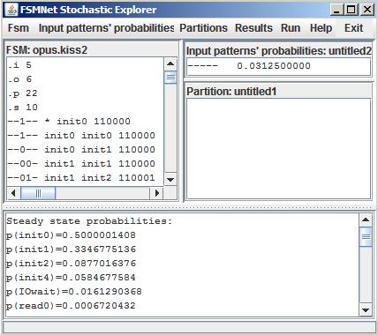
Probability distribution of the FSM
The first step of computational kernel extraction procedure is probabilistic analysis of the FSM.
State | Steady state probability
init0 | 0.5000001408
init1 | 0.3346775136
init2 | 0.0877016376
init4 | 0.0584677584
IOwait | 0.0161290368
read0 | 0.0006720432
write0 | 0.0006720432
RMACK | 0.0006720432
WMACK | 0.0006720432
read1 | 0.0003360216
It is seen that FSM “opus”-benchmark spends 83% of its operation time in states “init0” and “init1”.

Slide 26
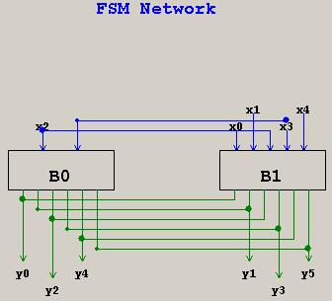
Decomposed FSM network
After computational kernel is identified, it should be separated from the rest of the circuit.
The applet of additive decomposition is used to divide the original circuit into two alternatively working sub-FSMs.

Slide 27
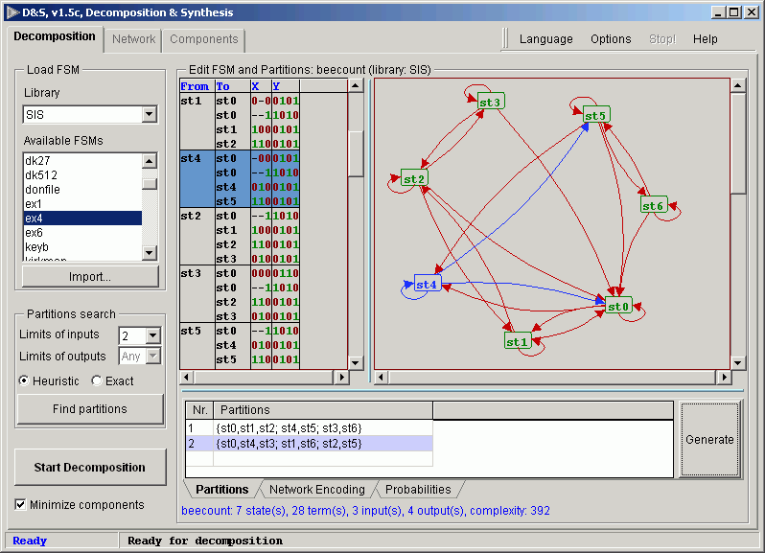
Decomposition applet

Slide 28
Implementation summary
VHDL description for prototype FSM and decomposed network can be generated by decomposition applet. This descriptions are used to implement and verify both designs using FPGA-based development board.
XPower Analyzer is a tool for power consumption estimation featured in Xilinx ISE. It is used to evaluate the quality of the decomposed design in comparison with the original.
Design | Area (LUTs) | Power Consumptions (mW)
Original | 25 | 4.65
Decomposed | 36 | 1.85
As it is seen from the table, the dynamic power consumption has been reduced by the factor of 2.5, while area overhead is 44%.

