Slide 1

IAY 0600
Digital Systems Design
  Event-Driven Simulation
  VHDL Discussion
Alexander Sudnitson
Tallinn University of Technology

Slide 2
Simulation
Simulation is the process of conducting experiments on a model of a system for the purpose of understanding or verifying the operation of the actual system.
Simulation in the VHDL/PLD methodology:
  Functional verification verifies the functional operation of a description.
  Post-synthesis simulation verifies that the synthesizer accurately translated the description to logic.
  Timing simulation verifies that the synthesized logic, when mapped to the target PLD, will meet the system’s requirements.
Construct semantics are defined in the IEEE Std 1076 Language Reference Manual (LRM) in terms of how an event-driven simulator must execute the constructs.

Slide 3
Simulation
VHDL is an event-driven language.
A VHDL simulator must provide data structures and algorithms that allow it to efficiently simulate the execution of concurrent statements in a VHDL program.
Simulator's sequential execution must be able to provide the illusion of concurrency.
Changes in input and output signals occur in simulation time: the time value maintained by the simulator, as opposed to real time.
There are three common kinds of simulators:
  time driven
  event driven
  cycle based (for simulation of sequental systems)

Slide 4
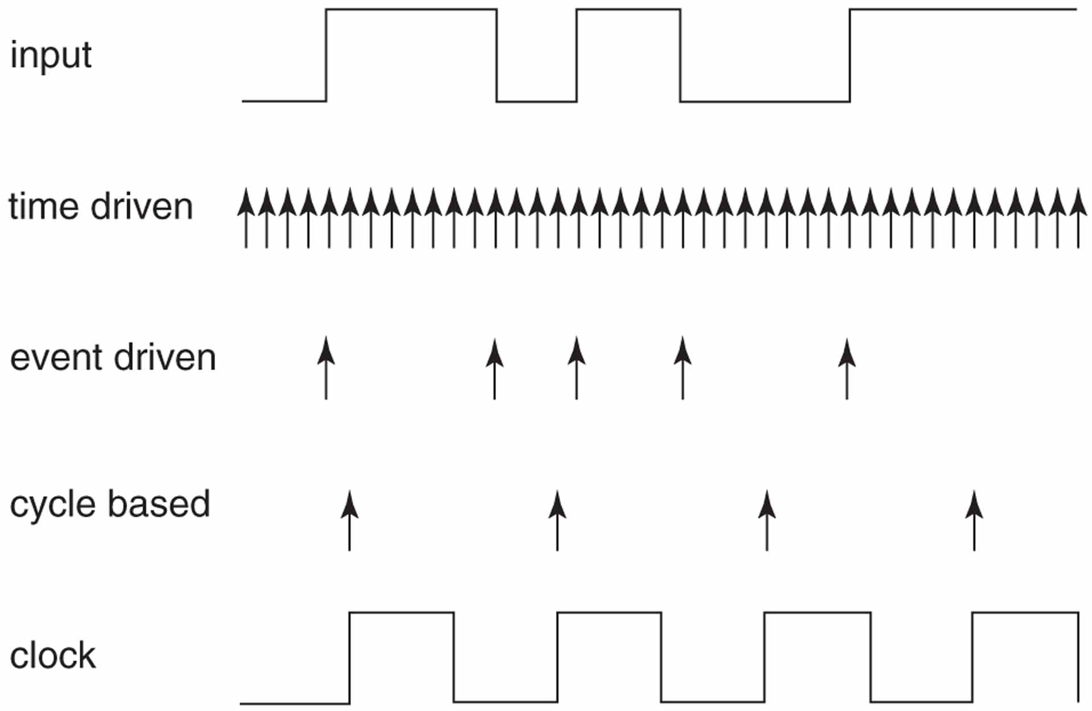
Time of execution of simulation cycles

Slide 5
Steps in an event-driven simulation
The LRM (Language Reference Manual) defines how an event-driven simulator must execute the VHDL.
Simulator vendors implement this concepts.
An event-driven simulator performs three steps to accomplish a simulation:
elaboration
initialization
repeated execution of simulation cycles

Slide 6
Elaboration
In VHDL the statement part of an architecture body can contain only concurrent statements.
The process statement is the basic behavioral statement.
Every concurrent VHDL statement has an equivalent process representation.
We use the term simulation process to mean a process that is equivalent to some concurrent statement in a design entity’s architecture and is used for the simulation of that statement.
Elaboration is the creation of a simulation model for a design entity from its VHDL description. This simulation model consists of a net of simulation processes.
During elaboration, all concurrent statements are converted to equivalent simulation processes.

Slide 7
Flattening a hierarchical structure
Any VHDL program can ultimately be viewed as collection of simulation processes communicating through signals, that is, a simulation net. The resulting simulation net is executed to simulate the design entity’s behavior.
During elaboration a design that has a hierarchical structure is flattened until entire design is described by a simulation net.
In addition, all of the data objects (an object is a named item that has a value of a specified type) declared in the description are created.

Slide 8
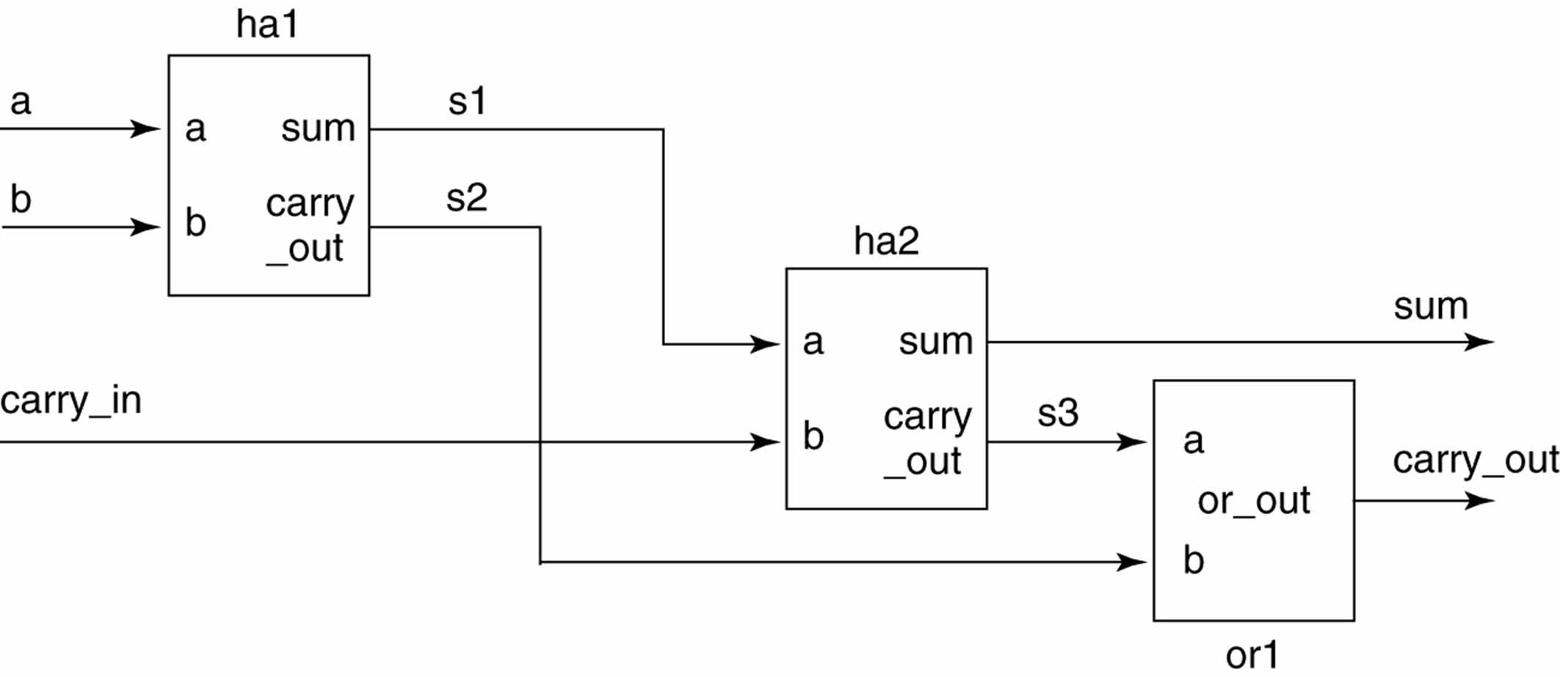
A simple example (full adder)

Slide 9
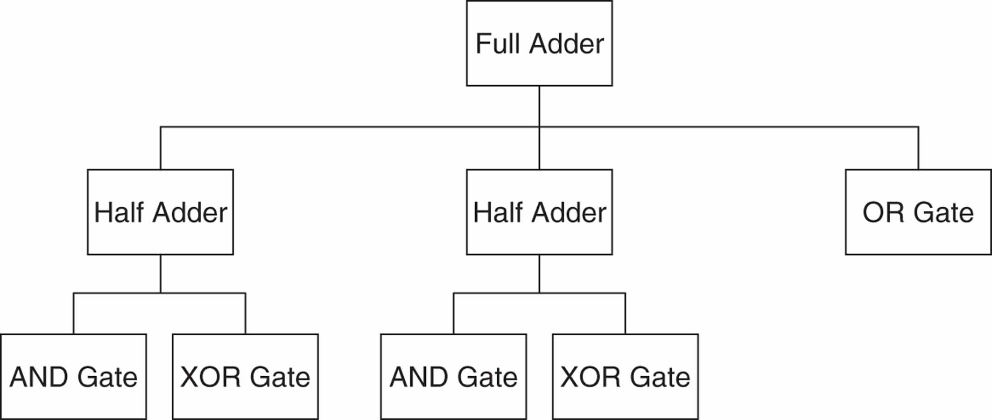
Hierarchy tree for a full adder
Design entities with behavioral (dataflow) descriptions.
These design entities are the primitive components and are converted to equivalent simulation processes.

Slide 10
A single inverter circuit to be simulated
To illustrate the simulation of hierarchical design, lets consider trivial structure that consists of the instantiation of a single inverter component. The design file contains two design entities.
library ieee ;
use ieee.std_logic_1164.all ;
entity not_gate is -- not gate entity with name not_gate
port (x : in std.logic ; o : out std_logic) ;
end ;
architecture dataflow of not_gate is
begin
o <= not x ;
end dataflow ;

Slide 11
A single inverter circuit to be simulated
library ieee ;
use ieee.std_logic_1164.all ;
entity ckt is -- top level entity
port (a : in std_logic ; f : out std_logic) ;
end ;
architecture struct of skt is -- top level architecture
begin
u0 : entity not_gate port map (x => a, o => f ) ;
end struct ;
The second design entity, ckt, is the circuit whose operation we wish to verify.

Slide 12
Testbench for inverter circuit
To simulate ckt we use a testbench named testbench.
Design entity ckt is the UUT in design entity testbench.
library ieee ;
use ieee.std_logic_1164.all ;
entity testbench is
end testbench ;
architecture behavior of testbench is
signal a : std_logic;
signal f : std_logic ;
begin
uut : entity ckt port map (a => a, f => f ) ;

Slide 13
Testbench for inverter circuit
tb : process
constant period : time := 20 ns ;
begin
wait for period ; -- Wait 20 ns after initialization
a <= ‘ 1 ‘ ;
wait for period ; -- Wait another 20 ns
assert ( f = ‘ 0 ‘ )
a <= ‘ 0 ‘ ;
report “test failed” severity error ;
wait for period ; -- Wait another 20 ns
assert ( f = ‘ 1 ‘ )
report “test failed” severity error ;
wait ;
end process ;
end behavior ;

Slide 14
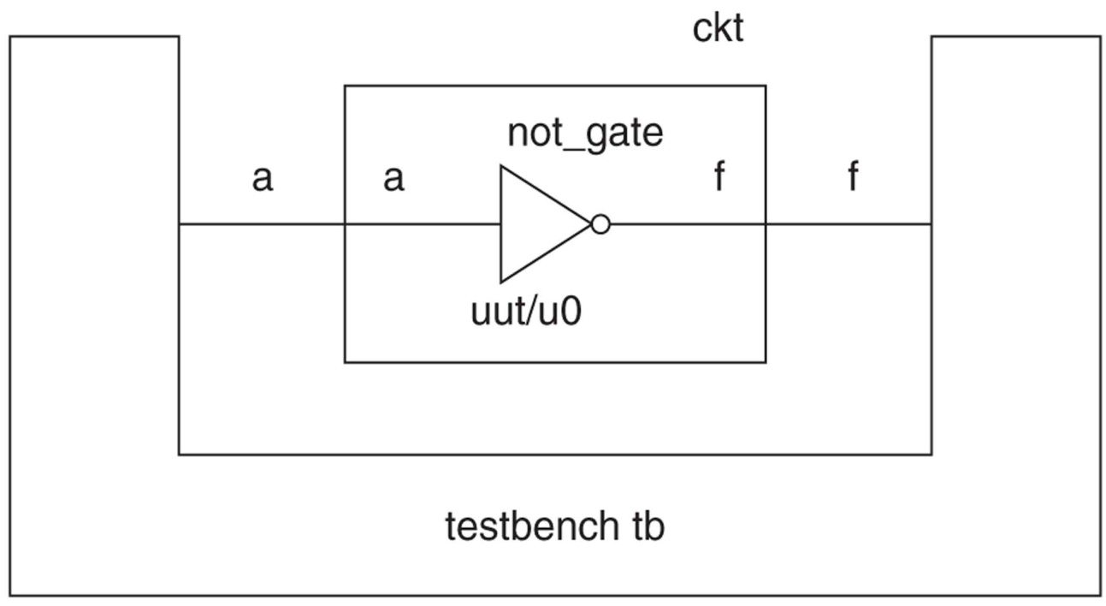
Relationship of the testbench to the circuit
Design entity not_gate has dataflow architecture which is behavioral. Thus, not_gate is a primitive component. The elaboration create a simulation process uut/u0, which represents an instance of not_gate (u0) in an instance of skt(uut). In the simulation process, the label uut/u0 represents the hierarchical path to u0.
A conceptual representation of the simulation process uut/u0 is:
uut_u0: process (a)
begin
f <= not a ;
end process

Slide 15
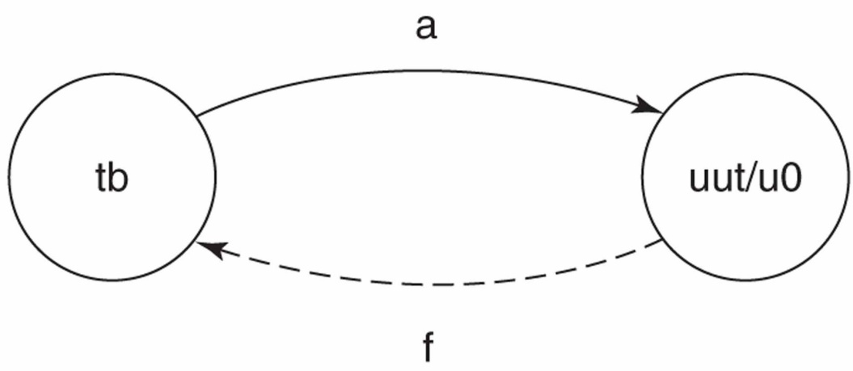
Simulation net created by elaboration
The simulation net created by this elaboration. Each
circle represents a simulation process. The directed arrow from tb to uut/u0 indicates that tb assigns a value to a and that uut/u0 is sensitive to a. The
dashed directed arrow from uut/u0 to tb indicates that uut/u0 assigns a value to f and that tb reads this value. A dashed directed arrow is used to distinguish that although tb reads f, it is not sensitive to f (does not have f in its sensitivity list).

Slide 16
Signal drivers
Driver is a source (contributor) to the value of a signal. During elaboration only one driver is created for each signal assigned a value in a simulation process.
If two (or more) different simulation processes contain assignments to the same signal than this signal is multiply driven (drivers are associated with each simulation process).
A signal driver is modeled as a queue.
Each time a signal assignment statement is executed, the simulator posts (schedules) a transaction in the signal’s driver. Each transaction is a pair consisting of a value component and a time component.
Transactions are ordered in a signal’s driver queue based on their time component. The ordered set of transactions specifies projected values (projected waveforms).

Slide 17
Signal drivers
During a simulation cycle, if a signal driver queue has a transaction with a time component equal to the current simulation time, that is said to be active driver during this simulation time.
If a signal has multiple sources (a multiple driven signal), the current values of all signal’s sources must be resolved to determine the current value of the signal. The simulator automatically performs this resolution operation.
If a signal’s declaration specifies an initial value, the signal is initially set to this value. Otherwise, each signal is initially set to its default value. This value is the leftmost value for its type. For std_logic, this value is the uninitialized value ‘U’.
The simulator maintains a current value variable for each signal. If signal has a single driver, the current value of signal is the same as the current value of its driver.

Slide 18
Simulator kernel process
During a simulation, the kernel process coordinates the activities of the simulation processes. The kernel process is responsible for detecting events and causing the appropriate simulation processes to execute in response to those events.
The kernel process maintains the current value variable for each signal in the simulation model. It utilizes the resolution function to determine a multiple driven signal’s current value from its drivers’ current values.
A simulator program is typically run on a host computer with a single CPU (only one simulation process can actually be executing at a time). So, the simulator must execute simulation processes sequentially, but in a way that models concurrent operation.

Slide 19
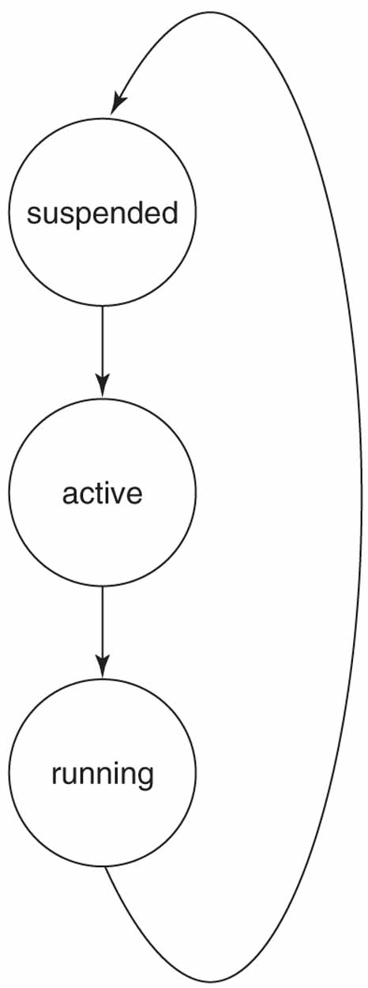
States of a simulation process
Three states:
Suspended: simulation process is not running or active.
Active: simulation process is in the active processes queue waiting to be executed.
Running: simulator is executing the simulation process.

Slide 20
Active and waiting processes’ queues
All simulation processes that need to be run during a particular simulation cycle are placed in the active processes queue by the kernel. The kernel than takes each simulation process from the queue and executes it until it suspends.
If a simulation process is suspended because of of a wait statement of the form wait for time_expression, that simulation process is put in the waiting processes queue in time order. A simulation process in the waiting processes queue is referred to as a scheduled process because it is scheduled to be resumed (be placed in the active processes queue) at a specific future time.
When a simulation process without a sensitivity list or wait statement is simulated, than such a process never suspends (however syntactically it is legal).

Slide 21
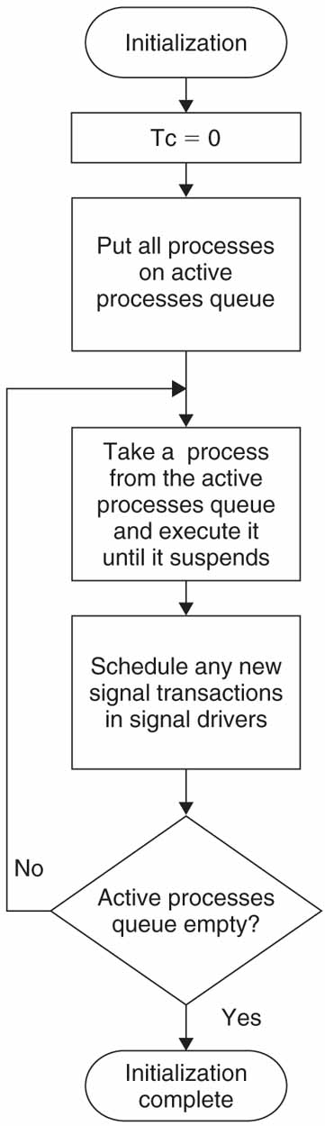
Simulation initialization
At the beginning of the initialization phase, the cuurent simulation time (Tc) is set to 0.
The kernel places all of the simulation processes in the active processes queue. The initial execution of each simulation process ensures that all initial transactions are scheduled, so than the simulation may continue.

Slide 22
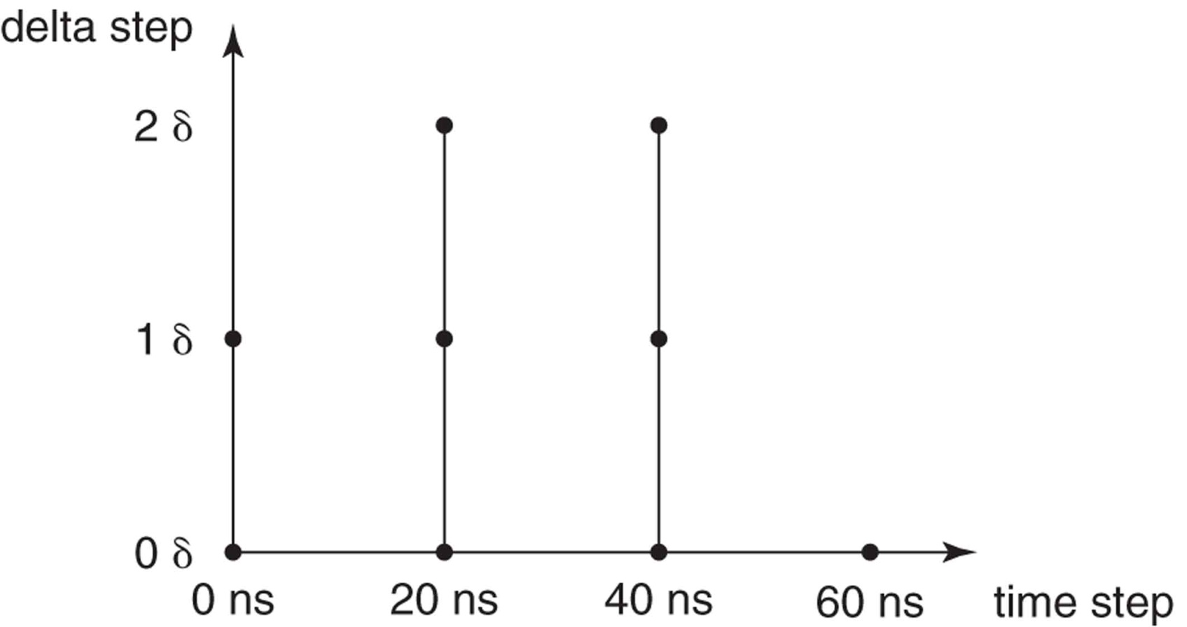
Delta delays. Two-dimensonal view of time
Testbenches can use signal assignment with after clause.
Example: x <= a and b after 2 ns;
If a signal assignment wthout an after clause is executed, the associated transaction is assigned a time component 1 delta (δ) delay greater than the current simulation time.
Since a delta delay is infinitesimal, when added to the current simulation time it does not advance the numerical time value. Consceptually, simulation time is viewed as two-dimensional.

Slide 23
Simulation cycles: update phase
After the initialization phase, all simulation processes are in suspended states. The simulation cycle is then executed.
A simulation cycle consists of two phases: an update phase and an execution phase.
The update phase first determines the next value for the current simulation time. Based on this new simulation time, a determination is made as to whether the simulation is complete.
A change in a signal’s value can occur only during the update phase. If a signal’s update results in an event, all simulation processes sensitive to this event are placed in the active processes queue. In addition, all simulation processes that are scheduled to resume at the current simulation time are placed in the active processes queue.

Slide 24
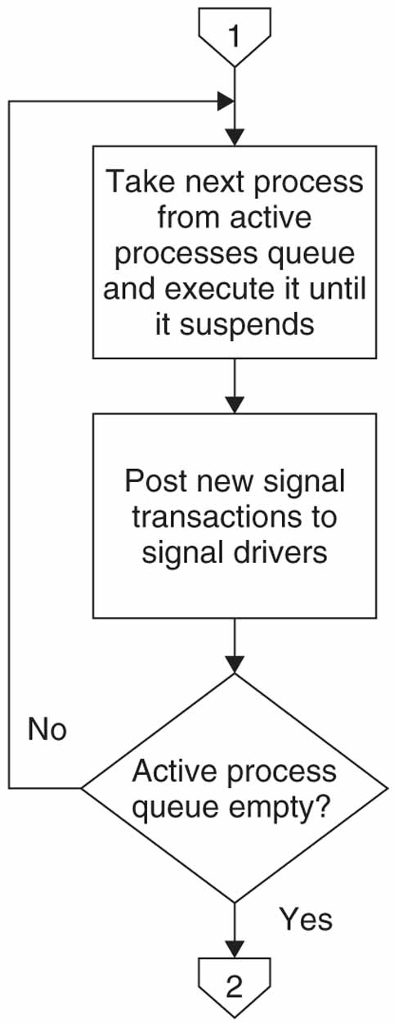
Simulation cycles: execution phase
Each simulation process in the active processes queue is executed until it suspends. Execution of a signal assignment statements causes transactions to be scheduled for specified signal’s driver.
The order in which the cernel takes simulation processes from the active processes queue and executes them is not important, because these processes are concurrent.

Slide 25
When do signals take new values?
It is not until simulation process suspends that the transactions resulting from signal assignment in that process are placed in the appropriate signal driver queues.
It is not until the update phase of the next simulation cycle, after all the simulation processes that were in the active processes queue during the current simulation cycle have been executed and suspended, that any signals assigned values by these processes are updated.
This means that the assignment of a new value to a signal cannot take effect until the update phase of the next simulation cycle. This is after the process containing the assignment has suspended. Therefore, the simulation process does not see the effect of any signal assignment until the next time it resumes.

Slide 26
Summary of simulation cycle steps
The time of the next simulation cycle is determined. If Tn = Tc + δ, the next cycle is a delta simulation cycle.
Simulation is complete if Tn = TIME’HIGH and there are no signal drivers with transactions scheduled for Tn (active drivers) or simulation processes scheduled to resume at Tn.
If the simulation is not complete, the current simulation time is set to Tn.
The value of all signals having transactions scheduled for Tc are updated. Events may occur on some signals as a result of updating their values.

Slide 27
Summary of simulation cycle steps
All processes that are sensitive to the events in (4) are put in the active processes queue.
All processes scheduled to resume at Tc are also put in the active processes queue.
Each simulation process is taken from the active processes queue and executed until it suspends. Execution of simulation processes may cause new transactions to be posted in signal drivers.
Return to step 1.

Slide 28
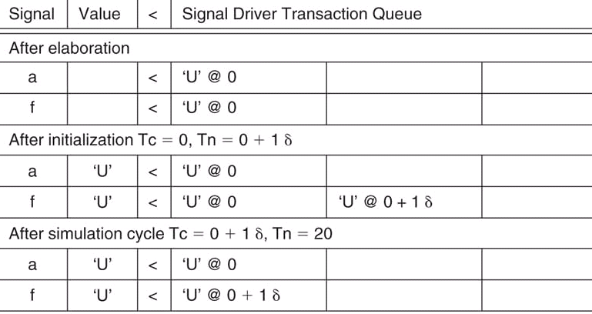
Simulation cycles for inverter example
Since this value is the same as the previous value, no event occurs. So, no processes are placed in the active processes queue

Slide 29
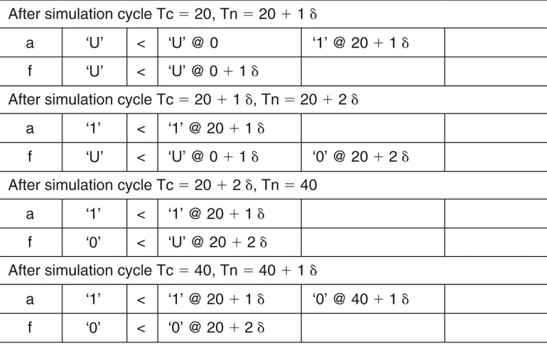
Simulation cycles for inverter example

Slide 30
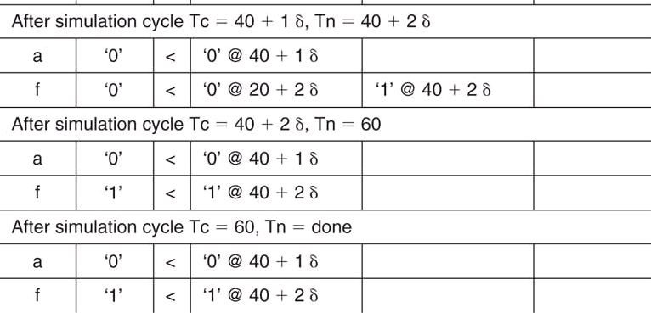
Simulation cycles for inverter example

Slide 31
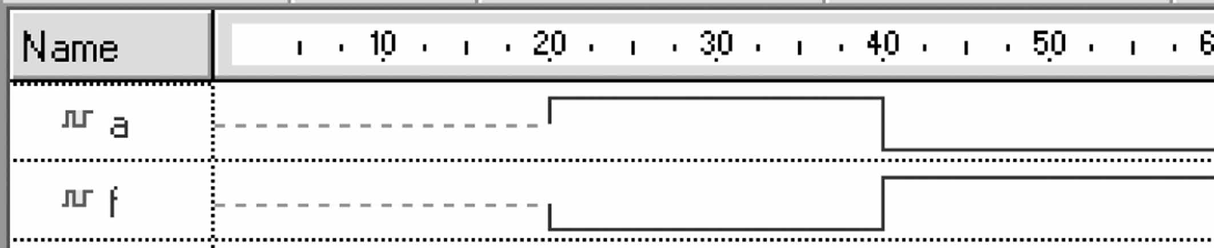
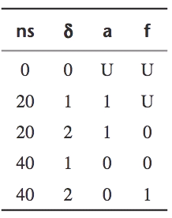
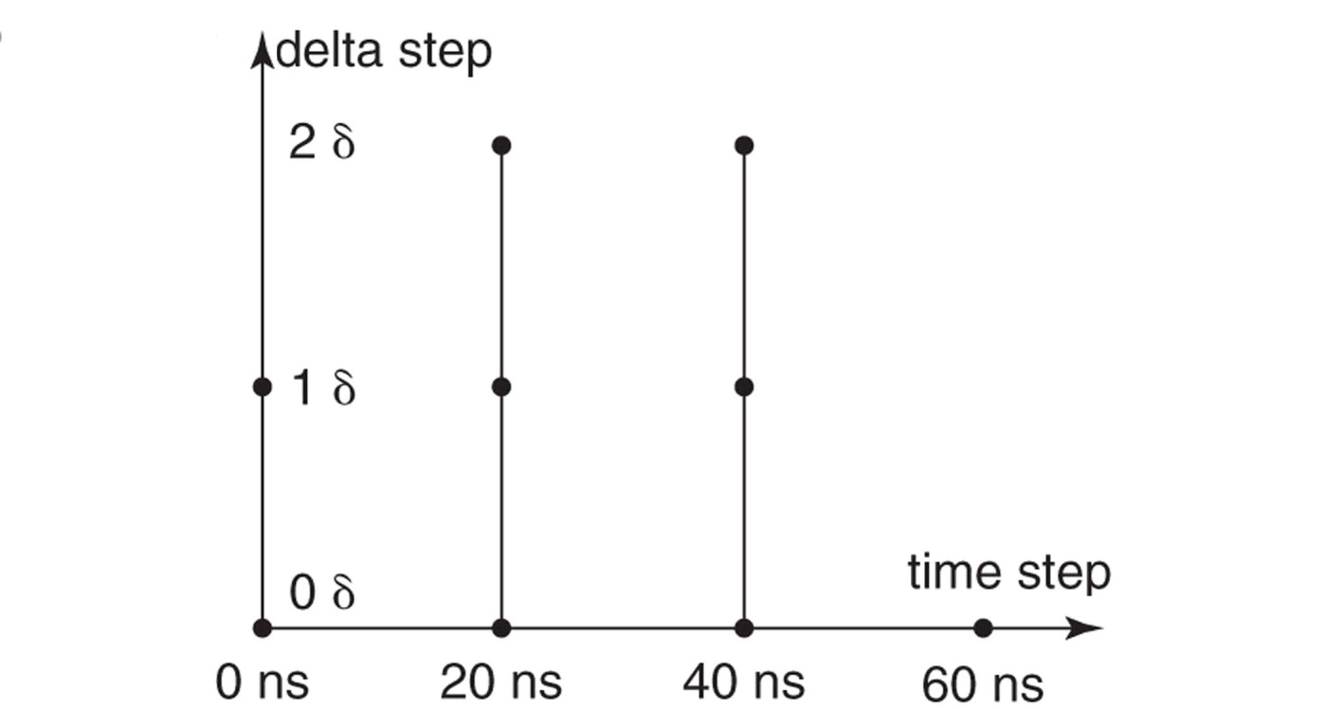
Waveform and simulation cycles of inverter
A simulation cycles list only shows deltas where an event occurred.

Slide 32
Signals versus Variables
Signals in an architecture:
An initial value specified in a signal’s declaration is not synthesizable.
Must be declared outside of any processes.
Are visible to all processes (and other concurrent statements) in the architecture in which they are declared.
Have current and projected (future) values.
Variables in an architecture
An initial value specified in a variable’s declaration in a process is not synthesizable.
Can only be declared within process or subprograms.
Are not visible outside of the process or subprogram in which they are declared. Variables are local to the process.
Have only a current value.

Slide 33
Signals versus Variables
Signals in an architecture:
Retain their values between executions of a process.
A signal assignment schedules a transaction in the signal’s driver queue. If the signal assignment has no after clause, the assigned value takes effect at the update phase of the next simulation cycle (one δ later). The signal’s value is not changed during the current simulation cycle.
Variables in an architecture
Retain their values between executions of the process in which they are declared. Do not retain their values between executions of the subprogram in which they are declared.
When a variable assignment statement is executed, the variable takes its new value immediately. Statements in the process that follow the variable assignment statement see its new value.

