Slide 1



Slide 2
INSTRUCTION FETCH –DECODE AND EXECUTE CYCLE.
The basic function performed by a computer is execution of a program, which consists of a set of instructions stored in memory. The processor does the actual work by executing instructions specified in the program. In its simplest form, instruction processing consists of two steps: The processor reads (fetches) instructions from memory one at a time, decodes the fetched instructions and executes each instruction. Program execution consists of repeating the process of instruction fetch and instruction execution.

Slide 3
INSTRUCTION FETCH –DECODE AND EXECUTE CYCLE.
The instruction execution may involve several operations however, depending on the nature of the instruction. The processing required for a single instruction is called an instruction cycle. Using the simplified two-step description described in our previous lectures, the instruction cycle is depicted in Figure 3 below. The two steps are referred to as the fetch cycle and the execute cycle. Program execution halts only if the machine is turned off, some sort of unrecoverable error occurs, or a program instruction that halts the computer is encountered.

Slide 4


Slide 5
At the beginning of each instruction cycle, the processor fetches an instruction from memory. In a typical processor, a register called the program counter (PC) holds the address of the instruction to be fetched next. Unless told otherwise, the processor always increments the PC after each instruction fetch so that it will fetch the next instruction in sequence (i.e., the instruction located at the next higher memory address).

Slide 6
So, for example, consider a computer in which each instruction occupies one 16-bit word of memory. Assume that the program counter (PC) is set to location 300.The processor will next fetch the instruction at location 300. On succeeding instruction cycles, it will fetch instructions from locations 301, 302, 303, and so on. This sequence may be altered as explained earlier .

Slide 7
The fetched instruction is loaded into a register in the processor known as the instruction register (IR). The instruction contains bits that specify the action the processor is to take. The processor interprets the instruction and performs the required action. In general, these actions fall into four categories:

Slide 8
Processor-memory: Data may be transferred from processor to memory or from memory to processor.
Processor-I/O: Data may be transferred to or from a peripheral device by transferring between the processor and an I/O module.
Data processing: The processor may perform some arithmetic or logic operation on data.
Control: An instruction may specify that the sequence of execution be altered.

Slide 9
For example, the processor may fetch an instruction from location 149, which
specifies that the next instruction will be from location 182. The processor will remember this fact by setting the program counter to 182.Thus, on the next fetch
cycle, the instruction will be fetched from location 182 rather than 150.

Slide 10
An instruction’s execution may involve a combination of these actions.
Consider a simple example using a hypothetical machine that includes the characteristics listed in Figure 3.1. The processor contains a single data register, called an accumulator (AC). Both instructions and data are 16 bits long. Thus, it is convenient to organize memory using 16-bit words. The instruction format provides 4 bits for the opcode, so that there can be as many as 2⁴ = 16 different opcodes, and up to 2¹² = 4096 (4K) words of memory can be directly addressed.

Slide 11
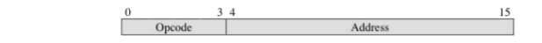
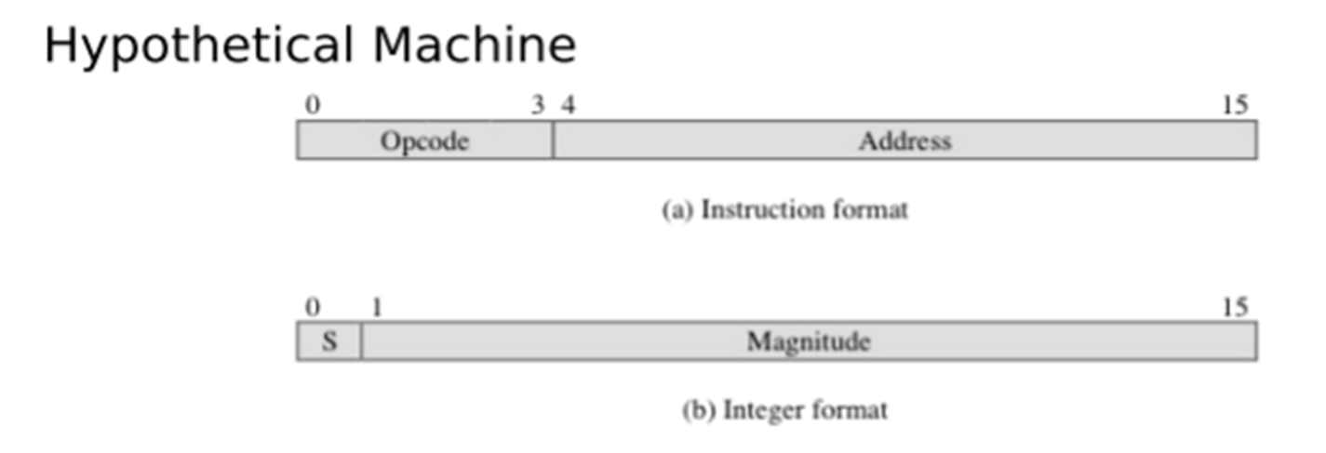
(a) Instruction format
(b) Integer format
Program counter (PC) = Address of instruction
Instruction register (IR) = Instruction being executed
Accumulator (AC) = Temporary storage
(c) Internal CPU registers
0001 Load AC from memory
0010 Store AC to memory
0101 Add to AC from memory
(d) Partial list of opcodes
Figure 3.1 Characteristics of a Hypothetical Machine

Slide 12
Figure 3.2 Example of Program Execution (contents of memory and registers in hexadecimal)

Slide 15
Figure 3.2 above illustrates a partial program execution, showing the relevant portions of memory and processor registers. The program fragment shown adds the contents of the memory word at address 940 to the contents of the memory word at address 941 and stores the result in the latter location. Three instructions, which can be described as three fetch and three execute cycles, are required:

Slide 16
1. The PC contains 300, the address of the first instruction. This instruction (the value 1940 in hexadecimal) is loaded into the instruction register IR and the PC is incremented. Note that this process involves the use of a memory address
register (MAR) and a memory buffer register (MBR). For simplicity, these intermediate registers are ignored.
2. The first 4 bits (first hexadecimal digit) in the IR indicate that the AC is to be loaded. The remaining 12 bits (three hexadecimal digits) specify the address (940) from which data are to be loaded.

Slide 17
3. The next instruction (5941) is fetched from location 301 and the PC is incremented.
4. The old contents of the AC and the contents of location 941 are added and the result is stored in the AC.
5. The next instruction (2941) is fetched from location 302 and the PC is incremented.
6. The contents of the AC are stored in location 941.

Slide 18
In this example, three instruction cycles, each consisting of a fetch cycle and an execute cycle, are needed to add the contents of location 940 to the contents of 941.
With a more complex set of instructions, fewer cycles would be needed. Some older processors, for example, included instructions that contain more than one memory address. Thus the execution cycle for a particular instruction on such processors could involve more than one reference to memory.
Also, instead of memory references, an instruction may specify an I/O operation.

Slide 19
Example: For example, the PDP-11 processor includes an instruction, expressed symbolically as ADD B, A, that stores the sum of the contents of memory locations B and A into memory location A.
Solution: The following single instruction cycle will be interpreted as follows with attached figure3.2 algorithm that may fetch, decode and execute several instructions.
Fetch the ADD instruction.
Read the contents of memory location A into the processor.
Read the contents of memory location B into the processor. In order that the contents of A are not lost, the processor must have at least two registers for storing memory values, rather than a single accumulator.
Add the two values.
Write the result from the processor to memory location A.
Halt

Slide 20
Thus, the execution cycle for a particular instruction may involve more than one reference to memory. Also, instead of memory references, an instruction may specify an I/O operation. With these additional considerations in mind, Figure 3.3
provides a more detailed look at the basic instruction cycle of Figure 3.2.

Slide 21
The figure 3.3 is in the form of a state diagram. For any given instruction cycle, some states may be null and others may be visited more than once. The states can be described as follows:

Slide 22
i. Instruction address calculation (iac): Determine the address of the next instruction to be executed. Usually, this involves adding a fixed number to the address of the previous instruction. For example, if each instruction is 16 bits long and memory is organized into 16-bit words, then add 1 to the previous address.
If, instead, memory is organized as individually addressable 8-bit bytes, then add 2 to the previous address.
ii. Instruction fetch (if): Read instruction from its memory location into the processor.

Slide 23
iii. Instruction operation decoding (iod): Analyze instruction to determine type of operation to be performed and operand(s) to be used.
iv Operand address calculation (oac): If the operation involves reference to an operand in memory or available via I/O, then determine the address of the operand.

Slide 24
v Operand fetch (of): Fetch the operand from memory or read it in from I/O.
vi Data operation (do): Perform the operation indicated in the instruction.
vii Operand store (os): Write the result into memory or out to I/O.

Slide 25
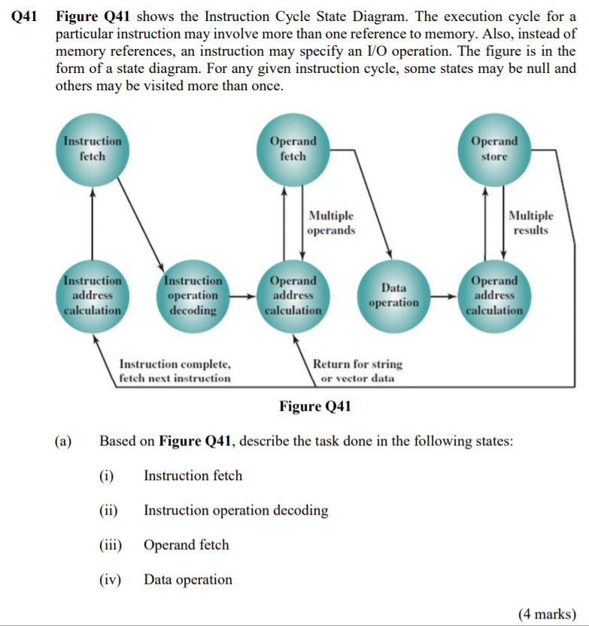
Figure 3.3 Instruction Cycle State Diagram

Slide 26
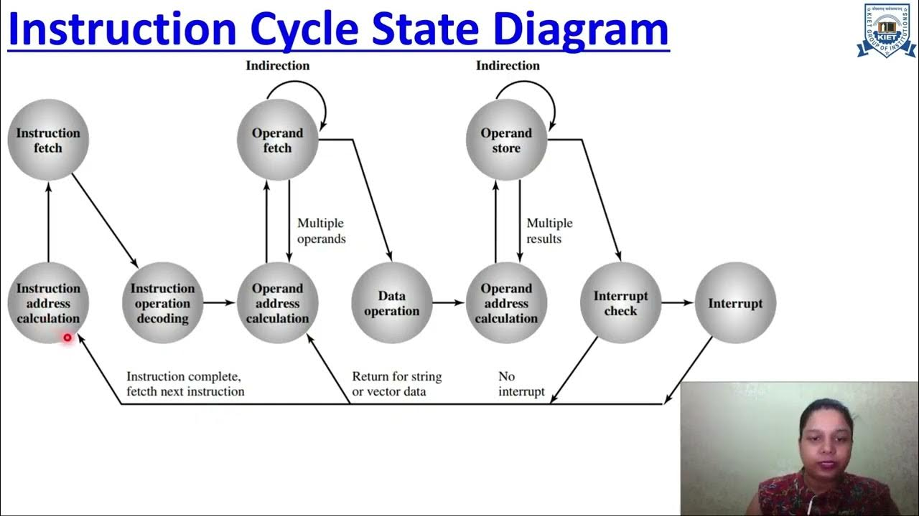
Exercise: Explain the above ICS_Diagram

Slide 27
In computing, a memory address is a reference to a specific memory location used at various levels by software and hardware. Memory addresses are fixed-length sequences of digits conventionally displayed and manipulated as unsigned integers.

Slide 28
What is Cache Memory?
Cache memory is an individual memory unit that functions like an assistant to main memory. Comparatively, it is smaller and much faster than the main memory. This is because it is tightly coupled with the processor and implemented on the processor chip itself.
Since it is smaller than the main memory, it cannot hold the entire program at once. So, it holds sections of the program (set of instructions) that are currently in execution in addition to the data associated with it.

Slide 29
How does Cache Memory Works?
In the beginning, the program and the data associated with the program lie in the main memory, and the cache is empty. When the processor starts executing the program, it reads the instruction from the main memory and places it on the processor chip (registers). Along with this, it places a copy of each instruction on to the cache. If execution of particular instruction requires any associated data, the processor access it from the main memory and places a copy of it on the cache memory also.
Now consider these instructions have to be executed repeatedly (as in the case of a loop). If the instructions are available in the cache, then the processor will directly access them from the cache memory. As the cache executes faster than the main memory, it will ultimately be faster in executing the instruction statement of the program.

Slide 30
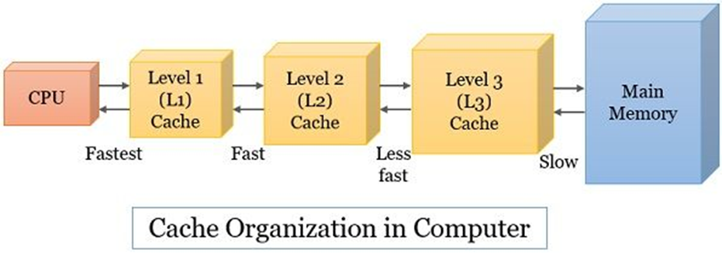
Types of Cache Memory
There are multiple levels of caches. We can classify them on the basis of their size and speed
L1 Cache: It is the smallest among all the caches and is much faster than any other cache.
L2 Cache: Comparatively, the L2 cache is larger and slower than the L1 cache.
L3 Cache: It is larger and slower than both the L1 and L2 cache.

Slide 31
What is Register?
A register is a small storage space within a computer's processor that holds data, instructions, and the processor's current status. Registers are used to transfer data to the CPU for immediate use during instruction execution.
Registers are built directly into the processor, so they are the smallest elements for holding data and have very fast access times. They can store a small amount of data, such as a few characters or bits, an instruction, or a storage address.
Registers are different from cache memory, which is a larger, slower form of memory that stores frequently accessed data from the main memory. Cache memory is located outside the CPU, while registers are located within the CPU.

Slide 32
Some examples of registers include:
Memory address register
Memory buffer register
Input output address register
Input output buffer register
Shift register
Program counter
Instruction registers
Accumulator register

Slide 33
Sizes of CPU Registers
The number and size of registers in a CPU are determined by the processor design and can have a significant impact on its performance and capabilities. Most modern computer processors include:
8-bit registers: These registers can store 8 bits of data (1 byte). They are often used for basic arithmetic operations and data manipulation.

Slide 34
16-bit registers: These registers can store 16 bits of data (2 bytes). They are commonly found in older processors or in specific architectures that require 16-bit operations.
32-bit registers: These registers can store 32 bits of data (4 bytes). They are widely used in many processors and are capable of handling larger data sizes and more complex calculations.
64-bit registers: These registers can store 64 bits of data (8 bytes). They are prevalent in modern processors and offer increased computational power and memory addressing capabilities.

Slide 35
Modern PCs today most often have 32-bit or 64-bit registers and are referred to as the 32-bit processors and 64-bit processors we often hear about. This indicates the size or width of the processor's registers and the amount of data the processor can handle in a single operation.
How does Register Works?
A program is a set of instructions that are brought to the main memory for execution. Now accessing an instruction from the main memory takes longer time than its execution. Thus, the CPU uses registers to hold the instructions, key variables and temporary results.

Slide 36
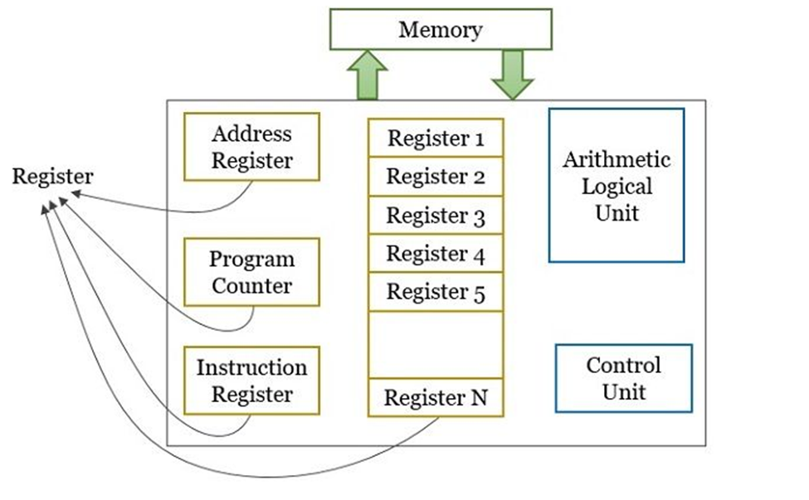

Slide 37
In this way, during program execution of each time, an instruction or a word from the main memory is fetched into the register. The CPU then access the instructions from the register and perform the desired action. CPU even stores temporary results and final results into the registers and from the register back to the main memory.
Types of CPU Registers: Depending on the CPUs architecture and design, the type and number of registers can vary. Common types of registers found in a CPU may include:

Slide 38
Program Counter (PC): The Program Counter keeps track of the memory address of the next instruction to be fetched and executed.
Instruction Register (IR): The Instruction Register holds the currently fetched instruction being executed. It holds an 8-bit opcode (machine instruction) that is currently being executed.
Accumulator (ACC): The Accumulator is a general-purpose register used for arithmetic and logical operations. It stores intermediate results during calculations.
General-Purpose Registers (R0, R1, R2…): These registers are used to store data during calculations and data manipulation. They can be accessed and utilized by the programmer for various purposes.
Address Registers (AR): Address Registers store memory addresses for data access or for transferring data between different memory locations.

Slide 39
Stack Pointer (SP): The Stack Pointer points to the top of the stack, which is a region of memory used for temporary storage during function calls and other operations.
Data Registers (DR): These registers store data fetched from memory or obtained from input/output operations.
Status Register/Flags Register (SR): The Status Register or Flags Register contains individual bits that indicate the outcome of operations, such as carry, overflow, zero result, and others. These flags help in making decisions and controlling program flow based on the results of previous operations.
Control Registers (CR): Control Registers manage various control settings and parameters related to the CPU's operation, such as interrupt handling, memory management, and system configuration.

Slide 40
Memory Buffer Register (MBR) It stores a word fetched from the main memory or I/O unit. It even stores the word that the process has to send back to the main memory or I/O unit.
Memory Address Register (MAR) It specifies the address in a memory from where the word will be read into MBR or where the word from MBR will be written into memory.
Instruction Buffer Register (IBR) The IBR register temporarily holds the right-hand instruction from the word in the memory.

Slide 41
Architecture of Register Memory
This architecture works by following instructions that tell the CPU what operations to do on the registers and memory. This is called a "register plus memory" architecture when all the data needed for an operation is already in the registers.
An operation can use two pieces of data: one from memory and one from a register. Or, both pieces of data can be in registers or in memory. This is different from other architectures. Examples of this type of architecture are Intel x86 and IBM System/360 computers.
The CPU has a small number of registers, and they are tiny in size, less than 64 bits. Registers are faster than disk memory and main memory (RAM). The size of the general-purpose registers affects how much data the CPU can work with at once.

Slide 42
The computer has instructions that identify which register to use by a number or address, like R0, R1, R7, SP, and PC. Registers act as a link between the program and the computer's data storage.
Uses of Register Memory
Registers allow the CPU to quickly access data, instructions, and memory addresses that are frequently needed. The CPU processes the instructions stored in registers. All data must go through registers before the CPU can work with it. So, users enter data into registers for the CPU to process.
Registers enable fast storage, retrieval, and movement of data. Each type of register serves a specific purpose required by the CPU. Users don't need to understand registers deeply, as the CPU uses them as temporary storage and data buffers.

Slide 43
Registers act as holders for copying data from the main memory (RAM) so the processor can
access it quickly whenever needed. The data is kept in registers, which know the location and address, helping the CPU find the data it needs.
Depending on the task, base registers can modify computer operations or data values. In some instructions, the address portion gets added to the value in a register.
CPUs have a small amount of space allocated for registers. Registers are fast memory that stores instructions for the system to work on. By keeping temporary data in registers instead of RAM, programs can run faster. Registers allow quick access, enabling better CPU performance.

Slide 44
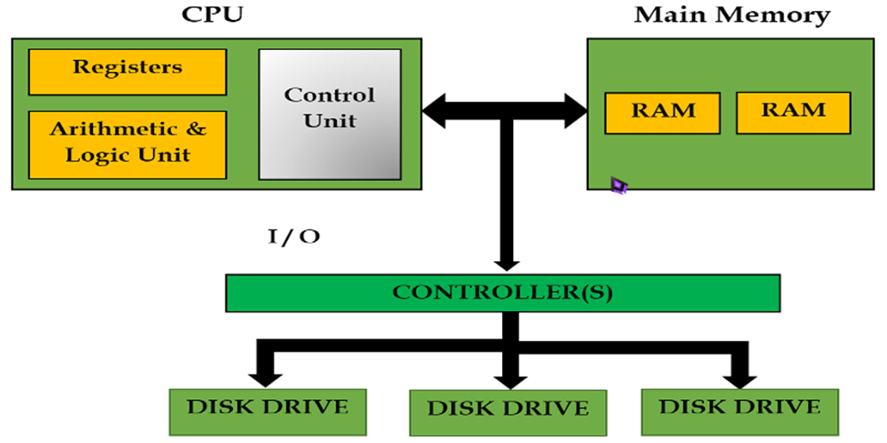

Slide 45
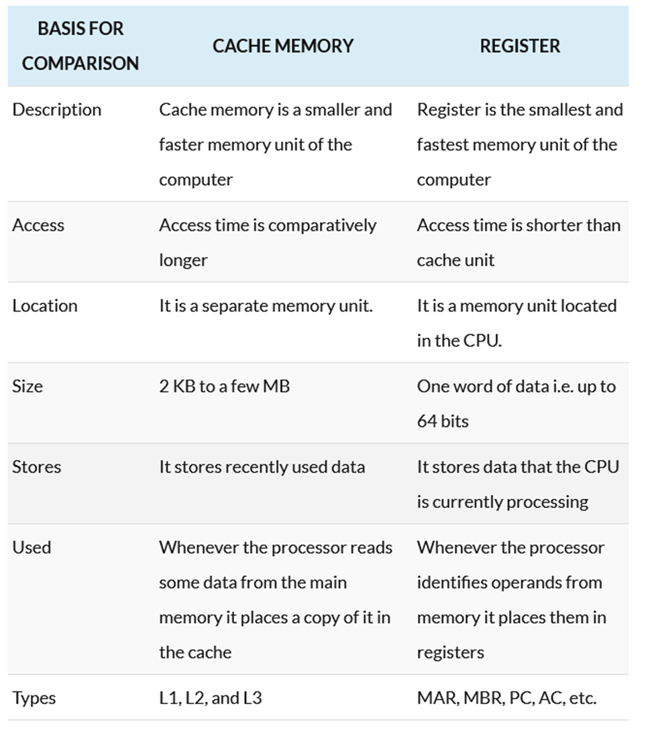
Difference between Cache Memory and Register

Slide 46
Memory addressing mode
Memory addressing mode is the method by which an instruction operand is specified. One of the functions of a microprocessor is to execute a sequence of instructions or programs stored in a computer memory (register) in order to perform a particular task.

Slide 47
Modes of addressing
There are many methods for defining or obtaining the effective address of an operators directly from the register. Such approaches are known as modes of addressing. The programs are usually written in a high level language, as it is a simple way to describe the variables and operations to be performed on the variables by the programmer. The following are the modes of addressing;

Slide 48
Cont. Figure 3.4

Slide 49
Cont.

Slide 50
Cont.
Note :
< - = assignment
M = the name for memory: M[R1] refers to contents of memory location whose address is given by the contents of R1
Number of addressing modes
The number of addressing modes are as follow;
Register Addressing Mode- In this mode the operands are in registers that reside within the CPU.

Slide 51
Cont.
Direct Addressing Mode and Indirect Address mode- In Direct Address Mode, the effective address is equal to the address part of the instruction.
Immediate Addressing Mode- In this mode the operand is specified in the instruction itself. In other words, an immediate-mode instruction has an operand field rather than an address field.

Slide 52
Cont.
Register Indirect Addressing Mode- In this mode the instruction specifies a register in the CPU whose contents give the address of the operand in memory.
Indexed Addressing Mode- In this mode the content of an index register is added to the address part of the instruction to obtain the effective address.

Slide 53
Cont.
Auto Increment Mode and Auto Decrement Mode- This is similar to the register indirect mode except that the register is incremented or decremented after (or before) its value is used to access memory.
Relative Addressing Mode: In this mode the content of the program counter is added to the address part of the instruction in order to obtain the effective address.

Slide 54
Advantages of addressing modes
The advantages of using the addressing mode are as follow;
a. To provide the user with programming flexibility by offering such facilities as memory pointers, loop control counters, data indexing, and program me displacement.
b. To decrease the counting of bits in the instruction pointing area.

Slide 55
Cont.
Uses of addressing modes
Some direction set models, for instance, Intel x86 and its substitutions, had a pile ground-breaking area direction. This plays out an assessment
of the fruitful operand location, anyway rather following up on that memory territory, it stacks the area that might have been gotten in the register.

Slide 56
INTEL 8088 AND ABOVE CPU REGISTERS
Generally (though not always) when we program in a high-level language we think in terms of the following types of constructs:
CONSTANTS numerical, string, or some other quantities whose unchanging actual values are known when the program written;
VARIABLES quantities (whose initial values may or may not be known) whose values change as the program executes;
PROCEDURES functions or SUBROUTINES which may or may not have arguments and may or may not return answers.

Slide 57
INTEL 8088 AND ABOVE CPU REGISTERS
None of these items has any real direct equivalent in terms of assembly language. Each, in practice, is a combination of several assembly language features. In assembly language, on the other hand, much thought goes into the use of the computer's memory (considered as a sequence of bytes or words) and the CPU's registers. A register is like a memory location in that it can store a byte (or word) value.

Slide 58
[These register sizes apply to CPUs like the 8088, 8086, 8080, Z80, etc. The 68000 CPU has all 4-byte registers. The Z8000 CPU has registers that can be grouped in various ways to contain anything from one byte to 8 bytes. Some TI microprocessors have no registers at all. However, a register has no address in the computer's memory. Registers are not a part of the computer's memory, but are built into the CPU itself.
Registers are so important in assembly language programming (on microcomputers) for various reasons. First, the variety of instructions using registers tends to be greater than that for operating on values stored at memory locations.

Slide 59
Second, these instructions tend to be shorter (i.e., take up less room to store in memory). Third, register-oriented instructions operate faster than memory-oriented instructions since the computer hardware can access a register much faster than a memory location. The 8086-family of microprocessors have a number of registers, all of which are partially or totally dedicated to some specific type of use.

Slide 60
Here is a list of the registers and their uses. Do not worry if their uses do not seem clear yet. For the present, it suffices for us that the italicized registers are so specialized that they can only be used for their special purpose, while the registers in normal type can often be used just like 16-bit (word) memory locations:

Slide 61
1. AX - The accumulator
2. BX - The pointer register
3. CX- The loop counter
4. DX- Used for multiplication and division
5. SI- The "source" string index register
6. DI -The "destination" string index register
7. BP- Used for passing arguments on the stack
8. SP- The stack pointer

Slide 62
9. IP -The instruction pointer
10. CS- The "code segment" register
11. DS -The "data segment" register
12. SS -The "stack segment" register
13. ES- The "extra segment" register
14. FLAG- The flag register

Slide 63
The first seven registers might reasonably be called "general purpose" registers since they can be used rather flexibly to manipulate word values until (or unless) their special functions are needed. AX, BX, CX, and DX are more flexible than the others in that they may be used either as word registers (containing 16-bit values) or as pairs of byte registers (containing 8-bit values). The byte-sized registers gotten this way are known as AL, BL, CL, DL, AH, BH, CH, and DH. For example, AL contains the less significant byte of AX, while AH contains the more significant byte.

Slide 64
Several of these special register types are common among microprocessors: The accumulator is often a special register which is designated to contain the results of certain arithmetic operations. Many instructions execute faster when operating on the accumulator more than when operating on other registers, which are in turn faster than operations on memory variables.

Slide 65
The 8088 has the 8-bit accumulator AL and the 16-bit accumulator AX. The instruction pointer (or program counter) is a register controlling the execution of programs. Recall that both programs and data are stored in the computer's memory. Most program code is stored in memory in such a way that sequentially executed instructions are actually stored sequentially in memory. The IP (instruction pointer) register contains the address of the next instruction to be executed controlling conditional execution of parts of a program.

Slide 66
For every instruction fetched from memory, the IP is automatically incremented by the number of bytes in the instruction. The stack pointer (SP) contains the address of the next memory location to the added to the stack.
The flag register contains a number of bit-sized "flags" describing the status and configuration of the CPU. Its main use is in controlling conditional execution of parts of a program.

Slide 67
MODES OF ADDRESSING THE REGISTERS
Table 3.2 shows different types of addressing mode, with the calculation of how these addresses are generated.

Slide 69
INSTRUCTION FORMAT
Each statement in a program consists of four parts or fields in the following format/ Syntax:
Label Opcode Operand Comment
Label – used to store a symbolic name for the memory location that it represents. All labels begin with a letter or one of the following special characters : , $ or ?. A label may be of any length from 1-35 characters .The label appears in a program to identify the name of a memory location for storing data.
Opcode - is designed to hold the instruction or opcode e.g ADD
Operand – Contains information used by the Opcode e.g in MOV AL, BL instruction has opcode MOV and operands BL and AL
Comment - begins with a „;‟

Slide 70
Types of instructions
i. Transfer instruction
MOV INSTRUCTION
Purpose: Data transfer between memory cells, registers and the accumulator.
Syntax: MOV Destination, Source
ii. Arithmetic instruction e.g. MUL instruction
Purpose: multiplication with sign
Syntax: MUL source
iii. INC and DEC instructions
Syntax:
INC destination ; destination = destination + 1
DEC destination ; destination = destination - 1

Slide 71
ADD* reg/memory, reg/memory/constant ------- Adds the two operands and stores the result into the first operand. If there is a result with carry, it will be set in CF.
SUB* reg/memory, reg/memory/constant ----- Subtracts the second operand from the first and stores the result in the first operand.
MUL reg/memory ----- Multiplies the operand with the Accumulator Register and stores the result in the Accumulator Register.

Slide 72
DIV reg/memory ----- Divides the Accumulator Register by the operand and stores the result in the Accumulator Register.
INC reg/memory ----- Increases the value of the operand by 1 and stores the result in the operand.
DEC reg/memory ---- Decreases the value of the operand by 1 and stores the result
in the operand.

Slide 73
SAMPLE PROGRAM ON TRANSFER INSTRUCTION
In FORTRAN :
A = B + 1
C = D – 1 (where A,B,C,D ARE INTEGERS*2)

Slide 74
ASSEMBLY code equivalent:
; Version 1
(A, B, C and D are all defined as DW ?)
MOV AX, B ; A = B
MOV A , AX; C = D
MOV AX , D
MOV C, AX; C = D
ADD A, 1; A = A + 1
SUB C, 1; C = C - 1
; Version 2
MOV AX, B
ADD AX, 1
MOV A, AX; A = B + 1
MOV AX, D
SUB AX, 1
MOV C, AX

Slide 75
Instruction set - the range of instructions that a CPU can execute. There are many different instructions that we can use in machine code, you have already met three (LDA, ADD, STO), but some processors will be capable of understanding many more. The selection of instructions that a machine can understand is called the instruction set. Below are a list of some other instructions that might be used:
ADD; add one number to another number
SUB; subtract one number to another number
INC; increment a number by 1
DEC; decrement a number by 1
MUL; multiply numbers together

Slide 76
Instruction set
OR ; boolean algebra function
AND; boolean algebra function
NOT; boolean algebra function
XOR; boolean algebra function
JNZ; jump to another section of code if a number is not zero (used for loops and ifs)
JZ ; jump to another section of code if a number is zero (used for loops and ifs)
JMP; jump to another section of code (used for loops and ifs)

Slide 77
Let us look at a more complex example of assembly code instructions:
1 LDA #12 ;loads the number 12 into the accumulator
2 MUL #2 ;multiplies the accumulator by 2 = 24
3 SUB #6 ;take 6 away from the accumulator = 18
4 JNZ 6 ;if the accumulator <> 0 then goto line 6
5 SUB #5 ;take 5 away from the accumulator (this line isn't executed!)
6 STO 34 ;saves the accumulator result (18) to the memory address 34

Slide 78
You'll notice that in general instructions have two main parts:
opcode - instruction name
operand - data or address
Addressing Mode | Symbol | Example | Description
Memory Location |  | LOAD 15 | 15 is treated as an address
Integer | # | LOAD #15 | 15 is treated as a number
Nothing |  | HALT | Some instruction don't need operands such as halting a program

Slide 79
Machine code and instruction sets
There is no set binary bit pattern for different opcodes in an instruction set. Different processors will use different patterns, but sometimes it might be the case that you are given certain bit patterns that represent different opcodes. You will then be asked to write machine code instructions using them. Below is an example of bit patterns that might represent certain instructions.

Slide 80
Machine code | Instruction | Addressing mode | Hexadecimal | Example
0000 | STORE | Address | 0 | STO 12
0001 | LOAD | Number | 1 | LDA #12
0010 | LOAD | Address | 2 | LDA 12
0100 | ADD | Number | 4 | ADD #12
1000 | ADD | Address | 8 | ADD 12
1111 | HALT | None | F | HALT

Slide 81
Exercise: Machine Code
Using the table above provide machine code to do the following:
LOAD 12
ADD #6
Answer :
0010 00001100
0100 00000110

Slide 82
END OF LECTURE THREE:

