Slide 1
COMPUTER ARCHITECTURE
(CSC 303 )
Course Lecturer: Enosegbe, Daniel l
TOPIC 2
23/10/2024

Slide 2
What is Computer Architecture?
• “Computer Architecture is the science and art of selecting and interconnecting hardware components to create computers that meet functional, performance and cost goals.”
- (WWW Computer Architecture Page )
• An analogy to architecture of buildings…
23/10/2024

Slide 3
Computer Architecture refers to those attributes of a system that have a direct impact on the logical execution of a program.
Examples:
the instruction set
the number of bits used to represent various data types
I/O mechanisms
memory addressing techniques
23/10/2024

Slide 4
Historical Development of Computers Continues…
Eckert and Mauchlys of Moore School of
Electrical Engineering of the University of
Pennsylvania, developed the first electronic
computer called Electrical Numerical Integrator
and Calculator (ENIAC) in 1946.
23/10/2024

Slide 5
John Von Newman, a mathematician at the
Institute of Advanced Studies, Princeton,
brought the idea of storing both instructions
and data in the computer’s primary memory
(Stored Program Concept). His idea gave
birth to Electronic Discrete Variable
Automatic Computer (EDVAC), which was
the first program computer in the US, in
1945. Many computing devices were
manufactured, taking this lead.
23/10/2024

Slide 6
The Von Neumann Architecture
Model for designing and building computers, based on the following three characteristics:
  The computer consists of four main sub-systems:
    Memory
    ALU (Arithmetic/Logic Unit)
    Control Unit
    Input/Output System (I/O)
  Program is stored in memory during execution.
  Program instructions are executed sequentially.
23/10/2024

Slide 7
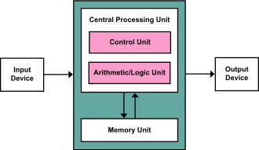
Von Neumann architecture scheme
23/10/2024

Slide 8
The Von Neumann Architecture
Bus
Memory
Processor (CPU)
Input-Output
Control Unit
ALU
Communicate with
"outside world", e.g.
Screen
Keyboard
Storage devices
...
Store data and program
Execute program
Do arithmetic/logic operations
requested by program

Slide 9
Computer Architecture and the Fetch-Execute Cycle
Von Neumann Architecture
23/10/2024

Slide 10
Objectives
Describe basic Von Neumann architecture,
Identifying the need for and the uses of special registers in the functioning of a processor.
23/10/2024

Slide 11
Stored Program
John Von Neumann introduced the idea.
Previously data and programs were stored in separate memories.
Von Neumann realised that data and programs are indistinguishable and can, therefore, use the same memory.
This led to the introduction of compilers which accepted text as input and produced binary code as output.
23/10/2024

Slide 12
Von Neumann Architecture
Program is stored in memory along with data.
Programs and data are indistinguishable.
Uses a single processor (A single-core processor is a microprocessor with one central processing unit (CPU) that can only run one set of instructions at a time).
Sequential carrying out of instructions.
23/10/2024

Slide 13
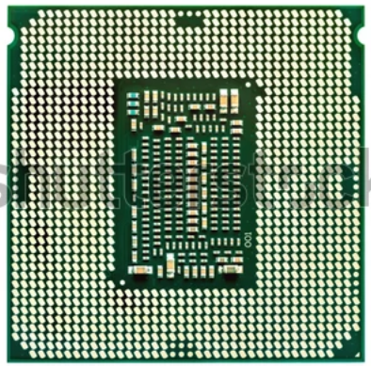
What is a Single-core Processor?
A single-core processor is a type of central processing unit (CPU) that has one core. This core is the brain of the CPU, responsible for executing instructions from programs and performing basic arithmetic, logical, control, and input/output operations. In the early days of computing, single-core processors were the norm, handling all computational tasks for a system.
23/10/2024

Slide 14
Advantages of Single-core Processors
Simplicity: Single-core processors are simpler in design and easier to manufacture, which can result in lower production costs.
Power Efficiency: In specific low-power applications, single-core processors can be more efficient, consuming less power than their multi-core counterparts.
Compatibility: Many legacy systems and software are optimized for single-core processors, ensuring broad compatibility with older applications and operating systems.
23/10/2024

Slide 15
Disadvantages of Single-core Processors
Limited Performance: Single-core processors struggle with multitasking and complex computations, leading to slower performance in modern applications.
Thermal Issues: Pushing a single core to handle multiple tasks can generate more heat, requiring better cooling solutions.
Outdated for Modern Needs: Most contemporary software and operating systems are designed to take advantage of multiple cores, making single-core processors less suitable for modern needs.
23/10/2024

Slide 16
Registers
Small, permanent storage locations within the CPU used for a particular purpose.
  They are only storage locations and do not do anything themselves.
A CPU register is a small storage space within a computer's Central Processing Unit (CPU) that holds data for immediate use by the CPU:
Purpose
Registers are used to store and manipulate data, such as instructions, storage addresses, or characters, during the execution of instructions.
23/10/2024

Slide 17
Function
Registers are critical for optimal CPU performance because they allow the CPU to quickly retrieve and manipulate data. This proximity to the CPU enables quicker instruction cycles, which enhances computational speed and efficiency.
Types
Some common types of registers include the program counter, instruction register, accumulator, and data registers
23/10/2024

Slide 18
Number and size
The number and size of registers varies depending on the CPU architecture. Modern CPUs
often have multiple general-purpose registers of 64-bits each.
Register transfer
Register transfer refers to the movement of data between registers in a CPU during instruction execution.
23/10/2024

Slide 19
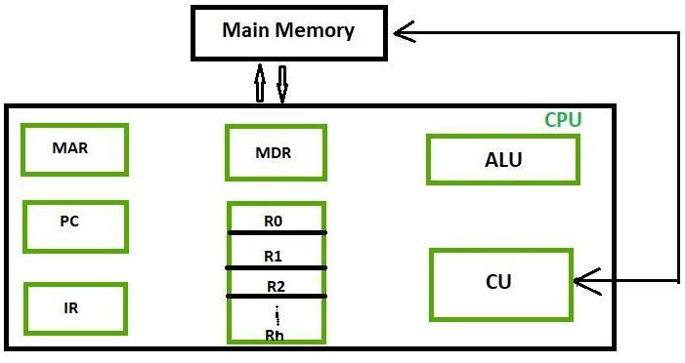
REGISTERS
A CPU register is a small storage location within the CPU, while a processor is the part
of the computer that provides instructions and processing power.
23/10/2024

Slide 20
A CPU register is a small storage location within the CPU, while a processor is the part
of the computer that provides instructions and processing power:
CPU register
A CPU register is a small, high-speed storage location within the CPU that holds
data needed for processing. Registers can hold instructions, storage addresses, or other data.
They are the fastest accessible memory locations in a computer, allowing the CPU to quickly
retrieve and manipulate data.
23/10/2024

Slide 21
Processor
Also known as the CPU, the processor provides the instructions and processing power
that a computer needs to work. A more powerful or updated processor can help a computer
complete tasks faster.
23/10/2024

Slide 22
Von Neumann Architecture
Uses a single processor which follows a linear sequence of fetch-decode-execute.
In order to do this, the processor has to use some special registers.
Register | Meaning
PC / SCR | Program Counter / Sequence Control Register
CIR | Current Instruction Register
MAR | Memory Address Register
MDR / MBR | Memory Data Register / Memory Buffer Register
ACC | Accumulator - Holds results
23/10/2024

Slide 23
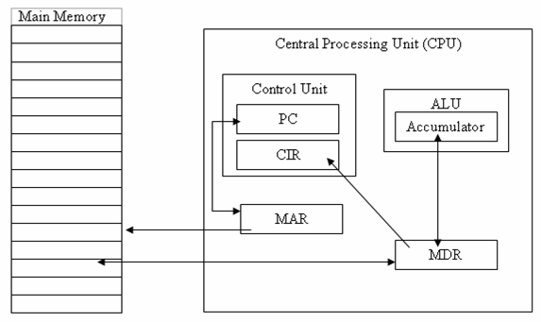
Typical Layout
1
4
3
2
23/10/2024

Slide 24
Central Processor Unit (CPU)
Contains:
  Arithmetic - Logic Unit (ALU) (also known as the arithmetic unit)
    Holds the accumulator.
    But also has other circuitry to do its job.
  Control Unit
    Holds PC & CIR
    But also has other circuitry to do its job.
  Memory Data Register (MDR)
  Memory Address Register (MAR).
Remember the registers are simply storage locations. The Control unit and the ALU hold some of these registers but they also have extra circuitry which actually do “things”.
23/10/2024

Slide 25
Typical Layout
1
4
3
2
23/10/2024

Slide 26
Control Unit
Has circuitry which fetches instructions from memory, decodes them and synchronises the operations before sending signals to other parts of the computer.
Also contains the instruction registers (PC & CIR).
23/10/2024

Slide 27
Typical Layout
1
4
3
2
23/10/2024

Slide 28
Program Counter (PC)
/
Sequence Control Register (SCR)
Stores the address of (so that the control unit can keep track of where to find) the next instruction to be accessed so that a copy of the instruction can be placed in the current instruction register.
  The initial contents of the PC is the address of the first instruction of a program and it is copied in by the Loader.
23/10/2024

Slide 29
Program Counter (PC)
After the address is copied into the MAR the PC is incremented by 1.
  At this point it could be said to hold the address of the instruction after the next instruction (as we have not technically started executing the next instruction we should still refer to it as the next instruction).
    Assumes that the instructions will be in consecutive locations but if it is a jump instruction the PC will be altered again at the end of the cycle.
23/10/2024

Slide 30
PC / SCR
Sometimes the program counter is called the Sequence Control Register (SCR) as the control unit uses its contents to control the sequence of instruction execution.
23/10/2024

Slide 31
Typical Layout
1
4
3
2
23/10/2024

Slide 32
Memory Address Register (MAR)
Also used to hold / store the memory address (copied from the PC) that contains the instruction to be used next but can also hold the memory address of data needed to execute the next instruction.
  After the address has been copied from the PC into the MAR the PC is incremented by 1.
23/10/2024

Slide 33
MAR
You may be wondering: why the address is copied into the MAR when it is already in the PC? Why not use the address straight from the PC?
  Basically the MAR may have to be used to store an address of data needed to execute the next instruction. As no register can hold more than one “thing” at a time the control unit may copy an address of data needed to execute the next instruction over the address of the next instruction in the PC.
23/10/2024

Slide 34
Typical Layout
1
4
3
2
23/10/2024

Slide 35
Memory Data Register (MDR)
/
Memory Buffer Register (MBR)
Acts like a buffer and holds anything that is copied from the memory ready for the processor to use it.
  This could be the next instruction copied from the memory address held in the MAR but it could also be a piece of data (copied in from an address in memory or back from the instruction in the CIR – see next slide) needed to execute the next instruction.
23/10/2024

Slide 36
MDR / MBR
Sometimes the memory data register is called the Memory Buffer Register (MBR) as it acts as a buffer between the primary memory and the processor.
23/10/2024

Slide 37
Typical Layout
1
4
3
2
23/10/2024

Slide 38
Current Instruction Register (CIR)
Holds the instruction while it is being executed.
The binary code held in the CIR is split into an operation code and an address.
23/10/2024

Slide 39
CIR
Again you may be wondering why the instruction is copied into the CIR when it is already in the MDR?
  Basically the MDR may have to be used to store data needed to execute the next instruction. As no register can hold more than one “thing” at a time the control unit may copy data needed to execute the next instruction over the current instruction in the MDR. So it would no longer “know” what it was supposed to do.
23/10/2024

Slide 40
Typical Layout
1
4
3
2
23/10/2024

Slide 41
Arithmetic - Logic Unit (ALU)
Internal circuitry processes data here (arithmetic and logical operations).
    Arithmetic operations are those that add and subtract numbers, and so on.
    Logical operations involve comparing binary patterns and making decisions.
Also contains the accumulator.
23/10/2024

Slide 42
Typical Layout
1
4
3
2
23/10/2024

Slide 43
Accumulator (ACC)
Stores results of calculations.
All input to and output from processor pass through the accumulator.
23/10/2024

Slide 44
Reset
Cycle is reset (restarted) by passing control back to the PC.
23/10/2024

Slide 45
Control Unit & ALU
Remember the registers are simply storage locations and do not “do” anything.
The Control Unit “does” everything described in this presentation except for arithmetic and logical operations which is done by the ALU, but even then the Control Unit tells it what to do (i.e. add this to this, compare this with this, etc…).
23/10/2024

Slide 46
Program Counter (PC)
/
Sequence Control Register (SCR)
Stores the address of (so that the control unit can keep track of where to find) the next instruction to be accessed so that a copy of the instruction can be placed in the current instruction register.
  The initial contents of the PC is the address of the first instruction of a program and it is copied in by the Loader (see Memory Management).
23/10/2024

Slide 47
Common confusions with the PC
The PC DOES NOT:
  Keep track of the number of programs running.
  Or
  Keep the order in which programs have been called.
23/10/2024

Slide 48
Memory Address Register (MAR)
Also used to hold / store the memory address (copied from the PC) that contains the instruction to be used next but can also hold the memory address of data needed to execute the next instruction.
  After the address has been copied from the PC into the MAR the PC is incremented by 1.
    Assumes that the instructions are in consecutive locations but if it is a jump instruction the PC will be altered again at the end of the cycle.
23/10/2024

Slide 49
Memory Data Register (MDR)
/
Memory Buffer Register (MDR)
Acts like a buffer and holds anything that is copied from the memory ready for the processor to use it.
  This could be the next instruction copied from the memory address held in the MAR but it could also be a piece of data (copied in from an address in memory or back from the instruction in the CIR – see next slide) needed to execute the next instruction.
23/10/2024

Slide 50
Current Instruction Register (CIR)
Holds the instruction while it is being executed.
The binary code held in the CIR is split into an operation code and an address.
23/10/2024

Slide 51
Accumulator (ACC)
Stores results of calculations.
All input to and output from processor pass through the accumulator.
23/10/2024

Slide 52
Non-Von Neumann Architectures
Physical limitations on speed of Von Neumann computers
Non-Von Neumann architectures explored to bypass these limitations
Parallel computing architectures can provide improvements; multiple operations occur at the same time
23/10/2024

Slide 53
Thank you for listening
23/10/2024

