Slide 1
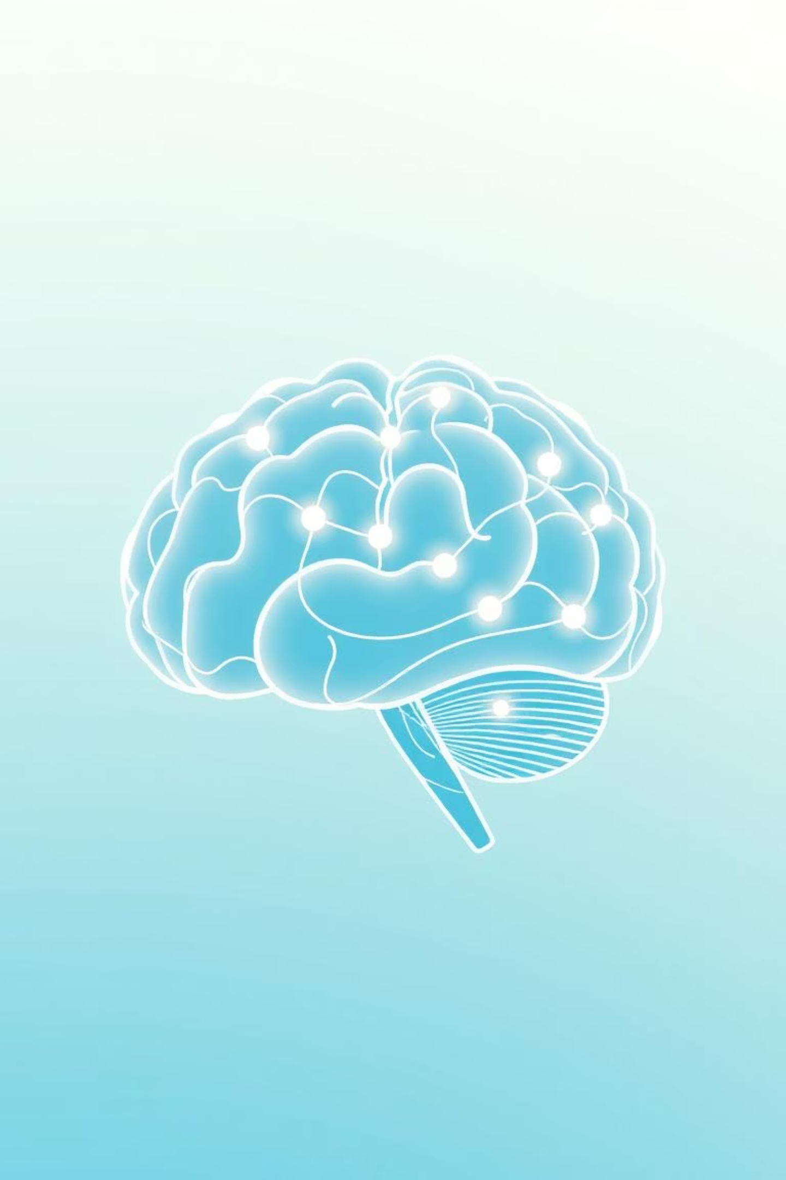
Emotion Detection from Text
Mini Project – TechnikNest AI/ML InternPresented by: Irum Imran

Slide 2

The Challenge: Understanding Human Emotion
Understanding the nuances of human emotion from text is a complex task for machines. This project aims to build a machine learning model capable of detecting underlying emotions in English sentences.
1
2
Project Goal
Chatbot Enhancement
Develop an ML-based model to classify emotions (joy, sadness, fear, etc.) from text input.
Enabling chatbots to respond empathetically and appropriately based on user emotion.
3
4
Mental Health Support
Sentiment Monitoring
Identifying distress signals in text for early intervention in mental health applications.
Analyzing public sentiment towards brands or topics from social media and reviews.

Slide 3




Methodology: From Data to Deployment
Our approach involved a structured pipeline, from data acquisition and preprocessing to model selection and final deployment.
Dataset Acquisition
Text Preprocessing
Utilized a pre-labeled dataset of sentences and corresponding emotions.
Applied tokenization, stopword removal, and TF-IDF vectorization to prepare text.
Model Selection
Deployment
Chose Multinomial Naive Bayes for its effectiveness in text classification.
Implemented as a Command Line Interface (CLI) application in Python.

Slide 4
Key Learnings & Skill Development
This project provided hands-on experience and a deeper understanding of critical concepts in NLP and machine learning.
NLP Fundamentals
Text Vectorization
Gained a foundational understanding of Natural Language Processing principles.
Mastered TF-IDF for transforming text into numerical representations for ML models.
ML Model Lifecycle
Model Persistence
Experienced the complete process of training, evaluating, and refining machine learning models.
Learned to save and load trained models efficiently using Joblib for later use.
CLI Application Development
Code Management
Developed practical skills in building user-friendly command-line tools.
Understood the importance of clear documentation and version control with GitHub.

Slide 5

Next Steps & Future Enhancements
Building on this foundation, several avenues can be explored to enhance the model's capabilities and expand its applications.
Deep Learning Models: Experiment with RNNs, LSTMs, or Transformers for potentially higher accuracy.
Expanded Emotion Categories: Increase the granularity of emotion detection to include more subtle states.
Multilingual Support: Adapt the model to detect emotions in languages beyond English.
Real-time Integration: Develop an API for seamless integration into live applications like chatbots or customer service platforms.
User Interface Development: Create a graphical user interface (GUI) or web application for broader accessibility.

