Slide 1
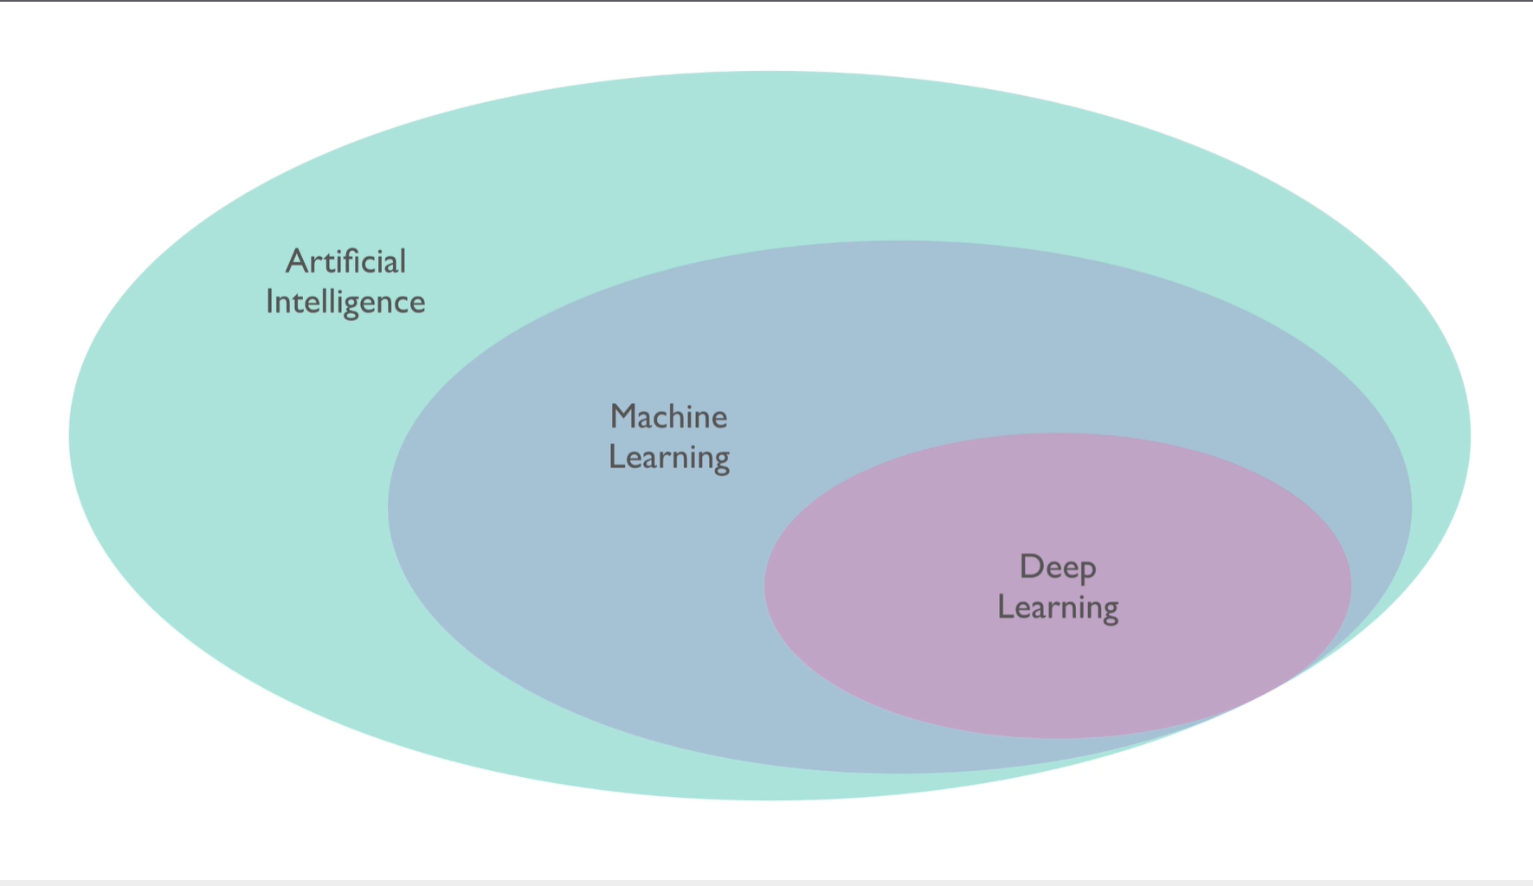
The overall landscape

Slide 2
Limitations
Two golden hypotheses
The inputs can predict the outputs
The data is sufficiently informative to learn the relationship between the input and the output

