Slide 1
2 player maze game

Slide 2
Game setup
The Game is set up in the IIT Delhi Campus
One player starts from the girls’ hostel side (at Himadri) and the other one starts from boys’ hostel (at Jwala)

Slide 3
Rules
The Players are allowed to move only on the campus roads.
There are Professors chasing the players who can move anywhere freely.
If they catch the player, it is transported to LHC to do an assignment. Players may choose to intentionally hit a prof to be transported closer to their destination.

Slide 4
Objective
Both players get randomly generated tasks (like “Buy ORS from Apollo”, or “Visit the research park”).
Whoever completes the task first wins and the game ends.

Slide 5
AT the start, you get a message saying “Welcome! Your tasks are being generated.” Each player gets a task selected randomly from 7 tasks. Then two more messages detailing the task each player has to perform are displayed. The game begins after the messages disappear.

Slide 6
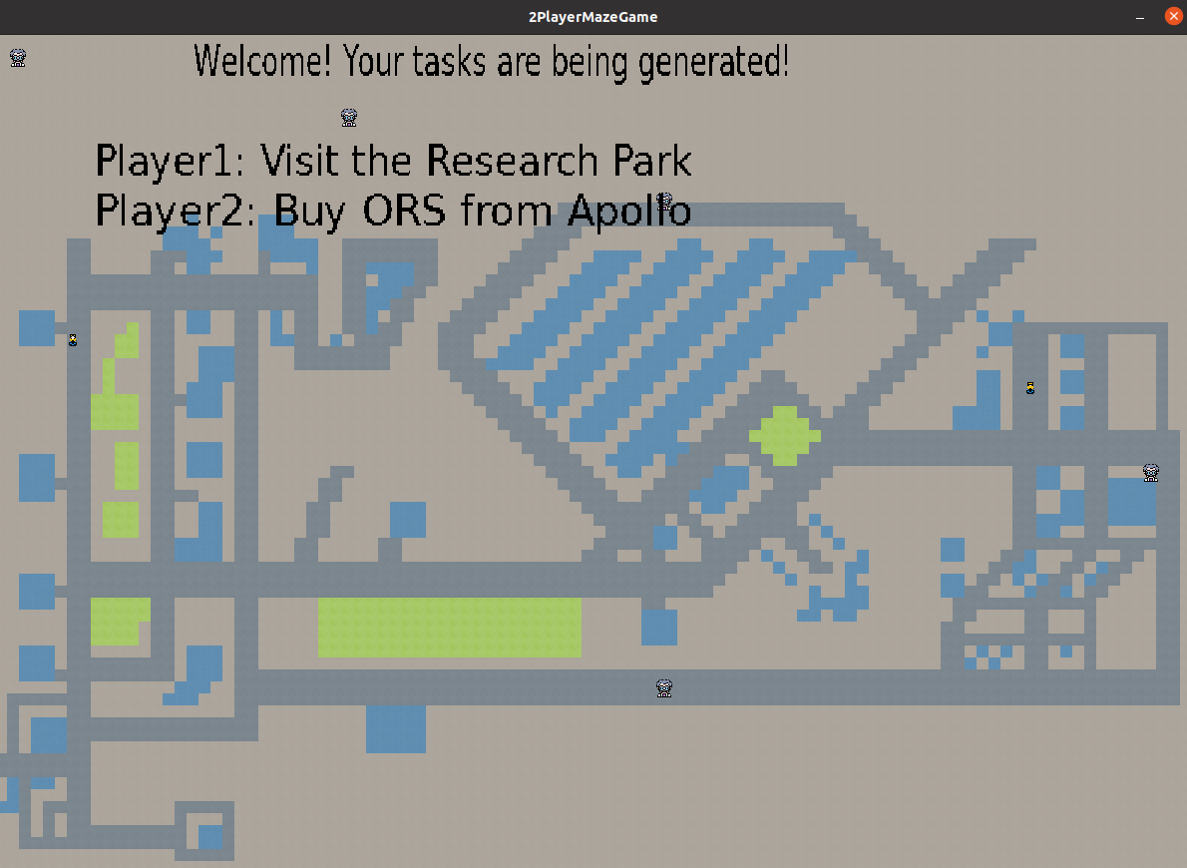

Slide 7
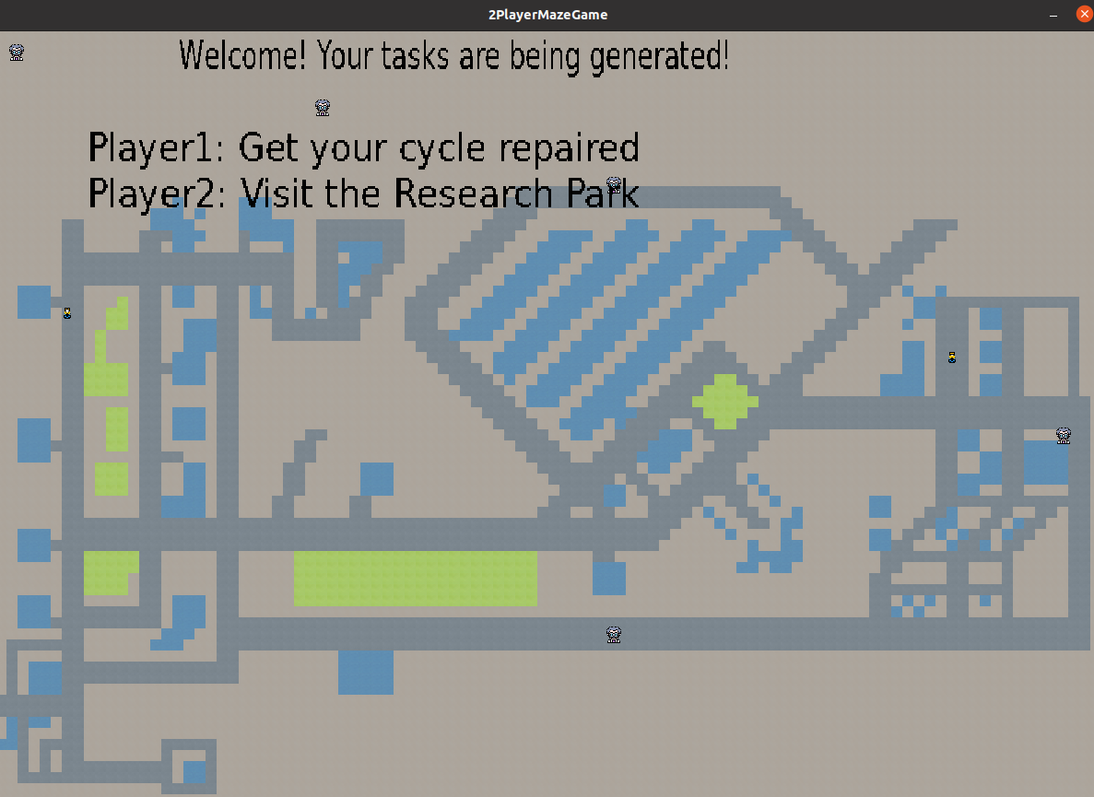

Slide 8
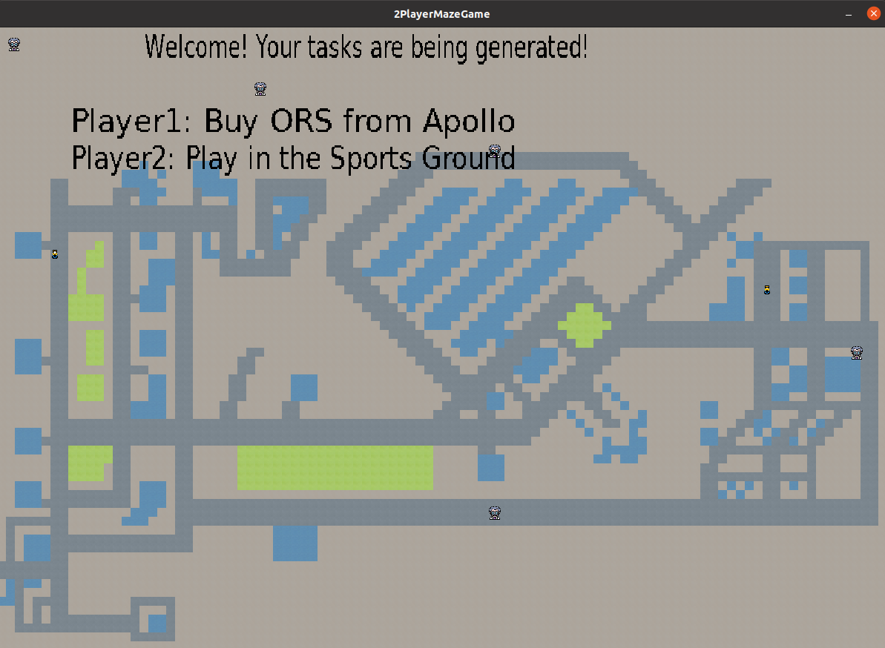

Slide 9
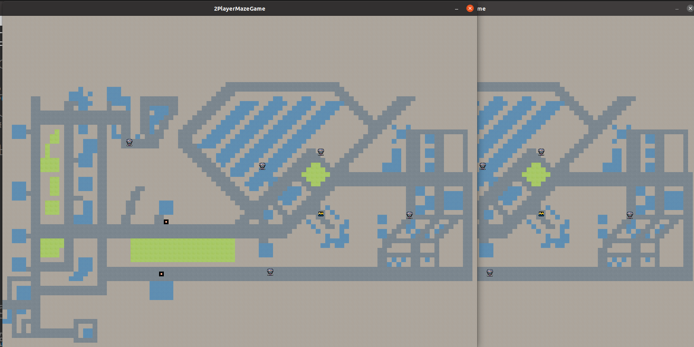
When you play the Game, it looks like this.

Slide 10
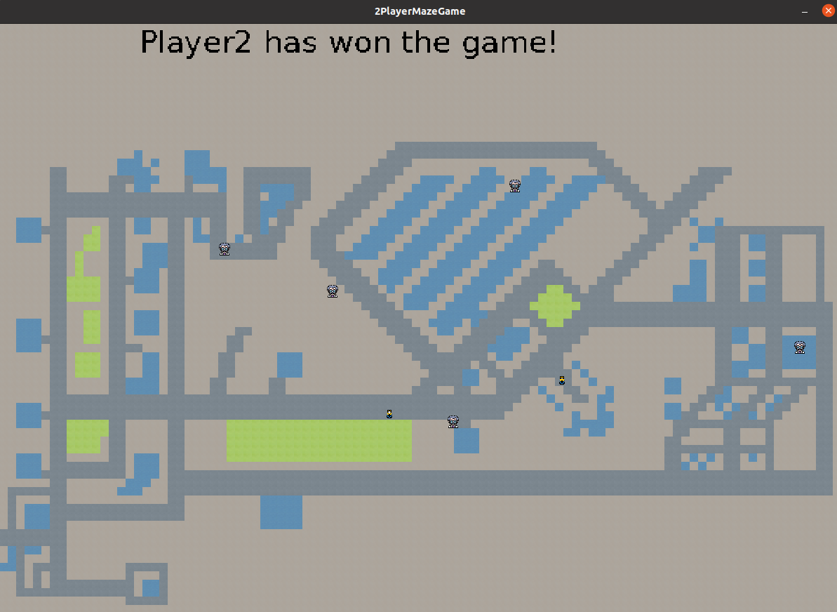
When you play the Game, it looks like this.

Slide 11
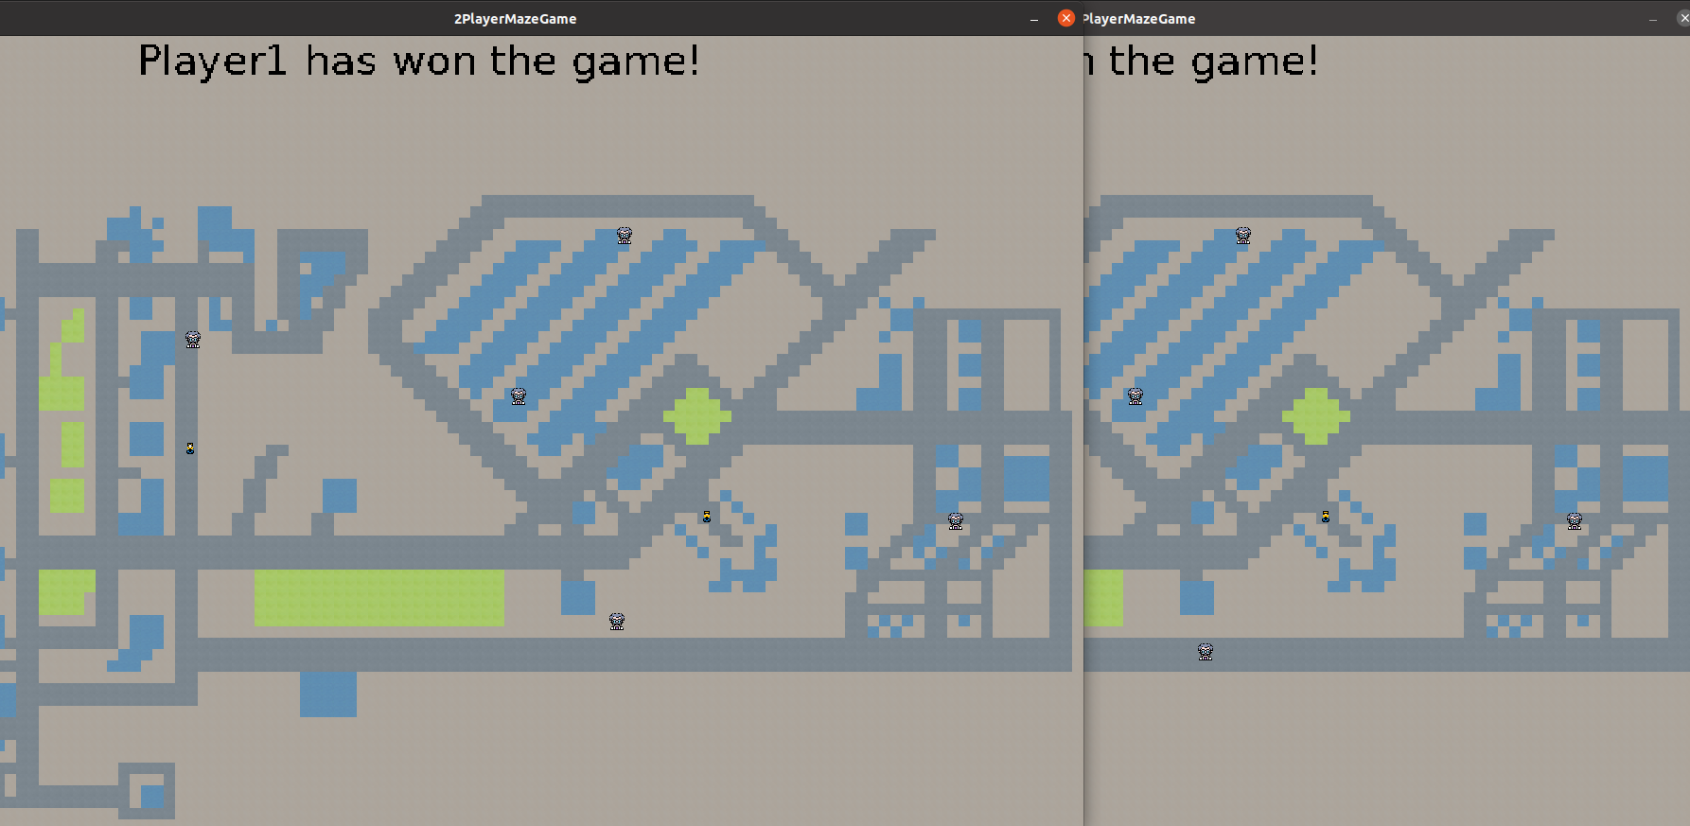
When you play the Game, it looks like this.

Slide 12
Thank you
By
Sunidhi Singh
2020CS10395
Anaad Kaur
2020CS10320

