Slide 1
DeFi Portfolio

Slide 2
Problem definition
Missing functionalities of the DeFi App:
Clear listing of rewards and commissions.
Different tables
Different plots
Export function of transactions / rewards / commissions
Analysis of individual pools
Display and export in fiat (to the corresponding timestamp)

Slide 3
Solution approach
Desktop Application
Connection with RPC server (defid.exe)
Reading all relevant data from the wallet (even if the wallet is encrypted)
Retrieval of the respective daily rates via the Coingecko API
Preparation of the data
Creation of tables and plots

Slide 4
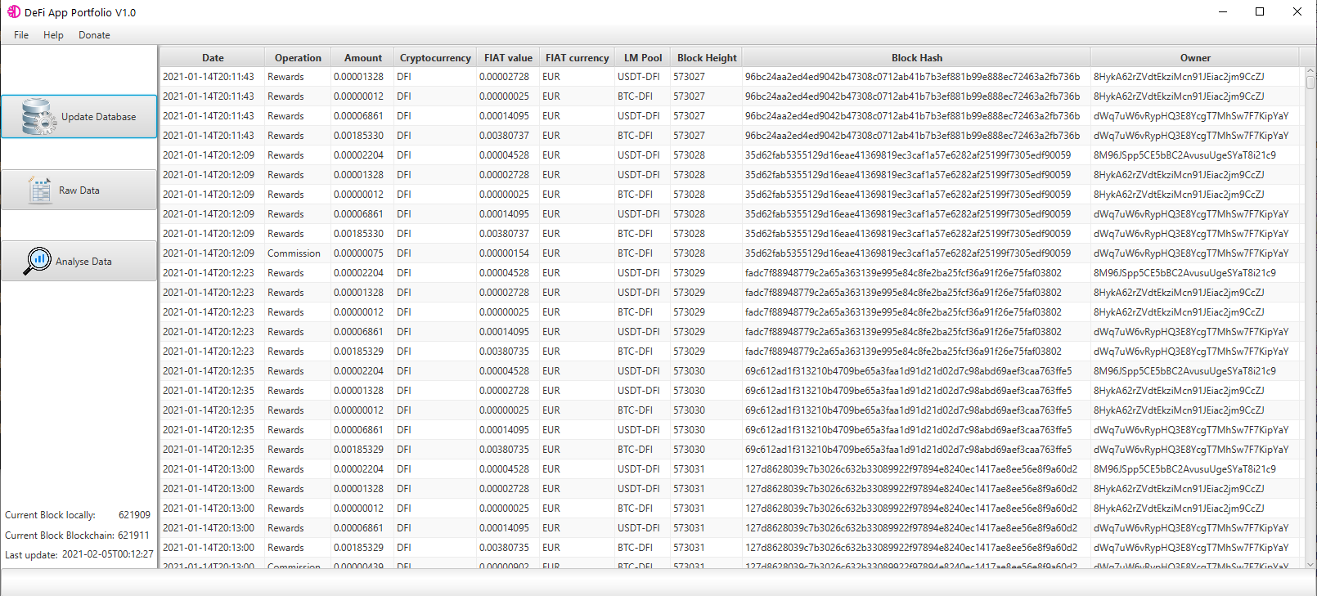
Function: Update Database (RPC Server - defid.exe)
Transactions, rewards and commissions are read and stored locally
Raw data table and block data are updated
Current block height is periodically queried and updated on the GUI

Slide 5
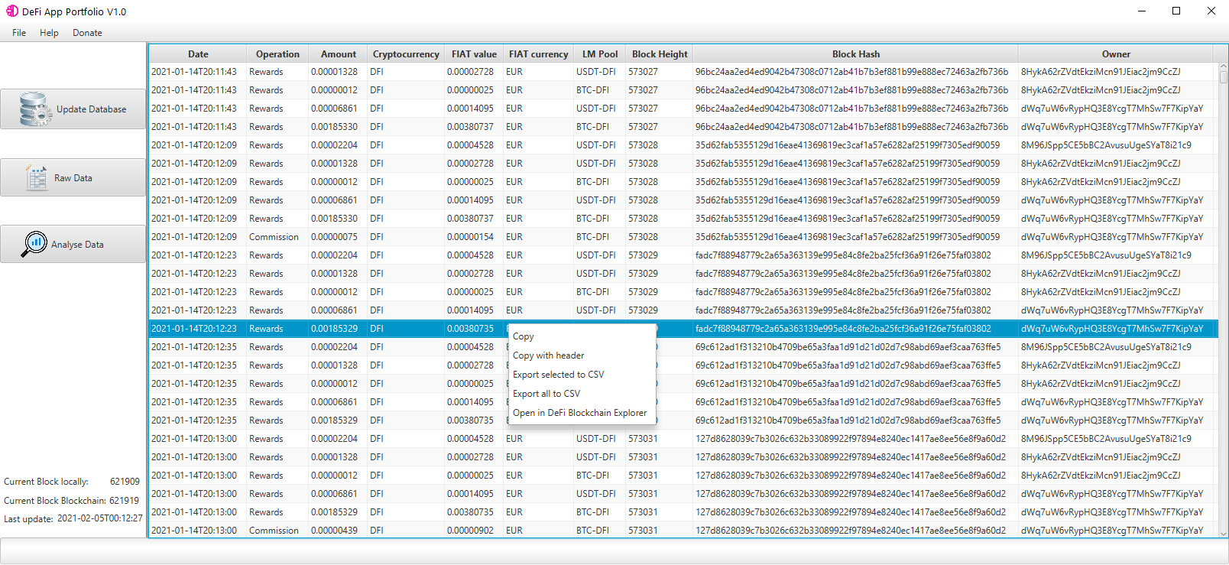
Function: Right click on all tables
Copy selected
Copy selected with header
Export selected to CSV
Export all to CSV
Open Block Hash in DeFi Blockhain Explorer

Slide 6
Analyse Data
Visualisazion of the data in plot and table
Specifications:
Time range
Intervall (Daily, Weekly, Monthly, Yearly)
Plot type (Individual, cumulated)
Pool pair (BTC-DFI, ETH-DFI, …)
Currency (Coin, Fiat)

Slide 7
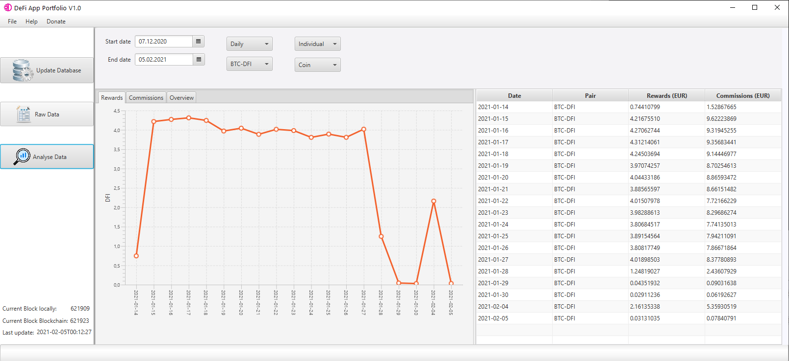

Slide 8
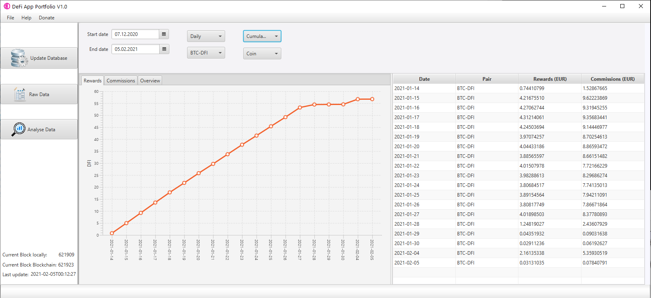

Slide 9
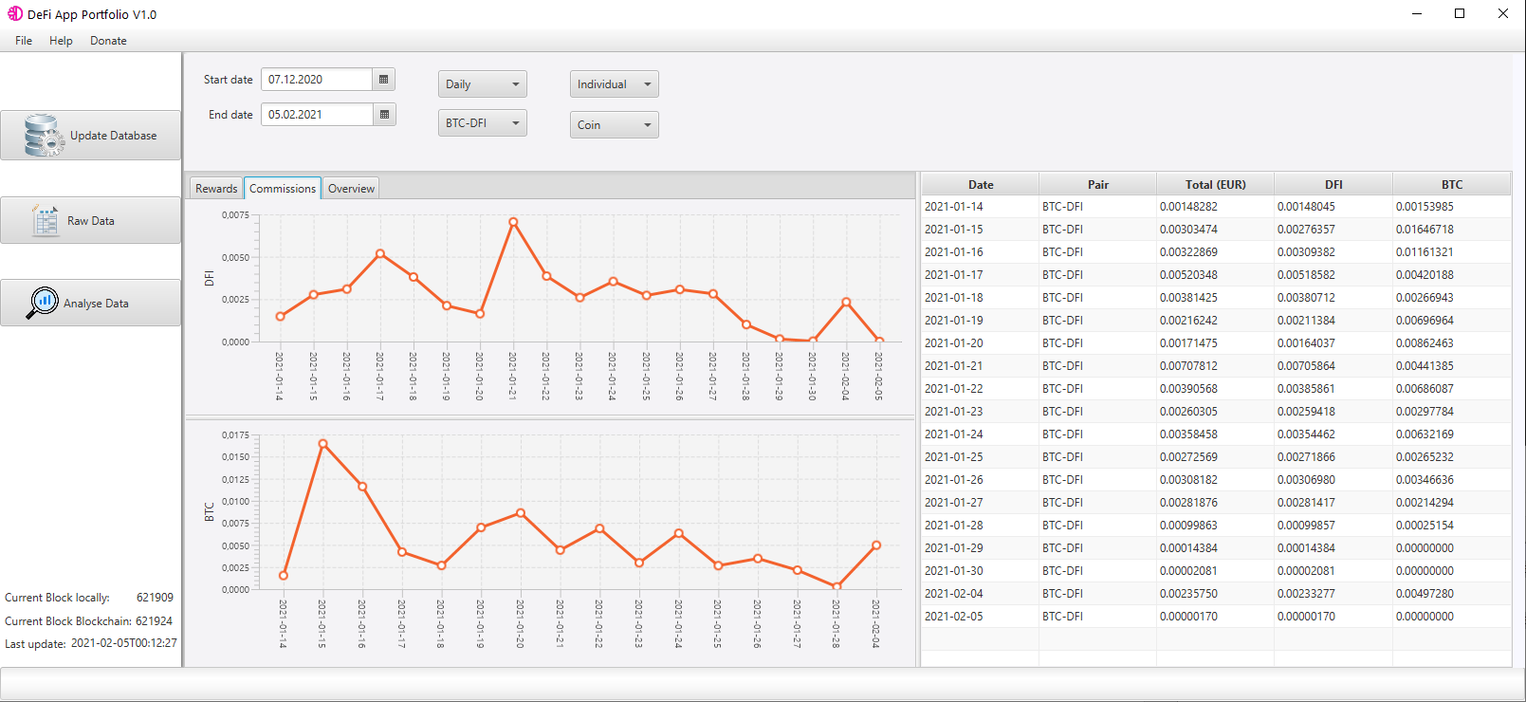

Slide 10
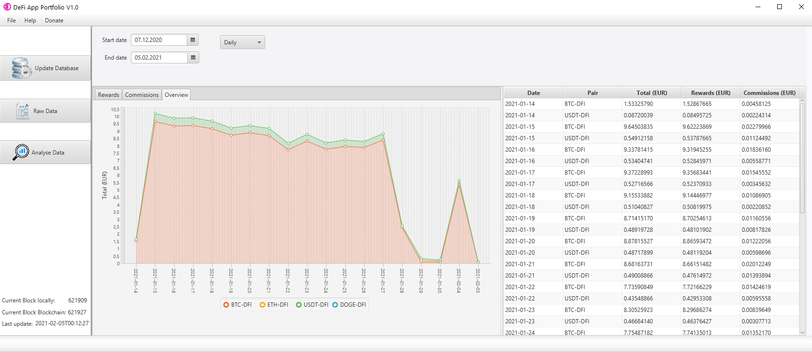

Slide 11
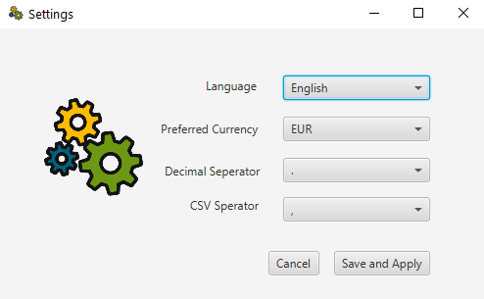
Language: English (planned German …etc.)
Preffered currency: EUR, USD, CHF
Decimal seperator: dot, comma
CSV seperator: comma, semicolon

Slide 12
Outlook and Ideas
Perfomance upgrade (Change to python to increase data processing)
Time course of the liquidity tokens
Time history of rewards/liquidity tokens (kind of yield)
Import CSV DeFi App (If available)
Cake Import / Comparison / Collected Plot / Table
Export for Cointracking ... etc.
Export wallet data to google sheet of Dennis Lach.
Hopefully more user feedback

