Slide 1


Dedan Kimathi University of Technology Centre for Data Science and Artificial Intelligence (DSAIL) DSAIL Camera Trap
Gabriel Kiarie

Slide 2
About Me
I am a research intern at The Centre for Data Science and Artificial Intelligence (DSAIL)
At DSAIL, we do research in data science and artificial intelligence
We also provide engineering solutions
I am also pursuing Masters in Telecommunication Engineering
https://kiariegabriel.github.io/
https://dekut-dsail.github.io/

Slide 3
Introduction
Severe degradation of ecosystems has greatly affected wildlife
Conservation efforts need to be revamped
Data collection is essential in conservation
Traditionally, data is collected by carrying out physical surveys
This method of data collection is inefficient
Sensors have been developed to collect ecological data
They include camera traps and Passive Acoustic Monitoring (PAM) sensors

Slide 4
Passive Acoustic Monitoring (PAM) Sensors
Ecosystems contain vast amount of sounds
These sounds offer potentially rich ecological information
Acoustic sensors are used in collect sound data
This sound is used to tell the abundance, distribution and behaviour of vocalising animals in an area
By analysing sound data collected by PAM sensors over a period of time, it is possible to determine trends in a given ecosystem
PAM sensors can be loaded with ML algorithms to perform automatic classification of recorded sounds
PAM sensors can be used to detect illegal activities

Slide 5
Camera Traps
A camera that is triggered by activities in its vicinity e.g. motion
Camera traps are used to collect images or videos of wildlife
A common practice is to fit the camera traps with motion sensors
Any motion in the vicinity of the camera traps triggers it to take images or videos.
The data collected can be relayed to the authority for real time monitoring
Alternatively the data can be stored and retrieved later

Slide 6
Camera Traps
The data collected by camera traps contain a lot of information
It can be used to tell/ estimate:
The population of animals
Species distribution
Health of the animals
Feeding habits
Human intrusion
Camera traps can be loaded with machine learning (ML) algorithms to perform automatic objects classification

Slide 7
Sensors and data collection
Sensors allow for remote and non-invasive monitoring of ecosystems
These sensors collect huge amount of data
The data can be relayed to authority or saved on the devices and then retrieved later
Some sensors process the data and relay results instead
Commercial sensors for ecological data collection exist in the market
These sensors are, however, not easy to customise and generally expensive
Researchers have set out to develop low cost sensor

Slide 8
Low cost sensors for data collection
Recent years have seen development of low-cost and low-power processing board
These devices are portable and can be interfaced with sensors for data collection
Several smart devices based on these processing boards have been developed and deployed for data collection
We will have a look at some of these devices.

Slide 9
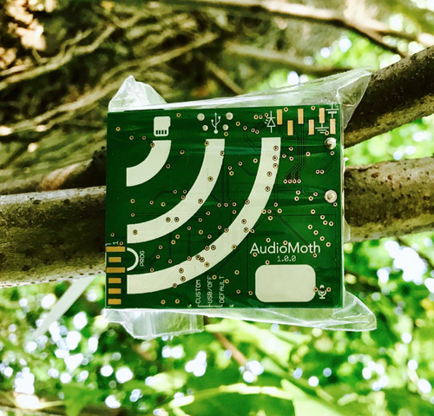
The AudioMoth
The AudioMoth is an open-source, low-cost, small-sized and low-energy acoustic detector
It was developed with an aim to monitor anthropogenic disturbances in the tropical forests
The AudioMoth has been used to collect sound data
Sound data offer potentially rich ecological information
An AudioMoth deployed to listen for the presence of cicada species in the New Forest National Park, UK

Slide 10
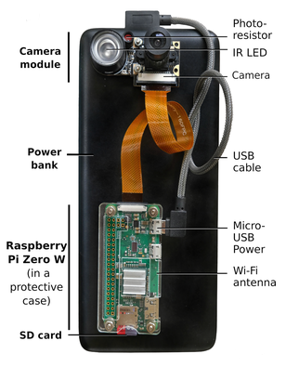
Plant–Insect Interactions Camera Trap (PICT)
PICT is a Raspberry Pi based camera trap
It was developed to study interaction between plants and insects
The camera trap collects videos at >720p resolution
PICT has been tested in a Central African rainforest to collect data on insect pollination
Parts of PICT

Slide 11
DSAIL Low-Cost Sensors
At DSAIL, we required autonomous sensors for ecological data collection
We developed low-cost camera traps and acoustic sensors
The sensors are based on the Raspberry Pi single board computer
They have been deployed at the Dedan Kimathi University of Technology Conservancy for data collection
We will be talking about the camera trap

Slide 12
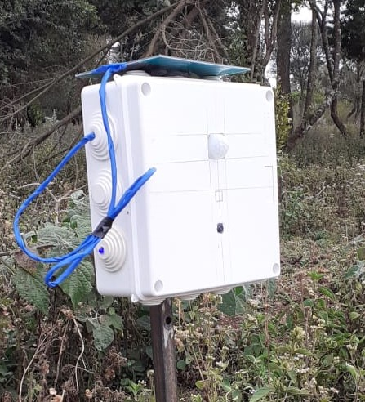
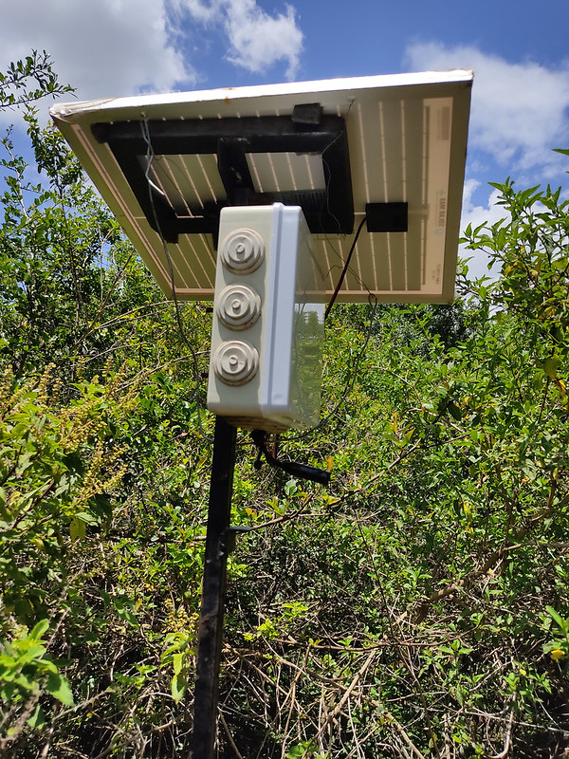
DSAIL Low-Cost Sensors
DSAIL Camera Trap deployed for data
collection
DSAIL Bioacoustics Sensor deployed for data
collection

Slide 13
The DSAIL Camera Trap
The DSAIL Camera Trap is a Raspberry Pi based camera trap
The camera trap has been used to collect over 8,000 images of wild animals
It comprises:
A Raspberry Pi
A Raspberry Pi camera
A Passive Infrared (PIR) motion sensor
A battery
A solar panel
DSAIL power management board

Slide 14
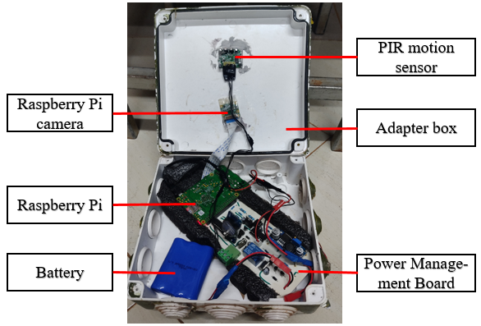
The DSAIL Camera Trap
Parts of the DSAIL Camera Trap

Slide 15
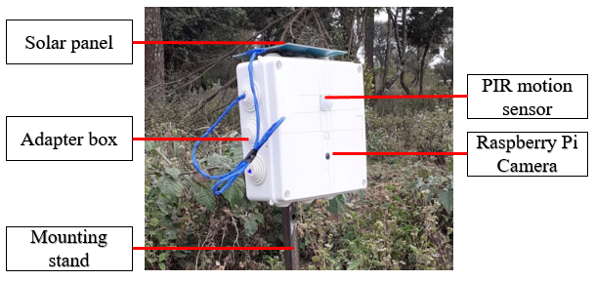
The DSAIL Camera Trap
Parts of the DSAIL Camera Trap

Slide 16
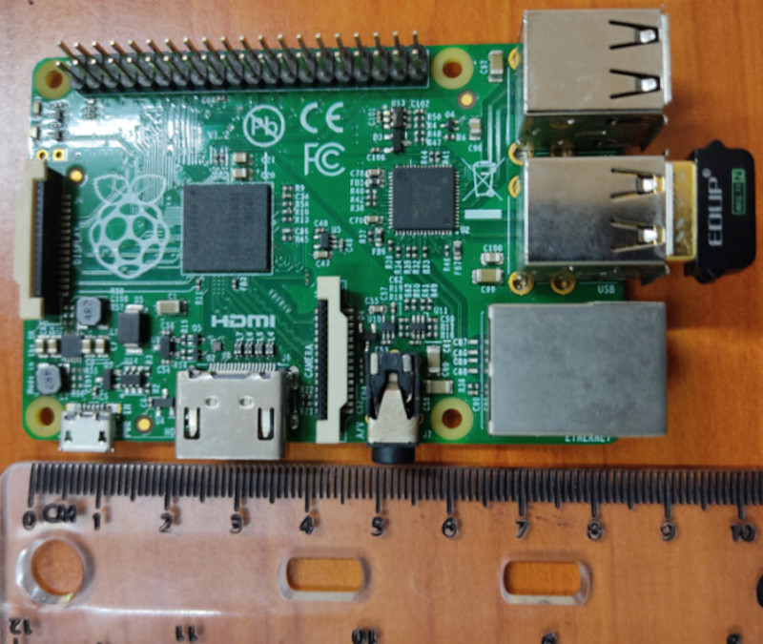
The Raspberry Pi
The Raspberry Pi is a credit card sized single board computer
It is the central device in the camera trap
It controls operation of the system
Through the camera, it takes picture/ videos and save them onto its storage (SD Card)
The Raspberry Pi

Slide 17
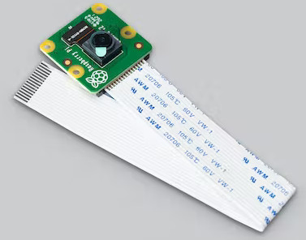
The Raspberry Pi Camera
The Raspberry Pi Camera is a camera designed for the Raspberry Pi
The Raspberry Pi Camera Module v2 is a high quality 8 megapixel
It is used to take high quality pictures and videos using the Raspberry Pi
The Raspberry Pi Camera Module V2

Slide 18
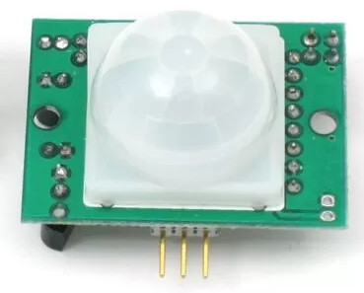
A Passive Infrared (PIR) Motion Sensor
The PIR motion sensor is used to detect motion of moving objects
It detects the infrared rays(heat) released by objects
Using these rays it can determine the stationarity of objects
When the sensor detects motion, it triggers the Raspberry Pi to take pictures/ videos
PIR motion sensor

Slide 19
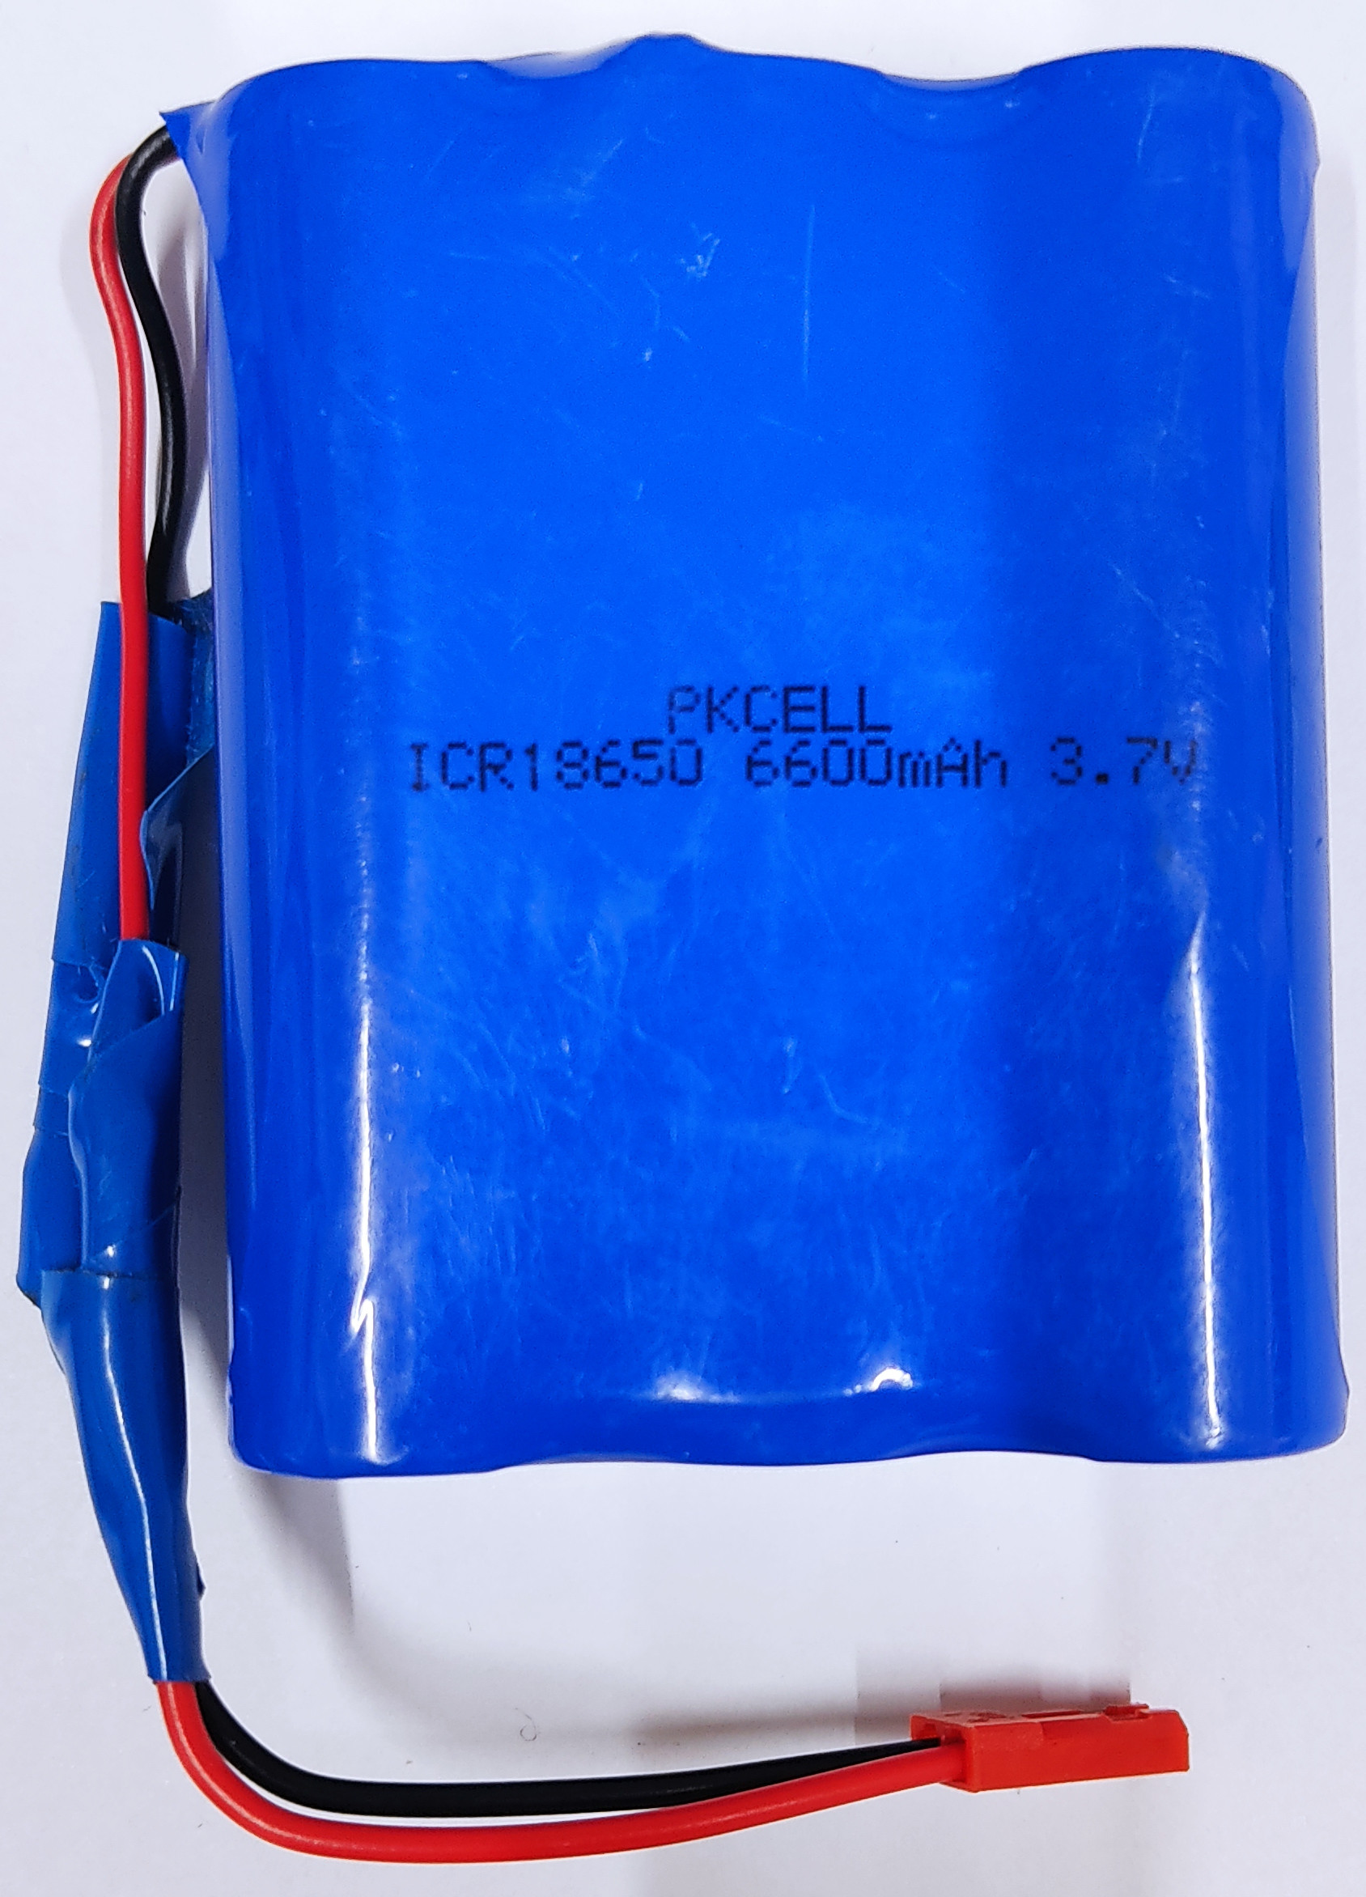
Parts of the DSAIL Camera Trap
The DSAIL Camera Trap is deployed far from the grid
A battery is used to power the camera trap
A lithium polymer battery

Slide 20
A Solar Panel
A solar panel is used to charge the battery
A solar panel converts sunlight to electrical energy
By adding a solar panel, the system is able to last longer in the wild

Slide 21
DSAIL Power Management Board
The DSAIL Power Management Board acts like a power supply to the system
The board was designed to power the Raspberry autonomously
It enables:
The user to schedule operation time of the camera trap
The Raspberry Pi to monitor the battery voltage
The Raspberry Pi to shutdown when the battery gets drained or at the end of scheduled operation time
The Raspberry Pi to schedule the system to restart at the start of the scheduled operation time
To system to restart at the start of the scheduled operation time

Slide 22
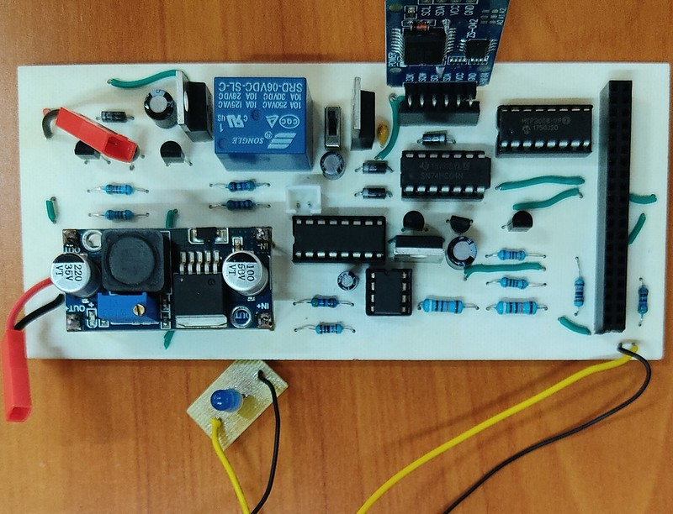
DSAIL Power Management Board
DSAIL Power Management Board

Slide 23
THE END
THANK YOU
https://kiariegabriel.github.io/
https://dekut-dsail.github.io/

