Slide 1
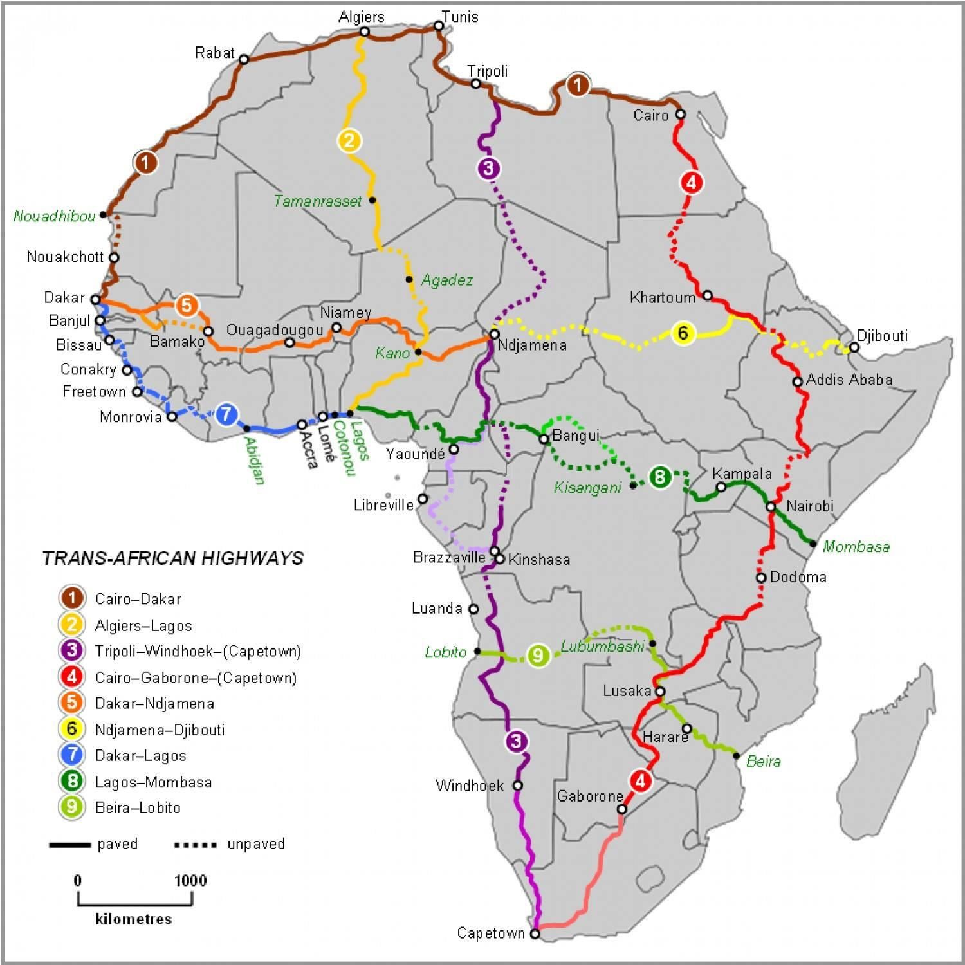
Introduction
Transport is not as self-evident in Africa as in Europe. Many routes are less accessible, and distances are generally larger. When delivering medicines or organs, the right conditions can be crucial. Temperature, humidity, or shocks can change chemical properties. It is a risk for doctors to use these packages as it is not guaranteed that they will work. Doctors should be able to decide to order a new batch as soon as the products are not acceptable for use anymore.
Problems of African deliveries:
Fewer connections between locations
Poor condition of roads
Extreme temperatures
Drastic humidity changes
Little or no mobile service/internet
Our Solution
Our solution for preventing broken packages is real-time information for multiple medicine boxes. The possibility to cancel or reorder at the very moment a package is in a critical condition. We make use of LoRaWAN to tackle the lack of connection in Africa. The device has a GPS tracking system, and a sensor to give an as accurate as possible temperature, and humidity percentage to notify when one is too high or low. For the orientation of the package we’ve decided to use a gyroscope. The shocks will be determined with a tilt switch in combination with the gyroscope to conclude if the shock is big enough to cause damage.

Slide 2
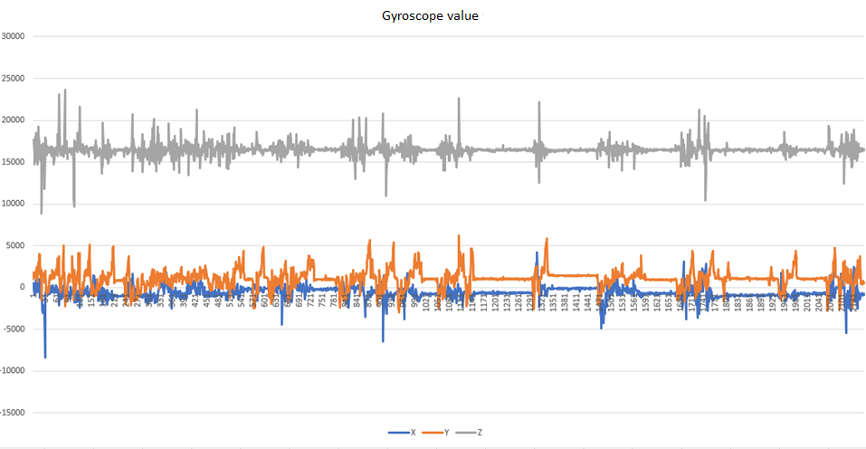
Results
The doctor and rider can monitor the temperature and humidity of the medicine boxes and get notifications when the box fell over or was shocked with potential damages. Making a gyroscope into a shock sensor comes with great challenges. We drove around measuring and noting when big shocks took place. Together with this data we use a tilt switch to make sure the shock was a damaging one. This graph is one of the test drives. Note how there seem to be a lot of shocks going on but, most of this data is the car accelerating. An important axis to look at is the X-axis (blue) in combination with the Y-axis (orange).
Both driver and doctor get an android application. The driver can accept orders and be notified if the status is critical. The doctor can track where the package is and if it is still in usable condition. If it is not, he will be immediately notified, and he can reorder the next batch of medicine.
The driver can connect to the device with Bluetooth to set up the critical values of the package.

Slide 3
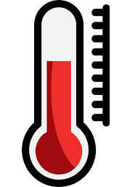
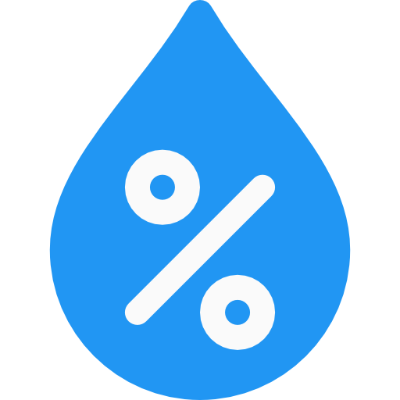
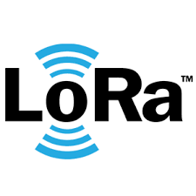

Performances
-40°C to 125°C, ±0.5 °C accuracy
0-100%, ±2.0 % accuracy
1 transmit every 30seconds to 5minutes
±6mA consumption (About 3 full days with 9V)
Conclusions
The temperature sensor we used (HIH8120) is was the most efficient choice for the device. However the combination of gyroscope (LSM9DS1) and tilt switch (LM393) can be made more efficient in the future by making use of a shock/vibration sensor and sensor specifically for orientation not with a build in accelerometer.
LoRaWAN was a difficult point to tackle. It used a lot of memory which made us use 2 chips instead of one.
There is still room for expansion by adding more sensors to read different data or adding a reusable power source like solar power.

