Slide 1
Scruff: A Deep Probabilistic Cognitive Architecture
Avi Pfeffer
Charles River Analytics

Slide 3
Motivation 1: Knowledge + Data
Hypothesis: Effective general-purpose learning requires the ability to combine knowledge and data
Deep neural networks can be tremendously effective
Stackable implementation using back-propagation
Well-designed cost functions for effective gradient descent
Given a lot of data, DNNs can discover knowledge
But without a lot of data, need to use prior knowledge, which is hard to express in neural networks

Slide 4
Challenges to Deep Learning (Marcus)
Data hungry
Limited capacity to transfer
Cannot represent hierarchical structure
Struggles with open-ended inference
Hard to explain what it’s doing
Hard to integrate with prior knowledge
Cannot distinguish causation from correlation
Assumes stable world
Encoding prior knowledge can help with a lot of these

Slide 5
Making Probabilistic Programming as Effective as Neural Networks
Probabilistic programming provides an effective way to combine domain knowledge with learning from data
But has hitherto not been as scalably learnable as neural nets
Can we incorporate many of the things that make deep nets effective into probabilistic programming?
Backpropagation
Stochastic gradient descent
Appropriate error functions including regularization
Appropriate activation functions
Good structures

Slide 6
Motivation 2: Perception as Predictive Coding
Recent trends in cognitive science (Friston, Clark) view perception as a process of prediction
Dual node architecture
Predictions
Percepts
Errors

Slide 7
Friston: Free Energy Principle
Many brain mechanisms can be understood as minimizing free energy
"Almost invariably, these involve some form of message passing or belief propagation among brain areas or units”
"Recognition can be formulated as a gradient descent on free energy"

Slide 8
Neats and Scruffies
Neats:
Use clean and principled frameworks to build intelligence
E.g. logic, graphical models
Scruffies:
Use whatever mechanism works
Many different mechanisms are used in a complex intelligent system
Path-dependence of development
My view:
Intelligence requires many mechanisms
But having an overarching neat framework helps make them work together coherently
Ramifications for cognitive architecture: Need to balance neatness and scruffiness in a well thought out way

Slide 9
The Motivations Coincide!
What we want:
A representation and reasoning framework that combines benefits of PP and NNs:
Bayesian
Encodes knowledge for predictions
Scalably learnable
Able to discover relevant domain features
A compositional architecture:
Supports composing different mechanisms together
Able to build full cognitive systems
In a coherent framework

Slide 10
Time for some caveats

Slide 11
This is work in progress

Slide 12
I am not a cognitive scientist

Slide 13
Metaphor!

Slide 14
Introducing Scruff: A Deep Probabilistic Cognitive Architecture

Slide 15
Main Principle 1: PP Trained Like NN
A fully-featured PP language:
Can create program structures incorporating domain knowledge
Learning approach:
Density differentiable with respect to parameters
Derivatives computed using automatic differentiation
Dynamic programming for backprop-like algorithm
Flexibility of learning
Variety of density functions possible
Easy framework for regularization
Many probabilistic primitives correspond to different kinds of activation functions

Slide 16
Main Principle #2: Neat and Scruffy Programming
Many reasoning mechanisms (scruffy)
All in a unifying Bayesian framework (neat)
Hypothesis: General cognition and learning can be modeled by combining many different mechanisms within a general coherent paradigm
Scruff framework ensures that any mechanism you build makes sense

Slide 17
A Compositional Neat and Scruffy Architecture

Slide 18
Haskell for Neat and Scruffy Programming
The Haskell programming language:
Purely functional
Rich type system
Lazy evaluation
Haskell is perfect for neat/scruffy programming
Purely functional: no side effects means different mechanisms can’t clobber each other
Rich type system enables tight control over combinations of mechanisms
Lazy evaluation enables declarative specification of anytime computations
The Scruff aesthetic
Disciplined language supports improvisational development process

Slide 19
Expressivity versus Tractability
Tractability: What models can you reason about efficiently?
Expressivity: What models can you define?

Slide 20
Expressivity versus Tractability in Probabilistic Programming
One approach (e.g., Figaro, Church, BLOG):
Provide an expressive language
Provide a general-purpose inference algorithm (e.g. MCMC)
Try to make the algorithm as efficient as possible
But in practice, often still too inefficient

Slide 21
Expressivity versus Tractability in Probabilistic Programming
Another approach (e.g., Infer.NET):
Limit the expressivity of the language (e.g., only finite factor graphs)
Use an efficient algorithm for the restricted language
But might not be able to build the models you need
Some languages (e.g. Stan) use a combination of approaches:
General-purpose algorithm for continuous variables, but limited support for discrete variables

Slide 22

Expressivity versus Tractability in Probabilistic Programming
A third approach (Venture)
Provide an expressive language
Give the user a language to control the application of inference interactively
But requires expertise, and still no guarantees

Slide 23
Scruff’s Approach: Tractability by Construction
Goals:
Ensure that any model built in Scruff supports tractable inference
While allowing many reasoning mechanisms
And providing an expressive language
Tractability is relative to a reasoning mechanism
The same model can be tractable for one mechanism and intractable for another
E.g. Gaussian is tractable for sampling but not for exact enumeration of values
Scruff’s type system helps ensure tractability by construction

Slide 24
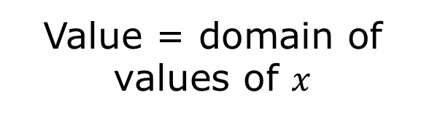
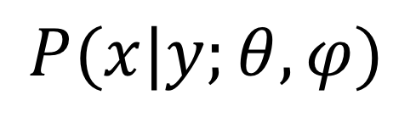
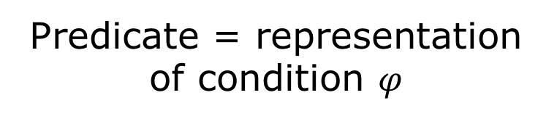
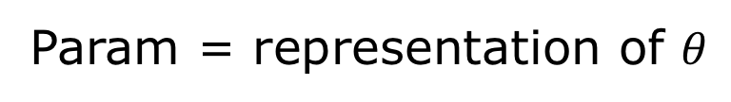
Scruff’s Type System: Key Concepts
Model = functional form
Param = representation of $θ$
$$P(x|y;θ,φ)$$
Value = domain of values of $x$
Predicate = representation of condition $φ$
Scalar = numerical basis, e.g. Double or arbitrary precision rational

Slide 25
Example: Pentagon with Fixed Endpoints
c
b
a
l
u
x
Model: Pentagon l u
Param: (a,b,c)
Value: Double
Scalar: Double
Predicate: InRange Double

Slide 26
Examples of Type Classes Representing Capabilities
Generative
Enumerable
HasDensity
HasDeriv
ProbComputable
Conditionable

Slide 27
Examples of Conditioning (1)
Specific kinds of models can be conditioned on specific kinds of predicates
E.g., Mapping represents many-to-one function of random variable
Can condition on value being one of a finite set of elements, which in turn conditions the argument

Slide 28
Examples of Conditioning (2)
MonotonicMap represents a monotonic function
Can condition on value being within a given range, which conditions the argument to be within a range

Slide 29
Current Examples of Model Classes
Atomics like Flip, Select, Uniform, Normal, Pentagon
Mapping, Injection, Monotonic Map
If
Mixture of any number of models of same type
Choice between two models of different types

Slide 30
Choosing Between Inference Mechanisms
What happens if a model is tractable for multiple inference mechanisms?
Example:
Compute expectations by sampling
Compute expectations by enumerating support
Current approaches:
Figaro:
Automatic decomposition of problem
Choice of inference method for each subproblem using heuristics
What if cost and accuracy are hard to predict using heuristics?
Venture:
Inference programming
Requires expertise
May be hard for human to know how to optimize

Slide 31
Reinforcement Learning for Optimizing Inference
Result of a computation is represented as infinite stream of successive approximations
Implemented using Haskell’s laziness
As we’re applying different inference algorithms, we consume values from these streams
We can use these values to estimate how well the methods are doing
We have a reward signal for reinforcement learning!

Slide 32
Network of Reinforcement Learners
Any given inference task might involve multiple choices
RL
RL
RL
RL

Slide 33
Strategies For Choosing Between Streams
Multiple streams represent answer to same computation
Multi-armed bandit problem
Example: Computing expectation using a hybrid strategy that chooses between sampling and support method
RL
RL
RL
Choice
RL

Slide 34
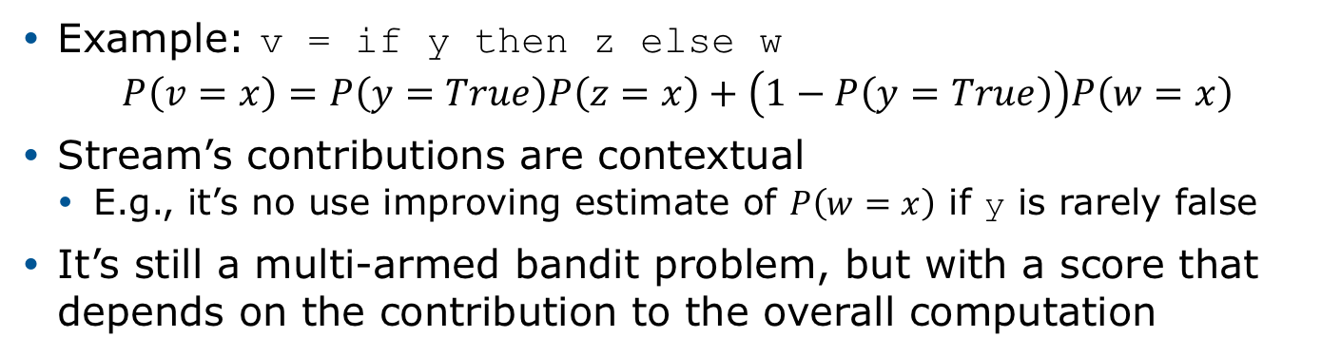
Strategies for Combining Streams
Example: v = if y then z else w
$$P\left(v=x\right)=P\left(y=True\right)P\left(z=x\right)+\left(1−P\left(y=True\right)\right)P\left(w=x\right)$$
Stream’s contributions are contextual
E.g., it’s no use improving estimate of $P\left(w=x\right)$ if y is rarely false
It’s still a multi-armed bandit problem, but with a score that depends on the contribution to the overall computation
RL
RL
RL
Combine
RL

Slide 35
Strategies for Merging Streams
If a variable depends on a variable with infinite support, the density of the child is the sum of contributions of infinitely many variables
Each contribution may itself be an infinite stream
Need to merge the stream of streams into a single stream
Simple strategy: triangle
We also have a more intelligent lookahead strategy

Slide 36
Scruff for Natural Language Understanding

Slide 37
Deep Learning for Natural Language
Motivation: deep learning killed the linguists
Superior performance at many tasks
Machine translation is perhaps the most visible
Key insight: word embeddings (e.g. word2vec)
Instead of words being atoms, words are represented by a vector of features
This vector represents the contexts in which the word appears
Similar words share similar contexts
This lets you share learning across words!

Slide 38
Critiques of Deep Learning for Natural Language
Recently, researchers (e.g. Marcus) have started questioning the suitability of deep learning for tasks like NLP
Some critical shortcomings:
Inability to represent hierarchical structure
Sentences are just sequences of words
Don’t compose (Lake & Baroni)
Struggles with open-ended inference that goes beyond what is explicit in the text
Related: hard to encode prior domain knowledge

Slide 39
Bringing Linguistic Knowledge into Deep Models
Linguists have responses to these limitations
But models built by linguists have been outperformed by data-driven deep nets
Clearly, the ability to represent words as vectors is important, as is the ability to learn hidden features automatically
Can we merge linguistic knowledge with word vectors and learning of hidden features?

Slide 40
Grammar Models
Linguists represent the structure of language using grammars
Hierarchical
Sentences are organized in larger and larger structures that encompass subsentences
Long-range reasoning
A question word at the beginning of a sentence entails a question mark at the end of the sentence
Structure sharing
The same concept (e.g. noun phrase) can appear in different places in a sentence
Recursive
The same structure can exist at multiple levels and contain itself
In ”The boy who went to school ran away”, “The boy who went to school” is a noun phrase that contains the noun phrases “The boy” and “school”
We propose deep probabilistic context free grammars to obtain these advantages

Slide 41
Context Free Grammars (CFGs)
Non-terminals: parts of speech and organizing structures, e.g. s, np, det, noun
Terminals: words, e.g. the, cat, ate
Grammar rules take a non-terminal and generate a sequence of non-terminals or terminals
s → pp np vp
pp → prep np
vp → verb
vp → verb np
np → det noun
np → noun
np → adj noun
prep → in
det → the
det → a
noun → morning
noun → cat
noun → breakfast
verb → ate

Slide 42
CFG Derivations/Parses
Starting with the start symbol, apply rules until you reach the sentence
Chart parsing (dynamic programming) does this in O(mn³) time and space where m is number of rules and n is number of words
s → pp np vp
pp → prep np
vp → verb
vp → verb np
np → det noun
np → noun
np → adj noun
prep → in
det → the
det → a
noun → morning
noun → cat
noun → breakfast
verb → ate
s
pp
vp
np
np
np
prep
det
noun
det
noun
verb
noun
in
the
morning
the
cat
ate
breakfast

Slide 43
Probabilistic Context Free Grammars (PCFGs)
Each grammar rule has an associated probability
Probabilities of rules for the same non-terminal sum to 1
Defines a generative probabilistic model for generating sentences
1.0: s → pp np vp
1.0: pp → prep np
0.4: vp → verb
0.6: vp → verb np
0.3: np → det noun
0.5: np → noun
0.2: np → adj noun
1.0: prep → in
0.7: det → the
0.3: det → a
0.4: noun → morning
0.5: noun → cat
0.1: noun → breakfast
1.0: verb → ate

Slide 44
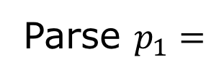
PCFG Derivations/Parses
Each rule in parse annotated with probability that it is chosen
1.0: s → pp np vp
1.0: pp → prep np
0.4: vp → verb
0.6: vp → verb np
0.3: np → det noun
0.5: np → noun
0.2: np → adj noun
1.0: prep → in
0.7: det → the
0.3: det → a
0.4: noun → morning
0.5: noun → cat
0.1: noun → breakfast
1.0: verb → ate
s
1.0
pp
1.0
vp
0.6
Parse $p_{1}=$
np
np
np
0.3
0.3
0.5
prep
det
noun
det
noun
verb
noun
1.0
0.7
0.4
0.7
0.5
1.0
0.1
in
the
morning
the
cat
ate
breakfast

Slide 45

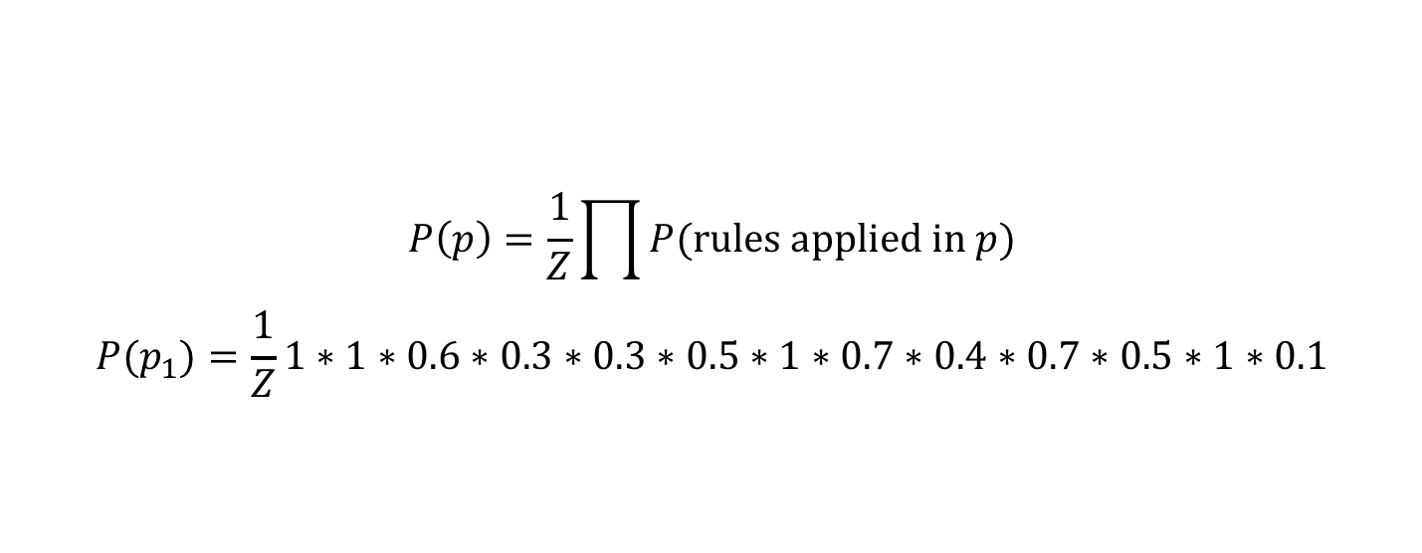
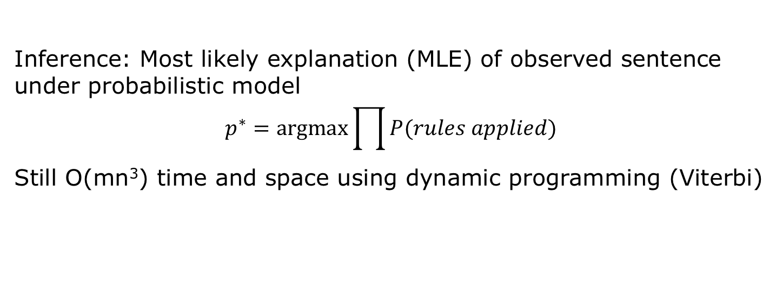
PCFG Inference
$$P\left(p\right)=\frac{1}{Z}\prod{P(rules applied in p)}$$
$$P(p_{1})=\frac{1}{Z}1∗1∗0.6∗0.3∗0.3∗0.5∗1∗0.7∗0.4∗0.7∗0.5∗1∗0.1$$
s
1.0
pp
1.0
vp
0.6
Parse $p_{1}=$
np
0.3
np
0.3
np
0.5
prep
det
noun
det
noun
verb
noun
1.0
0.7
0.4
0.7
0.5
1.0
0.1
in
the
morning
the
cat
ate
breakfast
Inference: Most likely explanation (MLE) of observed sentence under probabilistic model
$$p^{∗}=argmax\prod{P(rules applied)}$$
Still O(mn³) time and space using dynamic programming (Viterbi)

Slide 46
Deep PCFGs
Non-terminals, terminals, and grammar rules, like PCFGs
Each terminal t is represented by word2vec features w_{t}
Each non-terminal n is represented by hidden features h_{n}
Each grammar rule is associated with a Scruff network to generate features
0.3: np → det noun
h_{np}
Scruff network
h_{det}
h_{noun}

Slide 47
Parameter Sharing
The same network for non-terminal rule applied every time
Single network for all terminal productions from a non-terminal
h_{s}
h_{vp}
h_{vp}
Scruff network
Scruff network
Scruff network
h_{pp}
h_{np}
h_{vp}
h_{verb}
h_{np}
h_{verb}
h_{np}
h_{np}
h_{np}
h_{pp}
Scruff network
Scruff network
Scruff network
Scruff network
h_{det}
h_{noun}
h_{noun}
h_{adj}
h_{noun}
h_{prep}
h_{np}
h_{noun}
h_{prep}
h_{det}
h_{verb}
Scruff network
Scruff network
Scruff network
Scruff network
w
w
w
w

Slide 48
Scruff Model for Parse p₁
h_{s}
Scruff network
h_{pp}
h_{vp}
Scruff network
Scruff network
h_{np}
h_{np}
h_{np}
h_{prep}
h_{verb}
Scruff network
Scruff network
Scruff network
h_{det}
h_{noun}
h_{det}
h_{noun}
h_{noun}
Scruff network
Scruff network
Scruff network
Scruff network
Scruff network
Scruff network
Scruff network
w_{in}
w_{the}
w_{morning}
w_{the}
w_{cat}
w_{ate}
w_{breakfast}

Slide 49
Parsing in Deep PCFGs
Assume individual Scruff networks are tractable
Inference in such a network takes O(1) time
Given a parse, computing MAP non-terminal features is O(n)
Tree-structured network
But parse depends on non-terminal features
Want to construct parse and features simultaneously

Slide 50
Dynamic Programming for Deep PCFGs
Similar dynamic programming algorithm to PCFGs works
Table with best parse and feature values for each substring
For each substring (shortest to longest)
Consider all ways to break substring into two shorter substrings – O(n)
Consider all relevant rules – O(m)
For each such possibility:
Compute the MAP feature values of the longer substring from the shorter substrings’ feature values – O(1) using Scruff network
Compute the probability of the shorter substrings’ feature values given the longer substring’s feature values – O(1) using Scruff network
Multiply this probability by the rule probability to get the score
Choose the possibility with the highest score and record in the table
This has to be done for O(n²) substrings, for a total cost of O(mn³)
Tractable by construction!

Slide 51
Learning in Deep PCFGs
Parameters to be learned are rule probabilities and weights of Scruff networks
Stochastic gradient descent
For each training instance
Compute the MAP parse and feature values
Construct the resulting Scruff model
With parameter sharing!
Compute the gradient of the probability of the parse using automatic differentiation

Slide 52
Differentiating Models With Respect to Parameters
Binder et al. 96 learned parameters of Bayesian network using gradient descent on density
Required performing inference in each step of gradient descent to obtain posterior distribution over each variable
Our approach is similar, except that we use automatic differentiation to compute gradient in a single backward pass
Dynamic programming avoids duplicate computation and results in exponential savings
To do: Translate Scruff model fragments (e.g. models associated with specific productions in a DPCFG) into efficient implementations like TensorFlow

Slide 53
Scruff Models for Predictive Coding

Slide 54
Scruff as a Cognitive Architecture
Deep PCFGs bring one kind of linguistic knowledge into models that discover latent features
Moves towards addressing technological motivation
But what about scientific motivation of developing a cognitive architecture?
Can we use Scruff models to create models for predictive coding?
We’re working on two such kinds of models
Deep noisy-or networks
Deep conditional linear Gaussian networks

Slide 55
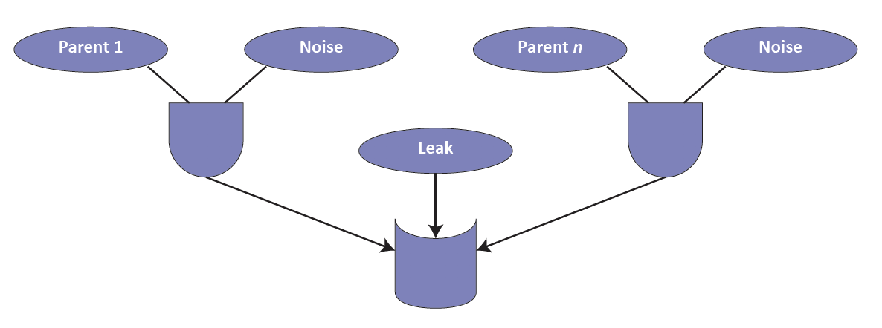
Noisy-Or Model
Causes
Effect

Slide 56
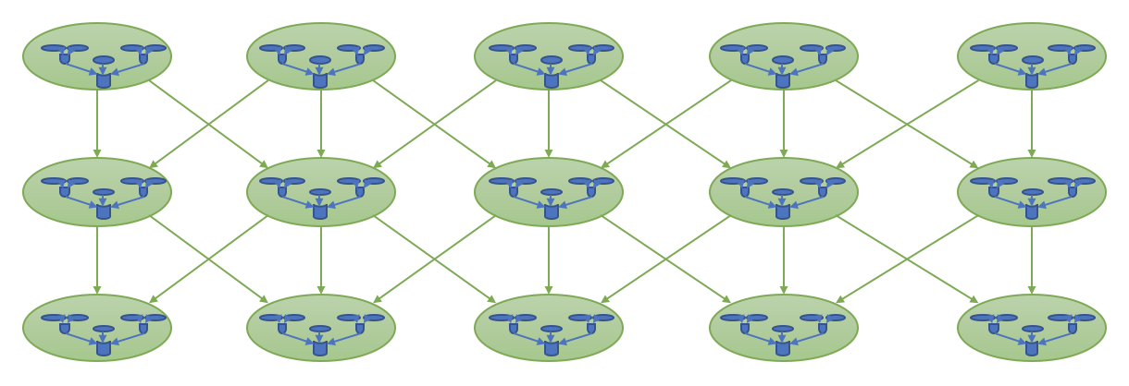
Deep Noisy-Or Network (DNON)
Can be complete or incomplete
Can include known causal pathways

Slide 57
Tractability by Construction for DNONs
Interesting facts about noisy-or models:
If you condition on the effect being False, you can condition the causes independently
O(n) to perform exact inference throughout DNON using a single backward pass, where n is number of nodes in DNON
But if you condition on the effect being True, all the causes become coupled
Need to use approximation algorithms like belief propagation
Scruff type system has different type classes for different inference capabilities
Can say explicitly:
Conditioning on the output being False is tractable for backward inference
Conditioning on the output being True is tractable for belief propagation

Slide 58
Deep Noisy-Or as Anomaly Explainer
With many parameter configurations, noisy-or will predict True for all nodes with high probability
So a False observation is an indication of surprise
This makes a deep noisy-or network ideal for explaining surprises/anomalies
Only process the False observations
This is fast!
Predictive coding interpretation
Always predict True
Only process the errors (False predictions)

Slide 59
Conditional Linear Guassian (CLG) Models
Linear Gaussian
Each node is defined by a Gaussian
Mean is linear function of values of its parents
Network of linear Gaussian nodes defines multivariate Gaussian
Conditional linear Gaussian
Add discrete variables
Only as parents of continuous nodes
Mean of a continuous node could be one of several linear functions of its continuous parents
Choice of linear function depends on discrete parents
d1
c1
d1 = flip(0.6)
c1 = Gaussian(2, 1)
c2 = Gaussian(if d1 then c1 + 2 else –3*c1, 1)
c2

Slide 60
Deep LG and CLG Models
Deep linear Gaussian model
Just like a regular linear Gaussian model, but with linear Gaussian nodes stacked in layers
Compositional definition of high-dimensional multivariate Gaussian
Deep CLG model
Adds a tractable Scruff network of discrete variables at the roots
Could be single layer
Natural predictive coding interpretation
Forward pass predicts mean of every node
Backwards pass propagates deviations from mean

Slide 61
Conclusion and Future Work
We have a framework for deep probabilistic models and examples of models
Need to implement these models scalably using appropriate hardware
Need to compare models to other probabilistic programs and neural networks
How much does being able to encode knowledge help?
How much does learning deep features help?
Applications
We have a framework to develop cognitive models based on predictive coding
Need to actually build some of these models
Need to evaluate their explanatory power
Applications

Slide 62
Point of Contact
If you find this interesting, contact me!
Avi Pfeffer 617.491.3474 Ext. 513 apfeffer@cra.com

