Slide 1
Scaffolding the Generation of Machine Learning Models with SciRise
Presented by Dr Aneesha Bakharia Email: aneesha.bakharia@gmail.com Twitter: @aneesha
DeLBP Workshop at IJCAI 2017

Slide 2
2017 is an exciting time for Deep Learning and Machine Learning
Good Tools and Libraries
SciKit Learn
Tensor Flow
Keras
Auto ML
Lots of courses
MOOCs (ML and Data Science)
Udacity Deep Learning Foundation Nano Degree
Fast AI course
Andrew Ng’s new Coursera Course

Slide 3
Motivation
Even though we have lots of tools and courses it is still difficult for novice users
Lots of concepts are required to build a model that is able to generalise
Train/Test Split
Data Scaling
Feature Creation
Cross Validation
Model and Parameter Selection
Types of ML/DL and associated algorithms
Lots of users don’t know how to program or are learning to program while taking a ML/DL course
We need to make ML and DL easier and more accessible!

Slide 4

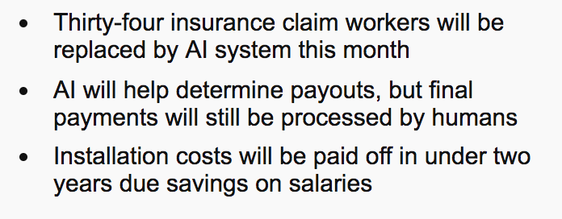
Motivation
Future job losses due to ML and DL won’t only come from Manufacturing and Transportation
Knowledge Workers need to upskill
http://www.abc.net.au/news/2017-01-06/japanese-insurance-company-replacing-staff-with-ai/8165418
We need to make ML and DL easier and more accessible!

Slide 5
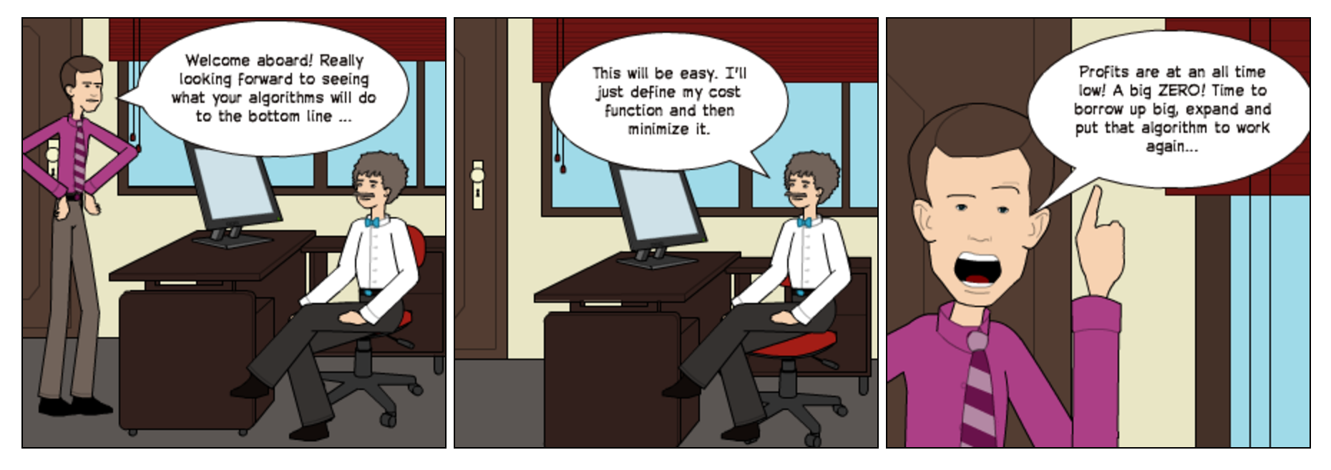
Motivation
ML and DL need to be applied to new domains areas
Domain areas not always seen in ML and DL publications
Andrew Ng describes Deep Learning as the new Electricity
High risk if incorrectly applied
We need to make ML and DL easier and more accessible!

Slide 6
Design Principles for a User Interface
Encapsulate ML experiment design
Include context-sensitive help/explanation
Recommend ML algorithms and parameters
Encourage experimentation
Integrate with Existing Data Science Tools
Generate High Quality Python Code
Python programming experience not required but the tool should help transition (scaffold) a user to code
Did not want a Flow based UI!
Needs wiring up
Becomes too big spatially
Hard to transition to code
What about a conversational UI?
Too many questions!

Slide 7
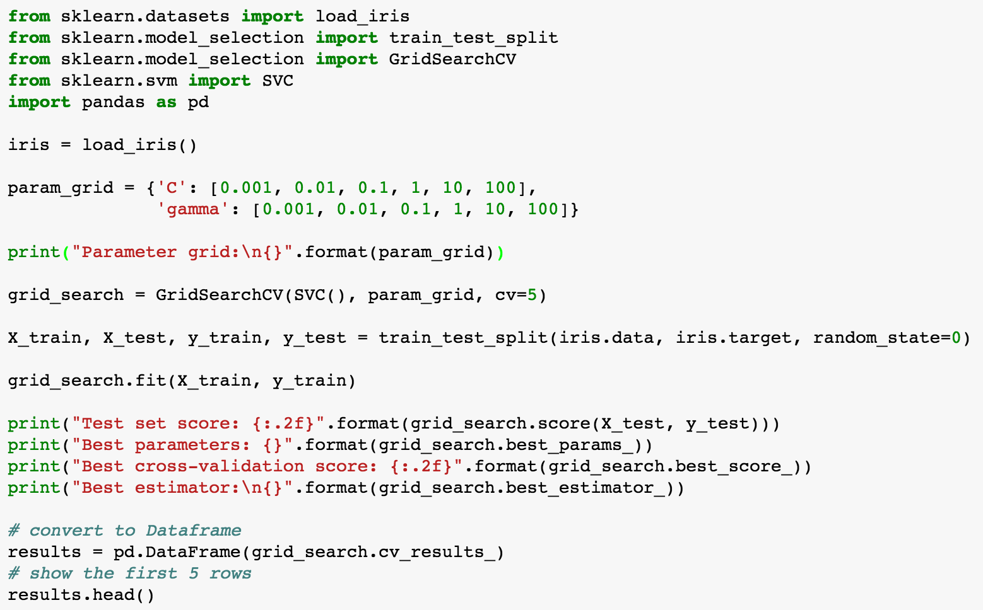
Implementation
Scikit Learn code is very declarative
While you make objects, you can use your code as a template for your next project
So let’s
Design UI components for SciKit Learn (Eg GridSearchCV)
Allow users to explore code for each component
Explain to users why a step/component is important
Generate code and integrate with Jupyter Notebooks

Slide 8
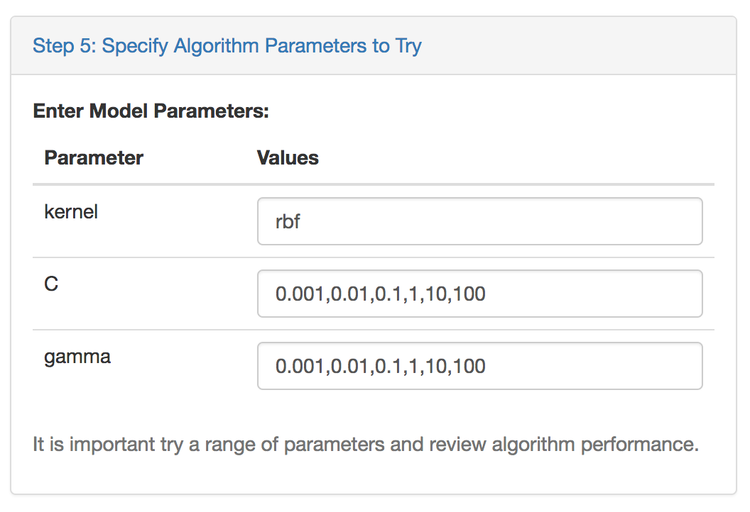
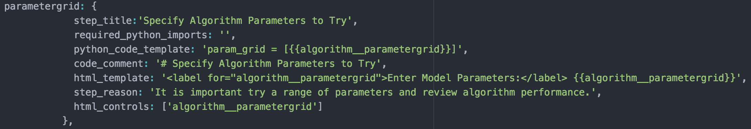
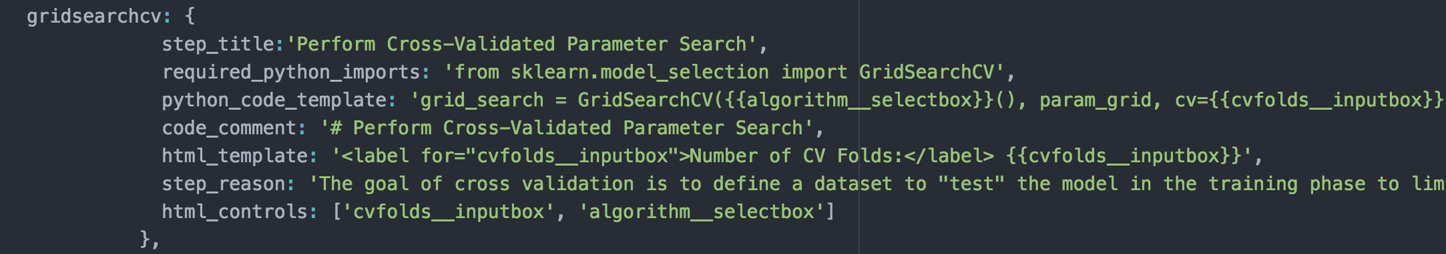
Component Definitions
Each component has a JSON definition
Template variables to create UI
jQuery Plugin renders the component UI
Auto-wiring between components

Slide 9
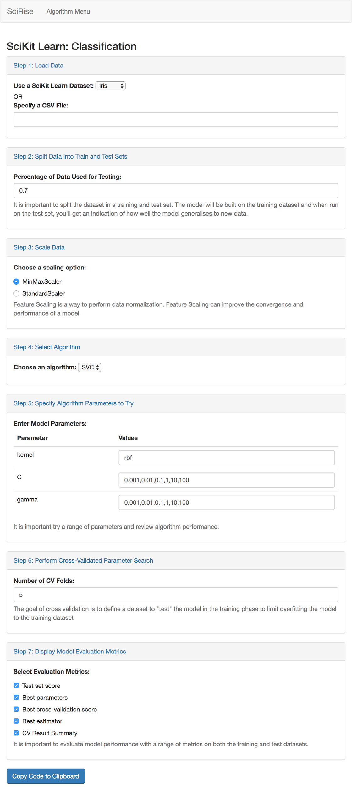
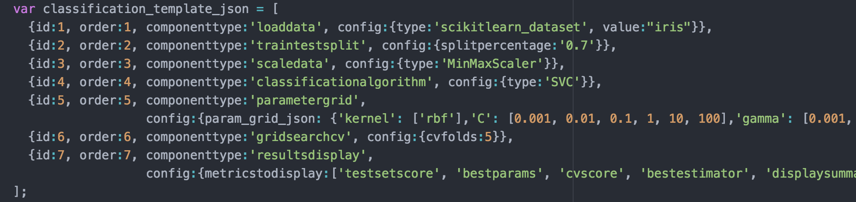
Classification in SciRise
JSON Blueprint
JSON to describe ML Experiment steps
Each step maps to a component
JSON is rendered to a component

Slide 10
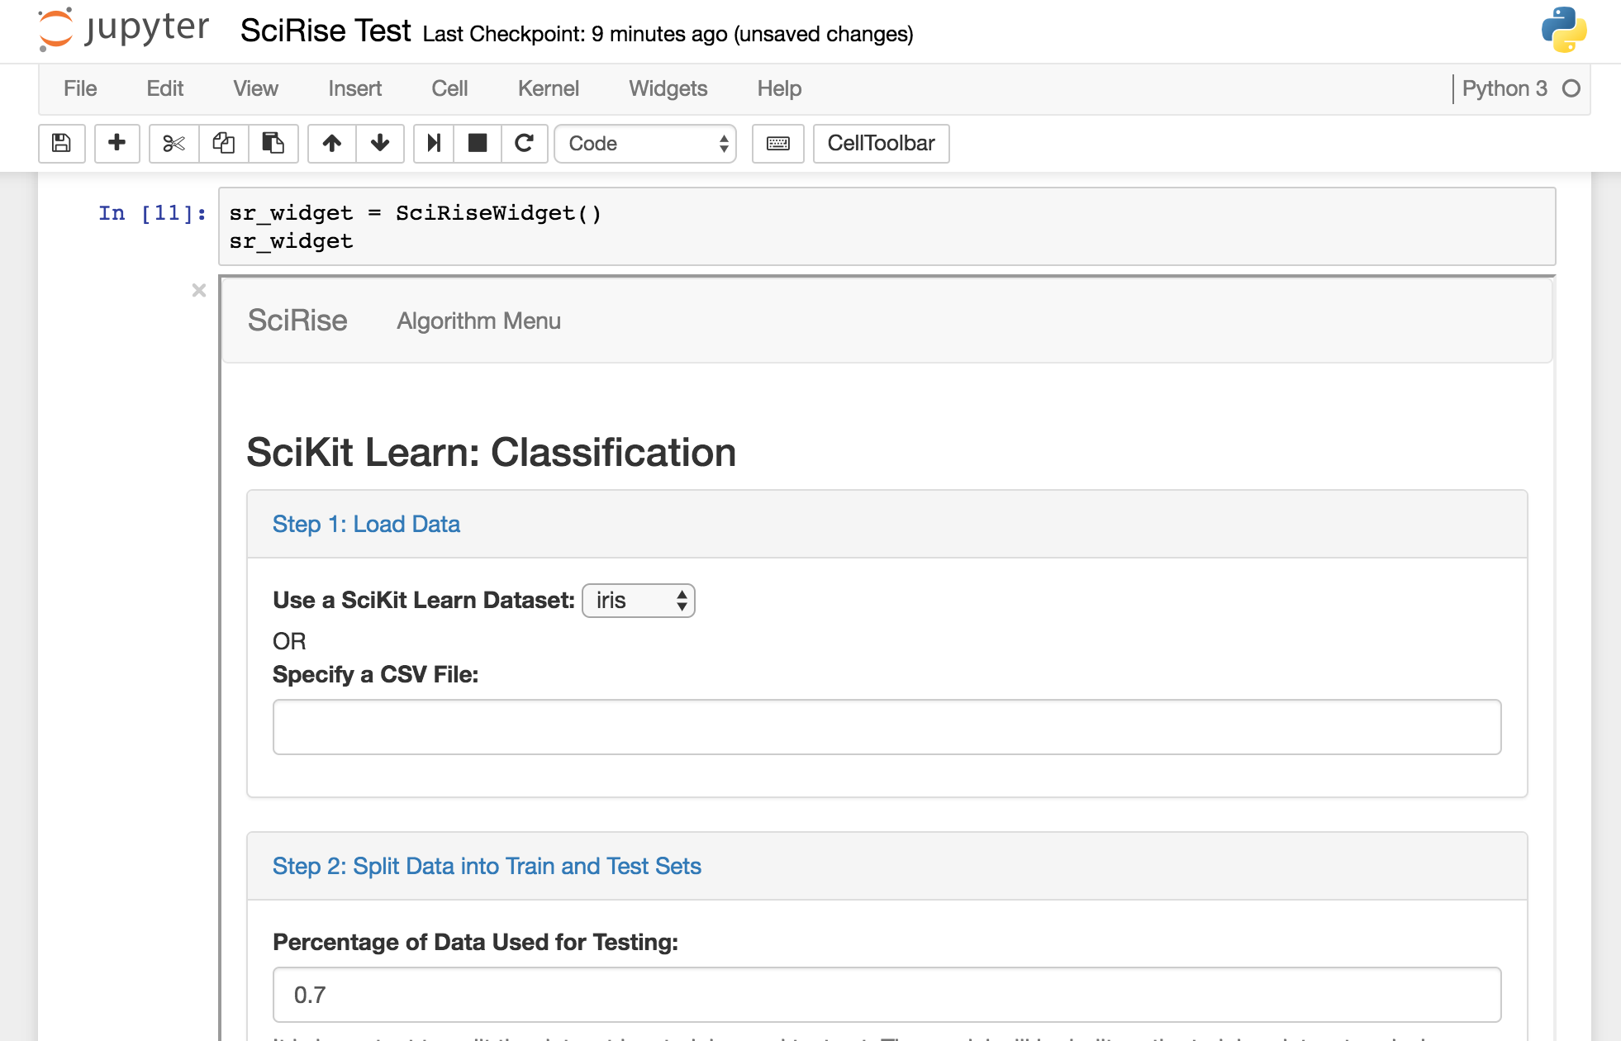
Demo
Classification
Jupyter Notebook Integration (iPython Widget)

Slide 11
Future Directions
&
Challenges
Version 1.0 Release
Dynamic component that can change each other
Full support for Classification, Clustering, Topic Modeling, Regression and AutoML
Full SciKit Learn CV Support with Pipelines and FeatureUnions
Data Processing and Feature Creation (New Component called Featurist)
Visualisation Components
Future
Keras Support
Deep Learning
Summarization
Embeddings
CNN
RNN and LSTM
GAN’s
Challenges
Time required to execute AutoML

Slide 12

Discussion

