Slide 1






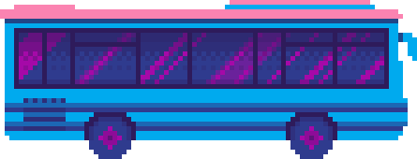



PRESENTATION
MONSTER SLAYER

Slide 2
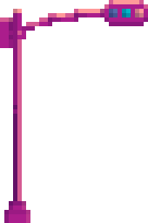
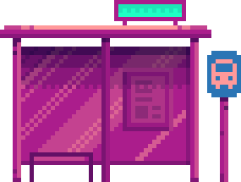
GAME DESCRIPTION:
MONSTER SLAYER
Game Title:
Genre: Adventure – Survival – 2D Platformer
Monster Slayer is a 2D side-scrolling adventure game that follows a lone explorer who becomes trapped in a dark, desolate swamp — a place that seems to defy all natural laws. To survive and escape, the player must traverse treacherous terrain, avoid deadly traps, battle strange creatures, and uncover the buried secrets hidden within the thick, ever-present mist.

Slide 3


ABOUT GAME
You are an archaeologist stranded in a mysterious, ancient swamp.
With no way out and danger lurking in every shadow, you must explore ruins, uncover lost secrets, and survive against strange creatures hiding beneath the foggy waters.

Slide 4


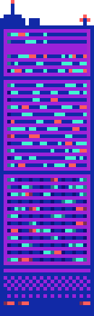

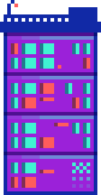

CONTROL GUIDE:
Controls:
Arrow Keys / WASD – Move & Jump
K – Attack
E – Interact with Objects
Objectives:
Explore the swamp
Survive traps, hostile creatures
Collect runes to offer to ancient relics

Slide 5
VISION AND GOAL
To create a simple yet engaging platformer game, where players explore and overcome challenges in a mysterious swamp world.
01
To improve our skills in game development, from idea generation to building a playable product.
02
To deliver a light and enjoyable gaming experience, accessible for both casual players and fans of classic adventure games.
03

Slide 6
THANK
YOU

