Slide 1
Network Security Laboratory Session5
Wifi cracking (wep + wpa)

Slide 2
Wireless LAN (WLAN)
A WLAN is a Wireless Local Area Network that links two or more devices using wireless communication
It is based on IEEE 802.11 protocol
WLAN can be classified depending on the security protocols they use
Three macro categories:
Open WLAN (no protection)
WEP (today is obsolete)
WPA (version 2 and 3)
WPA3 → More secure but …

Slide 3
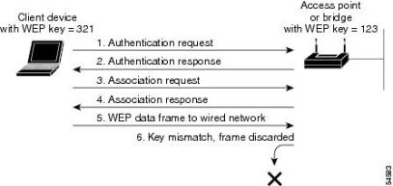
Wired Equivalent Privacy (WEP)
WEP weaknesses:
Stream cipher. Encryption algorithms applied to data streams, called stream ciphers, can be vulnerable to attack when a key is reused. The protocol's relatively small key space makes it impossible to avoid reusing keys
RC4 weaknesses. The RC4 algorithm itself has come under scrutiny for cryptographic weakness and is no longer considered safe to use. It makes use of an Initialization Vector (IV) combined with a key in order to crypt data. N.B.: the IV would be agreed on in advance by both the sender and the recipient. In addition, the IV can be transmitted independently or included as part of the session setup prior to message exchange
Shared key. The default configuration for these systems uses a single shared key for all users. You can't authenticate individual users when all users share the same key
WEP Negoziation:

Slide 4
Why WEP is weak
WEP is considered vulnerable for many other reasons:
IV length: 24 bit
The same IV can be reused more times
All connections are encrypted with the same Pre Shared Key (PSK)

Slide 5
WiFi Protected Access (WPA)
Several sub-catergories of WPA
WPA Personal
WPA Enterprise
WPA Personal: most commonly used at home (also known as WPA-PSK)
It is based on a Pre Shared Key

Slide 6
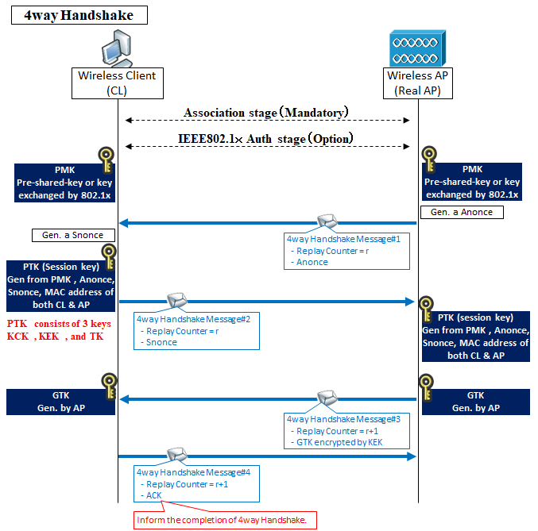
WPA Personal Handshake
This kind of handshake is based on mutual authentication
Each host must provide the right PTK, derived on the PMK (the password of the network)
The PTK is used to encrypt data
Each connection uses different PTK
A third host C can’t decrypt messages exchanged between the host CL (see image) and the AP
Result: WPA security improved

Slide 7
WPA Attacks
We have several ways to discover WPA passwords
Bruteforce attacks
Dictionary based attacks
All these attacks are addressed to the PMK, but….
THEY REQUIRE TIME!
Other types of attacks exploits the PSK
PSK is a key of 256 bit derived from PMK, ESSID and some others parameters
Possible attack: rainbow table attack

