Slide 1
Link Layer SECURITY
Objective:
Understanding a collision domain
Layer 2 protocol
Shared access to the same medium
Layer 2 addressing
Layer 2 General Security Issues
Wired L2 Security issues (802.3)
Wireless L2 Security issues (802.11)

Slide 2
Protocol Stacks
…excel.exe
word.exe …
Alice.exe
message
M
application
transport
network
link
physical
segment
AB
M
Direct Link
datagram
12
AB
M
1
frame
1R
₁₂
AB
M
1R
12
AB
M
link
physical
1R
12
AB
M
Switch (S)
Packet formats change from layer to layer
ffox.exe …
Bob.exe
…emule.exe
12
AB
M
network
link
physical
12
AB
M
M
application
transport
network
link
physical
R2
12
AB
M
1R
12
AB
M
AB
M
Link diretto
12
AB
M
R2
12
AB
M
Router (R)
2

Slide 3

Link Layer: Introduction
Some terminology:
hosts and routers are nodes
communication channels that connect adjacent nodes along communication path are links
wired links
wireless links
LANs
layer-2 packet is a frame, encapsulates datagram
data-link layer has responsibility of
transferring datagram from one node
to adjacent node over a link

Slide 4
Link layer: context
datagram transferred by different link protocols over different links:
e.g., Ethernet on first link, frame relay on intermediate links, 802.11 on last link
each link protocol provides different services
e.g., may or may not provide rdt over link
transportation analogy
trip from Princeton to Lausanne
limo: Princeton to JFK
plane: JFK to Geneva
train: Geneva to Lausanne
tourist = datagram
transport segment = communication link
transportation mode = link layer protocol
travel agent = routing algorithm

Slide 5
Link Layer Services
framing, link access:
encapsulate datagram into frame, adding header, trailer
channel access if shared medium
“MAC” addresses used in frame headers to identify source, dest
different from IP address!
reliable delivery between adjacent nodes
we learned how to do this already (chapter 3)!
seldom used on low bit-error link (fiber, some twisted pair)
wireless links: high error rates
Q: why both link-level and end2end reliability?

Slide 6
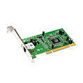
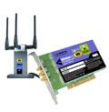
Where is the link layer implemented?
in each and every host
link layer implemented in “adaptor” (aka network interface card NIC)
Ethernet card, PCMCIA card, 802.11 card
implements link, physical layer
attaches into host’s system buses
combination of hardware, software, firmware
host schematic
application
transport
network
link
cpu
memory
link
physical
host
bus
(e.g., PCI)
controller
physical
transmission
network adapter
card

Slide 7
Adaptors Communicating
datagram
datagram
controller
controller
sending host
receiving host
datagram
frame
sending side:
encapsulates datagram in frame
adds error checking bits, rdt, flow control, etc.
receiving side
looks for errors, rdt, flow control, etc
extracts datagram, passes to upper layer at receiving side

Slide 8
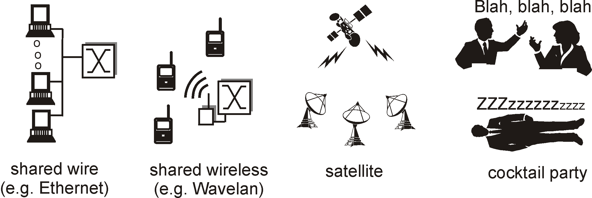
LINK TYPES
Two fundamental types:
Point-to-point (physical or virtual)
PPP, PPPoA, PPPoE
broadcast (shared medium: space, wires, also virtual)
Ethernet
802.11 wireless LAN
802.1q (Virtual LANs)
Broadcast links are evidently a challenge for confidentiality and integrity
Notes:
animazione

Slide 9

ETHERNET FRAME STRUCTURE
Addresses: 6 bytes
NICs process incoming frames only if Dst MAC corresponds to the NICs MAC, or to a broadcast address (ff:ff:ff:ff:ff:ff)
Otherwise the NIC should discard the frame
Type: code of transported layer 3 protocol (e.g. IP, IPv6, others were and are possible)
CRC: checked by receiver. Frame should be discarded if CRC not corresponding. Not cryptographic. Can be counterfeited.

Slide 10
MAC Addresses
IP address
Valid among layer 3 nodes
MAC address:
Works only within current link. Does not need configuration.
Hardwired within NICs. Cannot be used for authenticating stations. Cannot be used for managing Layer 2 ACLs

Slide 11
ARP: Address Resolution Protocol
Needed when an host must be
reached at layer 2.
Conversion IP -> MAC needed
Each station handles an ARP table
ARP Table: IP/MAC address triples < IP address; MAC address; TTL>
TTL (Time To Live)
237.196.7.78
1A-2F-BB-76-09-AD
237.196.7.23
237.196.7.14
LAN
71-65-F7-2B-08-53
58-23-D7-FA-20-B0
0C-C4-11-6F-E3-98
237.196.7.88

Slide 12
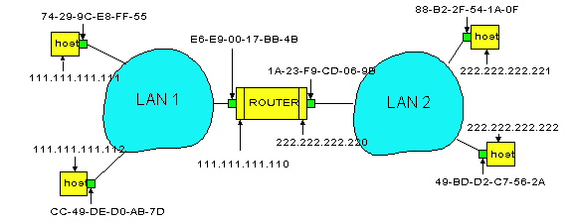
Routing between two LANs
A needs to contact B via R
Assume A knows B’s IP address.
R ha due tabelle ARP, una per dominio di collisione
In routing table at source Host, find router 111.111.111.110
In ARP table at source, find MAC address E6-E9-00-17-BB-4B, etc
A
R
B

Slide 13









A originates datagram D, A -> B
Is B in the same LAN? NO. Routing is needed via R.
R’s MAC address is needed. ARP is the recipe!
D is embedded in a frame F. Note that F goes from MAC A-> MAC R, but D refers IP A -> IP B
R received F, extracts D, sees B IP, and understands that B is within LAN2
R uses ARP for having the MAC address of B
R creates a frame F2, and sends it to B. F2 contains D (unchanged) but at layer 2 the conversation if between R and B.
A
R
B
Notes:
appare datagramma (nel datagramma deve apparire indirizzo mittente e destinatario)
3. appare frame ARP (destinato a tutti). deve comparire mac address mittente: 74-29-ecc-ecc- , destinatario: ff-ff-ff-ff-ff-ff-ff
4.

Slide 14
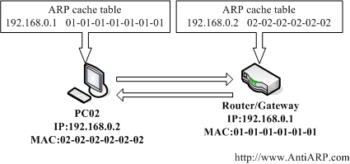
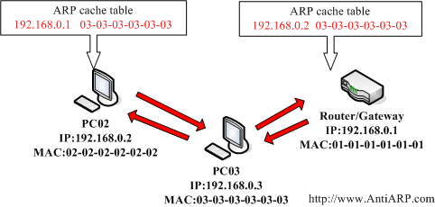
ARP Poisoning in LAN

Slide 15
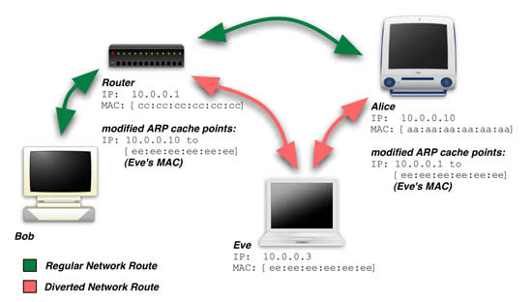
ARP poisoning in LAN

Slide 16
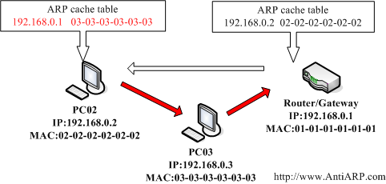
Half mitm

Slide 17
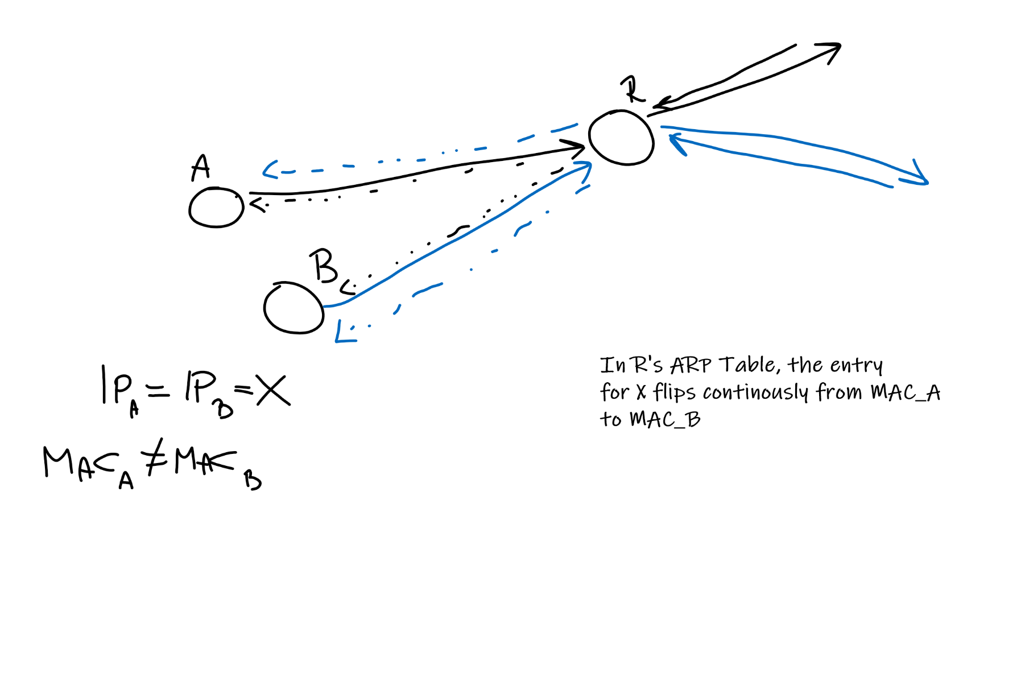
Accidental IP Conflict

Slide 18
Countermeasures
ARP Watching
Static ARP tables
ARP Jamming
SSL/TLS (but works only on a per app basis)
VPN technologies IP Sec, Tunnels, SSH
User isolation (Station can talk to router only)

Slide 19
Hubs
An hub repeats frames on each ports (expect the incoming one)
doppino intrecciato in rame
hub
Notes:
pallino che parte da uno e va verso tutti gli altri

Slide 20
Typical Switch workflow
When a new frame F enters some interface:
Lookup in the switch table for Dst MAC
if Dst MAC is in switch table then{
if MAC dst.intf = MAC src.intf then ignores this frame
else send F over MAC dst.intf ONLY
}
else broadcast F on all ports (except the incoming one)

Slide 21
Example
C sends frame F to D
switch
address
interface
1
A
B
E
G
1
1
2
3
2
3
hub
hub
hub
A
I
D
F
B
C
G
H
E
Switch receives F from C
C is discovered to operate from intf 1. This is recorded.
It is not known where D operates from
F is sent to intf 2 and 3
D receives F
Notes:
animazione.

Slide 22
Switch example
When D answers to C:
address
interface
switch
A
B
E
G
C
1
1
2
3
1
hub
hub
hub
A
I
F
D 2
D
G
B
C
E
H
D answers with F2
D is discovered to be operating from intf 2. This is recorded
C is known to work on intf 1, only this interface receives F2
Notes:
animazione

Slide 23
Port Stealing: example
C send a frame to R. G is an intruder
switch
address
interface
1
A
B
R
G
1
1
2
3
2
3
hub
hub
hub
A
I
R
G
B
C
H
G sends frames using R as source MAC. This forces wrong updating of the switch table
G can then capture frames to R, can record, filter and alter them. Then, for avoiding disruption of communication, it sends frames to the real R, stimulating re-update of the switch table
Notes:
animazione.

Slide 24
MAC Spoofing / Flooding
Flooding. Idea: the switch table needs memory.
This memory can be saturated producing a huge number of frames with random MAC sources. When this happens, a switch starts behaving like an hub.
Countermeasures: port locking, IEEE 802.1X

Slide 25
Local to remote attacks (1) DHCP spoofing
The DHCP requests are made in broadcast mode.
If the attacker replies before the real DHCP server it can manipulate:
IP address of the victim
GW address assigned to the victim
DNS address

Slide 26
Local to remote attacks (1) DHCP spoofing - countermeasures
YES - detection of multiple DHCP replies
YES – dhcp probe
YES – Switch ACLs, DHCP snooping
YES – DHCP starvator

Slide 27
Broadcast attacks
Example:
Fake victim’s IP
Generate broadcast traffic using the fake IP.
Answers flood the victim.
Depending on the type of attack, particular conditions are required
Rete
Attacker
IP falso: 192.168.0.1
Subnet hosts.
Passive attackers
Victim
IP: 192.168.0.1

Slide 28
COUNTERMEASURES
Limiting ICMP and other types of broadcast on LANs
Configure firewalls
IP spoofings are severely limited from LAN to LAN, but are still possible.

Slide 29
Other Local MITM Attacks DNS spoofing
If the attacker is able to sniff the ID of the DNS request,
he/she can reply before the real DNS server
MITM
HOST
serverX.localdomain.in
DNS
10.1.1.1
10.1.1.50

Slide 30
Local attacks DNS spoofing - countermeasures
YES - detect multiple replies (IDS)
YES - use lmhost or hosts file for static resolution of critical hosts
YES – DNSSEC
(not to be confused with DNS over TLS)
host.example.com. 86400 IN RRSIG A 5 3 86400 20030322173103 ( 20030220173103 2642 example.com.
oJB1W6WNGv+ldvQ3WDG0MQkg5IEhjRip8WTr
PYGv07h108dUKGMeDPKijVCHX3DDKdfb+v6o
B9wfuh3DTJXUAfI/M0zmO/zz8bW0Rznl8O3t
GNazPwQKkRN20XPXV6nwwfoXmJQbsLNrLfkG
J5D6fwFm8nN+6pBzeDQfsS3Ap3o= )

Slide 31
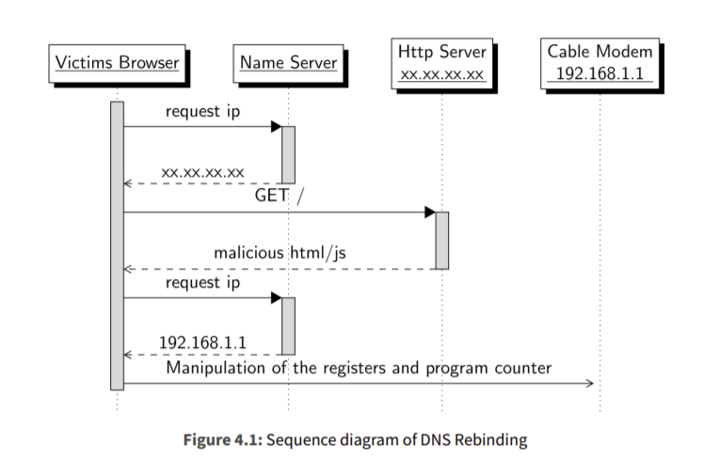
MISC: DNS rebinding

Slide 32
Local to remote attacks (2) ICMP redirect
The attacker can forge ICMP redirect packet in order to
redirect traffic to himself
T
G1
AT
ICMP redirect to AT
H
LAN

Slide 33
Others under-the-hood protocols
VLAN vulnerabilities (Hopping…)
STP, VSTP…

Slide 34
Wireless L2 Security

Slide 35
802.11 frame: Addressing
2
2
6
6
6
2
6
0 - 2312
4
frame
control
duration
address
1
address
2
address
3
seq
control
address
4
payload
CRC
Address 3: Used in WDS
Address 1: dst MAC address
Address 3: MAC address
BSSID
Address 2: src MAC address

Slide 36
802.11 frame: bridging
Internet
H1
R1
router
AP
R1 MAC addr H1 MAC addr
dest. address
source address
802.3 frame
AP MAC addr H1 MAC addr R1 MAC addr
address 1
address 2
address 3
802.11 frame

Slide 37
802.11 frame: more
frame seq #
(for reliable ARQ)
duration of reserved
transmission time (RTS/CTS)
2
2
6
6
6
2
6
0 - 2312
4
frame
control
duration
address
1
address
2
address
3
seq
control
address
4
payload
CRC
2
2
4
1
1
1
1
1
1
1
1
Protocol
version
Type
Subtype
To
DS
From
DS
More
frag
Retry
Power
mgt
More
data
WEP
Rsvd
frame type
(RTS, CTS, ACK, data)

Slide 38
802.11: BSS & ESS
ESSID = string denoting an AP group. Members of the group should be coordinated. Not necessarily configured in a WDS.
BSSID = single AP MAC address. Should be unique.
Association: process of entering a virtual collision domain
Beacon frames
Probe frames
Association requests
Association responses
Auth requests
Auth responses

Slide 39
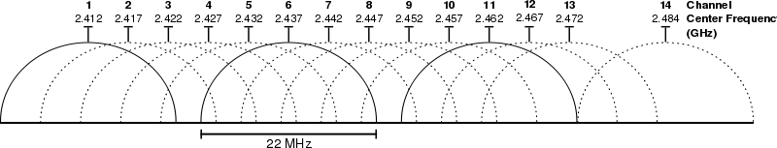
Channel allocation
802.11n APs take two 22Mhz Channel together

Slide 40
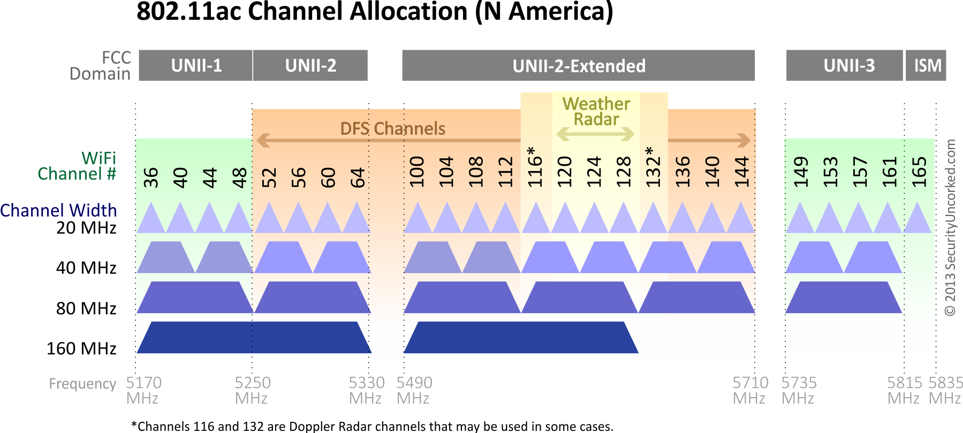

Slide 41
WLAN open
Virtually equivalent to an hubbed LAN
Sniffing is possible, but also ESSID & BSSID spoofing is very easy
Issues with captive portals
De-authentication attacks can block traffic
Primitive solution: WEP

Slide 42
Rogue ESSIDs
Technique:
Spoof ESSIDs, force association to wrong BSSID
Can MITM a whole set of stations
Results depend on the security level of victim ESSID

Slide 43
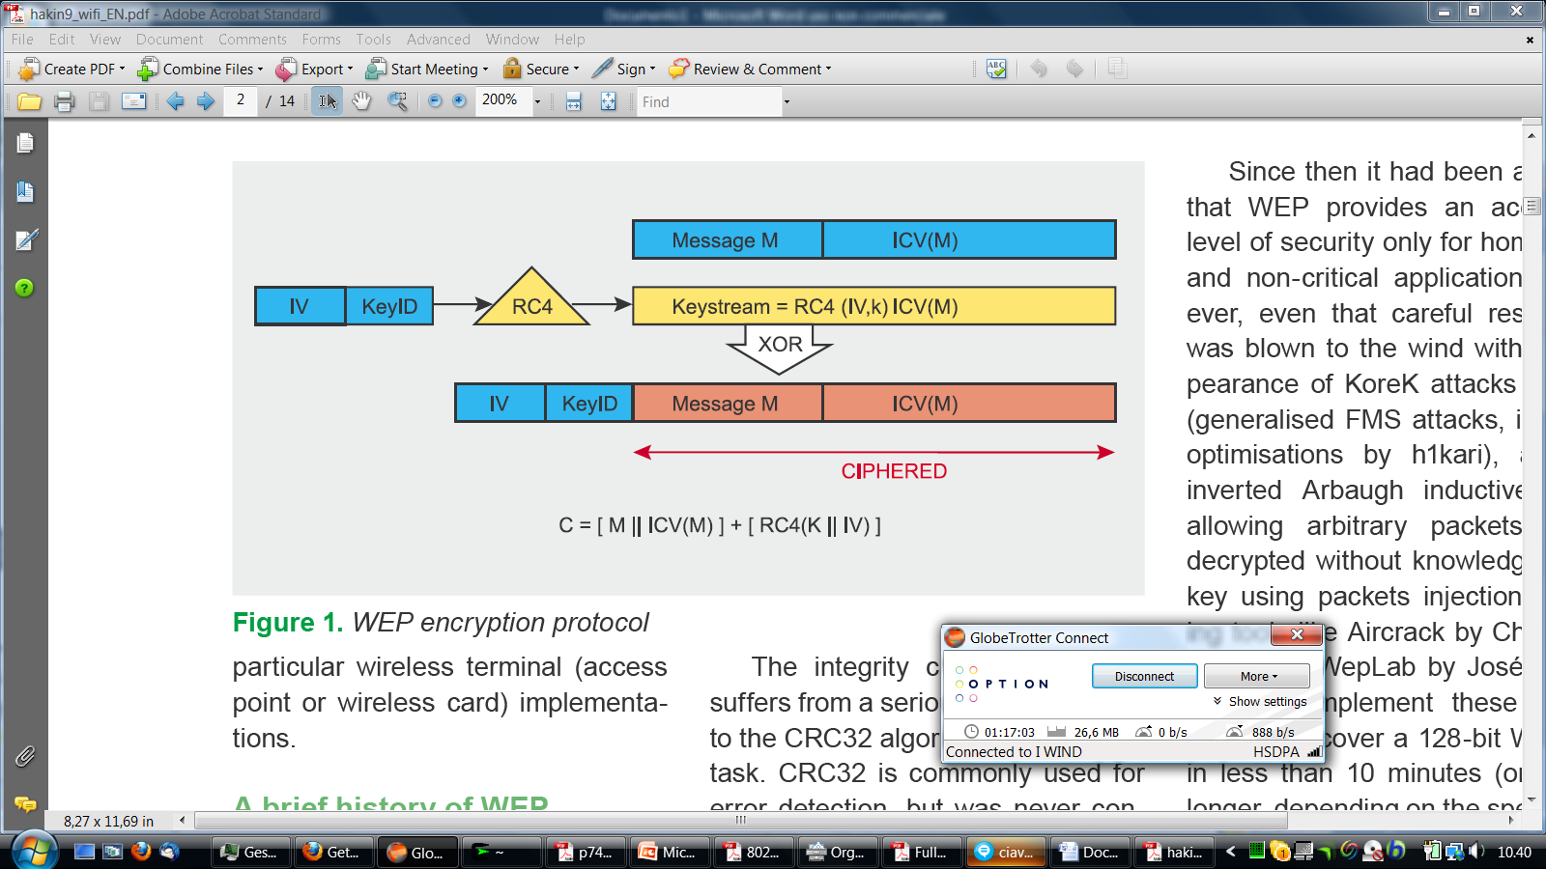
Wep Frame Format

Slide 44
WLAN WEP
Very simple cryptography with pre-shared key
Each frame is encoded in terms of
RC4( Key + IV )
IV is transmitted in plain text, and is only 24 bit long: repetitions are possible, thus allowing analysis
Once knowing the key, it is allowed Hub equivalent sniffing in promiscuous mode
Frames can be altered without knowing the key
ICV = CRC-32 → lot of predictable collisions

Slide 45
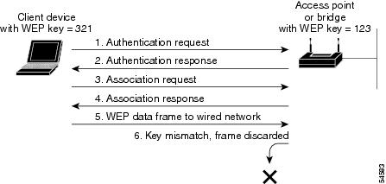
WEP Authentication (open)

Slide 46
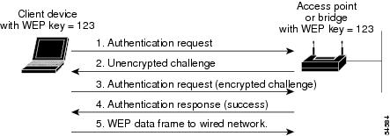
WEP Shared key authentication

Slide 47
WEP weaknesses
IV space is 24 bit = 16M
Any IV can be reused at any time
Allows replay attacks: one can collect lot of data encrypted with the IV of choice
Can decode RC4 sequence without knowledge of the key
Can find packets with same ICV

Slide 48
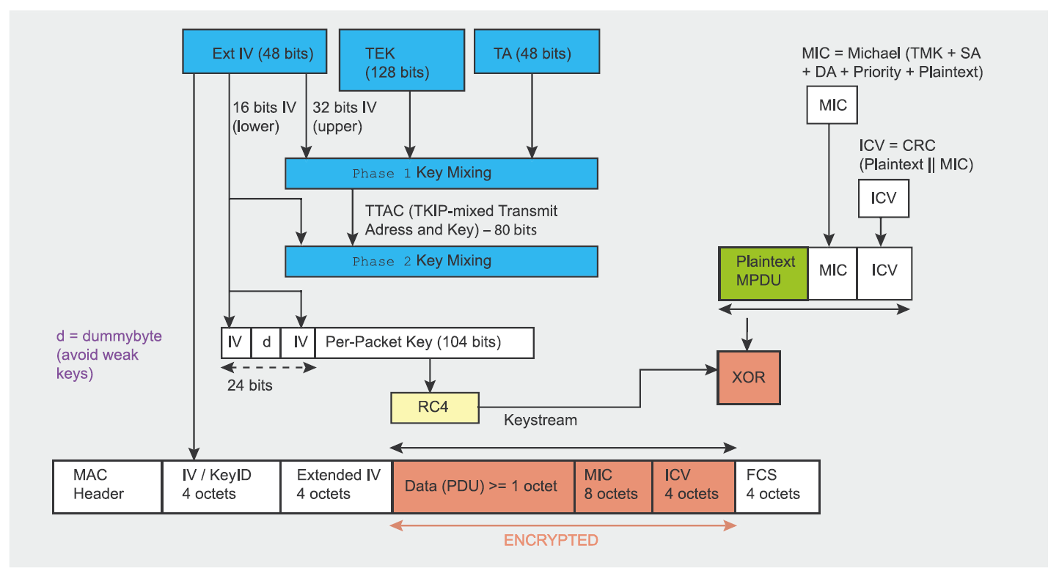
WPA: TKIP encryption scheme

Slide 49
WPA Personal
Pre-shared key with improvements
TKIP: keeps RC4 with longer IVs: can’t be reused. The new MIC (Message Integrity Check) was more cryptographically robust
WPA2 → CCMP = AES
Session PTK & GTK are exchanged during authentication. PTKs are Peer to Peer (WPA and WPA2)
Even if you know the pre-shared key, you can’t directly decode everybody’s else traffic
PTK & GTKs are periodically re-generated

Slide 50
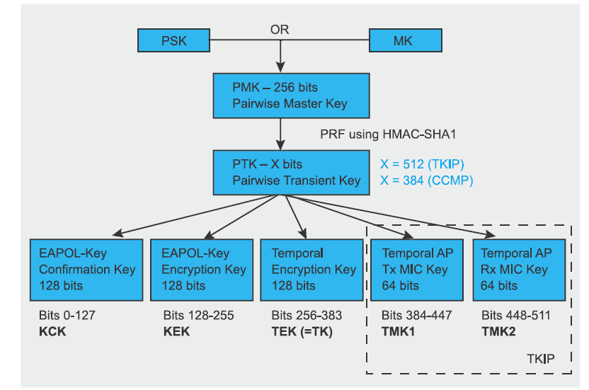
Key hierarchy

Slide 51
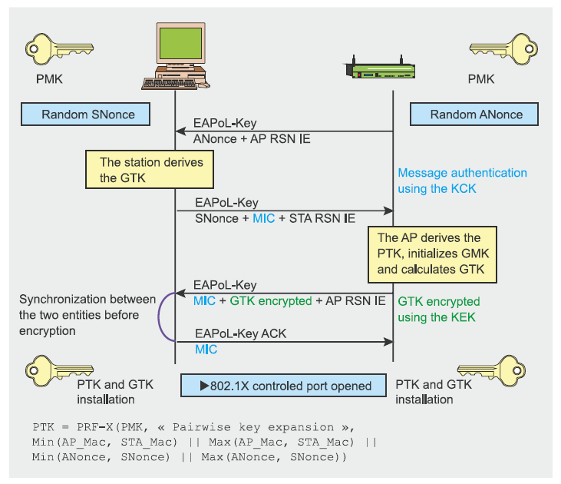
WPA Authorization process
PTK
PRF-X: RfC 4346

Slide 52
WPA-Personal
Step 2 is not present in WPA1/2-Personal
MK is obtained directly from PMK
PMK (256 bit) is obtained from passphrases according to a fixed algorithm
PBKDF2 (P, S, c, dkLen) = PMK (see RfC 2898)
where:
PBKDF2 is a HMAC-SHA1 «repeated» c times over P and S
P = passphrase, S = SSID, c = 4096 (!)
Output: PMK, (dkLen =256 bit long)
Possibility of rainbow table attack over common SSID
Rainbow tables: http://www.renderlab.net/projects/WPA-tables/
Bruteforcer: coWPAtty
Rainbow table generator : Pyrit
Most common SSIDs: http://www.wigle.net/gps/gps//Stat
Commond SSID should be avoided… as well as common passwords, but this is another story.

Slide 53
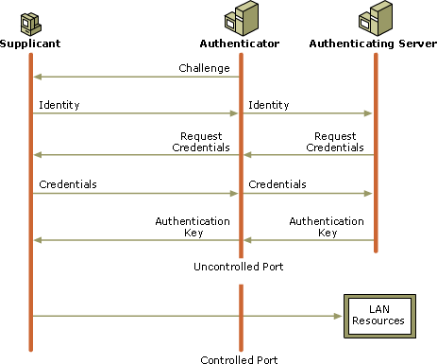
WPA Enterprise
An authenticated server comes into play
Personal account are now possible. There is no MASTER PMK

Slide 54
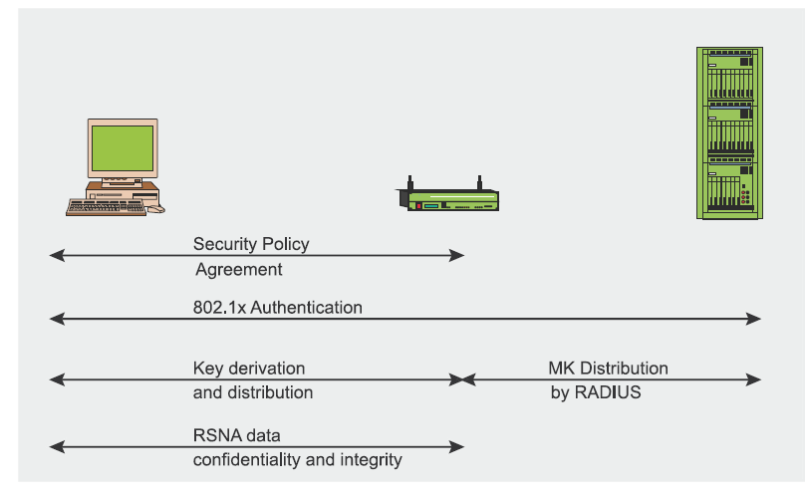
802.1x Authentication steps

Slide 55
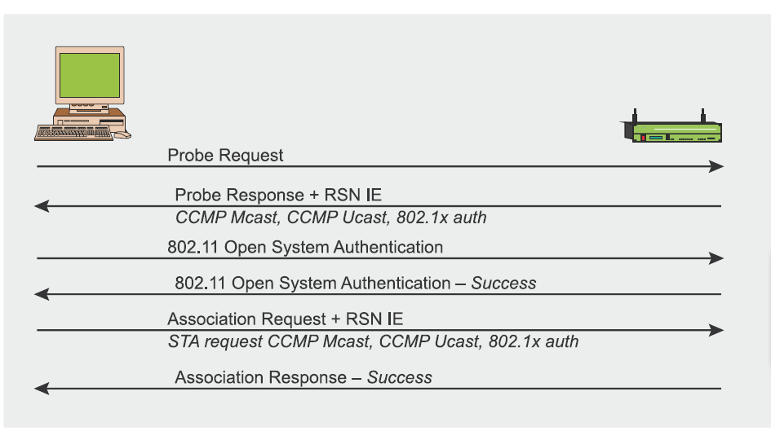
Step 1: pre-auth

Slide 56
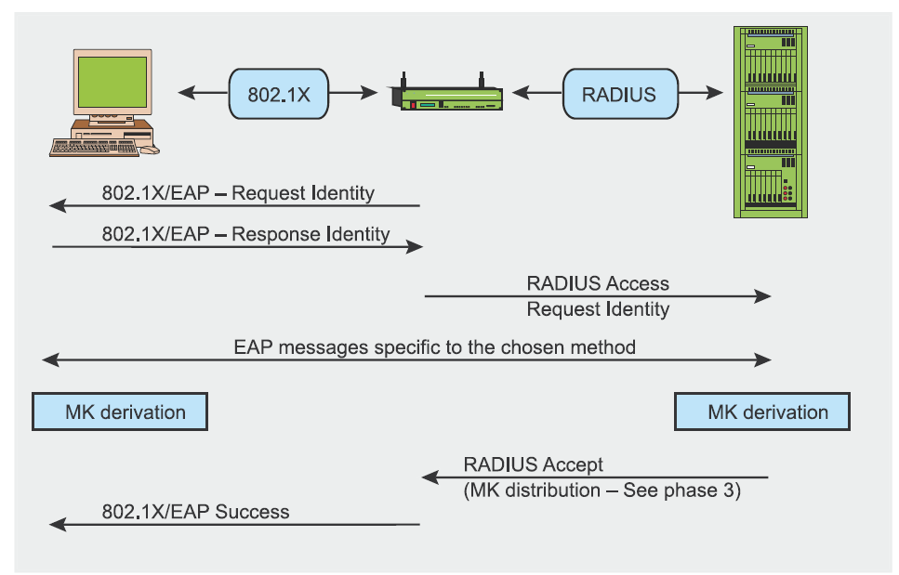
Step 2: Authentication
Step 3: Normal 4-way but with MK

Slide 57
Role of the RADIUS server
Provides AAA services
Authentication
Authorization
Accounting
Talks only with authorized authenticators providing the right “RADIUS secret”

Slide 58
PROs and CONs of a WPAx-Enterprise
Can handle individual accounts
More robust authentication on the AP+RADIUS side
Need more resources and careful configuration
RADIUS certificates still poorly handled on client side

Slide 59
CVE-2012-4366
Generation of passphrase based on the AP MAC value for some Belking AP models.
Example of CWE-656
Reliance on security through obscurity
On many old Telecom routers, the default WPA passphrase could be generated from router’s MAC address using an hardwired «encryption» algorithm

Slide 60
Other Things to know
WPA-Personal does not ensure PFS (Perfect Forward Secrecy)
De-Authentication → DoS
Rogue APs
Localization?
WPA2-Enterprise can sometimes be worse than WPA2-Personal
WPS: quick association, but known to be WEAK
Why ARP Spoofing is still possible?

Slide 61
WPA3
New handshake type: pfs, no rainbow tables
WPA3-SAE (dragonfly handshake, RFC7664)
P2P encryption on open wifi-s
Wifi enhanced open (OWE Opportunistic Wifi Encryption)
New encryption modes
Protected management frames

Slide 62
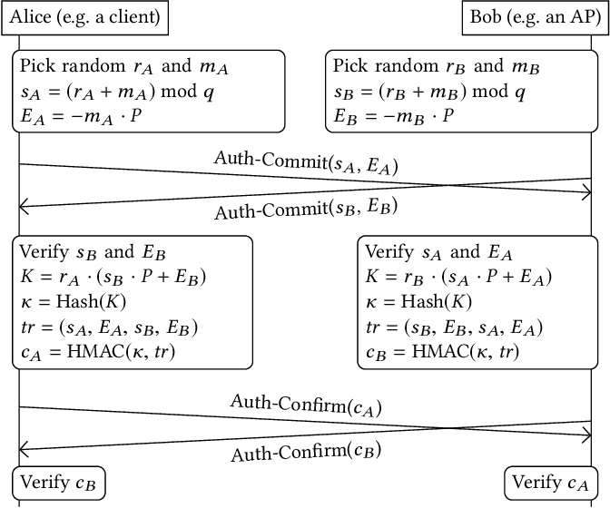

Slide 63
Summary: Wired & Wireless
MITM attacks
MAC Spoofing, port stealing (Wired, and sometimes Wireless open+wep)
ARP ←→ IP Spoofing (All)
DHCP Spoofing (All)
Broadcast attacks (All)
Wireless
Open WLANs, WEP WLANs : virtually an Ethernet domain with an hub
WPA & WPA2 WLANs: private unicast, possibility of user isolation

