Slide 1
Network Security Laboratory – Lecture 4
LAYER 2 ATTACKS

Slide 2
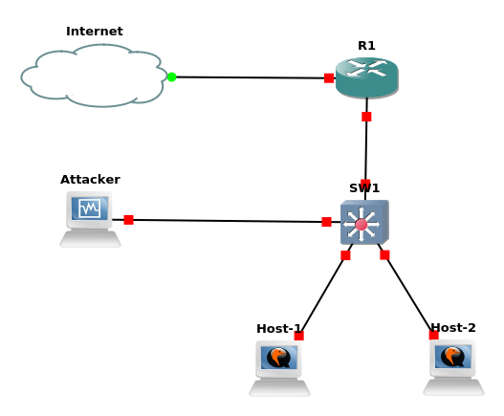
Layer 2 Attacks
Layer 2 attacks – They are performed into LAN
Most common attacks
Usually the target is a switch, a router or an host

Slide 3
MAC Flooding
Question: How does a switch work? What happens when its ARP table is full?
This attack tries to exploit the limit of the switch mac table size
The attacker sends messages through the network using random mac address
The switch tries to learn all the new entries
When the mac table of the switch is full, all the new packages will be sent in broadcast (the switch will start working as an HUB - fail open condition)
This happens because the switch is no more able to memorize new <mac_address,port> pairs

Slide 4
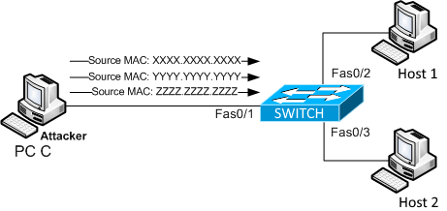
MAC Flooding

Slide 5
ARP Spoofing
The attacker send (spoofed) ARP messages onto a local area network with the aim to associate its MAC address with the IP address of another host
In this way, the traffic meant for a specific host will be sent to the attacker IP address from the default gateway
When performing an ARP Spoofing attack inside an enterprise network, we are basically performing a port stealing attack
Port stealing attack occurs when we force the link between a switch port and a mac address
When this happens the switch will forward the frame of that mac address to our port instead of the original one

Slide 6
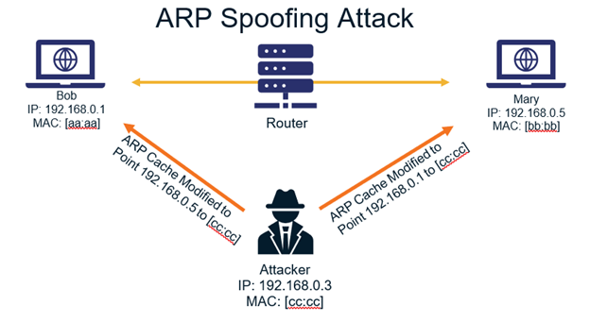
ARP Spoofing

Slide 7
Scapy Module
Scapy is a python module very useful in networking
Its main purpose is to sniff traffick, build and send new packets
It will be useful during almost ALL our laboratory session
On scapy website there are some useful tips to create packets and perform attacks
Scapy Documentation: https://scapy.readthedocs.io/en/latest/

Slide 8
Challanges
Check the course website in order to start the today’s challenges:
MacFloodingChallenge
ArpSpoofingChallange
The goal is to sniff packets exchanged between 2 hosts, decrypt data and read messages in plaintext

Slide 9
Useful Commands
Sending data with Scapy (Mac Flooding)
sendp(Ether(src=<<MAC_ADDRESS>>, dst=<<MAC_ADDRESS>>)/ARP(op=2, psrc="<<IP_ADDRESS(Or subnet)>>", hwdst="<<BROADCAST_MAC_ADDRESS>>"), loop=1)
RandMAC() → inside scapy for generating random mac address
Sending data with Scapy (ARP Spoofing)
sendp(pkt = Ether(src='<<VICTIM_MAC_ADDRESS>>', dst=’<<BROADCAST_MAC_ADDRESS>>')/ARP(op=2, hwsrc='<<VICTIM_MAC_ADDRESS>>’, pdst='<<VICTIM_IP_ADDRESS>>')
sudo tshark -Y '<<FILTER>>' -Tfields -e data > raw.txt
xxd -r -p > output.txt
openssl enc -<<CYPHER>> -d -k <<KEY>>-base64

