Slide 1

Cryptography and Network Security
Lecture slides by Davide Fuscà and G. Ianni for the Network and Computer Security course at Università della Calabria

Slide 2
OVERVIEW
The Tor network is a group of volunteer-operated servers that allows people to improve their privacy and security on the Internet
Tor's users employ this network by connecting through a series of virtual tunnels, thus allowing both organizations and individuals to share information over public networks without compromising their privacy

Slide 3
USES OF TOR
Individuals use Tor to keep websites from tracking them and their family members, or when these are blocked by their local Internet providers
Journalists use Tor to communicate more safely with whistleblowers and dissidents
A branch of the U.S. Navy uses Tor for open source intelligence gathering, and one of its teams used Tor while deployed in the Middle East recently
Law enforcement uses Tor for visiting or surveilling web sites without leaving government IP addresses in their web logs, and for security during sting operations

Slide 4
WHY WE NEED TOR
Using Tor protects you against a traffic analysis
Knowing the source and destination of your Internet traffic allows others to track your behavior and interests
A basic problem for the privacy is that the recipient of your communications can see that you sent it by looking at headers. So can authorized intermediaries like Internet service providers
Encryption does not help against these attackers, since it only hides the content of Internet traffic, not the headers.
Notes:
Traffic analysis can be used to infer who is talking to whom over a public network

Slide 5
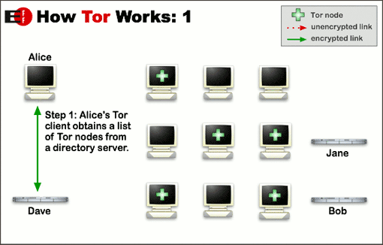
HOW WORKS TOR

Slide 6
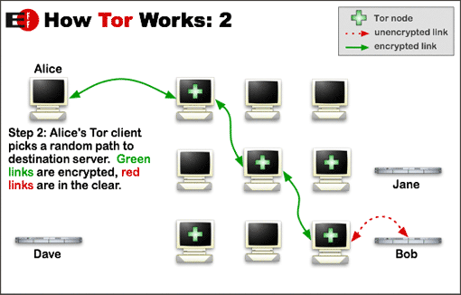
HOW WORKS TOR
Notes:
To create a private network pathway with Tor, the user's software or client incrementally builds a circuit of encrypted connections through relays on the network. The circuit is extended one hop at a time, and each relay along the way knows only which relay gave it data and which relay it is giving data to. No individual relay ever knows the complete path that a data packet has taken. The client negotiates a separate set of encryption keys for each hop along the circuit to ensure that each hop can't trace these connections as they pass through.

Slide 7
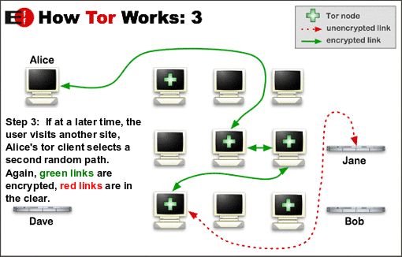
HOW WORKS TOR
Notes:
Once a circuit has been established, many kinds of data can be exchanged and several different sorts of software applications can be deployed over the Tor network. Because each relay sees no more than one hop in the circuit, neither an eavesdropper nor a compromised relay can use traffic analysis to link the connection's source and destination. Tor only works for TCP streams and can be used by any application with SOCKS support.
For efficiency, the Tor software uses the same circuit for connections that happen within the same ten minutes or so. Later requests are given a new circuit, to keep people from linking your earlier actions to the new ones.

Slide 8
TYPES OF RELAYS
By default, Tor bounces connections through 3 relays:
Entry/Guard Relay – This is the entry point to the Tor network
Middle Relay – Used to transport traffic from the guard relay to the exit relay
Exit Relay – These relays are the exit point at the edge of the Tor network
How do we know we can actually trust relays? How can we be sure relays won’t track who we’re connecting to and sniff the data we send across the wire?
Notes:
Once a circuit has been established, many kinds of data can be exchanged and several different sorts of software applications can be deployed over the Tor network. Because each relay sees no more than one hop in the circuit, neither an eavesdropper nor a compromised relay can use traffic analysis to link the connection's source and destination. Tor only works for TCP streams and can be used by any application with SOCKS support.
For efficiency, the Tor software uses the same circuit for connections that happen within the same ten minutes or so. Later requests are given a new circuit, to keep people from linking your earlier actions to the new ones.

Slide 9
WHY ONION
How the encryption works when a client makes a connection through the Tor network:
The client encrypts the original data in such a way that only the exit relay can decrypt it
This encrypted data is then encrypted again in such a way that only the middle relay can decrypt it
Finally, this encrypted data is encrypted once more in such a way that only the guard relay can decrypt it
Notes:
Once a circuit has been established, many kinds of data can be exchanged and several different sorts of software applications can be deployed over the Tor network. Because each relay sees no more than one hop in the circuit, neither an eavesdropper nor a compromised relay can use traffic analysis to link the connection's source and destination. Tor only works for TCP streams and can be used by any application with SOCKS support.
For efficiency, the Tor software uses the same circuit for connections that happen within the same ten minutes or so. Later requests are given a new circuit, to keep people from linking your earlier actions to the new ones.

Slide 10


WHY ONION
This means that we have wrapped our original data in layers of encryption, much like an onion
Notes:
Once a circuit has been established, many kinds of data can be exchanged and several different sorts of software applications can be deployed over the Tor network. Because each relay sees no more than one hop in the circuit, neither an eavesdropper nor a compromised relay can use traffic analysis to link the connection's source and destination. Tor only works for TCP streams and can be used by any application with SOCKS support.
For efficiency, the Tor software uses the same circuit for connections that happen within the same ten minutes or so. Later requests are given a new circuit, to keep people from linking your earlier actions to the new ones.

Slide 11
STAYING ANONYMOUS
Tor can't solve all anonymity problems
Tor focuses only on protecting the transport of data
You need to use protocol-specific support software if you don't want the sites you visit to see your identifying information:
For example, you can use Tor Browser while browsing the web to withhold some information about your computer's configuration
Also, to protect your anonymity, be smart:
For example don't provide your name or other revealing information in web forms.
Notes:
Once a circuit has been established, many kinds of data can be exchanged and several different sorts of software applications can be deployed over the Tor network. Because each relay sees no more than one hop in the circuit, neither an eavesdropper nor a compromised relay can use traffic analysis to link the connection's source and destination. Tor only works for TCP streams and can be used by any application with SOCKS support.
For efficiency, the Tor software uses the same circuit for connections that happen within the same ten minutes or so. Later requests are given a new circuit, to keep people from linking your earlier actions to the new ones.

Slide 12
TRANSPARENT SOCKS
Provides transparent network access through a SOCKS proxy
TSocks intercepts the calls applications make to establish TCP connections and transparently proxies them as necessary
Using tsocks configured with tor, any application that uses sockets can be made to use the socks proxy and become anonymous.
Notes:
Once a circuit has been established, many kinds of data can be exchanged and several different sorts of software applications can be deployed over the Tor network. Because each relay sees no more than one hop in the circuit, neither an eavesdropper nor a compromised relay can use traffic analysis to link the connection's source and destination. Tor only works for TCP streams and can be used by any application with SOCKS support.
For efficiency, the Tor software uses the same circuit for connections that happen within the same ten minutes or so. Later requests are given a new circuit, to keep people from linking your earlier actions to the new ones.

Slide 13
HIDDEN SERVICE
Tor makes it possible for users to hide their locations while offering various kinds of services
A hidden service needs to advertise its existence in the Tor network before clients will be able to contact it
Therefore, the service randomly picks some relays, builds circuits to them, and asks them to act as introduction points by telling them its public key
Notes:
Once a circuit has been established, many kinds of data can be exchanged and several different sorts of software applications can be deployed over the Tor network. Because each relay sees no more than one hop in the circuit, neither an eavesdropper nor a compromised relay can use traffic analysis to link the connection's source and destination. Tor only works for TCP streams and can be used by any application with SOCKS support.
For efficiency, the Tor software uses the same circuit for connections that happen within the same ten minutes or so. Later requests are given a new circuit, to keep people from linking your earlier actions to the new ones.

Slide 14
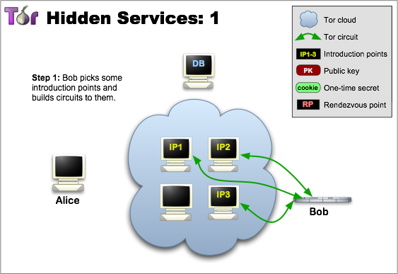
HIDDEN SERVICE: STEP 1

Slide 15
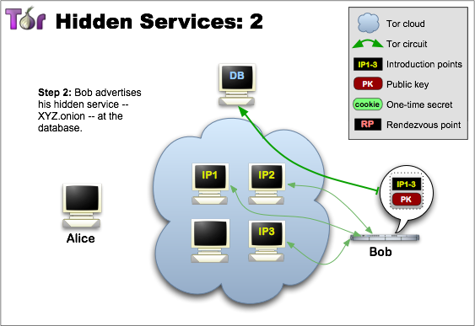
HIDDEN SERVICE: STEP 2

Slide 16
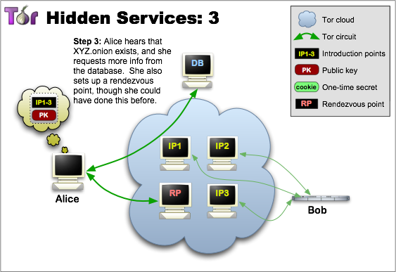
HIDDEN SERVICE: STEP 3

Slide 17
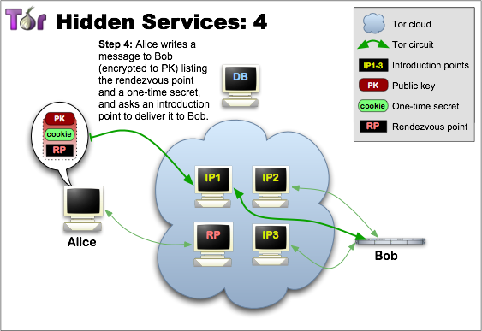
HIDDEN SERVICE: STEP 4

Slide 18
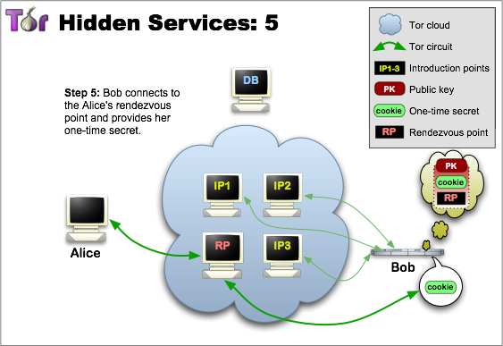
HIDDEN SERVICE: STEP 5

Slide 19
TOR WEAKNESSES
Traffic Analysis
Traffic Confirmation Attack (July 4 2014)
The attacker controls or observes the relays on both ends of a Tor circuit and then compares traffic timing, volume, or other characteristics to conclude that the two relays are indeed on the same circuit
Sybil attack
The attacker subverts the reputation system of a peer-to-peer network by creating a large number of pseudonymous identities

Slide 20
User Fingerprinting
https://panopticlick.eff.org/
http://www.browserleaks.com/canvas
http://browserspy.dk/

Slide 21
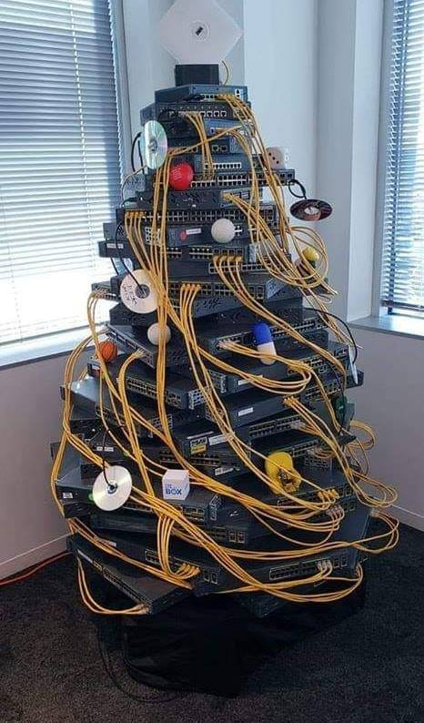
Happy Christmas! (And good season holidays)

