Slide 1
Cryptography and Network Security
Chapter 11
INTEGRITY
Fifth Edition
by William Stallings
Lecture slides by Lawrie Brown
Notes:
Lecture slides by Lawrie Brown for “Cryptography and Network Security”, 5/e, by William Stallings, Chapter 11 – “Cryptographic Hash Functions”.

Slide 2
Scenario
Say that one day an hacker changes a bank account balance
Or, a destination bank account during a transfer
Is there a way to detect and prevent it?

Slide 3
Chapter 11 – Cryptographic Hash Functions
Each of the messages, like each one he had ever read of Stern's commands, began with a number and ended with a number or row of numbers. No efforts on the part of Mungo or any of his experts had been able to break Stern's code, nor was there any clue as to what the preliminary number and those ultimate numbers signified.
—Talking to Strange Men, Ruth Rendell
Notes:
Opening quote.

Slide 4
Hash Functions
condenses arbitrary message to fixed size
  h = H(M)
usually assume hash function is public
hash used to detect changes to message
want a cryptographic hash function
  computationally infeasible to find data mapping to specific hash (one-way property)
  computationally infeasible to find two data to same hash (collision-free property)
Notes:
A hash function H accepts a variable-length block of data M as input and produces a fixed-size hash value h = H(M). A "good" hash function has the property that the results of applying the function to a large set of inputs will produce outputs that are evenly distributed, and apparently random. In general terms, the principal object of a hash function is data integrity. A change to any bit or bits in M results, with high probability, in a change to the hash code. The kind of hash function needed for security applications is referred to as a cryptographic hash function. A cryptographic hash function is an algorithm for which it is computationally infeasible (because no attack is significantly more efficient than brute force) to find either (a) a data object that maps to a pre-specified hash result (the one-way property) or (b) two data objects that map to the same hash result (the collision-free property). Because of these characteristics, hash functions are often used to determine whether or not data has changed.

Slide 5
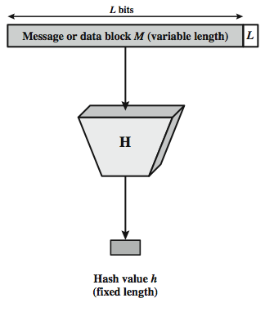
Cryptographic Hash Function
Notes:
Stallings Figure 11.1 depicts the general operation of a cryptographic hash function. Typically, the input is padded out to an integer multiple of some fixed length (e.g., 1024 bits) and the padding includes the value of the length of the original message in bits. The length field is a security measure to increase the difficulty for an attacker to produce an alternative message with the same hash value.

Slide 6
Usages
Digital signatures
Password storage
  store hash of passwords not actual values
Message and file integrity
  for intrusion detection and virus detection
  keep & check hash of files on system
Pseudorandom function (PRF) or pseudorandom number generator (PRNG)
Digital currencies proof-of-work
Proof of existence at a given time
Notes:
Hash functions are commonly used to create a one-way password file. Chapter 20 explains a scheme in which a hash of a password is stored by an operating system rather than the password itself. Thus, the actual password is not retrievable by a hacker who gains access to the password file. In simple terms, when a user enters a password, the hash of that password is compared to the stored hash value for verification. This approach to password protection is used by most operating systems.
Hash functions can be used for intrusion detection and virus detection. Store H(F) for each file on a system and secure the hash values (e.g., on a CD-R that is kept secure). One can later determine if a file has been modified by recomputing H(F). An intruder would need to change F without changing H(F).
A cryptographic hash function can be used to construct a pseudorandom function (PRF) or a pseudorandom number generator (PRNG). A common application for a hash-based PRF is for the generation of symmetric keys. We discuss this application in Chapter 12.

Slide 7
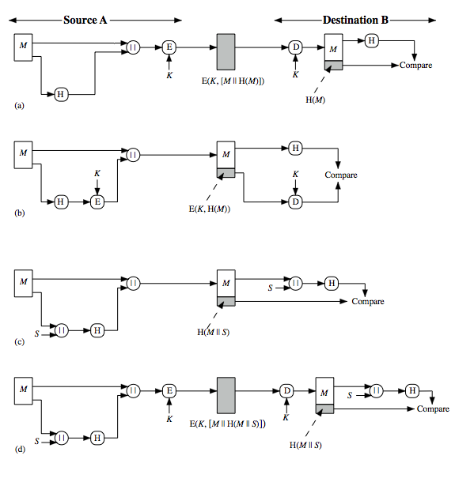
Hash Functions & Message Authent-ication
Notes:
Message authentication is a mechanism or service used to verify the integrity of a message, by assuring that the data received are exactly as sent. Stallings Figure 11.2 illustrates a variety of ways in which a hash code can be used to provide message authentication, as follows:
The message plus concatenated hash code is encrypted using symmetric encryption. Since only A and B share the secret key, the message must have come from A and has not been altered. The hash code provides the structure or redundancy required to achieve authentication.
Only the hash code is encrypted, using symmetric encryption. This reduces the processing burden for those applications not requiring confidentiality.
Shows the use of a hash function but no encryption for message authentication. The technique assumes that the two communicating parties share a common secret value S. A computes the hash value over the concatenation of M and S and appends the resulting hash value to M. Because B possesses S, it can recompute the hash value to verify. Because the secret value itself is not sent, an opponent cannot modify an intercepted message and cannot generate a false message.
Confidentiality can be added to the approach of (c) by encrypting the entire message plus the hash code.
When confidentiality is not required, method (b) has an advantage over methods (a) and (d), which encrypts the entire message, in that less computation is required.

Slide 8
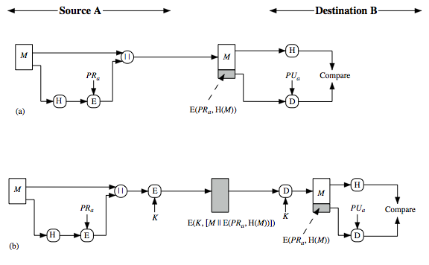
Hash Functions & Digital Signatures
Notes:
Another important application, which is similar to the message authentication application, is the digital signature. The operation of the digital signature is similar to that of the MAC. In the case of the digital signature, the hash value of a message is encrypted with a user's private key. Anyone who knows the user's public key can verify the integrity of the message that is associated with the digital signature. In this case an attacker who wishes to alter the message would need to know the user's private key. As we shall see in Chapter 14, the implications of digital signatures go beyond just message authentication. Stallings Figure 11.3 illustrates, in a simplified fashion, how a hash code is used to provide a digital signature:
The hash code is encrypted, using public-key encryption and using the sender's private key. As with Figure 11.2b, this provides authentication. It also provides a digital signature, because only the sender could have produced the encrypted hash code. In fact, this is the essence of the digital signature technique.
If confidentiality as well as a digital signature is desired, then the message plus the private-key-encrypted hash code can be encrypted using a symmetric secret key. This is a common technique.

Slide 9
Attack surface of Message integrity checks
Let’s talk about it

Slide 10
Two Simple Insecure Hash Functions
consider two simple insecure hash functions
bit-by-bit exclusive-OR (XOR) of every block
  C_{i} = b_{i1} xor b_{i2} xor . . . xor b_{im}
  a longitudinal redundancy check
  reasonably effective as data integrity check
one-bit circular shift on hash value
  for each successive n-bit block
    rotate current hash value to left by1bit and XOR block
  good for data integrity but useless for security
Notes:
To get some feel for the security considerations involved in cryptographic hash functions, we present two simple, insecure hash functions in this section. One of the simplest hash functions is the bit-by-bit exclusive-OR (XOR) of every block, which can be expressed as shown. This operation produces a simple parity for each bit position and is known as a longitudinal redundancy check. It is reasonably effective for random data as a data integrity check. Each n-bit hash value is equally likely. Thus, the probability that a data error will result in an unchanged hash value is 2^{–n}. With more predictably formatted data, the function is less effective. For example, in most normal text files, the high-order bit of each octet is always zero. So if a 128-bit hash value is used, instead of an effectiveness of 2^{–128}, the hash function on this type of data has an effectiveness of 2^{–112}.
A simple way to improve matters is to perform a one-bit circular shift, or rotation, on the hash value after each block is processed. Although this second procedure provides a good measure of data integrity, it is virtually useless for data security when an encrypted hash code is used with a plaintext message. Given a message, it is an easy matter to produce a new message that yields that hash code: Simply prepare the desired alternate message and then append an n-bit block that forces the new message plus block to yield the desired hash code.

Slide 11
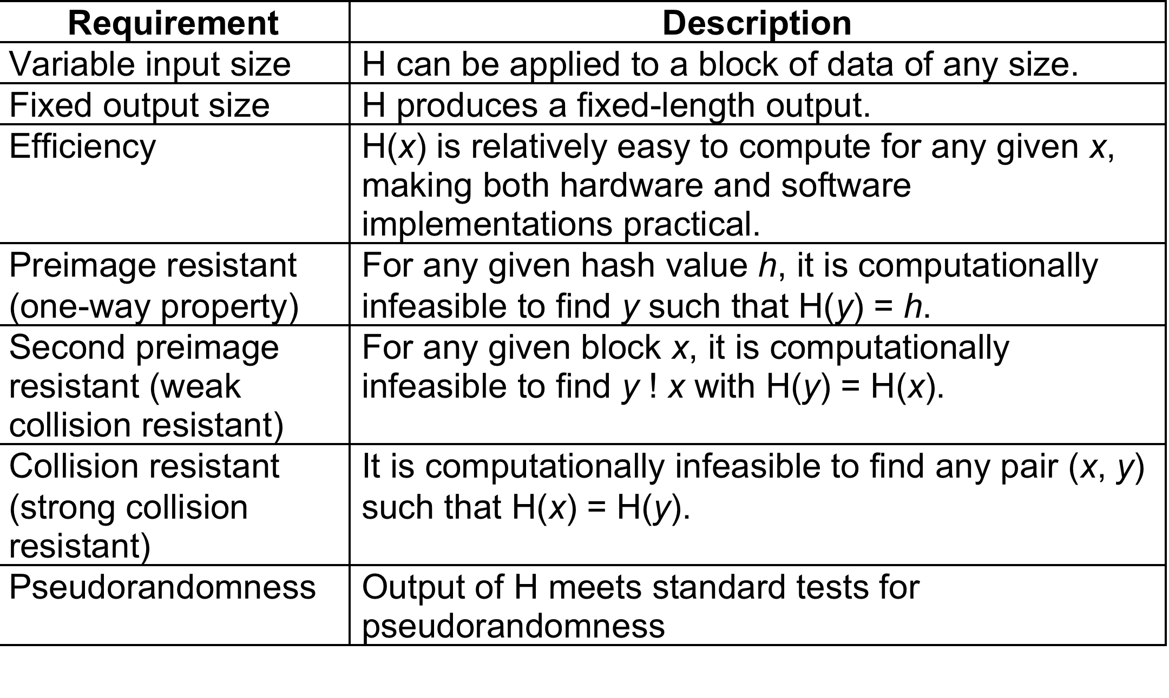
Hash Function Requirements
Notes:
Stallings Table 11.1 lists the generally accepted requirements for a cryptographic hash function. The first three properties are requirements for the practical application of a hash function. The fourth property, preimage (for a hash value h = H(x), we say that x is the preimage of h) resistant, is the one-way property: it is easy to generate a code given a message, but virtually impossible to generate a message given a code. This property is important if the authentication technique involves the use of a secret value (Figure 11.2c). The fifth property, second preimage resistant, guarantees that it is impossible to find an alternative message with the same hash value as a given message. This prevents forgery when an encrypted hash code is used (Figure 11.2b and Figure 11.3a). A hash function that satisfies the first five properties in Table 11.1 is referred to as a weak hash function. If the sixth property, collision resistant, is also satisfied, then it is referred to as a strong hash function. A strong hash function protects against an attack in which one party generates a message for another party to sign. The final requirement, pseudorandomness, has not traditionally been listed as a requirement of cryptographic hash functions, but is more or less implied.

Slide 12
Attacks on Hash Functions
have brute-force attacks and cryptanalysis
a preimage or second preimage attack
  find y s.t. H(y) equals a given hash value
collision resistance
  find two messages x & y with same hash so H(x) = H(y)
hence value 2^{m/2} determines strength of hash code against brute-force attacks
  128-bits inadequate, 160-bits suspect
Notes:
As with encryption algorithms, there are two categories of attacks on hash functions: brute-force attacks and cryptanalysis. A brute-force attack does not depend on the specific algorithm but depends only on bit length. In the case of a hash function, a brute-force attack depends only on the bit length of the hash value. A cryptanalysis, in contrast, is an attack based on weaknesses in a particular cryptographic algorithm.
For a preimage or second preimage attack, an adversary wishes to find a value y such that H(y) is equal to a given hash value h. The brute force method is to pick values of y at random and try each value until a collision occurs. For an m-bit hash value, the level of effort is proportional to 2^{m}. Specifically, the adversary would have to try, on average, 2^{m–1} values of y to find one that generates a given hash value h.
For a collision resistant attack, an adversary wishes to find two messages or data blocks, x and y, that yield the same hash function: H(x) = H(y). This requires much less effort than a preimage or second preimage attack. The effort required is explained by a mathematical result referred to as the birthday paradox (next slide).
If collision resistance is required, then the value 2^{m/2} determines the strength of the hash code against brute-force attacks. Van Oorschot and Wiener presented a design for a $10 million collision search machine for MD5, which has a 128-bit hash length, that could find a collision in 24 days. Thus a 128-bit code may be viewed as inadequate. The next step up, if a hash code is treated as a sequence of 32 bits, is a 160-bit hash length. With a hash length of 160 bits, the same search machine would require over four thousand years to find a collision. With today's technology, the time would be much shorter, so that 160 bits now appears suspect.

Slide 13
Birthday Attacks
might think a 64-bit hash is secure
but by Birthday Paradox is not
birthday attack works thus:
  given user prepared to sign a valid message x
  opponent generates 2^{m/2} variations x’ of x, all with essentially the same meaning, and saves them
  opponent generates 2^{m/2} variations y’ of a desired fraudulent message y
  two sets of messages are compared to find pair with same hash (probability > 0.5 by birthday paradox)
  have user sign the valid message, then substitute the forgery which will have a valid signature
conclusion is that need to use larger MAC/hash
Notes:
The Birthday Attack exploits the birthday paradox – the chance that in a group of people two will share the same birthday – only 23 people are needed for a Pr>0.5 of this. Can generalize the problem to one wanting a matching pair from any two sets, and show need 2^{m/2} in each to get a matching m-bit hash.
Yuval proposed the strategy shown to exploit the birthday paradox in a collision resistant attack. Note that creating many message variants is relatively easy, either by rewording or just varying the amount of white-space in the message. All of which indicates that larger MACs/Hashes are needed.

Slide 14
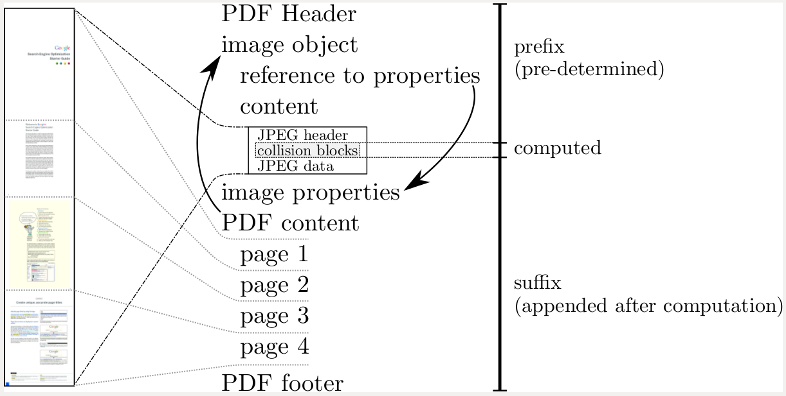
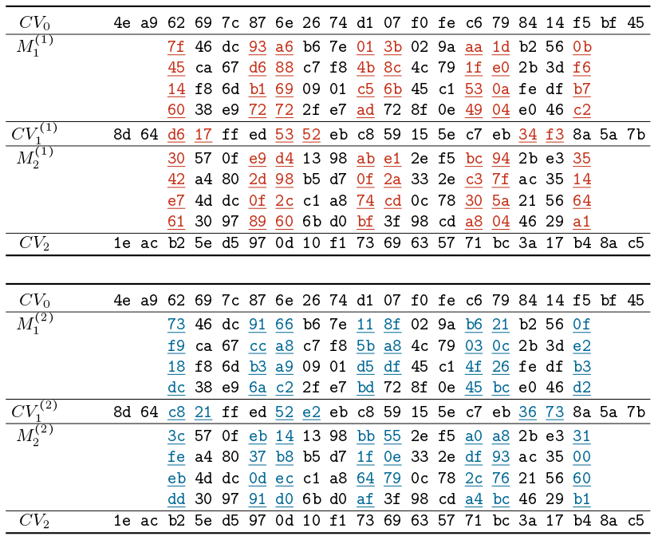
Case study: the SHAttered attack
“Universal” fixed strings for birthday attacks in SHA1 are known
Tool: sha1-collider
SHA-1(P∣∣M₁⁽¹⁾∣∣M₂⁽¹⁾∣∣S)
= SHA-1 (P∣∣M₁⁽²⁾∣∣M₂⁽²⁾∣∣S)

Slide 15
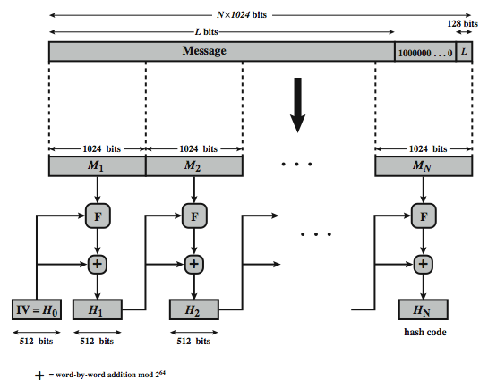
SHA-512 Overview
Notes:
Now examine the structure of SHA-512, noting that the other versions are quite similar.
SHA-512 follows the structure depicted in Stallings Figure 11.8. The processing consists of the following steps:
• Step 1: Append padding bits, consists of a single 1-bit followed by the necessary number of 0-bits, so that its length is congruent to 896 modulo 1024
• Step 2: Append length as an (big-endian) unsigned 128-bit integer
• Step 3: Initialize hash buffer to a set of 64-bit integer constants (see text)
• Step 4: Process the message in 1024-bit (128-word) blocks, which forms the heart of the algorithm. Each round takes as input the 512-bit buffer value H_{i}, and updates the contents of that buffer.
• Step 5: Output the final state value as the resulting hash
See text for more details.

Slide 16
Length extension attack
Hash(message₁) = H can be used to calculate Hash(message₁ ‖ message₂)
  Without knowing message₁
MD5, SHA-1, and SHA-2 are vulnerable. SHA-3 is not

Slide 17
Length Extension Attacks
Nested Hashing is necessary for many hash formulas because of the above
SHA-1(s || M || F) = EasyFunction(SHA-1(s||M), F)

Slide 18
HMAC
specified as Internet standard RFC2104
uses hash function on the message:
  HMAC_{K}(M)= Hash[(K⁺ XOR opad) ||
  Hash[(K⁺ XOR ipad) || M)] ]
  where K⁺ is the key padded out to size
  opad, ipad are specified padding constants
overhead is just 3 more hash calculations than the message needs alone
any hash function can be used
  eg. MD5, SHA-1, RIPEMD-160, Whirlpool
Notes:
The idea of a keyed hash evolved into HMAC, designed to overcome some problems with the original proposals. It involves hashing padded versions of the key concatenated with the message, and then with another outer hash of the result prepended by another padded variant of the key. The hash function need only be used on 3 more blocks than when hashing just the original message (for the two keys + inner hash). HMAC can use any desired hash function, and has been shown to have the same security as the underlying hash function. Can choose the hash function to use based on speed/security concerns.

Slide 19
Block Ciphers as Hash Functions
can use block ciphers as hash functions
  using H₀=0 and zero-pad of final block
  compute: H_{i} = E_{Mi} [H_{i-1}]
  and use final block as the hash value
  similar to CBC but without a key
resulting hash is too small (64-bit)
  both due to direct birthday attack
  and to “meet-in-the-middle” attack
other variants also susceptible to attack
Notes:
A number of proposals have been made for hash functions based on using a cipher block chaining technique, but without the secret key (instead using the message blocks as keys). One of the first such proposals was that of Rabin, which divided a message M into fixed-size blocks, and usde a symmetric encryption system such as DES to compute the hash code G as shown. This is similar to the CBC technique, but in this case there is no secret key. As with any hash code, this scheme is subject to the birthday attack, and if the encryption algorithm is DES and only a 64-bit hash code is produced, then the system is vulnerable. Furthermore, another version of the birthday attack can be used even if the opponent has access to only one message and its valid signature and cannot obtain multiple signings, known as a “meet-in-the-middle” attack (see text). It can be shown that some form of birthday attack will succeed against any hash scheme involving the use of cipher block chaining without a secret key provided that either the resulting hash code is small enough (e.g., 64 bits or less) or that a larger hash code can be decomposed into independent subcodes. Thus, attention has been directed at finding other approaches to hashing.

Slide 20
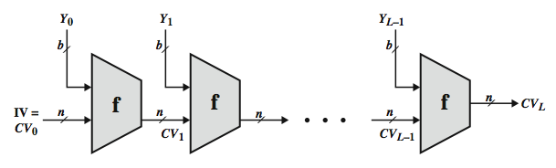
Hash Function Cryptanalysis
cryptanalytic attacks exploit some property of alg so faster than exhaustive search
hash functions use iterative structure
  process message in blocks (incl length)
attacks focus on collisions in function f
Notes:
As with encryption algorithms, cryptanalytic attacks on hash functions seek to exploit some property of the algorithm to perform some attack other than an exhaustive search. In recent years, have much effort, and some successes, in developing cryptanalytic attacks on hash functions. Must consider the overall structure of a typical secure hash function, referred to as an iterated hash function, as indicated in Stallings Figure 11.7. This was proposed by Merkle and is the structure of most hash functions in use today. The hash function takes an input message and partitions it into L fixed-sized blocks of b bits each. If necessary, the final block is padded to b bits. The final block also includes the value of the total length of the input to the hash function. The inclusion of the length makes the job of the opponent more difficult. The hash algorithm involves repeated use of a compression function, f, that takes two inputs (an n-bit input from the previous step, called the chaining variable, and a b-bit block) and produces an n-bit output. At the start of hashing, the chaining variable has an initial value that is specified as part of the algorithm. The final value of the chaining variable is the hash value. Often, b > n; hence the term compression. The motivation for this iterative structure stems from the observation by Merkle and Damgard that if the compression function is collision resistant, then so is the resultant iterated hash function. Therefore, the structure can be used to produce a secure hash function to operate on a message of any length. Cryptanalysis of hash functions focuses on the internal structure of f and is based on attempts to find efficient techniques for producing collisions for a single execution of f. Once that is done, the attack must take into account the fixed value of IV. The attack on f depends on exploiting its internal structure. The attacks that have been mounted on hash functions are rather complex and beyond our scope here.

Slide 21
Secure Hash Algorithm
SHA originally designed by NIST & NSA in 1993
was revised in 1995 as SHA-1
US standard for use with DSA signature scheme
  standard is FIPS 180-1 1995, also Internet RFC3174
  nb. the algorithm is SHA, the standard is SHS
based on design of MD4 with key differences
produces 160-bit hash values
recent 2005 results on security of SHA-1 have raised concerns on its use in future applications
Notes:
In recent years, the most widely used hash function has been the Secure Hash Algorithm (SHA). The Secure Hash Algorithm (SHA) was developed by the National Institute of Standards and Technology (NIST) and published as a federal information processing standard (FIPS 180) in 1993; a revised version was issued as FIPS 180-1 in 1995 and is generally referred to as SHA-1. The actual standards document is entitled Secure Hash Standard. SHA is based on the hash function MD4 and its design closely models MD4. SHA-1 produces a hash value of 160 bits. In 2005, a research team described an attack in which two separate messages could be found that deliver the same SHA-1 hash using 2^69 operations, far fewer than the 2^80 operations previously thought needed to find a collision with an SHA-1 hash [WANG05]. This result has hastened the transition to newer, longer versions of SHA.

Slide 22
Revised Secure Hash Standard
NIST issued revision FIPS 180-2 in 2002
adds 3 additional versions of SHA
  SHA-256, SHA-384, SHA-512
designed for compatibility with increased security provided by the AES cipher
structure & detail is similar to SHA-1
hence analysis should be similar
but security levels are rather higher
Notes:
In 2002, NIST produced a revised version of the standard, FIPS 180-2, that defined three new versions of SHA, with hash value lengths of 256, 384, and 512 bits, known as SHA-256, SHA-384, and SHA-512. Collectively, these hash algorithms are known as SHA-2. These new versions have the same underlying structure and use the same types of modular arithmetic and logical binary operations as SHA-1, hence analyses should be similar. A revised document was issued as FIP PUB 180-3 in 2008, which added a 224-bit version. SHA-2 is also specified in RFC 4634, which essentially duplicates the material in FIPS 180-3, but adds a C code implementation.
In 2005, NIST announced the intention to phase out approval of SHA-1 and move to a reliance on the other SHA versions by 2010.

Slide 23
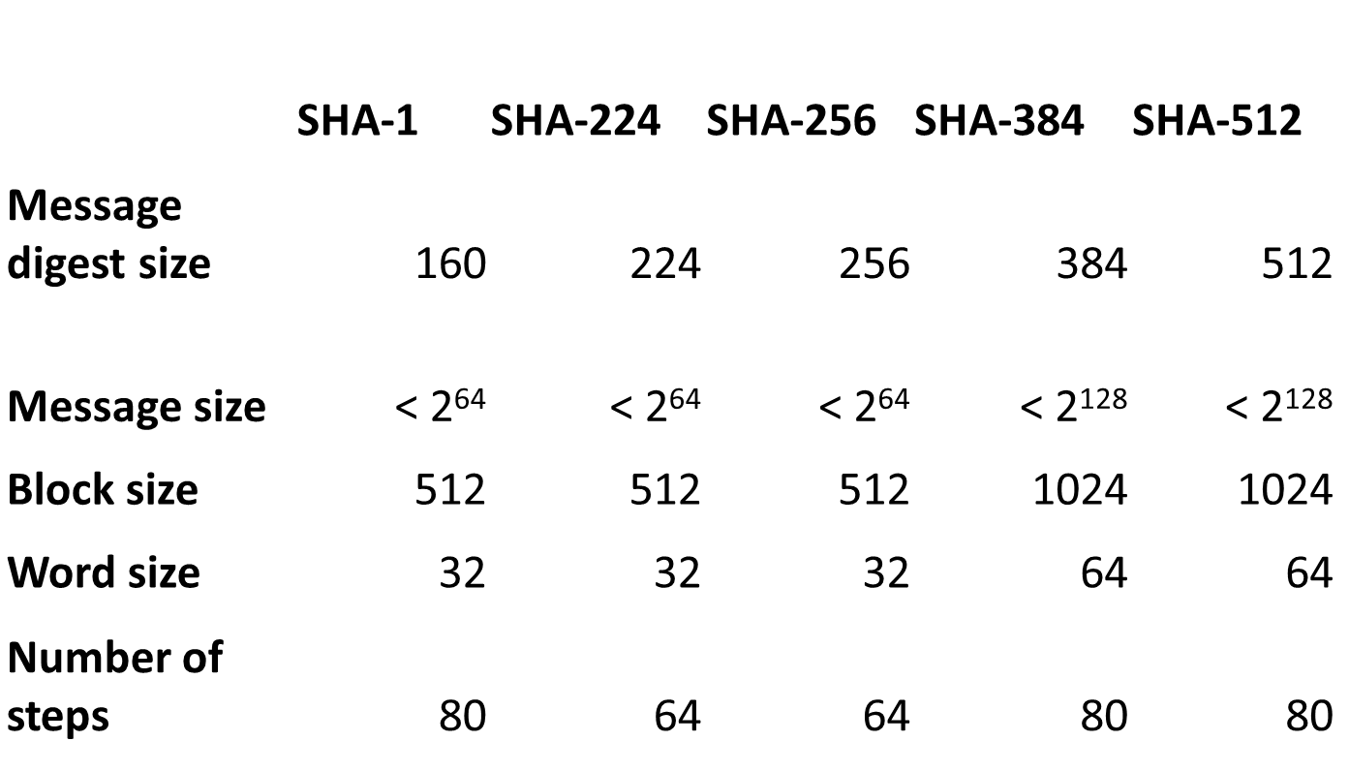
SHA Versions
Notes:
Stallings Table 11.3 provides a comparison of the various parameters for the SHA hash functions.

Slide 24
SHA-512 Compression Function
heart of the algorithm
processing message in 1024-bit blocks
consists of 80 rounds
  updating a 512-bit buffer
  using a 64-bit value Wt derived from the current message block
  and a round constant based on cube root of first 80 prime numbers
Notes:
The SHA-512 Compression Function is the heart of the algorithm. In this Step 4, it processes the message in 1024-bit (128-word) blocks, using a module that consists of 80 rounds, labeled F in Stallings Figure 11.8, and is shown in detail in Figure 11.9. Each round takes as input the 512-bit buffer value, and updates the contents of the buffer. At input to the first round, the buffer has the value of the intermediate hash value. Each round t makes use of a 64-bit value Wt derived using a message schedule from the current 1024-bit block being processed. Each round also makes use of an additive constant Kt, based on the fractional parts of the cube roots of the first eighty prime numbers. The constants provide a “randomized” set of 64-bit patterns, which should eliminate any regularities in the input data. The output of the eightieth round is added to the input to the first round to produce the final hash value for this message block, which forms the input to the next iteration of this compression function, as shown on the previous slide.

Slide 25
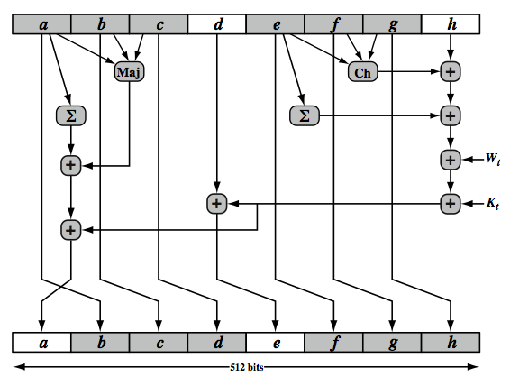
SHA-512 Round Function
Notes:
The structure of each of the 80 rounds is shown in Stallings Figure 11.10. Each 64-bit word is shuffled along one place, and in some cases manipulated using a series of simple logical functions (ANDs, NOTs, ORs, XORs, ROTates), in order to provide the avalanche & completeness properties of the hash function. The elements are:
Ch(e,f,g) = (e AND f) XOR (NOT e AND g)
Maj(a,b,c) = (a AND b) XOR (a AND c) XOR (b AND c)
∑(a) = ROTR(a,28) XOR ROTR(a,34) XOR ROTR(a,39)
∑(e) = ROTR(e,14) XOR ROTR(e,18) XOR ROTR(e,41)
+ = addition modulo 2^64
Kt = a 64-bit additive constant
Wt = a 64-bit word derived from the current 512-bit input block.
Six of the eight words of the output of the round function involve simply permutation (b, c, d, f, g, h) by means of rotation. This is indicated by shading in Figure 11.10. Only two of the output words (a, e) are generated by substitution. Word e is a function of input variables d, e, f, g, h, as well as the round word W t and the constant Kt. Word a is a function of all of the input variables, as well as the round word W t and the constant Kt.

Slide 26
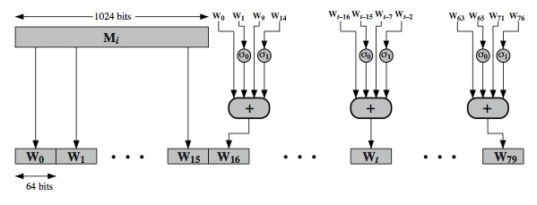
SHA-512 Round Function
Notes:
Stallings Figure 11.11 illustrates how the 64-bit word values Wt are derived from the 1024-bit message. The first 16 values of Wt are taken directly from the 16 words of the current block. The remaining values are defined as a function of the earlier values using ROTates, SHIFTs and XORs as shown. The function elements are:
∂0(x) = ROTR(x,1) XOR ROTR(x,8) XOR SHR(x,7)
∂1(x) = ROTR(x,19) XOR ROTR(x,61) XOR SHR(x,6)
Thus, in the first 16 steps of processing, the value of W_{t} is equal to the corresponding word in the message block. For the remaining 64 steps, the value of W_{t} consists of the circular left shift by one bit of the XOR of four of the preceding values of W_{t}, with two of those values subjected to shift and rotate operations. This introduces a great deal of redundancy and interdependence into the message blocks that are compressed, which complicates the task of finding a different message block that maps to the same compression function output.
See text for details of an example based on one in FIPS 180.

Slide 27
SHA-3
SHA-1 "broken”
SHA-2 (esp. SHA-512) “wavering” (as of 2020)
  shares same structure and mathematical operations as predecessors so have concern
NIST announced in 2007 a competition for the SHA-3 next gen NIST hash function
Notes:
As yet, SHA-1 has not yet been "broken". That is, no one has demonstrated a technique for producing collisions in less than brute-force time. However, because SHA-1 is very similar in structure and in the basic mathematical operations used to MD5 and SHA-0, both of which have been broken, SHA-1 is considered insecure and has been phased out for SHA-2.
SHA-2, particularly the 512-bit version, would appear to provide unassailable security. However, SHA-2 shares the same structure and mathematical operations as its predecessors, and this is a cause for concern. Because it will take years to find a suitable replacement for SHA-2, should it become vulnerable, NIST decided to begin the process of developing a new hash standard. Accordingly, NIST announced in 2007 a competition to produce the next generation NIST hash function, to be called SHA-3. NIST would like to have a new standard in place by the end of 2012, but emphasizes that this is not a fixed timeline.

Slide 28
SHA-3 Requirements
replace SHA-2 with SHA-3 in any use
  so use same hash sizes
preserve the online nature of SHA-2
  so must process small blocks (512 / 1024 bits)
evaluation criteria
  security close to theoretical max for hash sizes
  cost in time & memory
  characteristics: such as flexibility & simplicity
Notes:
The basic requirements that must be satisfied by any candidate for SHA-3 are:
It must be possible to replace SHA-2 with SHA-3 in any application by a simple drop-in substitution. Therefore, SHA-3 must support hash value lengths of 224, 256, 384, and 512 bits.
SHA-3 must preserve the online nature of SHA-2. That is, the algorithm must process comparatively small blocks (512 or 1024 bits) at a time instead of requiring that the entire message be buffered in memory before
Beyond these basic requirements, NIST has defined a set of evaluation criteria. These criteria are designed to reflect the requirements for the main applications supported by SHA-2, and are:
• Security: The strength of SHA-3 should be close to the theoretical maximum for the different required hash sizes, and for both preimage resistance and collision resistance. SHA-3 algorithms must be designed to resist any potentially successful attack on SHA-2 functions
• Cost: be both time and memory efficient over a range of hardware platforms.
• Algorithm and implementation characteristics: such as flexibility (e.g., tunable parameters for security/performance tradeoffs, opportunity for parallelization, and so on), and simplicity (which makes it easier to analyze the security properties of the algorithm)

Slide 29
SHA1 collisions
https://alf.nu/SHA1

Slide 30
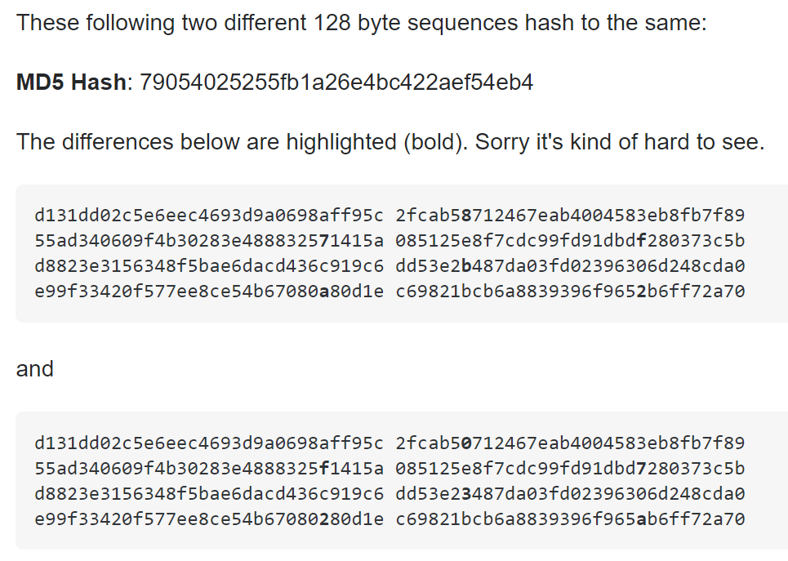
MD5 Collisions

Slide 31
Popular hash functions
MD5 (Broken)
SHA1 (Broken)
SHA-2 (224, 256, 384, 512 bits)
  SHA-2 it’s broken up to a few rounds
SHA-3 (224, 256, 384, 512 bits)
Blake (based on CHACHA)
Sm3 (Chinese), gost (Russian)

