Slide 1

The road to PKI Key distribution and exchange

Slide 2
Yes, Diffie-Hellman exchange works, but
Distributing public keys is subject to MITM
Need of a way of having trusted public keys

Slide 3
Distribution of Public Keys
Distribution methods:
public announcement with optional one time install (pinning)
Example: SSH infrastructure
publicly available directory
Example: PGP infrastructure
public-key authority
Dynamic publication and verification of public keys: similar to OCSP protocol
public-key certificates
Example: the real PKI
Notes:
Several techniques have been proposed for the distribution of public keys, which can mostly be grouped into the categories shown.

Slide 4
Public Announcement
users distribute public keys to recipients or broadcast to community at large
eg. append PGP keys to email messages or post to news groups or email list
major weakness is forgery
anyone can create a key claiming to be someone else and broadcast it
until forgery is discovered can masquerade as claimed user
Example: SSH servers
Notes:
The point of public-key encryption is that the public key is public, hence any participant can send his or her public key to any other participant, or broadcast the key to the community at large. Its major weakness is forgery, anyone can create a key claiming to be someone else and broadcast it, and until the forgery is discovered they can masquerade as the claimed user.

Slide 5
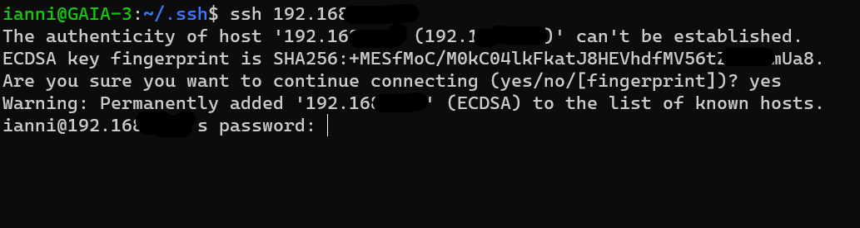
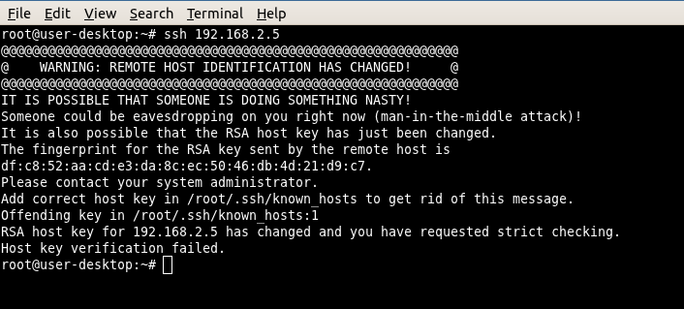
Example: SSH

Slide 6
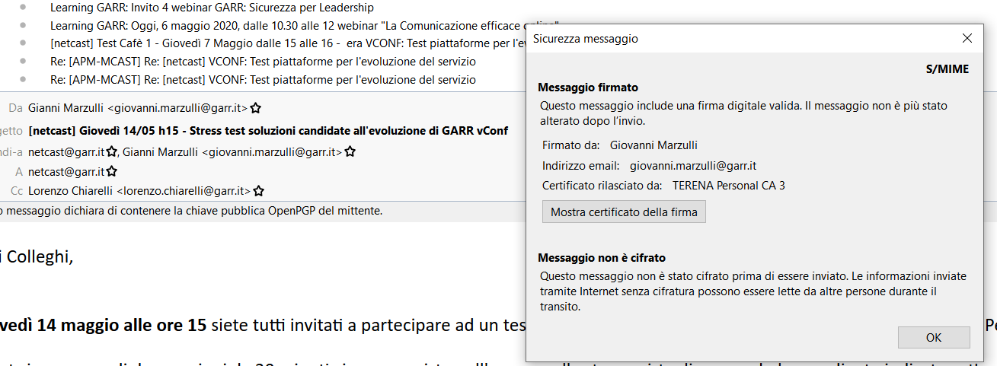
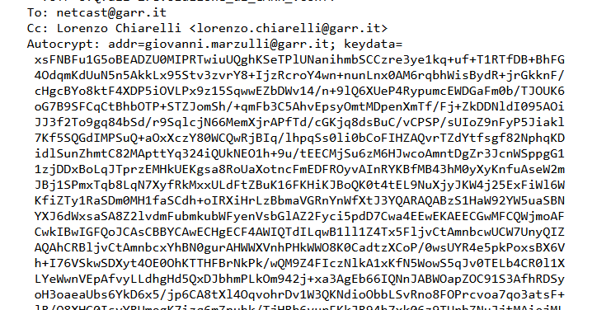

Example: PGP

Slide 7
Publicly Available Directory
can obtain greater security by registering keys with a public directory
directory must be trusted with properties:
contains {name,public-key} entries
participants register securely with directory
participants can replace key at any time
directory is periodically published
directory can be accessed electronically
still vulnerable to tampering or forgery
Notes:
A greater degree of security can be achieved by maintaining a publicly available dynamic directory of public keys. Maintenance and distribution of the public directory would have to be the responsibility of some trusted entity or organization. This scheme is clearly more secure than individual public announcements but still has vulnerabilities to tampering or forgery.

Slide 8
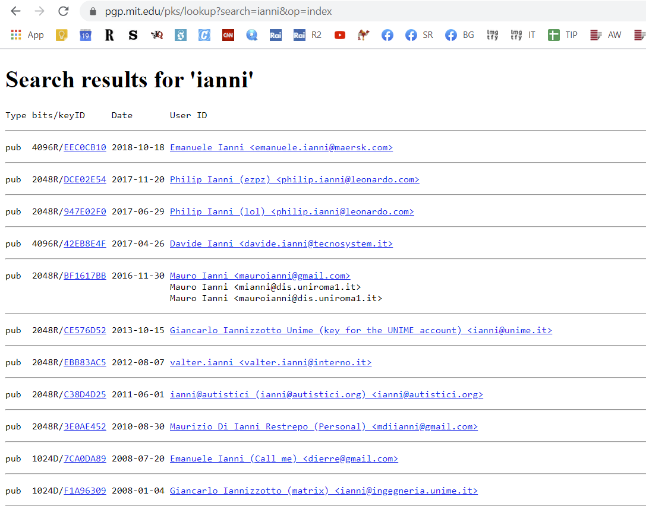
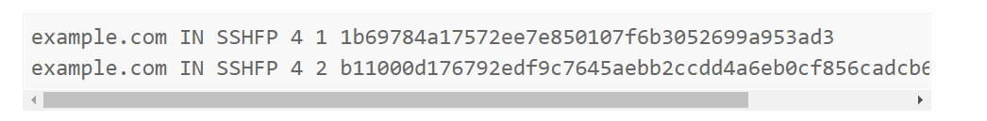
Example: PGP, DNS

Slide 9
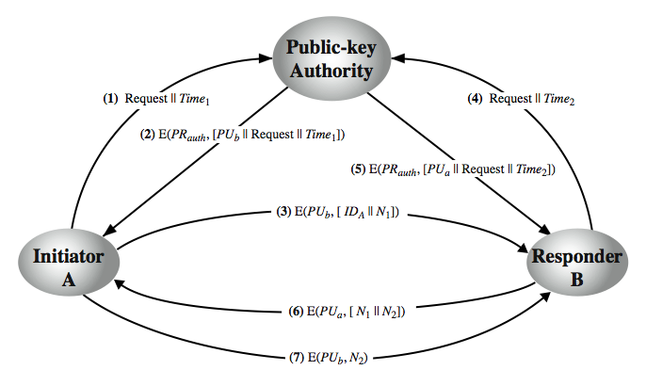
Public-Key Authority
Notes:
Stallings Figure 14.11 “Public-Key Authority” illustrates a typical protocol interaction. As before, the scenario assumes that a central authority maintains a dynamic directory of public keys of all participants. In addition, each participant reliably knows a public key for the authority, with only the authority knowing the corresponding private key. See text for details of steps in protocol. A total of seven messages are required. However, the initial four messages need be used only infrequently because both A and B can save the other's public key for future use, a technique known as caching. Periodically, a user should request fresh copies of the public keys of its correspondents to ensure currency.

Slide 10
Public-Key Certificates
certificates allow key exchange without real-time access to public-key authority
a certificate binds identity to public key
usually with other info such as period of validity, rights of use etc
with all contents signed by a trusted Public-Key or Certificate Authority (CA)
can be verified by anyone who knows the public-key authorities public-key
Notes:
An further improvement, first suggested by Kohnfelder, is to use certificates, which can be used to exchange keys without contacting a public-key authority, in a way that is as reliable as if the keys were obtained directly from a public-key authority. A certificate binds an identity to public key, with all contents signed by a trusted Public-Key or Certificate Authority (CA). A user can present his or her public key to the authority in a secure manner, and obtain a certificate. The user can then publish the certificate. Anyone needing this user's public key can obtain the certificate and verify that it is valid by way of the attached trusted signature. A participant can also convey its key information to another by transmitting its certificate. Other participants can verify that the certificate was created by the authority, provided they know its public key.
One scheme has become universally accepted for formatting public-key certificates: the X.509 standard. X.509 certificates are used in most network security applications, including IP security, secure sockets layer (SSL), secure electronic transactions (SET), and S/MIME. Will discuss it in much more detail later.

Slide 11
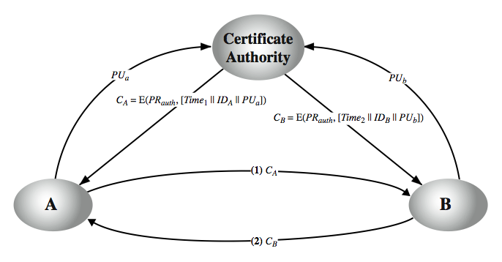
Public-Key Certificates
Issuing a CSR
Signed CSR
becomes a certificate
Notes:
A certificate scheme is illustrated in Stallings Figure 14.12. Each participant applies to the certificate authority, supplying a public key and requesting a certificate. Application must be in person or by some form of secure authenticated communication. For participant A, the authority provides a certificate CA. A may then pass this certificate on to any other participant, who can read and verify the certificate by verifying the signature from the certificate authority. Because the certificate is readable only using the authority's public key, this verifies that the certificate came from the certificate authority. The timestamp counters the following scenario. A's private key is learned by an adversary. A generates a new private/public key pair and applies to the certificate authority for a new certificate. Meanwhile, the adversary replays the old certificate to B. If B then encrypts messages using the compromised old public key, the adversary can read those messages. In this context, the compromise of a private key is comparable to the loss of a credit card. The owner cancels the credit card number but is at risk until all possible communicants are aware that the old credit card is obsolete. Thus, the timestamp serves as something like an expiration date. If a certificate is sufficiently old, it is assumed to be expired.
One scheme has become universally accepted for formatting public-key certificates: the X.509 standard.

Slide 12

The main, biggest assumption
The CA is trusted and its public key is pinned somewhere in a secure place
E.g. in the operating system / browser / java keystore

Slide 13
Certificate contents (x509 format)
Common Name CN
Public key associated to the common name CN
Validity window
OCSP coordinates, CRL coordinates
Other fields (purpose, ecc.)
Digital signature of a CA authority

Slide 14
Certificate creation
A certificate request (CSR) is produced by X and submitted to a CA
The CSR contains PU_X
A RA (registration authority) validates the requests from X and submits it to the CA.
CA trusts RA and good security practices are assumed
Success: a new certificate C is issued. C contains PU_X, and it’s signed with PR_CA
Failure: no new certificate is issued

Slide 15
Examples of RA validation practices
When validating Web Sites + FQDNs
X must prove to control corresponding DNS, or prove to own the web server
For EV certificates, needs also personal identification and other legal stuff
When validating people
Legal identification of X (Photo ID, webcam, etc.)

Slide 16
CA public keys installation
These are installed one-time in a, tipically OS-wide data structure (the truststore), and replaced from time to time:
In case of certificate expiration
In case of revocation
When a new CA is accepted
Root CA public keys are within self-signed certificates, and are necessary for validation
Keystores/Truststores become a hot security point

Slide 17
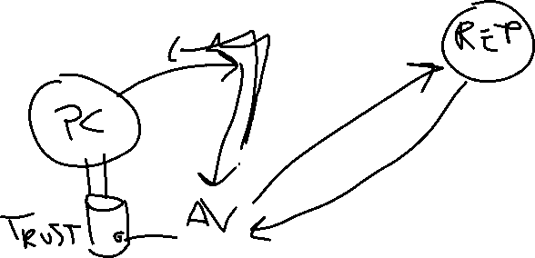
Example of keystore tampering
Avast Web Mail shield
Almost any commercial AV used to this (and still does in a way or another)

Slide 19
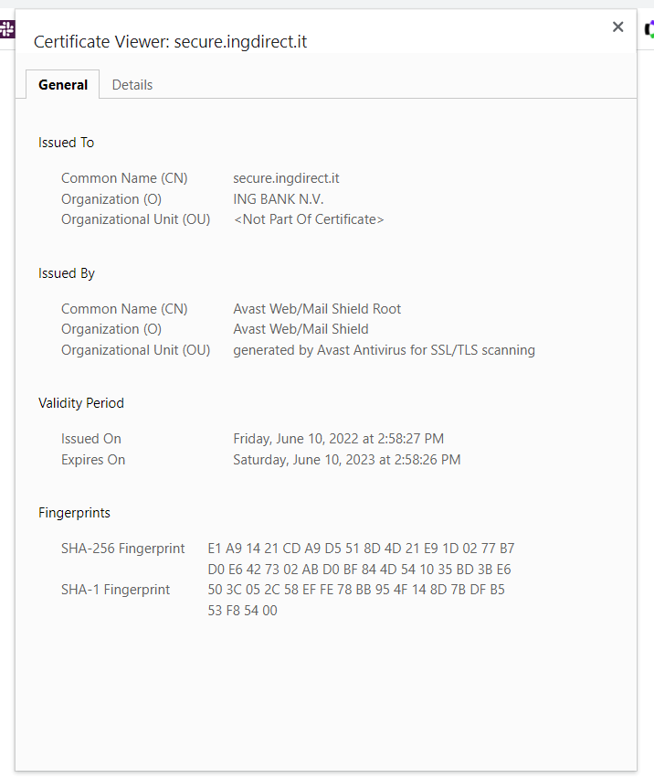

Slide 20
Example of CA private key theft
The Diginotar case and many more

Slide 21
Certificate validation
All these checks must be successful:
Identity check: some of the CNs should match the identity you’re looking for
Signature check: Digest must correspond to a known and accepted public key of a CA in the keystore
Validity time window must fit with current time
Certificate scope must match (can’t use a certificate for authorizing things not in the certificate scope)
Certificate must not be revoked
Quality check must be ok

Slide 22


Digest check
C = Certificate to be checked
D = Fingerprint of C
D = E(Pr_CA, H( C ) )
C’
H( C’ ) = D( Pu_CA, D’ )

Slide 23
Certificate revocation check
Alternatives:
Via an OCSP server. The OCSP server must be trusted on its own. The OCSP URL is usually in a certificate field
Performance problem and an example of possible domino attack
Availability → Confidentiality+Integrity
Via download of huge CRL txt files
Big performance problem
OCSP Stapling

Slide 24
Usage of public keys in certificate
BasicConstraints:
CA true or false, pathlen
KeyUsage values:
digitalSignature, nonRepudiation, keyEncipherment, dataEncipherment, keyAgreement, keyCertSign, cRLSign, encipherOnly and decipherOnly

Slide 25
Other known PKIs – Usages
Code signing PKIs: accountability of software packages
Public administration PKIs: legal documents, document storage
Digital Rights Management: distribution of decoding keys, etc.

Slide 26
Extended key usages
Value Meaning
----- -------
serverAuth SSL/TLS Web Server Authentication.
clientAuth SSL/TLS Web Client Authentication.
codeSigning Code signing.
emailProtection E-mail Protection (S/MIME).
timeStamping Trusted Timestamping
OCSPSigning OCSP Signing
ipsecIKE ipsec Internet Key Exchange
msCodeInd Microsoft Individual Code Signing (authenticode)
msCodeCom Microsoft Commercial Code Signing (authenticode)
msCTLSign Microsoft Trust List Signing
msEFS Microsoft Encrypted File System

Slide 27
PKI Assumptions and its attack surface from «ten risks of PKI»
Trust your CA and its CPS (Certificate Practice Statement)
Trust that a private key will be handled only by the legitimate handler (legal assumptions)
Trust the verifying computer/browser and its own root certificate list
The CA trusted list is as weak as the weakest CA in the bunch
Trust the association between
Identity ←→ Certificate
(homonymies are possible)

Slide 28
PKI Assumptions #2
5. Trust that CA is an authority on the binding which CA signs for (e.g. DNS, e-mail)
6. Assumes that user understands (part of) PKI
7. RA+CA binding is trusted
8. RA well identifies the certificate requester
9. Certificate practices (CSP) are respected
10. Single sign-on practices are a problem

Slide 29
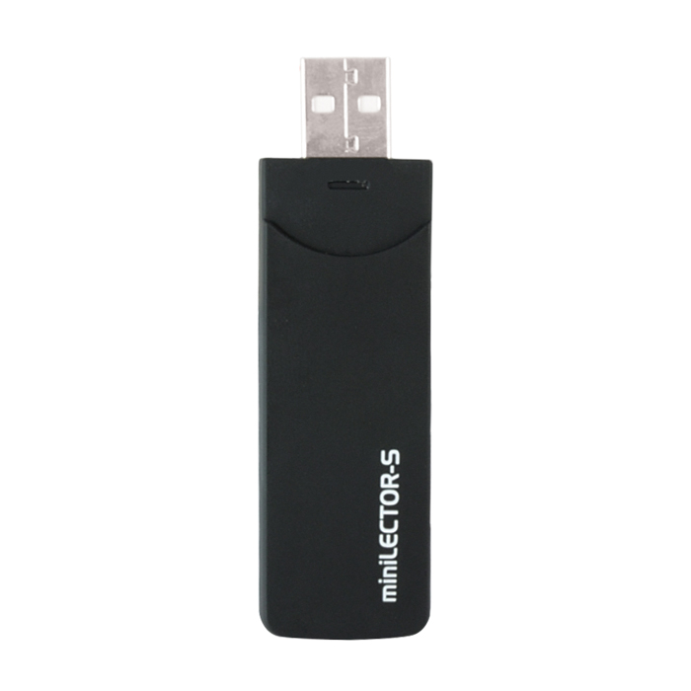

Signing devices
PKCS #11 tokens
HSMs

