Slide 1

Network & Security SSL/TLS
Prof. Giovambattista Ianni – Università della Calabria

Slide 2
History & GOALS
Since its earliest inception HTTP inventors felt the need of reassuring users so to allow
Secure e-commerce, secure banking, etc.
Internet before SSL was a wild world
https://www.feistyduck.com/ssl-tls-and-pki-history/
So, add a safety layer in-between Layer 7 and Layer 4 conversations
Parties can prove their identity
Parties can talk confidentially
Parties can talk with no tampering

Slide 3
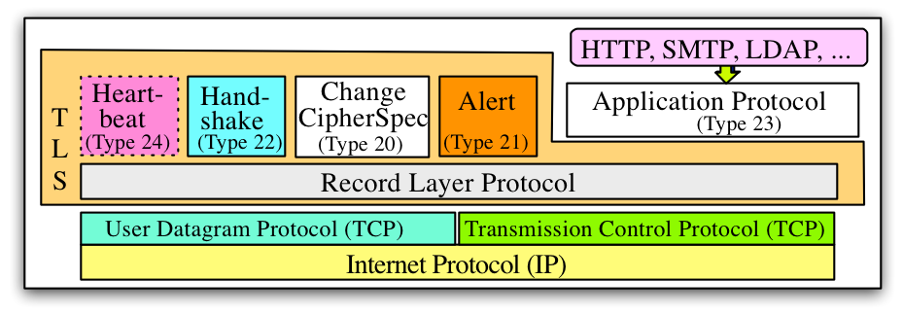
TLS Protocol SET
DTLS: TLS version specialized for UDP peculiarities

Slide 4
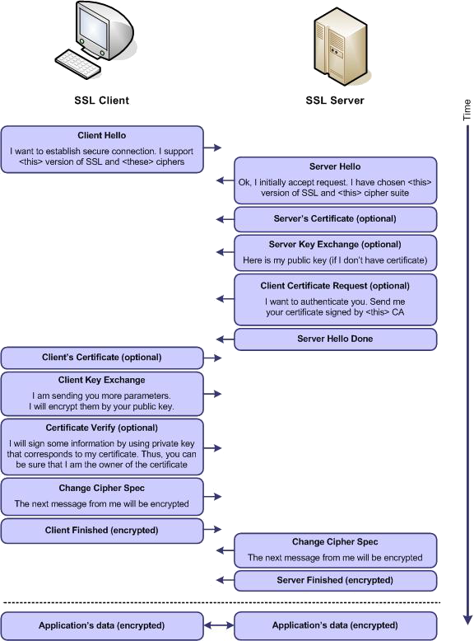
SSL Handshake

Slide 5
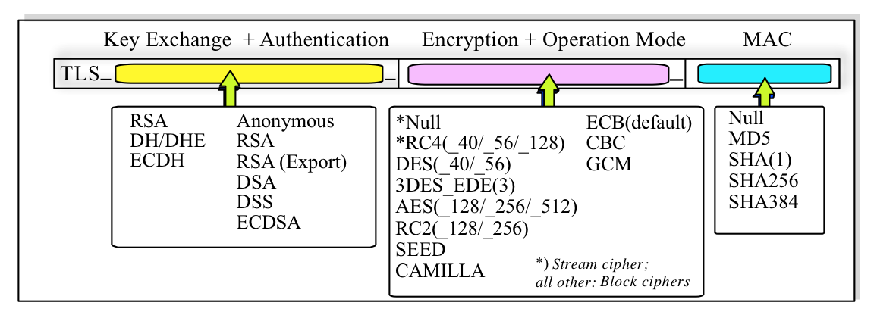
CIPHER SUITES

Slide 6
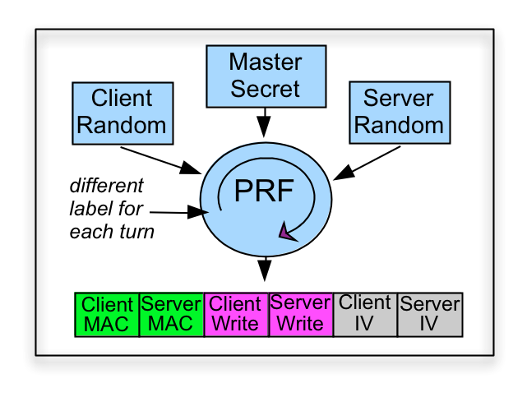
Encryption KEYS
Exchanged with
DH or RSA
PFS: Perfect Forward Secrecy

Slide 7
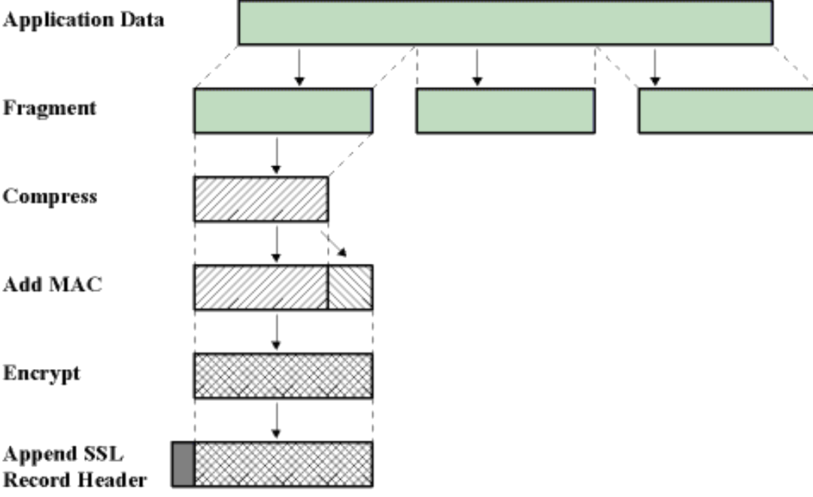
Ssl/TLS record processing
Fragmentation and packing in SSLPlaintext.
Packet compression in SSLCompressed.
Encryption of packets in SSLCiphertext:
Creation of MAC.
Append MAC to to SSLCompressed.
Encryption of packets using the chiper suite of choice.
If a block cipher is used then it is necessary a padding and in some cases the IV.

Slide 8
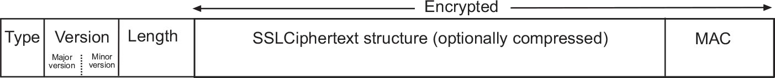
Ssl record processing (Cont.)
At the end of processing a header is added to the SSLCiphertext to get a SSLRecord, which is composed by:
TYPE: the type of packet (SSL Change CipherSpec Protocol, Alert Protocol, HandshakeProtocol or Application Data Protocol).
VERSION: the version of SSL.
LENGTH: 16-bit.

Slide 9
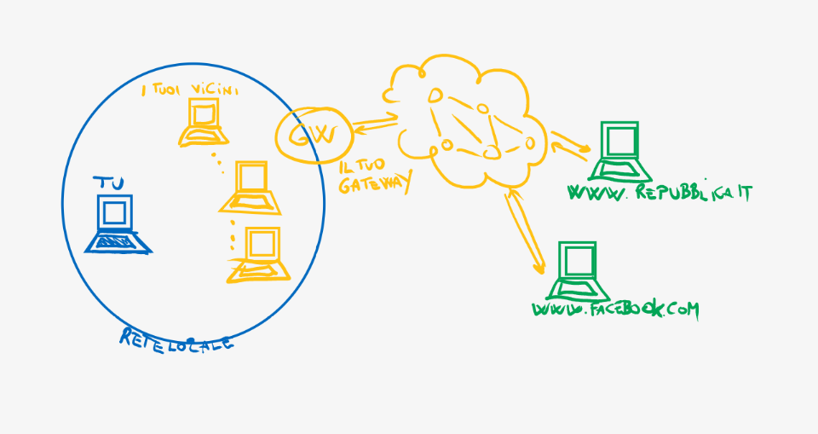
Your
gateway
Your
Neighbors
You
Your
Local
Network

Slide 10
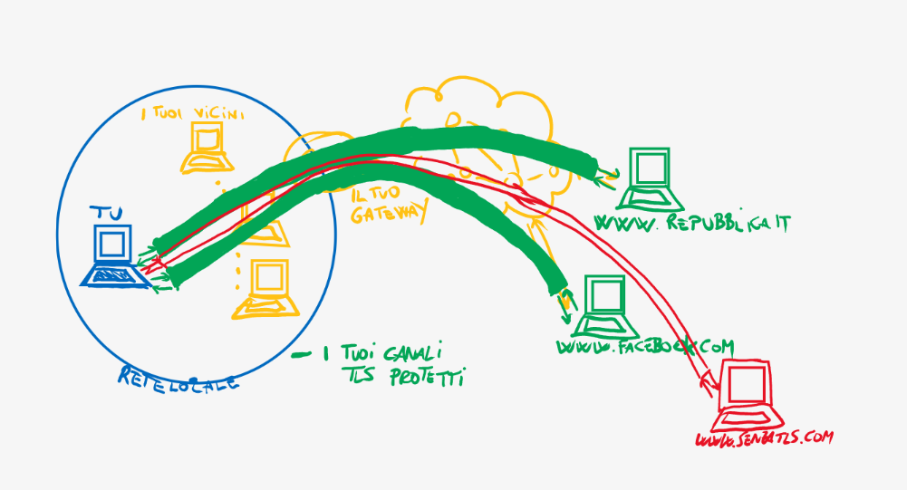
Your
gateway
Your
Neighbors
You
Unprotected
channel
Your
Local
Network
Your
Protected TLS
channels

Slide 11
POPULAR TLS LIBRARIES
OPENSSL (Open source)
LibreSSL (Open source)
BoringSSL (Google)
Schannel (Microsoft)
Secure Transport (Apple)

Slide 12
Vulnerabilities

Slide 13
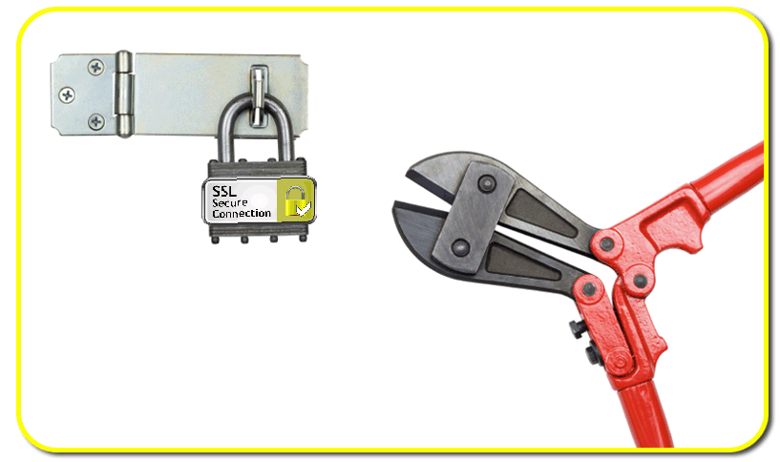
Attacks against TLS/ssl
BEAST
CRIME
BREACH
POODLE
HEARTBLEED
DROWN…
SSLSTRIPping

Slide 14
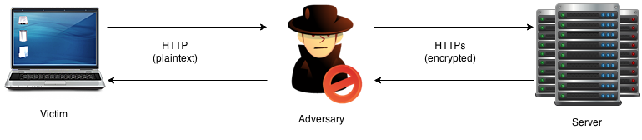
SSLSTRIP
Fallback attack from https to http
Still tremendous impact
Mitigated by HSTS headers

Slide 15

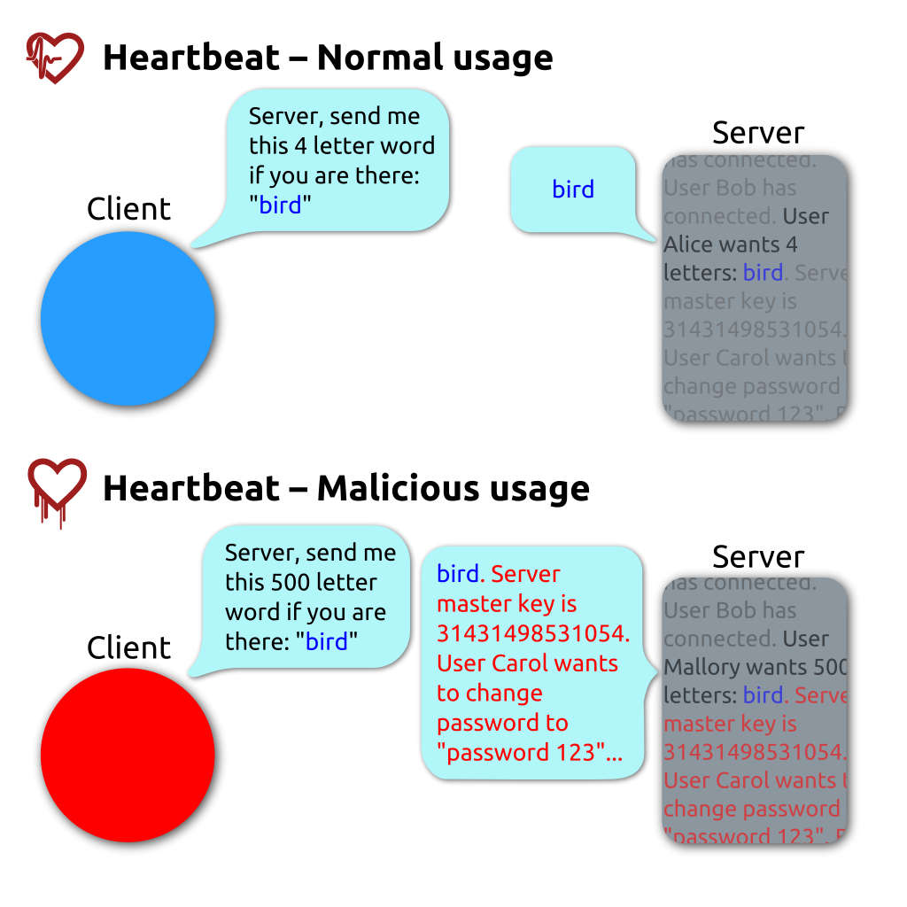
heartbeat
heartBLEED
The heartbeat TLS subprotocol (code 24) allows to check if the secure connection between client and server is still active.
It is a kind of TLS-level ping
The client sends a heartbeat request containing a text and its length.
The server should reply with an echo, containing the same message received from the client.

Slide 16

HEARTBLEED bug ON openSSL 1.0.1e
The bug was caused by not checking the size of the sent message.
If a message with a size greater than the real one is requested, the client's message and all the data of the adjacent memory cells will be returned until the requested size is reached.
In this way sensitive data could be COLLECTED in clear text.
HOWEVER, Although an attacker has good control over the size of the exposed memory block, he has no control over its location, and therefore cannot choose what content will be revealed.

Slide 17
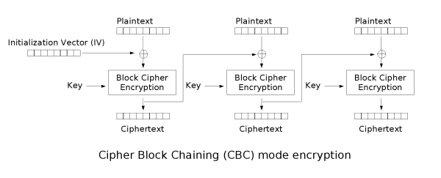
BEAST
Up to TLS 1.0 the IV of the first block of the first message is the last ciphertext block of the last message sent.
This makes the IV predictable.

Slide 18
Beast (cont.)
If the the attacker knows the last block of the last encrypted message can then try to guess the plaintext.
This is computationally difficult, but if the attacker is able to insert text in the user's plaintext then the TLS record will be occupied in part by the injected data and partly from the secret.
Suppose have a 16 byte encrypted text occupying 15 byte with the text, then the injected guess it will be easier to do.
If an attacker can cause the user to make more requests to the server by a guess&checking attack she/he can relatively easily gain access to sensitive data (like web cookies).

Slide 19
Crime
Message length

Slide 20
CRIME (cont.)
Many servers support TLS compression to reduce congestion or the timing of loading.
The main method used is DEFLATE, composed by algorithms
LZ77, used to eliminate the redundancy of sequences
Huffman Coding, used to eliminate the redundancy of symbols
The attack works by trying to guess a secret by observing the length of the message sent. When in a guess message lengths are not larger than usual the guess is correct.
If compression is disabled, TLS CRIME can not be applied
Monitor the traffic data
The victims use https for authenticating and use TLS for compression
Injected Javascript to force the victim's browser to send repeated requests to the server

Slide 21
BREACH
Description
Based on the analysis of the compressed HTTP response.
The compression method must be DEFLATE, which compresses only HTTP body.
Requirements
Traffic monitoring of the victim.
Forcing the victim to visit a web page controlled by the attacker.
The application must support HTTP compression.
The response should contain the token or secret in the body.
Countermeasures
Disable the HTTP compression.
Length hiding.
Masking secrets

Slide 22
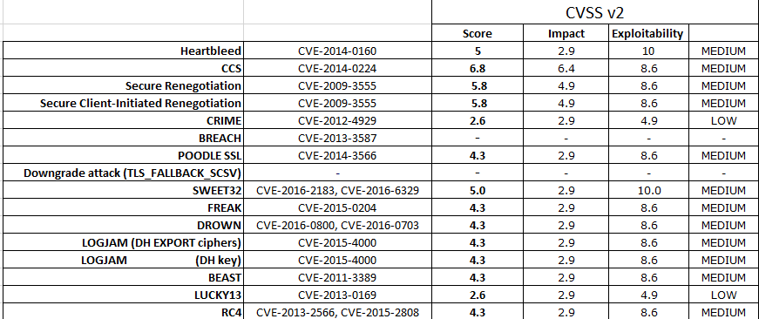
TLS Known (PAST) vulnerabilities

Slide 23
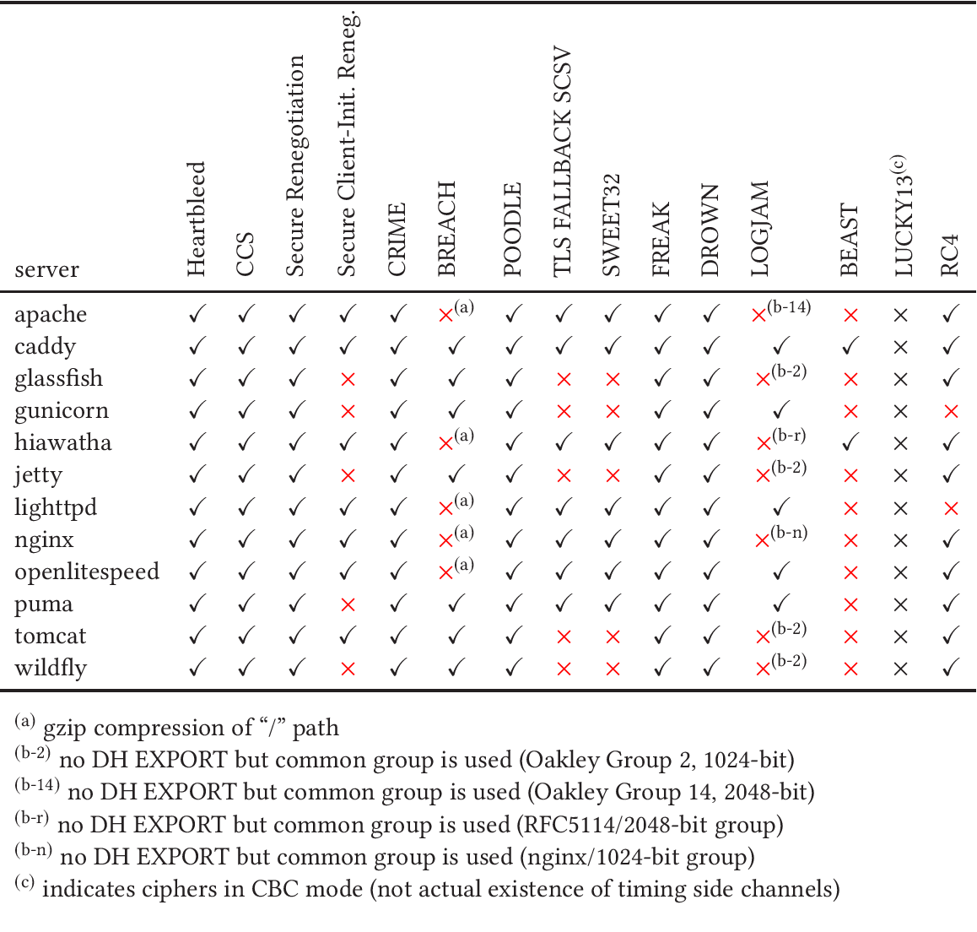
Source: “Secure by default - the case of TLS” (2017)

Slide 24
Test web-server
Can test the web server through several tools analyzing which protocols and ciphers are supported:
SSLYZE
SSLSCAN
Qualys SSL check (online) https://www.ssllabs.com/ssltest/

Slide 25
The LESSONS TO LEARN
Follow updates on TLS security very carefully
Balance compatibility with security
HTTP must be deprecated ALWAYS, not just for what you believe is a “delicate” web site

