Slide 1

NAT and Firewall traversal

Slide 2
PART I - RECAP
NAT and Firewall traversal

Slide 3
A typical firewalled company
Mondo esterno
LAN (REDAREA)
10.1.0.0/16
eth2
eth1
eth0
10.1.2.0/24
DMZ
10.1.1.0/24

Slide 4
IPTables internals
Based on the notion of «Chains»
Each chain is a list of filtering «rules»

Slide 5
From LAN to Internet
iptables -A laninet -s ! 10.1.1.0/24 -j DROP
iptables -A laninet -p tcp --dport ftp -j ACCEPT
iptables -A laninet -m state ESTABLISHED,RELATED -j ACCEPT
iptables -A laninet -p tcp --dport http -j ACCEPT
iptables -A laninet -p tcp -j REJECT --reject-with tcp-reset
From Internet to LAN
iptables -A inetlan –d ! 10.1.1.0/24 -j DROP
iptables -A inetlan –s 10.1.2.0/24 -j DROP
iptables -A inetlan –s 10.1.1.0/24 -j DROP
iptables -A inetlan -m state --state ESTABLISHED,RELATED -j ACCEPT
iptables -A inetlan -p tcp -j REJECT --reject-with tcp-reset

Slide 6
NAT: Network Address Translation
Motivation: local network uses just one IP address as far as outside world is concerned :
range of addresses not needed from ISP: just one IP address for all devices
can change addresses of devices in local network without notifying outside world
can change ISP without changing IP addresses of devices in local network
it is a first form of firewalling: internal devices are not directly accessible (192.168.0.1 or 10.0.0.1 are not valid addresses outside).

Slide 7
NAT: Network Address Translation
NAT translation table
WAN side addr LAN side addr
1: host 10.0.0.1
sends datagram to
128.119.40.186, 80
2: NAT router
changes datagram
source addr from
10.0.0.1, 3345 to
138.76.29.7, 5001,
it updates table
138.76.29.7, 5001 10.0.0.1, 3345
…… ……
S: 10.0.0.1, 3345
D: 128.119.40.186, 80
10.0.0.1
1
2
S: 138.76.29.7, 5001
D: 128.119.40.186, 80
10.0.0.4
10.0.0.2
138.76.29.7
S: 128.119.40.186, 80
D: 10.0.0.1, 3345
4
S: 128.119.40.186, 80
D: 138.76.29.7, 5001
3
4: NAT router
changes datagram
dest addr from
138.76.29.7, 5001 to 10.0.0.1, 3345
10.0.0.3
3: Reply arrives
dest. address:
138.76.29.7, 5001

Slide 8
NAT: Network Address Translation
Implementation: NAT router must:
outgoing datagrams: replace source (IP address, port number) outgoing datagram to (NAT IP address, new port number
remote clients/servers will respond using (NAT IP address, new port number) as destination addr.
remember (in the NAT translation table) every translation pair (source IP address, port number) ←→ (new port number)
incoming datagrams: replace (NAT IP address, new port number) in dest fields based on the NAT translation table

Slide 9
NAT: Network Address Translation
16-bit port-number field:
60,000 simultaneous ports with a single LAN-side address!
Controversial:
A router should not alter the level protocols 4 (transport)
P2P apps suffer. In general, there can be only one server on each port (eg a single web server on port 80, etc.).
Solves the problem of the few addresses. Limited support for transport protocols other than TCP, UDP

Slide 10
Port Forwarding
NAT forwarding table
WAN side addr LAN side addr
3: host 10.0.0.1
sends datagram to
128.119.40.186
4: NAT router
changes datagram
source addr from
10.0.0.1, 80 to
138.76.29.7, 80
138.76.29.7, 80 10.0.0.1, 80
…… ……
S: 10.0.0.1, 80
D: 128.119.40.186,501
10.0.0.1
3
4
S: 138.76.29.7, 80
D: 128.119.40.186, 501
10.0.0.4
10.0.0.2
138.76.29.7
S: 128.119.40.186, 501
D: 10.0.0.1, 80
2
S: 128.119.40.186, 501
D: 138.76.29.7, 80
1
2: NAT router
changes datagram
dest addr from
138.76.29.7 to 10.0.0.1
10.0.0.3
1: Reply arrives
dest. address:
138.76.29.7, 80
This table is set manually or programmed via UPnP. The internal server must have IP FIXED.

Slide 11
NAT and other transport protocols
NAT and ICMP
You can not use the port number, it is used the "ident" ICMP field
NAT and GRE
A single GRE tunnel in a simple router, otherwise use the tunnel id.
iptables –A FORWARD –p 47 –j ACCEPT
iptables –A FORWARD –i eth0 –p tcp –-dport 1723 –m state –state ESTABLISHED, RELATED –j ACCEPT
iptables –FORWARD –o eth1 –p tcp –-sport 1723 –m state –state ESTABLISHED, RELATED–j ACCEPT

Slide 12
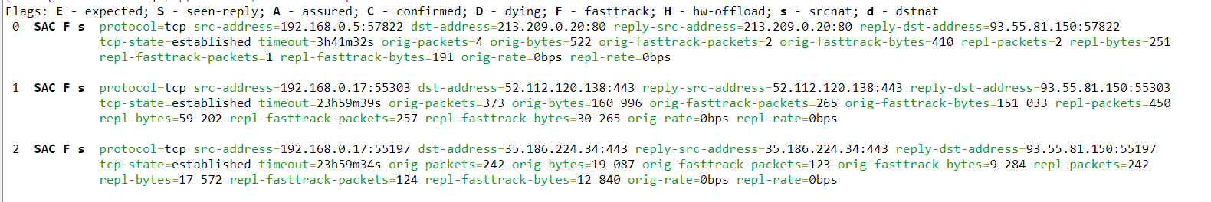
Connection table

Slide 13
NAT and P2P connections
Consider two peers, Alice and Bob
Alice and Bob out of NAT (public IP):
Can open free mutual connections
Alice and Bob inside NAT (no public IP nor Port Forwarding):
Can not open a mutual TCP connection, or talk directly via UDP
Alice inside NAT, Bob outside NAT
Alice can open connections to Bob, but not the reverse (but Bob can use a "callback" protocol via server)

Slide 14
PART II How Skype & Co. bypass firewall and router NATs?

Slide 15
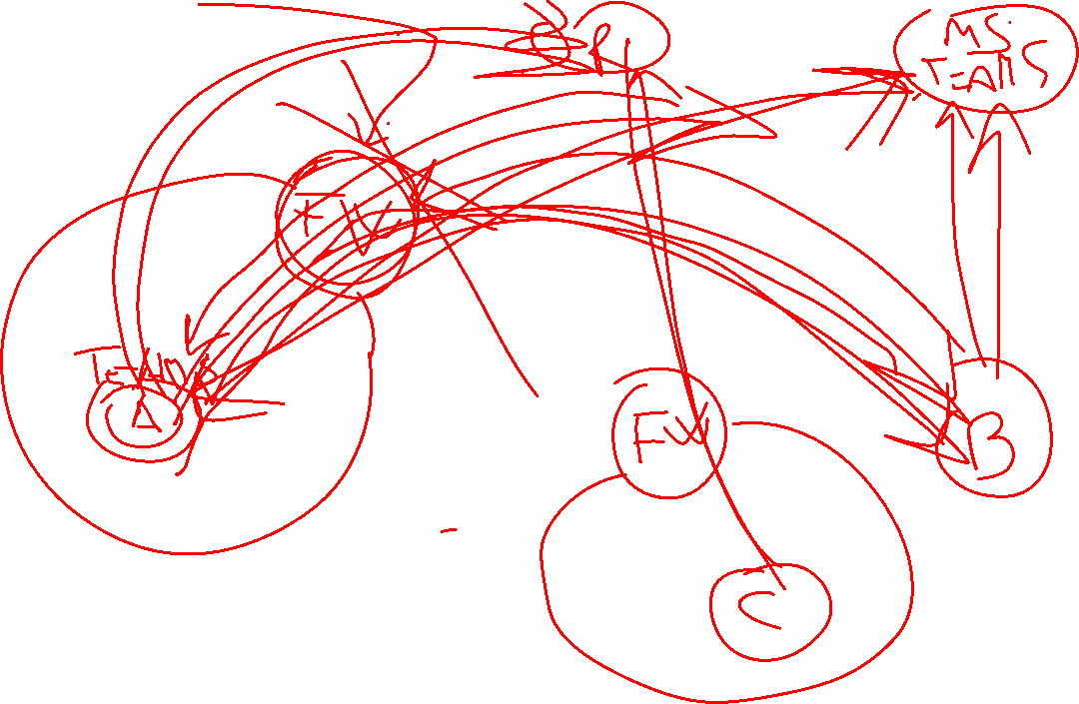
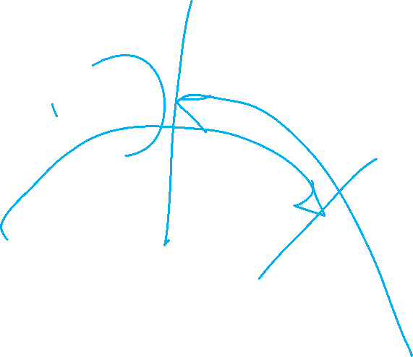

Slide 16
Firewall
Typically an attacker cannot directly start a conversation to an internal PC from the outside (connections have to be established from the inside)

Slide 17
A Firewall is a problem…
when two computers (behind NAT+firewalls) require to talk directly to each other
If, for example, their users want to call each other using Voice over IP (VoIP)
Whichever party calls the other, the recipient's firewall will decline the apparent attack and will simply discard the data packets
At least that's what a network administrator would expect...

Slide 18
Firewall hole punching
Why thus Skype and other P2Ps work as smoothly behind a NAT firewall as they do if the PC is connected directly to the internet?
The reason for this is that the inventors of Skype and similar software have come up with a solution…

Slide 19
Considerations
A firewall must also let packets through into the local network
Users want to view websites, read e-mails, etc
The firewall must therefore forward the relevant data packets from outside, to the workstation computer on the LAN
However it only does so, when it is convinced that a packet represents the response to an outgoing data packet
A NAT router/firewall therefore keeps tables of which internal computer has communicated with which external computer and which ports the two have used (connection tracking)

Slide 20
The trick
The trick used by VoIP software consists of “persuading” the firewall that a connection has been established, to which it should allocate subsequent incoming data packets
The fact that audio data for VoIP is sent using the UDP protocol (which is not connection-oriented) acts to Skype's advantage
with UDP, a firewall sees only the addresses and ports of the source and destination systems and if for an incoming UDP packet, these match an NAT table entry, it will pass the packet on to an internal computer

Slide 21
Switching
The switching server, with which both ends of a call are in constant contact, plays an important role when establishing a connection using Skype
This occurs via a TCP connection, which the clients themselves establish
The Skype server therefore always knows under what address a Skype user is currently available on the internet
Whenever possible, the actual telephone connections do not run via a Skype server (or with other peers) but rather the clients exchange data directly

Slide 22
Example
Alice wants to call Bob
Alice notifies a Skype Server about this request
The Skype server collects implicit and explicit info from Alice
The Alice request reveals her IP 1.1.1.1 and UDP outgoing port 1414
The skype server notifies Bob about Alice coordinates
Bob is instead recorded as reachable at 2.2.2.2:2828 (UDP)

Slide 23
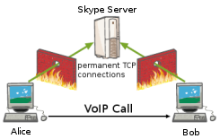
Step 1: Alice (visible on the network with IP 1.1.1.1) tries to call Bob, which signals Skype

Slide 24
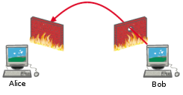
Step 2: Bob tries to reach Alice on known IP and port. The Bob's router / firewall allows this marking the outgoing datagram as NEW. Alice's subsequent replies will be tagged as ESTABLISHED (related to the first datagram to Bob)

Slide 25
Example
Bob's Skype program then punches a hole in its own network firewall: It sends a UDP packet to 1.1.1.1 port 1414
This is discarded by Alice's firewall, but Bob's firewall doesn't know that
The Bob's firewall now thinks that anything which comes from 1.1.1.1 port 1414 and is addressed to Bob's IP address 2.2.2.2 and port 2828 is legitimate (it must be the response to the query which has just been sent by Bob)

Slide 26
Example
Now, the Skype server passes Bob's coordinates on to Alice, whose Skype application attempts to contact Bob at 2.2.2.2:2828
Bob's firewall sees the recognised sender address and passes the apparent response on to Bob's PC (and his Skype phone rings)

Slide 27
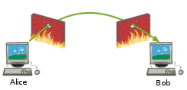
Step 3: Alice finally reaches Bobs computer through the hole.

Slide 28
Note
This simplified description depends on the specific properties of the firewalls used. But it corresponds in principle to our observations of the process of establishing a connection between two Skype clients, each of which was behind a Linux firewall. The firewalls were configured with NAT for a LAN and permitted outgoing UDP traffic

Slide 29
Linux NAT
Linux' NAT functions have the VoIP friendly property of, at least initially, not changing the ports of outgoing packets
The NAT router merely replaces the private, local IP address with its own address - the UDP source port selected by Skype is retained
Only when multiple clients on the local network use the same source port, the NAT router resets the outgoing port number to a previously unused value
Each set of two IP addresses and ports must be able to be unambiguously assigned to a connection between two computers at all times
The router will subsequently have to reconstruct the internal IP address of the original sender from the response packet's destination port

Slide 30
Other NAT routers
Other NAT routers will try to assign ports in a specific range
for example ports from 30,000 onwards, and translate UDP port 1414, if possible, to 31414
This is, of course, no problem for Skype
The procedure described above continues to work in a similar manner without limitations, provided it is possible to reconstruct from the Alice’s port value, the actual value replaced by his router

Slide 31
Complication
It becomes a little more complicated if a firewall simply assigns ports in sequence
Check Point's FireWall-1: the first connection is assigned 30001, the next 30002, etc.
The Skype server knows that Bob is talking to it from port 31234, but the connection to Alice will run via a different port

Slide 32
NAT Testing
How a commercial NAT router reallocates the ports?
http://nattest.net.in.tum.de/?mod=publications

Slide 33
Complication
But even here Skype is able to bypass the firewall
It simply runs through the ports above 31234 in sequence, hoping at some point to stumble on the right one
If this doesn't work at the first go, Skype doesn't give up. Bob's Skype opens a new connection to the Skype server, the source port of which is then used for a further sequence of probes

Slide 34
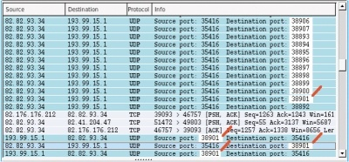
Skype can do port scans. Here it suceeds on port 38901 and connects through the firewall.

Slide 35
necessity of predicting the two port numbers
Nevertheless, in very active networks Alice may not find the correct open port
The same also applies for a particular type of firewall, which assigns every new connection to a random source port
The Skype server is then unable to tell Alice where to look for a suitable hole in Bob's firewall
In such cases a Skype server ( or a so-called super-peer) is then used as a relay
https://secure.wikimedia.org/wikipedia/en/wiki/Network_address_translation

Slide 36
Skype server as a relay
A Skype relay can accept incoming connections from both Alice and Bob and relays the packets onwards
This solution is always possible, as long as the firewall permits outgoing UDP traffic
It involves, however, an additional load on the infrastructure, because all audio data has to run through Skype's relay
The extended packet transmission times can also result in an unpleasant delay
Skype relays are not necessarily official servers: a client skype can inadvertendly be a relay!

Slide 37
UDP hole punching
Use of the procedure described above is not limited to Skype and is known as "UDP hole punching“
Other network services such as the Hamachi gaming VPN application, which relies on peer-to-peer communication between computers behind firewalls, use similar procedures
RFC 3489 "Simple Traversal of UDP through NAT" (STUN) describes a protocol which with two STUN clients can get around the restrictions of NAT with the help of a STUN server

Slide 38
DIY hole punching
You can try UDP hole punching:
hping3 + netcat (Linux)
Local is a computer behind a Linux firewall (local-fw) with a stateful firewall which only permits outgoing (UDP) connections
For simplicity, in our test the test computer remote was connected directly to the internet with no firewall

Slide 39
DIY hole punching
Firstly start a UDP listener on UDP port 14141 on the local/1 console behind the firewall:
local/1# nc -u –l 14141 or
local/1# nc -u –l -p 14141
An external computer remote then attempts to contact it :
remote# echo "hello" | nc -p 53 -u local-fw 14141
However, as expected nothing is received on local/1 and, thanks to the firewall, nothing is returned to remote.
Now on a second console, local/2, hping3, our universal tool for generating IP packets, punches a hole in the firewall :
local/2# hping3 -c 1 --udp -s 14141 -p 53 remote

Slide 40
DIY hole punching
remote will send back a "port unreachable" response via ICMP - however this is of no consequence. On the second attempt :
remote# echo "hello" | nc -p 53 -u local-fw 14141
the netcat listener on console local/1 then coughs up a "hello” (the UDP packet from outside has passed through the firewall and arrived at the computer behind it)

Slide 41
DIY hole punching
Network administrators who do not appreciate this sort of hole in their firewall and are worried about abuse, are left with only one option (they have to block outgoing UDP traffic, or limit it to essential individual cases)
UDP is not required for normal internet communication anyway (the web, e-mail and similar all use TCP, but not DNS)
Streaming protocols (voIP, etc.) may encounter problems, as they often use UDP because of the reduced overhead
TCP hole punching is also possible

Slide 42
Surprise!
hole punching also works with TCP
After an outgoing SYN packet the firewall / NAT router will forward incoming packets with suitable IP addresses and ports to the LAN even if they fail to be ACK’ed or the wrong sequence number is ACK’ed.
Linux firewalls at least, clearly fail to evaluate this information consistently
Establishing a TCP connection in this way is, however, not quite simple, because Alice does not have the sequence number sent in Bob's first packet.
The packet containing this information was discarded by her firewall.

