Slide 1
Network Security Laboratory Session 6
Layer 3 attacks

Slide 2
IP Spoofing
Similar to ARP spoofing attack but it relies on the IP address of a victim host
There are many different techniques to perform this attack but the most common is to use an ARP poisoner
In this case the ARP poisoner will send ARP reply associating its MAC address to the victim IP Address
When the router will forward packets the attacker will receive all the data

Slide 3
Man In The Middle (MITM)
All the attacks we built so far are part of MITM
A MITM is a type of attack in which an Host is able to capture, read and forward packets of other hosts
We will try to create a full-duplex MITM, based on ARP Spoofing, using ettercap

Slide 4
DNS Spoofing
DNS cache poisoning (or DNS Spoofing), is a form of computer security hacking in which corrupt Domain Name System data is introduced into the DNS resolver's cache
It causes the name server to return an incorrect result record (for example, an wrong IP address)
All the traffic is diverted to the attacker's computer (or to any other computer)

Slide 5
DHCP Spoofing
DHCP Spoofing attack is the most relyable MITM attack
A victim will receive an IP address from the Rogue DHCP server and will be connected to its subnet
All traffick will be captured from the Rogue server

Slide 6
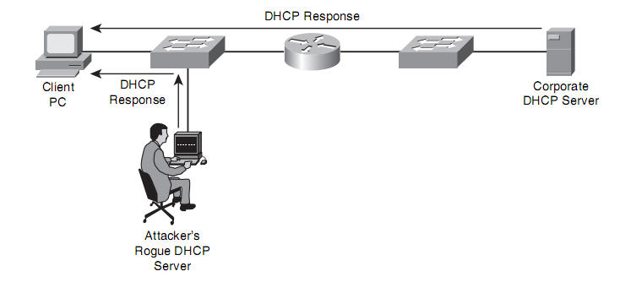
DHCP Spoofing

Slide 7
Ettercap
Ettercap is a well-known tool for MITM attacks
We will focus on ARP and DNS spoofing attacks
Install Ettercap using the following command
sudo apt install ettercap-text-only

