Slide 1
Network Security Laboratory – Lecture 4
LAYER 2 ATTACKS
Dott. Andrea Baffa
email: abaffa94@servizimicrosoft.unical.it

Slide 2
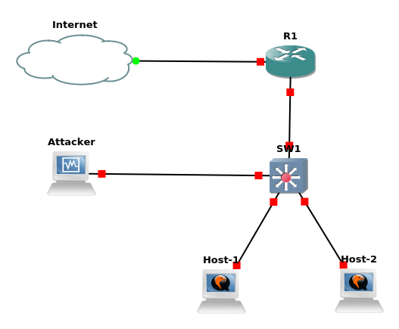
Layer 2 Attacks
Layer 2 attacks are attacks that works into LAN
This attacks are the most common
Usually the target is a switch, a router or an host

Slide 3
MAC Flooding
This attack try to exploit the limit of the switch mac table size
An attacker fill this mac table sending random mac address that the switch will learn
When the mac table of the switch is full then it will start to broadcast the coming packages (like an HUB)
This happens because the switch cannot memorize on which port a mac address talk

Slide 4
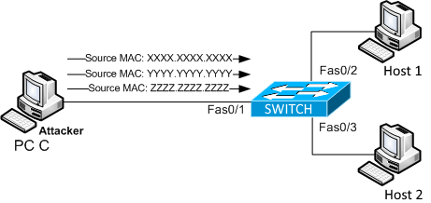
MAC Flooding

Slide 5
ARP Spoofing
This attack is based on using the mac address of another host in order to force other hosts to send frames to it.
When we perform an ARP Spoofing inside an enterprise network and we are connected to a switch we are basically performing also a port stealing attack.
Port stealing attaack occurs when we force the link between a switch port and a mac address
When this happens the switch will forward the frame of that mac address to our port instaed of the original one

Slide 6
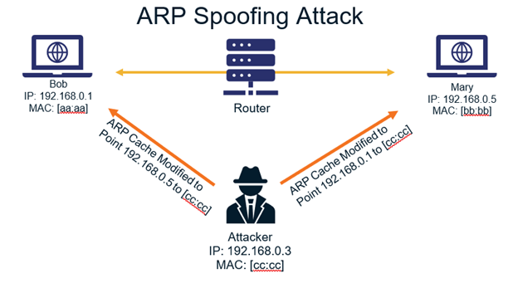
ARP Spoofing

Slide 7
Scapy Module
Scapy is a python module very useful in networking
Its main purpose is to sniff traffick and forge packets
We will use in our laboratory to forge packets for our attacks
On scapy website there are some useful tips to create packets and perform attacks
Scapy Documentation: https://scapy.readthedocs.io/en/latest/

Slide 8
Challanges
On the course website there are two challenges:
MacFloodingChallenge
ArpSpoofingChallange
The scope is to find the flags and send it on email to:
abaffa94@servizimicrosoft.unical.it
With subject: [MacFloodingChallenge] or [ArpSpoofingChallenge]
On the body must be specified the text of the flag!

Slide 9
Useful Commands
Sending data with Scapy (Mac Flooding)
sendp(Ether(src=<<MAC_ADDRESS>>, dst=<<MAC_ADDRESS>>)/ARP(op=2, psrc="<<IP_ADDRESS(Or subnet)>>", hwdst="<<BROADCAST_MAC_ADDRESS>>"), loop=1)
RandMAC() → inside scapy for generating random mac address
Sending data with Scapy (ARP Spoofing)
sendp(pkt = Ether(src='<<VICTIM_MAC_ADDRESS>>', dst=’<<BROADCAST_MAC_ADDRESS>>')/ARP(op=2, hwsrc='<<VICTIM_MAC_ADDRESS>>’, pdst='<<VICTIM_IP_ADDRESS>>')
sudo tshark -Y '<<FILTER>>' -Tfields -e data > raw.txt
xxd -r -p > output.txt
openssl enc -<<CYPHER>> -d -k <<KEY>>-base64

Slide 10
Questions?

Slide 11
The lesson is over. Thank you!

