Slide 1

Windows Internals Tour
Windows Security
Andrea Dell’Amico – Microsoft Student Partner
andrea.dellamico@msptechrep.com

Slide 2
Roadmap
Security Principles
Code Integrity – Patch Guard
User Account Control
Data Execution Prevention
Address Space Layout Randomization
EFS
Trusted Platform Module (TPM)
BitLocker ™
Digital rights management (DRM)

Slide 3
The Security Problem
System is secure if its resources are utilized and access is as intended under all circumstances
Security violations:
Unauthorized reading of data (theft of information)
Unauthorized modification of data
Unauthorized destruction of data
Security measures:
Physical
User authorization
Weakness at high-level security may circumvent low-level (operating system) measures

Slide 4
Solving the Security Problem
Access to a system (1) vs. access to resources on a system (2)
(1) is solved through
Authentication
Local or networked database of users
(2) is solved through
Permissions
Mandatory vs. discretionary access control
Capabilities vs. access control lists

Slide 5
Authentication
Username/password, biometric ID, smartcards
Special case of keys/capabilities
System generated vs. User generated passwords (hard to remember/easy to guess)
Paired passwords: system selects one/user responds appropriately
How to store passwords securely
one-way functions executed on passwords
easy to calculate but hard to invert
Shadow passwords
restricted access to password files

Slide 6
Security Ratings & Windows NT
Windows NT was designed to be secure from the start, which meant aiming at achieving a security rating from a recognized rating system
In 1981 the National Computer Security Center (NCSC www.radium.nsc.mil/tpep) was established as part of the US DoD’s NSA to help government, corporations and home users protect proprietary, confidential information
Part of the goal was to create security ratings, also known as the “Orange Book”, which were defined in 1983

Slide 7
Security Ratings
A1 | Verified Design
B3 | Security Domains
B2 | Structured Protection (Trusted XENIX)
B1 | Labeled Security Protection (HP-UX, Trusted IRIX, Tru64 UNIX)
C2 | Controlled Access Protection (highest level considered practical for general purpose OS)
C1 | Discretionary Access Protection (obsolete)
D | Minimal Protection (e.g. DOS)

Slide 8
Windows Security Support
Microsoft’s goal was to achieve C2, which requires:
Secure Logon: NT provides this by requiring user name and password
Discretionary Access Control: fine grained protection over resources by user/group
Security Auditing: ability to save a trail of important security events, such as access or attempted access of a resource
Object reuse protection: must initialize physical resources that are reused e.g. memory, files

Slide 9
Code Integrity - PatchGuard
Code Integrity (CI) protects Windows by verifying that system binaries haven’t been tampered
CI starts as Windows starts up. The boot loader checks the integrity of the kernel, the Hardware Abstraction Layer (HAL), and the boot-start drivers.

Slide 10
Code Integrity - PatchGuard
CI checks also all binaries loaded into protect process and system DLL
Only signed Driver on x64 system
OS can be booted in Test Mode, but no DRM will works (eg. no DVD or WMV play)

Slide 11
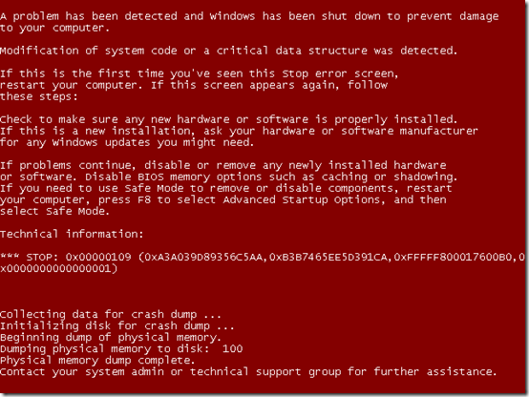

Code Integrity - PatchGuard
And if something goes wrong?
Check Mark Russinovich Blog to see how change BSOD Colors!
http://shortlink.it/s/iVwl

Slide 12
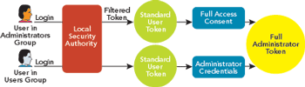
User Account Control
Implementation of Principle of least privilege

Slide 13
User Account Control
No need to have administrative token to do «common» jobs
Most application are now written to support UAC
There is a legacy support to avoid poor written programs

Slide 14
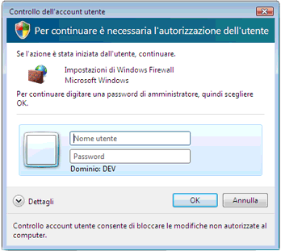
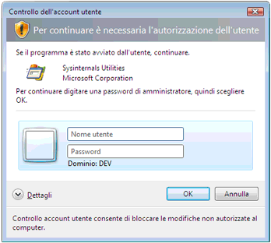
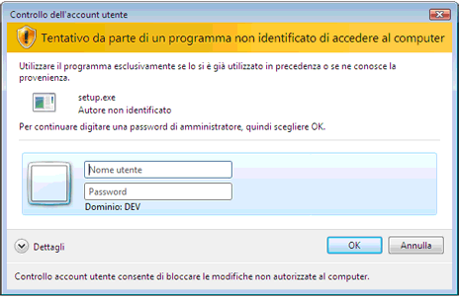
UAC Dialogs

Slide 15
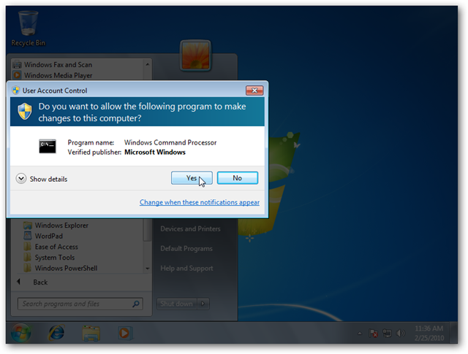
UAC Secure Desktop
UAC Prompt only appear on Secure Desktop mode (default)
Secure Desktop works on a different session from user one
No interaction between Secure Desktop session and user session -> no malware can click in place of user

Slide 16
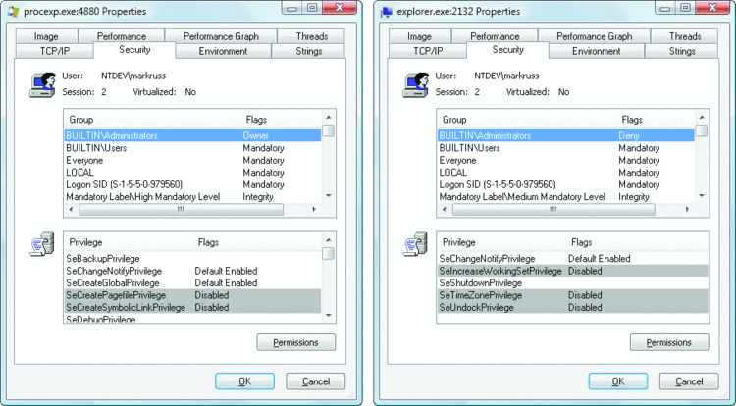
UAC Token
Admin
User
Notes:
Un gruppo con il flag di sola negazione può essere utilizzato solo per negare l'accesso dell'utente a una risorsa, mai per consentire tale accesso, chiudendo un punto di vulnerabilità che potrebbe essere creato se il gruppo venisse rimosso completamente. Se, ad esempio, un file contenesse un elenco di controllo di accesso (ACL, Access Control List) che negasse al gruppo Administrators qualsiasi tipo di accesso, ma concedesse determinati tipi di accessi a un altro gruppo a cui l'utente appartiene, all'utente verrebbe concesso l'accesso se il gruppo Administrators fosse assente dal token, concedendo alla versione utente standard dell'identità dell'utente un numero di accessi maggiore rispetto alla relativa identità amministrativa.
I sistemi autonomi, che sono in genere rappresentati dai computer di casa, e i sistemi appartenenti a un dominio gestiscono l'accesso in modalità Approvazione amministratore da parte degli utenti remoti in modo differente in quanto i computer connessi a un dominio possono utilizzare gruppi amministrativi di dominio nelle relative autorizzazioni per le risorse. Quando un utente accede a una condivisione file di un computer autonomo, Windows richiede l'identità utente standard dell'utente remoto, mentre in sistemi appartenenti a un dominio Windows rispetta tutte le appartenenze ai gruppi di dominio dell'utente richiedendo l'identità amministrativa dell'utente.

Slide 17
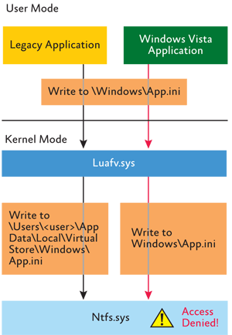
UAC File Virtualization
Virtualization improve compatibility
Give to legacy Application the possibility to write in some path that are not allowed by new security model
Implemented as a Filter Driver
No interaction with new programs that follow Microsoft Guideline (manifest, 64bit, etc.)

Slide 18
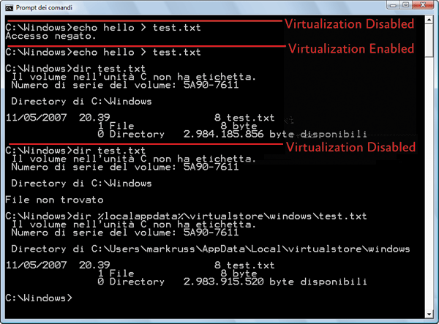
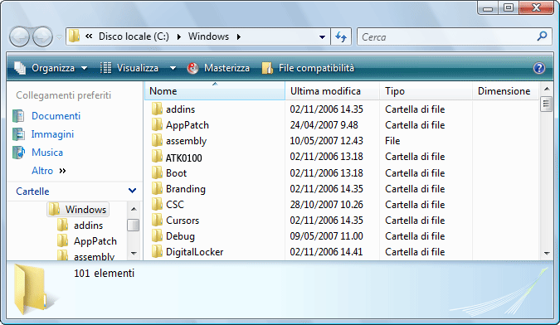
UAC File Virtualization

Slide 19
Registry Virtualization
Implementation slightly different from File System Virtualization, will work not as a filter but inside the configuration manager
Only commonly modified keys by legacy application are virtualized

Slide 20
Data Execution Prevention
Windows XP SP2 and newer OS support Data Execution Prevention (DEP)
Prevents code from executing in a memory page not specifically marked as executable
Stops exploits that rely on getting code executed in data areas
Relies on hardware ability to mark pages as non executable, AMD NX or Intel XD
Processor support:
About all CPU from Intel, AMD and VIA shipped in last 3 years.

Slide 21
Data Execution Prevention
Attempts to execute code in a page marked no execute result in:
User mode: access violation exception
Kernel mode: ATTEMPTED_EXECUTE_OF_NOEXECUTE_MEMORY bugcheck (blue screen)
Memory that needs to be executable must be marked as such using page protection bits on VirtualAlloc and VirtualProtect APIs:
PAGE_EXECUTE, PAGE_EXECUTE_READ, PAGE_EXECUTE_READWRITE, PAGE_EXECUTE_WRITECOPY

Slide 22
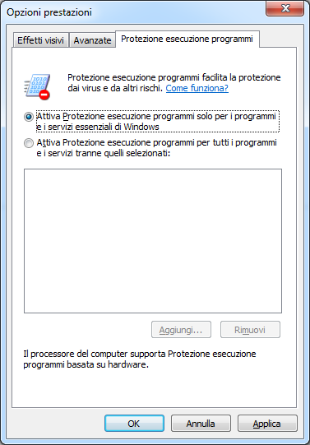
Data Execution Prevention
User can select witch programs are protected by DEP
Can be disabled changing registry key for each program image

Slide 23
Address Space Layout Randomization
Many exploits use buffer overflow technique to use some code that is already present in memory to do “bad” things
If you know where the code is… you can try to execute it…
ASLR make this kind of operation more hard, because move the well know DLL and System Components…

Slide 24
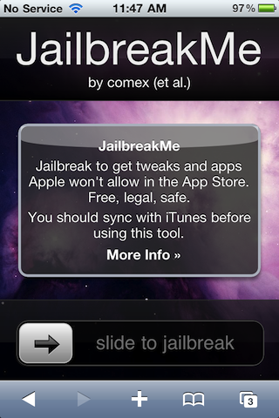
Address Space Layout Randomization
The absence of ASLR in some modern OS causes many security problems, just think of iPhone iOS Jailbreak, done by web browser…

Slide 25
Address Space Layout Randomization
How it works?
DLL address will be computed at boot time
Executable address are calculated when the image is loaded using a 8 bit pseudo random number
Also Stack and Heap are randomized

Slide 26
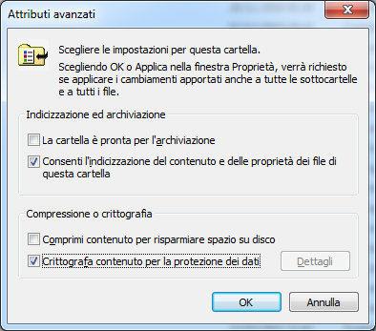
EFS
Native encryption for NTFS File System
Transparent for user
Key is encrypted with user password or Smart Card

Slide 27
Flow of EFS
Application
1
Application writes data to an encrypted file
2
NTFS places data in file system cache
EFS driver
NTFS file system driver
Cache manager
4
Cache manager lazy writes data to disk via NTFS
3
NTFS asks EFS driver to encrypt file contents headed to disk
5
NTFS writes encrypted file contents to disk
Volume
Note: EFS driver has been merged into NTFS on Windows XP and later

Slide 28
EFS weak point
If password is compromised, encryption is compromised
If the domain password is cached, can be cracked offline after having access to the system

Slide 29
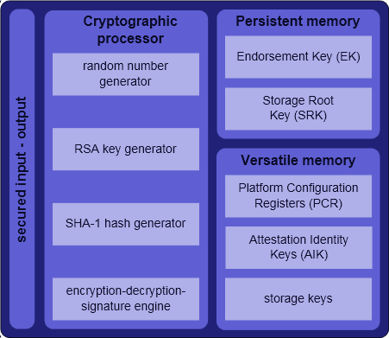
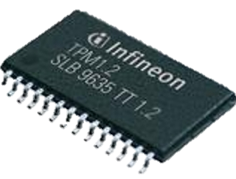
Trusted Platform Module

Slide 30
Trusted Platform Module
Can be disable by user
Direct Anonymous Attestation
Linux Kernel 2.6.13 has TPM Support

Slide 31
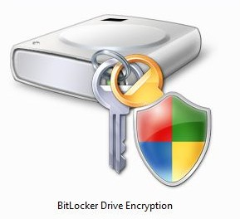
BitLocker ™
Introduced first on Windows Vista, now on 7 and 2008 R2
Can protect not only users files but also the whole system partition
Use AES 128 or AES 256 to encrypt data
Will use TPM 1.2 if present on the system

Slide 32
BitLocker™ Drive Encryption Architecture

Slide 33


Disk Layout And Key Storage
OS Volume Contains
Encrypted OS
Encrypted Page File
Encrypted Temp Files
Encrypted Data
Encrypted Hibernation File
Where’s the Encryption Key?
SRK (Storage Root Key) contained in TPM
SRK encrypts FVEK (Full Volume Encryption Key) protected by TPM/PIN/USB Storage Device
FVEK stored (encrypted by SRK) on hard drive in the OS Volume
3
OS Volume
2
FVEK
1
SRK
System
System Volume Contains:
MBR, Boot manager, Boot Utilities
(Unencrypted, small)

Slide 34

How to Crack BitLocker ™?
Find target machine
Check if is power on or standby
Cool RAM with very cold spray
Dump memory with USB boot disk
Find BitLocker Key inside some memory location…
Easy?

Slide 35
Digital rights management (DRM)
Content Scrambling System (CSS)
Advanced Access Content System (AACS)
Protected Media Path

Slide 36

any questions?

Slide 37
Grazie a tutti per l’attenzione!

Slide 38


Microsoft, Windows Server 2003 R2, Windows Server 2008, Windows 7 and Window Vista are either registered trademarks or trademarks of Microsoft Corporation in the United States and/or other countries. The names of actual companies and products mentioned herein may be the trademarks of their respective owners. The information herein is for informational purposes only and represents the current view of Microsoft Corporation as of the date of this presentation. Because Microsoft must respond to changing market conditions, it should not be interpreted to be a commitment on the part of Microsoft, and Microsoft cannot guarantee the accuracy of any information provided after the date of this presentation. MICROSOFT MAKES NO WARRANTIES, EXPRESS, IMPLIED OR STATUTORY, AS TO THE INFORMATION IN THIS PRESENTATION.

Slide 39
Copyright Notice
These materials are part of the Windows Operating System Internals Curriculum Development Kit, developed by David A. Solomon and Mark E. Russinovich with Andreas Polze
Microsoft has licensed these materials from David Solomon Expert Seminars, Inc. for distribution to academic organizations solely for use in academic environments (and not for commercial use)
Andrea Dell’Amico – Microsoft Student Partner – Academic Club

