Slide 1

Network & Computer Security SSL/TLS
Prof. Giovambattista Ianni – Università della Calabria

Slide 2
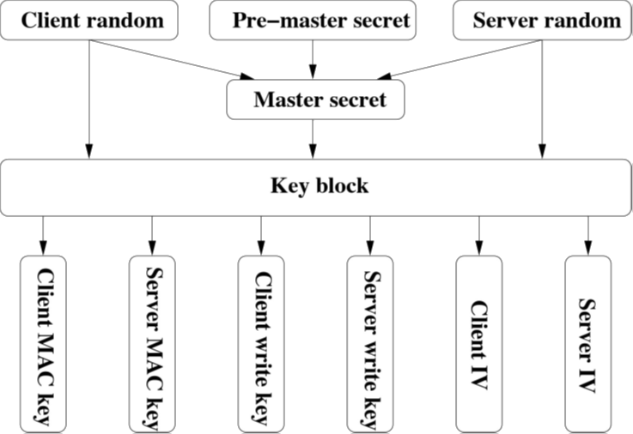
Key generation
Establish a pre_master_key of 48 byte using public key algorithms (e.g. RSA, Diffie-Hellman and FORTEZZA)
Generate master_secret applying a hash function to:
pre_master_key
ServerHello.random
ClientHello.random

Slide 3
Key generation (CONT.)
Produce key_block with master_secret
Iteratively use this function until key_block is long enough
Parts of the key_block
MAC secrets
Cryptographic keys
IVs (for CBC block ciphers or similar)

Slide 4
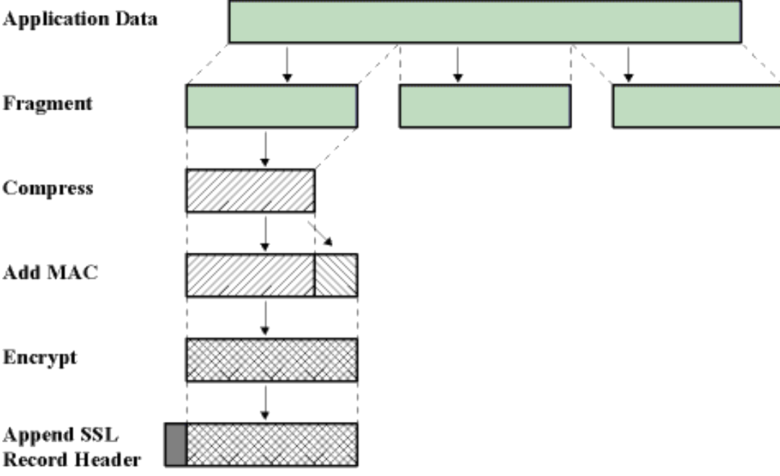
Ssl record processing
Fragmentation and packing in SSLPlaintext.
Packet compression in SSLCompressed.
Encryption of packets in SSLCiphertext:
Creation of MAC.
Append MAC to to SSLCompressed.
Encryption of packets using the chipper suite chose.
If block cipher is used then is necessary a padding and in some cases the IV.

Slide 5
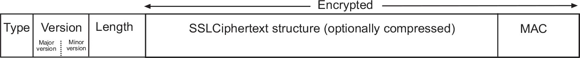
Ssl record processing (Cont.)
At the end of process a header is added to the SSLCiphertext to get a SSLRecord, which is composed by:
TYPE: the type of packet (SSL Change CipherSpec Protocol,Alert Protocol, HandshakeProtocol or Application Data Protocol).
VERSION: the version of SSL.
LENGHT:16-bit.

Slide 6
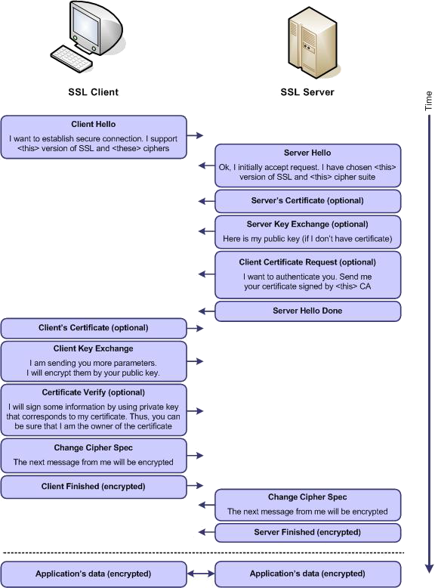
SSL step-by-step

Slide 7
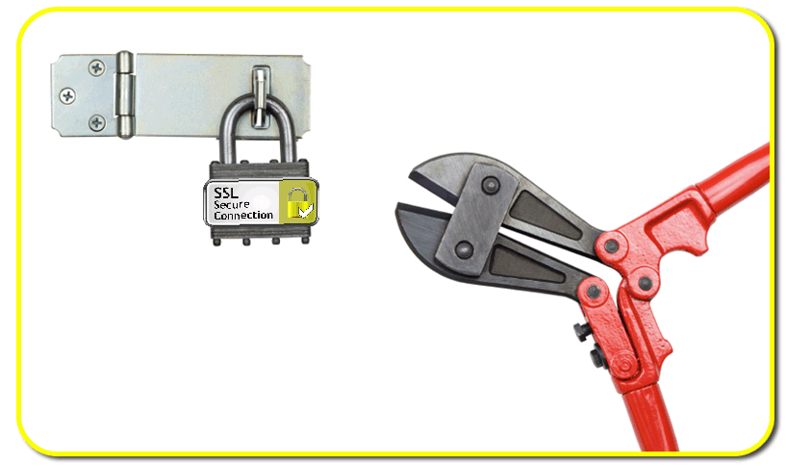
Attacks against ssl
BEAST
CRIME
BREACH

Slide 8
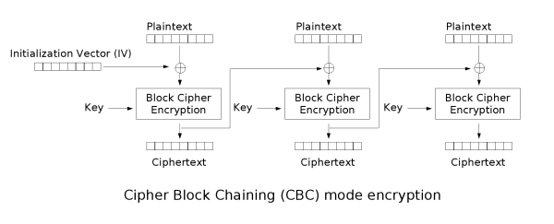
BEAST
Up to TLS 1.0 the IV of the first block of the first message is the last ciphertext block of the last message sent.
This makes the IV predictable.

Slide 9
Beast (cont.)
If the the attacker knows the last block of the last encrypted message can then try to guess the plaintext.
This is computationally difficult, but if the attacker is able to insert text in the user's plaintext then the TLS record will be occupied in part by the injected data and partly from the secret.
Suppose have a 16 byte encrypted text occupying 15 byte with the text, then the injected guess it will be easier to do.
If an attacker can cause the user to make more requests to the server by a guess&checking attack she/he can relatively easily gain access to sensitive data (like web cookies).

Slide 10
crime
Message length

Slide 11
CRIME (cont.)
Many servers support TLS compression to reduce congestion or the timing of loading.
The main method used is DEFLATE, composed by algorithms
LZ77, used to eliminate the redundancy of sequences
Huffman Coding, used to eliminate the redundancy of symbols
The attack works by trying to guess a secret by observing the length of the message sent. When in a guess message lengths are not larger than usual the guess is correct.
If compression is disabled, TLS CRIME can not be applied
Monitor the traffic data
The victims use https for authenticating and use TLS for compression
Injected Javascript to force the victim's browser to send repeated requests to the server

Slide 12
BREACH
Description
Based on the analysis of the compressed HTTP response.
The compression method must be DEFLATE, which compresses only HTTP body.
Requirements
Traffic monitoring of the victim.
Forcing the victim to visit a web page controlled by the attacker.
The application must support HTTP compression.
The response should contain the token or secret in the body.
Countermeasures
Disable the HTTP compression.
Length hiding.
Masking secrets

Slide 13
Test web-server
Can test the web server through several tools analyzing which protocols and ciphers are supported:
SSLYZE
SSLSCAN
Qualys SSL check (online) https://www.ssllabs.com/ssltest/

