Slide 1

Chapter 12 – Software Security
First Edition
by William Stallings and Lawrie Brown
Lecture slides by Lawrie Brown
Notes:
Lecture slides prepared by Dr Lawrie Brown (UNSW@ADFA) for “Computer Security: Principles and Practice”, 1/e, by William Stallings and Lawrie Brown, Chapter 12 “Software Security”.

Slide 2

many vulnerabilities result from poor programming practises
  cf. Open Web Application Security Top Ten include 5 software related flaws
  Cf. the CWE database
often from insufficient checking / validation of program input
awareness of issues is critical
Notes:
This chapter explores the general topic of software security. There are many vulnerabilities related to program deficiencies that result in the subversion of security mechanisms and allow unauthorized access and use of computer data and resources. The Open Web Application Security Project Top Ten list of critical web application security flaws includes five related to insecure software code. These include unvalidated input, cross-site scripting, buffer overflow, injection flaws, and improper error handling. These flaws occur as a consequence of insufficient checking and validation of data and error codes in programs. Awareness of these issues is a critical initial step in writing more secure program code.

Slide 3

software quality and reliability
  accidental failure of program
  from theoretically random unanticipated input
  improve using structured design and testing
  not how many bugs, but how often triggered
software security is related
  but attacker chooses input distribution, specifically targeting buggy code to exploit
  triggered by often very unlikely inputs
  which common tests don’t identify
Notes:
Software security is closely related to software quality and reliability, but with subtle differences. Software quality and reliability is concerned with the accidental failure of a program as a result of some theoretically random, unanticipated input, system interaction, or use of incorrect code. These failures are expected to follow some form of probability distribution. The usual approach to improve software quality is to use some form of structured design and testing to identify and eliminate as many bugs as is reasonably possible from a program. The testing usually involves variations of likely inputs and common errors, with the intent of minimizing the number of bugs that would be seen in general use. The concern is not the total number of bugs in a program, but how often they are triggered, resulting in program failure.
Software security differs in that the attacker chooses the probability distribution, targeting specific bugs that result in a failure that can be exploited by the attacker. These bugs may often be triggered by inputs that differ dramatically from what is usually expected, and hence are unlikely to be identified by common testing approaches.

Slide 4
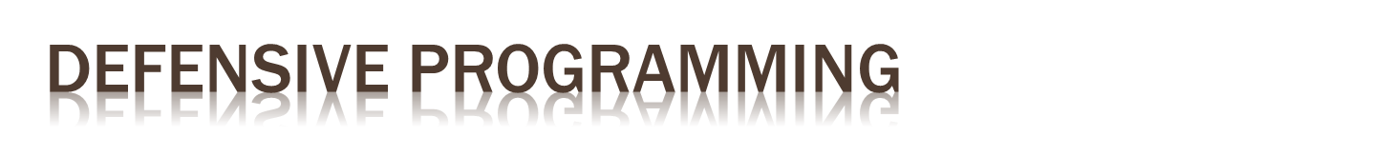
a form of defensive design to ensure continued function of software despite unforeseen usage
requires attention to all aspects of program execution, environment, data processed
also called secure programming
assume nothing, check all potential errors
rather than just focusing on solving task
must validate all assumptions
Notes:
Writing secure, safe code requires attention to all aspects of how a program executes, the environment it executes in, and the type of data it processes. Nothing can be assumed, and all potential errors must be checked. Wikipedia:
Defensive programming is a form of defensive design intended to ensure the continuing function of a piece of software in spite of unforeseeable usage of said software. The idea can be viewed as reducing or eliminating the prospect of Murphy's Law having effect. Defensive programming techniques come into their own when a piece of software could be misused mischievously or inadvertently to catastrophic effect.
Defensive programming is sometimes referred to as secure programming. A difference between defensive programming and normal practices is that nothing is assumed. All error states are accounted for and handled. In short, the programmer never assumes a particular function call or library will work as advertised, and so handles it in the code. When writing a program, programmers typically focus on what is needed to solve whatever problem the program addresses. Hence their attention is on the steps needed for success, and the “normal” flow of execution of the program, rather than considering every potential point of failure. They often make assumptions about the type of inputs a program will receive and the environment it executes in. Defensive programming means these assumptions need to be validated by the program, and all potential failures handled gracefully and safely.

Slide 5
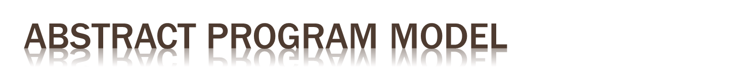
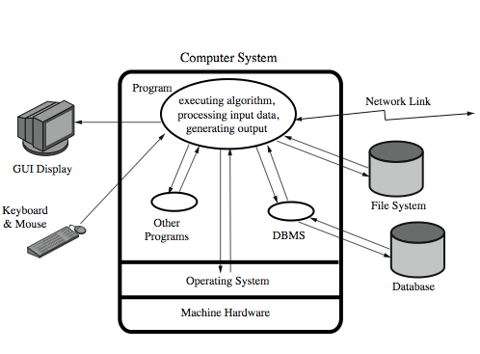
Notes:
To help clarify the issues, consider the abstract model of a program shown in Figure 12.1. This illustrates the concepts taught in most introductory programming courses. A program reads input data from a variety of possible sources, processes that data according to some algorithm, and then generates output, possibly to multiple different destinations. It executes in the environment provided by some operating system, using the machine instructions of some specific processor type. While processing the data, the program will use system calls, and possibly other programs available on the system. These may result in data being saved or modified on the system, or cause some other side effect as a result of the program execution. All of these aspects can interact with each other, often in complex ways. Correctly anticipating, checking and handling all possible errors will certainly increase the amount of code needed in, and the time taken to write, a program. This conflicts with business pressures to keep development times as short as possible to maximize market advantage. Unless software security is a design goal, addressed from the start of program development, a secure program is unlikely to result.

Slide 6

security and reliability common design goals in most engineering disciplines
  society not tolerant of bridge/plane etc failures
software development not as mature
  much higher failure levels tolerated
despite having a number of software development and quality standards
  main focus is general development lifecycle
  increasingly identify security as a key goal
Notes:
The necessity for security and reliability to be design goals from the inception of a project has long been recognized by most engineering disciplines. Society in general is intolerant of bridges collapsing, buildings falling down or airplanes crashing. The design of such items is expected to provide a high likelihood that these catastrophic events will not occur. Software development has not yet reached this level of maturity, and society tolerates far higher levels of failure in software than it does in other engineering disciplines. This is despite the best efforts of software engineers, and the development of a number of software development and quality standards. While the focus of these standards is on the general software development lifecycle, they increasingly identify security as a key design goal. In recent years increasing recognition has been given to software security issues by a number of major companies, including Microsoft and IBM. The topic of software development techniques and standards, and the integration of security with them, is well beyond the scope of this text. However we will explore some specific software security issues, which should be incorporated into a wider development methodology.

Slide 7

incorrect handling a very common failing
input is any source of data from outside
  data read from keyboard, file, network
  also execution environment, config data
must identify all data sources
and explicitly validate assumptions on size and type of values before use
Notes:
Incorrect handling of program input is one of the most common failings in software security. Program input refers to any source of data that originates outside the program, and whose value is not explicitly known by the programmer when the code was written. This obviously includes data read into the program from user keyboard or mouse entry, files, or network connections. However, it also includes data supplied to the program in the execution environment, the values of any configuration or other data read from files by the program, and values supplied by the operating system to the program. All sources of input data, and any assumptions about the size and type of values they take, have to be identified. Those assumptions must be explicitly verified by the program code, and the values used in a manner consistent with these assumptions. The two key areas of concern for any input are the size of the input, and the meaning and interpretation of the input.

Slide 8

often have assumptions about buffer size
  eg. that user input is only a line of text
  size buffer accordingly but fail to verify size
  resulting in buffer overflow (see Ch 11)
testing may not identify vulnerability
  since focus on “normal, expected” inputs
safe coding treats all input as dangerous
  hence must process so as to protect program
Notes:
When reading or copying input from some source, programmers often make assumptions about the maximum expected size of input. If the input is text entered by the user, either as a command-line argument to the program, or in response to a prompt for input, the assumption is often that this input would not exceed a few lines in size. Consequently, the programmer allocates a buffer of typically 512 or 1024 bytes to hold this input, but often does not check to confirm that the input is indeed no more than this size. If it does exceed the size of the buffer, then a buffer overflow occurs which can potentially compromise the execution of the program. We discuss the problems of buffer overflows in detail in Chapter 11. Testing of such programs may well not identify the buffer overflow vulnerability, as the test inputs provided would usually reflect the range of inputs the programmers expect users to provide. These are unlikely to include sufficiently large inputs to trigger the overflow, unless this vulnerability is being explicitly tested.
Writing code that is safe against buffer overflows requires a mindset that regards any input as dangerous, and processes it in a manner that does not expose the program to danger. With respect to the size of input, this means either using a dynamically sized buffer to ensure that sufficient space is available, or processing the input in buffer sized blocks. Even if dynamically sized buffers are used, care is needed to ensure that the space requested does not exceed available memory. These checks must apply wherever data whose value is unknown enters, or is manipulated by, the program. They must also apply to all potential sources of input.

Slide 9

program input may be binary or text
  binary interpretation depends on encoding and is usually application specific
  text encoded in a character set e.g. ASCII
  internationalization has increased variety
  also need to validate interpretation before use
    e.g. filename, URL, email address, identifier
failure to validate may result in an exploitable vulnerability
Notes:
The other key concern with program input is its meaning and interpretation. Program input data may be broadly classified as textual or binary. When processing binary data, the program assumes some interpretation of the raw binary values as representing integers, floating point numbers, character strings, or some more complex structured data representation. The assumed interpretation must be validated as the binary values are read. The details of how this is done will depend very much on the particular interpretation of encoding of the information. More commonly though, programs process textual data as input. The raw binary values are interpreted as representing characters, according to some character set. Traditionally, the ASCII character set was assumed, although common systems like Windows and MacOSX both use different extensions to this to manage accented characters. With increasing internationalization of programs, there is an increasing variety of character sets being used. Care is needed to identify just which set is being used, and hence just what characters are being read. Beyond identifying which characters are input, their meaning has also to be identified. They may represent an integer or floating-point number. They might be a filename, a URL, an email address, or an identifier of some form. Depending on how these inputs are used, it may be necessary to confirm that the values entered do indeed represent the expected type of data. Failure to do so could result in a vulnerability that permits an attacker to influence the operation of the program, with possibly serious consequences.

Slide 10

flaws relating to invalid input handling which then influences program execution
  often when passed as a parameter to a helper program or other utility or subsystem
most often occurs in scripting languages
  encourage reuse of other programs / modules
  often seen in web CGI scripts
Notes:
The term injection attack refers to a wide variety of program flaws related to invalid handling of input data. Specifically, this problem occurs when program input data can accidentally or deliberately influence the flow of execution of the program. There are a wide variety of mechanisms by which this can occur. One of the most common is when input data is passed as a parameter to another helper program on the system, whose output is then processed and used by the original program. This most often occurs when programs are developed using scripting languages such as perl, PHP, python, sh and many others. Such languages encourage the reuse of other existing programs and system utilities where possible to save coding effort. They may be used to develop applications on some system. More commonly, they are now often used as web CGI scripts to process data supplied from HTML forms.

Slide 11

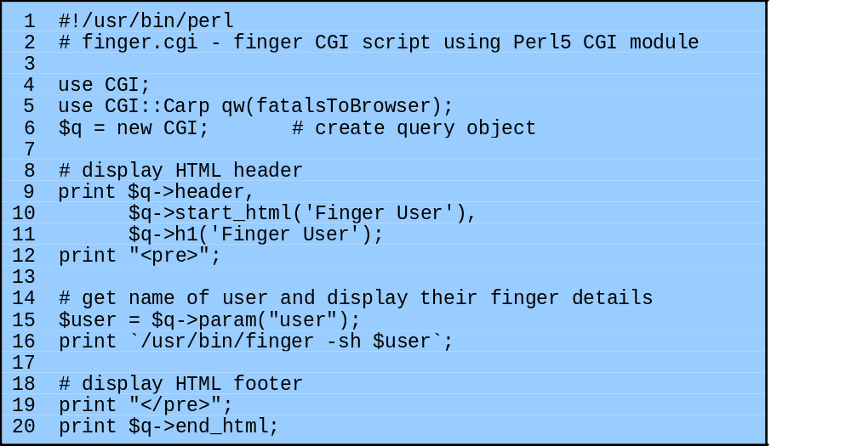
Notes:
Consider the example perl CGI script shown here in Figure 12.2a, which is designed to return some basic details on the specified user using the Unix “finger” command. This script would be placed in a suitable location on the web server, and invoked in response to a simple form, such as that shown in the text Figure 12.2b. The script retrieves the desired information by running a program on the server system, and returning the output of that program, suitably reformatted if necessary, in a HTML web page. This type of simple form and associated handler were widely seen, and were often presented as simple examples of how to write and use CGI scripts. Unfortunately this script contains a critical vulnerability. The value of the user is passed directly to the finger program as a parameter. If the identifier of a legitimate user is supplied, for example “lpb”, then the output will be the information on that user. However if an attacker provides a value that includes shell meta-characters, for example “xxx; echo attack success; ls -l finger*”, then the result is that the attacker is able to run any program on the system with the privileges of the web server. In this example the extra commands were just to display a message and list some files in the web directory. But any command could be used. This is known as a command injection attack, since the input is used in the construction of a command that is subsequently executed by the system with the privileges of the web server. The main concern of this script’s designer was to provide web access to an existing system utility. The expectation was that the input supplied would be the login or name of some user, as it is when a user on the system runs the finger program. It is only when the web interface is provided, where the program is now run with the privileges of the web server but with parameters supplied by an unknown external user, that security concerns arise.

Slide 12

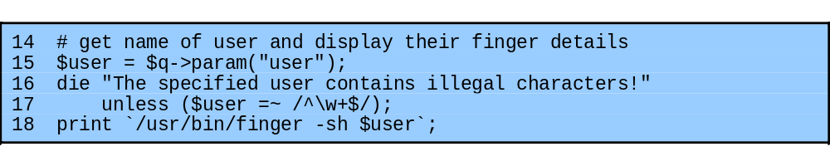
counter attack by validating input
  compare to pattern that rejects invalid input
  see example additions to script:
Notes:
To counter this attack, a defensive programmer needs to explicitly identify any assumptions as to the form of input, and to verify any input data conforms to those assumptions before any use of the data. This is usually done by comparing the input data to a pattern that describes its assumed form, and rejecting any input that fails this test. We discuss the use of pattern matching in the section on input validation. A suitable extension of the vulnerable finger CGI script is shown in Figure 12.2d. This adds a test which ensures the user input contains just alphanumeric characters. If not, the script terminates with an error message specifying that the supplied input contained illegal characters. Note that while this example uses perl, the same type of error can occur in a CGI program written in any language. While the solution details differ, they all involve checking that the input matches assumptions about its form.

Slide 13
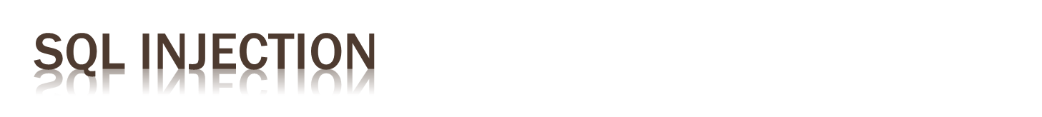
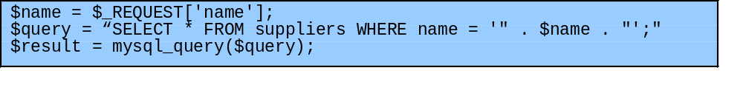
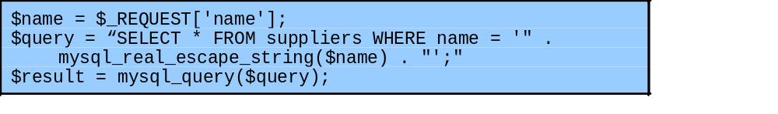
another widely exploited injection attack
when input used in SQL query to database
  similar to command injection
  SQL meta-characters are the concern
  must check and validate input for these
Notes:
Another widely exploited variant of this attack is SQL injection. In this attack, the user-supplied input is used to construct a SQL request to retrieve information from a database. Consider the excerpt of PHP code from a CGI script shown in Figure 12.3a. It takes a name provided as input to the script, typically from a form field similar to that shown in Figure 12.2b. It uses this value to construct a request to retrieve the records relating to that name from the database. The vulnerability in this code is very similar to that in the command injection example. The difference is that SQL metacharacters are used, rather than shell metacharacters. If a suitable name is provided, for example “Bob”, then the code works as intended, retrieving the desired record. However an input such as “Bob’ drop table suppliers --“ results in the specified record being retrieved, followed by deletion of the entire table! This would have rather unfortunate consequences for subsequent users. To prevent this type of attack, the input must be validated before use. Any metacharacters must either be escaped, canceling their effect, or the input rejected entirely. Given the widespread recognition of SQL injection attacks, many languages used by CGI scripts contain functions that can sanitize any input that is subsequently included in a SQL request. The code shown in Figure 12.3b illustrates the use of a suitable PHP function to correct this vulnerability.

Slide 14
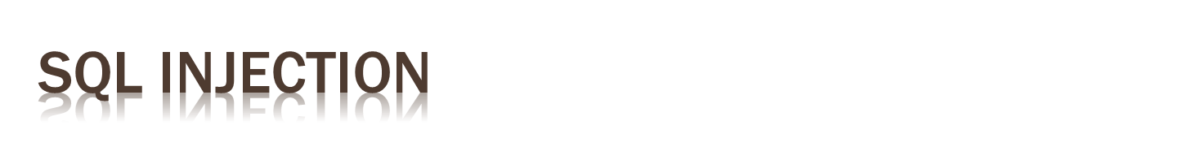
Attempts to manipulate the interaction between web application and database
Inserting data with irregular size in query form
Login via SQL injection
  authentication without a password
Access to tables
  display content
Edit the database
  insert, delete data

Slide 15

The attacker must know information about the structure of the database ...
One way to do this is to take advantage of the error messages that the DBMS returns following query failed
One can discover a vulnerabilityfor example by input '**** and checking the error messages you
  Display errors is useful during development and debugging
  However usually the display of errors is removed at the time of opening the site to the public, just to reduce the possibility to acquire information on the database

Slide 16
Blind SQL injection techniques allow the collection of information on databases with no error messages
  vulnerability to SQL injection:
    http://newspaper.com/items.php?id=2
    SELECT title, descr, body FROM items WHERE ID = 2
    http://newspaper.com/items.php?id=2 AND 1=1
    http://newspaper.com/items.php?id=2 AND 1=2
  the first query gives the same result as the original query, the second query gives no result, then the intruder can derive that the term AND is performed in the query, and that the page contains a vulnerability

Slide 17
DBMS Fingerprinting
  enter in a query DBMS-dependent functions in order to identify the type of DBMS
  now(), getdate() e sysdate() (MySQL, MSSQL & Oracle)
Timing attack
  insert in a query expression that, upon the occurrence of a certain condition, executes a command particularly time-consuming
  the attacker can understand if the condition is verified or not by the time it takes for the web server to respond

Slide 18
select *
from users
where uname = ‘ ”uname” ’ and pass= ‘ ”pass” ‘;
select *
from users
where uname = ‘existing_uname’ and pass= ‘’ OR 1=1 --‘;

Slide 19
select *
from users
where uname = ‘ ”uname” ’ and pass= ‘ ”pass” ‘;
select *
from users
where uname = ‘existing_uname’ and
pass= ‘any_pwd'; DELETE FROM users; --‘;
SQL Injection experiments: http://sqlzoo.net/hack/

Slide 20
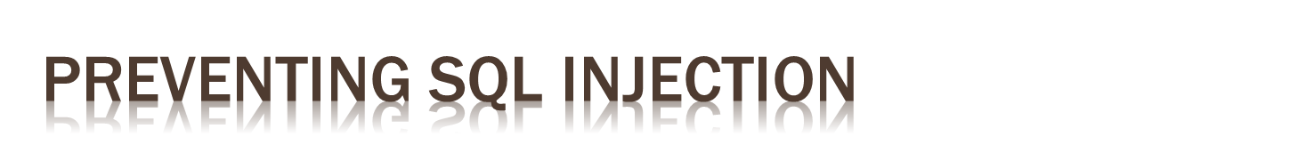
Verify the type of data entered by the user/attacker (server side data validation)
HASH or encrypt sensitive data (example: passwords)
Hide any error messages
Use prepared statements instead of creating query strings from the input parameters
  PreparedStatement pstmt= conn.prepareStatement(
  “ select balance
  from account
  where account_number =?“);
  pstmt.setString(1,accnt_number);
  pstmt.execute();

Slide 21
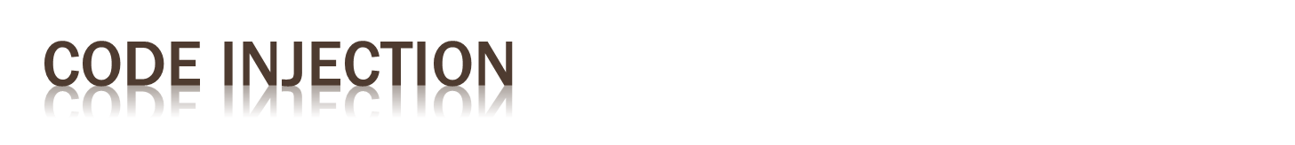
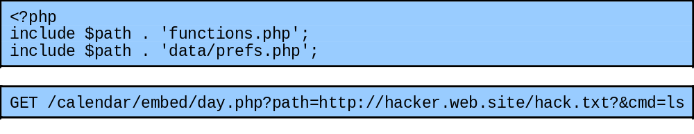
further variant
input includes code that is then executed
  see PHP remote code injection vulnerability
    variable + global field variables + remote include
  this type of attack is widely exploited
Notes:
A third common variant is the code injection attack, where the input includes code that is then executed by the attacked system. Many of the buffer overflow examples include a code injection component. However, there are also significant concerns about the injection of scripting language code into remotely executed scripts. Figure 12.4a illustrates a few lines from the start of a vulnerable PHP calendar script. The flaw results from the use of a variable to construct the name of a file that is then included into the script. Unfortunately attackers do not “play by the rules”. Just because a script is not supposed to be called directly, does not mean it is not possible. The access protections must be configured in the web server to block direct access to prevent this. Otherwise, if direct access to such scripts is combined with two other features of PHP, a serious attack is possible. The first is that PHP originally assigned the value of any input variable supplied in the HTTP request to global variables with the same name as the field. Hence a user could specify values for any desired global variable, and they would be created and passed to the script. In this example, the variable $path is not expected to be a form field. The second PHP feature concerns the behavior of the include command. Not only could local files be included, but if a URL is supplied, the included code can be sourced from anywhere on the network. Combine all of these elements, and the attack may be implemented using a request similar to that shown in Figure 12.4b. This results in the $path variable containing the URL of a file containing the attacker’s PHP code. It also defines another variable, $cmd, which tells the attacker’s script what command to run. This specific type of attack is known as a PHP remote code injection vulnerability. Recent reports indicate that a very large number of PHP CGI scripts are vulnerable to this attack, and are being actively exploited.

Slide 22

attacks where input from one user is later output to another user
XSS commonly seen in scripted web apps
  with script code included in output to browser
  any supported script, e.g. Javascript, ActiveX
  assumed to come from application on site
XSS reflection
  malicious code supplied to site
  subsequently displayed to other users
Notes:
Another broad class of vulnerabilities concerns input provided to a program by one user, that is subsequently output to another user, known as cross-site scripting (XSS) attacks because they are most commonly seen in scripted web applications. This vulnerability involves the inclusion of script code in the HTML content of a web page displayed by a user’s browser. The script code could be Javascript, ActiveX, VBScript, Flash or just about any client-side scripting language supported by a user’s browser. To support some categories of web applications, script code may need to access data associated with other pages currently displayed by the user’s browser. Since this clearly raises security concerns, browsers impose security checks and restrict such data access to pages originating from the same site. The assumption is that all content from one site is equally trusted, and hence is permitted to interact with other content from that site. Cross-site scripting attacks exploit this assumption. This data can include page contents, session cookies, and a variety of other objects. Attackers use a variety of mechanisms to inject malicious script content into pages returned to users by the targeted sites. The most common variant is the XSS reflection vulnerability. The attacker includes the malicious script content in data supplied to a site. If this content is subsequently displayed to other users without sufficient checking, they will execute the script assuming it is trusted to access any data associated with that site..

Slide 23
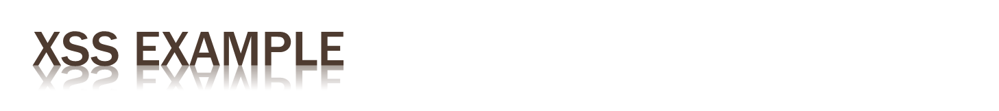
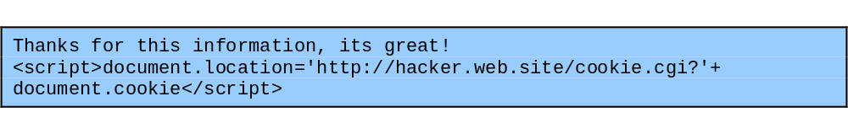
cf. guestbooks, wikis, blogs etc
where comment includes script code
  e.g. to collect cookie details of viewing users
need to validate data supplied
  including handling various possible encodings
attacks both input and output handling
Notes:
Consider the widespread use of “guestbook” programs, wikis, and blogs by many web sites. They all allow users accessing the site to leave comments, which are subsequently viewed by other users. Unless the contents of these comments are checked, and any dangerous code removed, the attack is possible. Consider the example shown from Figure 12.5a. If this text were saved by a guestbook application, then when viewed it displays a little text and then executes the Javascript code. This code replaces the document contents with the information returned by the attacker’s cookie script, which is provided with the cookie associated with this document. Many sites require users to register before using features like a guestbook application. With this attack, the user’s cookie is supplied to the attacker, who could then use it to impersonate the user on the original site. This example obviously replaces the page content being viewed with whatever the attacker’s script returns. By using more sophisticated Javascript code though, it is possible for the script to execute with very little visible effect. To prevent this attack, any user-supplied input should be examined, and any dangerous code removed, or escaped to block its execution. While the example shown may seem easy to check and correct, the attacker will not necessarily make the task this easy, as the information may be variously encoded and obscured. The same code may have all of the characters relating to the script code encoded using HTML character entities, as shown in the text Figure 12.5b. XSS attacks illustrate a failure to correctly handle both program input and program output. The failure to check and validate the input results in potentially dangerous data values being saved by the program. However the program is not the target. Rather it is subsequent users of the program, and the programs they use to access it, which are the target. If all potentially unsafe data output by the program is sanitized, then the attack cannot occur.

Slide 24
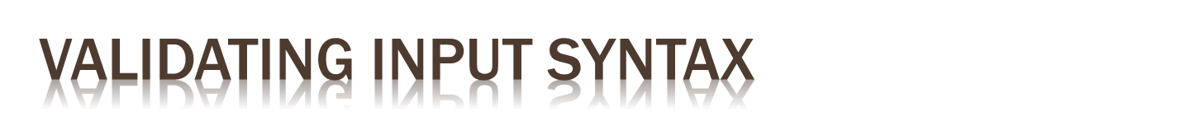
to ensure input data meets assumptions
  e.g. is printable, HTML, email, userid etc
compare to what is known acceptable
not to known dangerous
  as can miss new problems, bypass methods
commonly use regular expressions
  pattern of characters describe allowable input
  details vary between languages
bad input either rejected or altered
Notes:
Given the programmer cannot control the content of input data, it is necessary to ensure that such data conforms with any assumptions made about it before subsequent use. If the data is textual, these assumptions may be that it contains only printable characters, has certain HTML markup, is the name of a person, a userid, an email address, a filename or is a URL. A program using such input should confirm that it meets these assumptions. An important principle is that input data should be compared against what is wanted, accepting only valid input. The alternative is to compare the input data with known dangerous values. The problem with this approach is that new problems, and methods of bypassing existing checks continue to be discovered. By trying to block known dangerous input data, an attacker using a new encoding may succeed. By only accepting known safe data, the program is more likely to remain secure. This type of comparison is commonly done using regular expressions. It may be explicitly coded by the programmer, or may be implicitly included in a supplied input processing routine. A regular expression is a pattern composed of a sequence of characters that describe allowable input variants. Some characters in a regular expression are treated literally, and the input compared to them must contain those characters at that point. Other characters have special meanings, allowing the specification of alternative sets of characters, classes of characters, and repeated characters. Details of regular expression content and usage vary from language to language. An appropriate reference should be consulted for the language in use. If the input data fails the comparison, it could be rejected. Alternatively, it may be altered so that it does conform. This generally involves “escaping” metacharacters to remove any special interpretation, thus rendering the input safe.

Slide 25

may have multiple means of encoding text
  due to structured form of data, e.g. HTML
  or via use of some large character sets
Unicode used for internationalization
  uses 16-bit value for characters
  UTF-8 encodes as 1-4 byte sequences
  have redundant variants
    e.g. / is 2F, C0 AF, E0 80 AF
    hence if blocking absolute filenames check all!
must canonicalize input before checking
Notes:
Have issue of multiple, alternative encodings of the input data, which may allow multiple representations of characters. It can also occur because some character set encodings include multiple encodings of the same character. This is particularly obvious with the use of Unicode, and its UTF-8 encoding, which is widely used to support internationalization. It is the native character set used in the Java language, and in Windows XP and later. Unicode uses a 16-bit value to represent each character.. However many programs, databases, and other computer and communications applications assume an 8-bit character representation, with the first 128 values corresponding to ASCII. To accommodate this, a Unicode character can be encoded as a 1 to 4 byte sequence using the UTF-8 encoding. Any specific character is supposed to have a unique encoding. However, if the strict limits in the specification are ignored, common ASCII characters may have multiple encodings. For example, the forward slash character ‘/’, used to separate directories in a UNIX filename, has the hexadecimal value ‘2F’ in both ASCII and UTF-8. However UTF-8 also allows the redundant, longer encodings: ‘C0 AF’ and ‘E0 80 AF’. While strictly only the shortest encoding should be used, many Unicode decoders accept any valid equivalent sequence. Consider the consequences of multiple encodings when validating input. There is a class of attacks that attempt to supply an absolute pathname for a file to a script that expects only a simple local filename. Given the possibility of multiple encodings, the input data must first be transformed into a single, standard, minimal representation. This process is called canonicalization, and involves replacing alternate, equivalent encodings by one common value. Once this is done, the input data can then be compared with a single representation of acceptable input values.

Slide 26
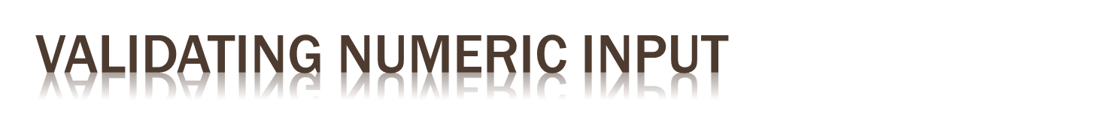
may have data representing numeric values
internally stored in fixed sized value
  e.g. 8, 16, 32, 64-bit integers or 32, 64, 96 float
  signed or unsigned
must correctly interpret text form
and then process consistently
  have issues comparing signed to unsigned
  e.g. large positive unsigned is negative signed
  could be used to thwart buffer overflow check
Notes:
There is an additional concern when the input data represents a numeric value. Such values are represented on a computer by a fixed size value. Integers are commonly 8, 16, 32 and now 64-bits in size. Floating point numbers may be 32, 64, 96 or other numbers of bits, depending on the computer processor used. These values may also be signed or unsigned. When the input data is interpreted, the various representations of numeric values, including optional sign, leading zeroes, decimal values, and power values must be handled appropriately. The subsequent use of numeric values must also be monitored. Problems particularly occur when a value of one size or form is cast to another. For example, a buffer size may be read as an unsigned integer. It may later be compared with the acceptable maximum buffer size. Depending on the language used, the size value that was input as unsigned may subsequently be treated as a signed value in some comparison. This leads to a vulnerability because negative values have the top bit set. This is the same bit pattern used by large positive values in unsigned integers. So the attacker could specify a very large actual input data length, which is treated as a negative number when compared with the maximum buffer size. Being a negative number it clearly satisfies a comparison with a smaller, positive buffer size. However when used, the actual data is much larger than the buffer allows, and an overflow occurs as a consequence of incorrect handling of the input size data. Once again, care is needed to check assumptions about data values, and to ensure all use is consistent with these assumptions.

Slide 27

powerful testing method using a large range of randomly generated inputs
  to test whether program/function correctly handles abnormal inputs
  simple, free of assumptions, cheap
  assists with reliability as well as security
can also use templates to generate classes of known problem inputs
  could then miss bugs, so use random as well
Notes:
A powerful approach called fuzzing was developed by Professor Barton Miller at the University of Wisconsin Madison in 198 to test for potential types of non-standard inputs that might be exploited by an attacker to subvert a program. It uses randomly generated data as inputs to a program. The intent is to determine whether the program or function correctly handles all such abnormal inputs, or whether it crashes or otherwise fails to respond appropriately. In the latter cases the program or function clearly has a bug that needs to be corrected. The major advantage of fuzzing is its simplicity, and its freedom from assumptions about the “expected” input to any program, service or function. The cost of generating large numbers of tests is very low. Further such testing assists in identifying reliability as well as security deficiencies in programs. While the input can be completely randomly generated, it may also be randomly generated according to some template. Such templates are designed to examine likely scenarios for bugs. This might include excessively long inputs, or textual inputs that contain no spaces or other word boundaries, for example. When used with network protocols, it might specifically target critical aspects of the protocol. The intent of using such templates is to increase the likelihood of locating bugs. The disadvantage is that the templates incorporate assumptions about the input. Hence bugs triggered by other forms of input would be missed. This suggests that a combination of these approaches is needed for a reasonably comprehensive coverage of the inputs.

Slide 28

next concern is processing of data by some algorithm to solve required problem
compiled to machine code or interpreted
  have execution of machine instructions
  manipulate data in memory and registers
security issues:
  correct algorithm implementation
  correct machine instructions for algorithm
  valid manipulation of data
Notes:
The second component of our model of computer programs is the processing of the input data according to some algorithm. For procedural languages like C and its descendents, this algorithm specifies the series of steps taken to manipulate the input to solve the required problem. High-level languages are typically compiled and linked into machine code, when is then directly executed by the target processor. Alternatively, a high-level language such as Java may be compiled into an intermediate language that is then interpreted by a suitable program on the target system. The same may be done for programs written using an interpreted scripting language. In all cases the execution of a program involves the execution of machine language instructions by a processor to implement the desired algorithm. These instructions will manipulate data stored in various regions of memory, and in the processor’s registers. From a software security perspective, the key issues are whether the implemented algorithm correctly solves the specified problem, whether the machine instructions executed correctly represent the high-level algorithm specification, and whether the manipulation of data values in variables, as stored in machine registers or memory, is valid and meaningful.

Slide 29

issue of good program development
to correctly handle all problem variants
  c.f. Netscape random number bug
  supposed to be unpredictable, but wasn’t
when debug/test code left in production
  used to access data or bypass checks
  c.f. Morris Worm exploit of sendmail
interpreter incorrectly handles semantics
hence care needed in design/implement
Notes:
The first issue is primarily one of good program development technique. The algorithm may not correctly implement all cases or variants of the problem. This might allow some seemingly legitimate program input to trigger program behavior that was not intended, providing an attacker with additional capabilities. A good example of this was the bug in some early releases of the Netscape web browser. Their implementation of the random number generator used to generate session keys for secure web connections was inadequate. The assumption was that these numbers should be unguessable, short of trying all alternatives. However, due to a poor choice of the information used to seed this algorithm, the resulting numbers were relatively easy to predict. As a consequence, it was possible for an attacker to guess the key used, and then decrypt the data exchanged over a secure web session. This flaw was fixed by re-implementing the random number generator to ensure that it was seeded with sufficient unpredictable information that it was not possible for an attacker to guess its output. Another well-known example is the TCP session spoof or hijack attack. See text for details. Another variant of this issue is when the programmers deliberately include additional code in a program to help test and debug it. While this valid during program development, all to often this code remains in production releases of a program. At the very least, this code could inappropriately release information to a user of the program. At worst, it may permit a user to bypass security checks or other program limitations and perform actions they would not otherwise be allowed to perform. This type of vulnerability was seen in the sendmail mail delivery program in the late 1980’s, and famously exploited by the Morris Internet Worm. A further example concerns the implementation of the interpreter for interpreted high or intermediate-level languages. These examples illustrate the care that is needed when designing and implementing a program.

Slide 30

ensure machine instructions correctly implement high-level language code
  often ignored by programmers
  assume compiler/interpreter is correct
  c.f. Ken Thompson’s paper
requires comparing machine code with original source
  slow and difficult
  is required for higher Common Criteria EAL’s
Notes:
The second issue concerns the correspondence between the algorithm specified in some programming language, and the machine instructions that are run to implement it. This issue is one that is largely ignored by most programmers. The assumption is that the compiler or interpreter does indeed generate or execute code that validly implements the language statements. When this is considered at all, the issue is typically one of efficiency, usually addressed by specifying the required level of optimization flags to the compiler. With compiled languages, as Ken Thompson famously noted in [THOM84], a malicious compiler programmer could include instructions in the compiler to emit additional code when some specific input statements were processed. These statements could even include part of the compiler, so that these changes could be reinserted when it was compiled, even after all trace of them had been removed from the compiler source. If this were done, the only evidence of these changes would be found in the machine code. Locating this would require careful comparison of the generated machine code with the original source. For large programs, with many source files, this would be an exceedingly slow and difficult task. One that in general is very unlikely to be done. However the development of trusted computer systems with very high assurance level is the one area where this level of checking is required. Specifically, certification of computer systems using a Common Criteria assurance level of EAL7 require validation of the correspondence between design, source code and object code.

Slide 31

data stored as bits/bytes in computer
  grouped as words, longwords etc
  interpretation depends on machine instruction
languages provide different capabilities for restricting/validating data use
  strongly typed languages more limited, safer
  others more liberal, flexible, less safe e.g. C
strongly typed languages are safer
Notes:
The next issue concerns the correct interpretation of data values. At the most basic level, all data on a computer is stored as groups of binary bits, saved in bytes of memory, be grouped together as a word or longword values. They may be accessed and manipulated in memory, or they may be copied into processor registers before being used. Whether a group of bits is interpreted as representing a character, an integer, a floating point number, a memory address (pointer), or some more complex interpretation depends on the program operations used to manipulate it, and ultimately on the specific machine instructions executed. Different languages provide varying capabilities for restricting and validating assumptions on the interpretation of data in variables. If the language includes strong typing, then the operations performed on any specific type of data will be limited to appropriate manipulations of the values. This greatly reduces the likelihood of inappropriate manipulation and use of variables introducing a flaw in the program. Other languages though, allow a much more liberal interpretation of data, and permit program code to explicitly change their interpretation. The widely used language C has this characteristic. In particular, it allows easy conversion between interpreting variables as integers, and interpreting them as memory addresses (pointers). This results in errors caused by the inappropriate manipulation and use of pointers. A related issue is the occurrence of errors due to the incorrect manipulation of pointers in complex data structures, such as linked lists or trees, resulting in corruption of the structure, or changing of incorrect data values. Any such programming bugs could provide a means for an attacker to subvert the correct operation of a program, or simply to cause it to crash. The best defense against such errors is to use a strongly typed programming language.

Slide 32

issue of dynamic memory allocation
  used to manipulate unknown amounts of data
  allocated when needed, released when done
memory leak occurs if incorrectly released
many older languages have no explicit support for dynamic memory allocation
  rather use standard library functions
  programmer ensures correct allocation/release
modern languages handle automatically
Notes:
Related to the issue of interpretation of data values is the allocation and management of dynamic memory storage, generally using the process heap. Many programs, which manipulate unknown quantities of data, use dynamically allocated memory to store data when required. This memory must be allocated when needed, and released when done. If a program fails to correctly manage this process, the consequence may be a steady reduction in memory available on the heap to the point where it is completely exhausted. This is known as a memory leak, and often the program will crash once the available memory on the heap is exhausted. This provides an obvious mechanism for an attacker to implement a denial of service attack on such a program. Many older languages, including C, provide no explicit support for dynamically allocated memory. Instead support is provided by explicitly calling standard library routines to allocate and release memory. Unfortunately, in large complex programs, determining exactly when dynamically allocated memory is no longer required can be a very difficult task. As a consequence, memory leaks in such programs can easily occur, and be very difficult to identify and correct. There are library variants that implement much higher levels of checking and debugging such allocations which can be used to assist this process. Other languages like Java and C++ manage memory allocation and release automatically. While such languages do incur an execution overhead to support this automatic management, the resulting programs and generally far more reliable. The use of such languages is strongly encouraged to avoid memory management problems.

Slide 33

when multiple threads/processes access shared data / memory
unless access synchronized can get corruption or loss of changes due to overlapping accesses
so use suitable synchronization primitives
  correct choice & sequence may not be obvious
have issue of access deadlock
Notes:
Another topic of concern is management of access to common, shared memory by several processes, or threads within a process. Without suitable synchronization of accesses, it is possible that values may be corrupted, or changes lost, due to overlapping access, use and replacement of shared values. The resulting race condition occurs when multiple processes and threads compete to gain uncontrolled access to some resource. This problem is a well-known and documented issue that arises when writing concurrent code, whose solution requires the correct selection and use of appropriate synchronization primitives. Even so, it is neither easy nor obvious what the most appropriate and efficient choice is. If an incorrect sequence of synchronization primitives is chosen, it is possible for the various processes or threads to deadlock, each waiting on a resource held by the other. There is no easy way of recovering from this flaw without terminating one or more of the programs. An attacker could trigger such a deadlock in a vulnerable program to implement a denial of service upon it. In large complex applications, ensuring that deadlocks are not possible can be very difficult. Care is needed to carefully design and partition the problem to limit areas where access to shared memory is needed, and to determine the best primitives to use.

Slide 34

programs execute on systems under O/S
  mediates and shares access to resources
  constructs execution environment
  with environment variables and arguments
systems have multiple users
  with access permissions on resources / data
programs may access shared resources
  e.g. files
Notes:
The third component of our model of computer programs is that it executes on a computer system under the control of an operating system (O/S). This aspect of a computer program is often not emphasized in introductory programming courses, however from the perspective of writing secure software it is critical. Excepting dedicated embedded applications, in general, programs do not run in isolation on most computer systems. Rather, they run under the control of an operating system that mediates access to the resources of that system, and shares their use between all the currently executing programs. The operating system constructs an execution environment for a process when a program is run. In addition to the code and data for the program, the process includes information provided by the operating system. These include environment variables which may be used to tailor the operation of the program, and any command-line arguments specified for the program. All such data should be considered external inputs to the program, whose values need validation before use. Generally these systems have a concept of multiple users on the system. Resources, like files and devices, are owned by a user, and have permissions granting access with various rights to different categories of users. From the perspective of software security, programs need access to the various resources, such as files and devices, they use. Unless appropriate access is granted, these programs will likely fail. However excessive levels of access is also dangerous, since any bug in the program could then potentially compromise more of the system. There are also concerns when multiple programs access shared resources, such as a common file. This is a generalization of the problem of managing access to shared memory, and many of the same concerns apply, and appropriate synchronization mechanisms are needed.

Slide 35

set of string values inherited from parent
  can affect process behavior
  e.g. PATH, IFS, LD_LIBRARY_PATH
process can alter for its children
another source of untrusted program input
attackers use to try to escalate privileges
privileged shell scripts targeted
  very difficult to write safely and correctly
Notes:
Environment variables are a collection of string values inherited by each process from its parent, that can affect the way a running process behaves. The operating system includes these in the processes memory when it is constructed. By default, they are a copy of the parent’s environment variables. However, the request to execute a new program can specify a new collection of values to use instead. A program can modify the environment variables in its process at any time, and these in turn will be passed to its children. Some environment variable names are well known and used by many programs and the operating system. Other may be custom to a specific program. Environment variables are used on a wide variety of operating systems, including all Unix variants, DOS and Microsoft Windows systems, and others. Well known environment variables include the variable PATH which specifies the set of directories to search for any given command, IFS which specifies the word boundaries in a shell script, and LD_LIBRARY_PATH which specifies the list of directories to search for dynamically loadable libraries. All of these have been used to attack programs. The security concern for a program is that these provide another path for untrusted data to enter a program, and hence need to be validated. The most common use of these variables in an attack is by a local user on some system attempting to gain increased privileges on the system. The goal is to subvert a program that grants superuser or administrator privileges, coercing it to run code of the attackers selection with these higher privileges. Some of the earliest attacks using environment variables targeted shell scripts that executed with the privileges of their owner, rather than the user running them. It is generally recognized that writing secure, privileged shell scripts is very difficult. Hence their use is strongly discouraged.

Slide 36

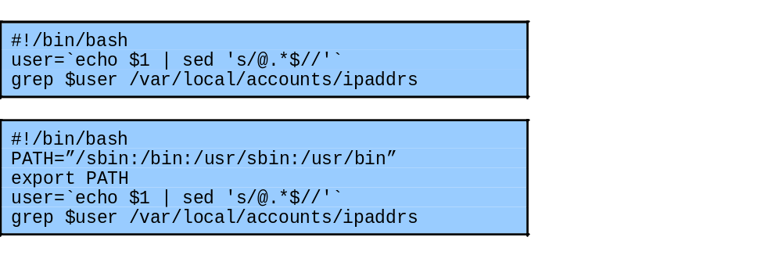
using PATH or IFS environment variables
cause script to execute attackers program
with privileges granted to script
almost impossible to prevent in some form
Notes:
Consider the simple example script shown in Figure 12.6a. This scriptretrieves the mapping for a user to an IP address. Since that information is held in a directory of privileged user accounting information, general access to that directory is not granted. Instead the script is run with the privileges of its owner, which does have access to the relevant directory. This type of simple utility script is very common on many systems. However it contains a number of serious flaws. The first concerns the interaction with the PATH environment variable. This simple script calls two separate programs: sed and grep. The programmer assumes that the standard system versions of these scripts would be called. But they are specified just by their filename. To locate the actual program, the shell will search each directory named in the PATH variable for a file with the desired name. The attacker simply has to redefine the PATH variable to include a directory they control, which contains a program called grep for example. Then when this script is run, the attacker’s grep program is called instead of the standard system version. This program can do whatever the attacker desires, with the privileges granted to the shell script. To address this vulnerability the script could be rewritten to use absolute names for each program. Alternatively the PATH variable could be reset to a known default value by the script, as shown in Figure 12.6b. Unfortunately this version of the script is still vulnerable, this time due to the IFS variable. This is used to separate the words that form a line of commands. Consider the effect of using the ‘=’ character. Then the assignment of a new value to the PATH variable is now interpreted as a command to execute the program PATH with the list of directories as its argument. If the attacker has also changed the PATH variable to include a directory with an attack program PATH, then this will be executed when the script is run. It is essentially impossible to prevent this form of attack on a shell script.

Slide 37
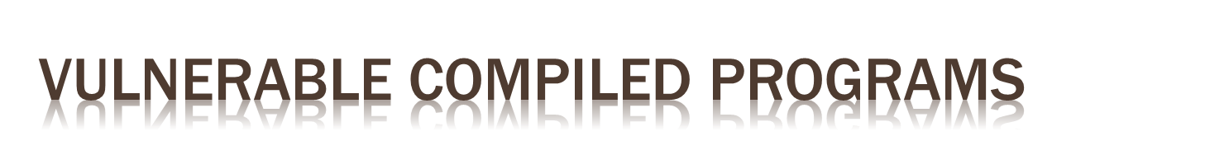
if invoke other programs can be vulnerable to PATH variable manipulation
  must reset to “safe” values
if dynamically linked may be vulnerable to manipulation of LD_LIBRARY_PATH
  used to locate suitable dynamic library
  must either statically link privileged programs
  or prevent use of this variable
Notes:
Even if a compiled program is run with elevated privileges, it may still be vulnerable to attacks using environment variables. If this program executes another program, depending on the command used to do this, the PATH variable may still be used to locate it. Hence any such program must reset this to known safe values first. This at least can be done securely. However there are other vulnerabilities. Essentially all programs on modern computer systems use functionality provided by standard library routines. A dynamically linked executable program does not include the code for common libraries, but rather has a table of names and pointers to all the functions its needs to use. When the program is loaded into a process, this table is resolved to reference a single copy of any library, shared by all processes needing it on the system. However there are reasons why different programs may need different versions of libraries with the same name. Hence there is usually a way to specify a list of directories to search for dynamically loaded libraries. On many Unix systems this is the LD_LIBRARY_PATH environment variable. Its use does provide a degree of flexibility with the use of dynamic libraries. But again it also introduces a possible mechanism for attack. The attacker constructs a custom version of a common library, placing the desired attack code in a function known to be used by some target, dynamically linked, program. Then by setting the LD_LIBRARY_PATH variable to reference their copy of the library first, when the target program is run and calls the known function, the attackers code is run with the privileges of the target program. To prevent this type of attack a statically linked executable can be used, at a cost in memory efficiency. Alternatively, again some modern operating systems block the use of this environment variable when the program executed runs with different privileges.

Slide 38

exploit of flaws may give attacker greater privileges - privilege escalation
hence run programs with least privilege needed to complete their function
  determine suitable user and group to use
  whether grant extra user or group privileges
    latter preferred and safer, may not be sufficient
  ensure can only modify files/dirs needed
    otherwise compromise results in greater damage
    recheck these when moved or upgraded
Notes:
The consequence of many program flaws we discuss is that the attacker is able to execute code with the privileges and access rights of the compromised program or service. If these privileges are greater than those available already to the attacker, then this results in a privilege escalation, an important stage in the overall attack process. Using the higher levels of privilege may enable the attacker to make changes to the system, ensuring future use of these greater capabilities. This strongly suggests that programs should execute with the least amount of privileges needed to complete their function. This is know as the principle of least privilege, and is widely recognized as a desirable characteristic in a secure program. Whenever a privileged program runs, care must be taken to carefully determine the appropriate user and group privileges required. One key decision involves whether to grant additional user or just group privileges. Where appropriate the latter is generally preferred. Another concern is ensuring that any privileged program can modify only those files and directories necessary. A common deficiency found with many privileged programs is for them to have ownership of all associated files and directories. If the program is then compromised, the attacker then has greater scope for modifying and corrupting the system. This violates the principle of least privilege. Care is needed to assign the correct file and group ownerships to files and directories managed by privileged programs. Problems with this can manifest particularly when a program is moved from one computer system to another, or when there is a major upgrade of the operating system.

Slide 39

programs with root / administrator privileges a major target of attackers
  since provide highest levels of system access
  are needed to manage access to protected system resources, e.g. network server ports
often privilege only needed at start
  can then run as normal user
good design partitions complex programs in smaller modules with needed privileges
Notes:
The greatest concerns with privileged programs occur when they execute with root or administrator privileges. These provide very high levels of access and control to the system. Acquiring such privileges is typically the major goal of an attacker on any system. Hence any such privileged program is a key target. The principle of least privilege indicates that such access short be granted as rarely, and as briefly as possible. Unfortunately, due to the design of operating systems, and the need to restrict access to underlying system resources, there are circumstances when such access must be granted. Classic examples include the programs used to allow a user to login or to change passwords on a system, which are only accessible to the root user. Another common example is network servers that need to bind to a privileged service port. Traditionally, such server programs executed with root privileges for the entire time they were running, but they only need root privileges to initially bind to the desired privileged port. Once this is done they could reduce their user privileges to those of another special system user. Any subsequent attack is then much less significant. Good defensive program design requires that large complex programs be partitioned into smaller modules, each granted the privileges they require, only for as long as they need them. This form of program modularization provides a greater degree of isolation between the components, reducing the consequences of a security breach in one component. In addition, being smaller, each component module is easier to test and verify. Ideally the few components that require elevated privileges can be kept small, and subject to much greater scrutiny than the remainder of the program.

Slide 40
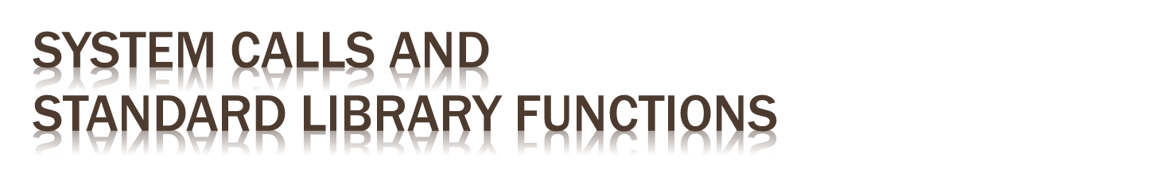
programs use system calls and standard library functions for common operations
  and make assumptions about their operation
  if incorrect behavior is not what is expected
  may be a result of system optimizing access to shared resources
    by buffering, re-sequencing, modifying requests
  can conflict with program goals
Notes:
Except on very small, embedded systems, no computer program contains all of the code it needs to execute. Rather, programs make calls to the operating system to access the system’s resources, and to standard library functions to perform common operations. When using such functions, programmers commonly make assumptions about how they actually operate. Most of the time they do indeed seem to perform as expected. However there are circumstances when the assumptions a programmer makes about these functions are not correct. The result can be that the program does not perform as expected. Part of the reason for this is that programmers tend to focus on the particular program they are developing, and view it in isolation. However on most systems this program will simply be one of many running, and sharing the available system resources. The operating system and library functions attempt to manage their resources in a manner that provides the best performance to all the programs running on the system. This does result in requests for services being buffered, re-sequenced, or otherwise modified to optimize system use. Unfortunately there are times when these optimizations conflict with the goals of the program. Unless the programmer is aware of these interactions, and explicitly codes for them, the resulting program may not perform as expected.

Slide 41

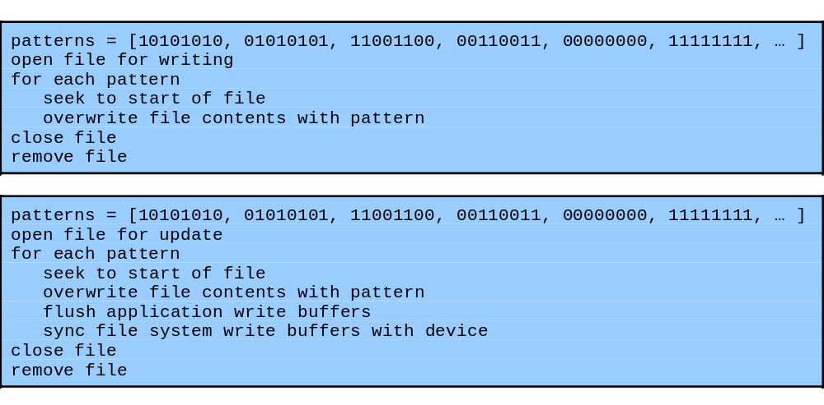
Notes:
An excellent illustration of these issues is given by Venema in his discussion of the design of a secure file shredding program [VENE06]. The problem is how to securely delete a file so that its contents cannot subsequently be recovered. Just using the standard file delete utility or system call does not suffice, as this simply removes the linkage between the file’s name and its contents. The contents still exist on the disk until those blocks are eventually reused in another file. Even when blocks from a deleted file are reused, the data in the files can still be recovered because not all traces of the previous bit values are removed. Consequently, the standard recommendation is to repeatedly overwrite the data contents with several distinct bit patterns to minimize the likelihood of the original data being recovered. So a secure file shredding program might perhaps implement the algorithm like that shown in Figure 12.7a. However when an “obvious” implementation of this algorithm is tried, the file contents were still recoverable afterwards. Venema details a number of flaws in this algorithm that means the program does not behave as expected. These flaws relate to incorrect assumptions about how the relevant system functions operate (see text). With suggested changes, the algorithm for a secure file shredding program changes to that shown in Figure 12.7b. This is certainly more likely to achieve the desired result, however examined more closely there are yet more concerns. All of this indicates that writing a really secure file shredding program is actually an extremely difficult exercise. There are so many layers of code involved, each of which makes assumptions about what the program really requires in order to provide the best performance. Venema concludes his discussion by noting that in fact the program may actually be solving the wrong problem. This is a critical issue for the secure programmer, to try and ensure they are actually solving the right problem.

Slide 42

programs may access shared resources
  e.g. mailbox file, CGI data file
need suitable synchronization mechanisms
  e.g. lock on shared file
alternatives
  lockfile - create/check, advisory, atomic
  advisory file lock - e.g. flock
  mandatory file lock - e.g. fcntl, need release
    later mechanisms vary between O/S
    have subtle complexities in use
Notes:
There are circumstances in which multiple programs need to access a common system resource, often a file containing data created and manipulated by multiple programs. Examples include mail client and mail delivery programs sharing access to a user’s mailbox file, or various users of a web CGI script updating the same file used to save submitted form values. This is a variant of the issue of synchronizing access to shared memory we discuss in Section 12.3. As in that case, the solution is to use an appropriate synchronization mechanism to serialize the accesses to prevent errors. The most common technique is to acquire a lock on the shared file, ensuring that each process has appropriate access in turn. There are several methods used for this, depending on the operating system in use.
The oldest and most general technique is to use a lockfile. A process must create and own the lockfile in order to gain access to the shared resource. Any other process that detects the existence of a lockfile must wait until it is removed before creating its own to gain access. Issues - is purely advisory, process of checking the lockfile does not exist, and then creating the lockfile must be executed as an atomic operation, without the possibility of interruption. There are more modern and alternative locking mechanisms available for files. These may also be advisory, or can also be mandatory, where the operating system guarantees that a locked file cannot be accessed inappropriately. The issue with mandatory locks is the mechanisms for removing them should the locking process crash or otherwise not release the lock. These mechanisms are also implanted differently on different operating systems. Note there are subtle complexities related to locking files using different types of read or write access. Suitable program or function references should be consulted on the correct use of these features. Hence care is needed to ensure the mechanism used

Slide 43

many programs use temporary files
often in common, shared system area
must be unique, not accessed by others
commonly create name using process ID
  unique, but predictable
  attacker might guess and attempt to create own between program checking and creating
secure temp files need random names
  some older functions unsafe
  must need correct permissions on file/dir
Notes:
Many programs need to store a temporary copy of data while they are processing it. A temporary file is commonly used for this purpose. Most operating systems provide well-known locations for placing temporary files, and standard functions for naming and creating them. The critical issue with temporary files is that they are unique, and not accessed by other processes. In a sense this is the opposite problem to managing access to a shared file. The most common technique for constructing a temporary file name is to include a value such as the process identifier. As each process has its own distinct identifier, this should guarantee a unique name. The program generally checks to ensure the file does not already exist, perhaps left over from a crash of a previous program, and then creates the file. This approach suffices from the perspective of reliability, but not with respect to security. Again the problem is that an attacker does not “play by the rules”. They could attempt to guess the temporary filename a privileged program will use, and then attempt to create their own version in the interval between the program checking the file does not exist, and subsequently creating it. This is another example of a race condition, very similar to that when two processes race to access a shared file when locks are not used. cf tripwire bug discussed in text. Secure temporary file creation and use preferably requires the use of a random temporary filename. The creation of this file should be done using an atomic system primitive, as is done with the creation of a lockfile. The standard C function “mkstemp()” is suitable, however the older functions “tmpfile()”, “tmpnam()”, and “tempnam()” are all insecure unless used with care. It is also important that the minimum access is given to this file. When the file is created in a shared temporary directory, the access permissions should specify that only the owner of the temporary file, or the system administrators, should be able to remove it.

Slide 44

may use services of other programs
must identify/verify assumptions on data
esp older user programs
  now used within web interfaces
  must ensure safe usage of these programs
issue of data confidentiality / integrity
  within same system use pipe / temp file
  across net use IPSec, TLS/SSL, SSH etc
also detect / handle exceptions / errors
Notes:
As well as using functionality provided by the operating system and standard library functions, programs may also use functionality and services provided by other programs. Unless care is taken with this interaction, failure to identify assumptions about the size and interpretation of data flowing between different programs can result in security vulnerabilities. The flow of information between programs can be viewed as output from one forming input to the other. Such issues are of particular concern when the program being used was not originally written with this wider use as a design issue, and hence did not adequately identify all the security concerns that might arise. This occurs particularly with the current trend of providing web interfaces to programs that users previously ran directly on the server system. A further concern relates to protecting the confidentiality and integrity of the data flowing between various programs. When these programs are running on the same computer system, appropriate use of system functionality such as pipes or temporary files provide this protection. If the programs run on different systems, linked by a suitable network connection, then appropriate security mechanisms should be employed by these network connections. Alternatives include the use of IP Security (IPSec), Transport Layer/Secure Socket Layer Security (TLS/SSL), or Secure Shell (SSH) connections. Suitable detection and handling of exceptions and errors generated by program interaction is also important from a security perspective. When one process invokes another program as a child process, it should ensure that program terminates correctly, and accept its exit status. It must also catch and process signals resulting from interaction with other programs and the operating system.

Slide 45

final concern is program output
  stored for future use, sent over net, displayed
  may be binary or text
conforms to expected form / interpretation
  assumption of common origin,
  c.f. XSS, VT100 escape seqs, X terminal hijack
uses expected character set
target not program but output display device
Notes:
The final component of our model of computer programs is the generation of output as a result of the processing of input and other interactions. This output might be stored for future use, in files or a database for example, transmitted over a network connection, or be destined for display to some user. As with program input, the output data may be classified as binary or textual. It is important from a program security perspective that the output really does conform to the expected form and interpretation. If directed to a user, it will be interpreted and displayed by some appropriate program or device. If this output includes unexpected content, then anomalous behavior may result, with detrimental affects on the user. A critical issue here is the assumption of common origin. If a user is interacting with a program, the assumption is that all output seen was created by, or at least validated by, that program. Consider the examples detailed in the text - VT100 escape sequences, X window session hijack, and XSS guestbook attacks. Another issue here is that different character sets allow different encodings of “meta-characters”, which may change the interpretation of what is valid output. If the display program or device is unaware of the specific encoding used, it might make a different assumption to the program, possibly subverting the filtering. Hence it is important for the program to either explicitly specify encoding where possible c.f. Content-Type HTTP response header, or otherwise ensure it conforms to the display expectations, to avoid this. Note in these examples of security flaws that result from program output, the target of compromise was not the program generating the output, but rather the program or device used to display the output.

Slide 46

discussed software security issues
handling program input safely
  size, interpretation, injection, XSS, fuzzing
writing safe program code
  algorithm, machine language, data, memory
interacting with O/S and other programs
  ENV, least privilege, syscalls / std libs, file lock, temp files, other programs
handling program output
Notes:
Chapter 12 summary.

