Slide 1
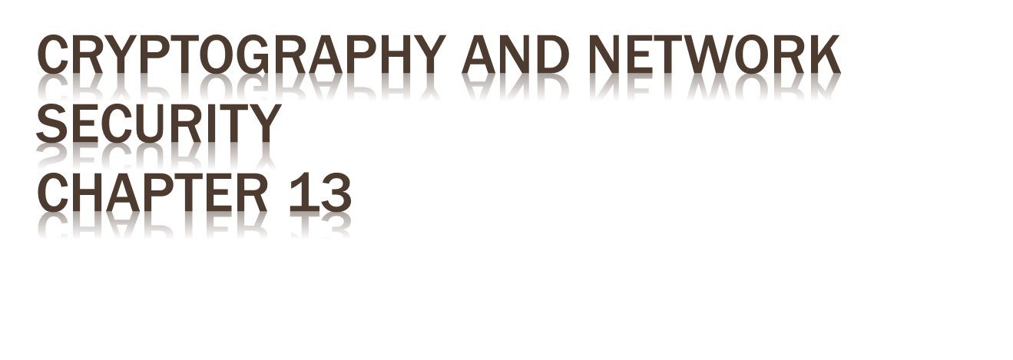
Fifth Edition
by William Stallings
Lecture slides by Lawrie Brown
Notes:
Lecture slides by Lawrie Brown for “Cryptography and Network Security”, 5/e, by William Stallings, Chapter 13 – “Digital Signatures”.

Slide 2

To guard against the baneful influence exerted by strangers is therefore an elementary dictate of savage prudence. Hence before strangers are allowed to enter a district, or at least before they are permitted to mingle freely with the inhabitants, certain ceremonies are often performed by the natives of the country for the purpose of disarming the strangers of their magical powers, or of disinfecting, so to speak, the tainted atmosphere by which they are supposed to be surrounded.
—The Golden Bough, Sir James George Frazer
Notes:
Opening quote.

Slide 3

have looked at message authentication
  but does not address issues of lack of trust
digital signatures provide the ability to:
  verify author, date & time of signature
  authenticate message contents
  be verified by third parties to resolve disputes
hence include authentication function with additional capabilities
Notes:
The most important development from the work on public-key cryptography is the digital signature. Message authentication protects two parties who exchange messages from any third party. However, it does not protect the two parties against each other either fraudulently creating, or denying creation, of a message. A digital signature is analogous to the handwritten signature, and provides a set of security capabilities that would be difficult to implement in any other way. It must have the following properties:
• It must verify the author and the date and time of the signature
• It must to authenticate the contents at the time of the signature
• It must be verifiable by third parties, to resolve disputes
Thus, the digital signature function includes the authentication function.

Slide 4

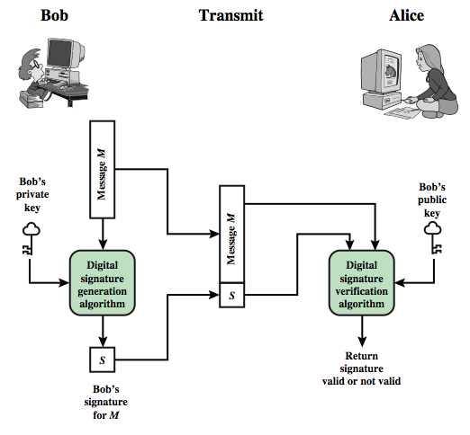
Notes:
Stallings Figure 13.1 is a generic model of the process of making and using digital signatures. Bob can sign a message using a digital signature generation algorithm. The inputs to the algorithm are the message and Bob's private key. Any other user, say Alice, can verify the signature using a verification algorithm, whose inputs are the message, the signature, and Bob's public key.

Slide 5

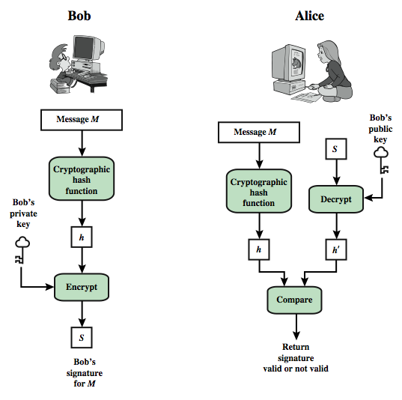
Notes:
In simplified terms, the essence of the digital signature mechanism is shown in Stallings Figure 13.2. This repeats the logic shown in Figure 11.3. On example, using RSA, is available at this book's Web site.
We begin this chapter with an overview of digital signatures. Then, we introduce the Digital Signature Standard (DSS).

Slide 6

attacks
  key-only attack
  known message attack
  generic chosen message attack
  directed chosen message attack
  adaptive chosen message attack
break success levels
  total break
  selective forgery
  existential forgery
Notes:
[GOLD88] lists the following types of attacks, in order of increasing severity. Here A denotes the user whose signature is being attacked and C denotes the attacker.
• Key-only attack: C only knows A's public key.
• Known message attack: C is given access to a set of messages and signatures.
• Generic chosen message attack: C chooses a list of messages before attempting to breaks A's signature scheme, independent of A's public key. C then obtains from A valid signatures for the chosen messages. The attack is generic because it does not depend on A's public key; the same attack is used against everyone.
• Directed chosen message attack: Similar to the generic attack, except that the list of messages is chosen after C knows A's public key but before signatures are seen.
• Adaptive chosen message attack: C is allowed to use A as an "oracle." This means the A may request signatures of messages that depend on previously obtained message-signature pairs.
[GOLD88] then defines success as breaking a signature scheme as an outcome in which C can do any of the following with a non-negligible probability:
• Total break: C determines A's private key. • Universal forgery: C finds an efficient signing algorithm that provides an equivalent way of constructing signatures on arbitrary messages.
• Selective forgery: C forges a signature for a particular message chosen by C.
• Existential forgery: C forges a signature for at least one message. C has no control over the message. Consequently this forgery may only be a minor nuisance to A.

Slide 7

must depend on the message signed
must use information unique to sender
  to prevent both forgery and denial
must be relatively easy to produce
must be relatively easy to recognize & verify
be computationally infeasible to forge
  with new message for existing digital signature
  with fraudulent digital signature for given message
be practical save digital signature in storage
Notes:
On the basis of the properties on the previous slide, we can formulate the requirements for a digital signature as shown. A variety of approaches has been proposed for the digital signature function. A secure hash function, embedded in a scheme such as that shown in Stallings Figure 13.2, provides a basis for satisfying these requirements. However care must be taken in the design of the details of the scheme. These approaches fall into two categories: direct and arbitrated.

Slide 8

involve only sender & receiver
assumed receiver has sender’s public-key
digital signature made by sender signing entire message or hash with private-key
can encrypt using receivers public-key
important that sign first then encrypt message & signature
security depends on sender’s private-key
Notes:
The term direct digital signature refers to a digital signature scheme that involves only the communicating parties (source, destination). It is assumed that the destination knows the public key of the source. Direct Digital Signatures involve the direct application of public-key algorithms involving only the communicating parties. A digital signature may be formed by encrypting the entire message with the sender’s private key, or by encrypting a hash code of the message with the sender’s private key. Confidentiality can be provided by further encrypting the entire message plus signature using either public or private key schemes. It is important to perform the signature function first and then an outer confidentiality function, since in case of dispute, some third party must view the message and its signature. But these approaches are dependent on the security of the sender’s private-key. Will have problems if it is lost/stolen and signatures forged. The universally accepted technique for dealing with these threats is the use of a digital certificate and certificate authorities. We defer a discussion of this topic until Chapter 14, and focus in this chapter on digital signature algorithms. Also need time-stamps and timely key revocation.

Slide 9

signature variant of ElGamal, related to D-H
  so uses exponentiation in a finite (Galois)
  with security based difficulty of computing discrete logarithms, as in D-H
use private key for encryption (signing)
uses public key for decryption (verification)
each user (eg. A) generates their key
  chooses a secret key (number): 1 < x_{A} < q-1
  compute their public key: y_{A} = a^{xA} mod q
Notes:
Recall from Chapter 10, that in 1984, T. Elgamal announced a public-key scheme based on discrete logarithms, closely related to the Diffie-Hellman technique [ELGA84, ELGA85]. The ElGamal encryption scheme is designed to enable encryption by a user's public key with decryption by the user's private key. The ElGamal signature scheme involves the use of the private key for encryption and the public key for decryption. The ElGamal cryptosystem is used in some form in a number of standards including the digital signature standard (DSS) and the S/MIME email standard. As with Diffie-Hellman, the global elements of ElGamal are a prime number q and a, which is a primitive root of q. User A generates a private/public key pair as shown. The security of ElGamal is based on the difficulty of computing discrete logarithms, to recover either x given y, or k given K (next slide).

Slide 10

Alice signs a message M to Bob by computing
  the hash m = H(M), 0 <= m <= (q-1)
  chose random integer K with 1 <= K <= (q-1) and gcd(K,q-1)=1
  compute temporary key: S₁ = a^{k} mod q
  compute K⁻¹ the inverse of K mod (q-1)
  compute the value: S₂ = K⁻¹(m-x_{A}S₁) mod (q-1)
  signature is:(S₁,S₂)
any user B can verify the signature by computing
  V₁ = a^{m} mod q
  V₂ = y_{A}^{S1} S₁^{S2} mod q
  signature is valid if V₁ = V₂
Notes:
To sign a message M, user A first computes the hash m = H(M), such that m is an integer in the range 0 <= m <= q – 1. A then forms a digital signature as shown.
The basic idea with El Gamal signatures is to again choose a temporary random signing key, protect it, then use it solve the specified equation on the hash of the message to create the signature (in 2 pieces). Verification consists of confirming the validation equation that relates the signature to the (hash of the) message (see text for proof). Again note that El Gamal encryption involves 1 modulo exponentiation and multiplications (vs 1 exponentiation for RSA).

Slide 11

use field GF(19) q=19 and a=10
Alice computes her key:
  A chooses x_{A}=16 & computes y_{A}=10¹⁶ mod 19 = 4
Alice signs message with hash m=14 as (3,4):
  choosing random K=5 which has gcd(18,5)=1
  computing S₁ = 10⁵ mod 19 = 3
  finding K⁻¹ mod (q-1) = 5⁻¹ mod 18 = 11
  computing S₂ = 11(14-16.3) mod 18 = 4
any user B can verify the signature by computing
  V₁ = 10¹⁴ mod 19 = 16
  V₂ = 4³.3⁴ = 5184 = 16 mod 19
  since 16 = 16 signature is valid
Notes:
Here is an example of creating and verifying an ElGamal signature from the text using the prime field GF(19); that is, q = 19. It has primitive roots {2, 3, 10, 13, 14, 15}, as shown in Table 8.3. We choose a = 10. Alice generates a key pair as shown, which is = {19, 10, 4}. Alice can sign a message with hash m = 14 as shown to compute the signature pair (3,4). Any user B can verify the signature by computing confirming the validation equation as shown.

Slide 12

also uses exponentiation in a finite (Galois)
  security based on discrete logarithms, as in D-H
minimizes message dependent computation
  multiplying a 2n-bit integer with an n-bit integer
main work can be done in idle time
have using a prime modulus p
  p–1 has a prime factor q of appropriate size
  typically p 1024-bit and q 160-bit numbers
Notes:
As with the ElGamal digital signature scheme, the Schnorr signature scheme is based on discrete logarithms [SCHN89, SCHN91]. The Schnorr scheme minimizes the message dependent amount of computation required to generate a signature. The main work for signature generation does not depend on the message and can be done during the idle time of the processor. The message dependent part of the signature generation requires multiplying a 2n-bit integer with an n-bit integer. The scheme is based on using a prime modulus p, with p – 1 having a prime factor q of appropriate size; that is p – 1 = 1 (mod q). Typically, we use p approx 2¹⁰²⁴ and q approx 2¹⁶⁰. Thus, p is a 1024-bit number and q is a 160-bit number, which is also the length of the SHA-1 hash value.

Slide 13

choose suitable primes p , q
choose a such that a^{q} = 1 mod p
(a,p,q) are global parameters for all
each user (eg. A) generates a key
  chooses a secret key (number): 0 < s_{A} < q
  compute their public key: v_{A} = a^{-sA} mod q
Notes:
The first part of this scheme is the generation of a private/public key pair, which consists of the following steps:
Choose primes p and q, such that q is a prime factor of p – 1.
Choose an integer a such that a^{q} = 1 mod p. The values a, p, and q comprise a global public key that can be common to a group of users.
Choose a random integer s with 0 < s < q. This is the user's private key.
Calculate v = a^{–s} mod p. This is the user's public key.

Slide 14

user signs message by
  choosing random r with 0<r<q and computing x = a^{r} mod p
  concatenate message with x and hash result to computing: e = H(M || x)
  computing: y = (r + se) mod q
  signature is pair (e, y)
any other user can verify the signature as follows:
  computing: x' = a^{y}v^{e} mod p
  verifying that: e = H(M || x’)
Notes:
A user with public key s and private key v generates a signature as follows:
Choose a random integer r with 0 < r < q and compute x = a^{r} mod p. This is independent of any message M, hence can be pre-computed.
Concatenate message with x and hash result to compute: e = H(M || x)
Compute y = (r + se) mod q. The signature consists of the pair (e, y).
Any other user can verify the signature as follows:
Compute x' = a^{y}v^{e} mod p.
Verify that e = H(M || x').
See text for details of why the verification works.

Slide 15

US Govt approved signature scheme
designed by NIST & NSA in early 90's
published as FIPS-186 in 1991
revised in 1993, 1996 & then 2000
uses the SHA hash algorithm
DSS is the standard, DSA is the algorithm
FIPS 186-2 (2000) includes alternative RSA & elliptic curve signature variants
DSA is digital signature only unlike RSA
is a public-key technique
Notes:
DSA is the US Govt approved signature scheme, which is designed to provide strong signatures without allowing easy use for encryption. The National Institute of Standards and Technology (NIST) published Federal Information Processing Standard FIPS 186, known as the Digital Signature Standard (DSS). The DSS makes use of the Secure Hash Algorithm (SHA) described in Chapter 12 and presents a new digital signature technique, the Digital Signature Algorithm (DSA). The DSS was originally proposed in 1991 and revised in 1993 in response to public feedback concerning the security of the scheme. There was a further minor revision in 1996. In 2000, an expanded version of the standard was issued as FIPS 186-2. This latest version also incorporates digital signature algorithms based on RSA and on elliptic curve cryptography. In this section, we discuss the original DSS algorithm. The DSS uses an algorithm that is designed to provide only the digital signature function. Unlike RSA, it cannot be used for encryption or key exchange. Nevertheless, it is a public-key technique.

Slide 16

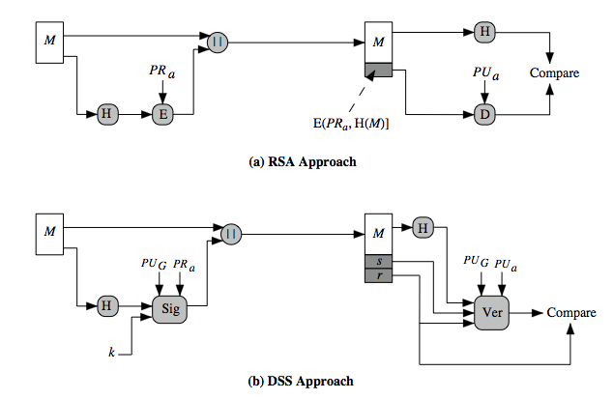
Notes:
Stallings Figure 13.3 contrasts the DSS approach for generating digital signatures to that used with RSA. In the RSA approach, the message to be signed is input to a hash function that produces a secure hash code of fixed length. This hash code is then encrypted using the sender's private key to form the signature. Both the message and the signature are then transmitted. The recipient takes the message and produces a hash code. The recipient also decrypts the signature using the sender's public key. If the calculated hash code matches the decrypted signature, the signature is accepted as valid. Because only the sender knows the private key, only the sender could have produced a valid signature. The DSS approach also makes use of a hash function. The hash code is provided as input to a signature function along with a random number k generated for this particular signature. The signature function also depends on the sender's private key (PR _{a}) and a set of parameters known to a group of communicating principals. We can consider this set to constitute a global public key (PU_{G}). The result is a signature consisting of two components, labeled s and r. At the receiving end, the hash code of the incoming message is generated. This plus the signature is input to a verification function. The verification function also depends on the global public key as well as the sender's public key (PU_{a}), which is paired with the sender's private key. The output of the verification function is a value that is equal to the signature component r if the signature is valid. The signature function is such that only the sender, with knowledge of the private key, could have produced the valid signature.

Slide 17

creates a 320 bit signature
with 512-1024 bit security
smaller and faster than RSA
a digital signature scheme only
security depends on difficulty of computing discrete logarithms
variant of ElGamal & Schnorr schemes
Notes:
The DSA is based on the difficulty of computing discrete logarithms (see Chapter 8) and is based on schemes originally presented by ElGamal [ELGA85] and Schnorr [SCHN91]. The DSA signature scheme has advantages, being both smaller (320 vs 1024bit) and faster (much of the computation is done modulo a 160 bit number), over RSA. Unlike RSA, it cannot be used for encryption or key exchange. Nevertheless, it is a public-key technique

Slide 18

have shared global public key values (p,q,g):
  choose 160-bit prime number q
  choose a large prime p with 2^{L-1} < p < 2^{L}
    where L= 512 to 1024 bits and is a multiple of 64
    such that q is a 160 bit prime divisor of (p-1)
  choose g = h^{(p-1)/q}
    where 1<h<p-1 and h^{(p-1)/q} mod p > 1
users choose private & compute public key:
  choose random private key: x<q
  compute public key: y = g^{x} mod p
Notes:
DSA typically uses a common set of global parameters (p,q,g) for a community of clients, as shown. A 160-bit prime number q is chosen. Next, a prime number p is selected with a length between 512 and 1024 bits such that q divides (p – 1). Finally, g is chosen to be of the form h^{(p–1)/q} mod p where h is an integer between 1 and (p – 1) with the restriction that g must be greater than 1. Thus, the global public key components of DSA have the same for as in the Schnorr signature scheme.
Then each DSA uses chooses a random private key x, and computes their public key as shown. The calculation of the public key y given x is relatively straightforward. However, given the public key y, it is computationally infeasible to determine x, which is the discrete logarithm of y to base g, mod p.

Slide 19

to sign a message M the sender:
  generates a random signature key k, k<q
  nb. k must be random, be destroyed after use, and never be reused
then computes signature pair:
  r = (g^{k} mod p)mod q
  s = [k⁻¹(H(M)+ xr)] mod q
sends signature (r,s) with message M
Notes:
To create a signature, a user calculates two quantities, r and s, that are functions of the public key components (p,q,g), the user’s private key (x), the hash code of the message H(M), and an additional integer k that should be generated randomly or pseudo-randomly and be unique for each signing. This is similar to ElGamal signatures, with the use of a per message temporary signature key k, but doing calculations first mod p, then mod q to reduce the size of the result. The signature (r,s) is then sent with the message to the recipient. Note that computing r only involves calculation mod p and does not depend on message, hence can be done in advance. Similarly with randomly choosing k’s and computing their inverses.

Slide 20

having received M & signature (r,s)
to verify a signature, recipient computes:
  w = s⁻¹ mod q
  u1= [H(M)w ]mod q
  u2= (rw)mod q
  v = [(g^{u1} y^{u2})mod p ]mod q
if v=r then signature is verified
see Appendix A for details of proof why
Notes:
At the receiving end, verification is performed using the formulas shown. The receiver generates a quantity v that is a function of the public key components, the sender’s public key, and the hash of the incoming message. If this quantity matches the r component of the signature, then the signature is validated. Note that the difficulty of computing discrete logs is why it is infeasible for an opponent to recover k from r, or x from s. Note also that nearly all the calculations are mod q, and hence are much faster save for the last step.
The structure of this function is such that the receiver can recover r using the incoming message and signature, the public key of the user, and the global public key. It is certainly not obvious that such a scheme would work. A proof is provided in Stallings appendix K.

Slide 21

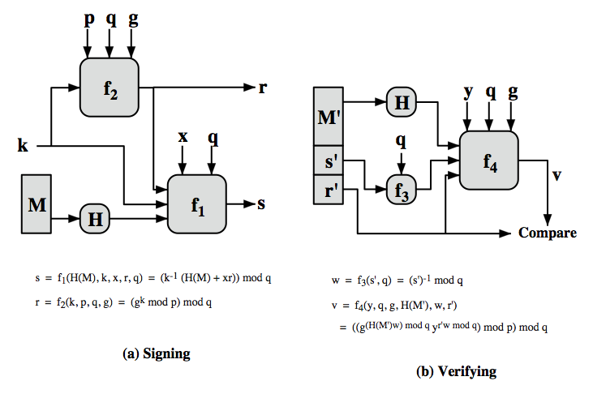
Notes:
Stallings Figure 13.5 depicts the functions of signing and verifying. The structure of the algorithm, as revealed here is quite interesting. Note that the test at the end is on the value r, which does not depend on the message at all. Instead, r is a function of k and the three global public-key components. The multiplicative inverse of k (mod q) is passed to a function that also has as inputs the message hash code and the user's private key. The structure of this function is such that the receiver can recover r using the incoming message and signature, the public key of the user, and the global public key.

Slide 22

have discussed:
  digital signatures
  ElGamal & Schnorr signature schemes
  digital signature algorithm and standard
Notes:
Chapter 13 summary

