Slide 1
Cryptography and Network Security
Chapter 23
Fifth Edition
by William Stallings
Lecture slides by Lawrie Brown
Notes:
Lecture slides by Lawrie Brown for “Cryptography and Network Security”, 5/e, by William Stallings, Chapter 23 – “Legal and Ethical Aspects”.

Slide 2
Chapter 23 – Legal and Ethical Aspects
touch on a few topics including:
  cybercrime and computer crime
  intellectual property issues
  privacy
  ethical issues
Notes:
The legal and ethical aspects of computer security encompass a broad range of topics, and a full discussion is well beyond the scope of this book, however we touch on a few important topics in this area, including: cybercrime and computer crime; intellectual property issues; privacy and ethical issues.

Slide 3
Cybercrime / Computer Crime
“criminal activity in which computers or computer networks are a tool, a target, or a place of criminal activity”
categorize based on computer’s role:
  as target
  as storage device
  as communications tool
more comprehensive categorization seen in Cybercrime Convention, Computer Crime Surveys
Notes:
Computer crime, or cybercrime, is a term used broadly to describe criminal activity in which computers or computer networks are a tool, a target, or a place of criminal activity. These categories are not exclusive and many activities can be characterized as falling in one or more categories. The term cybercrime has a connotation of the use of networks specifically, whereas computer crime may or may not involve networks. The U.S. Department of Justice categorizes computer crime based on the role that the computer plays in the criminal activity, as follows:
• Computers as targets: to acquire information stored on that computer system, to control the target system without authorization or payment (theft of service), or to alter the integrity of data or interfere with the availability of the computer or server.
• Computers as storage devices: as a passive storage medium, e.g. for stolen password lists, credit card or calling card numbers, proprietary corporate information, pornographic image files, or "warez" (pirated commercial software).
• Computers as communications tools: often traditional crimes committed online. Examples include the illegal sale of prescription drugs, controlled substances, alcohol, and guns; fraud; gambling; and child pornography.
A more specific list of crimes is defined in the international Convention on Cybercrime and shown in Table 18.1, in the text. Yet another categorization is used in the CERT 2006 annual E-crime Survey, the results of which are shown in Table 23.2.

Slide 4
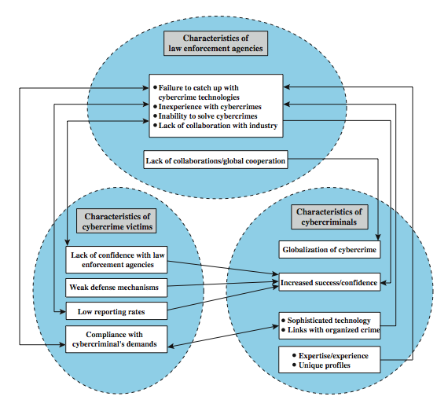
Law Enforcement Challenges
Notes:
The deterrent effect of law enforcement on computer and network attacks correlates with the success rate of criminal arrest and prosecution. The nature of cybercrime is such that consistent success is extraordinarily difficult. To see this, consider the vicious cycle of cybercrime, involving law enforcement agencies, cybercriminals, and cybercrime victims, as illustrated in Figure 23.1 from the text.
For law enforcement agencies, cybercrime presents some unique difficulties. Proper investigation requires a fairly sophisticated grasp of the technology, and many jurisdictions lack investigators knowledgeable and experienced in dealing with it. Lack of resources represents another handicap. The global nature of cybercrime is an additional obstacle: many crimes will involve perpetrators who are remote from the target system, in another jurisdiction or even another country. A lack of collaboration and cooperation with remote law enforcement agencies can greatly hinder an investigation. Initiatives such as international Convention on Cybercrime introduces a common terminology for crimes and a framework for harmonizing laws globally.
The relative lack of success in bringing cybercriminals to justice has led to an increase in their numbers, boldness, and the global scale of their operations. The cybercriminal tends to be young and very computer-savvy, but the range of behavioral characteristics is wide.
The success of cybercriminals, and the relative lack of success of law enforcement, influence the behavior of cybercrime victims. Reporting rates are low because of a lack of confidence in law enforcement, a concern about corporate reputation, and a concern about civil liability. The low reporting rates and reluctance to work with law enforcement feeds into the law enforcement handicaps, completing the vicious cycle.

Slide 5
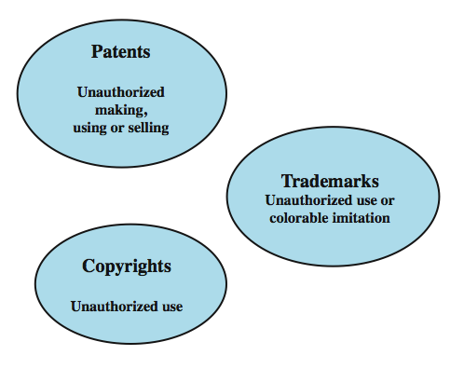
Intellectual Property
Notes:
The U.S. legal system, and legal systems generally, distinguish three primary types of property: real, personal and intellectual. Intellectual property is any intangible asset that consists of human knowledge and ideas. Examples include software, data, novels, sound recordings, the design of a new type of mousetrap, or a cure for a disease. There are three main types of intellectual property for which legal protection is available: copyrights, trademarks, and patents. The legal protection is against infringement, which is the invasion of the rights secured by, copyrights, trademarks, and patents. The right to seek civil recourse against anyone infringing his or her property is granted to the IP owner. Depending upon the type of IP, infringement may vary, as illustrated in Figure 23.2 from the text.

Slide 6
Copyright
protects tangible or fixed expression of an idea but not the idea itself
is automatically assigned when created
may need to be registered in some countries
exists when:
  proposed work is original
  creator has put original idea in concrete form
  e.g. literary works, musical works, dramatic works, pantomimes and choreographic works, pictorial, graphic, and sculptural works, motion pictures and other audiovisual works, sound recordings, architectural works, software-related works.
Notes:
Copyright law protects the tangible or fixed expression of an idea, not the idea itself. Copyright is automatically assigned to newly created works in countries that subscribe to the Berne convention, which encompasses the vast majority of nations. Some countries, such as the United States, provide additional legal protection if the work is registered. Copyright exists if the following conditions are fulfilled:
• the proposed work is original
• the creator has put this original idea into a concrete form, such as hard copy (paper), software, or multimedia form
Examples of items that may be copyrighted include: literary works, musical works, dramatic works, pantomimes and choreographic works, pictorial, graphic, and sculptural works, motion pictures and other audiovisual works, sound recordings, architectural works, software-related works.

Slide 7
Copyright Rights
copyright owner has these exclusive rights, protected against infringement:
  reproduction right
  modification right
  distribution right
  public-performance right
  public-display right
Notes:
The copyright owner has the following exclusive rights, protected against infringement:
• Reproduction right: lets the owner make copies of a work.
• Modification right: also known as the derivative-works right, concerns modifying a work to create a new or derivative work.
• Distribution right: lets the owner publicly sell, rent, lease, or lend copies of the work.
• Public-performance right: applies mainly to live performances.
• Public-display right: lets the owner publicly show a copy of the work directly or by means of a film, slide, or television image.

Slide 8
Patents
grant a property right to the inventor
  to exclude others from making, using, offering for sale, or selling the invention
types:
  utility - any new and useful process, machine, article of manufacture, or composition of matter
  design - new, original, and ornamental design for an article of manufacture
  plant - discovers and asexually reproduces any distinct and new variety of plant
e.g. RSA public-key cryptosystem patent
Notes:
A patent for an invention is the grant of a property right to the inventor. The right conferred by the patent grant is, in the language of the U.S. statute and of the grant itself, "the right to exclude others from making, using, offering for sale, or selling" the invention in the United States or "importing" the invention into the United States. Similar wording appears in the statutes of other nations.
There are three types of patents:
• Utility patents: may be granted to anyone who invents or discovers any new and useful process, machine, article of manufacture, or composition of matter, or any new and useful improvement thereof;
• Design patents: may be granted to anyone who invents a new, original, and ornamental design for an article of manufacture; and
• Plant patents: may be granted to anyone who invents or discovers and asexually reproduces any distinct and new variety of plant.
An example of a patent from the computer security realm is the RSA public-key cryptosystem. From the time it was granted in 1983 until the patent expired in 2000, the patent holder, RSA Security, was entitled to receive a fee for each implementation of RSA.

Slide 9
Trademarks
a word, name, symbol, or device
  used in trade with goods
  indicate source of goods
  to distinguish them from goods of others
trademark rights may be used to:
  prevent others from using a confusingly similar mark
  but not to prevent others from making the same goods or from selling the same goods or services under a clearly different mark
Notes:
A trademark is a word, name, symbol, or device that is used in trade with goods to indicate the source of the goods and to distinguish them from the goods of others. A servicemark is the same as a trademark except that it identifies and distinguishes the source of a service rather than a product. The terms trademark and mark are commonly used to refer to both trademarks and servicemarks. Trademark rights may be used to prevent others from using a confusingly similar mark, but not to prevent others from making the same goods or from selling the same goods or services under a clearly different mark.

Slide 10
Intellectual Property Issues and Computer Security
software programs
  protect using copyright, perhaps patent
database content and arrangement
  protect using copyright
digital content audio / video / media / web
  protect using copyright
algorithms
  may be able to protect by patenting
Notes:
Intellectual Property Relevant to Network and Computer Security include:
• Software: This includes programs produced by vendors of commercial software (e.g., operating systems, utility programs, applications) as well as shareware, proprietary software created by an organization for internal use, and software produced by individuals. For all such software, copyright protection is available if desired. In some cases, a patent protection may also be appropriate.
• Databases: A database may consist of data that is collected and organized in such a fashion that it has potential commercial value. An example is an economic forecasting database. Such databases may be protected by copyright.
• Digital content: This category includes audio files, video files, multimedia, courseware, Web site content, and any other original digital work that can be presented in some fashion using computers or other digital devices.
• Algorithms: An example of a patentable algorithm, previously cited, is the RSA public-key cryptosystem.

Slide 11
U.S. Digital Millennium Copyright ACT (DMCA)
implements WIPO treaties to strengthens protections of digital copyrighted materials
encourages copyright owners to use technological measures to protect their copyrighted works, including:
  measures that prevent access to the work
  measures that prevent copying of the work
prohibits attempts to bypass the measures
  have both criminal and civil penalties for this
Notes:
The U.S. Digital Millennium Copyright ACT (DMCA) has had a profound effect on the protection of digital content rights in both the U.S. and worldwide. The DMCA, signed into law in 1998, is designed to implement World Intellectual Property Organization (WIPO) treaties, signed in 1996. In essence, DMCA strengthens the protection of copyrighted materials in digital format.
The DMCA encourages copyright owners to use technological measures to protect copyrighted works. These measures fall into two categories: measures that prevent access to the work and measures that prevent copying of the work. Further, the law prohibits attempts to bypass such measures. Specifically, the law states that "No person shall circumvent a technological measure that effectively controls access to a work protected under this title." Among other effects of this clause, it prohibits almost all unauthorized decryption of content. The law further prohibits the manufacture, release, or sale of products, services, and devices that can crack encryption designed to thwart either access to or copying of material unauthorized by the copyright holder. Both criminal and civil penalties apply to attempts to circumvent technological measures and to assist in such circumvention.

Slide 12
DMCA Exemptions
certain actions are exempted from the DMCA provisions:
  fair use
  reverse engineering
  encryption research
  security testing
  personal privacy
considerable concern exists that DMCA inhibits legitimate security/crypto research
Notes:
Certain actions are exempted from the provisions of the DMCA and other copyright laws, including the following:
• Fair use: This concept is not tightly defined. It is intended to permit others to perform, show, quote, copy, and otherwise distribute portions of the work for certain purposes, including review, comment, and discussion of copyrighted works.
• Reverse engineering: of a software product is allowed if the user has the right to use a copy of the program and if the purpose of the reverse engineering is not to duplicate the functionality of the program but rather to achieve interoperability.
• Encryption research: "Good faith" encryption research is allowed. This exemption allows decryption attempts to advance the development of encryption technology.
• Security testing: is the access of a computer or network for the good faith testing, investigating, or correcting a security flaw or vulnerability, with the authorization of the owner or operator.
• Personal privacy: is generally permitted to bypass technological measures if that is the only reasonable way to prevent the access to result in the revealing or recording of personally identifying information.
Despite the exemptions built into the act, there is considerable concern, especially in the research and academic communities, that the act inhibits legitimate security and encryption research. These parties feel that DMCA stifles innovation and academic freedom and is a threat to open source software development

Slide 13
Digital Rights Management (DRM)
systems and procedures ensuring digital rights holders are clearly identified and receive stipulated payment for their works
  may impose further restrictions on their use
no single DRM standard or architecture
goal often to provide mechanisms for the complete content management lifecycle
provide persistent content protection for a variety of digital content types / platforms / media
Notes:
Digital Rights Management (DRM) refers to systems and procedures that ensure that holders of digital rights are clearly identified and receive the stipulated payment for their works. The systems and procedures may also impose further restrictions on the use of digital objects, such as inhibiting printing or prohibiting further distribution.
There is no single DRM standard or architecture. DRM encompasses a variety of approaches to intellectual property management and enforcement by providing secure and trusted automated services to control the distribution and use of content. In general, the objective is to provide mechanisms for the complete content management lifecycle (creation, subsequent contribution by others, access, distribution, use), including the management of rights information associated with the content.
DRM systems should meet the following objectives:
1. Provide persistent content protection against unauthorized access to the digital content, limiting access to only those with the proper authorization.
2. Support a variety of digital content types (e.g., music files, video streams, digital books, images).
3. Support content use on a variety of platforms, (e.g., PCs, PDAs, iPods, mobile phones).
4. Support content distribution on a variety of media, including CD-ROMs, DVDs, and flash memory.

Slide 14
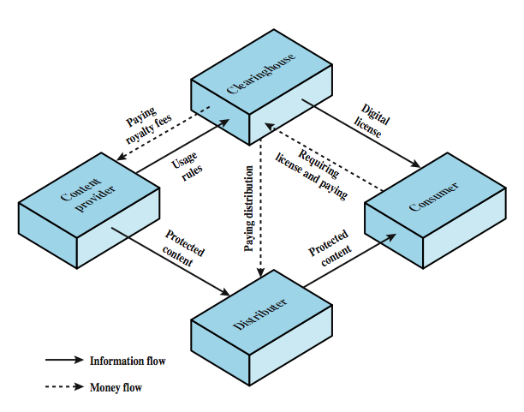
DRM Components
Notes:
Figure 23.3 from the text, illustrates a typical DRM model in terms of the principal users of DRM systems. These are:
• Content provider: Holds the digital rights of the content and wants to protect these rights. Examples are a music record label and a movie studio.
• Distributor: provides distribution channels, such as an online shop or a Web retailer. e.g. an online distributor receives digital content from the content provider and creates a Web catalogue presenting the content and rights metadata for its promotion.
• Consumer: Uses the system to access the digital content by retrieving downloadable or streaming content through the distribution channel and then paying for the digital license. The player/viewer application used by the consumer takes charge of initiating license request to the clearinghouse and enforcing the content usage rights.
• Clearinghouse: Handles the financial transaction for issuing the digital license to the consumer and pays royalty fees to the content provider and distribution fees to the distributor accordingly. The clearinghouse is also responsible for logging license consumptions for every consumer.
In this model, the distributor need not enforce the access rights. Instead, the content provider protects the content in such a way (typically encryption) that the consumer must purchase a digital license and access capability from the clearinghouse. The clearinghouse consults usage rules provided by the content provider to determine what access is permitted and the fee for a particular type of access. Having collected the fee, the clearinghouse credits the content provider and distributor appropriately.

Slide 15
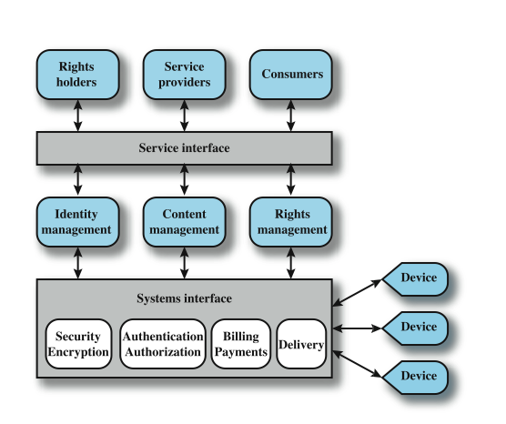
DRM System Architecture
Notes:
Figure 23.4 shows a generic system architecture to support DRM functionality.
The system is access by parties in three roles. Rights holders are the content providers, who either created the content or have acquired rights to the content. Service providers include distributors and clearinghouses. Consumers are those who purchase the right to access to content for specific uses.
There is system interface to the services provided by the DRM system:
• Identity management: mechanisms for unique entities, such as parties and content.
• Content management: processes and functions to manage the content lifecycle.
• Rights management: processes and functions needed to manage rights, rights holders, and associated requirements.
Below these management modules are common functions. The security/encryption module provides functions to encrypt content and to sign license agreements. The identity management service makes use of the authentication and authorization functions to identify all parties in the relationship. Using these functions, the identity management service includes the following: Allocation of unique party identifiers, User profile and preferences, User's device management, Public key management.
Billing/payments functions deal with the collection of usage fees from consumers and the distribution of payments to rights holders and distributors. Delivery functions deal with the delivery of content to consumers.

Slide 16
Privacy
overlaps with computer security
have dramatic increase in scale of info collected and stored
  motivated by law enforcement, national security, economic incentives
but individuals increasingly aware of access and use of personal / private info
concerns on extent of privacy compromise have seen a range of responses
Notes:
An issue with considerable overlap with computer security is that of privacy. On the one hand, the scale and interconnectedness of personal information collected and stored in information systems has increased dramatically, motivated by law enforcement, national security, and economic incentives. The last mentioned has been perhaps the main driving force. In a global information economy, it is likely that the most economically valuable electronic asset is aggregations of information on individual. On the other hand, individuals have become increasingly aware of the extent to which government agencies, businesses, and even Internet users have access to their personal information and private details about their lives and activities. Concerns about the extent to which personal privacy has been and may be compromised have led to a variety of legal and technical approaches to reinforcing privacy rights.

Slide 17
EU Privacy Law
European Union Data Protection Directive was adopted in 1998 to:
  ensure member states protect fundamental privacy rights when processing personal info
  prevent member states from restricting the free flow of personal info within EU
organized around principles of:
  notice, consent, consistency, access, security, onward transfer, enforcement
Notes:
A number of international organizations and national governments have introduced laws and regulations intended to protect individual privacy.
European Union Data Protection Directive was adopted in 1998, to both (1) ensure that member states protected fundamental privacy rights when processing personal information, and (2) prevent member states from restricting the free flow of personal information within the EU. The Directive is organized around the following principles of personal information use:
• Notice: organizations must notify individuals what personal information they are collecting, the uses of that information, and what choices the individual may have.
• Consent: individuals must be able to choose whether and how their personal information is used by, or disclosed to, third parties. They have the right not to have any sensitive information collected or used without express permission, including race, religion, health, union membership, beliefs, and sex life.
• Consistency: organizations may use personal information only in accordance with the terms of the notice given the data subject and the choices the make on its use
• Access: individuals must have the right and ability to access their information and correct, modify, or delete any portion of it.
• Security: organizations must provide adequate security, using technical and other means, to protect the integrity and confidentiality of personal information.
• Onward transfer: third parties receiving personal information must provide the same level of privacy protection as the organization from whom the information is obtained.
• Enforcement: grants a private right of action to data subjects when organizations do not follow the law.

Slide 18
US Privacy Law
have Privacy Act of 1974 which:
  permits individuals to determine records kept
  permits individuals to forbid records being used for other purposes
  permits individuals to obtain access to records
  ensures agencies properly collect, maintain, and use personal info
  creates a private right of action for individuals
also have a range of other privacy laws
Notes:
The first comprehensive privacy legislation adopted in the United States was the Privacy Act of 1974, which dealt with personal information collected and used by federal agencies. The act is intended to:
1. Permit individuals to determine what records pertaining to them are collected, maintained, used, or disseminated.
2. Permit individuals to forbid records obtained for one purpose to be used for another purpose without consent.
3. Permit individuals to obtain access to records pertaining to them and to correct and amend such records as appropriate.
4. Ensure that agencies collect, maintain, and use personal information in a manner that ensures that the information is current, adequate, relevant, and not excessive for its intended use.
5. Create a private right of action for individuals whose personal information is not used in accordance with the act.
As with all privacy laws and regulations, there are exceptions and conditions attached to this act, such as criminal investigations, national security concerns, and conflicts between competing individual rights of privacy.
While the 1974 Privacy Act covers government records, a number of other U.S. laws have been enacted that cover other areas, including: Banking and financial records, Credit , Medical and health insurance records, Children's privacy, Electronic communications.

Slide 19
Organizational Response
“An organizational data protection and privacy policy should be developed and implemented. This policy should be communicated to all persons involved in the processing of personal information. Compliance with this policy and all relevant data protection legislation and regulations requires appropriate management structure and control. Often this is best achieved by the appointment of a person responsible, such as a data protection officer, who should provide guidance to managers, users, and service providers on their individual responsibilities and the specific procedures that should be followed. Responsibility for handling personal information and ensuring awareness of the data protection principles should be dealt with in accordance with relevant legislation and regulations. Appropriate technical and organizational measures to protect personal information should be implemented.”
Notes:
Organizations need to deploy both management controls and technical measures to comply with laws and regulations concerning privacy as well as to implement corporate policies concerning employee privacy. ISO 17799 (Code of Practice for Information Security Management) states the requirement as follows:
ISO 17799: Data protection and privacy of personal information
An organizational data protection and privacy policy should be developed and implemented. This policy should be communicated to all persons involved in the processing of personal information. Compliance with this policy and all relevant data protection legislation and regulations requires appropriate management structure and control. Often this is best achieved by the appointment of a person responsible, such as a data protection officer, who should provide guidance to managers, users, and service providers on their individual responsibilities and the specific procedures that should be followed. Responsibility for handling personal information and ensuring awareness of the data protection principles should be dealt with in accordance with relevant legislation and regulations. Appropriate technical and organizational measures to protect personal information should be implemented.

Slide 20
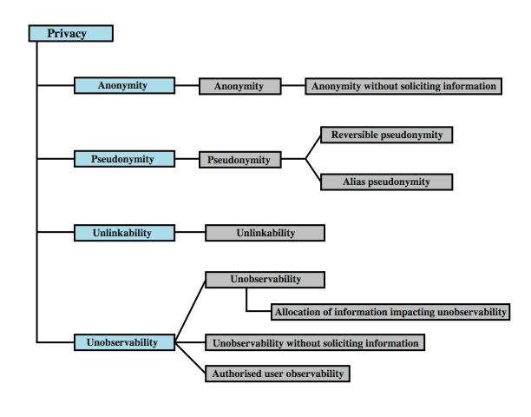
Common Criteria Privacy Class
Notes:
The Common Criteria specification includes a definition of a set of functional requirements in a Privacy Class, which should be implemented in a trusted system. The purpose of the privacy functions is to provide a user protection against discovery and misuse of identity by other users. It is primarily concerned with the privacy of an individual with respect to their use of computer resources, rather than the privacy of their personal information. This specification is a useful guide to how to design privacy support functions as part of a computer system.
Figure 23.5 shows a breakdown of privacy into four major areas:
• Anonymity: Ensures that a user may use a resource or service without disclosing the user’s identity. Specifically, this means that other users or subjects are unable to determine the identity of a user bound to a subject (e.g., process or user group) or operation. It further means that the system will not solicit the real name of a user. Anonymity need not conflict with authorization and access control functions, which are bound to computer-based user IDs, not to personal user information.
• Pseudonymity: ensures that a user may use a resource or service without disclosing its user identity, but can still be accountable for that use. The system shall provide an alias to prevent other users from determining a user's identity but the system shall be able to determine the user's identity from an assigned alias.
• Unlinkability: ensures that a user may make multiple uses of resources or services without others being able to link these uses together.
• Unobservability: ensures that a user may use a resource or service without others, especially third parties, being able to observe that the resource or service is being used.

Slide 21
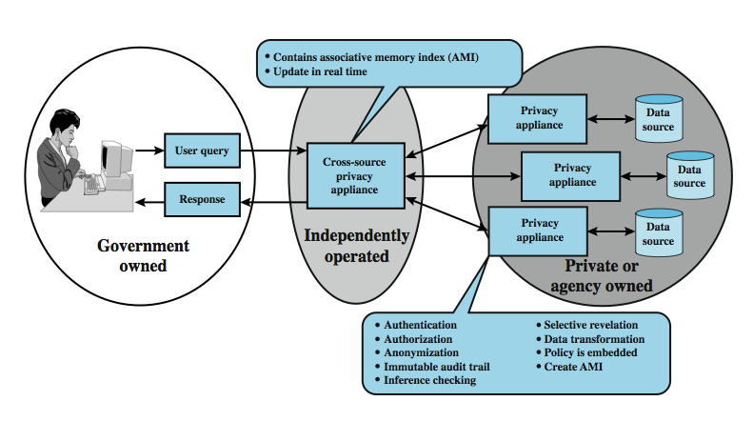
Privacy and Data Surveillance
Notes:
The demands of homeland security and counterterrorism have imposed new threats to personal privacy. Law enforcement and intelligence agencies have become increasingly aggressive in using data surveillance techniques. Also, private organizations are increasing their ability to build detailed profiles of individuals. Both policy and technical approaches are needed to protect privacy when both government and non-government organizations seek to learn as much as possible about individuals. In terms of technical approaches, the requirements for privacy protection for information systems can be addressed in the context of database security.
Figure 23.6 shows a privacy appliance, which is a tamper-resistant, cryptographically protected device that is interposed between a database and the access interface. It implements privacy protection functions, including verifying the user's access permissions / credentials and creating an audit log. Some of its specific functions are:
• Data transformation: encodes or encrypts portions of the data so as to preserver privacy but still allow data analysis functions needed for effective use.
• Anonymization: removes specific identifying information from query results, replacing themwith an anonymized unique identifier
• Selective revelation: a method for minimizing exposure of individual information while enabling continuous analysis of potentially interconnected data.
• Immutable audit: a method that identifies where data goes and who has seen it.
• Associative memory: a software module that recognizes patterns / connections between pieces of data that the human user may have missed or didn’t know existed.

Slide 22
Ethical Issues
have many potential misuses / abuses of information and electronic communication that create privacy and security problems
ethics:
  a system of moral principles relating benefits and harms of particular actions to rightness and wrongness of motives and ends of them
ethical behavior here not unique
but do have some unique considerations
  in scale of activities, in new types of entities
Notes:
Because of the ubiquity and importance of information systems in organization of all types, there are many potential misuses and abuses of information and electronic communication that create privacy and security problems. In addition to questions of legality, misuse and abuse raise concerns of ethics. Ethics refers to a system of moral principles that relates to the benefits and harms of particular actions, and to the rightness and wrongness of motives and ends of those actions.
To a certain extent, a characterization of what constitutes ethical behavior for those who work with or have access to information systems is not unique to this context. The basic ethical principles developed by civilizations apply. However, there are some unique considerations surrounding computers and information systems. Firstly, computer technology makes possible a scale of activities not possible before. This includes a larger scale of record keeping, particularly on individuals with the ability to develop finer-grained personal information collection and more precise data mining and data matching. The expanded scale of communications and the expanded scale of interconnection brought about by the Internet magnify the power of an individual to do harm. Secondly, computer technology has involved the creation of new types of entities for which no agreed ethical rules have previously been formed, such as databases, Web browsers, chat rooms, cookies, and so on.

Slide 23
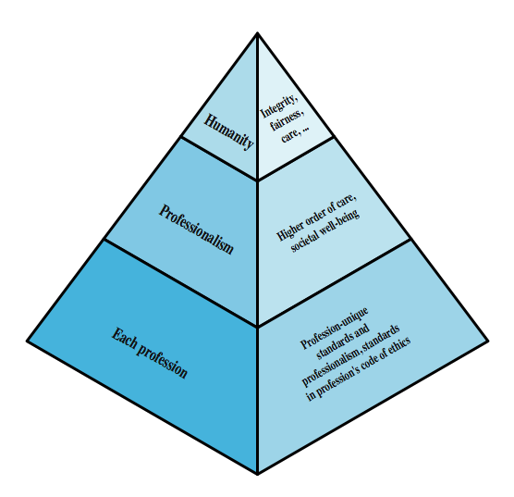
Ethical Hierarchy
Notes:
It has always been the case that those with special knowledge or special skills have additional ethical obligations beyond those common to all humanity. We can illustrate this in terms of an ethical hierarchy , as illustrated in Figure 23.7 from the text. At the top of the hierarchy are the ethical values professionals share with all human beings, such as integrity, fairness, and justice. Being a professional with special training imposes additional ethical obligations with respect to those affected by his or her work. General principles applicable to all professionals arise at this level. Finally, each profession has associated with it specific ethical values and obligations related to the specific knowledge of those in the profession and the powers that they have to affect others. Most professions embody all of these levels in a professional code of conduct, a subject discussed subsequently.

Slide 24
Ethical Issues Related to Computers and Info Systems
some ethical issues from computer use:
  repositories and processors of information
  producers of new forms and types of assets
  instruments of acts
  symbols of intimidation and deception
those who understand / exploit technology, and have access permission, have power over these
issue is balancing professional responsibilities with ethical or moral responsibilities
Notes:
Now consider some ethical issues that arise from computer technology. A classic paper on computers and ethics points out that ethical issues arise as the result of the roles of computers, such as:
• Repositories and processors of information: Unauthorized use of otherwise unused computer services or of information stored in computers raises questions of appropriateness or fairness.
• Producers of new forms and types of assets: For example, computer programs are entirely new types of assets, possibly not subject to the same concepts of ownership as other assets.
• Instruments of acts: To what degree must computer services and users of computers, data, and programs be responsible for the integrity and appropriateness of computer output?
• Symbols of intimidation and deception: The images of computers as thinking machines, absolute truth producers, infallible, subject to blame, and as anthropomorphic replacements of humans who err should be carefully considered.
Those who can understand and exploit the technology, plus those who have obtained access permission, have power related to those assets.
Another listing of ethical issues is shown in Table 23.3 in the text.
Both of these lists are concerned with balancing professional responsibilities with ethical or moral responsibilities.

Slide 25
Ethical Question Examples
whistle-blower
  when professional ethical duty conflicts with loyalty to employer
  e.g. inadequately tested software product
  organizations and professional societies should provide alternative mechanisms
potential conflict of interest
  e.g. consultant has financial interest in vendor which should be revealed to client
Notes:
We cite two areas here of the types of ethical questions that face a computing or IS professional.
The first is that IS professionals may find themselves in situations where their ethical duty as professionals comes into conflict with loyalty to their employer. Such a conflict may give rise for an employee to consider 'blowing the whistle,' or exposing a situation that can harm the public or a company's customers. For example, a software developer may know that a product is scheduled to ship with inadequate testing to meet the employer's deadlines. The decision of whether to blow the whistle is one of the most difficult that an IS professional can face. Organizations have a duty to provide alternative, less extreme opportunities for the employee, such as an in-house ombudsperson coupled with a commitment not to penalize employees for exposing problems in-house. Additionally, professional societies should provide a mechanism whereby society members can get advice on how to proceed.
Another example of an ethical question concerns a potential conflict of interest. For example, if a consultant has a financial interest in a certain vendor, this should be revealed to any client if that vendor's products or services might be recommended by the consultant.

Slide 26
Codes of Conduct
ethics not precise laws or sets of facts
many areas may present ethical ambiguity
many professional societies have ethical codes of conduct which can:
  be a positive stimulus and instill confidence
  be educational
  provide a measure of support
  be a means of deterrence and discipline
  enhance the profession's public image
Notes:
Unlike scientific and engineering fields, ethics cannot be reduced to precise laws or sets of facts. Although an employer or a client of a professional can expect that the professional has an internal moral compass, many areas of conduct may present ethical ambiguities. To provide guidance to professionals and to articulate what employers and customers have a right to expect, a number of professional societies have adopted ethical codes of conduct. A professional code of conduct can:
1. serve as a positive stimulus for ethical conduct on the part of the professional, and to instill confidence in the customer or user of an IS product or service.
2. be educational and inform the professional about what should be their commitment to undertake a certain level of quality of work & their responsibility for the well being of users of their product and the public, to the extent the product may affect non-users. The code also serves to educate managers on their responsibility to encourage and support employee ethical behavior and on their own ethical responsibilities.
3. provide a measure of support for a professional whose decision to act ethically in a situation may create conflict with an employer or customer.
4. be a means of deterrence and discipline. A professional society can use a code as a justification for revoking membership or even a professional license. An employee can use a code as a basis for a disciplinary action.
5. enhance the profession's public image, if it is seen to be widely honored.

Slide 27
Codes of Conduct
see ACM, IEEE and AITP codes
place emphasis on responsibility other people
have some common themes:
  dignity and worth of other people
  personal integrity and honesty
  responsibility for work
  confidentiality of information
  public safety, health, and welfare
  participation in professional societies to improve standards of the profession
  the notion that public knowledge and access to technology is equivalent to social power
Notes:
Consider the professional code of ethics for computer professionals from the ACM (Figure 23.8 in the text), IEEE (23.9) and AITP (23.10).
A number of common themes emerge from these codes, including (1) dignity and worth of other people, (2) personal integrity and honesty, (3) responsibility for work, (4) confidentiality of information, (5) public safety, health, and welfare, (6) participation in professional societies to improve standards of the profession, and (7) the notion that public knowledge and access to technology is equivalent to social power.
All three codes place their emphasis on the responsibility of professionals to other people, which, after all, is the central meaning of ethics. This emphasis on people rather than machines or software is to the good. However, the codes make little specific mention of the subject technology, namely computers and information systems. That is, the approach is quite generic and could apply to most professions and does not fully reflect the unique ethical problems related to the development and use of computer and IS technology. For example, these codes do not specifically deal with the issues raised in Table 23.3 or by [PARK88] listed in the preceding subsection.

Slide 28
Summary
reviewed a range of topics:
  cybercrime and computer crime
  intellectual property issues
  privacy
  ethical issues
Notes:
Chapter 23 summary.

