Slide 1
Heartbleed
ISC2 Gauteng
Notes:
Picture from http://www.xnvx.com/data/media/87/Bleeding_Heart_By_Elpartydiablo.jpg

Slide 2
whoami
Dominic White
CTO @ SensePost
We
Hack | Build | Train | Scan
Stuff
@singe / @sensepost
dominic@sensepost.com
info/research/job @sensepost.com

Slide 3

What Happened
7 April 2014 – Vulnerability announced to the world with a website, OpenSSL vulnerability announcement and new code release (1.0.1g)
Found by two groups; Google Security Team (Neel Mehta & Condenomicon)
Told that private keys to SSL certificates could be exposed – uh oh
Operating systems had not packaged the new release, so many were vulnerable
Many big name companies were vulnerable; Big Tech names, Banks, Law Enforcement, Intelligence Agencies
Online testers appeared, and were quickly swamped
But ….

Slide 4

What is it?
Vulnerability in a widely used cryptographic library
i.e. lots of Unix things use this to do encryption
Vulnerability specific to SSL Heartbeats
RFC 6520 https://tools.ietf.org/html/rfc6520
Introduced on Dec 31 2011 by Dr Stephen Henson
Allows you to read parts of a program memory
Buffer Over Read

Slide 5
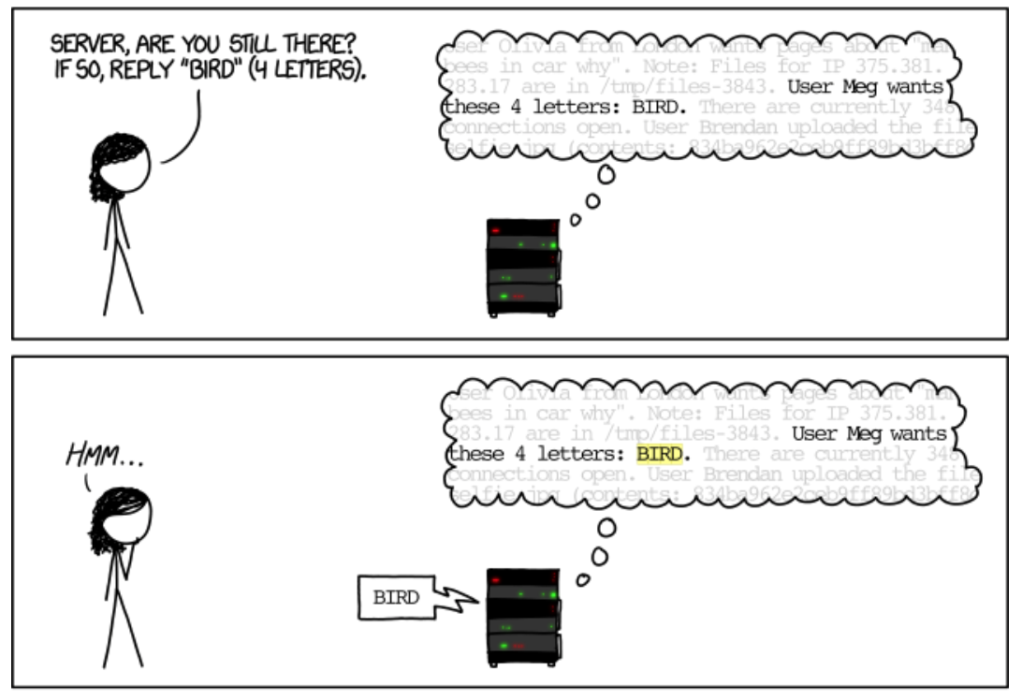
Notes:
http://xkcd.com/1354/

Slide 6
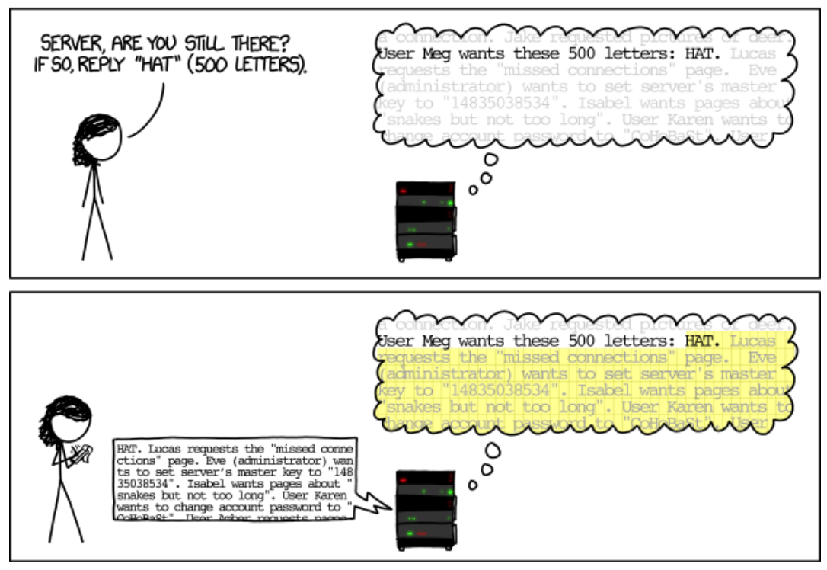

Slide 7
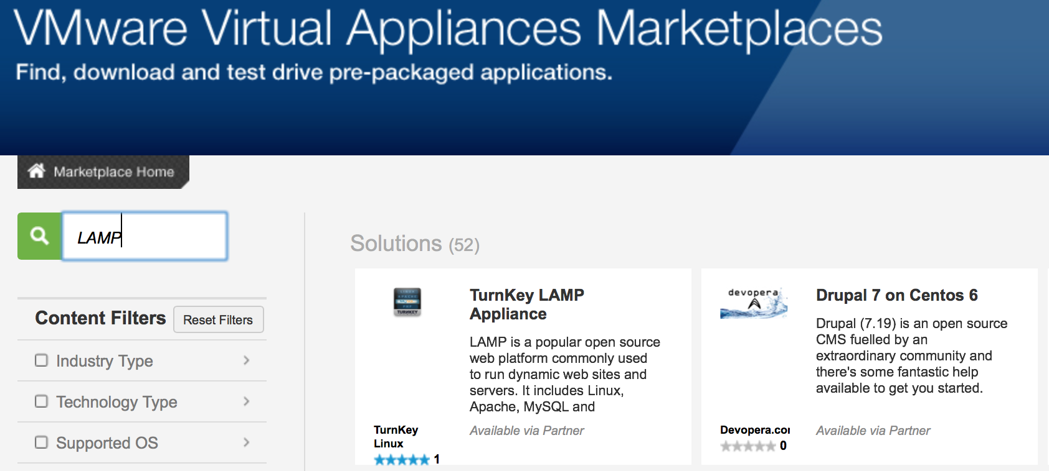
Demo
Extracting cookies & private SSL keys from a vulnerable server

Slide 8

Why does it work
OpenSSL is just the library, the actual process is something like Apache, Nginx, Dovecot, Exim etc.
These processes have a HEAP, in which data used by the process is stored.
If the process is active, it changes a lot
Certificate private keys are made up
of two large prime numbers; we can
find these if they were used recently

Slide 9
The slow path to enlightenment
Initial testers looked for vanilla SSL on port 443 using TLS v1.1
Most famous and first PoC by Jared Stafford; ssltest.py
But:
SSL runs on non-standard ports
Some servers didn’t support TLS v1.1
SSL can be invoked on clear-text ports with STARTLS
STARTTLS is different for different protocols
Clients are vulnerable too!
Lots of debate about whether keys could be grabbed
CloudFlare challenge cleared that up
IDS signatures were quickly defeated

Slide 10
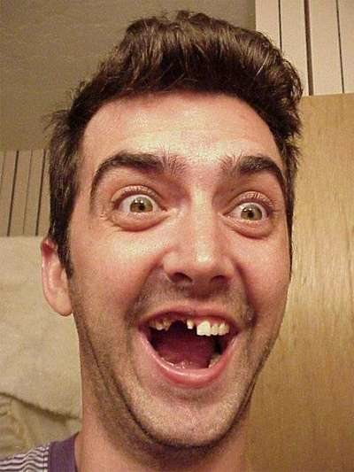
Meanwhile ….
#heartbleedvirus
Bruce Schneier
“On the scale of 1 to 10, this is an 11.”
I’m not Vulnerable, the scanner said so!
Claims of NSA backdoor bogey men
EVERYBODY CHANGE ALL YOUR PASSWORDS!
NO WAIT, CHANGE THEM AGAIN!

Slide 11
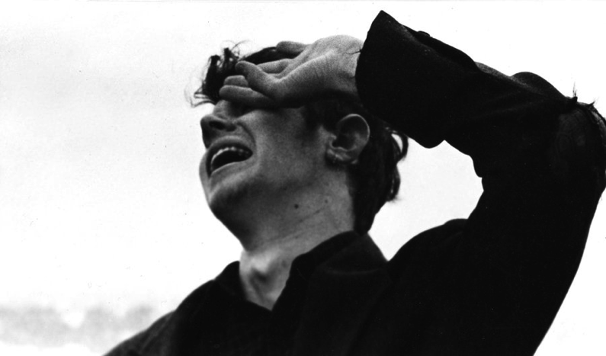
How Bad Was It?
Masscan (Robert Graham)
615 268 / 28 581 134
After one month 318 239
Our clients
1.8% when it broke
Offered free “complete” scan
24 / 224 186

Slide 12
Tactical Defence
Fix the Vuln
Cleanup
Patch it
OpenSSL >= 1.0.1g
Old versions < 1.0.1 unaffected
Disable it
Firewall, VPN?
Reconfigure it
Disable heartbeats
Enable Perfect Forward Secrecy
IDS it?
Do not rely on this
Change certificates
Revoke the old ones
Reset sessions
i.e. invalidate all cookies
Change passwords
Only affected user-stores

Slide 13
Defence in Depth
One 0day shouldn’t ruin your day
But this one was tricky
Early alerting
Response procedures (IR)
Ability to act quickly (devsecops)
Avoid heterogeneity/monocultures?

Slide 14
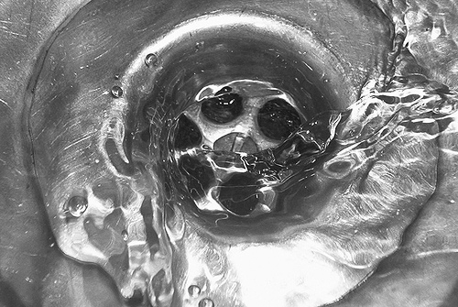
The State of OpenSSL’s Future
Massive amount of legacy code
Incredibly complex to maintain
2 people effectively doing most of it
C considered harmful today
Pointer arithmetic makes problems
FIPS certification dangerous
Certifies bad crypto & bad implementations
OpenBSD’s OpenSSL rampage -> LibreSSL
OpenSSL just got a ton of funding

Slide 15
Eye Openers
We thought OpenSSL was okay
Ok, lots didn’t, but nobody did anything about it
We think lots of other things are ok
ESR’s Linus’ Law: “Given enough eyeballs, all bugs are shallow”
But!
We found the bug
People actually patched it
Others
The rise of the branded bug
The trail of fakes
Media still drives reactions

Slide 16
Thanks & References
Hackerfantastic
Tool & Presentation
Erratarob
Tool/s & blogs
XKCD
Comics!
Elpartydiablo & xnvx.com
Background

