Slide 1
The IPSec Protocol Suite

Slide 2
IPSec
IPsec is a suite of protocols. It consists of:
Protocols that provide encryption-authenticity of the data stream (ESP, AH)
Protocols that implement the initial key exchange to realize the encrypted stream (+ ISAKMP IKE).

Slide 3
Set up Ipsec (1)
http://www.unixwiz.net/techtips/iguide-ipsec.html#flavors
AH vs ESP
AH (authenticate)
provides authentication and message integrity, but it does not provide confidentiality
ESP (encrypt+authenticate)
provides authentication, confidentiality and message integrity check

Slide 4
Set up Ipsec (2)
Tunnel mode vs Transport mode
IPsec supports two modes of operation
Transport Mode
provides a secure connection between two endpoints (host-to-host)
Only the IP’s payload is encrypted and not the header
Computationally lighter
Tunnel Mode
gateway-to-gateway connection
the entire IP packet is encrypted
computationally expensive
only the gateway needs support of the Ipsec suite

Slide 5
Set up IPsec (3)
MD5 vs SHA-1 vs DES vs 3DES vs AES vs blah blah blah
Encryption methods:
In Authentication mode, ciphers are used to calculate an Integrity Check Value (ICV) over the packet's contents. ICV it's usually built on top of a cryptographic hash such as MD5 or SHA-1. It incorporates a secret key known to both ends, and this allows the recipient to compute and check the ICV in the same way.
In Encryption mode, ciphers are used with a secret key to encrypt the data before transmission (algorithms such as DES, 3DES, Blowfish, AES).

Slide 6
Set up Ipsec (4)
IKE vs manual keys
The Internet Key Exchange protocol is used to establish a security association (SA)
used to establish a shared session secret, that is, a shared key corresponding to the session to be established
from the shared secret are then derived encryption keys that will be used for the next communication.
Manual keys require manual entry of the secret values for key exchange (occurs out-of-band)
Main mode vs aggressive mode
efficiency-versus-security tradeoff during the initial key exchange (IKE).
Main mode requires 6 packets back and forth, but affords complete security during the establishment of an IPsec connection
Aggressive Mode uses half the exchanges providing a bit less security because some information is transmitted in cleartext.

Slide 7
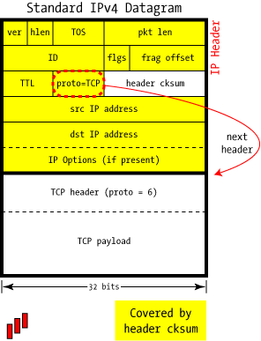
Standard IP Datagram (1)
http://www.unixwiz.net/techtips/iguide-ipsec.html#ip
ver
version of the protocol
hlen
IP Header length, as a four-bit quantity of 32-bit words. A standard IPv4 header is always 20 bytes long (5 words).
TOS
Type of Service. Specifies how the datagram should be handled (optimize for bandwidth? Latency? Low cost? Reliability?)
pkt len
Overall packet length in bytes (up to 65535). This count includes the bytes of the header.
ID
Used to associate related packets that have been fragmented
flgs
Bits used for control and protocol datagram fragmentation

Slide 8
Standard IP Datagram (2)
http://www.unixwiz.net/techtips/iguide-ipsec.html#ip
frag offset
tells the offset (measured in blocks of 8 bytes) of a particular fragment
TTL
This is the Time to Live of the datagram.
proto
Shows the code associated with the protocol used in the data field of the IP datagram, for example the TCP protocol is associated with the code 6, for UDP code 17. Other protocols (47, GRE. 50, ESP. 51, AH)
header checksum
it's designed to detect errors in transit. This is not a cryptographic checksum, and it doesn't cover any part of the datagram that follow the IP header.

Slide 9
Standard IP Datagram (3)
http://www.unixwiz.net/techtips/iguide-ipsec.html#ip
src IP address
Shows the IP address associated with the host of the sender of the datagram (32-bit)
dst IP address
Shows the IP address associated with the host of the recipient of the datagram
IP Options
Options (optional and not used a lot) for more specific uses of the protocol.
Payload
Data in transit.

Slide 10
AH: Authentication Only (1)
AH is used to authenticate, but not encrypting, IP traffic
serves the purpose of ensuring that we're really talking to who we think we are, detecting alteration of data while in transit, and (optionally) to guard against replay by attackers who capture data from the wire and attempt to re-inject that data back onto the wire at a later date
Authentication…
…is performed by computing a cryptographic hash-based message authentication code over nearly all the fields of the IP packet (excluding those which might be modified in transit, such as TTL or the header checksum), and stores this in a newly-added AH header

Slide 11
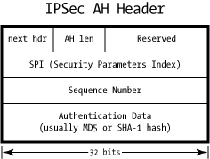
AH: Authentication Only (2)
http://www.unixwiz.net/techtips/iguide-ipsec.html#ah
next hdr
This identifies the protocol type of the following payload.
AH len
Defines the length of the whole AH header
Reserved
This field is reserved for future use and must be zero.
Security Parameters Index
identifies the parameters of current security combined with the pair of IP addresses.
Sequence Number
This is a monotonically increasing identifier that's used to assist in anti-replay protection.
Authentication Data
Contains the Integrity Check Value (ICV)

Slide 12
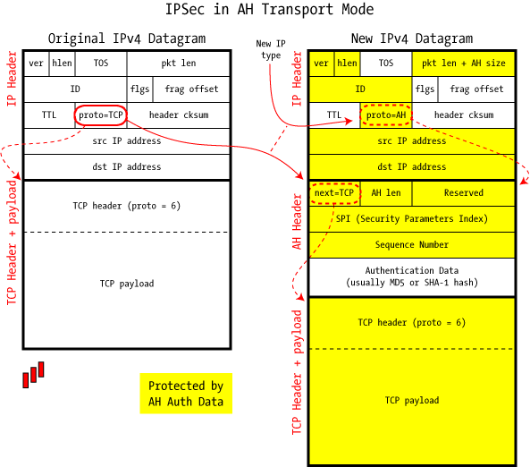
AH Transport Mode (1)

Slide 13
AH Transport Mode (2)
It’s used to protect an end-to-end conversation between two hosts.
This protection guarantees authentication only.
Only the payload of the IP datagram is handled by IPsec, inserting an header between the IP header and the upper levels

Slide 14
AH Transport Mode (3)
When traffic is protected using AH in transport mode, AH is added as a new header between the IP header and the payload protocol (TCP, UDP, etc.).
The IP header is changed to indicate that the next header to be treated is the AH protocol (next header field)
Then the entire resulting IP packet, with the exception of some mutable IP header field, is authenticated by the hashing process and sent to the destination
When the packet arrives at its destination and passes the authentication, the AH header is removed and the field Proto = AH header in the IP header is replaced with “Next Protocol”

Slide 15
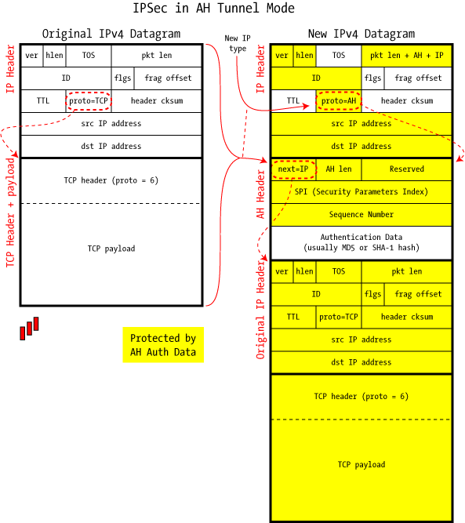
AH Tunnel Mode (1)

Slide 16
AH Tunnel Mode (2)
In tunnel mode a IP datagram is fully encapsulated in a new IP datagram using IPSec.
the packet is sealed with an Integrity Check Value to authenticate the sender and to prevent modification in transit
it encapsulates the full IP header as well as the payload, and this allows the source and destination addresses to be different from those of the encompassing packet (this allows formation of a tunnel)

Slide 17
AH Tunnel Mode (3)
When the packet arrives at its destination, after the authentication check, the entire IP header and AH are stripped off
The reconstituted packet could be delivered to the local machine or routed elsewhere (according to the destination IP address found in the encapsulated packet)
Transport mode is used strictly to secure an end-to-end connection between two computers
Tunnel mode is more typically used between gateways (routers, firewalls, or standalone VPN devices) to provide a Virtual Private Network

Slide 18
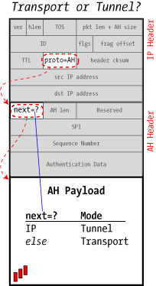
Transport or Tunnel? (1)

Slide 19
Transport or Tunnel? (2)
There is no explicit "Mode" field in Ipsec… what distinguishes Transport mode from Tunnel mode?
with the next header field in the AH header
When the next-header value is IP, it means that this packet encapsulates an entire IP datagram -> Tunnel mode.
Any other value (TCP, UDP, ICMP, etc.) ->Transport mode

Slide 20
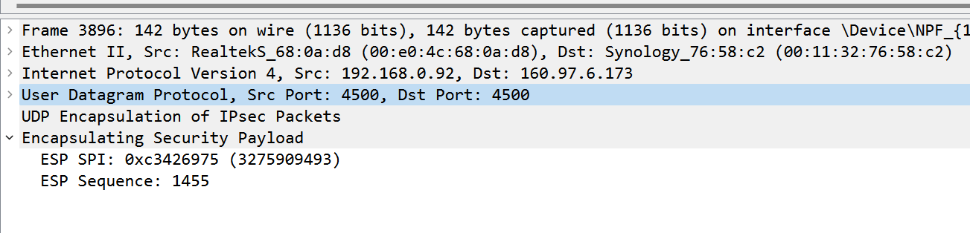
IPSec over UDP
NAT friendly IPSec:

Slide 21
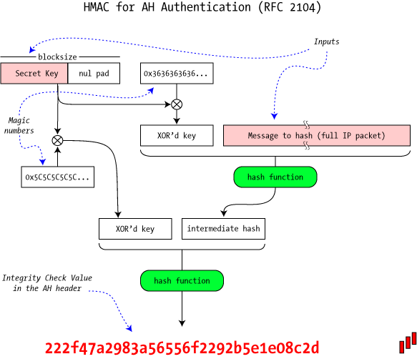
Authentication Algorithms (1)

Slide 22
Authentication Algorithms (2)
AH carries an Integrity Check Value in the Authentication Data portion of the header, built on top of standard cryptographic hash algorithms such as MD5 or SHA-1
Rather than use a straight checksum, it uses a Hashed Message Authentication Code (HMAC) which incorporates a secret value while creating the ICV
Though an attacker can easily recompute a hash, without the secret value he won't be able to recreate the proper ICV

Slide 23
AH and NAT
AH covers the integrity of the entire IP packet
ESP does not cover the IP header with controls of any kind neither in Tunnel mode nor in Transport mode
Works better with NAT

Slide 24
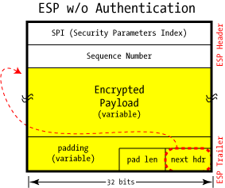
ESP — Encapsulating Security Payload
http://www.unixwiz.net/techtips/iguide-ipsec.html#esp

Slide 25
ESP — Encapsulating Security Payload
Its goal is to provide confidentiality and integrity checking and authenticity to communication.
Unlike AH, the IP header is not covered by integrity checks.
As with AH, it also provides Tunnel and Transport modes .
It's possible to use the service of confidentiality, or only authentication services and integrity (and possibly anti-replay), or both services together.

Slide 26
ESP –without encryption-
use a NULL algorithm
No confidentiality
It only makes sense if combined with ESP authentication

Slide 27
ESP – with encryption –
Adding encryption makes ESP a bit more complicated because the encapsulation surrounds the payload rather than preceding it as with AH
ESP includes header and trailer fields to support the encryption and optional authentication
DES, triple-DES, AES, and Blowfish are possible algorithms. Their use for a particular connection is specified by Security Associations (SA)

Slide 28
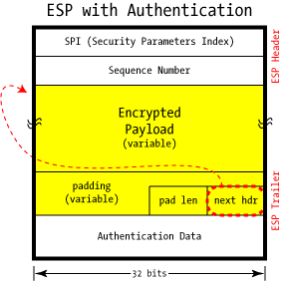
ESP – with encryption –

Slide 29
ESP – with encryption –
HMAC as AH
authentication is only for the ESP header and encrypted payload (the full IP packet isn’t covered)
When an outsider examines an IP packet containing ESP data, it's essentially impossible to make any real guesses about what's inside an ESP payload except for the usual data found in the IP header (particularly the source and destination IP addresses). It’s only possible to know that it's ESP data

Slide 30
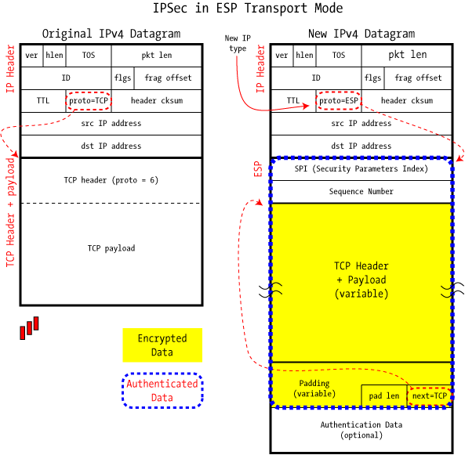
ESP Transport Mode

Slide 31
ESP Transport Mode
encapsulates just the datagram's payload and it is designed strictly for host-to-host communications
The original IP header is left in place
the source and destination IP addresses are unchanged

Slide 32
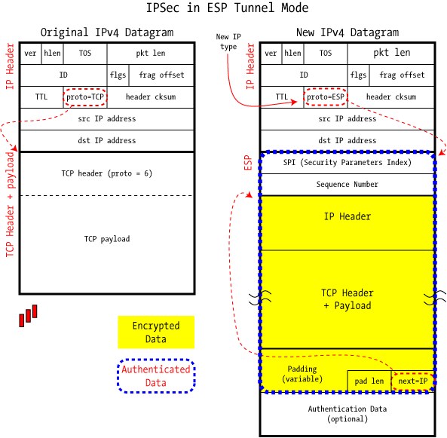
ESP Tunnel Mode

Slide 33
ESP Tunnel Mode
encapsulates an entire IP datagram

Slide 34
Summary
 | Transport Mode SA | Tunnel Mode SA
AH | Authenticates IP payload and selected portions of IP header and IPv6 extension headers. | Authenticates the entire inner IP packet (inner header plus IP payload) plus selected portions of the outer IP header and outer IPv6 extension headers.
ESP | Encrypts IP payload and any IPv6 extension headers following the ESP header. | Encrypts entire inner IP packet.
ESP with Authentication | Encrypts IP payload and any IPv6 extension headers following the ESP header. Authenticates IP payload but not IP header. | Encrypts entire inner IP packet. Authenticates inner IP packet.

Slide 35
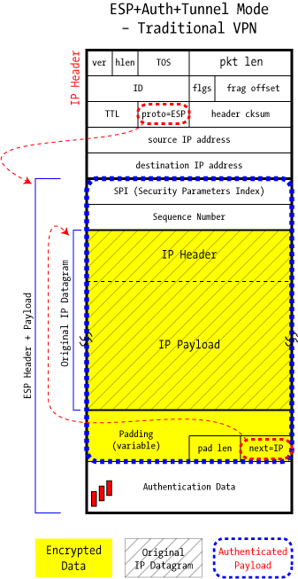
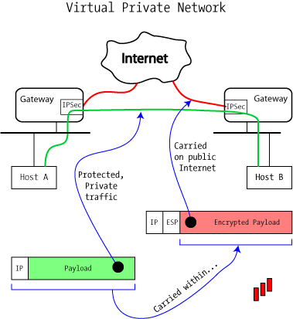
Building a real VPN
http://www.unixwiz.net/techtips/iguide-ipsec.html#vpn

Slide 36
Security Associations and the SPI
http://www.unixwiz.net/techtips/iguide-ipsec.html#other
SA: a one way logical connection between the sender and the receiver
Identified by three parameters :
Partner IP address
Security Parameters Index (SPI)
Identifier of the security protocol

Slide 37
Security Associations and the SPI
Security Association Database (SADB)
A database containing some SAs, present on the hosts
Security Parameter Index (SPI)
Unique index associated with each entry of the SADB
Identifies the SA associated with a packet
Security Policy Database (SPD)
Stores the policy used to determine the SA type (indicates preferences on what type of SA are acceptable)

Slide 38
IPSec ISAKMP + IKE

Slide 39
Internet Security Association and Key Management Protocol
ISAKMP protocol
defines procedures and packet formats to
establish, negotiate, modify, delete the security associations
defines payloads for exchanging key generation and authentication data
it’s independent of the key generation technique, encryption algorithm and authentication mechanism

Slide 40
ISAKMP message
An ISAKMP message consists of:
Header + one or more payloads
Transported in a transport protocol
specifications require support for UDP

Slide 41
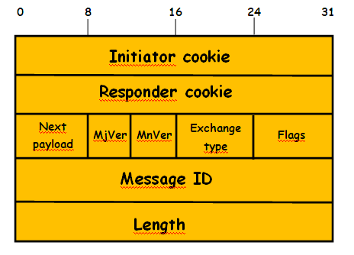
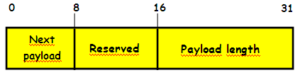
Header ISAKMP
Initiator Cookie (64 bit): Cookie of entity that initiated SA establishment, SA notification, or SA deletion. (used to prevent DOS attacks)
Responder Cookie (64 bit): Cookie of responding entity; null in first message from initiator
Next Payload (8 bit): Indicates the type of the first payload in the message; payloads are discussed in the next subsection
MajorVersion (4 bit): Indicates major version of ISAKMP in use
MinorVersion (4 bit): Indicates minor ISAKMP version in use.
Exchange Type (8 bit): Indicates the type of exchange
Flag (8 bit): Indicates specific options set for this ISAKMP exchange
Message ID (32 bit): Unique ID for this message
Length (32 bit): Length of total message in octets
ISAKMP Header
Generic payload header

Slide 42
Payload ISAKMP
Next Payload (8 bit): has a value of 0 if this is the last payload in the message; otherwise its value is the type of the next payload
Payload length (8 bit): indicates the length in octets of this payload
Generic payload header

Slide 43
ISAKMP Payload Types (1)
Type | Parameters | Description
SA (Security Association) | Domain of interpretation, situation | Used to negotiate security attributes and indicate the Domain of interpretation and Situation under which negotiation is taking place.
P (Proposal) | Proposal #, Protocol-ID, SPI Size, # of Transforms, SPI | Used during SA negotiation; indicates protocol to be used and number of transforms. (transform = data processing algorithm, e.g. hmac-md5, etc…)
T (Transform) | Transform #, Transform-ID, SA Attributes | Used during SA negotiation; indicates transform and related SA attributes

Slide 44
ISAKMP Payload Types (2)
Type | Parameters | Description
KE (Key Exchange) | Key Exchange data | Supports a variety of key exchange techniques.
ID (Identification) | ID Type, ID Data | Used to exchange identification information
CERT (Certificate) | Cert Encoding, Certificater Data | Used to transport certificates and other certificate- related information
CR (Certificate Request) | # Cert Types, Certificate Types, # Certificate Auths, certificate Authorities | Used to request certificates; indicates the types of certificates requested and the acceptable certificate authorities
HASH (Hash) | Hash data | Contains data generated by a hash function
SIG (Signature) | Signature Data | Contains data generated by a digital signature function

Slide 45
ISAKMP Payload Types (3)
Type | Parameters | Description
NONCE(nonce) | Nonce Data | Contains a nonce
N(Notification) | DOI,Protocol-ID,SPI Size, Notify Message Type, SPI,Notification Data | Used to transmit notification data, such as an error condition
D (Delete) | DOI,Protocol-ID, SPI Size, # of SPIs, SPI (one or more) | Indicates an SA that is no longer valid

Slide 46
Payload Types (1)
The SA payload is used to begin the establishment of an security association
the Domain of Interpretation parameter identifies the DOI under which negotiation is taking place
The Situation parameter defines the security policy for this negotiation (the levels of security required)
The Proposal payload contains information used during SA negotiation
indicates the protocol for this SA (ESP or AH), includes the sending entity's SPI and the number of transforms.
The Transform payload defines a security transform to be used to secure the communications channel for the designated protocol
The Transform # parameter serves to identify this particular payload so that the responder may use it to indicate acceptance of this transform
The Transform-ID and Attributes fields identify a specific transform (e.g., 3DES for ESP, HMAC-SHA-1-96 for AH) with its associated attributes

Slide 47
Payload Types (2)
The Key Exchange payload can be used for a variety of key exchange techniques(Oakley, Diffie-Hellman,..)
The data field contains the data required to generate a session key and is dependent on the key exchange algorithm used
The Identification payload is used to determine the identity of communicating peers and may be used for determining authenticity of information.
Typically the ID Data field will contain an IPv4 or IPv6 address.
The Certificate payload transfers a public-key certificate
The Certificate Encoding field indicates the type of certificate
The Certificate Request payload is used to request the certificate of the other communicating entity
The payload may list more than one certificate type that is acceptable and more than one certificate authority that is acceptable

Slide 48
Payload Types (3)
The Hash payload contains data generated by a hash function over some part of the message and/or ISAKMP state.
This payload may be used to verify the integrity of the data in a message or to authenticate negotiating entities
The Signature payload contains data generated by a digital signature function over some part of the message and/or ISAKMP state.
This payload is used to verify the integrity of the data in a message and may be used for nonrepudiation services
The Nonce payload contains random data
used to guarantee liveness during an exchange and protect against replay attack
The Notification payload contains either error or status information associated with this SA or this SA negotiation
The Delete payload indicates one or more SAs that the sender has deleted from its database and that therefore are no longer valid

Slide 49
ISAKMP: message exchange
Base
allows key exchange and authentication material to be transmitted together.
Minimizes the number of exchanges at the expense of not providing identity protection
Identity Protection
Expands the Base Exchange to protect the users' identities
Authentication Only
Used to perform mutual authentication, without a key exchange
Aggressive
Minimizes the number of exchanges at the expense of not providing identity protection
Informational
Used for one-way transmittal of information for SA management

Slide 50
(1) I → R : SA; NONCE | Begin ISAKMP-SA negotiation
(2) R → E : SA; NONCE | Basic SA agreed upon
(3) I → R : KE; ID_{I} ; AUTH | Key generated; Initiator identity verified by responder
(4) R → E : KE; ID_{R} ; AUTH | Responder identity verified by initiator; Key generated; SA established
Notation :
I = initiator
R = responder
* = signifies payload encryption after the ISAKMP header
AUTH = authentication mechanism used

Slide 51
Base Exchange
(1) I → R : SA; NONCE | Begin ISAKMP-SA negotiation
(2) R → E : SA; NONCE | Basic SA agreed upon
(3) I → R : KE; ID_{I} AUTH | Key generated; Initiator identity verified by responder
(4) R → E : KE; ID_{R} AUTH | Responder identity verified by initiator; Key generated; SA established
The first two messages provide cookies and establish an SA with agreed protocol and transforms
Both sides use a nonce to ensure against replay attacks
The last two messages exchange the key material and user IDs, with an authentication mechanism used to authenticate keys, identities, and the nonces from the first two messages

Slide 52
Identity Protection Exchange
(1) I → R : SA | Begin ISAKMP-SA negotiation
(2) R → E : SA | Basic SA agreed upon
(3) I → R : KE; NONCE | Key generated
(4) R → E : KE; NONCE | Key generated
(5)* I → R : ID_{I} ; AUTH | Initiator identity verified by responder
(6)* R → E : ID_{R} ; AUTH | Responder identity verified by initiator; SA established
Notation :
I = initiator
R = responder
* = signifies payload encryption after the ISAKMP header
AUTH = authentication mechanism used

Slide 53
Identity Protection Exchange
(1) I → R : SA | Begin ISAKMP-SA negotiation
(2) R → E : SA | Basic SA agreed upon
(3) I → R : KE; NONCE | Key generated
(4) R → E : KE; NONCE | Key generated
(5)* I → R : ID_{I} ; AUTH | Initiator identity verified by responder
(6)* R → E : ID_{R} ; AUTH | Responder identity verified by initiator; SA established
The first two messages establish the SA.
The next two messages perform key exchange, with nonces for replay protection.
Once the session key has been computed, the two parties exchange encrypted messages that contain authentication information, such as digital signatures and optionally certificates validating the public keys

Slide 54
Authentication Only Exchange
(1) I → R : SA; NONCE | Begin ISAKMP-SA negotiation
(2) R → E : SA; NONCE; ID_{R} ; AUTH | Basic SA agreed upon; Responder identity verified by initiator
(3) I → R : ID_{I}; AUTH | Initiator identity verified by responder; SA established
Notation :
I = initiator
R = responder
* = signifies payload encryption after the ISAKMP header
AUTH = authentication mechanism used

Slide 55
Authentication Only Exchange
(1) I → R : SA; NONCE | Begin ISAKMP-SA negotiation
(2) R → E : SA; NONCE; ID_{R} ; AUTH | Basic SA agreed upon; Responder identity verified by initiator
(3) I → R : ID_{I}; AUTH | Initiator identity verified by responder; SA established
The first two messages establish the SA.
In addition, the responder uses the second message to convey its ID and uses authentication to protect the message.
The initiator sends the third message to transmit its authenticated ID

Slide 56
Aggressive Exchange
(1) I → R : SA; KE; NONCE; ID_{I} ; | Begin ISAKMP-SA negotiation and key exchange
(2) R → E : SA; KE; NONCE; ID_{R} ; AUTH | Initiator identity verified by responder; Key generated; Basic SA agreed upon
(3)* I → R : AUTH | Responder identity verified by initiator; SA established
Notation :
I = initiator
R = responder
* = signifies payload encryption after the ISAKMP header
AUTH = authentication mechanism used

Slide 57
Aggressive Exchange
(1) I → R : SA; KE; NONCE; ID_{I} ; | Begin ISAKMP-SA negotiation and key exchange
(2) R → E : SA; KE; NONCE; ID_{R} ; AUTH | Initiator identity verified by responder; Key generated; Basic SA agreed upon
(3)* I → R : AUTH | Responder identity verified by initiator; SA established
In the first message, the initiator proposes an SA with associated offered protocol and transform options. The initiator also begins the key exchange and provides its ID.
In the second message, the responder indicates its acceptance of the SA with a particular protocol and transform, completes the key exchange, and authenticates the transmitted information.
In the third message, the initiator transmits an authentication result that covers the previous information, encrypted using the shared secret session key

Slide 58
Informational Exchange
1)* I → R : N/D | Error or status notification, or deletion
Used for one-way transmission of information for security association management
Notation :
I = initiator
R = responder
* = signifies payload encryption after the ISAKMP header
AUTH = authentication mechanism used

Slide 59
Security Association
The concept of a security association (SA) is fundamental to IPSec, but neither AH or ESP are concerned with the SA management
The security associations can be built manually or automatically
their management manual is not always practicable
IKE (Internet Key Exchange) protocol solves this problem

Slide 60
IKE (Internet Key Exchange)
Protocol for automatic key management necessary for all the operations of security provided by IPSec
Hybrid protocol
Works in the initial phases of a communication, allowing the creation of SA and archive management to these dedicated
ISAKMP based

Slide 61
IKE (Internet Key Exchange)
A Security Association is a contract established between two IPsec endpoints (hosts or security gateways)
Automatic negotiation of parameters to be used for the IPSec connection.
Separate SA required for each subnet or single host.
Separate SA required for inbound and outbound connection.
SAs are assigned a unique Security Parameters Index (SPI) and are maintained in a database

Slide 62
IKE Elements
Internet Security and Key Management Protocol (ISAKMP)
The current implementation provides for the combined use of the features of two protocols
OAKLEY (a protocol by which two authenticated parties can reach an agreement about the key material to use and that will take advantage of the features for the IKE key exchange);
SKEME: a key exchange protocol similar to OAKLEY, but, IKE will use different features such as public-key encryption method and the fast renewal of the key

Slide 63
IKE: The purpose
The IKE negotiation occurs in two phases:
The first phase sets up a Internet Security Association Key Management Security Association (ISAKMP SA)
The second phase the ISAKMP SA is used for the negotiation and setup the IPSec SAs

Slide 64
IKE: Phase 1
Establishes an ISAKMP SA to be used as a secure channel to the subsequent negotiation IPSec, in particular:
Negotiates security parameters
Generate a shared secret
Authentic parts

Slide 65
IKE: Phase 1
IKE phase one occurs in two modes:
Main mode: consists of six messages exchanged of which three are transmitted from the sender to the recipient and three response in the opposite direction
Aggressive mode: uses only three messages. Two messages sent by the sender and one response.
The main difference, in addition to the number of messages used, is that that the first mode, though slower, provides protection of identity
Both modes authenticate the parties and establish an ISAKMP SA
The aggressive mode can do so by using half of the messages
The price to pay, for greater speed, is the absence of support for the identification of the participants and therefore the possibility of attacks of man-in-the-middle in the case of using pre-shared keys

Slide 66
IKE: Phase 2
Also called Quick mode
Is used principally to negotiate the IPSec services of a general nature and regenerate the key material
Is similar to a “Aggressive mode” negotiation but less complex because it exploits the communication already in place (see below ..)

Slide 67
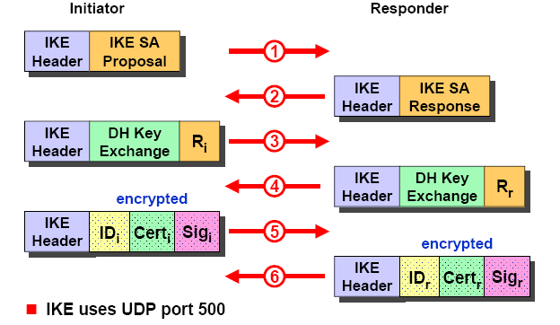
IKE Phase 1 - Main Mode Establish a Secure Negotiation Channel

Slide 68
IKE Phase 1 - Main Mode Establish a Secure Negotiation Channel
6 messages exchanged between initiator and responder to estabilish a IKE Security Association (IKE SA)
IKE uses UDP port 500
Msg #1
The initiator sends an IKE SA Proposal listing all supported authentication methods, Diffie-Hellman groups, a choice of encryption and hash algorithms and the desired SA lifetime
Msg #2
The responder answers with an IKE SA Response indicating the preferred authentication method, Diffie-Hellman group, encryption and hash algorithm and acceptable SA lifetime
If the two parties were able to successfully negotiate a common set of methods the protocol is continued by establishing an encrypted communication channel using the Diffie-Hellman Key-Exchange algorithm

Slide 69
IKE Phase 1 - Main Mode Establish a Secure Negotiation Channel
Msg #3
The initiator sends his part of the Diffie-Hellman secret plus a random value
Msg #4
The responder does the same by sending his part of the Diffie-Hellman secret plus a random value
Diffie-Hellman Key-Exchange can now be completed by both parties forming the common shared secret.
This shared secret is used to generate a symmetric session key with which the remaining messages of the IKE protocol are going to be encrypted

Slide 70
IKE Phase 1 - Main Mode Establish a Secure Negotiation Channel
Msg #5
The initiator sends his identity optionally followed by a certificate linking the identity to a public key.
This is followed by a hash over all message fields signed by a preshared secret or a private RSA key.
Msg #6
The same as Msg #5 but formed and sent by the responder
If the identity of both peers is successfully authenticated then an IKE SA has been established

Slide 71
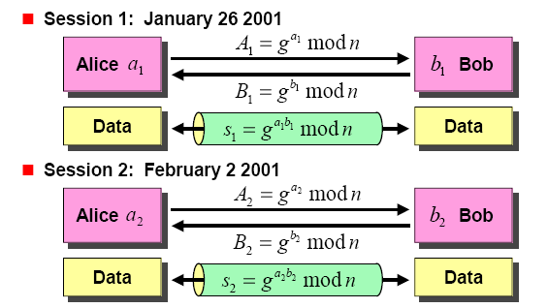
The Diffie-Hellman Key-Exchange Algorithm Perfect Forward Secrecy
If key s1 gets compromised, then key s2 is still totally secure!

Slide 72
IKE Aggressive Mode
The aggressive mode obtains the same result as the main mode, but with a smaller number of messages (three instead of six) at a price, however, not to authenticate the identities of the two parties
given that payloads are exchanged before it is completed the Diffie-Hellman exchange, they are transmitted in clear and not encrypted as in the case of the main mode

Slide 73
IKE: Phase 2
After completing phase 1, with the main mode, with the aggressive mode, the two parties have created a SA, and then can proceed to phase 2
This negotiation takes place with the Quick Mode
Contrary to what happens in the phase 1, here all the messages are encrypted because protected from the SA

Slide 74
IKE Phase 2 - Quick Mode Establish or Renew an IPsec SA
Encrypted Quick Mode Message Exchange
All Quick Mode negotiations are encrypted with a shared secret.
Key derived from a Diffie-Hellmann key-exchange plus additional parameters.
Negotiation of IPsec Parameters
Phase 2 Quick Mode establishes an IPsec SA using the secure channel created by the phase 1 IKE SA.
The specific configuration parameters for the IPsec connection are negotiated (AH, ESP, authentication / encryption methods and parameters).
Quick Mode can be used repeatedly to renew IPSec SAs about to expire.
Optional Perfect Forward Secrecy
If perfect forward secrecy is required, each consecutive Quick Modes will do a fresh Diffie-Hellmann key-exchange.

