Slide 1
Network Security Laboratory – Lecture 3
SSL and tls

Slide 2
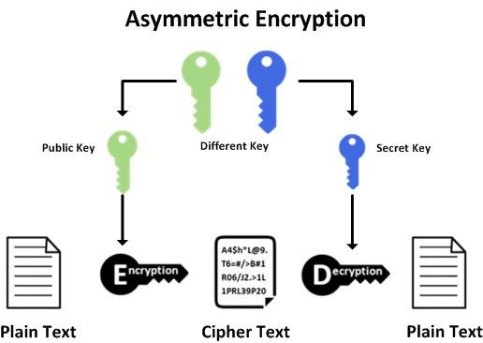
Asymmetric Cryptography

Slide 3
Secure Socket Layer (SSL) and Transport Layer Security (TLS)
Cryptographic protocols designed to provide security over network
TLS: provides privacy and data integrity between hosts
The connection is SECURE since data are encrypted with symmetric cryptography
The IDENTITY of hosts is authenticated with public key cryptography
The connection is RELIABLE since messages includes a message integrity check using a Message Authentication Code to prevent manipulation during transmission

Slide 4
How does it work?
The client contacts the server using a secure URL (HTTPS…)
The server sends the client its certificate and public key
The client verifies this with a Trusted Root Certification Authority to ensure the certificate is legitimate
The client and server negotiate the strongest type of encryption that each can support
The client encrypts a session (secret) key with the server’s public key, and sends it back to the server
The server decrypts the client communication with its private key, and the session is established
The session key (symmetric encryption) is now used to encrypt and decrypt data transmitted between the client and server

Slide 5
Certificates
It is an electronic document used to verify the owner’s identity
It includes information about owner identity, the public key and the signature of the entity who verified the certificate’s content
In a common Public Key Infrastructure (PKI), certificates are released by a Certificate Authority (CA)
Based on X509 protocol

Slide 6
Certificate Validation
When a connection is setup, the server sends to the client its certificate and the client checks if it is valid
In order to do that, the client has to check if:
The subject of the certificate matches the hostname (i.e., domain name) to which the client is trying to connect
The certificate is signed by a trusted certificate authority
A TLS server may be configured with a self-signed certificate
In this case clients will generally be unable to verify the certificate thus, communication will end (unless the certificate checking is disabled)

Slide 7
Self Signed Certificates
We could generate self-signed certificates
In order to create a self-signed certificate we must create a custom Certificate Authority
This type of certificate could be used for testing purposes
They are not valid because since self-signed certificates are “NOT TRUSTED” by a Certificate Authority

Slide 8
Simple SSL/TLS Stream
In order to create a simple connection between 2 hosts using SSL/TLS protocol, we could use openssl
Server Side: openssl s_server –key [key] –cert [cert] -accept <<port>>
Client side: openssl s_client <<host>>:<<port>>
On wireshark we could see handshake and how message are encrypted

Slide 9
Start a Web Server with certificate
Let’s now start your own web server
Install a new self-signed certificate on your server
Follow the steps on the course material

Slide 10
Letsencrypt certificates
Letsencrypt it’s a free Certificate Authority
Try to obtain a valid certificate using letsencrypt

Slide 11
Configure Web Server with Letsencrypt certificate
Change the configuration of Apache in order to use letsencrypt certificate
Connect with a browser
There are any differences on browser between selfsigned and valid certificates?

