Slide 1
Cryptography and Network Security Chapter 3
Fifth Edition
by William Stallings
Lecture slides by Lawrie Brown
Adapted by G. Ianni for the Network and Security course at Università della Calabria
Notes:
Lecture slides by Lawrie Brown for “Cryptography and Network Security”, 5/e, by William Stallings, Chapter 3 – “Block Ciphers and the Data Encryption Standard”.

Slide 2
Chapter 3 – Block Ciphers and the Data Encryption Standard
All the afternoon Mungo had been working on Stern's code, principally with the aid of the latest messages which he had copied down at the Nevin Square drop. Stern was very confident. He must be well aware London Central knew about that drop. It was obvious that they didn't care how often Mungo read their messages, so confident were they in the impenetrability of the code.
—Talking to Strange Men, Ruth Rendell
Notes:
Intro quote.

Slide 3
Modern Block Ciphers
now look at modern block ciphers
one of the most widely used types of cryptographic algorithms
provide secrecy /authentication services
focus on DES (Data Encryption Standard)
to illustrate block cipher design principles
Notes:
The objective of this chapter is to illustrate the principles of modern symmetric ciphers. For this purpose, we focus on the most widely used symmetric cipher: the Data Encryption Standard (DES). Although numerous symmetric ciphers have been developed since the introduction of DES, and although it is destined to be replaced by the Advanced Encryption Standard (AES), DES remains the most important such algorithm. Further, a detailed study of DES provides an understanding of the principles used in other symmetric ciphers. This chapter begins with a discussion of the general principles of symmetric block ciphers. Next, we cover full DES. Following this look at a specific algorithm, we return to a more general discussion of block cipher design.

Slide 4
Block vs Stream Ciphers
block ciphers process messages in blocks, each of which is then en/decrypted
like a substitution on very big characters
64-bits or more
stream ciphers process messages a bit or byte at a time when en/decrypting
many current ciphers are block ciphers
better analysed
broader range of applications
Notes:
Block ciphers work a on block / word at a time, which is some number of bits. All of these bits have to be available before the block can be processed. Stream ciphers work on a bit or byte of the message at a time, hence process it as a “stream”. Block ciphers are currently better analysed, and seem to have a broader range of applications, hence focus on them.

Slide 5
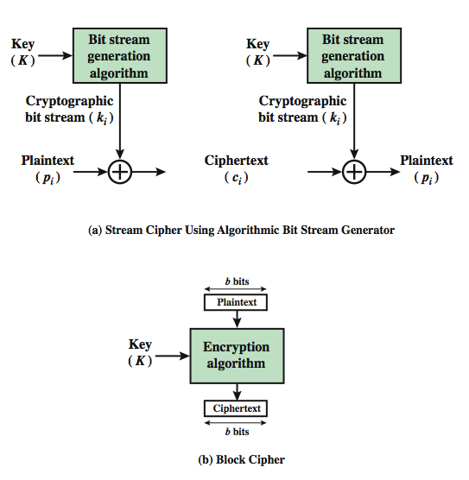
Block vs Stream Ciphers
Notes:
A block cipher is one in which a block of plaintext is treated as a whole and used to produce a ciphertext block of equal length. Typically, a block size of 64 or 128 bits is used. As with a stream cipher, the two users share a symmetric encryption key (Figure 3.1b). A stream cipher is one that encrypts a digital data stream one bit or one byte at a time. In the ideal case, a one-time pad version of the Vernam cipher would be used (Figure 2.7), in which the keystream (k ) is as long as the plaintext bit stream (p).

Slide 6
Block Cipher Principles
most symmetric block ciphers are based on a Feistel Cipher Structure
needed since must be able to decrypt ciphertext to recover messages efficiently
block ciphers look like an extremely large substitution
would need table of 2⁶⁴ entries for a 64-bit block
instead create from smaller building blocks
using idea of a product cipher
Notes:
Most symmetric block encryption algorithms in current use are based on a structure referred to as a Feistel block cipher. A block cipher operates on a plaintext block of n bits to produce a ciphertext block of n bits. An arbitrary reversible substitution cipher for a large block size is not practical, however, from an implementation and performance point of view. In general, for an n-bit general substitution block cipher, the size of the key is n x 2^{n}. For a 64-bit block, which is a desirable length to thwart statistical attacks, the key size is 64x 2⁶⁴ = 2⁷⁰ = 10²¹ bits. In considering these difficulties, Feistel points out that what is needed is an approximation to the ideal block cipher system for large n, built up out of components that are easily realizable.

Slide 7
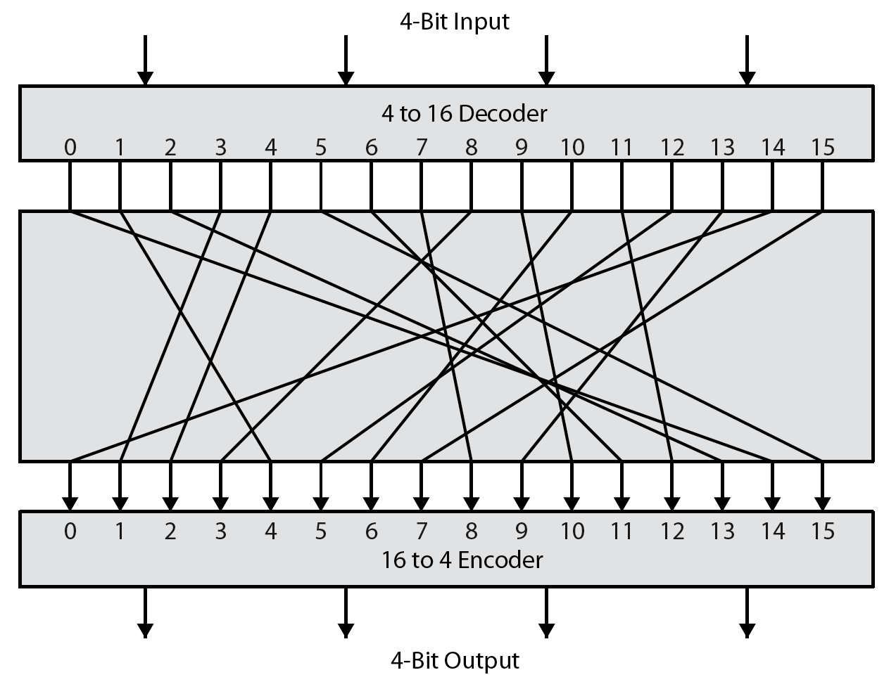
Ideal Block Cipher
Notes:
Feistel refers to an n-bit general substitution as an ideal block cipher, because it allows for the maximum number of possible encryption mappings from the plaintext to ciphertext block. A 4-bit input produces one of 16 possible input states, which is mapped by the substitution cipher into a unique one of 16 possible output states, each of which is represented by 4 ciphertext bits. The encryption and decryption mappings can be defined by a tabulation, as shown in Stallings Figure 3.2. It illustrates a tiny 4-bit substitution to show that each possible input can be arbitrarily mapped to any output - which is why its complexity grows so rapidly.

Slide 8
Claude Shannon and Substitution-Permutation Ciphers
Claude Shannon introduced idea of substitution-permutation (S-P) networks in 1949 paper
form basis of modern block ciphers
S-P nets are based on the two primitive cryptographic operations seen before:
substitution (S-box)
permutation (P-box)
provide confusion & diffusion of message & key
Notes:
Feistel proposed that we can approximate the ideal block cipher by utilizing the concept of a product cipher, which is the execution of two or more simple ciphers in sequence in such a way that the final result or product is cryptographically stronger than any of the component ciphers. In particular, Feistel proposed the use of a cipher that alternates substitutions and permutations, as a practical application of a proposal by Claude Shannon. Claude Shannon’s 1949 paper has the key ideas that led to the development of modern block ciphers. Critically, it was the technique of layering groups of S-boxes separated by a larger P-box to form the S-P network, a complex form of a product cipher. He also introduced the ideas of confusion and diffusion, notionally provided by S-boxes and P-boxes (in conjunction with S-boxes).

Slide 9
Confusion and Diffusion
cipher needs to completely obscure statistical properties of original message
a one-time pad does this
more practically Shannon suggested combining S & P elements to obtain:
diffusion – dissipates statistical structure of plaintext over bulk of ciphertext
confusion – makes relationship between ciphertext and key as complex as possible
Notes:
The terms diffusion and confusion were introduced by Claude Shannon to capture the two basic building blocks for any cryptographic system. Shannon's concern was to thwart cryptanalysis based on statistical analysis. Every block cipher involves a transformation of a block of plaintext into a block of ciphertext, where the transformation depends on the key. The mechanism of diffusion seeks to make the statistical relationship between the plaintext and ciphertext as complex as possible in order to thwart attempts to deduce the key. Confusion seeks to make the relationship between the statistics of the ciphertext and the value of the encryption key as complex as possible, again to thwart attempts to discover the key.
So successful are diffusion and confusion in capturing the essence of the desired attributes of a block cipher that they have become the cornerstone of modern block cipher design.

Slide 10
Feistel Cipher Structure
Horst Feistel devised the feistel cipher
based on concept of invertible product cipher
partitions input block into two halves
process through multiple rounds which
perform a substitution on left data half
based on round function of right half & subkey
then have permutation swapping halves
implements Shannon’s S-P net concept
Notes:
Horst Feistel, working at IBM Thomas J Watson Research Labs devised a suitable invertible cipher structure in early 70's.
One of Feistel's main contributions was the invention of a suitable structure which adapted Shannon's S-P network in an easily inverted structure. It partitions input block into two halves which are processed through multiple rounds which perform a substitution on left data half, based on round function of right half & subkey, and then have permutation swapping halves. Essentially the same h/w or s/w is used for both encryption and decryption, with just a slight change in how the keys are used. One layer of S-boxes and the following P-box are used to form the round function.

Slide 11
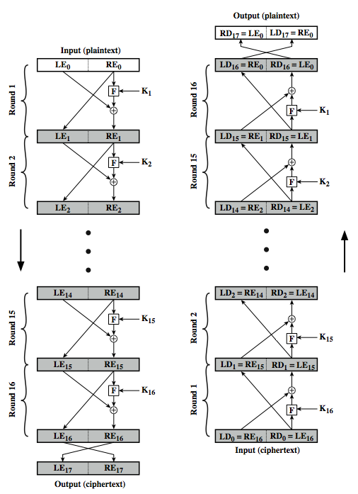
Feistel Cipher Structure
Notes:
Stallings Figure 3.3 illustrates the classical feistel cipher structure, with data split in 2 halves, processed through a number of rounds which perform a substitution on left half using output of round function on right half & key, and a permutation which swaps halves, as listed previously. The LHS side of this figure shows the flow during encryption, the RHS in decryption.
The inputs to the encryption algorithm are a plaintext block of length 2w bits and a key K. The plaintext block is divided into two halves, L₀ and R₀. The two halves of the data pass through n rounds of processing and then combine to produce the ciphertext block. Each round i has as inputs L_{i–1} and R_{i–1}, derived from the previous round, as well as a subkey K_{i}, derived from the overall K. In general, the subkeys K are different from K and from each other.
The process of decryption with a Feistel cipher is essentially the same as the encryption process. The rule is as follows: Use the ciphertext as input to the algorithm, but use the subkeys K_{i} in reverse order. That is, use K_{n} in the first round, K_{n–1} in the second round, and so on until K₁ is used in the last round. This is a nice feature because it means we need not implement two different algorithms, one for encryption and one for decryption. See discussion in text for why using the same algorithm with a reversed key order produces the correct result, noting that at every round, the intermediate value of the decryption process is equal to the corresponding value of the encryption process with the two halves of the value swapped.

Slide 12
Feistel Cipher Design Elements
block size
key size
number of rounds
subkey generation algorithm
round function
fast software en/decryption
ease of analysis
Notes:
The exact realization of a Feistel network depends on the choice of the following parameters and design features:
block size - increasing size improves security, but slows cipher
key size - increasing size improves security, makes exhaustive key searching harder, but may slow cipher
number of rounds - increasing number improves security, but slows cipher
subkey generation algorithm - greater complexity can make analysis harder, but slows cipher
round function - greater complexity can make analysis harder, but slows cipher
fast software en/decryption - more recent concern for practical use
ease of analysis - for easier validation & testing of strength

Slide 13
Data Encryption Standard (DES)
most widely used block cipher in world
adopted in 1977 by NBS (now NIST)
as FIPS PUB 46
encrypts 64-bit data using 56-bit key
has widespread use
has been considerable controversy over its security
Notes:
The most widely used private key block cipher, is the Data Encryption Standard (DES). It was adopted in 1977 by the National Bureau of Standards as Federal Information Processing Standard 46 (FIPS PUB 46). DES encrypts data in 64-bit blocks using a 56-bit key. The DES enjoys widespread use. It has also been the subject of much controversy its security.

Slide 14
DES History
IBM developed Lucifer cipher
by team led by Feistel in late 60’s
used 64-bit data blocks with 128-bit key
then redeveloped as a commercial cipher with input from NSA and others
in 1973 NBS issued request for proposals for a national cipher standard
IBM submitted their revised Lucifer which was eventually accepted as the DES
Notes:
In the late 1960s, IBM set up a research project in computer cryptography led by Horst Feistel. The project concluded in 1971 with the development of the LUCIFER algorithm. LUCIFER is a Feistel block cipher that operates on blocks of 64 bits, using a key size of 128 bits.
Because of the promising results produced by the LUCIFER project, IBM embarked on an effort, headed by Walter Tuchman and Carl Meyer, to develop a marketable commercial encryption product that ideally could be implemented on a single chip. It involved not only IBM researchers but also outside consultants and technical advice from NSA. The outcome of this effort was a refined version of LUCIFER that was more resistant to cryptanalysis but that had a reduced key size of 56 bits, to fit on a single chip.
In 1973, the National Bureau of Standards (NBS) issued a request for proposals for a national cipher standard. IBM submitted the modified LUCIFER. It was by far the best algorithm proposed and was adopted in 1977 as the Data Encryption Standard.

Slide 15
DES Design Controversy
although DES standard is public
was considerable controversy over design
in choice of 56-bit key (vs Lucifer 128-bit)
and because design criteria were classified
subsequent events and public analysis show in fact design was appropriate
use of DES has flourished
especially in financial applications
still standardised for legacy application use
Notes:
Before its adoption as a standard, the proposed DES was subjected to intense & continuing criticism over the size of its key & the classified design criteria.
Recent analysis has shown despite this controversy, that DES is well designed. DES is theoretically broken using Differential or Linear Cryptanalysis but in practise is unlikely to be a problem yet. Also rapid advances in computing speed though have rendered the 56 bit key susceptible to exhaustive key search, as predicted by Diffie & Hellman.
DES has flourished and is widely used, especially in financial applications. It is still standardized for legacy systems, with either AES or triple DES for new applications.

Slide 16
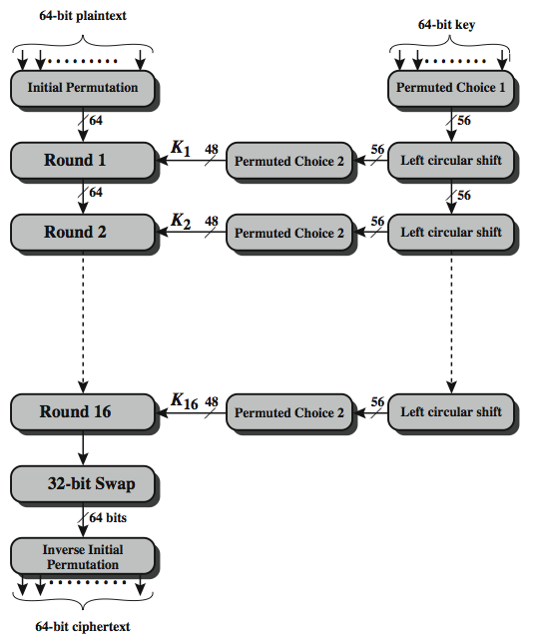
DES Encryption Overview
Notes:
The overall scheme for DES encryption is illustrated in Stallings Figure 3.4, which takes as input 64-bits of data and of key.
The left side shows the basic process for enciphering a 64-bit data block which consists of:
- an initial permutation (IP) which shuffles the 64-bit input block
- 16 rounds of a complex key dependent round function involving substitutions & permutations
- a final permutation, being the inverse of IP
The right side shows the handling of the 56-bit key and consists of:
- an initial permutation of the key (PC1) which selects 56-bits out of the 64-bits input, in two 28-bit halves
- 16 stages to generate the 48-bit subkeys using a left circular shift and a permutation of the two 28-bit halves

Slide 17
Initial Permutation IP
first step of the data computation
IP reorders the input data bits
even bits to LH half, odd bits to RH half
quite regular in structure (easy in h/w)
example:
IP(675a6967 5e5a6b5a) = (ffb2194d 004df6fb)
Notes:
The initial permutation and its inverse are defined by tables, as shown in Stallings Tables 3.2a and 3.2b, respectively. The tables are to be interpreted as follows. The input to a table consists of 64 bits numbered left to right from 1 to 64. The 64 entries in the permutation table contain a permutation of the numbers from 1 to 64. Each entry in the permutation table indicates the position of a numbered input bit in the output, which also consists of 64 bits.
Note that the bit numbering for DES reflects IBM mainframe practice, and is the opposite of what we now mostly use - so be careful! Numbers from Bit 1 (leftmost, most significant) to bit 32/48/64 etc (rightmost, least significant).
For example, a 64-bit plaintext value of “675a6967 5e5a6b5a” (written in left & right halves) after permuting with IP becomes “ffb2194d 004df6fb”. Note that example values are specified using hexadecimal.

Slide 18
DES Round Structure
uses two 32-bit L & R halves
as for any Feistel cipher can describe as:
L_{i} = R_{i–1}
R_{i} = L_{i–1} ⊕ F(R_{i–1}, K_{i})
F takes 32-bit R half and 48-bit subkey:
expands R to 48-bits using perm E
adds to subkey using XOR
passes through 8 S-boxes to get 32-bit result
finally permutes using 32-bit perm P
Notes:
We now review the internal structure of the DES round function F, which takes R half & subkey, and processes them. The round key K_{i} is 48 bits. The R input is 32 bits. This R input is first expanded to 48 bits by using a table that defines a permutation plus an expansion that involves duplication of 16 of the R bits (Table 3.2c). The resulting 48 bits are XORed with K_{i} This 48-bit result passes through a substitution function that produces a 32-bit output, which is permuted as defined by Table 3.2d. This follows the classic structure for a feistel cipher.
Note that the s-boxes provide the “confusion” of data and key values, whilst the permutation P then spreads this as widely as possible, so each S-box output affects as many S-box inputs in the next round as possible, giving “diffusion”.

Slide 19
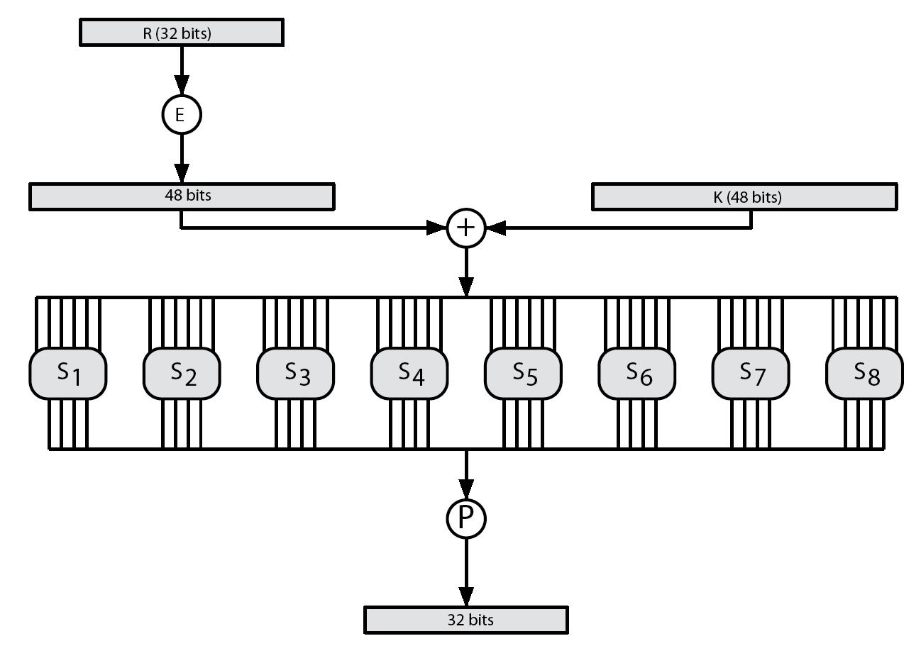
DES Round Structure
Notes:
Stallings Figure 3.7 illustrates the internal structure of the DES round function F. The R input is first expanded to 48 bits by using expansion table E that defines a permutation plus an expansion that involves duplication of 16 of the R bits (Stallings Table 3.2c). The resulting 48 bits are XORed with key K_{i} . This 48-bit result passes through a substitution function comprising 8 S-boxes which each map 6 input bits to 4 output bits, producing a 32-bit output, which is then permuted by permutation P as defined by Stallings Table 3.2d.

Slide 20
Substitution Boxes S
have eight S-boxes which map 6 to 4 bits
each S-box is actually 4 little 4 bit boxes
outer bits 1 & 6 (row bits) select one row of 4
inner bits 2-5 (col bits) are substituted
result is 8 lots of 4 bits, or 32 bits
row selection depends on both data & key
feature known as autoclaving (autokeying)
example:
S(18 09 12 3d 11 17 38 39) = 5fd25e03
Notes:
The substitution consists of a set of eight S-boxes, each of which accepts 6 bits as input and produces 4 bits as output. These transformations are defined in Stallings Table 3.3, which is interpreted as follows: The first and last bits of the input to box Si form a 2-bit binary number to select one of four substitutions defined by the four rows in the table for Si. The middle four bits select one of the sixteen columns. The decimal value in the cell selected by the row and column is then converted to its 4-bit representation to produce the output. For example, in S1, for input 011001, the row is 01 (row 1) and the column is 1100 (column 12). The value in row 1, column 12 is 9, so the output is 1001.
The example lists 8 6-bit values (ie 18 in hex is 011000 in binary, 09 hex is 001001 binary, 12 hex is 010010 binary, 3d hex is 111101 binary etc), each of which is replaced following the process detailed above using the appropriate S-box. ie
S1(011000) lookup row 00 col 1100 in S1 to get 5
S2(001001) lookup row 01 col 0100 in S2 to get 15 = f in hex
S3(010010) lookup row 00 col 1001 in S3 to get 13 = d in hex
S4(111101) lookup row 11 col 1110 in S4 to get 2 etc

Slide 21
DES Key Schedule
forms subkeys used in each round
initial permutation of the key (PC1) which selects 56-bits in two 28-bit halves
16 stages consisting of:
rotating each half separately either 1 or 2 places depending on the key rotation schedule K
selecting 24-bits from each half & permuting them by PC2 for use in round function F
note practical use issues in h/w vs s/w
Notes:
The DES Key Schedule generates the subkeys needed for each data encryption round. A 64-bit key is used as input to the algorithm, though every eighth bit is ignored, as indicated by the lack of shading in Table 3.4a. It is first processed by Permuted Choice One (Stallings Table 3.4b). The resulting 56-bit key is then treated as two 28-bit quantities C & D. In each round, these are separately processed through a circular left shift (rotation) of 1 or 2 bits as shown in Stallings Table 3.4d. These shifted values serve as input to the next round of the key schedule. They also serve as input to Permuted Choice Two (Stallings Table 3.4c), which produces a 48-bit output that serves as input to the round function F.
The 56 bit key size comes from security considerations as we know now. It was big enough so that an exhaustive key search was about as hard as the best direct attack (a form of differential cryptanalysis called a T-attack, known by the IBM & NSA researchers), but no bigger. The extra 8 bits were then used as parity (error detecting) bits, which makes sense given the original design use for hardware communications links. However we hit an incompatibility with simple s/w implementations since the top bit in each byte is 0 (since ASCII only uses 7 bits), but the DES key schedule throws away the bottom bit! A good implementation needs to be cleverer!

Slide 22
DES Decryption
decrypt must unwind steps of data computation
with Feistel design, do encryption steps again using subkeys in reverse order (SK16 … SK1)
IP undoes final FP step of encryption
1st round with SK16 undoes 16th encrypt round
….
16th round with SK1 undoes 1st encrypt round
then final FP undoes initial encryption IP
thus recovering original data value
Notes:
As with any Feistel cipher, DES decryption uses the same algorithm as encryption except that the subkeys are used in reverse order SK16 .. SK1.
If you trace through the DES overview diagram can see how each decryption step top to bottom with reversed subkeys, undoes the equivalent encryption step moving from bottom to top.

Slide 23
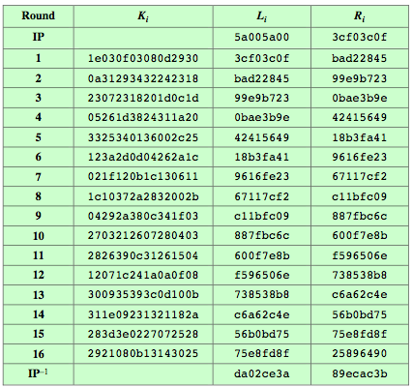
DES Example
Notes:
Can now work through an example, and consider some of its implications. In this example, the plaintext is a hexadecimal palindrome, with:
Plaintext: 02468aceeca86420
Key: 0f1571c947d9e859
Ciphertext: da02ce3a89ecac3b
Table 3.5 shows the progression of the algorithm. The first row shows the 32-bit values of the left and right halves of data after the initial permutation. The next 16 rows show the results after each round. Also shown is the value of the 48-bit subkey generated for each round. The final row shows the left and right-hand values after the inverse initial permutation. These two values combined form the ciphertext.

Slide 24
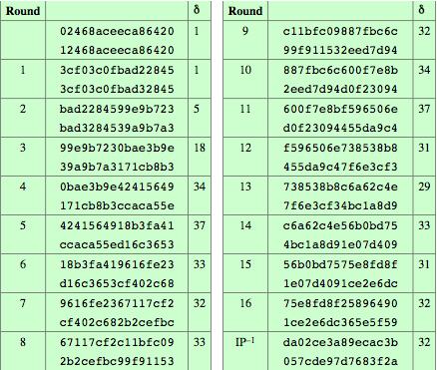
Avalanche in DES
Notes:
A desirable property of any encryption algorithm is that a small change in either the plaintext or the key should produce a significant change in the ciphertext. In particular, a change in one bit of the plaintext or one bit of the key should produce a change in many bits of the ciphertext. This is referred to as the avalanche effect. Using the example from Table 3.5, Table 3.6 shows the result when the fourth bit of the plaintext is changed, so that the plaintext is 12468aceeca86420. The second column of the table shows the intermediate 64-bit values at the end of each round for the two plaintexts. The third column shows the number of bits that differ between the two intermediate values. The table shows that after just three rounds, 18 bits differ between the two blocks. On completion, the two ciphertexts differ in 32 bit positions. Table 3.7 in the text shows a similar test using the original plaintext of with two keys that differ in only the fourth bit position. Again, the results show that about half of the bits in the ciphertext differ and that the avalanche effect is pronounced after just a few rounds.

Slide 25
Avalanche Effect
key desirable property of encryption alg
where a change of one input or key bit results in changing approx half output bits
making attempts to “home-in” by guessing keys impossible
DES exhibits strong avalanche
Notes:
A desirable property of any encryption algorithm is that a small change in either the plaintext or the key should produce a significant change in the ciphertext. In particular, a change in one bit of the plaintext or one bit of the key should produce a change in many bits of the ciphertext. If the change were small, this might provide a way to reduce the size of the plaintext or key space to be searched. DES exhibits a strong avalanche effect, as may be seen in Stallings Table 3.5.

Slide 26
Strength of DES – Key Size
56-bit keys have 2⁵⁶ = 7.2 x 10¹⁶ values
brute force search looks hard
recent advances have shown is possible
in 1997 on Internet in a few months
in 1998 on dedicated h/w (EFF) in a few days
in 1999 above combined in 22hrs!
still must be able to recognize plaintext
DES is nowadays OBSOLETE
Notes:
Since its adoption as a federal standard, there have been lingering concerns about the level of security provided by DES in two areas: key size and the nature of the algorithm.
With a key length of 56 bits, there are 2⁵⁶ possible keys, which is approximately 7.2*10¹⁶ keys. Thus a brute-force attack appeared impractical.
However DES was finally and definitively proved insecure in July 1998, when the Electronic Frontier Foundation (EFF) announced that it had broken a DES encryption using a special-purpose "DES cracker" machine that was built for less than $250,000. The attack took less than three days. The EFF has published a detailed description of the machine, enabling others to build their own cracker [EFF98].
There have been other demonstrated breaks of the DES using both large networks of computers & dedicated h/w, including:
- 1997 on a large network of computers in a few months
- 1998 on dedicated h/w (EFF) in a few days
- 1999 above combined in 22hrs!
It is important to note that there is more to a key-search attack than simply running through all possible keys. Unless known plaintext is provided, the analyst must be able to recognize plaintext as plaintext.
Clearly must now consider alternatives to DES, the most important of which are AES and triple DES.

Slide 27
Strength of DES – Analytic Attacks
now have several analytic attacks on DES
these utilise some deep structure of the cipher
by gathering information about encryptions
can eventually recover some/all of the sub-key bits
if necessary then exhaustively search for the rest
generally these are statistical attacks
differential cryptanalysis
linear cryptanalysis
related key attacks
Notes:
Another concern is the possibility that cryptanalysis is possible by exploiting the characteristics of the DES algorithm. The focus of concern has been on the eight substitution tables, or S-boxes, that are used in each iteration. These techniques utilise some deep structure of the cipher by gathering information about encryptions so that eventually you can recover some/all of the sub-key bits, and then exhaustively search for the rest if necessary. Generally these are statistical attacks which depend on the amount of information gathered for their likelihood of success. Attacks of this form include differential cryptanalysis. linear cryptanalysis, and related key attacks.

Slide 28
Strength of DES – Timing Attacks
attacks actual implementation of cipher
use knowledge of consequences of implementation to derive information about some/all subkey bits
specifically use fact that calculations can take varying times depending on the value of the inputs to it
particularly problematic on smartcards
Notes:
We will discuss timing attacks in more detail later, as they relate to public-key algorithms. However, the issue may also be relevant for symmetric ciphers. A timing attack is one in which information about the key or the plaintext is obtained by observing how long it takes a given implementation to perform decryptions on various ciphertexts. A timing attack exploits the fact that an encryption or decryption algorithm often takes slightly different amounts of time on different inputs. The AES analysis process has highlighted this attack approach, and showed that it is a concern particularly with smartcard implementations, though DES appears to be fairly resistant to a successful timing attack.

Slide 29
Differential Cryptanalysis
one of the most significant recent (public) advances in cryptanalysis
known by NSA in 70's cf DES design
Murphy, Biham & Shamir published in 90’s
powerful method to analyse block ciphers
used to analyse most current block ciphers with varying degrees of success
DES reasonably resistant to it, cf Lucifer
Notes:
Biham & Shamir show Differential Cryptanalysis can be successfully used to cryptanalyse the DES with an effort on the order of 2⁴⁷ encryptions, requiring 2⁴⁷ chosen plaintexts. Although 2⁴⁷ is certainly significantly less than 2⁵⁵, the need for the adversary to find 2⁴⁷ chosen plaintexts makes this attack of only theoretical interest. They also demonstrated this form of attack on a variety of encryption algorithms and hash functions.
Differential cryptanalysis was known to the IBM DES design team as early as 1974 (as a T attack), and influenced the design of the S-boxes and the permutation P to improve its resistance to it. Compare DES’s security with the cryptanalysis of an eight-round LUCIFER algorithm which requires only 256 chosen plaintexts, verses an attack on an eight-round version of DES requires 2¹⁴ chosen plaintexts.

Slide 30
Differential Cryptanalysis
a statistical attack against Feistel ciphers
uses cipher structure not previously used
design of S-P networks has output of function f influenced by both input & key
hence cannot trace values back through cipher without knowing value of the key
differential cryptanalysis compares two related pairs of encryptions
Notes:
The differential cryptanalysis attack is complex. The rationale behind differential cryptanalysis is to observe the behavior of pairs of text blocks evolving along each round of the cipher, instead of observing the evolution of a single text block. Each round of DES maps the right-hand input into the left-hand output and sets the right-hand output to be a function of the left-hand input and the subkey for this round, which means you cannot trace values back through cipher without knowing the value of the key. Differential Cryptanalysis compares two related pairs of encryptions, which can leak information about the key, given a sufficiently large number of suitable pairs.

Slide 31

Differential Cryptanalysis Compares Pairs of Encryptions
with a known difference in the input
searching for a known difference in output
when same subkeys are used
Notes:
This attack is known as Differential Cryptanalysis because the analysis compares differences between two related encryptions, and looks for a known difference in leading to a known difference out with some (pretty small but still significant) probability. If a number of such differences are determined, it is feasible to determine the subkey used in the function f.
In differential cryptanalysis, we start with two messages, m and m', with a known XOR difference dm = m xor m', and consider the difference between the intermediate message halves: dm = m xor m'. Then we have the equation from Stallings section 3.4 which shows how this removes the influence of the key, hence enabling the analysis. Suppose that many pairs of inputs to f with the same difference yield the same output difference if the same subkey is used. To put this more precisely, let us say that X may cause Y with probability p, if for a fraction p of the pairs in which the input XOR is X, the output XOR equals Y. We want to suppose that there are a number of values of X that have high probability of causing a particular output difference.

Slide 32
Differential Cryptanalysis
have some input difference giving some output difference with probability p
if find instances of some higher probability input / output difference pairs occurring
can infer subkey that was used in round
then must iterate process over many rounds (with decreasing probabilities)
Notes:
The overall strategy of differential cryptanalysis is based on these considerations for a single round. The procedure is to begin with two plaintext messages m and m’ with a given difference and trace through a probable pattern of differences after each round to yield a probable difference for the ciphertext. You submit m and m’ for encryption to determine the actual difference under the unknown key and compare the result to the probable difference. If there is a match, then suspect that all the probable patterns at all the intermediate rounds are correct. With that assumption, can make some deductions about the key bits. This procedure must be repeated many times to determine all the key bits.

Slide 33
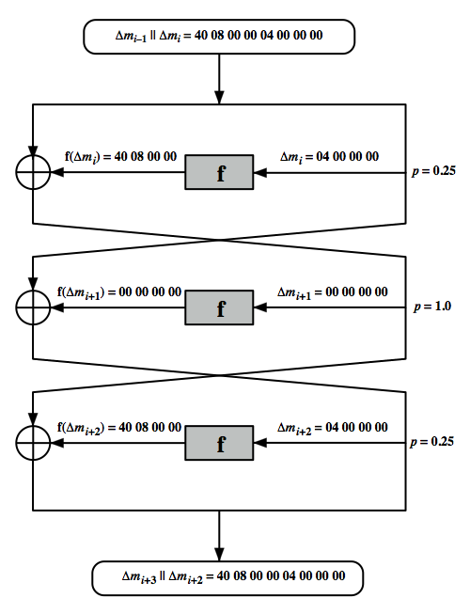
Differential Cryptanalysis
Notes:
Stallings Figure 3.7 illustrates the propagation of differences through three rounds of DES. The probabilities shown on the right refer to the probability that a given set of intermediate differences will appear as a function of the input differences. Overall, after three rounds the probability that the output difference is as shown is equal to 0.25*1*0.25=0.0625. Since the output difference is the same as the input, this 3 round pattern can be iterated over a larger number of rounds, with probabilities multiplying to be successively smaller.

Slide 34
Differential Cryptanalysis
perform attack by repeatedly encrypting plaintext pairs with known input XOR until obtain desired output XOR
when found
if intermediate rounds match required XOR have a right pair
if not then have a wrong pair, relative ratio is S/N for attack
can then deduce keys values for the rounds
right pairs suggest same key bits
wrong pairs give random values
for large numbers of rounds, probability is so low that more pairs are required than exist with 64-bit inputs
Biham and Shamir have shown how a 13-round iterated characteristic can break the full 16-round DES
Notes:
Differential Cryptanalysis works by performing the attack by repeatedly encrypting plaintext pairs with known input XOR until obtain desired output XOR. See [BIHA93] for detailed descriptions. Attack on full DES requires an effort on the order of 2⁴⁷ encryptions, requiring 2⁴⁷ chosen plaintexts to be encrypted, with a considerable amount of analysis – in practise exhaustive search is still easier, even though up to 2⁵⁵ encryptions are required for this.

Slide 35
Linear Cryptanalysis
another recent development
also a statistical method
must be iterated over rounds, with decreasing probabilities
developed by Matsui et al in early 90's
based on finding linear approximations
can attack DES with 2⁴³ known plaintexts, easier but still in practise infeasible
Notes:
A more recent development is linear cryptanalysis. This attack is based on finding linear approximations to describe the transformations performed in DES. This method can find a DES key given 2^43 known plaintexts, as compared to 2^47 chosen plaintexts for differential cryptanalysis. Although this is a minor improvement, because it may be easier to acquire known plaintext rather than chosen plaintext, it still leaves linear cryptanalysis infeasible as an attack on DES. Again, this attack uses structure not seen before. So far, little work has been done by other groups to validate the linear cryptanalytic approach.

Slide 36
Linear Cryptanalysis
find linear approximations with prob p != ½
P[i₁,i₂,...,i_{a}] ⊕ C[j₁,j₂,...,j_{b}] = K[k₁,k₂,...,k_{c}]
where i_{a},j_{b},k_{c} are bit locations in P,C,K
gives linear equation for key bits
get one key bit using max likelihood alg
using a large number of trial encryptions
effectiveness given by: |p–¹/₂|
Notes:
The objective of linear cryptanalysis is to find an effective linear equation relating some plaintext, ciphertext and key bits that holds with probability p<>0.5 as shown. Once a proposed relation is determined, the procedure is to compute the results of the left-hand side of the equation for a large number of plaintext-ciphertext pairs, in order to determine whether the sum of the key bits is 0 or 1, thus giving 1 bit of info about them. This is repeated for other equations and many pairs to derive some of the key bit values. Because we are dealing with linear equations, the problem can be approached one round of the cipher at a time, with the results combined. See [MATS93] for details.

Slide 37
DES Design Criteria
as reported by Coppersmith in [COPP94]
7 criteria for S-boxes provide for
non-linearity
resistance to differential cryptanalysis
good confusion
3 criteria for permutation P provide for
increased diffusion
Notes:
Although much progress has been made in designing block ciphers that are cryptographically strong, the basic principles have not changed all that much since the work of Feistel and the DES design team in the early 1970s. Some of the criteria used in the design of DES were reported in [COPP94], and focused on the design of the S-boxes and on the P function that distributes the output of the S boxes, as summarized above. See text for further details.

Slide 38
Block Cipher Design
basic principles still like Feistel’s in 1970’s
number of rounds
more is better, exhaustive search best attack
function f:
provides “confusion”, is nonlinear, avalanche
have issues of how S-boxes are selected
key schedule
complex subkey creation, key avalanche
Notes:
The cryptographic strength of a Feistel cipher derives from three aspects of the design: the number of rounds, the function F, and the key schedule algorithm. Briefly discuss these.
The greater the number of rounds, the more difficult it is to perform cryptanalysis, even for a relatively weak F. In general, the criterion should be that the number of rounds is chosen so that known cryptanalytic efforts require greater effort than a simple brute-force key search attack. This criterion is attractive because it makes it easy to judge the strength of an algorithm and to compare different algorithms.
The function F provides the element of confusion in a Feistel cipher, want it to be difficult to “unscramble” the substitution performed by F. One obvious criterion is that F be nonlinear. The more nonlinear F, the more difficult any type of cryptanalysis will be. We would like it to have good avalanche properties, or even the strict avalanche criterion (SAC). Another criterion is the bit independence criterion (BIC). One of the most intense areas of research in the field of symmetric block ciphers is that of S-box design. Would like any change to the input vector to an S-box to result in random-looking changes to the output. The relationship should be nonlinear and difficult to approximate with linear functions.
A final area of block cipher design, and one that has received less attention than S-box design, is the key schedule algorithm. With any Feistel block cipher, the key schedule is used to generate a subkey for each round. Would like to select subkeys to maximize the difficulty of deducing individual subkeys and the difficulty of working back to the main key. The key schedule should guarantee key/ciphertext Strict Avalanche Criterion and Bit Independence Criterion.

Slide 39
Summary
have considered:
block vs stream ciphers
Feistel cipher design & structure
DES
details
strength
Differential & Linear Cryptanalysis
block cipher design principles
Notes:
Chapter 3 summary.

Slide 40
Cryptography and Network Security Chapter 5
Fifth Edition
by William Stallings
Lecture slides by Lawrie Brown
Adapted by G. Ianni for the Network and Computer Security course at Università della Calabria
Notes:
Lecture slides by Lawrie Brown for “Cryptography and Network Security”, 5/e, by William Stallings, Chapter Chapter 5 –”Advanced Encryption Standard”.

Slide 41
Chapter 5 –Advanced Encryption Standard
"It seems very simple."
"It is very simple. But if you don't know what the key is it's virtually indecipherable."
—Talking to Strange Men, Ruth Rendell
Notes:
Intro quote.

Slide 42
Origins
clear a replacement for DES was needed
have theoretical attacks that can break it
have demonstrated exhaustive key search attacks
can use Triple-DES – but slow, has small blocks
US NIST issued call for ciphers in 1997
15 candidates accepted in Jun 98
5 were shortlisted in Aug-99
Rijndael was selected as the AES in Oct-2000
issued as FIPS PUB 197 standard in Nov-2001
Notes:
The Advanced Encryption Standard (AES) was published by NIST (National Institute of Standards and Technology) in 2001. AES is a symmetric block cipher that is intended to replace DES as the approved standard for a wide range of applications. The AES cipher (& other candidates) form the latest generation of block ciphers, and now we see a significant increase in the block size - from the old standard of 64-bits up to 128-bits; and keys from 128 to 256-bits. In part this has been driven by the public demonstrations of exhaustive key searches of DES. Whilst triple-DES is regarded as secure and well understood, it is slow, especially in s/w. In a first round of evaluation, 15 proposed algorithms were accepted. A second round narrowed the field to 5 algorithms. NIST completed its evaluation process and published a final standard (FIPS PUB 197) in November of 2001. NIST selected Rijndael as the proposed AES algorithm. The two researchers who developed and submitted Rijndael for the AES are both cryptographers from Belgium: Dr. Joan Daemen and Dr.Vincent Rijmen.

Slide 43
The AES Cipher - Rijndael
designed by Rijmen-Daemen in Belgium
has 128/192/256 bit keys, 128 bit data
an iterative rather than feistel cipher
processes data as block of 4 columns of 4 bytes
operates on entire data block in every round
designed to be:
resistant against known attacks
speed and code compactness on many CPUs. Easy to be implemented on hardware and software. Can be parallelized
Implementations hard to be attacked
“Agile” key switching
design simplicity
Notes:
The Rijndael proposal for AES defined a cipher in which the block length and the key length can be independently specified to be 128,192,or 256 bits. The AES specification uses the same three key size alternatives but limits the block length to 128 bits. Rijndael is an academic submission, based on the earlier Square cipher, from Belgium academics Dr Joan Daemen and Dr Vincent Rijmen. It is an iterative cipher (operates on entire data block in every round) rather than feistel (operate on halves at a time), and was designed to have characteristics of: Resistance against all known attacks, Speed and code compactness on a wide range of platforms, & Design simplicity.

Slide 44
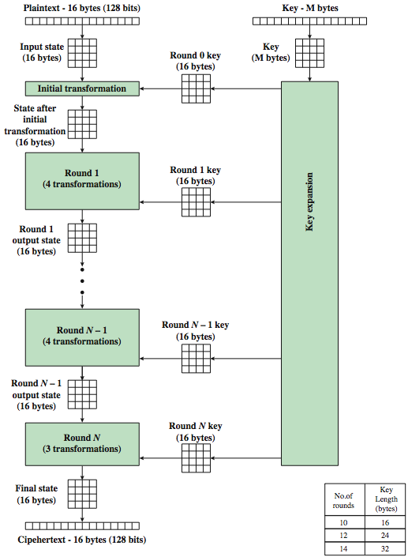
AES Encryption Process
Notes:
Stallings Figure 5.1 shows the overall encryption process in AES.

Slide 45
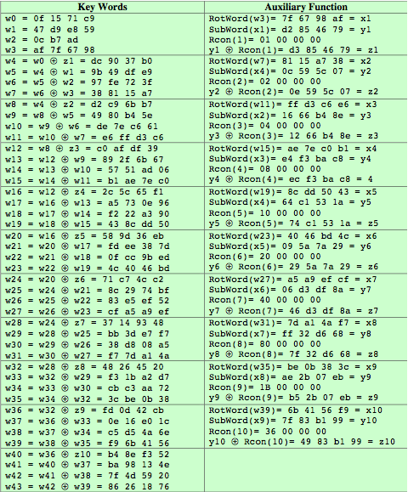
AES Example Key Expansion
Notes:
We now work through an example, and consider some of its implications. The plaintext, key, and resulting ciphertext are as follows:
Plaintext: 0123456789abcdeffedcba9876543210
Key: 0f1571c947d9e8590cb7add6af7f6798
Ciphertext: ff0b844a0853bf7c6934ab4364148fb9
Table 5.3 shows the expansion of the 16-byte key into 10 round keys. As previously explained, this process is performed word by word, with each four-byte word occupying one column of the word round key matrix. The left hand column shows the four round key words generated for each round. The right hand column shows the steps used to generate the auxiliary word used in key expansion. We begin, of course, with the key itself serving as the round key for round 0.

Slide 46
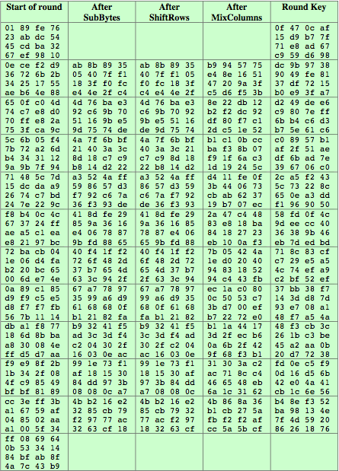
AES Example Encryption
Notes:
Next, Table 5.4 shows the progression of the state matrix through the AES encryption process. The first column shows the value of the state matrix at the start of a round. For the first row, the state matrix is just the matrix arrangement of the plaintext. The second, third, and fourth columns show the value of the state matrix for that round after the SubBytes, ShiftRows, and MixColumns transformations, respectively. The fifth column shows the round key. You can verify that these round keys equate with those shown in Table 5.3. The first column shows the value of the state matrix resulting from the bitwise XOR of the state after the preceding MixColumns with the round key for the preceding round.

Slide 47
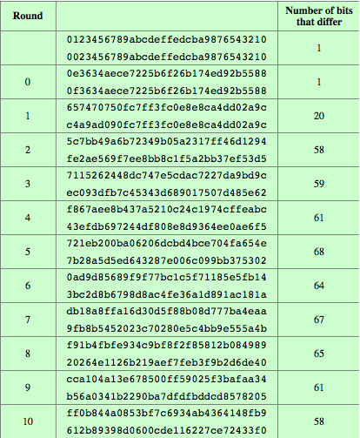
AES Example Avalanche
Notes:
In any good cipher design, want the avalanche effect, in which a small change in plaintext or key produces a large change in the ciphertext. Using the example from Table 5.4, Table 5.5 shows the result when the eighth bit of the plaintext is changed. The second column of the table shows the value of the state matrix at the end of each round for the two plaintexts. Note that after just one round, 20 bits of the state vector differ. And after two rounds, close to half the bits differ. This magnitude of difference propagates through the remaining rounds. A bit difference in approximately half the positions in the most desirable outcome.

Slide 48
Implementation Aspects
can efficiently implement on 32-bit CPU
redefine steps to use 32-bit words
can precompute 4 tables of 256-words
then each column in each round can be computed using 4 table lookups + 4 XORs
at a cost of 4Kb to store tables
designers believe this very efficient implementation was a key factor in its selection as the AES cipher
Available in Intel hardware (AES-NI instructions)
Notes:
AES can also be very efficiently implemented on an 32-bit processor, by rewriting the stage transformation to use 4 table lookups & 4 XOR’s per column of state. These tables can be computed in advance using the formulae shown in the text, and need 4Kb to store.
The developers of Rijndael believe that this compact, efficient implementation was probably one of the most important factors in the selection of Rijndael for AES.

Slide 49
Other symmetric BLOCK ciphers
ARIA (AES-based), LEA, SEED - S. Korea
Camellia - Japan, NTT+Mitsubishi, EU recommended
CAST5, IDEA (PGP)
Blowfish, twofish
Sm4 – China
GOST - Russia
Stream ciphers (more later): RC4, CHACHA

Slide 50
Cryptography and Network Security Chapter 6
Fifth Edition
by William Stallings
Lecture slides by Lawrie Brown
Adapted by G. Ianni for the Network and Computer Security course at Università della Calabria
Notes:
Lecture slides by Lawrie Brown for “Cryptography and Network Security”, 5/e, by William Stallings, Chapter 6 – “Block Cipher Operation”.

Slide 51
Chapter 6 – Block Cipher Operation
Many savages at the present day regard their names as vital parts of themselves, and therefore take great pains to conceal their real names, lest these should give to evil-disposed persons a handle by which to injure their owners.
— The Golden Bough, Sir James George Frazer
Notes:
Opening quote.

Slide 52
Double-DES?
could use 2 DES encrypts on each block
C = E_{K2}(E_{K1}(P))
issue of reduction to single stage
and have “meet-in-the-middle” attack, with known P and C
works whenever one uses a cipher twice
since X = E_{K1}(P) = D_{K2}(C)
attack by encrypting P with all keys and store them
then decrypt C with all possible keys and match X value
can show it takes O(2⁵⁶) steps and not O(2¹¹²)
Notes:
The simplest form of multiple encryption has two encryption stages and two keys - Double-DES.
Have concern that there might be a single key that is equivalent to using 2 keys as above, not likely but only finally proved as impossible in 1992.
More seriously have the “meet-in-the-middle” attack, first described by Diffie in 1977. It is a known plaintext attack (ie have know pair (P,C), and attempts to find by trial-and-error a value X in the “middle” of the double-DES encryption of this pair, and chances of this are much better at O(2^56) than exhaustive search at O(2^112).

Slide 53
Triple-DES with Two-Keys
hence must use 3 encryptions
would seem to need 3 distinct keys
but can use 2 keys with E-D-E sequence
C = E_{K1}(D_{K2}(E_{K1}(P)))
nb encrypt & decrypt equivalent in security
if K1=K2 then can work with single DES
standardized in ANSI X9.17 & ISO8732
Notes:
Triple-DES with two keys is a popular alternative to single-DES, but suffers from being 3 times slower to run. The use of encryption & decryption stages are equivalent, but the chosen structure allows for compatibility with single-DES implementations. 3DES with two keys is a relatively popular alternative to DES and has been adopted for use in the key management standards ANS X9.17 and ISO 8732. Currently, there are no practical cryptanalytic attacks on 3DES. Coppersmith notes that the cost of a brute-force key search on 3DES is on the order of 2^112 (=5*10^33) and estimates that the cost of differential cryptanalysis suffers an exponential growth, compared to single DES, exceeding 10^52.
There are several proposed attacks on 3DES that, although not currently practical, give a flavor for the types of attacks that have been considered and that could form the basis for more successful future attacks. See text for details.

Slide 54
Triple-DES with Three-Keys
can use Triple-DES with Three-Keys to avoid even these
C = E_{K3}(D_{K2}(E_{K1}(P)))
has been adopted by some Internet applications, eg PGP, S/MIME
Deprecated by NIST in 2017
Security key length equivalence:
80 bits (instead of 168)
Notes:
Although the attacks currently known appear impractical, anyone using two-key 3DES may feel some concern. Thus, many researchers now feel that three-key 3DES is the preferred alternative. Three-key 3DES has an effective key length of 168 bits and is defined as shown. A number of Internet-based applications have adopted three-key 3DES, including PGP and S/MIME.

Slide 55
Modes of Operation
block ciphers encrypt fixed size blocks
eg. DES encrypts 64-bit blocks with 56-bit key
need some way to en/decrypt arbitrary amounts of data in practise
NIST SP 800-38A defines 5 modes
have block and stream modes
to cover a wide variety of applications
can be used with any block cipher
Notes:
DES (or any block cipher) forms a basic building block, which en/decrypts a fixed sized block of data. However to use these in practise, we usually need to handle arbitrary amounts of data, which may be available in advance (in which case a block mode is appropriate), and may only be available a bit/byte at a time (in which case a stream mode is used). To apply a block cipher in a variety of applications, five "modes of operation" have been defined by NIST (SP 800-38A). In essence, a mode of operation is a technique for enhancing the effect of a cryptographic algorithm or adapting the algorithm for an application, such as applying a block cipher to a sequence of data blocks or a data stream. The five modes are intended to cover a wide variety of applications of encryption for which a block cipher could be used. These modes are intended for use with any symmetric block cipher, including triple DES and AES. .

Slide 56
Electronic Codebook Book (ECB)
message is broken into independent blocks which are encrypted
each block is a value which is substituted, like a codebook, hence name
each block is encoded independently of the other blocks
C_{i} = E_{K}(P_{i})
uses: secure transmission of single values
Notes:
The simplest mode is the electronic codebook (ECB) mode, in which plaintext is handled one block at a time and each block of plaintext is encrypted using the same key. The term codebook is used because, for a given key, there is a unique ciphertext for every b-bit block of plaintext. Therefore, we can imagine a gigantic codebook in which there is an entry for every possible b-bit plaintext pattern showing its corresponding ciphertext. For a message longer than b bits, the procedure is simply to break the message into b-bit blocks, padding the last block if necessary. Decryption is performed one block at a time, always using the same key. ECB is the simplest of the modes, and is used when only a single block of info needs to be sent (eg. a session key encrypted using a master key).

Slide 57
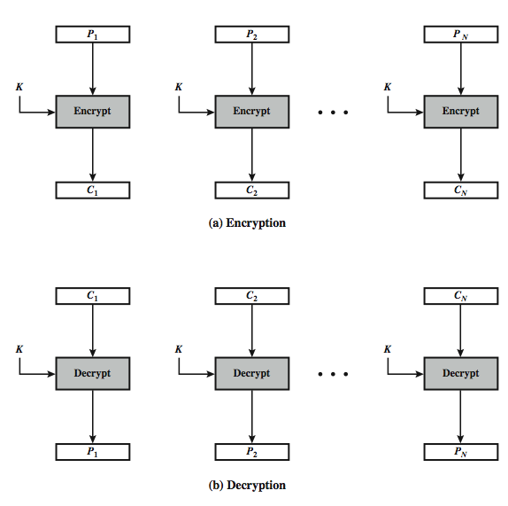
Electronic Codebook Book (ECB)
Notes:
Stallings Figure 6.3 illustrates the Electronic Codebook (ECB) Mode.

Slide 58
Advantages and Limitations of ECB
message repetitions may show in ciphertext
if aligned with message block
particularly with data such graphics
or with messages that change very little, which become a code-book analysis problem
weakness is due to the encrypted message blocks being independent
main use is sending a few blocks of data
Notes:
For lengthy messages, the ECB mode may not be secure. If the message is highly structured, it may be possible for a cryptanalyst to exploit these regularities. If the message has repetitive elements, with a period of repetition a multiple of b bits, then these elements can be identified by the analyst. This may help in the analysis or may provide an opportunity for substituting or rearranging blocks. Hence ECB is not appropriate for any quantity of data, since repetitions can be seen, esp. with graphics, and because the blocks can be shuffled/inserted without affecting the en/decryption of each block. Its main use is to send one or a very few blocks, eg a session encryption key.

Slide 59
Cipher Block Chaining (CBC)
message is broken into blocks
linked together in encryption operation
each previous cipher blocks is chained with current plaintext block, hence name
use Initial Vector (IV) to start process
C_{i} = E_{K}(P_{i} XOR C_{i-1})
C₋₁ = IV
uses: bulk data encryption, authentication, TCP
Notes:
To overcome the problems of repetitions and order independence in ECB, want some way of making the ciphertext dependent on all blocks before it. The CBC provides this, by combining the previous ciphertext block with the current message block before encrypting. In effect, we have chained together the processing of the sequence of plaintext blocks. The input to the encryption function for each plaintext block bears no fixed relationship to the plaintext block. Therefore, repeating patterns of b bits are not exposed. For decryption, each cipher block is passed through the decryption algorithm. The result is XORed with the preceding ciphertext block to produce the plaintext block. To produce the first block of ciphertext, an initialization vector (IV) is XORed with the first block of plaintext. On decryption, the IV is XORed with the output of the decryption algorithm to recover the first block of plaintext. The IV is a data block that is that same size as the cipher block, and is either well known (often all 0's), or otherwise is sent, ECB encrypted, just before starting CBC use. CBC mode is applicable whenever large amounts of data need to be sent securely, provided that all data is available in advance (eg email, FTP, web etc).

Slide 60
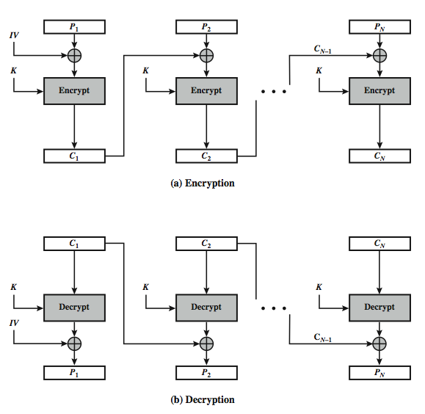
Cipher Block Chaining (CBC)
Notes:
Stallings Figure 6.4 illustrates the Cipher Block Chaining (CBC) Mode.

Slide 61
Message Padding
at end of message must handle a possible last short block
which is not as large as blocksize of cipher
pad either with known non-data value (eg nulls)
or pad last block along with count of pad size
eg. [ b1 b2 b3 0 0 0 0 5]
means have 3 data bytes, then 5 bytes pad+count
this may require an extra entire block over those in message
there are other, more esoteric modes, which avoid the need for an extra block
Bad Padding + CBC = Problems (see BEAST attack)
Notes:
One issue that arises with block modes is how to handle the last block, which may well not be complete. In general have to pad this block (typically with 0's), and then must recognise padding at other end - may be obvious (eg in text the 0 value should usually not occur), or otherwise must explicitly have the last byte as a count of how much padding was used (including the count). Note that if this is done, if the last block IS an even multiple of 8 bytes or has exactly the same form as pad+count, then will have to add an extra block, all padding so as to have a count in the last byte. There are other, more esoteric, “ciphertext stealing” modes, which avoid the need for an extra block.

Slide 62
Advantages and Limitations of CBC
a ciphertext block depends on all blocks before it
any change to a block affects all following ciphertext blocks
need Initialization Vector (IV)
which must be known to sender & receiver
if sent in clear, an attacker can change bits of first block, and change IV to compensate
hence IV must either be a fixed value (as in EFTPOS)
or must be sent encrypted in ECB mode before the rest of message
Notes:
CBC is the block mode generally used. The chaining provides an avalanche effect, which means the encrypted message cannot be changed or rearranged without totally destroying the subsequent data. However there is the issue of ensuring that the IV is either fixed or sent encrypted in ECB mode to stop attacks on 1st block.

Slide 63
Stream Modes of Operation
block modes encrypt entire block
may need to operate on smaller units
real time data
convert block cipher into stream cipher
cipher feedback (CFB) mode
output feedback (OFB) mode
counter (CTR) mode
use block cipher as some form of pseudo-random number generator
Notes:
For AES, DES, or any block cipher, encryption is performed on a block of b bits. However, it is possible to convert a block cipher into a stream cipher, using one of the three modes to be discussed in this and the next two sections: cipher feedback (CFB) mode, output feedback (OFB) mode, and counter (CTR) mode. A stream cipher eliminates the need to pad a message to be an integral number of blocks. It also can operate in real time. Thus, if a character stream is being transmitted, each character can be encrypted and transmitted immediately using a character-oriented stream cipher. Idea here is to use the block cipher essentially as a pseudo-random number, and to combine these "random" bits with the message. One desirable property of a stream cipher is that the ciphertext be of the same length as the plaintext. Thus, if 8-bit characters are being transmitted, each character should be encrypted to produce a ciphertext output of 8 bits. If more than 8 bits are produced, transmission capacity is wasted.

Slide 64
Cipher FeedBack (CFB)
message is treated as a stream of bits
added to the output of the block cipher
result is feed back for next stage (hence name)
standard allows any number of bit (1,8, 64 or 128 etc) to be feed back
denoted CFB-1, CFB-8, CFB-64, CFB-128 etc
most efficient to use all bits in block (64 or 128)
C_{i} = P_{i} XOR E_{K}(C_{i-1})
C₋₁ = IV
uses: stream data encryption, authentication
Notes:
Cipher feedback (CFB) mode is one alternative. As with CBC, the units of plaintext are chained together, so that the ciphertext of any plaintext unit is a function of all the preceding plaintext. In this case, rather than units of b bits, the plaintext is divided into segments of s bits. The input to the encryption function is a b-bit shift register that is initially set to some initialization vector (IV). The leftmost (most significant) s bits of the output of the encryption function are XORed with the first segment of plaintext P1 to produce the first unit of ciphertext C1, which is then transmitted. In addition, the contents of the shift register are shifted left by s bits and C1 is placed in the rightmost (least significant) s bits of the shift register. This process continues until all plaintext units have been encrypted. For decryption, the same scheme is used, except that the received ciphertext unit is XORed with the output of the encryption function to produce the plaintext unit. Note that it is the encryption function that is used, not the decryption function.
As originally defined, CFB was to "consume" as much of the "random" output as needed for each message unit (bit/byte) before "bumping" bits out of the buffer and re-encrypting. This is wasteful though, and slows the encryption down as more encryptions are needed. An alternate way to think of it is to generate a block of "random" bits, consume them as message bits/bytes arrive, and when they're used up, only then feed a full block of ciphertext back. This is CFB-64 or CFB-128 mode (depending on the block size of the cipher used eg DES or AES respectively). CFB is the usual choice for quantities of stream oriented data, and for authentication use.

Slide 65
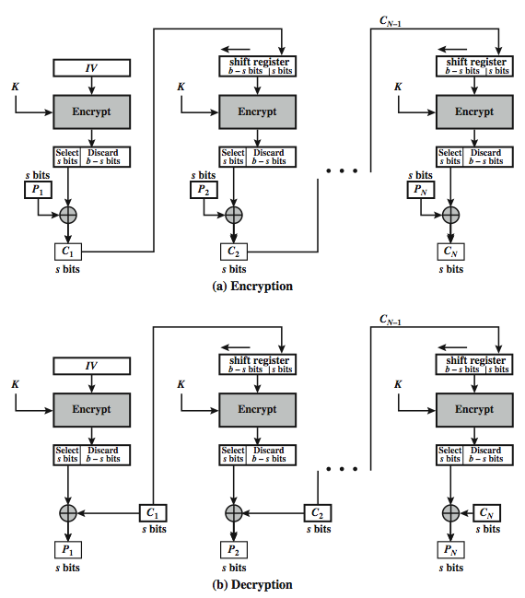
s-bit Cipher FeedBack (CFB-s)
Notes:
Stallings Figure 6.5 illustrates the operation of s-bit Cipher FeedBack (CFB) Mode.

Slide 66
Advantages and Limitations of CFB
appropriate when data arrives in bits/bytes
most common stream mode
limitation is need to stall while do block encryption after every n-bits
note that the block cipher is used in encryption mode at both ends
errors propagate for several blocks after the error
Notes:
CFB is the usual stream mode. As long as can keep up with the input, doing encryptions every 8 bytes. A possible problem is that if its used over a "noisy" link, then any corrupted bit will destroy values in the current and next blocks (since the current block feeds as input to create the random bits for the next). So either must use over a reliable network transport layer (typical) or use OFB/CTR.

Slide 67
Output FeedBack (OFB)
message is treated as a stream of bits
output of cipher is added to message
output is then feed back (hence name)
feedback is independent of message
can be computed in advance
O_{i} = E_{K}(O_{i-1})
C_{i} = P_{i} XOR O_{i}
O₋₁ = IV
uses: stream encryption on noisy channels, UDP
Notes:
An alternative to CFB is OFB. Here the generation of the "random" bits is independent of the message being encrypted. The output feedback (OFB) mode is similar in structure to that of CFB, except that the output of the encryption function is fed back to the shift register in OFB, whereas in CFB the ciphertext unit is fed back to the shift register. The other difference is that the OFB mode operates on full blocks of plaintext and ciphertext, not on an s-bit subset. The advantage is that firstly, they can be computed in advance, which is good for bursty traffic, and secondly, any bit error only affects a single bit. Thus this is good for noisy links (eg satellite TV transmissions etc).

Slide 68
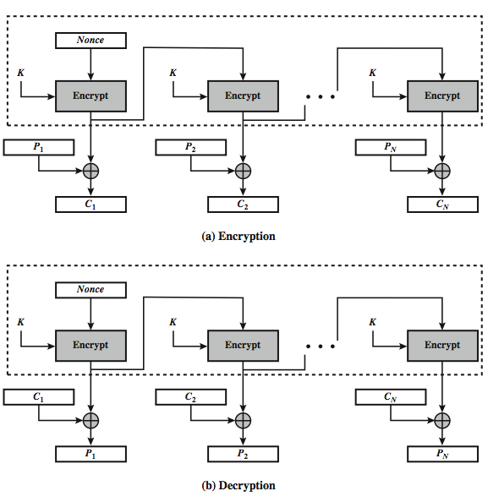
Output FeedBack (OFB)
Notes:
Stallings Figure 6.6 illustrates the Output FeedBack (OFB) Mode.

Slide 69
Advantages and Limitations of OFB
needs an IV which is unique for each use
if ever reuse attacker can recover outputs
bit errors do not propagate
more vulnerable to message stream modification
sender & receiver must remain in sync
only use with full block feedback
subsequent research has shown that only full block feedback (ie OFB-64 or OFB-128) should ever be used
Notes:
As with CBC and CFB, the OFB mode requires an initialization vector. In the case of OFB, the IV must be a nonce; that is, the IV must be unique to each execution of the encryption operation. The reason for this is that the sequence of encryption output blocks, Oi. , depends only on the key and the IV, and does not depend on the plaintext. Therefore, for a given key and IV, the stream of output bits used to XOR with the stream of plaintext bits is fixed. If two different messages had an identical block of plaintext in the identical position, then an attacker would be able to determine that portion of the O stream.
One advantage of the OFB method is that bit errors in transmission do not propagate. The disadvantage of OFB is that it is more vulnerable to a message stream modification attack than is CFB.
OFB has the structure of a typical stream cipher, in that the cipher generates a stream of bits as a function of an initial value and a key, and that stream of bits is XORed with the plaintext bits. Hence the sender & receiver need to remain in sync, or all data is lost. Also, research has shown that you should only ever use a full block feedback ie OFB-64/128 mode. Hence OFB encrypts plaintext a full block at a time, where typically a block is 64 or 128 bits.

Slide 70
Counter (CTR)
a “new” mode, though proposed early on
similar to OFB but encrypts counter value rather than any feedback value
must have a different key & counter value for every plaintext block (never reused)
O_{i} = E_{K}(i)
C_{i} = P_{i} XOR O_{i}
uses: high-speed network encryptions, UDP
Notes:
The Counter (CTR) mode is a variant of OFB, but which encrypts a counter value (hence name). Although it was proposed many years before, it has only recently been standardized for use with AES along with the other existing 4 modes. It is being used with applications in ATM (asynchronous transfer mode) network security and IPSec (IP security). A counter, equal to the plaintext block size is used. The only requirement stated in SP 800-38A is that the counter value must be different for each plaintext block that is encrypted. Typically the counter is initialized to some value and then incremented by 1 for each subsequent block. As with the OFB mode, the initial counter value must be a nonce; be different for all of the messages encrypted using the same key. Further, all counter values across all messages must be unique. If, contrary to this requirement, a counter value is used multiple times, then the confidentiality of all of the plaintext blocks corresponding to that counter value may be compromised.

Slide 71
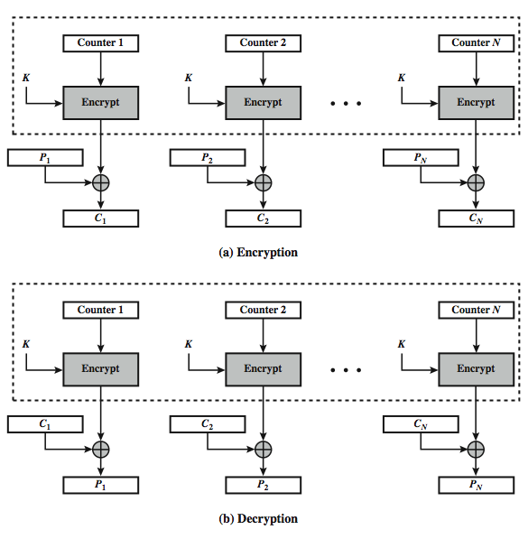
Counter (CTR)
Notes:
Stallings Figure 6.7 illustrates the Counter (CTR) Mode.

Slide 72
Advantages and Limitations of CTR
efficiency
can do parallel encryptions in h/w or s/w
can preprocess in advance of need
good for bursty high speed links
random access to encrypted data blocks
provable security (good as other modes)
but must ensure never reuse key/counter values, otherwise could break (cf OFB)
Notes:
CTR mode has a number of advantages in parallel h/w & s/w efficiency, can preprocess the output values in advance of needing to encrypt, can get random access to encrypted data blocks, and is simple. But like OFB have issue of not reusing the same key+counter value.

Slide 73
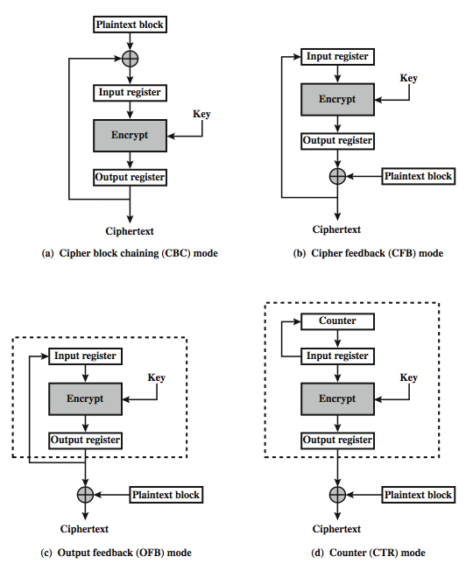
Feedback Character-istics
Notes:
Note that, with the exception of ECB, all of the NIST-approved block cipher modes of operation involve feedback. This is clearly seen in Stallings Figure 6.8. To highlight the feedback mechanism, it is useful to think of the encryption function as taking input from a input register whose length equals the encryption block length and with output stored in an output register. The input register is updated one block at a time by the feedback mechanism. After each update, the encryption algorithm is executed, producing a result in the output register. Meanwhile, a block of plaintext is accessed. Note that both OFB and CTR produce output that is independent of both the plaintext and the ciphertext. Thus, they are natural candidates for stream ciphers that encrypt plaintext by XOR one full block at a time.

Slide 74
XTS-AES Mode
new mode, for block oriented storage use
in IEEE Std 1619-2007
concept of tweakable block cipher
different requirements to transmitted data
uses AES twice for each block
T_{j} = E_{K2}(i) XOR α^{j}
C_{j} = E_{K1}(P_{j} XOR T_{j}) XOR T_{j}
where i is tweak & j is sector no
each sector may have multiple blocks
Notes:
NIST is currently in the process of approving an additional block cipher mode of operation, XTS-AES. This mode is also an IEEE standard, IEEE Std 1619-2007, which describes a method of encryption for data stored in sector-based devices. The XTS-AES mode is based on the concept of a tweakable block cipher. The requirements for encrypting stored data, also referred to as "data at rest" differ somewhat from those for transmitted data (see text for list). Encryption of a single block involves two instances of the AES algorithm with two keys, and a number of parameters (see text). In essence, the parameter j is the block number within the sector, and i is the 128-bit tweak for the sector. Each data unit (sector) is assigned a tweak value that is a nonnegative integer. The tweak values are assigned consecutively, starting from an arbitrary nonnegative integer.
The plaintext of a sector or data unit is organized in to blocks of 128 bits, hence the input to the XTS-AES algorithm consists of m 128-bit blocks and possibly a final partial block. For encryption and decryption, each block is treated independently and encrypted. The only exception occurs when the last block has less than 128 bits. In that case, the last two blocks are encrypted/decrypted using a ciphertext- stealing technique instead of padding.

Slide 75
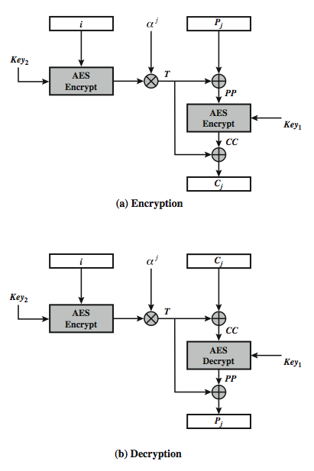
XTS-AES Mode per block
Notes:
Stallings Figure 6.9 illustrates the operation of the XTS-AES mode on a single block.

Slide 76
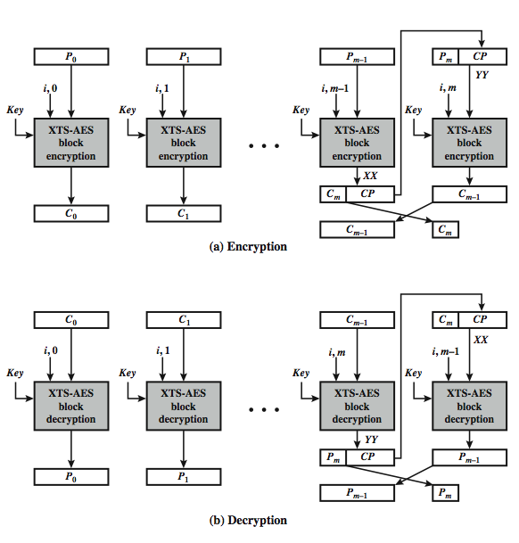
XTS-AES Mode Overview
Notes:
Stallings Figure 6.10 illustrates the ciphertext- stealing technique used in XTS-AES. This ensures that the encrypted data remains the same size as the original plaintext, which it must to fit on a block-oriented storage device. See text for more details.

Slide 77
Advantages and Limitations of XTS-AES
efficiency
can do parallel encryptions in h/w or s/w
random access to encrypted data blocks
has both nonce & counter
addresses security concerned related to stored data
Notes:
XTS-AES mode, like CTR mode, is suitable for parallel operation: because there is no chaining, multiple blocks can be encrypted or decrypted simultaneously. Unlike CTR mode, XTS-AES mode includes a nonce (the parameter i) as well as a counter (parameter j).

Slide 78
Summary
Multiple Encryption & Triple-DES
Modes of Operation
ECB, CBC, CFB, OFB, CTR, XTS-AES
Notes:
Chapter 6 summary.

