Slide 1

Computable functions in ASP Theory and implementation
Nicola Leone
Department of Mathematics and Computer Science (DeMaCS)
University of Calabria, Italy
leone@unical.it

Slide 2
Reference Scenario
P = a DLP* program:
Nonground, Disjunctive logic program under Answer Set semantics
AS(P) = The set of answer sets of P
Functional terms are explicitly allowed
p(s(X)) :- a(X, h(Z)).
We focus on programs with safe rules
equal(X,X).
p(X,Y) :- q(X).
Not allowed

Slide 3
Functions?
We are talking of functions and functional terms in the traditional logic programming sense:
father(gibbi) → father(gibbi)
sqr(3) → sqr(3)
[a,b,c] → list(a,list(b,c))
Recursive Function symbols → Undecidability
Horn Logic Programming is R.E.-complete (Tarnlünd 1977)
Goal: treat function symbols in ASP

Slide 4
Grounding basics
P → Grounder → grnd(P) → Model Generator/Checker → AS(P)
a(1). a(2). b(2,1).
R : p(X) v r(X) :- a(X), b(X,Y).
grnd(P) = { p(2) v r(2) :- a(2), b(2,1), …
p(1) v r(1) :- a(1), b(1,2) }
inst_{R}({a(1), a(2), b(2,1)}) = { p(2) v r(2) :- a(2), b(2,1) }
Active Facts + Rules

Slide 5
Grounding in the presence of function symbols
r(1). r(2).
r(f(X)) :- r(X), not a(X).
inst_{P} ( {r(1), r(2)} ) =
{ r(f(1)) :- r(1), not a(1)
r(f(2)) :- r(2), not a(2),
r(1), r(2) }
Γ_{P}(R) = inst_{P}(Heads(R))
Γ_{P}∞(Ø) might diverge
(reflecting the fact that infinite atoms depend from r(1) and r(2) )

Slide 6
Several attempts exist:
Top-Down:
Prolog:
SLD Termination analysis (A. Bossi and many others)
ASP:
Finitary programs (P. Bonatti et al.), FDNC programs (T. Eiter et al.)
Bottom-up:
Datalog with infinite relations (Ramakrishnan et al., others), Datalog with Value invention (Hull, Cabibbo, others), omega-restricted programs (Syrjänen)
Idea: introduce a “bottom-up” based class of programs. But none of the above directly applies.

Slide 7
Idea:
Consider the class of programs for which:
Γ_{P}∞(Ø) is finite (and computable)
Theorem:
Γ_{P}∞(Ø) constitutes a finite ground program for which it holds
AS(P) = AS(Γ_{P}∞(Ø))
Theorem:
Deciding if Γ_{P}∞(Ø) is finite is R.E.-Complete

Slide 8
But
We can do better:
There are other classes of programs for which an equivalent, finite, ground program exists:
path([X | Y]) :- edge(X,Y).
path([X | [Y | W]]) :- edge(X,Y), path([Y|W]),
not member(X, [Y|W]).
Γ_{P}∞(Ø) diverges, but AS(P) is computable

Slide 9
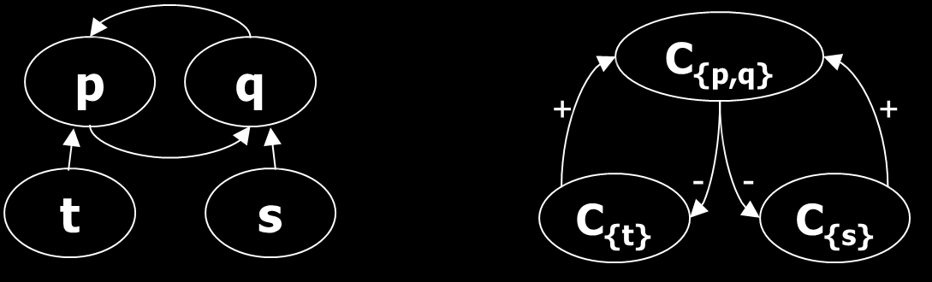
Program Components
a → EDB predicate q(X) :- s(X), p(Y,X).
q(g(3)). p(X,Y) :- q(g(X)), t(f(Y)).
s(X) v t(f(X)) :- a(X), not q(X).
(Positive) Dependency graph Component graph

Slide 10
A refined operator
Φ_{M,R}(X) = Simpl(Inst_{M}(Heads(R U X))
Simplification and Modularization

Slide 11
Intelligent Instantiation
p(f(X)) : - p(X), not q(X). p(1). q(f(1)).
Φ⁰_{{p},{q(f(1))}}(∅) = {p(1)}
Φ¹_{{p},{q(f(1))}}({p(1)}) = {
p(1),
p(f(1)) :- p(1)
}
, not q(1)
Φ²_{{p},{q(f(1))}}({p(1), p(f(1)) :- p(1)}) = {
p(1),
p(f(1)) :- p(1)
,
p(f(f(1))) :- p(f(1)), not q(f(1))
}
Notes:
Esempio di grafo dei moduli con esempio..

Slide 12
Finitely-ground programs
Given a partition <C₁, …, C_{n}> of predicates of P, P is finitely-ground iff the last element P^{γ} = S_{n} of the sequence
S_{i}= S_{i-1} U Φ_{Mi,Si-1}(X) ( S₀ = EDB(P) )
converges to a finite ground program.
M_{i} ≈ the module defining predicates in C_{i}
Theorem: AS(P) = AS(P^{γ}) (for any γ)

Slide 13
fg-programs: pros & cons
Pros:
A very expressive class: fg-programs correspond to terminating computations of Turing Machines:
Theorem: Any recursive function can be “expressed” by fg-programs.
Fg-programs have a finite set of finite answer sets
Cons:
Semidecidable: might be undesirable in certain applications… fd-programs fit better.

Slide 14
FD-programs
A simple, decidable subclass of fg-programs
All the arguments of P must be finite-domain.
Given the graph of arguments of P, any argument q[k] must be such that if q(…,t,…) appears in a head, either:
t is variable free ( q(…, f(a,g(b)),…) is OK. ), or
t is subterm of another fd-argument appearing in the body
(q(…, X,…)) :- q(f(X), … ) is OK if q[1] is fd), or
t appears in some body arguments which is not recursive with q[k]
(q(…, X,…)) :- p(f(X), … ) is OK if p[1] is not recursive with q[k]
Notes:
Esempio.

Slide 15
FD-programs
FD-program:
q(f(0)).
q(X) :- q(f(X)).
Non FD-program:
q(f(0)).
q(X) :- q(f(X)).
s(f(X)) :- s(X). → s[1] is not an FD
v(X) :- q(X), s(X). argument

Slide 16
FD-programs: pros & cons
Pros:
Much simpler static check than norm-based analysis
It subsumes other known static conditions, e.g. ω-restricted programs
E.g. p(X) :- p(f(X)) is fd but not ω-restricted
Cons:
Certain “meaningful” programs might fall outside the class. In such a case fg-programs fit better.

Slide 17
DLV-Complex
Extends former DLV-EX:
Features function symbols, lists, sets
Implements DLP*
Defaults to fd-programs.
Static check can be relaxed for having fg-programs (but the grounder might not terminate)
Available at
http://www.mat.unical.it/dlv-complex

Slide 18
Some insights
Available language in DLV-complex:
Rules of form
A₁ v … v A_{n} :- B₁, … , B_{n}, not C₁, …, not C_{n}
A_{i},B_{i},C_{i} are literals allowing true negation and functional, list and set complex terms
p(X,f(a)), p({c,d}, [r|T]) , ...
B_{i}, C_{i} can be custom library predicates
#ext(a,b) → an infinite external relation

Slide 19
Some insights (2)
Function symbols implemented using the DLV-EX framework [Calimeri et al. 2007, 2005]:
p(f(X)) :- a(X) → p(S) :- a(X), #function_pack(S,f,X)
Several libraries of list and set manipulation predicates available:
Fast: do not resort to logic programming
#Subset, #Member, #Intersection, #Union, #Card, #Insertion...
#Head, #Last, #DelAll,, #Append, #Member, #Length, #Reverse, #Sublist...

Slide 20
Related Work
Finitary programs
Dual approach
p(f(X)) :- p(X) Finitary
p(X) :- p(f(X)) Finitely ground
Finitary → “top-down” safety
p(X) :- a(X,Y).
Finitely ground → “bottom-up” safety
e(X,X).
P(X,Y) :- a(Y).
Disallowed
Disallowed

Slide 21
Related Work (2)
ω-restricted programs
ω-stratification: unstratified components belong to the single, uppermost ω layer
All head variables must be bound to a positive atom belonging to a previous layer
Much more restricted than fd-programs
Others
SLD termination, Value invention

Slide 22
What the reviewers said..
How fast it goes?
“Hope my Hanoi towers runs faster”
A new programming style is in principle possible
Notes:
It would be a good idea to mention work [A]
“Don’t even dare to think that I authored [A]”
You could add more examples
“.. It’s worth mentioning that [A] is plenty of examples..”

Slide 23
Conclusions
Possible developments:
Extend the range of fd-programs
Investigate the relationship of finitary programs with magic sets
Conjecture: magic(P) is fg, if P is finitary(*)
Above conjecture proven for some fragments
Prototype available at
http://www.mat.unical.it/dlv-complex

Slide 24
Functions?
Functional terms are intended in the «traditional» logic programming sense: no explicit semantics is attached. A ground functional term represents a «value», just as a function-free ground term.
Functional terms can represent values that are not originally present in the Herbrand Universe
Ex.: hasFather(ciccio) :- father(ciccio,f(ciccio)).
The name of ciccio’s father does not need to be known

Slide 25
Functions and finiteness
As already pointed out, a program with recursive function symbols might have an infinite ground program, which makes the computation infeasible in practice
Ex.: int(s(X)) :- int(X). int(0).
TP⁰ = TP(∅) = {int(0)}
TP¹ = TP⁰ ∪ {int(s(0))}
TP² = TP¹ ∪ {int(s(s(0)))}
TP³ = TP² ∪ {int(s(s(s(0))))}
….
The immediate consequence operator TP does not converge finitely to a fixpoint, even on a simple positive program like this.

Slide 26
Ensure Computability
In general:
Function symbols + recursion → Undecidability
Horn Logic Programming is R.E.-complete (Tarnlünd 1977)
Even a Turing Machine can be simulated
see e.g., an encoding in DLV syntax at https://www.mat.unical.it/dlv-complex#Examples
Some subclasses of programs with function symbols can be identified, that ensure termination.
Ex.: Finite-Domain programs, omega-restricted programs, argument-restricted programs, etc.
Program belonging to such classes must comply with some syntactical restrictions

Slide 27
Arguments
A predicate p of arity n has n arguments.
p[k] stands for the argument at position k
Ex.: predicate «p» of arity 3
p(X,f(ciccio),a)
in this case, p[1] = X, p[2] = f(ciccio), p[3] = a
Notes:
Esempio.

Slide 28
Argument Graph G^{A}(P)
Given a program P, G^{A}(P) is a directed graph containing a node for each argument p[i] of an IDB predicate p of P; there is an arc (q[j], p[i]) iff there is a rule r in P having an atom p(t₁…t_{n}) in the head, an atom q(v₁…v_{m}) in B⁺(r) and p(t₁…t_{n}) and q(v₁…v_{m}) are such that the same variable appears within terms t_{i} and v_{j}, respectively.
q(g(3)).
p(X,Y) :- q(g(X)), t(f(Y)).
s(X) | t(f(X)) :- a(X), not q(X).
q(X) :- s(X), p(Y,X).
p[1]
p[2]
q[1]
t[1]
s[1]

Slide 29
Recursive Arguments
Given a program P, an argument p[i] is said to be recursive with q[j] if there exists a cycle in the Argument Graph of P involving both p[i] and q[j].
the Argument Graph keeps track of (body-head) dependencies between the arguments of predicates sharing some variable.
it is a more detailed version of the commonly used (predicate) dependency graph.
t(X,Y):- a(X,Y), not q(X).
q(f(X)) :- q(X), t(Y, f(X)).
Argument q[1] is recursive.
q[1]
t[2]

Slide 30
FD-programs: definition
FINITE-DOMAIN programs: a simple, decidable subclass of ASP programs
All the arguments of a program P must be finite-domain.
An argument q[k] in the Argument Graph is FINITE-DOMAIN if for all occurrences q(…,t,…) of it appearing in the head of a rule, one of the following conditions holds:
t is variable free (e.g. q(…, f(a,g(b)),…) is OK. ), or
t is subterm of another fd-argument appearing in the body
(e.g. q(…, X,…) ) :- p(f(X), … ) is OK if p[1] is fd), or
t appears in some body arguments which is not recursive with q[k]
(e.g. q(…, X,…) ) :- p(f(X), … ) is OK if p[1] is not recursive with q[k]
Notes:
Esempio.

Slide 31
FD-programs: examples
FD-program (q[1] is a FD argument)
q(f(0)). (condition 1 holds)
q(X) :- q(f(X)). (condition 2 holds)
q(f(X)) :- q(X), t(f(X)). (condition 3 holds)
Non FD-program (s([1]) is not a FD argument)
q(f(0)). (q[1]: condition 1 holds)
q(X) :- q(f(X)). (q[1]: condition 2 holds)
s(f(X)) :- s(X). (s[1]: no condition hold)
v(X) :- q(X), s(X). (v[1]: condition 2 holds)

Slide 32
Finitely-ground (FG) Programs
INTUITION: The class of Finitely Ground Programs is the set of programs for which the «intelligent» instantiation is finite and computable, i.e., the TP operator converges finitely to a fix-point.

Slide 33
Finitely-ground (FG) and Finite Domain (FD) Programs
THEOREM: Every FD program is Finitely Ground.
Example: The following program is not FD, even if it is Finitely Ground.
p(f(X)) :- q(X).
q(X) :- p(X), r(X).

Slide 34
Functions in DLV / DLV2
Functions are Implemented in DLV: it fully supports both Finitely Ground Programs and Finite Domain programs. Actually, DLV is able to recognize Argument Restricted (AR) programs, which is a super-class of FD. AR programs require a more involved and less intuitive syntactic check to be recognized.
If a program P is finitely ground, then DLV instantiator terminates over P, generating its correct instantiation. By default, DLV checks the input program P: if it belongs to the class of AR programs, then DLV guarantees termination. If not, DLV returns an error.
The user must take over the responsibility about the program being finitely ground in order to run non-AR programs. With option –nofinitecheck, DLV skips the finite domain check. The instantiation will then terminates if the program is FG.
DLV2 & I-DLV+WASP currently do not apply any syntactical check, so the responsibility is left to the user.

Slide 35
Lists in DLV-DLV2-IDLV
Very common data structure
Easily obtained via function symbols
However, due to the usefulness
explicit syntax is supported
Dedicated built-ins are available

Slide 36
Lists in DLV-DLV2-IDLV
A list is a binary function denoted with a special syntax:
[ H | T ]
where the first argument «H» is a term, called the head of the list, and the second argument «T» is a list.
In addition, a list can be represented by explicitly listing its elements.
[ a, b, c ] = [ a | [ b, c ] ] = [ a | [ b | [ c ] ] ]
= [ a | [ b | [ c | [ ] ] ] ]

Slide 37
Lists in DLV-DLV2-IDLV
LIST TERMS
A list term can be of the two forms:
− [ t1, . . . , tn ], where t1, . . . , tn are terms;
− [ h | t ], where h (the head of the list) is a term, and t (the tail of the list) is a list term.
Examples:
The term [ a,d,a ] in the atom palindromic([a,d,a])
[ jan,feb,mar ]
[jan | [ feb,mar,apr,may,jun ] ]
[ [jan,31] | [ [ feb,28 ], [ mar,31 ], [ apr,30 ], [ may,31], [ jun,30 ] ] ].

Slide 38
Built-in predicates for Lists
I-DLV (and DLV2) comes with a rich library of built-in predicates for list manipulation.
A built-in atom is of the form
&p(t₀,.., t_{n} ; u₀,…, u_{m})
where n,m >= 0
t₀,.., t_{n} are input terms, and are separated from the output terms u₀,…, u_{m} by a semicolon (“;”);
an input/output term can be either a constant or a variable.
Intuitively, output terms are computed on the basis of the input ones, according to a semantics which is defined “a priori” for each predicate, as reported next.

Slide 39
Built-in predicates for Lists

Slide 40
Lists: example
Compute all simple (i.e. with no repeated vertices) paths in a graph:
simplePath([X|[Y]]) :- edge(X,Y).
simplePath([X|[Y|W]]) :- edge(X,Y), simplePath([Y|W]),
not &member(X,[Y|W];).
Compute all simple cycles in a graph:
simpleCycle([X]) :- edge(X,X).
simpleCycle([X|L]) :- simplePath([X|L]), &last(L;Y), edge(Y,X).
Compute simple paths of maximum length:
maxPath(P) :- simplePath(P), &length(P;L),
L = #max { X : simplePath(Q), &length(Q;X) }.

Slide 41
LISTS: Applications
Lists can easily represent trees:
[root| List-of-subtrees]
Leaf node: [a|[]] = [a]
[a | [ [b], [c | [ d ] ] ] ]
- the list rooted in a
- b and c are the children of a
- d is a child of c
- b and d are leaves
List can therefore represent the HTML trees of web pages

Slide 42
DIADEM ERC Advanced Grant @Oxford - G. Gottlob
Domain-centric, Intelligent, Automated Data Extraction
fully automated extraction from domain-specific websites
no per site training, no user input other than the domain model
main target: websites with structured records
based on extensive domain knowledge
web form understanding
result page analysis (records, attributes)
navigation blocks classification (next page link, detail pages)
Template language on Datalog^{¬,Agg} rules compiled to DLV, plus Gazetteers, GATE annotation&regex, ML classifiers

Slide 43
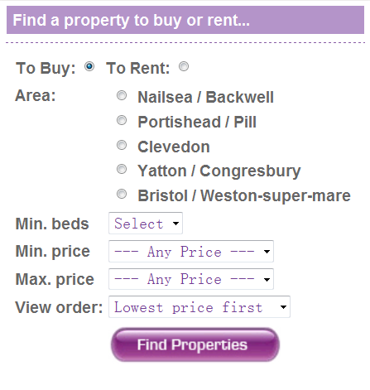
Web Form Understanding with OPAL
Ontology-based Pattern Analysis with Logic
Recognizes and labels groups of fields + classifies them w.r.t. the domain ontology
Reasoning on structural & visual patterns + annotations
group(Es) :- similarFieldSequence(Es),
leastCommonAncestor(A,Es),
not hasAdditionalField(A,Es).
leastCommonAncestor(A,Es) :- commonAncestor(A,Es),
not ( child(C,A), commonAncestor(C,Es) ).
partOf(E,A) :- group(Es),
member(E,Es), leastCommonAncestor(A,Es).
Notes:
Bottom up process to
associate fields with text labels (e.g., Min.Beds with the field on its right),
group fields in segments by similarity (e.g., list of radio button in the midlde) and associate labels to segments (e.g., Area is label for the whole segment)
Uses text annotations on labels to Classify segments w.r.t. Real Estate ontology (e.g., the segment labelled Area is of type Location in our ontology, as the inner fields are annotated with locations by our gazetteers, etc.)
The heuristics to associate labels to fields are based on structural (e.g., siblings descendants) and visual observation (e.g., north west proximity)

Slide 44
Result Page Analyses with AMBER
Adaptable Model Based Extraction of Result Pages
Reasoning on annotations and page structure to identify records & attributes
price
location
consistent_cluster_members(C, N1, N2, N3) :- pivot(N1), pivot(N2), ...
similar_depth(N1, N2), similar_depth(N2, N3), similar_depth(N1,N3),
similar_tree_distance(N1, N2, N3).
Notes:
We cluster the page into (possibly multiple) data areas (zones of the page containing records, only one in the picture).
To drive the clustering, we observe that each record must have an annotation that is mandatory for the domain, for instance price. Thereby, we cut out a lot of noise. Clusters have different properties we
Force with rules (e.g., similar depth, consistent distance among price nodes, continuous i.e., no gaps between them).
Once we have the clusters, for each we identify its records segmenting repetive structures (e.g., sequences of nodes with same tags). We don’t guess and check but rather we use again knowledge from the domain to narrow the search and break ties.
The attributes are then assign by relaying on the annotations.

Slide 45

Applications: Ontology Representation and Reasoning
PROBLEM:
Ontologies are typically represented in First-Order Logic (FOL) and manipulated under the Open World Assumption (OWA)
Existential quantification is one of the most meaningful OWA operators provided by FOL
Existential quantifiers are not allowed in DLP
IDEA:
Simulate existential quantification in DLP via "skolemization"
EXAMPLE:
$∀$X person(X) → $∃$Y father(X,Y) (FOL statement)
father(X,f_{r,2}(X)) :- person(X) (Skolemized DLP rule)

Slide 46
DLV-complex evolution: implementation details
Functional terms handling in DLV has been totally re-engineered in the last few years:
In a preliminary implementation of DLV-complex, functional terms were represented and manipulated as string constants
In the latest version of DLV, functions are natively supported as a new kind of terms
Significant performance improvements are shown by the results of a preliminary experimental analysis we carried out

Slide 47
DLV-complex evolution: some experimental results
We compared the first version of DLV-complex against the latest version of DLV over some popular skolemized ontologies used by (Benedikt et Al.) for benchmarking chase-based tools
Tested scenarios:
Doctors (Geets et Al.): this ontology is based on schemas inspired by real databases about medical data and aims at simulating a common use case for data exchange, i.e. take two databases from the same domain but with different schemas and bring them to a unified target representation.
LUBM (Guo et Al.): this is a popular benchmark domain in the Semantic Web community.
STB-128 and ONT-256 (Arocena et Al.): these are two existing sets (Arocena et Al., Section 5) of dependencies (TGDs, primary keys, foreign keys) produced via iBench, a well-established tool for generating integration metadata that is widely used in the database community

Slide 48
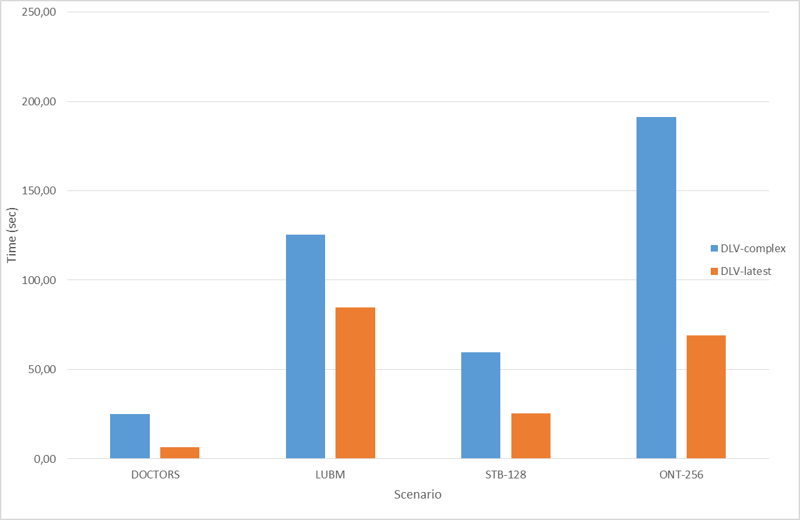
DLV-complex evolution: some experimental results
 | DLV-complex | DLV-latest
DOCTORS
10k | 0,50 | 0,24
100k | 4,40 | 1,62
500k | 24,95 | 8,00
1m | 49,91 | 16,16
LUBM
21 univ. | 63,55 | 25,19
34 univ. | 105,58 | 40,99
55 univ. | 172,90 | 68,65
89 univ. | 285,34 | 109,28
144 univ. | 0,10 | 178,96
STB-128
Instance 1 | 59,68 | 25,34
ONT-256
Instance 1 | 191,38 | 68,99
Average | 86,85 | 45,49
Table: Overall running times in seconds
Figure: Average running times in seconds

Slide 49
Thanks!
Question time

