Slide 1
Computable Functions in ASP Theory and Implementation
F. Calimeri, S. Cozza, G. Ianni, N. Leone
Department of Mathematics and Computer Science
University of Calabria, Italy
24° International Conference on Logic Programming – ICLP 2008
Udine, Italy, December 9-13, 2008

Slide 2
Reference Scenario
P = a Disjunctive Logic Program with Functions (ASP^{f} program)
under Answer Set semantics
AS(P) = The set of the answer sets of P
Functional terms are explicitly allowed
p(s(X)) :- a(X, h(Z)).
We focus on programs with safe rules
p(X,Y) :- q(X).
Not allowed

Slide 3
Which Functions?
Functional terms are intended in the «traditional» logic programming sense: no explicit semantics is attached.
A ground functional term represents a «value», just as a function-free ground term.
Functional terms can represent values that are not originally present in the Herbrand Universe
Ex.: hasFather(bob) :- father(bob,f(bob)).
The name of bob’s father does not need to be known
“Value invention”

Slide 4
Functions and finiteness
A program with function symbols might have an answer set of infinite size:
Program: int(0). int(s(X)) :- int(X).
Answer Set: {int(0), int(s(0)), int(s(s(0))), int(s(s(s(0)))), …. } (infinite set)
and even infinitely many answer sets:
Program: int(0). int(s(X)) :- int(X). good(X) :- int(X), not bad(X). bad(X) :- int(X), not good(X)
Answer Set: Infinitely many infinite answer sets with bad(n) or good(n) for any integer n.
Function symbols → Undecidability
Horn Logic Programming is R.E.-complete (Tarnlünd 1977)
Goal: Managing function symbols in ASP
Ensuring Computability

Slide 5
Our Key Contribution
Theoretical Contribution:
A new notion of Computable Functions in ASP (Finitely Ground Programs)
Reasoning is decidable
Answer Sets are computable
Finitely Ground (FG) Programs have been then used by many researchers
After 10 years it is still the standard notion for computable functions in ASP
Practical Contribution:
Algorithms and Implementation
An ASP System supporting functions and lists
Fully compliant with Finitely Ground Theory
Profitably used in applications even at industrial level

Slide 6
How can we ensure computability?
Problem: Any ASP^{f} program P has an infinite instantiation ground(P)
Observation: We cannot compute the answer sets of P from ground(P).
If we can find some finite set of ground rules P’ which is “equivalent” to ground(P) (i.e., AS(P) = AS(P’)), then we can compute the answer sets of P through P’.

Slide 7
How can we ensure computability?
Idea: Adopt an “Intelligent Grounding Procedure”
Generate only the “relevant” instantiation of P, by a bottom-up procedure:
Set A = Facts
REPEAT
1. Instantiate the rules’ bodies with the atoms in A
2. Add the head atoms of the generated instances to A
UNTIL no new atom has been added to A in step 2
OUTPUT the set P’ of generated instances
If the procedure converges finitely, then AS(P’) is computable
AND P’ is “equivalent” to ground(P), i.e., AS(P) = AS(P’)

Slide 8
Grounding basics
P → Grounder → grnd(P) → Model Generator/Checker → AS(P)
a(1). a(2). b(2,1).
R : p(X)|r(X) :- a(X), b(X,Y).
grnd(P) = { p(2)|r(2) :- a(2), b(2,1), p(2)|r(2) :- a(2), b(2,2)
p(1)|r(1) :- a(1), b(1,2), p(1)|r(1) :- a(1), b(1,1) }
inst_{R}({a(1), a(2), b(2,1)}) = { p(2)|r(2) :- a(2), b(2,1) }
Facts + Heads of generated rule instances

Slide 9
Grounding in the presence of functions
r(1). r(2).
r(f(X)) :- r(X), not a(X).
inst_{P} ( {r(1), r(2)} ) =
{ r(f(1)) :- r(1), not a(1)
r(f(2)) :- r(2), not a(2),
r(1), r(2) }
Γ_{P}(R) = inst_{P}(Heads(R))
Γ_{P}∞(Ø) might diverge
(reflecting the fact that infinite atoms depend from r(1) and r(2) )

Slide 10
Finitely-Ground programs
P is finitely ground (fg) if Γ_{P}^{n}(Ø) converges finitely to a fixpoint
i.e., Γ_{P}^{n}(Ø) = Γ_{P}^{n-1}(Ø) (for a finite n)
Theorem:
If P is finitely ground then
1. AS(P) = AS(Γ_{P}∞(Ø))
2. The Answer Sets of P are Computable
3. Brave and Cautious Reasonable are Decidable

Slide 11
But
We can do better:
There are other classes of programs for which an equivalent, finite, ground program exists:
path([X | Y]) :- edge(X,Y).
path([X | [Y | W]]) :- edge(X,Y), path([Y|W]),
not member(X, [Y|W]).
Γ_{P}∞(Ø) diverges, but AS(P) could be computed
We made Γ_{P} more clever, to skip “inapplicable” instances and exploit stratification.

Slide 12
Finitely-Ground (FG) Programs
INTUITION: The class of Finitely Ground Programs is the set of programs for which the «intelligent» instantiation is finite and computable, i.e., instantiation operator converges finitely to a fix-point.

Slide 13
FG-programs: pros & cons
Pros:
A very expressive class: fg-programs correspond to terminating computations of Turing Machines:
Theorem: Any recursive function can be “expressed” by FG-programs.
FG-programs have a finite set of finite answer sets
Reasoning over FG programs is decidable
Cons:
Theorem: Deciding if Γ_{P}∞(Ø) is finite is R.E.-Complete
Semidecidability might be undesirable in certain applications

Slide 14
FD-programs
A simple, decidable subclass of FG-programs
Theorem: Every FD program is Finitely Ground.
Vice Versa does not hold
First implemented in DLV, then replaced by Argument Restricted
Notes:
Esempio.

Slide 15
The DLV System with Functions and Lists
Recursive Functions have been implemented in DLV since 2008
First implementation by strings and external built-ins
Native implementation in current I-DLV / DLV2
Full compliance with the theory of Finitely Ground
DLV guarantees the finiteness of the computation on any FG programs
Reasoning and Answer Set Computation
Notes:
Esempio.

Slide 16
The DLV System with Functions and Lists
Lists are implemented in DLV as well
An explicit syntax is supported (Prolog like)
[H|T], [t1,…,tn]
[jan,feb,mar], [jan|[feb,mar]]
A List library with dedicated built-ins is available
Efficiency
Notes:
Esempio.

Slide 17
Applications
Web Information Extraction
Ontology Representation and Reasoning
Notes:
Esempio.

Slide 18
Web Information Extraction
Lists can easily represent trees:
[root| List-of-subtrees]
List can therefore represent the HTML trees of web pages
DLV is profitably used in the DIADEM project:
ERC Advanced Grant @Oxford - G. Gottlob
Domain-centric, Intelligent, Automated Data Extraction
The system is now applied in industrial applications by Wrapidity LTD
Notes:
Esempio.

Slide 19
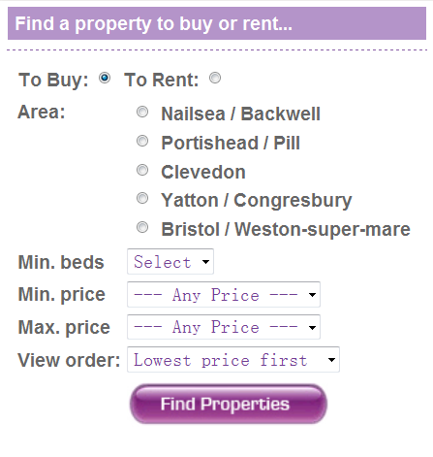
Web Form Understanding with OPAL
Ontology-based Pattern Analysis with Logic
Recognizes and labels groups of fields + classifies them w.r.t. the domain ontology
Reasoning on structural & visual patterns + annotations
group(Es) :- similarFieldSequence(Es),
leastCommonAncestor(A,Es),
not hasAdditionalField(A,Es).
leastCommonAncestor(A,Es) :- commonAncestor(A,Es),
not ( child(C,A), commonAncestor(C,Es) ).
partOf(E,A) :- group(Es),
member(E,Es), leastCommonAncestor(A,Es).
Notes:
Bottom up process to
associate fields with text labels (e.g., Min.Beds with the field on its right),
group fields in segments by similarity (e.g., list of radio button in the midlde) and associate labels to segments (e.g., Area is label for the whole segment)
Uses text annotations on labels to Classify segments w.r.t. Real Estate ontology (e.g., the segment labelled Area is of type Location in our ontology, as the inner fields are annotated with locations by our gazetteers, etc.)
The heuristics to associate labels to fields are based on structural (e.g., siblings descendants) and visual observation (e.g., north west proximity)

Slide 20
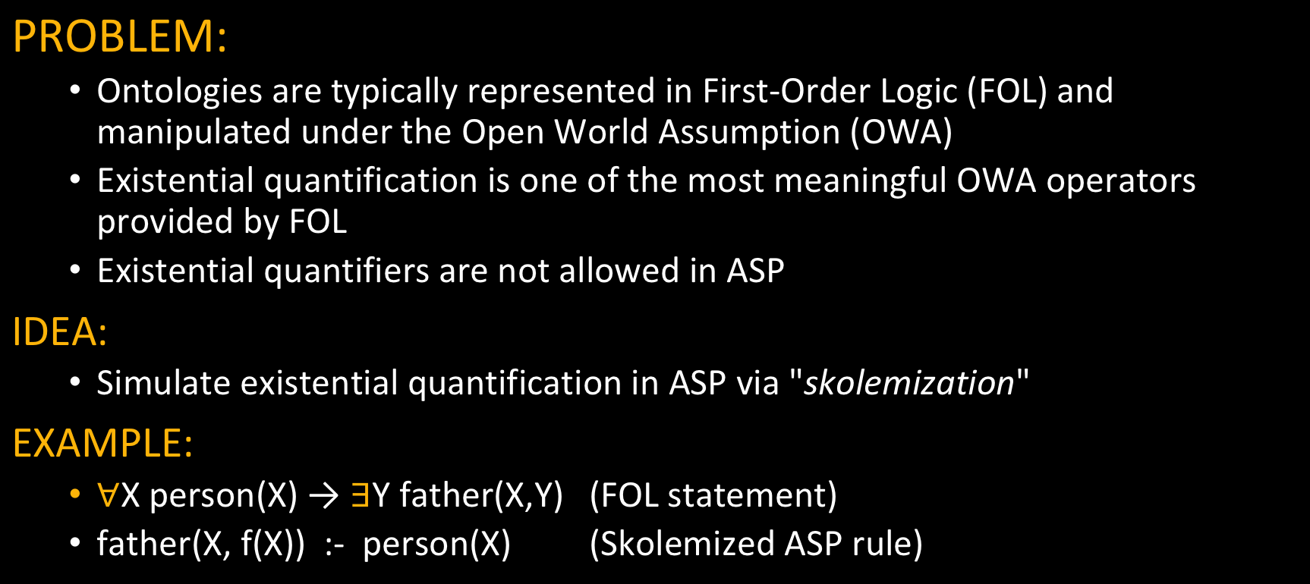
Ontology Representation and Reasoning
PROBLEM:
Ontologies are typically represented in First-Order Logic (FOL) and manipulated under the Open World Assumption (OWA)
Existential quantification is one of the most meaningful OWA operators provided by FOL
Existential quantifiers are not allowed in ASP
IDEA:
Simulate existential quantification in ASP via "skolemization"
EXAMPLE:
X person(X) → Y father(X,Y) (FOL statement)
father(X, f(X)) :- person(X) (Skolemized ASP rule)

Slide 21
Ontology Representation and Reasoning
Popular ontologies have been skolemized for reasoning with ASP:
Doctors (Geets et Al.): Medical data.
LUBM (Guo et Al.): University data.
STB-128 and ONT-256 (Arocena et Al.): Metadata for database integration.
Successfully used by (Benedikt et Al.) for benchmarking chase-based tools

Slide 22
Related Work
Classes of programs with computable answer sets:
[PTimeRecognizable]
ω -restricted [Syrianen et al. 2001]
λ-restricted [Gebser et al. 2007]
Finite-domain [Calimeri et al. 2008]
Safe [Greco et al. 2015]
Acyclic [Greco et al. 2015]
Argument-restricted [Lierler et al. 2009]
Notes:
Esempio.

Slide 23
Related Work
Classes of programs with computable answer sets:
[ExpTime Recognizable]
Bounded [Greco et al. 2013]
POLY-bounded [Zhang et al 2017]
Mapping-restricted [Calautti et al. 2017]
Rule-bounded [Calautti et al. 2014]
Size-restricted [Calautti et al. 2015]
For all these classes both ground and non-ground reasoning is decidable, and Answer Sets are computable.
Notes:
Esempio.

Slide 24
Related Work
Top-Down computable classes
FP2 Programs [Baselice and Bonatti, 2010]
Positive and Stratified Finitely Recursive Programs [Calimeri et al., 2009, Alviano et al., 2010]
Finitary Programs [Bonatti, 2002, 2004]
Classes with Finitely Representable Stable Models
FDNC Programs [Simkus and Eiter, 2007]
Bidirectional Programs [Eiter and Simkus, 2009]
Notes:
Esempio.

Slide 25
Related Work
Relation to Finitely Ground Programs:
FG ⊃ ω -restricted [Syrianen et al. 2001]
FG ⊃ λ-restricted [Gebser et al. 2007]
FG ⊃ Finite-domain [Calimeri et al. 2008]
FG ⊃ Safe [Greco et al. 2015]
FG ⊃ Acyclic [Greco et al. 2015]
FG ⊃ Argument-restricted [Lierler et al. 2009]
Notes:
Esempio.

Slide 26
Related Work
Relation to Finitely Ground Programs:
FG ⊃ Bounded [Greco et al. 2013]
FG ⊃ POLY-bounded [Zhang et al 2017]
FG ⊃ Mapping-restricted [Calautti et al. 2017]
FG ⊃ Rule-bounded [Calautti et al. 2014]
FG ⊃ Size-restricted [Calautti et al. 2015]
Notes:
Esempio.

Slide 27
Conclusion
A new notion of Computable Functions in ASP (Finitely Ground)
Powerful for Knowledge Representation and Reasoning
With desirable computational properties
An ASP System supporting functions and lists
Finitely Ground has become a standard notion for computable functions in ASP
The ASP System is profitably used in applications even at industrial level
Notes:
Esempio.

Slide 28
THANK YOU!

Slide 29
Related Work
Notable Decidable sub-classes of FG-programs in PTIME
ω -restricted [Syrianen et al. 2001]
λ-restricted [Gebser et al. 2007]
Finite-domain [Calimeri et al. 2008]
Safe [Greco et al. 2015]
Acyclic [Greco et al. 2015]
Argument-restricted [Lierler et al. 2009]
Notes:
Esempio.

Slide 30
Related Work
Known Relationships:
λ-restricted ⊃ ω-restricted
Finite-domain ⊃ ω-restricted
Safe ⊃ Finite-domain
Acyclic ⊃ Finite-domain
Arg-restricted ⊃ λ-restricted
Arg-restricted ⊃ Finite-domain
Notes:
Esempio.

Slide 31
Related Work
NOTA PER NICOLA: nel TPLP del 2015, in cui definiscono acyclic e safe, scrivono a chiare lettere che gli acyclic estendono di arg-restricted, mantenendo PTIME. Nel piu’ recente TOCL, in cui parlano dei mapping-restricted, fanno un mezzo riassunto dei related work ma si rimangiano la parola, indicando arg-restricted come i piu’ generali, ma soprattutto presentano acyclic e safe come estensioni dei Finite-Domain.
<<The class of safe programs (Greco et al. 2012b; Calautti et al. 2015c) is an extension of the class of finite domain programs>>
<< […] the class of finite domain programs. A further generalization of this class is the following. Acyclic programs […]>>
<<The classes of argument-restricted, bounded, and rule-bounded programs, being the more general ones proposed so far […]>>
Infatti nel TOCL si confronta poi con arg-restricted, non con le classi che nel TPLP indicava come piu’ grandi di ARG-restricted.
In queste slide facciamo riferimento alla versione del TOCL, in accordo alla quale potremmo concludere la slide precedente conl’affermazione: << Arg-restricted programs is the largest known sub-class of FG decidable in PTIME >> -- al momento questa frase l’abbiamo rimossa.
Notes:
Esempio.

Slide 32
Related Work
Decidable sub-classes extending Argument-restricted
Bounded [Greco et al. 2013] (EXPTIME)
POLY-bounded [Zhang et al 2017] (EXPTIME)
Mapping-restricted [Calautti et al. 2017] (EXPTIME)
Decidable sub-classes incomparable with Argument-restricted
Rule-bounded [Calautti et al. 2014] (NP)
Size-restricted [Calautti et al. 2015] (NP)
For all such subclasses (PTIME and others) both ground and non-ground reasoning is decidable, and Answer Sets are computable.
Notes:
Esempio.

Slide 33
Related Work
Known Relationships:
Size-restricted ⊃ Rule-bounded
Size-restricted ∦ Bounded
Rule-Bounded ∦ Mapping-restricted
Bounded ∦ Mapping-restricted
Bounded ∦ Rule-bounded
POLY-bounded ⊃ Bounded
POLY-bounded ⊃ Size-restricted
Notes:
Esempio.

Slide 34
NOTA PER NICOLA: Related Work
[NOTA per NICOLA: ci sono tante classi che costano piu’ di PTIME ed estendono argument-restricted; non c’e’ una gerarchia chiara, anche i recenti POLY-bounded di Zhang sembrano essere piu’ generali, dato che estendono due classi etrambe piu’ grandi di AR che sono incomparabili tra loro]. Non c’e’ una proof sulla relazione tra i due piu’ recenti, che sono Mapping restricted di greco et al. E questi POLY-bounded di Zhang]
Notes:
Esempio.

Slide 35
Related Work: other approaches
Top-Down computable classes
FP2 Programs [Baselice and Bonatti, 2010]
Positive and Stratified Finitely Recursive Programs [Calimeri et al., 2009, Alviano et al., 2010]
Finitary Programs [Bonatti, 2002, 2004] – «dual» notion of FG (for top-down), allow to represent all computable functions
Classes with Finitely Representable Stable Models
FDNC Programs [Simkus and Eiter, 2007]
Bidirectional Programs [Eiter and Simkus, 2009]
Notes:
Esempio.

Slide 36
Related Work: other approaches
Finitary ⊃ FP2
Finitary ∦ (positive and stratified) finitely recursive
FDNC and bidirectional programs:
guarantee a finite representation of Answer Sets
do not allow to represent all recursive relations, making them less expressive than FG.
Class | Ground Reasoning | Non-ground Reasoning | Class Membership
FP2 | decid. | uncomp. | decid.
Pos. Finitely Rec. | decid. | uncomp. | semi-decid.
Strat. Finitely Rec. | decid. | uncomp. | semi-decid.
Finitary | decid.* | uncomp. | undecid.
FDNC | decid. | comp. | decid.
Bidirectional | decid. | comp. | decid.
⋆ If odd cycles and head cycles are provided as input.
Notes:
Esempio.

Slide 37
Functions in DLV
Functions are Implemented in DLV: it fully supports both Finitely Ground Programs and Finite Domain programs. Actually, DLV is able to recognize Argument Restricted (AR) programs, which is a super-class of FD. AR programs require a more involved and less intuitive syntactic check to be recognized.
If a program P is finitely ground, then DLV instantiator terminates over P, generating its correct instantiation. By default, DLV checks the input program P: if it belongs to the class of AR programs, then DLV guarantees termination. If not, DLV returns an error.
The user must take over the responsibility about the program being finitely ground in order to run non-AR programs. With option –nofinitecheck, DLV skips the finite domain check. The instantiation will then terminates if the program is FG.
DLV2 & I-DLV+WASP currently do not apply any syntactical check, so the responsibility is left to the user.

Slide 38
Lists in DLV
Very common data structure
Easily obtained via function symbols
However, due to the usefulness
explicit syntax is supported
Dedicated built-ins are available

Slide 39
Lists in DLV
A list is a binary function denoted with a special syntax:
[ H | T ]
where the first argument «H» is a term, called the head of the list, and the second argument «T» is a list.
In addition, a list can be represented by explicitly listing its elements.
[ a, b, c ] = [ a | [ b, c ] ] = [ a | [ b | [ c ] ] ]
= [ a | [ b | [ c | [ ] ] ] ]

Slide 40
Lists in DLV
LIST TERMS
A list term can be of the two forms:
− [ t1, . . . , tn ], where t1, . . . , tn are terms;
− [ h | t ], where h (the head of the list) is a term, and t (the tail of the list) is a list term.
Examples:
The term [ a,d,a ] in the atom palindromic([a,d,a])
[ jan,feb,mar ]
[jan | [ feb,mar,apr,may,jun ] ]
[ [jan,31] | [ [ feb,28 ], [ mar,31 ], [ apr,30 ], [ may,31], [ jun,30 ] ] ].

Slide 41
Built-in predicates for Lists
I-DLV (and DLV2) comes with a rich library of built-in predicates for list manipulation.
A built-in atom is of the form
&p(t₀,.., t_{n} ; u₀,…, u_{m})
where n,m >= 0
t₀,.., t_{n} are input terms, and are separated from the output terms u₀,…, u_{m} by a semicolon (“;”);
an input/output term can be either a constant or a variable.
Intuitively, output terms are computed on the basis of the input ones, according to a semantics which is defined “a priori” for each predicate, as reported next.

Slide 42
Built-in predicates for Lists

Slide 43
Lists: example
Compute all simple (i.e. with no repeated vertices) paths in a graph:
simplePath([X|[Y]]) :- edge(X,Y).
simplePath([X|[Y|W]]) :- edge(X,Y), simplePath([Y|W]),
not &member(X,[Y|W];).
Compute all simple cycles in a graph:
simpleCycle([X]) :- edge(X,X).
simpleCycle([X|L]) :- simplePath([X|L]), &last(L;Y), edge(Y,X).
Compute simple paths of maximum length:
maxPath(P) :- simplePath(P), &length(P;L),
L = #max { X : simplePath(Q), &length(Q;X) }.

Slide 44
LISTS: Applications
Lists can easily represent trees:
[root| List-of-subtrees]
Leaf node: [a|[]] = [a]
[a | [ [b], [c | [ d ] ] ] ]
- the list rooted in a
- b and c are the children of a
- d is a child of c
- b and d are leaves
List can therefore represent the HTML trees of web pages

Slide 45
DIADEM ERC Advanced Grant @Oxford - G. Gottlob
Domain-centric, Intelligent, Automated Data Extraction
fully automated extraction from domain-specific websites
no per site training, no user input other than the domain model
main target: websites with structured records
based on extensive domain knowledge
web form understanding
result page analysis (records, attributes)
navigation blocks classification (next page link, detail pages)
Template language on Datalog^{¬,Agg} rules compiled to DLV, plus Gazetteers, GATE annotation&regex, ML classifiers

Slide 46
Web Form Understanding with OPAL
Ontology-based Pattern Analysis with Logic
Recognizes and labels groups of fields + classifies them w.r.t. the domain ontology
Reasoning on structural & visual patterns + annotations
group(Es) :- similarFieldSequence(Es),
leastCommonAncestor(A,Es),
not hasAdditionalField(A,Es).
leastCommonAncestor(A,Es) :- commonAncestor(A,Es),
not ( child(C,A), commonAncestor(C,Es) ).
partOf(E,A) :- group(Es),
member(E,Es), leastCommonAncestor(A,Es).
Notes:
Bottom up process to
associate fields with text labels (e.g., Min.Beds with the field on its right),
group fields in segments by similarity (e.g., list of radio button in the midlde) and associate labels to segments (e.g., Area is label for the whole segment)
Uses text annotations on labels to Classify segments w.r.t. Real Estate ontology (e.g., the segment labelled Area is of type Location in our ontology, as the inner fields are annotated with locations by our gazetteers, etc.)
The heuristics to associate labels to fields are based on structural (e.g., siblings descendants) and visual observation (e.g., north west proximity)

Slide 47
Result Page Analyses with AMBER
Adaptable Model Based Extraction of Result Pages
Reasoning on annotations and page structure to identify records & attributes
price
location
consistent_cluster_members(C, N1, N2, N3) :- pivot(N1), pivot(N2), ...
similar_depth(N1, N2), similar_depth(N2, N3), similar_depth(N1,N3),
similar_tree_distance(N1, N2, N3).
Notes:
We cluster the page into (possibly multiple) data areas (zones of the page containing records, only one in the picture).
To drive the clustering, we observe that each record must have an annotation that is mandatory for the domain, for instance price. Thereby, we cut out a lot of noise. Clusters have different properties we
Force with rules (e.g., similar depth, consistent distance among price nodes, continuous i.e., no gaps between them).
Once we have the clusters, for each we identify its records segmenting repetive structures (e.g., sequences of nodes with same tags). We don’t guess and check but rather we use again knowledge from the domain to narrow the search and break ties.
The attributes are then assign by relaying on the annotations.

Slide 48
Applications: Ontology Representation and Reasoning
PROBLEM:
Ontologies are typically represented in First-Order Logic (FOL) and manipulated under the Open World Assumption (OWA)
Existential quantification is one of the most meaningful OWA operators provided by FOL
Existential quantifiers are not allowed in ASP
IDEA:
Simulate existential quantification in ASP via "skolemization"
EXAMPLE:
X person(X) → Y father(X,Y) (FOL statement)
father(X, f(X)) :- person(X) (Skolemized ASP rule)

Slide 49
DLV-complex evolution: implementation details
Functional terms handling in DLV has been totally re-engineered in the last few years:
In a preliminary implementation of DLV-complex, functional terms were represented and manipulated as string constants
In the latest version of DLV, functions are natively supported as a new kind of terms
Significant performance improvements are shown by the results of a preliminary experimental analysis we carried out

Slide 50
DLV-complex evolution: some experimental results
We compared the first version of DLV-complex against the latest version of DLV over some popular skolemized ontologies used by (Benedikt et Al.) for benchmarking chase-based tools
Tested scenarios:
Doctors (Geets et Al.): this ontology is based on schemas inspired by real databases about medical data and aims at simulating a common use case for data exchange, i.e. take two databases from the same domain but with different schemas and bring them to a unified target representation.
LUBM (Guo et Al.): this is a popular benchmark domain in the Semantic Web community.
STB-128 and ONT-256 (Arocena et Al.): these are two existing sets (Arocena et Al., Section 5) of dependencies (TGDs, primary keys, foreign keys) produced via iBench, a well-established tool for generating integration metadata that is widely used in the database community

Slide 51
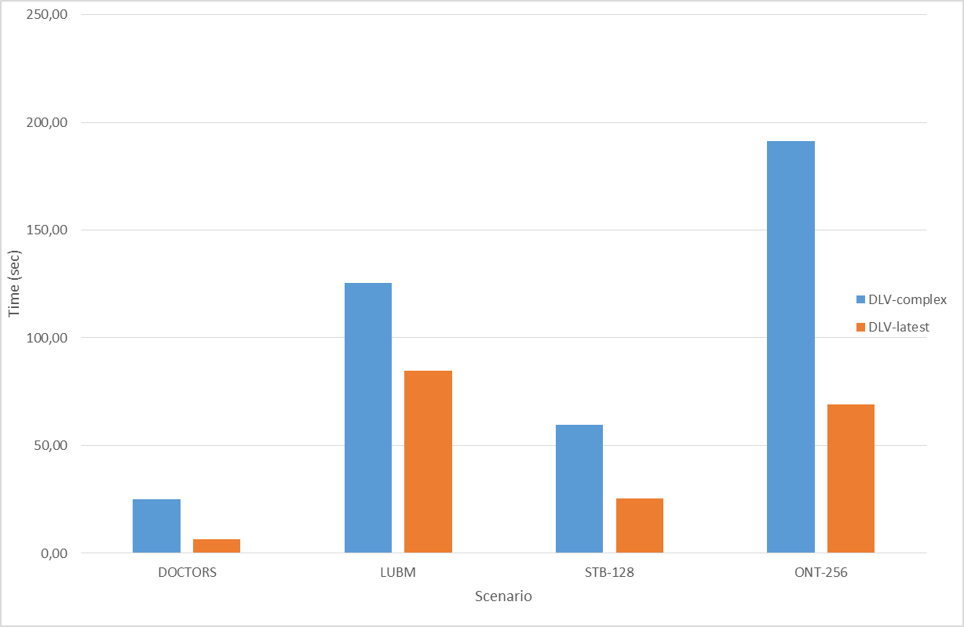
DLV-complex evolution: some experimental results
 | DLV-complex | DLV-latest
DOCTORS
10k | 0,50 | 0,24
100k | 4,40 | 1,62
500k | 24,95 | 8,00
1m | 49,91 | 16,16
LUBM
21 univ. | 63,55 | 25,19
34 univ. | 105,58 | 40,99
55 univ. | 172,90 | 68,65
89 univ. | 285,34 | 109,28
144 univ. | 0,10 | 178,96
STB-128
Instance 1 | 59,68 | 25,34
ONT-256
Instance 1 | 191,38 | 68,99
Average | 86,85 | 45,49
Table: Overall running times in seconds
Figure: Average running times in seconds

Slide 52
Thanks!
Question time

