Slide 1

Computable functions in ASP Theory and implementation
Nicola Leone
Department of Mathematics and Computer Science (DeMaCS)
University of Calabria, Italy
leone@unical.it

Slide 2
Reference Scenario
P = a DLP* program:
Nonground, Disjunctive logic program under Answer Set semantics
AS(P) = The set of answer sets of P
Functional terms are explicitly allowed
p(s(X)) :- a(X, h(Z)).
We focus on programs with safe rules
equal(X,X).
p(X,Y) :- q(X).
Not allowed

Slide 3
Functions?
We are talking of functions and functional terms in the traditional logic programming sense:
father(gibbi) → father(gibbi)
sqr(3) → sqr(3)
[a,b,c] → list(a,list(b,c))
Recursive Function symbols → Undecidability
Horn Logic Programming is R.E.-complete (Tarnlünd 1977)
Goal: treat function symbols in ASP

Slide 4
Grounding basics
P → Grounder → grnd(P) → Model Generator/Checker → AS(P)
a(1). a(2). b(2,1).
R : p(X) v r(X) :- a(X), b(X,Y).
grnd(P) = { p(2) v r(2) :- a(2), b(2,1), …
p(1) v r(1) :- a(1), b(1,2) }
inst_{R}({a(1), a(2), b(2,1)}) = { p(2) v r(2) :- a(2), b(2,1) }
Active Facts + Rules

Slide 5
Grounding in the presence of function symbols
r(1). r(2).
r(f(X)) :- r(X), not a(X).
inst_{P} ( {r(1), r(2)} ) =
{ r(f(1)) :- r(1), not a(1)
r(f(2)) :- r(2), not a(2),
r(1), r(2) }
Γ_{P}(R) = inst_{P}(Heads(R))
Γ_{P}∞(Ø) might diverge
(reflecting the fact that infinite atoms depend from r(1) and r(2) )

Slide 6
Several attempts exist:
Top-Down:
Prolog:
SLD Termination analysis (A. Bossi and many others)
ASP:
Finitary programs (P. Bonatti et al.), FDNC programs (T. Eiter et al.)
Bottom-up:
Datalog with infinite relations (Ramakrishnan et al., others), Datalog with Value invention (Hull, Cabibbo, others), omega-restricted programs (Syrjänen)
Idea: introduce a “bottom-up” based class of programs. But none of the above directly applies.

Slide 7
Idea:
Consider the class of programs for which:
Γ_{P}∞(Ø) is finite (and computable)
Theorem:
Γ_{P}∞(Ø) constitutes a finite ground program for which it holds
AS(P) = AS(Γ_{P}∞(Ø))
Theorem:
Deciding if Γ_{P}∞(Ø) is finite is R.E.-Complete

Slide 8
But
We can do better:
There are other classes of programs for which an equivalent, finite, ground program exists:
path([X | Y]) :- edge(X,Y).
path([X | [Y | W]]) :- edge(X,Y), path([Y|W]),
not member(X, [Y|W]).
Γ_{P}∞(Ø) diverges, but AS(P) is computable

Slide 9
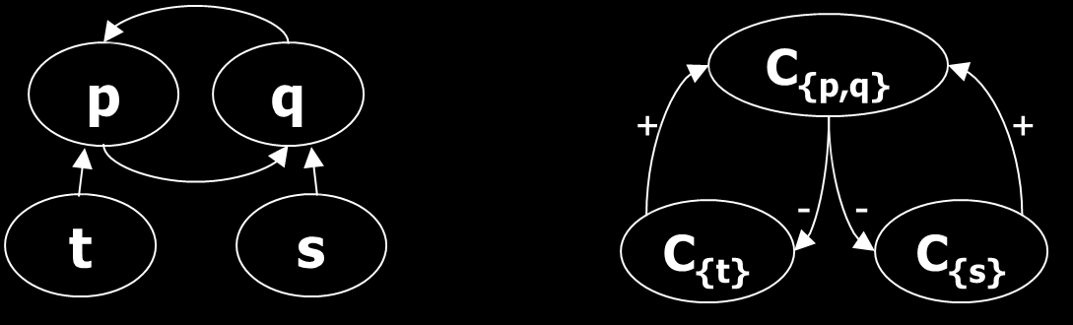
Program Components
a → EDB predicate q(X) :- s(X), p(Y,X).
q(g(3)). p(X,Y) :- q(g(X)), t(f(Y)).
s(X) v t(f(X)) :- a(X), not q(X).
(Positive) Dependency graph Component graph

Slide 10
A refined operator
Φ_{M,R}(X) = Simpl(Inst_{M}(Heads(R U X))
Simplification and Modularization

Slide 11
Intelligent Instantiation
p(f(X)) : - p(X), not q(X). p(1). q(f(1)).
Φ⁰_{{p},{q(f(1))}}(∅) = {p(1)}
Φ¹_{{p},{q(f(1))}}({p(1)}) = {
p(1),
p(f(1)) :- p(1)
}
, not q(1)
Φ²_{{p},{q(f(1))}}({p(1), p(f(1)) :- p(1)}) = {
p(1),
p(f(1)) :- p(1)
,
p(f(f(1))) :- p(f(1)), not q(f(1))
}
Notes:
Esempio di grafo dei moduli con esempio..

Slide 12
Finitely-ground programs
Given a partition <C₁, …, C_{n}> of predicates of P, P is finitely-ground iff the last element P^{γ} = S_{n} of the sequence
S_{i}= S_{i-1} U Φ_{Mi,Si-1}(X) ( S₀ = EDB(P) )
converges to a finite ground program.
M_{i} ≈ the module defining predicates in C_{i}
Theorem: AS(P) = AS(P^{γ}) (for any γ)

Slide 13
fg-programs: pros & cons
Pros:
A very expressive class: fg-programs correspond to terminating computations of Turing Machines:
Theorem: Any recursive function can be “expressed” by fg-programs.
Fg-programs have a finite set of finite answer sets
Cons:
Semidecidable: might be undesirable in certain applications… fd-programs fit better.

Slide 14
FD-programs
A simple, decidable subclass of fg-programs
All the arguments of P must be finite-domain.
Given the graph of arguments of P, any argument q[k] must be such that if q(…,t,…) appears in a head, either:
t is variable free ( q(…, f(a,g(b)),…) is OK. ), or
t is subterm of another fd-argument appearing in the body
(q(…, X,…)) :- q(f(X), … ) is OK if q[1] is fd), or
t appears in some body arguments which is not recursive with q[k]
(q(…, X,…)) :- p(f(X), … ) is OK if p[1] is not recursive with q[k]
Notes:
Esempio.

Slide 15
FD-programs
FD-program:
q(f(0)).
q(X) :- q(f(X)).
Non FD-program:
q(f(0)).
q(X) :- q(f(X)).
s(f(X)) :- s(X). → s[1] is not an FD
v(X) :- q(X), s(X). argument

Slide 16
FD-programs: pros & cons
Pros:
Much simpler static check than norm-based analysis
It subsumes other known static conditions, e.g. ω-restricted programs
E.g. p(X) :- p(f(X)) is fd but not ω-restricted
Cons:
Certain “meaningful” programs might fall outside the class. In such a case fg-programs fit better.

Slide 17
DLV-Complex
Extends former DLV-EX:
Features function symbols, lists, sets
Implements DLP*
Defaults to fd-programs.
Static check can be relaxed for having fg-programs (but the grounder might not terminate)
Available at
http://www.mat.unical.it/dlv-complex

Slide 18
Some insights
Available language in DLV-complex:
Rules of form
A₁ v … v A_{n} :- B₁, … , B_{n}, not C₁, …, not C_{n}
A_{i},B_{i},C_{i} are literals allowing true negation and functional, list and set complex terms
p(X,f(a)), p({c,d}, [r|T]) , ...
B_{i}, C_{i} can be custom library predicates
#ext(a,b) → an infinite external relation

Slide 19
Some insights (2)
Function symbols implemented using the DLV-EX framework [Calimeri et al. 2007, 2005]:
p(f(X)) :- a(X) → p(S) :- a(X), #function_pack(S,f,X)
Several libraries of list and set manipulation predicates available:
Fast: do not resort to logic programming
#Subset, #Member, #Intersection, #Union, #Card, #Insertion...
#Head, #Last, #DelAll,, #Append, #Member, #Length, #Reverse, #Sublist...

Slide 20
Related Work
Finitary programs
Dual approach
p(f(X)) :- p(X) Finitary
p(X) :- p(f(X)) Finitely ground
Finitary → “top-down” safety
p(X) :- a(X,Y).
Finitely ground → “bottom-up” safety
e(X,X).
P(X,Y) :- a(Y).
Disallowed
Disallowed

Slide 21
Related Work (2)
ω-restricted programs
ω-stratification: unstratified components belong to the single, uppermost ω layer
All head variables must be bound to a positive atom belonging to a previous layer
Much more restricted than fd-programs
Others
SLD termination, Value invention

Slide 22
What the reviewers said..
How fast it goes?
“Hope my Hanoi towers runs faster”
A new programming style is in principle possible
Notes:
It would be a good idea to mention work [A]
“Don’t even dare to think that I authored [A]”
You could add more examples
“.. It’s worth mentioning that [A] is plenty of examples..”

Slide 23
Conclusions
Possible developments:
Extend the range of fd-programs
Investigate the relationship of finitary programs with magic sets
Conjecture: magic(P) is fg, if P is finitary(*)
Above conjecture proven for some fragments
Prototype available at
http://www.mat.unical.it/dlv-complex

Slide 24

Applications: Ontology Representation and Reasoning
PROBLEM:
Ontologies are typically represented in First-Order Logic (FOL) and manipulated under the Open World Assumption (OWA)
Existential quantification is one of the most meaningful OWA operators provided by FOL
Existential quantifiers are not allowed in DLP
IDEA:
Simulate existential quantification in DLP via "skolemization"
EXAMPLE:
$∀$X person(X) → $∃$Y father(X,Y) (FOL statement)
father(X,f_{r,2}(X)) :- person(X) (Skolemized DLP rule)

Slide 25
DLV-complex evolution: implementation details
Functional terms handling in DLV has been totally re-engineered in the last few years:
In a preliminary implementation of DLV-complex, functional terms were represented and manipulated as string constants
In the latest version of DLV, functions are natively supported as a new kind of terms
Significant performance improvements are shown by the results of a preliminary experimental analysis we carried out

Slide 26
DLV-complex evolution: some experimental results
We compared the first version of DLV-complex against the latest version of DLV over some popular skolemized ontologies used by (Benedikt et Al.) for benchmarking chase-based tools
Tested scenarios:
Doctors (Geets et Al.): this ontology is based on schemas inspired by real databases about medical data and aims at simulating a common use case for data exchange, i.e. take two databases from the same domain but with different schemas and bring them to a unified target representation.
LUBM (Guo et Al.): this is a popular benchmark domain in the Semantic Web community.
STB-128 and ONT-256 (Arocena et Al.): these are two existing sets (Arocena et Al., Section 5) of dependencies (TGDs, primary keys, foreign keys) produced via iBench, a well-established tool for generating integration metadata that is widely used in the database community

Slide 27
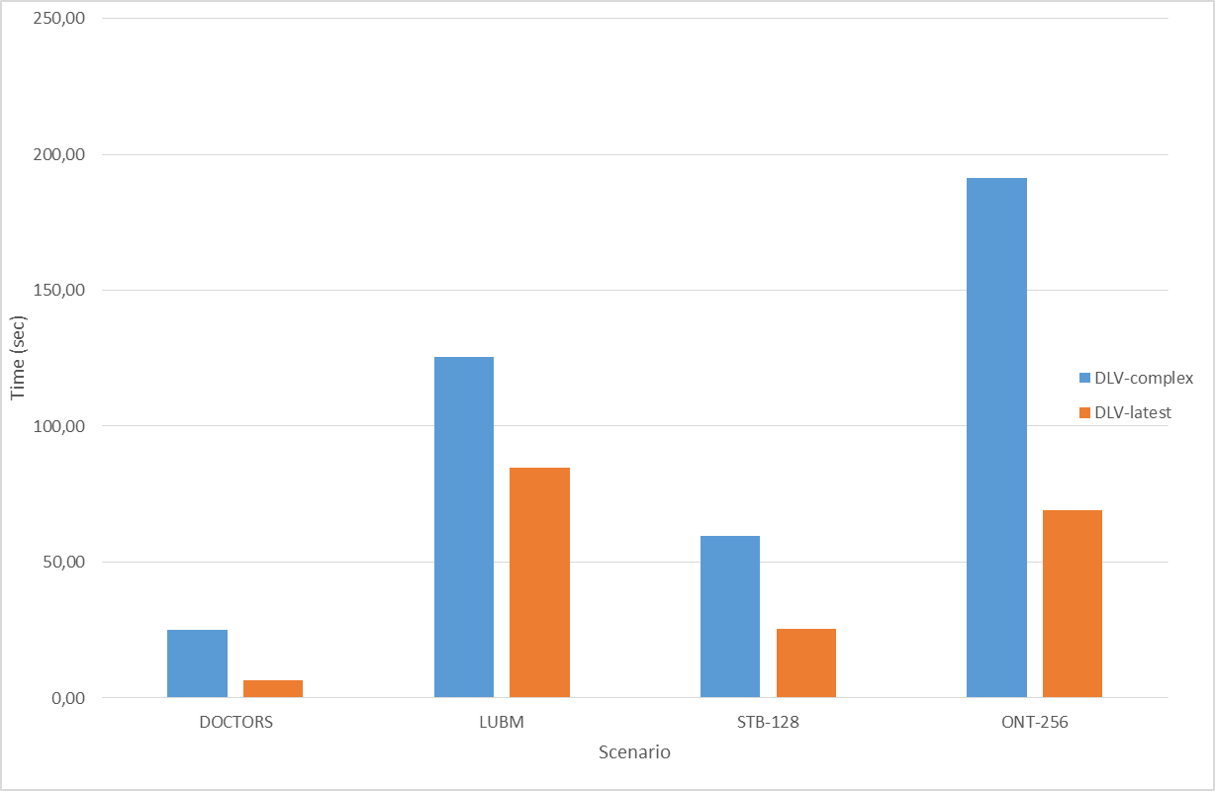
DLV-complex evolution: some experimental results
 | DLV-complex | DLV-latest
DOCTORS
10k | 0,50 | 0,24
100k | 4,40 | 1,62
500k | 24,95 | 8,00
1m | 49,91 | 16,16
LUBM
21 univ. | 63,55 | 25,19
34 univ. | 105,58 | 40,99
55 univ. | 172,90 | 68,65
89 univ. | 285,34 | 109,28
144 univ. | 0,10 | 178,96
STB-128
Instance 1 | 59,68 | 25,34
ONT-256
Instance 1 | 191,38 | 68,99
Average | 86,85 | 45,49
Table: Overall running times in seconds
Figure: Average running times in seconds

Slide 28
Thanks!
Question time

