Slide 1
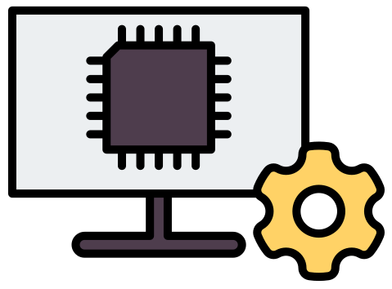
Basics of Power
Supply Unit

Slide 2
What is a Power Supply Unit (PSU)?
A Power Supply Unit (PSU) is an electronic device that provides the electrical power needed by a computer and its components.
The PSU converts the AC electrical power from the wall outlet into the DC voltages required by computer components, such as the motherboard, processor, storage devices, fans, and other hardware.

Slide 3
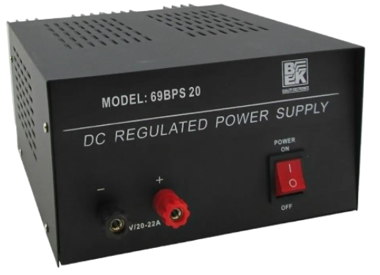
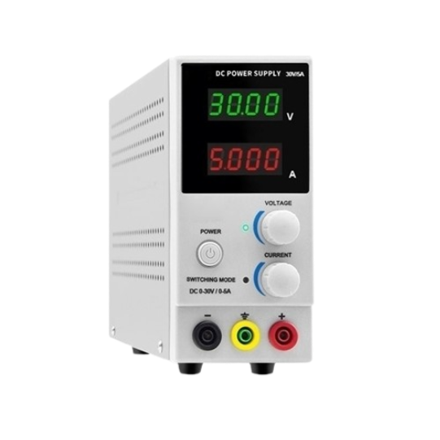
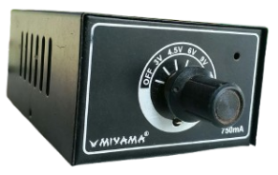
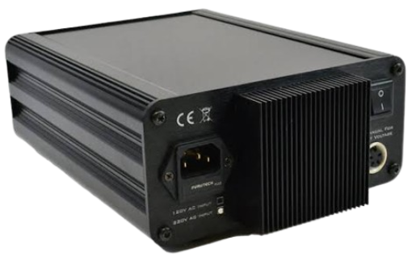
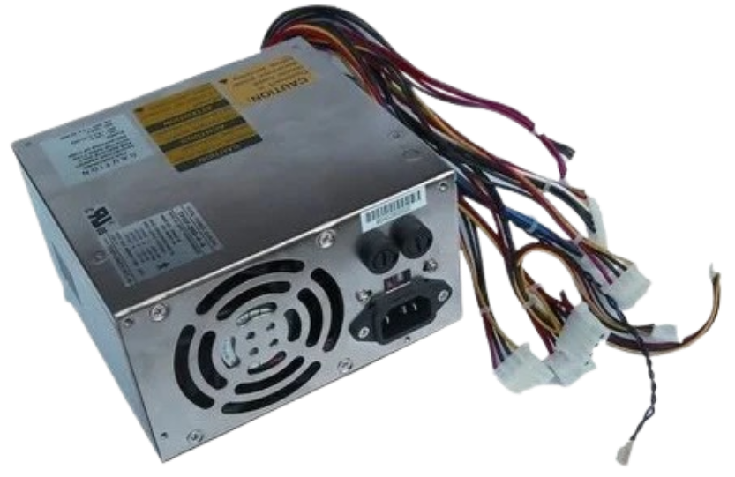
Types of Power Supply Unit
Type | Description | Example | Image
Fixed Power Supply | Provides a constant, predetermined output voltage that cannot normally be adjusted by the user. | 5 V DC, 9 V DC, or 12 V DC power supply
Variable/ Adjustable Power Supply | Allows the user to adjust the output voltage within a certain range. | 0–12 V DC adjustable power supply
Selectable-Voltage Power Supply | Provides several preset voltage levels that can be selected using a rotary switch or selector. | 3 V, 4.5 V, 6 V, 9 V, and 12 V
Linear Power Supply | Uses a linear voltage regulator to maintain a stable DC output voltage. | Traditional regulated bench power supply
Switching Power Supply (SMPS) | Uses high-frequency electronic switching to efficiently convert electrical power into the required output voltage. | Computer ATX PSU

Slide 4
AC to DC Power Conversion in a Power Supply Unit (PSU)
AC to DC conversion is one of the most important functions of a Power Supply Unit (PSU).
The electricity coming from the wall outlet is AC (Alternating Current), while most electronic circuits and computer components require DC (Direct Current).
Three Basic Processes in AC-to-DC Conversion
Rectification (AC to Pulsating DC)
A rectifier converts AC into pulsating DC. Diodes are used because they allow current to flow primarily in one direction.
  Main component: Diode - Perform the rectification
2. Filtering (Pulsating DC to Smoother DC)
After rectification, the DC still contains fluctuations called ripple. A filter reduces these fluctuations and produces a smoother DC voltage.
Main component: Capacitor - Stores and releases electrical energy to reduce ripple
3. Regulation – Smoother DC → Stable DC
Even after filtering, the voltage can still vary. A voltage regulator keeps the output voltage at the desired level.
Main component: Voltage Regulator IC - Maintains a relatively constant output voltage

Slide 5
Main Components of a Power Supply Unit (PSU)
Main Component / Section | Common Components Used | Main Function
Transformer | Transformer, ferrite core, primary and secondary windings | Changes the voltage level and provides isolation.
Rectifier | Diodes, bridge rectifier | Converts AC into pulsating DC.
Filter | Capacitors, inductors/chokes, resistors | Smooths DC and reduces ripple.
Switching Circuit | Power MOSFETs/transistors, resistors, capacitors | Switches power at high frequency for efficient power conversion.
Voltage Regulation Circuit | Voltage-reference IC/Zener diode, resistors, capacitors | Keeps the output voltage stable.
Cooling System | Cooling fan, heatsink | Removes heat and prevents overheating.

Slide 6
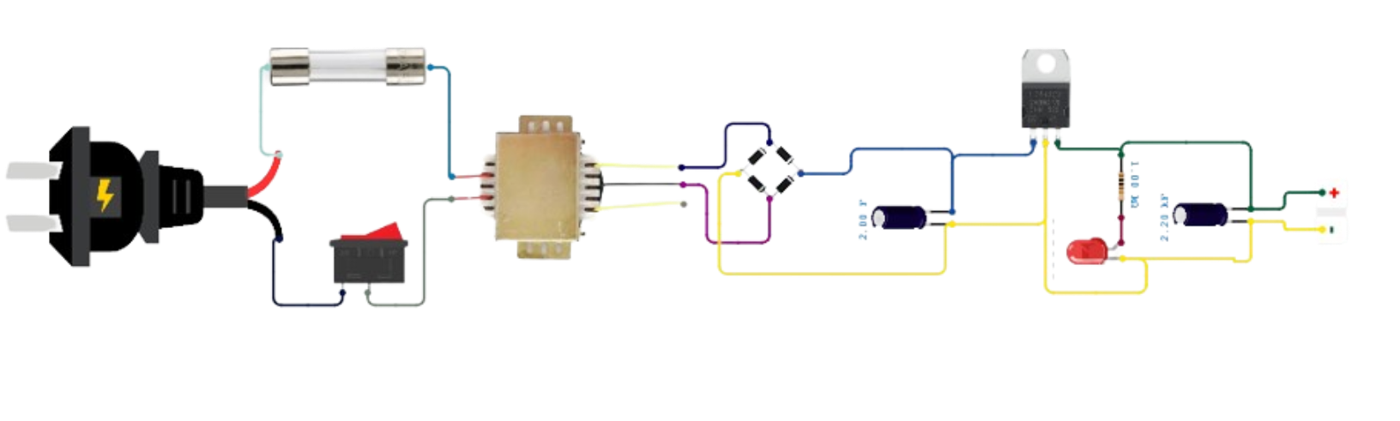
Basic Power Supply Assembly
12-0-12 V Step-Down Transformer
12V DC
220V AC

Slide 7
Role of Power Supply Units (PSUs) in IT Infrastructure
Converts Electrical Power - Converts the available AC power from the electrical outlet into the required DC voltages used by electronic components.
Regulates Voltage - Maintains the output voltage at a proper and stable level to prevent damage caused by excessive or insufficient voltage.
Protects Equipment - Helps protect electronic components from electrical problems such as overvoltage, overcurrent, short circuits, and overheating.
Supports Different Components - Provides different voltage levels required by various components, such as the CPU, motherboard, storage devices, fans, and other peripherals.

Slide 8
END OF WEEK 3 LESSON

