Slide 1
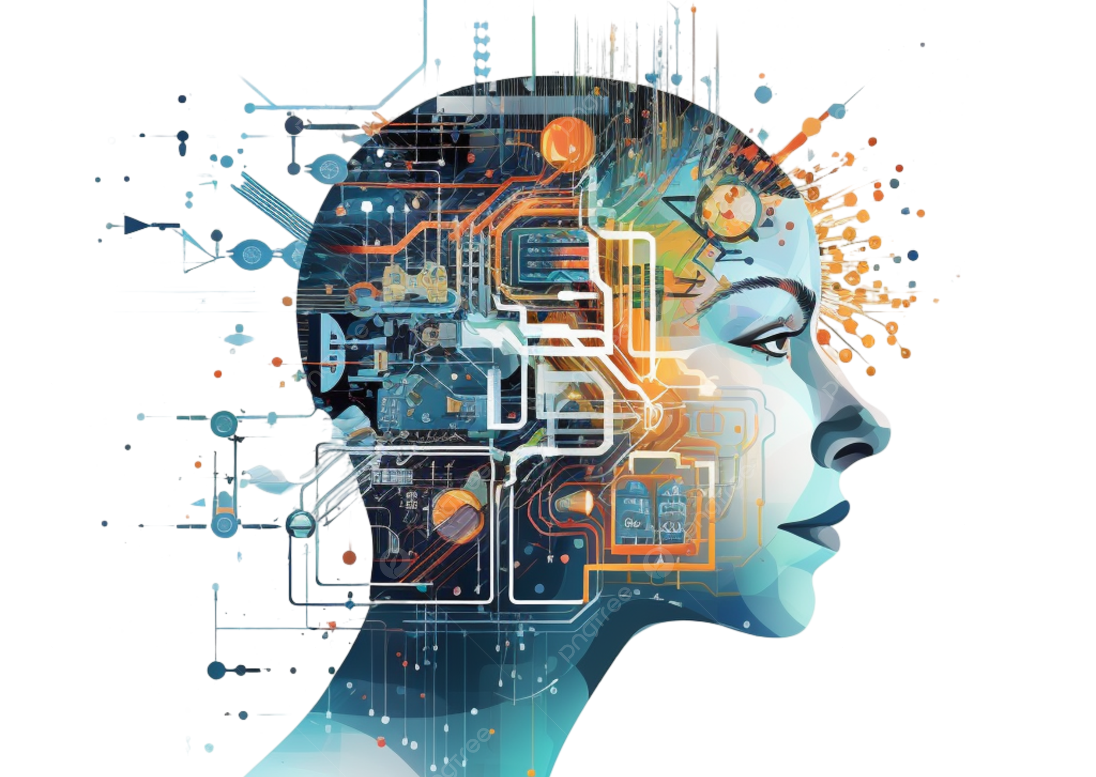
Machine
Learning

Slide 2
Machine
Learning

Slide 3
Machine Learning (ML) is a branch of Artificial Intelligence (AI) that enables computers to learn from data and make predictions or decisions without being explicitly programmed.
Machine
Learning

Slide 4

Models Used
K-Nearest Neighbors (KNN)
Decision Tree Classifier
Support Vector Machine (SVM)

Slide 5
K-Nearest Neighbors (KNN)
KNN is a simple, non-parametric algorithm used for classification and regression tasks.
It classifies data points based on their proximity to other labeled points.

Slide 6
Decision Tree Classifier
A decision tree is a flowchart-like structure used for decision-making.
It splits the data into subsets based on conditions on feature values.

Slide 7
Support Vector Machine (SVM)
SVM is a powerful algorithm used for classification and regression tasks.
It aims to find the hyperplane that best separates data points of different classes

Slide 8
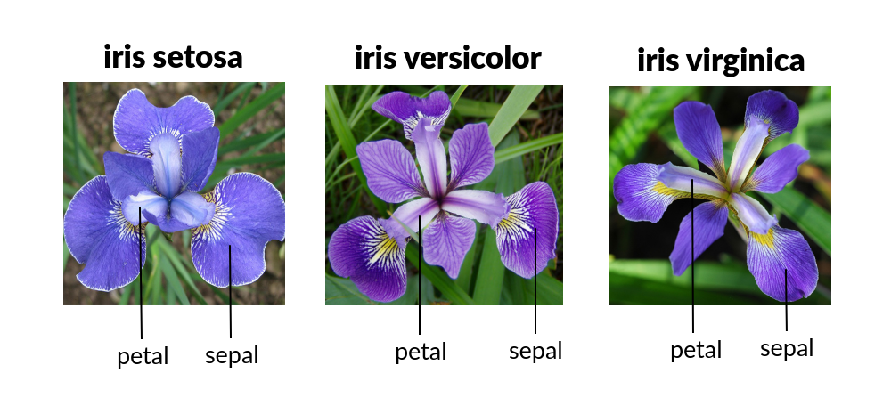
About Dataset

Slide 9
Overview and Insights
It contains 150 samples of iris flowers with the following features:
Sepal Length
Sepal Width
Petal Length
Petal Width
Class (Setosa, Versicolor, Virginica)

Slide 10
Let’s dive into VS Code to see the code in action!

Slide 11
Special Thanks to Dr. Alok Aggarwal

