Slide 1
Cloudant ToDo Example explained
Sebastian Moehn
IBM Cloud Data Services
Technical Sales Europe

Slide 2
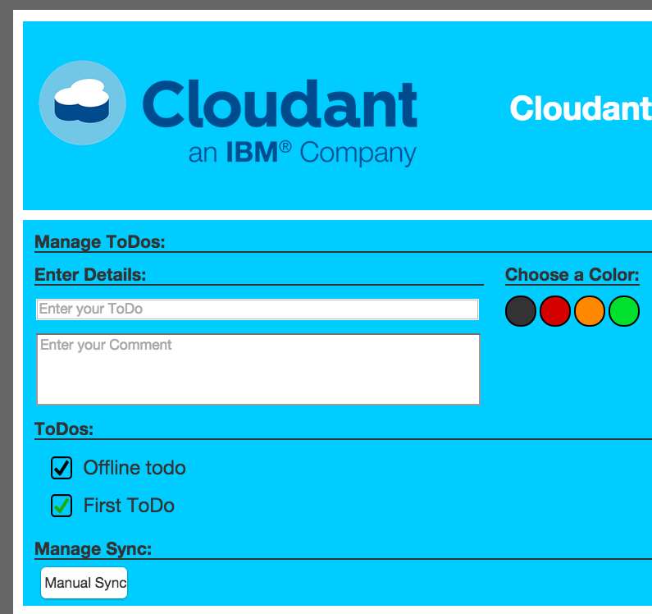
Demo: Offline ToDo List
Application Requirements:
App needs to work offline and online
App needs to work on any given device
Automated sync of new ToDos across devices and the cloud database
Included error handling and conflict resolution

Slide 3
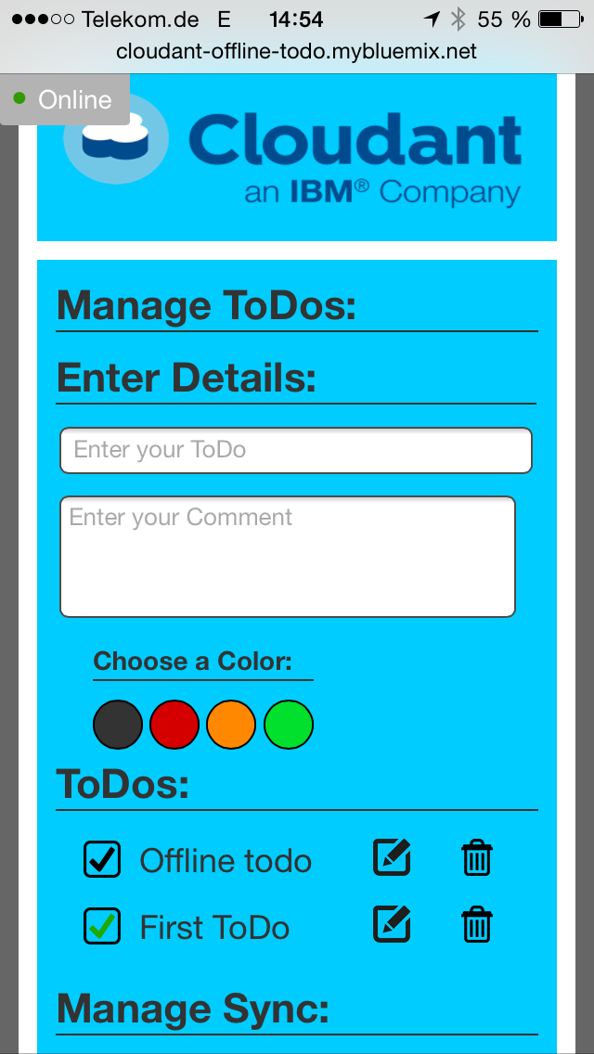
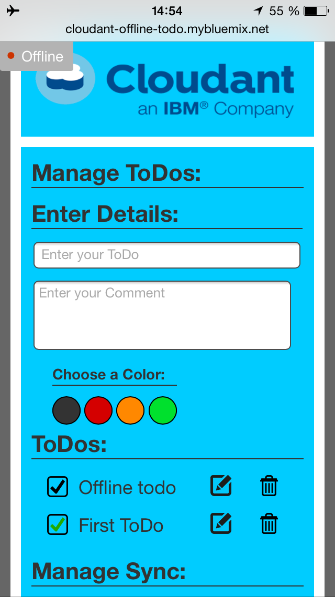
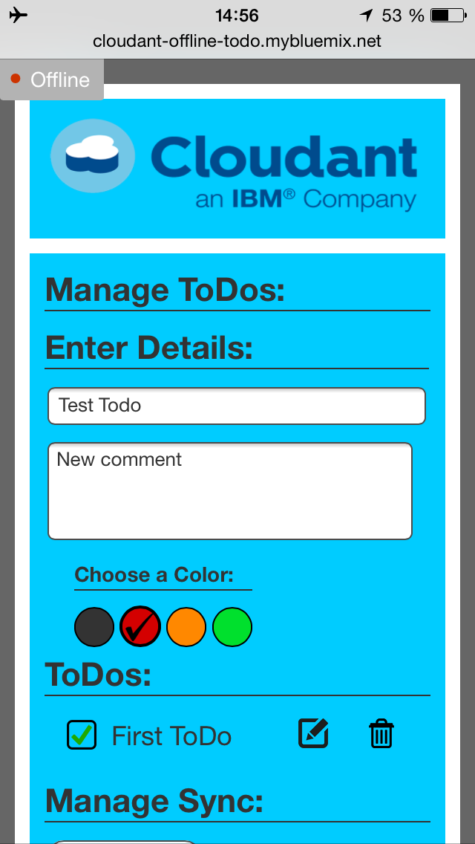
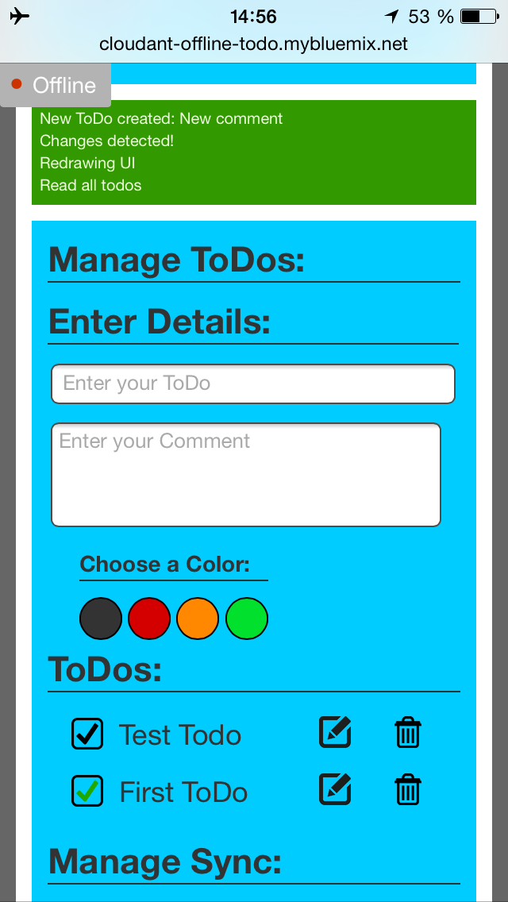
ToDo Offline Demo
… and sync them immediately when network is back!
Work with your ToDos online…
… make changes offline …
… and offline…

Slide 4
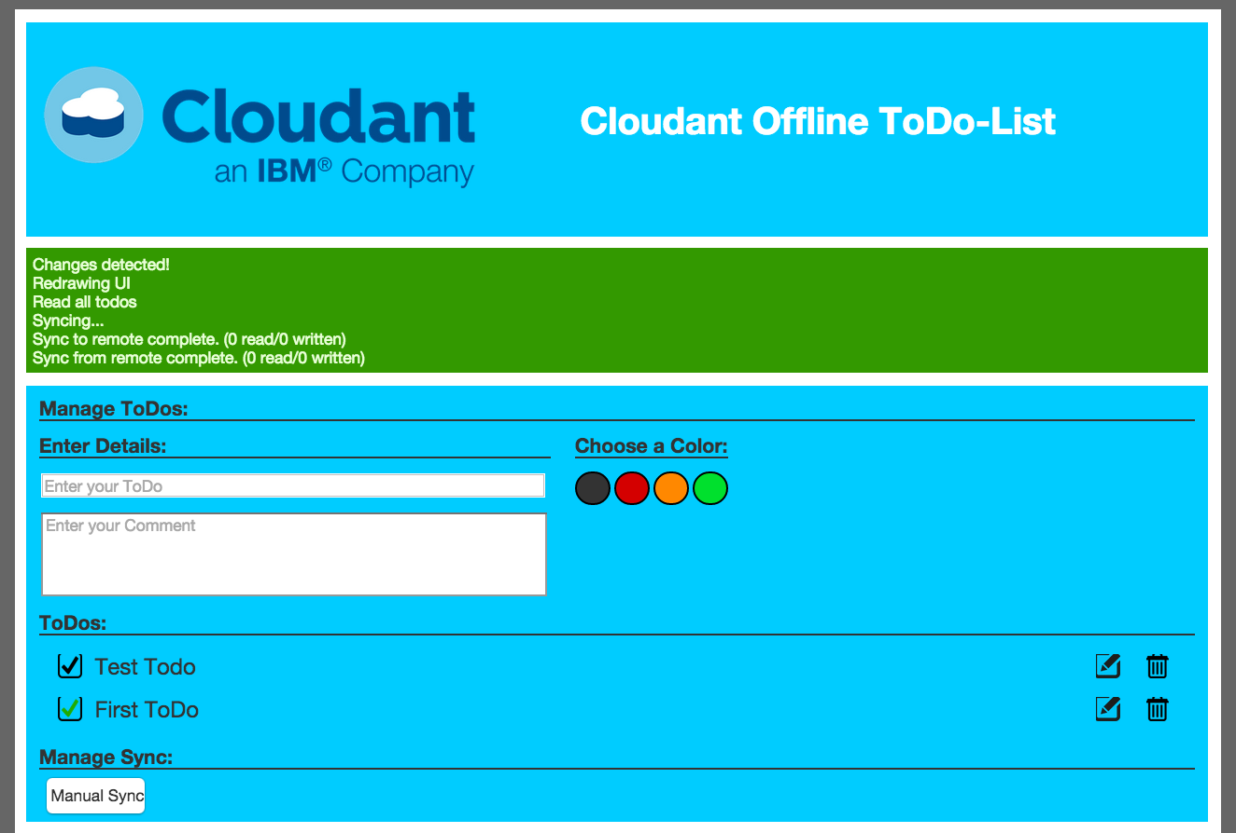
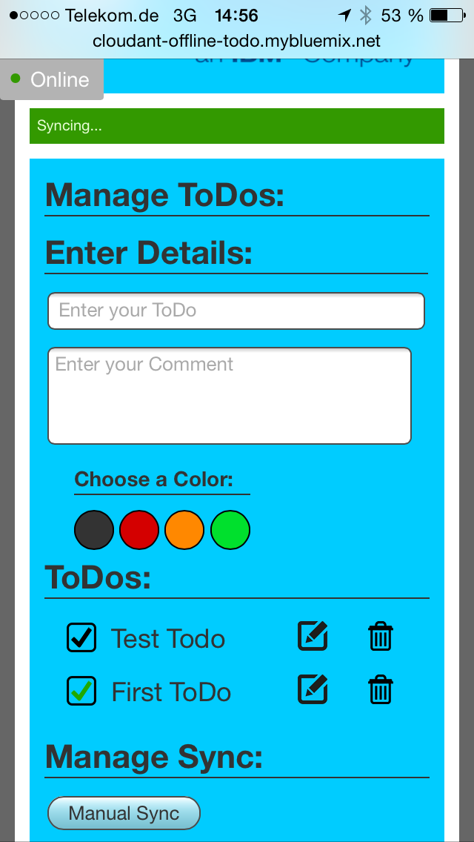
ToDo Offline Demo
Receive changes directly on every device as soon as they happen!
No need to write own Replication/Sync

Slide 5
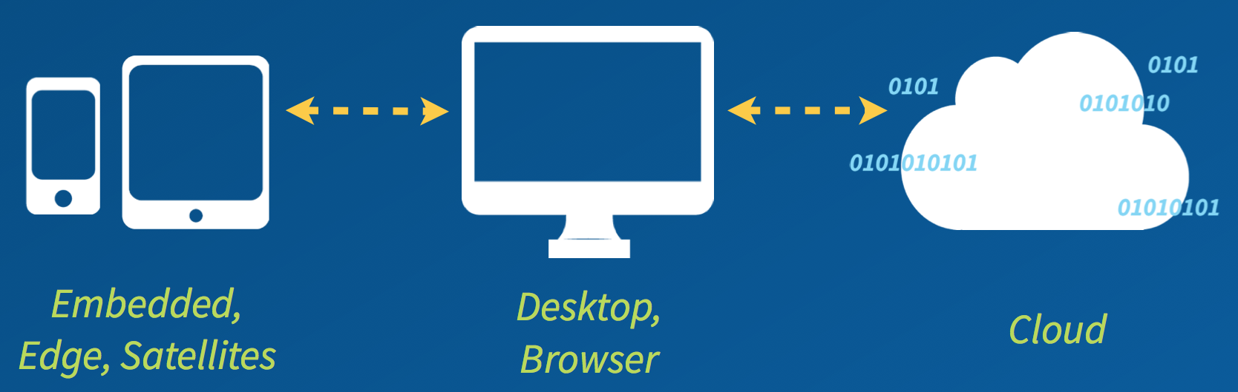
Functionality: Cloudant Save local, Sync later
Cloudant Sync (Android, iOS)
PouchDB
Cloudant Local
Couch DB
Cloudant DBaaS

Slide 6
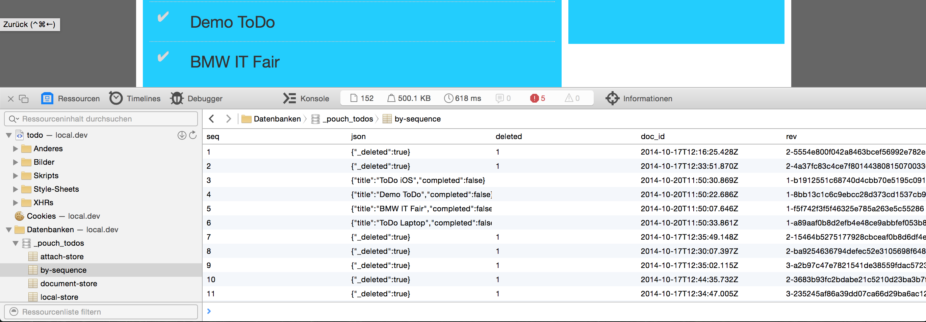
Local Database: PouchDB
JSON data is stored directly in the browser!
Automated sync to Cloudant (DBaaS)
Native iOS or Android apps can use the Cloudant Sync database (based on SQLite)

Slide 7
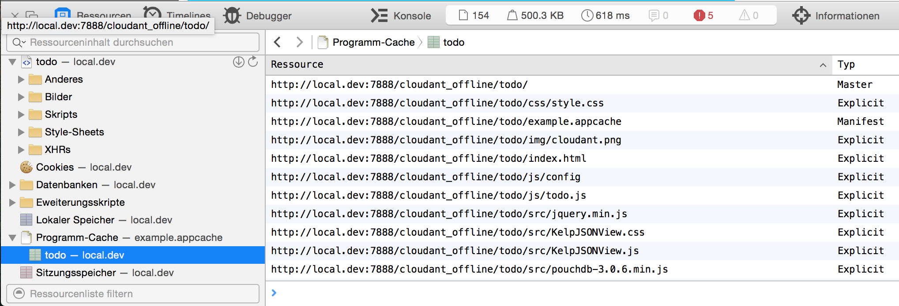
Local Data: HTML5
The complete application is directly stored on the device!
Utilizes HTML5 cache-manifest
Creation of native or hybrid apps possible with IBM Worklight
Distribution and device security possible with MaaS360

Slide 8
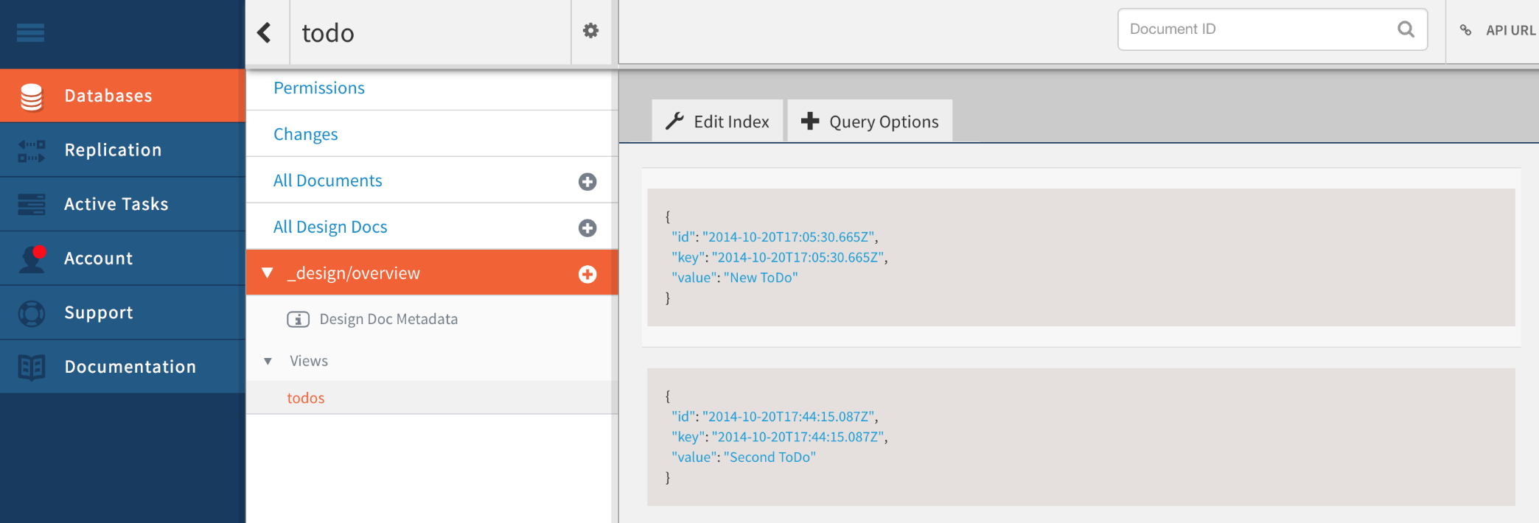
Sync Document to Cloudant
Automated sync from the device to Cloudant!
The whole app utilizes JSON for scalability and flexibility
Cloudant acts as the main cloud database for all user data

Slide 9
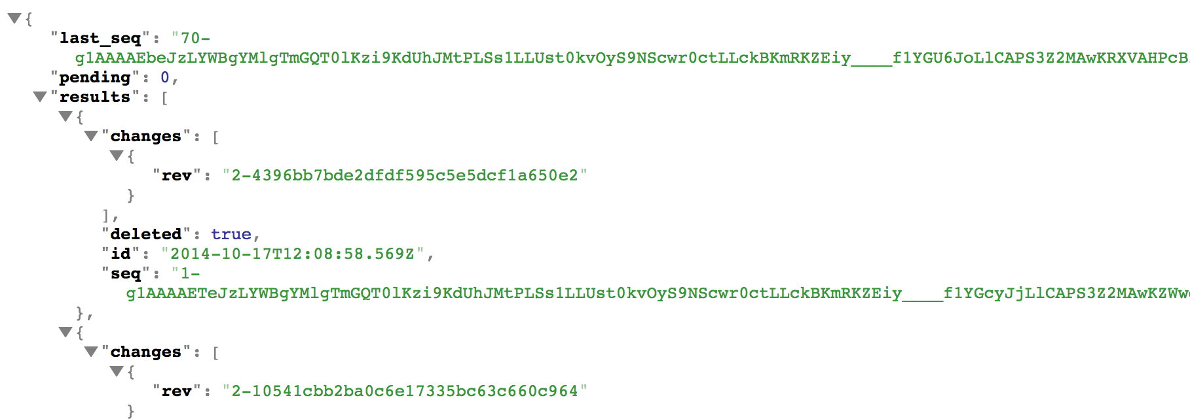
Listen globally: _changes
Listen for Changes on the Cloudant _changes feed!
Possibility to immediately react with sync on the device

Slide 10
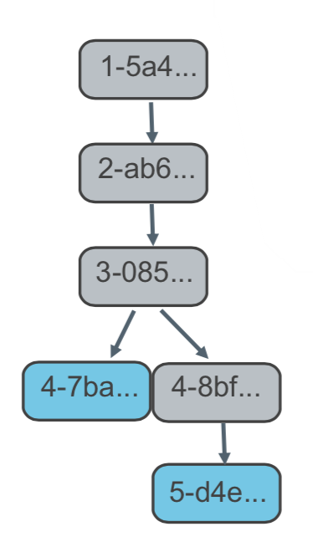
Track Conflicts: _conflicts
Easily track and handle document conflicts!
MVCC Model based on a document hash
Append only storage model
Ability to view, change and restore every leaf of the tree

Slide 11
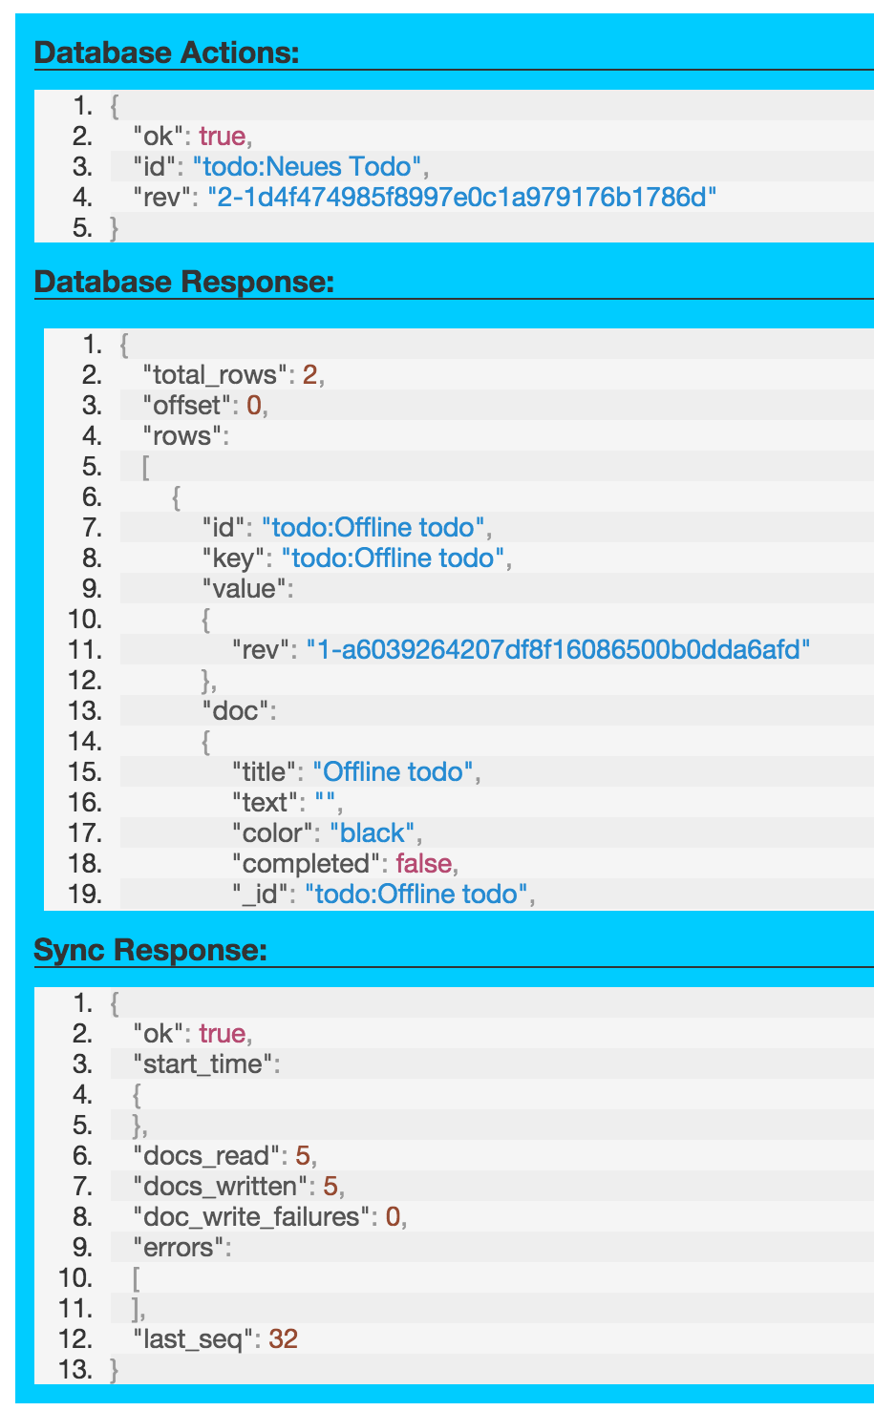
Offline ToDo demo
Listing off all JSON responses:
Offline PouchDB database
Cloudant Database response
Sync protocol response
Inspect JSON responses to demonstrate how JSON looks like and how to work with the protocol

Slide 12
See the demo live here:
http://cloudant-offline-todo.mybluemix.net/

