Slide 1




Excelssior Education Society’s K. C. College of Engineering & Management Studies & Research (Affiliated to the University of Mumbai & Approved by AICTE) Mith Bunder Road, Near Hume Pipe, Kopri, Thane (E) – 400603 NAAC Accredited with A Grade (NBA Accredited)
For Major Project of Final
Year Computer Engineering
Academic Year 2025-26
Smart Waste Management System with Citizen Participation using Machine Learning for Sustainable Urban Cleanliness
Student Name Roll No PRN
Shreya Patil 11 2022016402278515
Mandaar Pawar 12 2022016402279302
Shweta Shimpi 24 2022016402278264
Ninad Walke 35 2022016402278063
Guide :
Dr. Nita Patil
Department of Computer Engineering
K. C. College of Engineering & Management Studies & Research, Thane (E)

Slide 2
Excelssior Education Society’s K. C. College of Engineering & Management Studies & Research (Affiliated to the University of Mumbai & Approved by AICTE) Mith Bunder Road, Near Hume Pipe, Kopri, Thane (E) – 400603 NAAC Accredited with A Grade (NBA Accredited)
OUTLINE OF PRESENTATION
Introduction
Problem Statement
Literature Survey
Aims & Objective
System Analysis and Design
Methodology
Conclusion
References

Slide 3
Excelssior Education Society’s K. C. College of Engineering & Management Studies & Research (Affiliated to the University of Mumbai & Approved by AICTE) Mith Bunder Road, Near Hume Pipe, Kopri, Thane (E) – 400603 NAAC Accredited with A Grade (NBA Accredited)
INTRODUCTION
Waste management in urban areas has become a critical challenge due to rapid urbanization, rising populations, and inefficient traditional systems. Overflowing bins, delayed collection, and lack of real-time monitoring often lead to unsanitary conditions and environmental hazards. Moreover, limited citizen involvement and the absence of predictive analytics further reduce the efficiency of waste handling.
Our project, "Smart Waste Management System with Citizen Participation using Machine Learning for Sustainable Urban Cleanliness", aims to address these issues by combining technology with community engagement. Using machine learning, the system will predict waste generation patterns, optimize collection routes, and provide actionable insights through visual heatmaps.
An interactive citizen platform will enable real-time issue reporting, transparency in waste management operations, and increased public participation. By integrating data-driven decision-making with proactive civic involvement, this solution aspires to create cleaner, more efficient, and environmentally sustainable cities.

Slide 4
Excelssior Education Society’s K. C. College of Engineering & Management Studies & Research (Affiliated to the University of Mumbai & Approved by AICTE) Mith Bunder Road, Near Hume Pipe, Kopri, Thane (E) – 400603 NAAC Accredited with A Grade (NBA Accredited)
PROBLEM STATEMENT
Urban areas across the globe are facing a growing challenge in managing waste effectively due to rapid urbanization, population growth, and inefficient waste handling systems.Traditional waste management approaches often lack real-time monitoring, optimized collection routes, and active citizen engagement, resulting in overflowing bins, unsanitary conditions, and increased environmental pollution. Furthermore, the absence of predictive analytics leads to resource wastage and operational inefficiencies.
In many cities, citizens are either unaware of their role in maintaining cleanliness or lack accessible platforms to report waste-related issues. This gap between civic authorities and public participation hinders the creation of a sustainable and clean urban environment.
There is a pressing need for a smart waste management system that integrates machine learning for data-driven decision-making and citizen participation to ensure transparency, accountability, and proactive engagement. By leveraging technology and community involvement, cities can move towards a cleaner, more efficient, and environmentally sustainable waste management model.

Slide 5
Excelssior Education Society’s K. C. College of Engineering & Management Studies & Research (Affiliated to the University of Mumbai & Approved by AICTE) Mith Bunder Road, Near Hume Pipe, Kopri, Thane (E) – 400603 NAAC Accredited with A Grade (NBA Accredited)
LITERATURE SURVEY
Author(s) | Title | Method | Outcome
Raza et al., 2021 | Real-Time Trash Detection for Modern Societies Using CCTV | CNN-based object detection | High accuracy for 8 trash categories; effective real-timeCCTV detection
Malik et al., 2023 | Machine Learning-Based Automatic Litter Detection & Classification in Smart Cities | Transfer learning with CNN (VGG16, ResNet) | Effective multi- category classificati on
van Lieshout et al., 2023 | Advancing Deep Learning Detection of Floating Litter | Fine-uned Squeeze Net,DenseNet | Robust detection in aquatic environments
Pathak et al., 2024 | Smart City Community Watch – Camera-Based Illegal Dumping Detection | DL-based object/eventdetection | Detects illegal dumping in urban zones
Methodology
Acknowledgement
5
10/14/2024
project title

Slide 6
Excelssior Education Society’s K. C. College of Engineering & Management Studies & Research (Affiliated to the University of Mumbai & Approved by AICTE) Mith Bunder Road, Near Hume Pipe, Kopri, Thane (E) – 400603 NAAC Accredited with A Grade (NBA Accredited)
Author(s) | Title | Method | Outcome
Manivann an et al., 2024 | Garbage Monitoring & Management Using DL | UAV imagery,clustering + YOLOv4 detection | Detection+ route optimization
Sun et al.,2023 | YOLOv5- OCDS: An Improved Garbage Detection Model | YOLOv5 +ODConv + Soft- NMS +C3DCN | High real-time detection performance
Gilani et al., 2023 | Skip-YOLO in Multi-Scenes | YOLOv4- tiny + Skip connections | Robust in complex object environments
Cai et al., 2022 | YOLOG: Lightweight Network | Dilated- Deformable CNN + YOLOv4 | Lightweight & efficient
Methodology
Acknowledgement
6

Slide 7
Excelssior Education Society’s K. C. College of Engineering & Management Studies & Research (Affiliated to the University of Mumbai & Approved by AICTE) Mith Bunder Road, Near Hume Pipe, Kopri, Thane (E) – 400603 NAAC Accredited with A Grade (NBA Accredited)
AIMS & OBJECTIVES
Aim:
The aim of this project is to develop a Smart Waste Management System that leverages machine learning for efficient waste collection and prediction of waste generation patterns. It seeks to actively involve citizens in reporting and monitoring waste-related issues through an interactive platform. The ultimate goal is to promote sustainable urban cleanliness through data-driven decision-making and community participation.
Objectives:
1. To implement machine learning algorithms for predicting waste accumulation patterns and optimizing waste collection schedules to reduce operational inefficiencies.
2. To develop an interactive citizen platform that allows users to report waste-related issues and track resolution status, promoting transparency and engagement.
3. To generate visual heatmaps using collected data to identify high waste-generation zones and support authorities in making targeted, area-specific interventions.
4. To promote environmental awareness and participation by encouraging responsible waste disposal habits and feedback from the community through digital means.

Slide 8
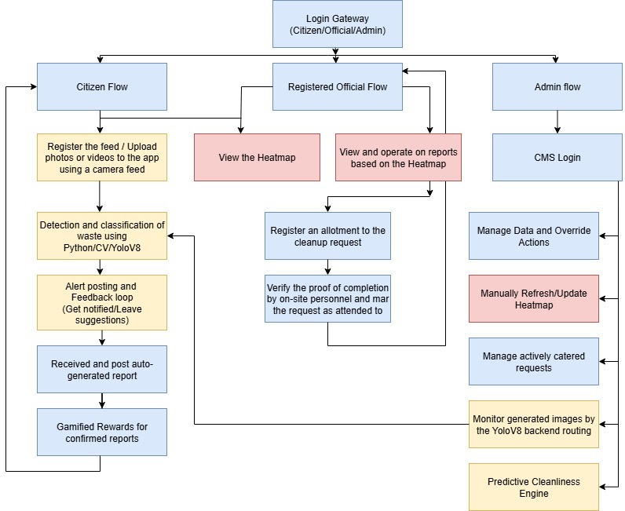
Excelssior Education Society’s K. C. College of Engineering & Management Studies & Research (Affiliated to the University of Mumbai & Approved by AICTE) Mith Bunder Road, Near Hume Pipe, Kopri, Thane (E) – 400603 NAAC Accredited with A Grade (NBA Accredited)
SYSTEM ANALYSIS AND DESIGN

Slide 9
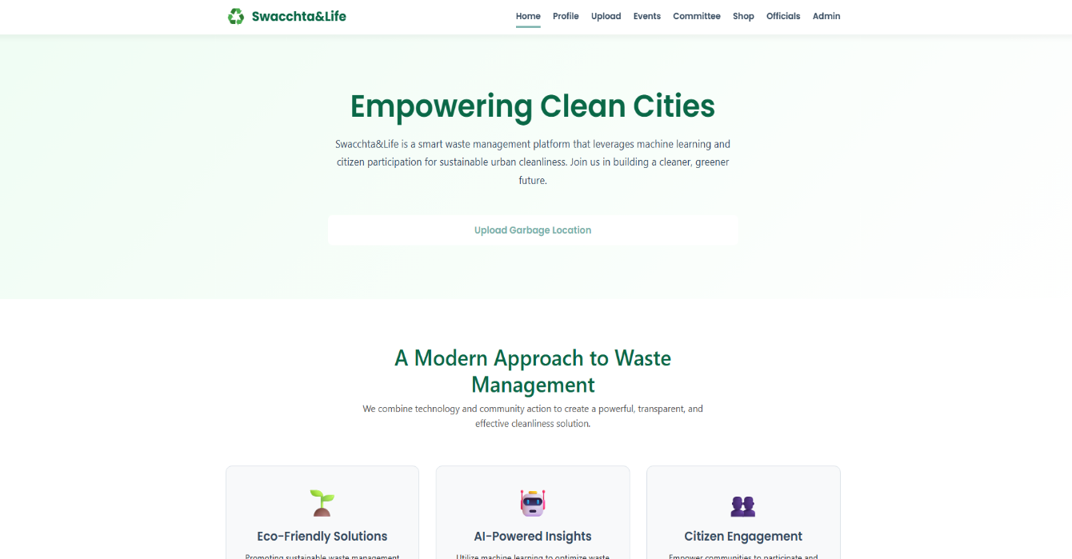
Excelssior Education Society’s K. C. College of Engineering & Management Studies & Research (Affiliated to the University of Mumbai & Approved by AICTE) Mith Bunder Road, Near Hume Pipe, Kopri, Thane (E) – 400603 NAAC Accredited with A Grade (NBA Accredited)
Excelssior Education Society’s K. C. College of Engineering & Management Studies & Research (Affiliated to the University of Mumbai & Approved by AICTE) Mith Bunder Road, Near Hume Pipe, Kopri, Thane (E) – 400603 NAAC Accredited with A Grade (NBA Accredited)
Home Page (After authentication)

Slide 10

Excelssior Education Society’s K. C. College of Engineering & Management Studies & Research (Affiliated to the University of Mumbai & Approved by AICTE) Mith Bunder Road, Near Hume Pipe, Kopri, Thane (E) – 400603 NAAC Accredited with A Grade (NBA Accredited)
Log in Page

Slide 11
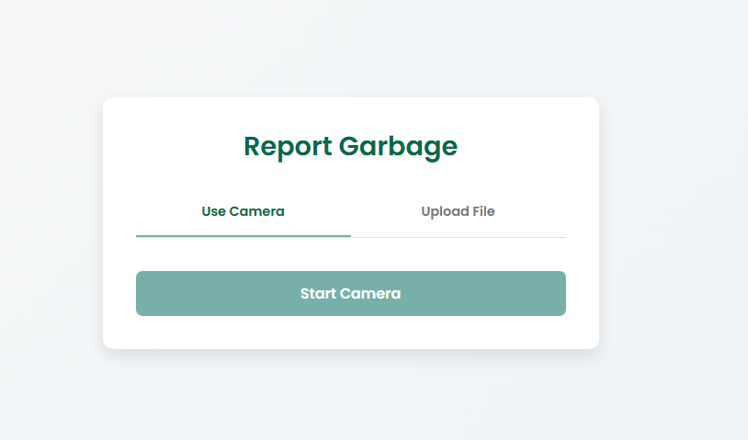
Excelssior Education Society’s K. C. College of Engineering & Management Studies & Research (Affiliated to the University of Mumbai & Approved by AICTE) Mith Bunder Road, Near Hume Pipe, Kopri, Thane (E) – 400603 NAAC Accredited with A Grade (NBA Accredited)
Report Garbage Page

Slide 12

Excelssior Education Society’s K. C. College of Engineering & Management Studies & Research (Affiliated to the University of Mumbai & Approved by AICTE) Mith Bunder Road, Near Hume Pipe, Kopri, Thane (E) – 400603 NAAC Accredited with A Grade (NBA Accredited)
Events Page

Slide 13
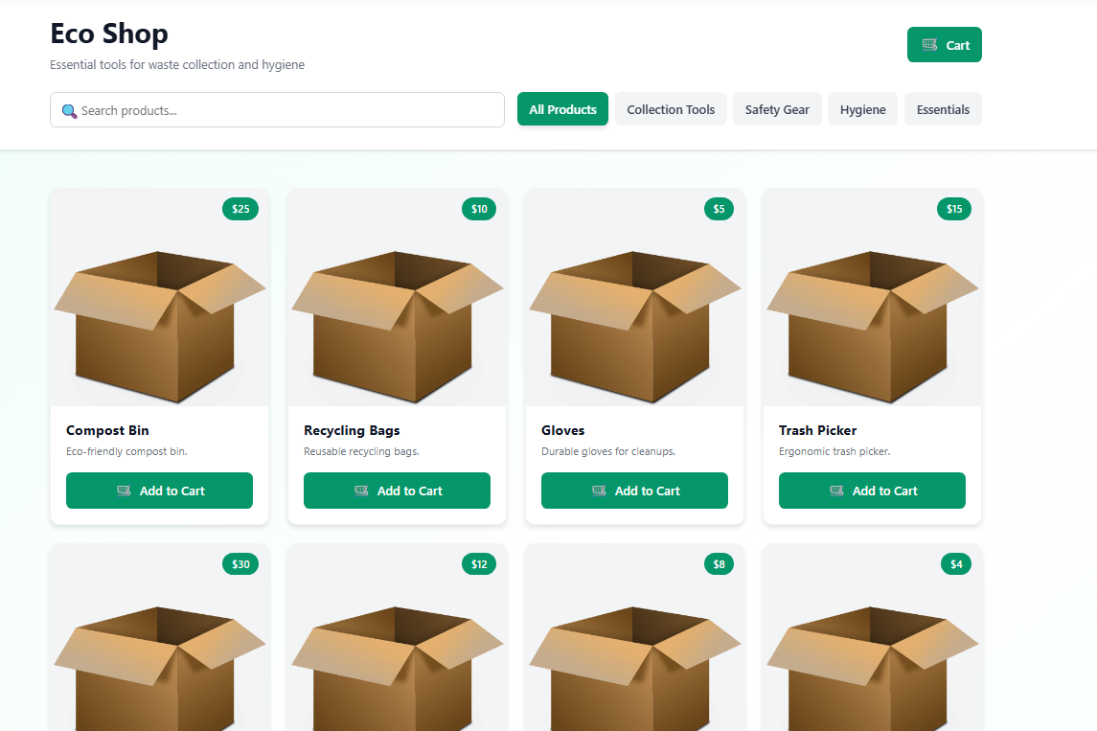
Excelssior Education Society’s K. C. College of Engineering & Management Studies & Research (Affiliated to the University of Mumbai & Approved by AICTE) Mith Bunder Road, Near Hume Pipe, Kopri, Thane (E) – 400603 NAAC Accredited with A Grade (NBA Accredited)
Shop Page

Slide 14
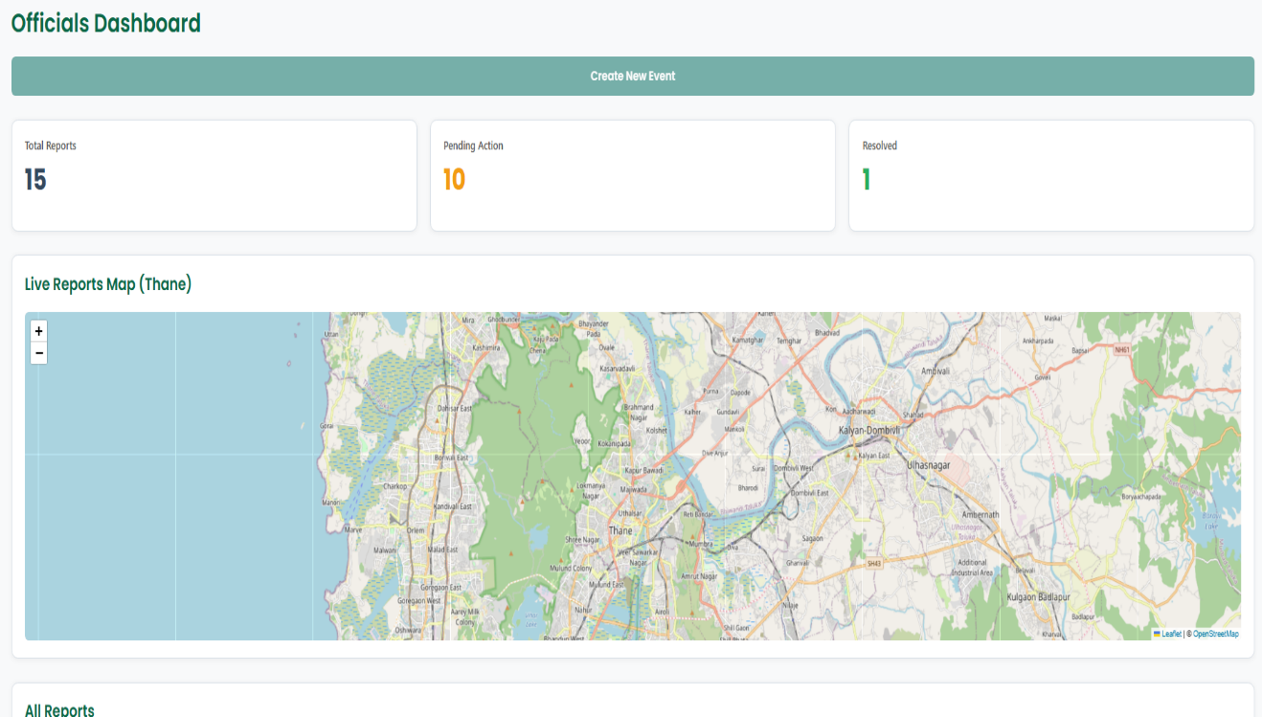
Excelssior Education Society’s K. C. College of Engineering & Management Studies & Research (Affiliated to the University of Mumbai & Approved by AICTE) Mith Bunder Road, Near Hume Pipe, Kopri, Thane (E) – 400603 NAAC Accredited with A Grade (NBA Accredited)
Officials Dashboard Page

Slide 15
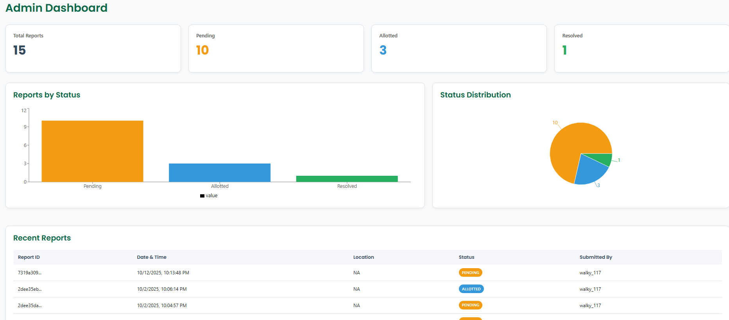
Excelssior Education Society’s K. C. College of Engineering & Management Studies & Research (Affiliated to the University of Mumbai & Approved by AICTE) Mith Bunder Road, Near Hume Pipe, Kopri, Thane (E) – 400603 NAAC Accredited with A Grade (NBA Accredited)
Admin Dashboard Page

Slide 16
Excelssior Education Society’s K. C. College of Engineering & Management Studies & Research (Affiliated to the University of Mumbai & Approved by AICTE) Mith Bunder Road, Near Hume Pipe, Kopri, Thane (E) – 400603 NAAC Accredited with A Grade (NBA Accredited)
METHODOLOGY
Core Frontend & Navigation Flow
The React_App provides the top-level User Interface (Nav, Dash, Map) for a seamless Single-Page Application
The React Router acts as the central control, directing user navigation to the correct functional module.
2. Committee Route and Governance Data
The Committee Route manages all administrative content and user interactions related to governance.
It handles the storage and retrieval of core structured data directly from Mongo Atlas.
3. Shop Route and E-commerce
The Shop Route presents product listings and manages the order creation process.
It saves inventory details to Mongo Atlas and fetches product media from Cloudinary.The route initiates payments by connecting to the secure RazorPay payment interface.
4. Reports Route and AI-Driven Analysis
The Reports Route manages the submission and display of analytical data.
It integrates with the YOLOv8 Object Detection service to analyze visual data and generate intelligent reports.

Slide 17
Excelssior Education Society’s K. C. College of Engineering & Management Studies & Research (Affiliated to the University of Mumbai & Approved by AICTE) Mith Bunder Road, Near Hume Pipe, Kopri, Thane (E) – 400603 NAAC Accredited with A Grade (NBA Accredited)
5. Events Route and Location Management
The Events Route is responsible for displaying and managing all location-specific events.
It uses React Leaflet to visualize event locations on an interactive map.
The route uses the Geocoding Module to convert event addresses into precise map coordinates.
6. Map Route and Geospatial Utilities
The Map Route renders the main application map view for general location browsing.
It relies on React Leaflet for the visual presentation and interactivity of the map.
The route utilizes the Geocoding Module for real-time address lookup and coordinate searching.
7. Architectural Strategy and External Services
The Cloud_Databases layer provides persistence via Mongo Atlas and media management via Cloudinary.
The External_API_Services layer groups all specialized tools (RazorPay, YOLOv8, Mapping, Geocoding) to decouple complex tasks from the core application logic.

Slide 18
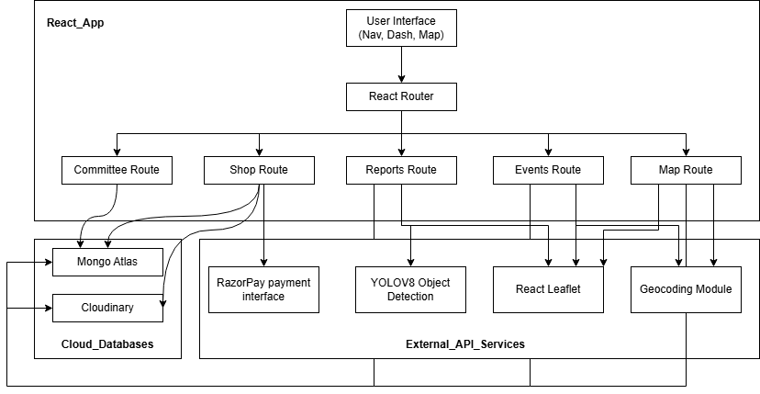
Excelssior Education Society’s K. C. College of Engineering & Management Studies & Research (Affiliated to the University of Mumbai & Approved by AICTE) Mith Bunder Road, Near Hume Pipe, Kopri, Thane (E) – 400603 NAAC Accredited with A Grade (NBA Accredited)

Slide 19

Excelssior Education Society’s K. C. College of Engineering & Management Studies & Research (Affiliated to the University of Mumbai & Approved by AICTE) Mith Bunder Road, Near Hume Pipe, Kopri, Thane (E) – 400603 NAAC Accredited with A Grade (NBA Accredited)
RESULT & ANALYSIS
Improved Cleanliness Management — Verified completion of tasks with a robust feedback loop and quality control measures.
Accurate Risk Prediction — Identified high-waste zones using past trends, events, and footfall patterns, enabling preventive action.
Sustainability Achieved — Used existing CCTV infrastructure, reduced hardware costs, and minimized fuel use with optimized routes.
Eco-Friendly Practices — Encouraged waste segregation and responsible disposal habits among citizens.
Efficient Monitoring — Centralized dashboard with real-time violation tracking, cleanup progress, heatmaps, and cleanliness scores.
Motivated Participation — Leaderboards and recognition boosted citizen and staff engagement.
Enhanced Accuracy — Manual review process ensured fairness and reliability of reports

Slide 20
Excelssior Education Society’s K. C. College of Engineering & Management Studies & Research (Affiliated to the University of Mumbai & Approved by AICTE) Mith Bunder Road, Near Hume Pipe, Kopri, Thane (E) – 400603 NAAC Accredited with A Grade (NBA Accredited)
CONCLUSION
The project successfully developed a real-time smart waste management system combining machine learning and citizen participation to improve urban cleanliness. Using YOLOv8 and CCTV feeds, the system achieved high waste detection accuracy without physical sensors, while predictive analytics identified high-risk zones for preventive cleaning. Route optimization minimized time, fuel use, and emissions, supporting sustainability. A centralized dashboard enhanced transparency, real-time monitoring, and public engagement, making the solution scalable, cost-effective, and well-suited for sustainable urban waste management.

Slide 21
Excelssior Education Society’s K. C. College of Engineering & Management Studies & Research (Affiliated to the University of Mumbai & Approved by AICTE) Mith Bunder Road, Near Hume Pipe, Kopri, Thane (E) – 400603 NAAC Accredited with A Grade (NBA Accredited)
REFERENCES
[1]Raza, A., et al. (2021). Real-Time Trash Detection for Modern Societies Using CCTV. CNN-based object detection applied on 2,100 annotated CCTV images, achieving mAP ~0.82 and accuracy ~90%.
[2]Malik, M., et al. (2023). Machine Learning-Based Automatic Litter Detection & Classification in Smart Cities. Transfer learning with CNN (VGG16, ResNet) achieving ~93% accuracy on urban litter datasets.
[3]van Lieshout, M., et al. (2023). Advancing Deep Learning Detection of Floating Litter. Fine-tuned SqueezeNet and DenseNet models achieving ~90% accuracy and F1 ~0.88 in aquatic environments.
[4]Pathak, S., et al. (2024). Smart City Community Watch – Camera-Based Illegal Dumping Detection. DL-based detection on municipal CCTV feeds achieving mAP ~0.85 for illegal dumping hotspots.
[5]Manivannan, R., et al. (2024). Garbage Monitoring & Management Using DL. UAV imagery with clustering + YOLOv4 detection achieving mAP ~0.845, enabling detection and route optimization.

Slide 22
Excelssior Education Society’s K. C. College of Engineering & Management Studies & Research (Affiliated to the University of Mumbai & Approved by AICTE) Mith Bunder Road, Near Hume Pipe, Kopri, Thane (E) – 400603 NAAC Accredited with A Grade (NBA Accredited)
Thank You

