Slide 1
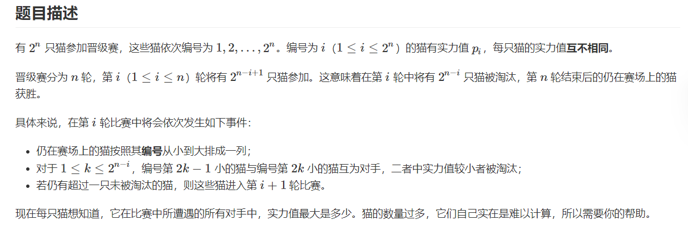
I - Alea jacta est!

Slide 2
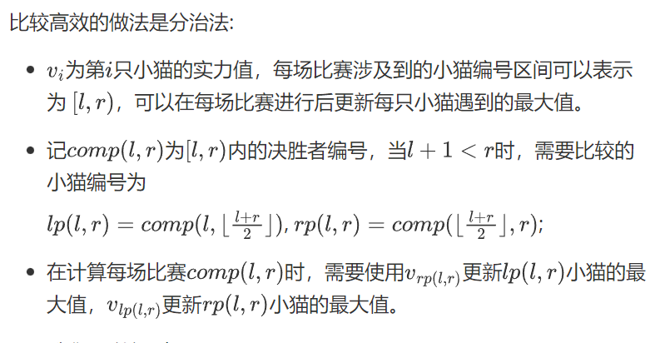
I - Alea jacta est!

Slide 3
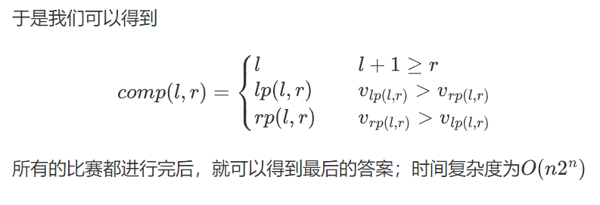
I - Alea jacta est!

Slide 4
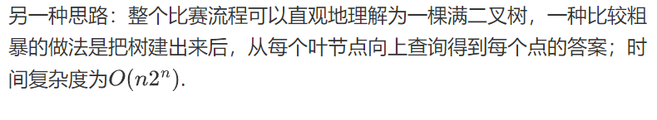
I - Alea jacta est!

Slide 5














I - Alea jacta est!
$$2_{9}$$
$$2_{9}$$
$$6_{8}$$
$$1_{6}$$
$$2_{9}$$
$$4_{7}$$
$$6_{8}$$
$$0_{2}$$
$$1_{6}$$
$$2_{9}$$
$$3_{4}$$
$$4_{7}$$
$$5_{3}$$
$$6_{8}$$
$$7_{5}$$
建树&求解
D&C

Slide 6
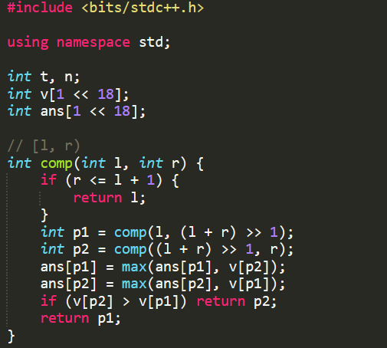
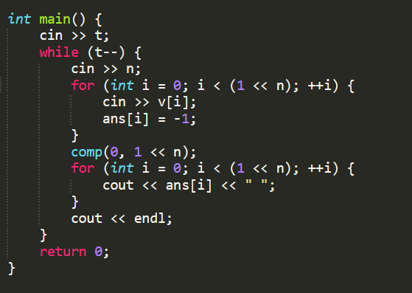
代码（解法1)

Slide 7
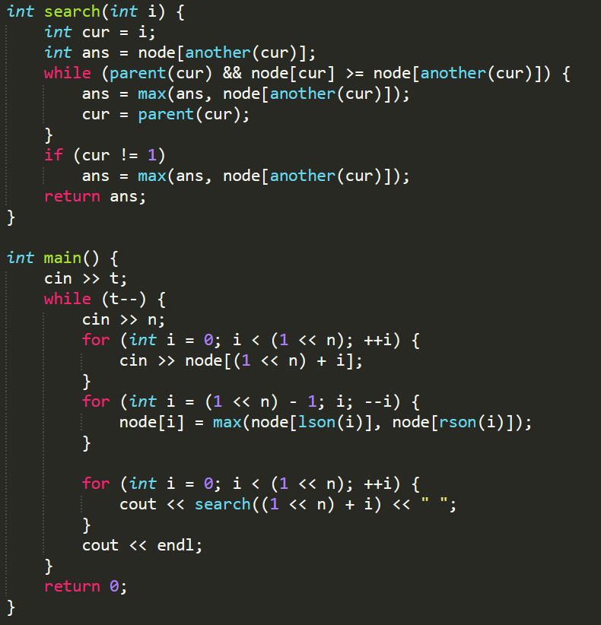
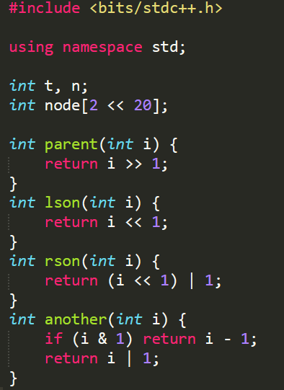
代码（解法2)

