Slide 1
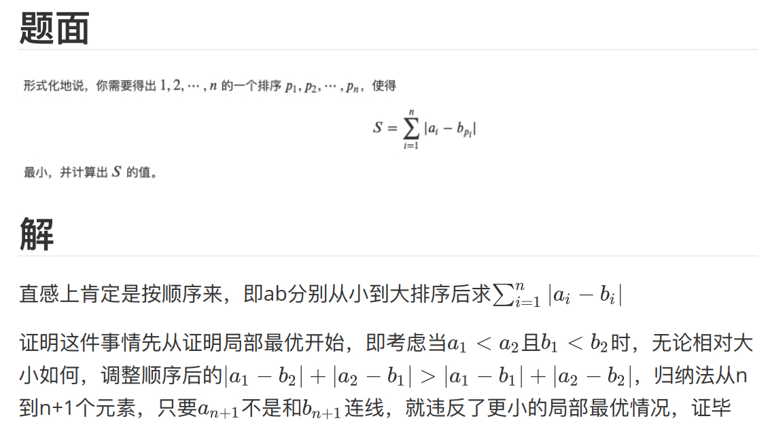

Slide 2

Main Code

