Slide 1
B
22373569王桢齐

Slide 2
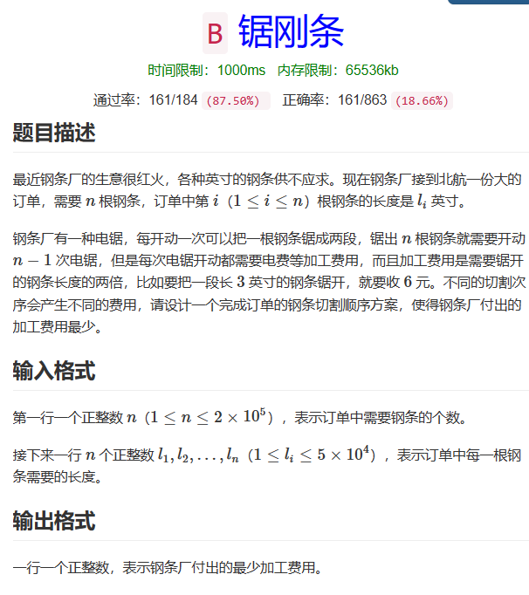
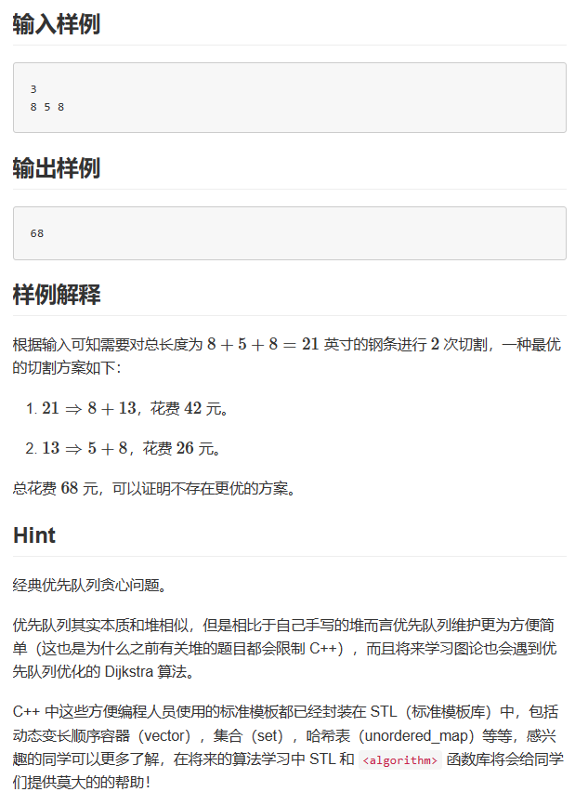

Slide 3
按题意，要一根变n根肯定需要操作n-1次，每次的费用尽可能小，即每次操作的俩钢条总长度尽可能小，就是答案的最少费用
#include <iostream>
#include <queue>
using namespace std;
#define ll long long
ll n, temp1, temp2;
ll ans;
priority_queue<ll, vector<ll>, greater<ll>> q;
// 小根堆
int main(){
cin >> n;
for (int i = 1; i <= n; ++i){
cin >> temp;
q.push(temp);
}
// 钢条据成好几段和把好几段钢条接起来算消耗是等价的
// 每次取出最小的两个合并后push回优先队列，最后队列中只剩一个元素表示已经连接好了
while (l.size() > 1){
temp1 = q.top();
q.pop();
temp2 = q.top();
q.pop();
ans += (temp1 + temp2) * 2;
q.push(l.top() + temp);
}
cout << ans << "\n";
return 0;
}

Slide 4
long long temp;
long long heap[1000000];
//n的父节点对应n/2,子节点为2n和2n+1
long long ans;
int n, size;
void adjustup(int now) {
if (now == 1)
return;
if (heap[now] < heap[now / 2]) {
swap(&heap[now], &heap[now / 2]);
adjustup(now / 2);
}
else
return;
}
//最后一个元素与其父节点比较，若小则交换，继续向上比较
int main(){
scanf("%d", &n);
for (int i = 1; i <= n; ++i){
cin>>temp;
insert(temp, i);
//新加元素插入到末端后调整至正确位置
}
size = n;
while (size != 1){
int num1 = heap[1];
pop();
int num2 = heap[1];
pop();
insert(num1 + num2, ++size);
ans +=(num1 + num2)*2;
}
cout<<ans;
return 0;
}
void swap(int* a, int* b) {
int exchange = *a;
*a = *b;
*b = exchange;
}
void insert(int x, int now) {
heap[now] = x;
adjustup(now);
//维护小根堆
}
void adjustdown(int now) {
int s = now * 2;
if (s <= size) {
if (s<size && heap[s]>heap[s + 1])
s++;
if (heap[now] > heap[s]) {
swap(&heap[now], &heap[s]);
adjustdown(s);
}
}
}
//顶部的每次向下和子节点比较，若大则交换，继续向下比较
void pop() {
heap[1] = heap[size--];
adjustdown(1);
//维护小根堆
}

Slide 5
B
22373569王桢齐

