Slide 1



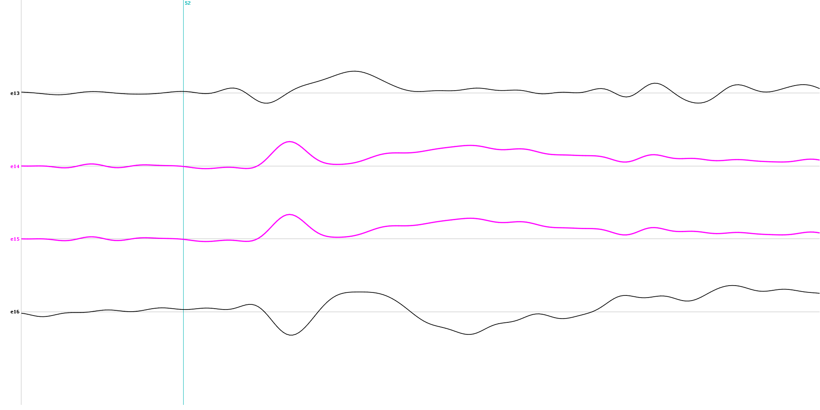
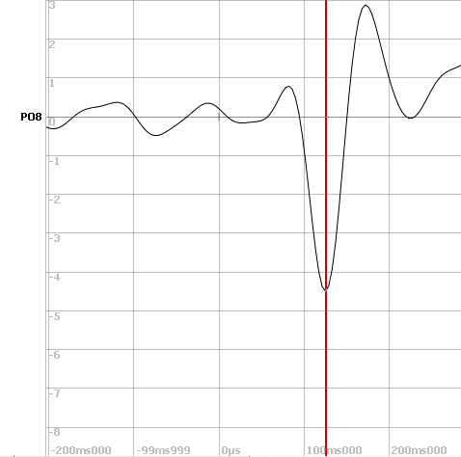
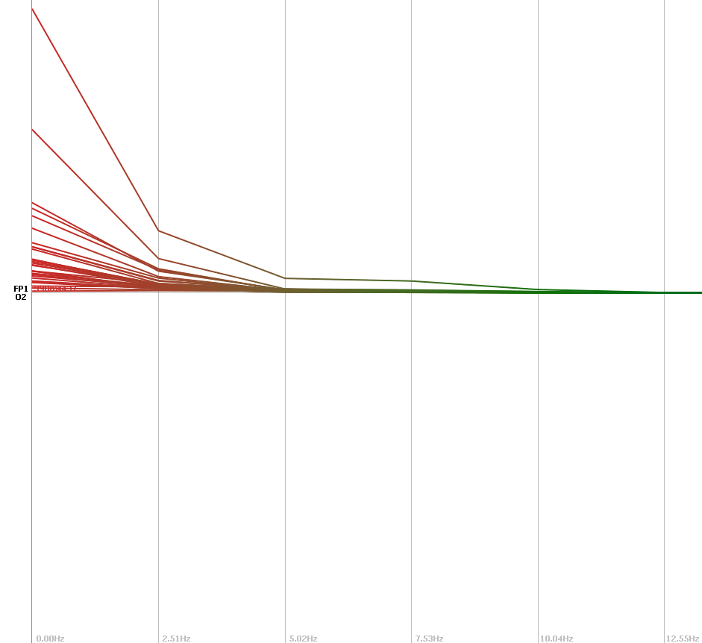
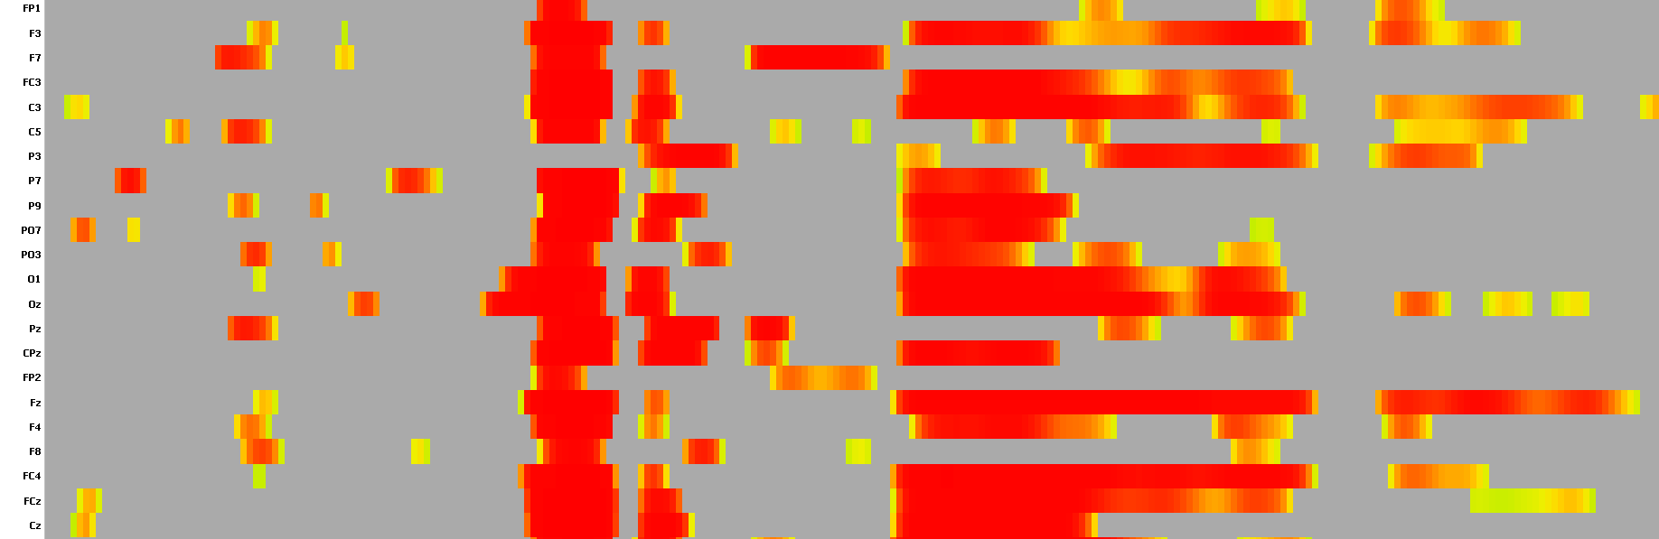
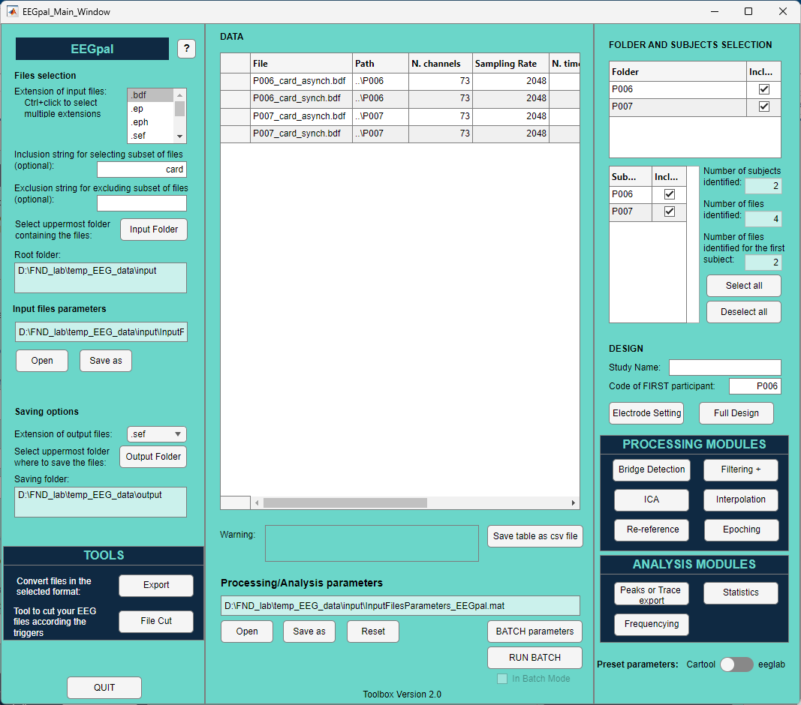
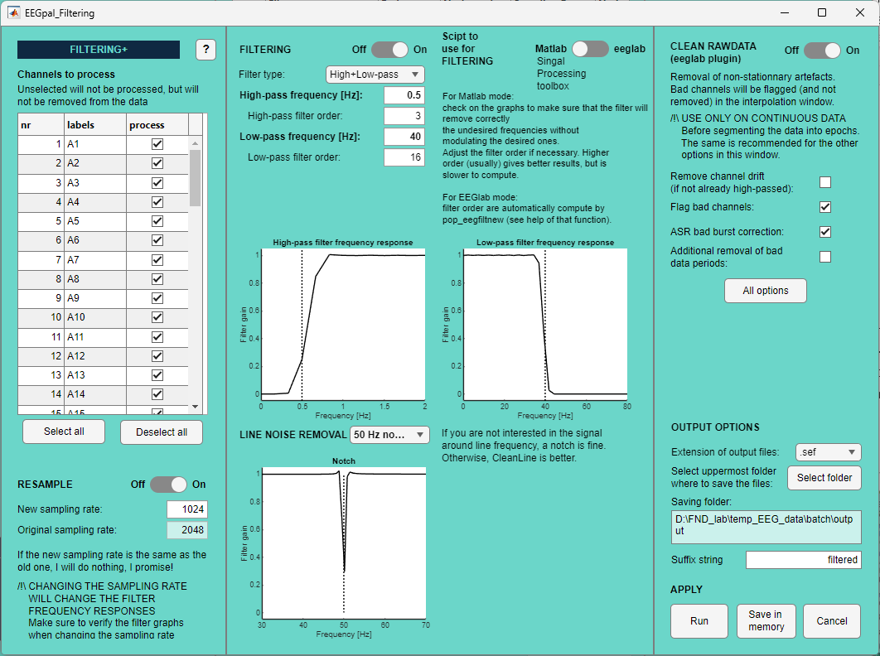
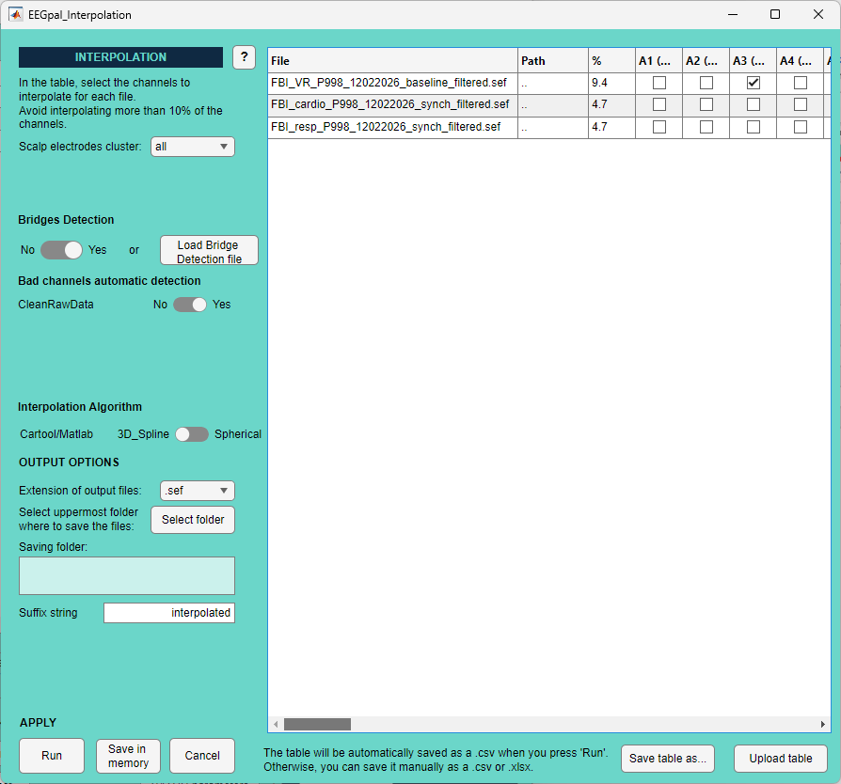
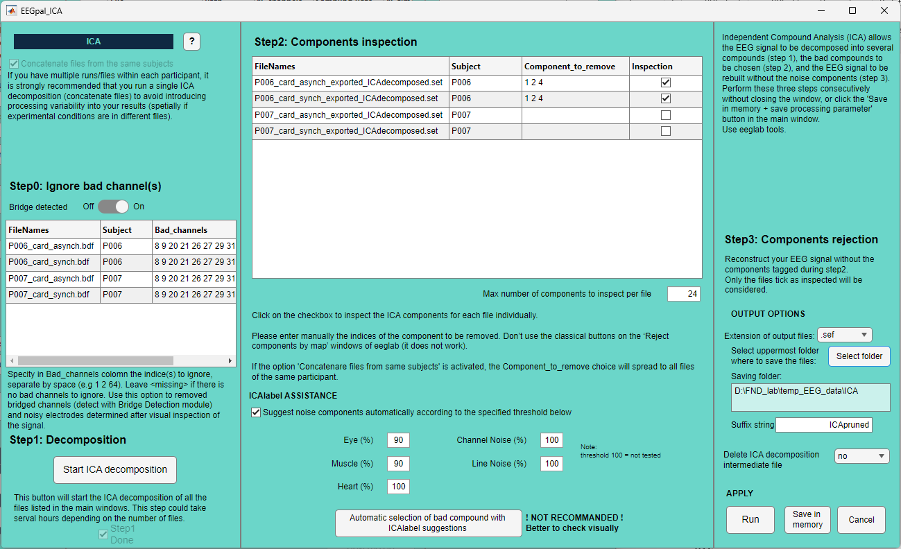
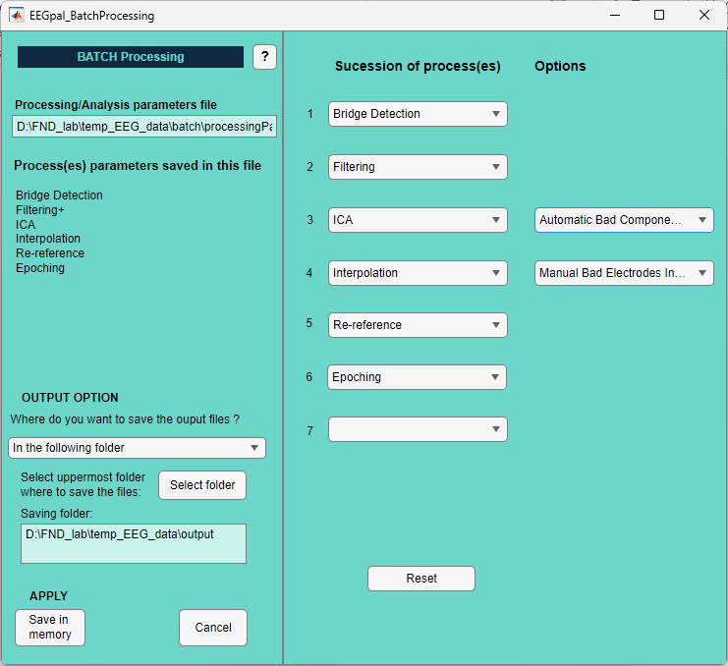
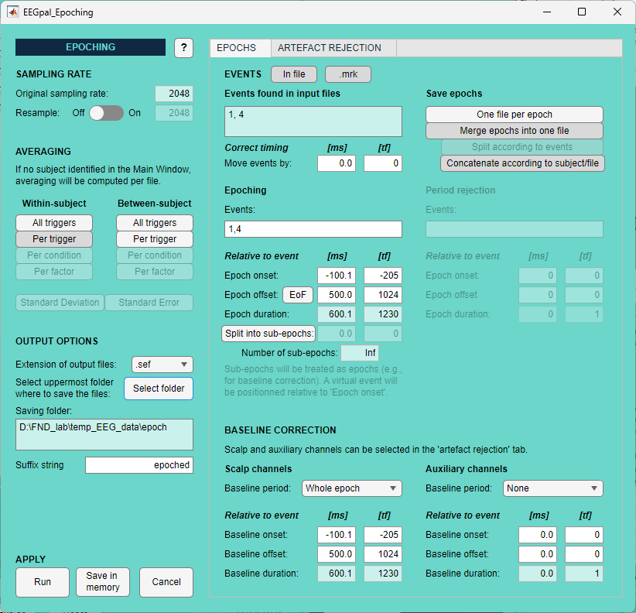
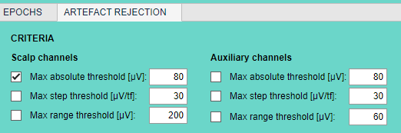
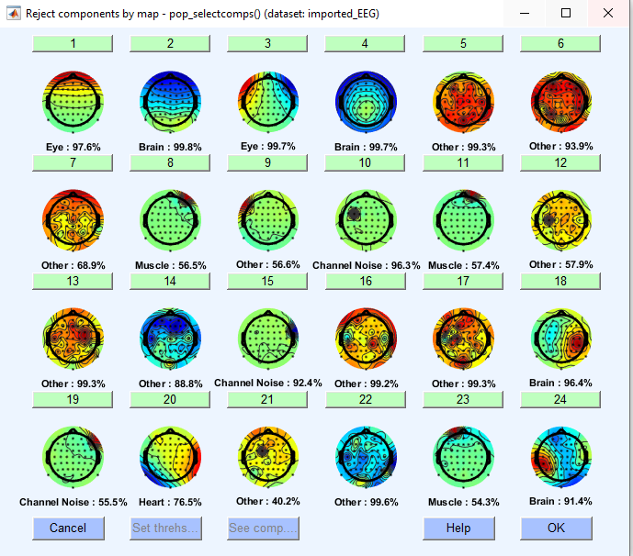
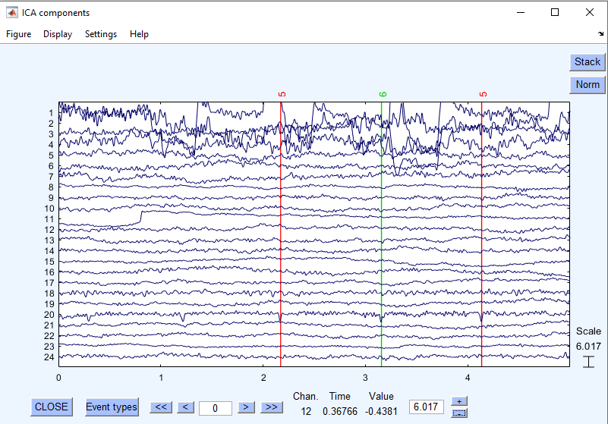
EEGpal: a new graphical user interface for performing automatic and semi-automatic EEG processing and analysis
Michael Mouthon, Michael De Pretto & Selma Aybek
Faculty of Science and Medicine, Section of Medicine, Department of Neuroscience and movement science, University of Fribourg
EEGpal is an open-source Matlab-based software for automated/semi-automated EEG data pre-processing and analyses. It proposes Graphical User Interfaces (GUIs) that allow EEG pre-processing to be batched across participants with a high degree of flexibility in processing parameters. The purpose is to offer a complement to the free software Cartool and an alternative to the original eeglab GUI.
Bridge Detection
Analysis
Automatic peak amplitude and latency extraction
Frequency analysis with Power Spectral density (PSD)
Statistic on tracks with T-test or ANOVA
Filtering+
Interpolation
Filtering with Matlab or eeglab function
Manual customization of channels selection for interpolation.
Clean Raw Data toolbox with:
ASR
Automatic bad channel suggestion
EEGpal
Automatic suggestions of bad channels (bridges + Clean Raw Data)
Interpolation with 3D_Spline (Cartool) or Spherical (eeglab) algo
Resample data
Export/Import of interpolation table to work in Excel
Notch Filter or CleanLine toolbox
s
ICA
Batch
Epoching/Averaging
ICA decomposition ignoring bad channel
Recomposition of the signal without bad components
Program the sequence of steps to be executed automatically.
Averaging within or between subject
Automatic Epochs rejection based on :
Absolute Amplitude
Step change
Amplitude range
Manual of automatic inspection of components
Topography and trace are displayed simultaneously for each component
Save all good epochs into one file or save one file per epoch.
Use the ICAlabel
toolbox to help components recognition
Baseline correction

