Slide 1
Validation EEGpal v2.0
Michaël Mouthon
28.09.2025

Slide 2
Description of the release
The version 2 bring a lot of utilities and adaptation. A complete lists of updates can be find in the realse version document but here is a global recapitulation:
Update of the recording system of the SessionParameters for all the modules
Introduction of the Batch system
Upgrade to eeglab 2025.1
Upgrade CleanLine toolbox
Upgrade CleanRawData toolbox
Automatic filling of ICA and interpolation with the bridged channels detected by eBridge
Modification of the interface on the main window (separate the saving of SessionsParameters and File FileSelectionParameters)
Otherwise the version 1.4 introduce :
The peak Detection module
Statistical module

Slide 3
Dataset
For this validation study, we are going to use the open public database of ERP CORE. It is a set of standard psychological experiments record with a 30 electrods Biosemi system. The purpose was to permit the evaluation of a eeg pipeline. The reference is: ERP CORE: An open resource for human event-related potential research
URL: https://osf.io/pfde9/
Here, we are going to use the data of the visual face recognition which generate a N170 compund which will be our reference point de validate the processing perfom by EEGpal.
Triggers:
"1-40": "Stimulus - faces“
"41-80": "Stimulus - cars“
"101-140": "Stimulus - scrambled faces“
"141-180": "Stimulus - scrambled cars“
"201": "Response - correct“
"202": "Response - error"
In our validation study, we will consider only face vs car and not scrambled stimulations

Slide 4
Difference of processing between ERP CORE database and EEGpal
The authors of the article have made several choice that we will not follow during these tests. Here is the list:
Downsample the data to 256 Hz. There is no need to do that. I stay with the original sampling rate of 1024 Hz
Consider only Epoch with a correct response: As the accuracy of participant is high (93%), I will simplify my work by considering all the trials independetely from their response
Re-ref at the begining of the processing (before filtering): This is unusual and go against the recommandation of Arnaud Delorme relative to the ICA decomposition. I will do it only for the validation 1 which test the results of EEGpal regarding to the article. Otherwise the re-ref is performed at the end
Low pass at the end of the processing: This is very unusual. I don’t understand the idea of it. I will perform the highpass and lowpass at the begining as usual.
Cut the between block time: The authors introduce a pause between block of experiment and these time were removed before ICA. I will not remove these segment because there is not trigger de deliminate them. It means that you have to perform a valual decision which is to much time consuming. In addition, these interval are not long and not to much artefacted. Anyway, we focus the ICA on the eye blink so there is no problem if movement during these periods.

Slide 5
Planning of the tests
Validation 1: Results processed by EEGpal 2.0 vs article results
Validation 2: Results processed by EEGpal 2.0 vs. EEGpal 1.4 with CleanRawData tool activated (to test the effect of the its upgrad)
Validation 3: Results processed by EEGpal 2.0 vs. Cartool
Validation 4: Results processed by EEGpal 2.0 batch automatique vs manuel
For the convenience of the analysis, the validation will be performed in a different order. We will first start by validation 4, then validation 2, then validation 1 and at the end validation 3.
Please refer to the corresponding section of this powerPoint.

Slide 6
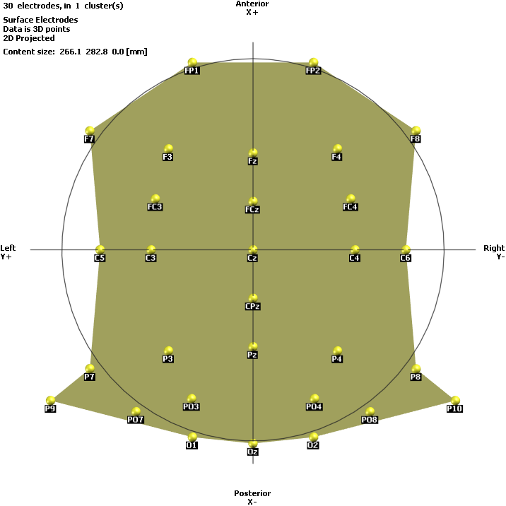
Electrode coordinate file
To generate the coordinate file, I have :
Copy the 64-Biosemi_OVAL_AB.xyz,
Rename it as coordinates_ERP_CORD.xyz (A)
Open it in Excel
Open sub-XXX_task-N170_electrodes.tsv in Excel (B)
Copy the x,y,z clumns from B into A
Copy the lavel from B to A
Modify the first ligne of A to have 30 in the cell A1

Slide 7
Validation 4: Results processed by EEGpal 2.0 batch automatique vs manuel
I start by the validation of the automatic batch system to check if it can be used by the other validation to save time.
The purpose is to check that the batch module and processing added in EEGpal work and gave coherent results.

Slide 8
Processing parameters for validation 4
Bridge detection
Filtering + : eeglab filter from 0.5-40 Hz + Cleanline 60 hz + Label bad channels
Visual inspection bad channel (for non automatic processing)
ICA with ignore bridged and bad channels (remove only eye compounds)
Temp ERP for visual inspection (for non automatic processing)
Interpolation
Re-Ref: to average ref
Epoching -100 to 300ms and shift the trigger of 26ms. Pre-baseline correction -100 to 0ms Artefact rejaction Amplitude + step ERP1 for trigger 1-40 (face) and ERP2 for trigger 41 -80 (car)
Substraction ERP1-ERP2
Negative Peak extraction between 110 à 150 ms

Slide 9
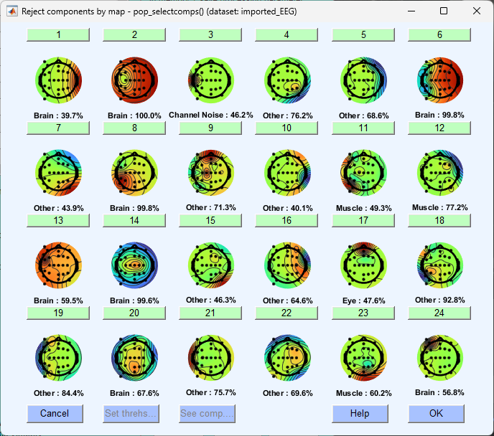
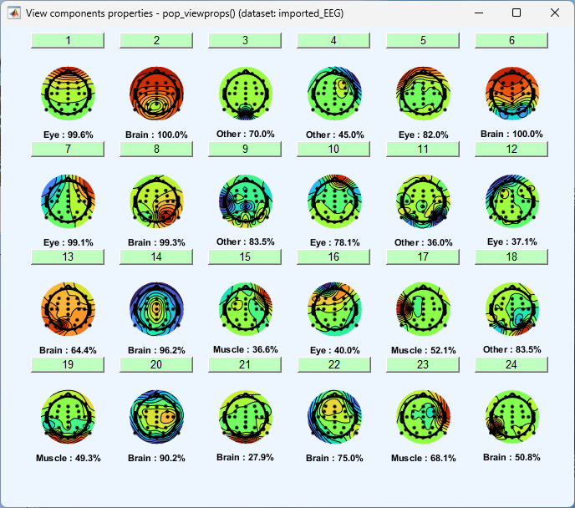
Crash during batch
Avant
ICA inspection crash car l’orientation des topographies sont incorrect (elles sont tourner de 90° horaire) !
Il a fallu que j’inverse la colonne de x et des y dans le fichier de coordonné. Comme il a enregistrer les coordonnés dans les fichiers décomposé, j’ai dû relancé l’ICA.
Il faut toujours vérifier l’orientation des topographie ICA dans eeglab. C’est un cauchemar pour ça mais il n'y a pas de solution de détection automatique.
WRONG
Après
GOOD

Slide 10
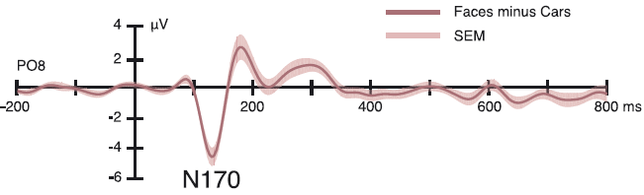
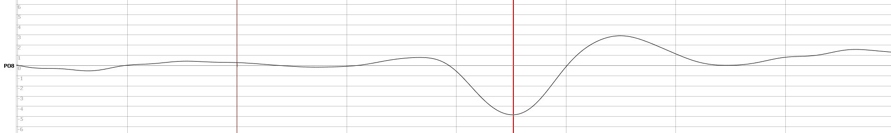
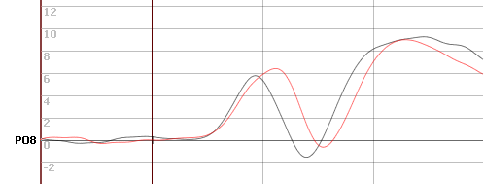
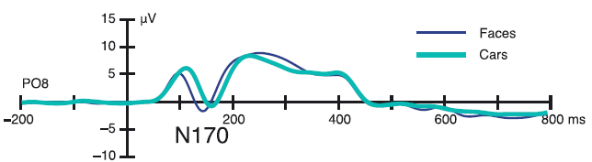
Comparaison between Kappenman article and automatic processing
126 ms
131 ms
Tout à fait comparable
Black = face
Red = car
Same results, latency for the car is later than the face

Slide 11
Manual processing bad channels inspection
subject | Bad channel
Sub-001 | Peut-être F8 | Sub-015 | -
Sub-002 | - | Sub-016 | -
Sub-003 | - | Sub-017 | C6
Sub-004 | - | Sub-018 | -
Sub-005 | Fp2 | Sub-019 | -
Sub-006 | - | Sub-020 | -
Sub-007 | - | Sub-021 | -
Sub-008 | - | Sub-022 | -
Sub-009 | C5 | Sub-023 | -
Sub-010 | - | Sub-024 | F8
Sub-011 | P7 | Sub-025 | -
Sub-012 | - | Sub-026 | -
Sub-013 | - | Sub-027 | -
Sub-014 | - | Sub-028 | -

Slide 12
Manual processing bad channels inspection
subject | Bad channel
Sub-029 | Oz
Sub-030 | -
Sub-031 | -
Sub-032 | -
Sub-033 | -
Sub-034 | -
Sub-035 | -
Sub-036 | -
Sub-037 | -
Sub-038 | -
Sub-039 | FP2
Sub-040 | -

Slide 13
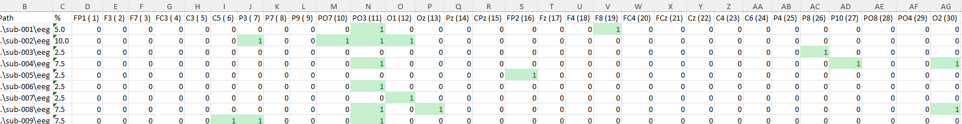
Question: Is the Flag bad channel suggested by CleanRawData are similar between the manual and automatic processing ?
Response: Yes. The suggestion of bad channels are exactely the same between the automatic and manual processing

Slide 14
Manual visual inspection to find the electrodes to interpolate
Procedure:
Compute the ERP without interpolation
Manual decision without look at the suggestion of the CleanRawData
Comparaison of the suggestion of clean raw data

Slide 15
Manual visual inspection to find theelectrodes to interpolate
subject | Visual check | Agree of not with CleanRawData
Sub-001 | F8 | F8 agree. PO3 not agree. Nothing special on the trace
Sub-002 | - | P3,P07,PO3,O1 not agree
Sub-003 | - | P8 not agree
Sub-004 | - | P03, P10,O2 not agree
Sub-005 | Fp2 | Fp2 agree
Sub-006 | P3 | PO3 not agree
Sub-007 | - | O1 not agree
Sub-008 | - | P03, Oz, O2 not agree
Sub-009 | C5, PO3 | C5, PO3 agree, P3 not agree
Sub-010 | C5 | C5 agree
Sub-011 | P7 | P3 P03 not agree
Sub-012 | Oz | Oz agree, P03 , PO4 not agree
Sub-013 | - | PO8 not agree
Sub-014 | - | PO3 not agree
Sub-015 | Fp2 | FP1, F7, F8 not agree
Notes:
Remarque: si je change le critère de détection de flag bad channel à ‘max accetpable high-frequency noise std deviation’=7 au lieu de 4 par défaut, il y a un peu moins de channel mais il continue a suggéré trop de bad channel. Pire, des bad channel qui sont coherent avec une decision humaine ne le sont plus et il garde des channel non sélectionner par humain.
Donc en conclusion, il faut laisser le parameter par défaut. Ça sert à rien de l’augumenter. On a de tout façon une évaluation différente par rapport à un humain.
Le test de faire le flag bad channel sur les Epoch temps est mieux mais toujours pas convaincant.

Slide 16
Manual visual inspection to find theelectrodes to interpolate
subject | Visual check | Agree of not with CleanRawData
Sub-016 | PO7 | PO3
Sub-017 | C6, P10 | P3, PO3, PO4
Sub-018 | - | PO3
Sub-019 | - | PO3
Sub-020 | F7 | PO3
Sub-021 | P10 | P07,P04
Sub-022 | Fp1 | Fp2
Sub-023 | P10 | Fp1, PO3, F8
Sub-024 | F8 | F8 PO3
Sub-025 | -
Sub-026 | - | PO3
Sub-027 | -
Sub-028 | -
Sub-029 | Oz, Fp2 | Oz, Fp2, PO3
Sub-030 | -

Slide 17
Manual visual inspection to find theelectrodes to interpolate
subject | Visual check | Agree of not with CleanRawData
Sub-031 | -
Sub-032 | CPz C4 | PO7, PO3, CPz, C4
Sub-033 | C6 | P3
Sub-034 | Fp1
Sub-035 | - | PO3, O2
Sub-036 | PO3
Sub-037 | - | C5
Sub-038 | -
Sub-039 | FP2 | PO3
Sub-040 | - | PO3
Summary: CleanRawData and human judgment are agreed only in 37.5% of the participants.
CleanRawData interpolate around 75% more than the human (much more conservative). It interpolate electrode which visually has no or low problem.

Slide 18
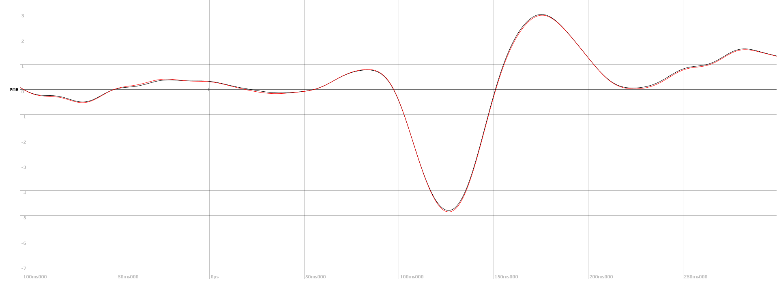
Sub-Question: Comparison of the results between human and flag bad channel of CleanRawData during a manual processing ?
As see in previous slices, the flag bad channel of CleanRawData remove a lot more channels than human following the strategy of Michaël Mouthon described in the manual of the Interpolatation module. It remove 75% more signal than a human. The positive side that in 90% of cases, bad channel choosen by a human where also choosen by CleanRawData. And remove just more signal. The change of the threshold parameter seems to be not efficient because a still remove more channel than a human but the coherence between human choice and automatic decrease (tested with the threshold high-frequency noise std deviation=7 instead of 4 as default.
Now the important would be to see the impact on the final result:
Faces-cars
Black = Human interpolation
Red = CleanRawData interpolation
Stat paired T-test FDR corrected:
No difference in N170 but difference in 232-235ms

Slide 19
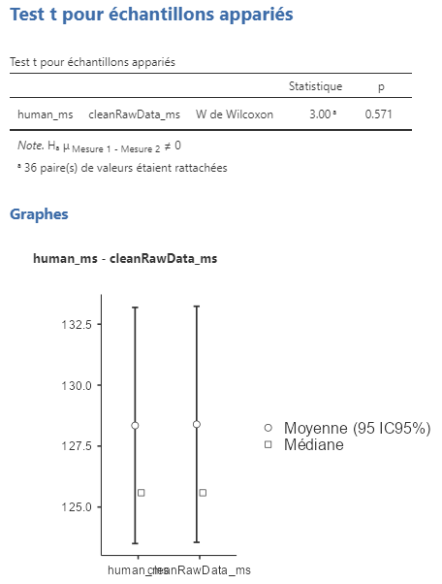
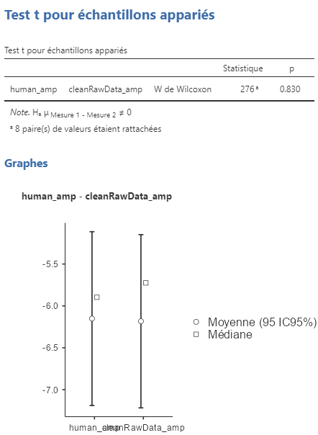
Sub-Question: Comparison of the results between human and flag bad channel of CleanRawData during a manual processing ?
In addition, perform a statistique on the N170 peak extraction between 188-282 TF (on channel 28 = PO8).
Time of the peak N170
Amplitude of the peak N170
No difference of N170 peak if you interpolate based on human decision or automatic flag bad channel decison from CleanRawData. So you can use the cleanRawData option.

Slide 20
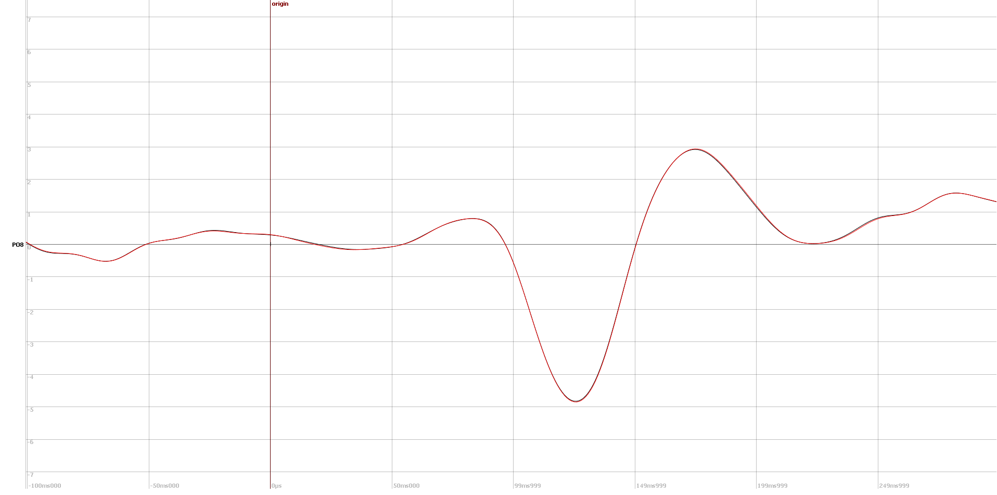

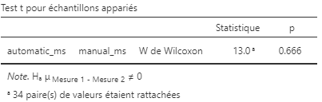
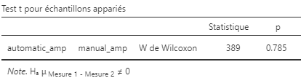
Validation 4: N170 ERP batch vs. Manual processing
For the manual, I have take the cleanRawData version to be more comparable
Black = Batch Automatic
Red = Manual processing
Stat paired T-test FDR corrected:
No difference
In addition, perform a statistique on the N170 peak extraction between 188-282 TF (on channel 28 = PO8).
Time of the peak N170
Amplitude of the peak N170

Slide 21
Conclusion for the validation 4:
The statistical result on the N170 are identical after a automatic processing in Batch mode or processing running manualy step by step.
The statistical results of the N170 are identical between an manual interpolation after a human visual inspection or after interpolation following the flag bad channel of CleanRawData toolbox.
In conclusion, the batch mode of EEGpal is validated !!!!!!
The next tests could be perfom in batch automatic mode.

Slide 22
Validation 2: Results processed by EEGpal 2.0 and EEGpal 1.4
The eeglab version has been upgrade from 2023.1 to 2025 + upgrade of CleanLine from 2.0 to v2.1 + upgrade clean_rawdata from v2.91 to v2.10 + firfilt v2.8 (function use for filtering)
The purpose of this validation is to check if the results are still similar after the upgrades.

Slide 23
Processing parameters for validation 2
Bridge detection
Filtering + : eeglab filter from 0.5-40 Hz + Cleanline 60 hz + CleanRawData (ASR + Label bad channels)
Visual inspection bad channel performed during validation 4
ICA with ignore bridged and bad channels (remove only eye compounds)
Interpolation automatic with Flag Bad channel suggestions
Re-Ref: to average ref
Epoching -100 to 300ms and shift the trigger of 26ms. Pre-baseline correction -100 to 0ms Artefact rejaction Amplitude + step ERP1 for trigger 1-40 (face) and ERP2 for trigger 41 -80 (car)
Substraction ERP1-ERP2
Negative Peak extraction between 110 à 150 ms

Slide 24
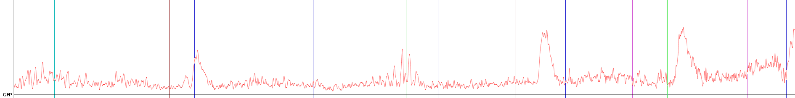
Comparaison results of Filtering +
Illustration based on sub-01
Black = results of Filtering+ in EEGpal 1.4
Red = results of Filtering+ in EEGpal 2
Total overlap between the two files. The results is identical ! (checked on several subjects)
Comparaison results of ICA
Black = results of ICA in EEGpal 1.4
Red = results of ICA in EEGpal 2
Similar but with small difference due to the ICA decomposition itself which is never exactely the same

Slide 25
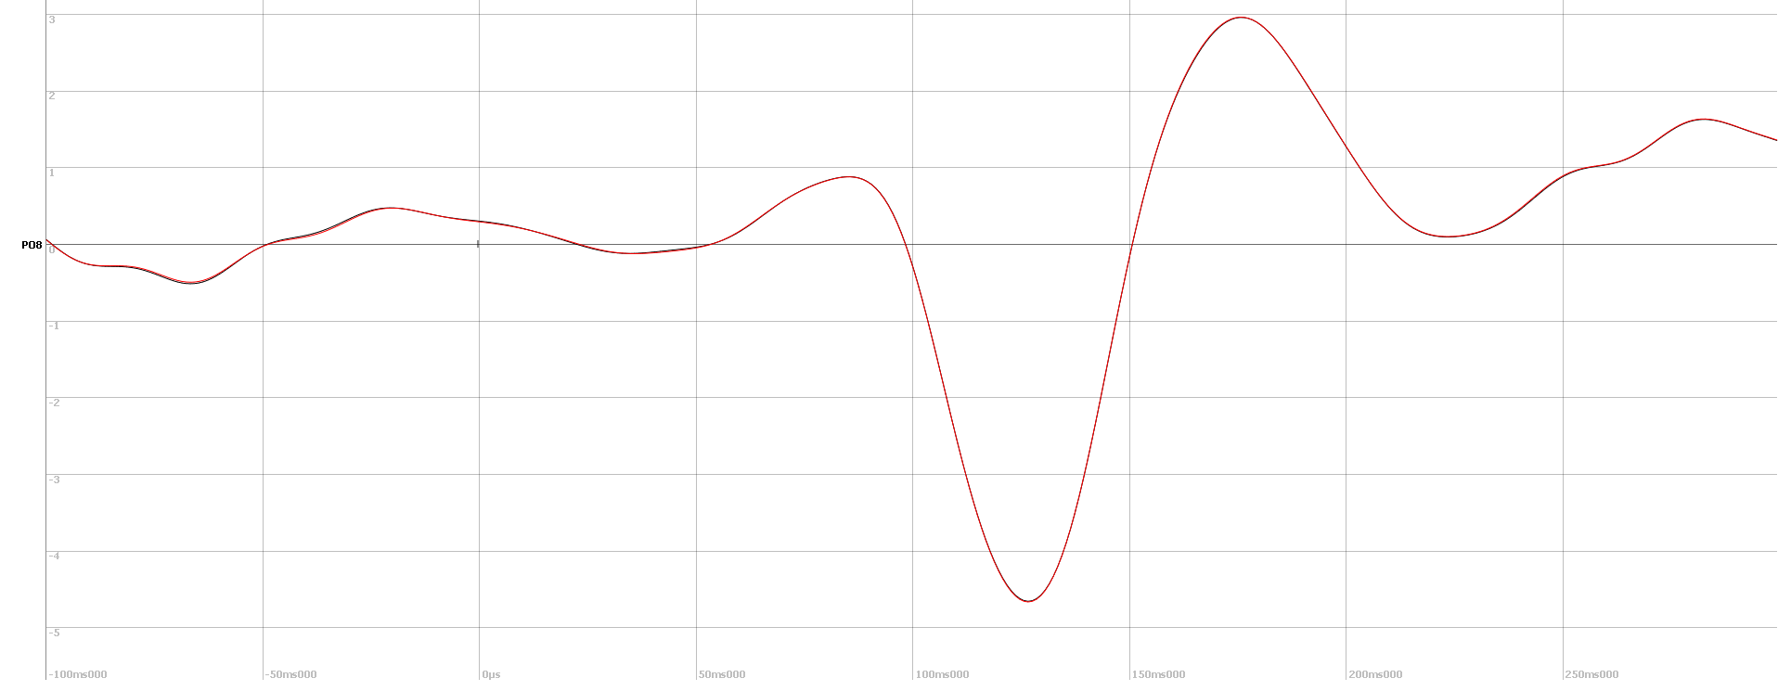
Validation 2: EEGpal 2.0 vs. EEGpal 1.4
Black = processing with EEGpal 1.4
Red = processing with EEGpal 2 (in batch mode)
In grey, the electrodewise paired T-test uncorrected or FDR corrected don’t show any significant results on PO8.
The results are identical. It validate that the deveoppement of EEGpal 2 + upgrade of eeglab tools has not change the results of the processing.

Slide 26
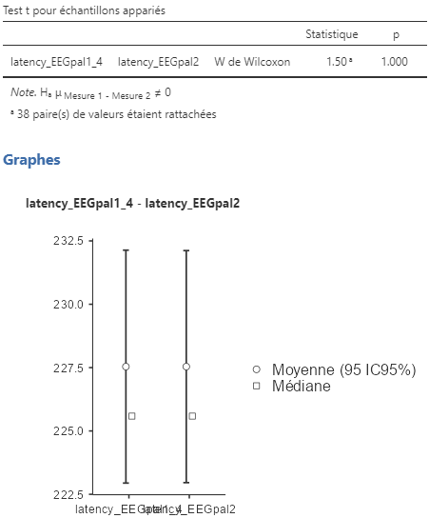
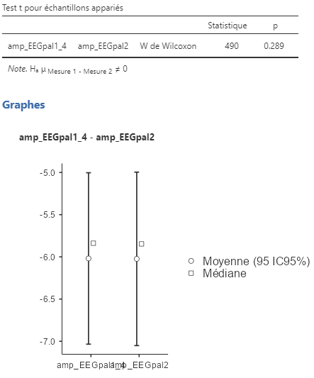
Validation 2: EEGpal 2.0 Vs EEGpal 1.4
In addition, perform a statistique on the N170 peak extraction between 188-282 TF (on channel 28 = PO8).
The peak extraction is perform with the module Peaks export of EEGpal
Time of the peak N170
Amplitude of the peak N170
Nothing significant.
It is the same results between the two processings.

Slide 27
Conclusion for the validation 2:
The statistical result on the N170 are identical after a processing pipeline with EEGpal 1.4 and EEGpal 2 (performed in batch mode)
In conclusion, the upgrade of EEGpal codes (batch mode, sessionParameters, automatic bad ICA components suggestions) and the update of eeglab and its pluging doesn’t change the results of the previous EEGpal

Slide 28
Processing parameters for validation 1
Filtering + : eeglab filter from 0.1-20 Hz
Re-Ref: to average ref
ICA to remove only eye compounds (without ignoring bad channels)
Interpolation of the same electrodes as the authors suggested (according to the file \processing_scripts\EEG_ERP_Processing\Interpolate_Channels_N170.xlsx
Epoching -200 to 800ms and shift the trigger of 26ms. Pre-baseline correction -200 to 0ms Artefact rejaction Amplitude + step ERP1 for trigger 1-40 (face) and ERP2 for trigger 41 -80 (car) Downsample to 256 Hz to be able to compare
Substraction ERP1-ERP2
Negative Peak extraction between 110 à 150 ms

Slide 29
Detail of the preprocessing of ERPcore
Script1 :
Shift les trigger de 26ms pour prendre en compte le rafraichissement de l’écran
Download sample de 1024 à 256 Hz
Re-ref à l’average reference
Mettre les coordonné des électrodes
DC correction avec un high-pass à 0.1 Hz
Script2 :
EEG cut pour retirer les segments entre les blocks
Retire les noisy segment de l’EEG avant l’ICA. Rejection automatique avec les deux techniques habituelles en même temps :
Max amplitude
Max step
Il ajuste les threshold en fonction de l’inspection visuel du signal
Script3 :
Runica : Décomposition ICA.
Preparation manuel d’un fichier Excel avec les composantes à retirer
Détection des composant lier au mouvement des yeux vertical et horizontal
Script4 :
Recomposition du signal dans les composantes des yeux
Script5 :
Epoching, séparation des EPOCH par conditions de -200 à 800ms
Pre-Baseline correction de -200 à 0ms
Scripts6 :
Inspection visuel des data et génération du fichier « Interpolate_Channels_N170.xlsx » avec les électrodes à interpoller.
Lire le fichier précédent et interpolle les électrodes
Il récupère aussi des fichier Excel avec les Epoch qui sont noisy (amplitude, step, etc..) mais je comprend pas bien pourquoi car on les a retirer avant
Script 7 :
Effectue le moyennage en excluant les trials avec une réponse fausse
Applique un filtre low-pass à 20Hz
Script 8 :
Plot les résultats

Slide 30
Interpolation for EEGpal processing
After comparing the visual inspection done for the validation 4 and the suggested bad electrodes provided by the authors in the ERP CORE dataset (folder: \processing_scripts\EEG_ERP_Processing\Interpolate_Channels_N170.xlsx), I have seen that we were agree at 80% on the bad electrodes. So I decided to interpolate the same electrodes as the authors to make the comparison between the two processing easier.

Slide 31
For the ERPcore dataset
I will work on the data preprocessed available in the repository « N170 All Data and Scripts ».
The final processed file are #_N170_shifted_ds_reref_ucbip_hpfilt_ica_corr_cbip_elist_bins_epoch_interp_ar.set. It contains the accepted epoched (epoched file). The marker B1 are for face correct and B2 for car correct. Unfortunately, EEGpal don’t manage event with string name. I have manipulated the script open_eeglab.m from EEGpal in order that it saved a marker 1 when it is B1 and a 2 when it is B2. It works.
Then I use the Epoching module of EEGpal to obtain ERPs for each participant. :
EPOCH-200 to 800 ms
No baseline correction (already done by their processing script)
No artefact rejection (already done by their processing script)

Slide 32
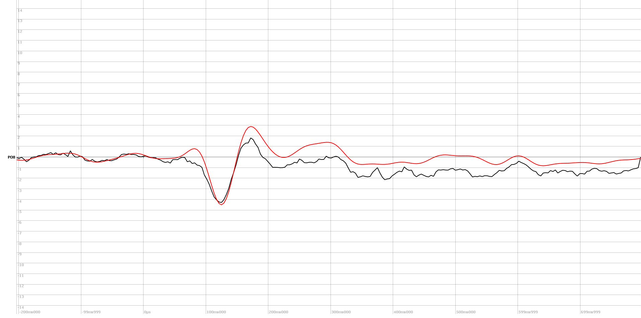
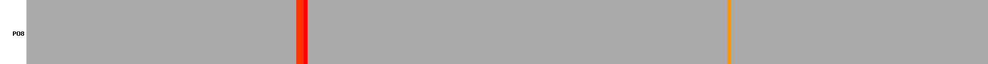
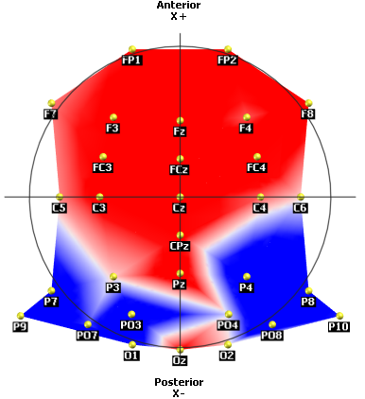
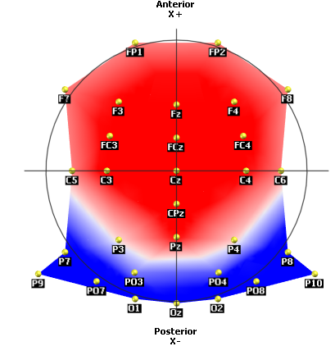
Validation 1: Grand mean
Paired T-test p<0.05 with FDR correction
There is some siginificant difference between 81-89 ms but it not impact the N170
Black = Processing of done by ERPcore teams
Red = processing done with EEGpal
Topo N170
ERPcore
The N170 topo is even better for the processing with EEGpal2
EEGpal

Slide 33
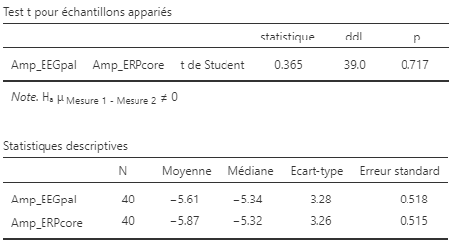
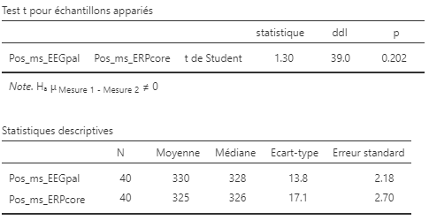
Validation 1: Peaks analysis
In addition, perform a statistique on the N170 peak extraction between 73-96 TF (on channel 28 = PO8).
The peak extraction is perform with the module Peaks export of EEGpal
Amplitude
Latency
No significant difference

Slide 34
Conclusion for the validation 1:
The statistical result on the N170 are similat after a processing pipeline with EEGpal 2 and the piepline processing porposed by Emily S. Kappenman in ERPcore.
In conclusion, the EEGpal software has been validated with an external dataset. It provide similar results as the authors script. The results coming from EEGpal are trust full.

Slide 35
Processing parameters for validation 3 for Cartool
Filtering + : Signal processing filter from 0.5-40 Hz 1 Notch 60 Hz
Interpolation using Matlab mode of the electrode according interpolation table from validation 4
Re-Ref: to average ref
Epoching -100 to 300ms Pre-baseline correction -100 to 0ms Artefact rejaction Amplitude Averaging between ! (generate directely the grand mean with the option between) ERP1 for trigger 1-40 (face) and ERP2 for trigger 41 -80 (car) Substraction ERP1-ERP2

Slide 36
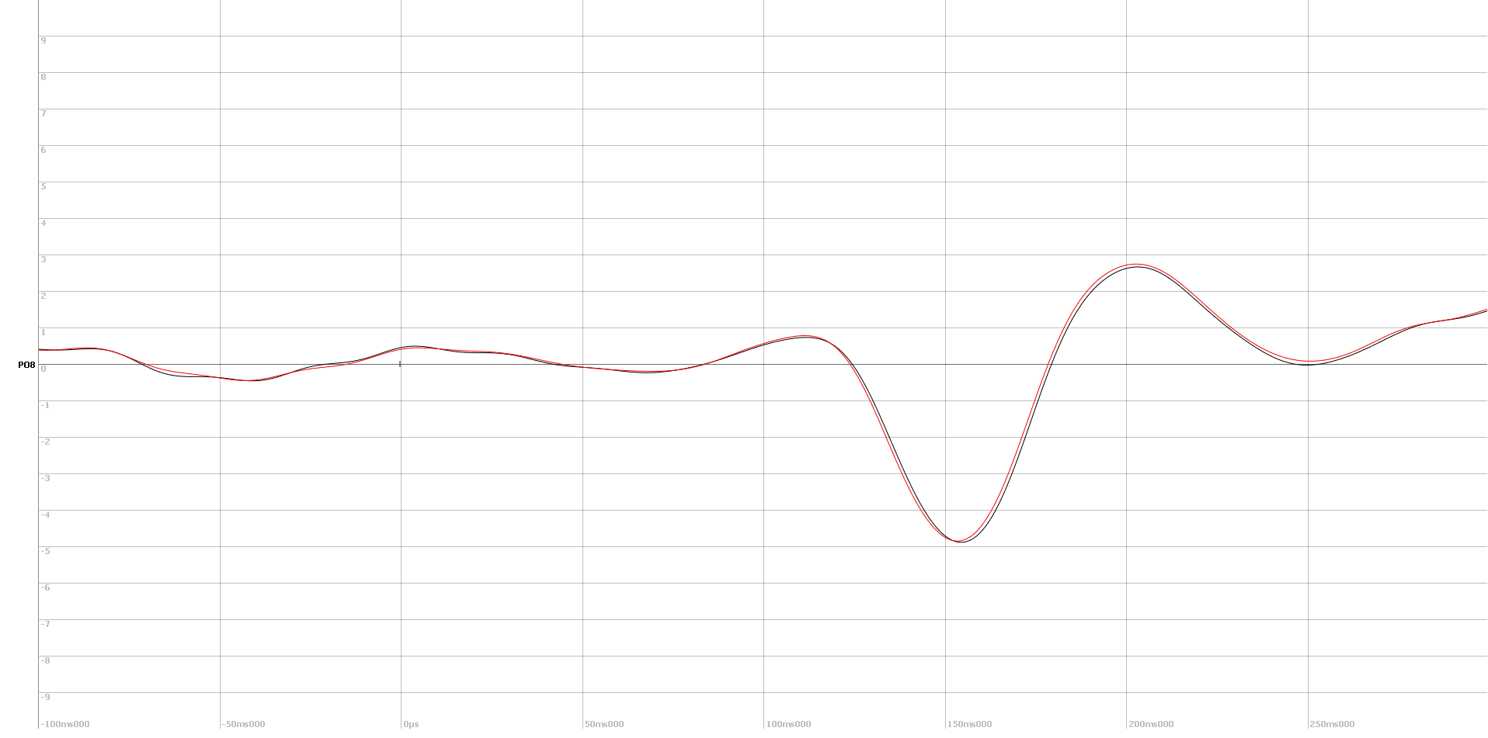
Validation 3: Grand mean
Black = Cartool Processing
Red = EEGpal processing
The processing is validated ! It is the same results between EEGpal and Cartool.
The N70 peak is at 153 ms instead of 125 ms for the other validation. The reason is that I did not move the origin of 26ms as the ERPcore’s authors + 2ms shit due to the difference of filtering.

Slide 37
Conclusion for the validation 3
The results of processing perform by EEGpal in Cartool mode are still identical as processing perform in Cartool directely, even after upgrade to EEGpal2. The original purpose of EEGpal is conserve !

Slide 38
General conclusion of the validation process
This validation work has demonstrated :
The results obtained after processing the EEGpal 2.0 with an external dataset on a well-known brain component (N170) were trustful. They were similar to those published in the article. : Kappenman ES, Farrens JL, Zhang W, Stewart AX, Luck SJ (2021). ERP CORE: An open resource for human event-related potential research. Neuroimage, 15;225:117465. doi: 10.1016/j.neuroimage.2020.117465
The new batch system of EEGpal 2.0 is working and produce the same results as a manual step-by-step processing
The results from EEGpal 2.0 are comparable with the results from the previous version 1.4
For people using Cartool, the results are almost identical using EEGpal 2.0
In conclusion, EEGpal is operational and can be relied upon for your future EEG research.

