Slide 1
Validation EEGpal v1.2
Michaël Mouthon
05.06.2024

Slide 2
Description of the release
After meeting with Selma and Natascha, it has been decided that we could use EEGpal if it call the exact function of eeglab which is well known in scientific community.
It is why I had to modify the module Filtering+ and Interpolation, in order to call eeglab function instead of other alternatives.

Slide 3
Steps of the processing
Read bdf and suppress EXG channels
Filter 0.3-40 + 50 Hz Notch (no ASR, no Cleanline)
Interpolate the same channels. Table of interpolation is :
Re-ref on the average channel
ICA decompositions (EEGlab decomposition for Cartool, EEGpal and EEGLAB)
Epoching automatic with 100microV rejection threshold. No Baseline correction
Make grant average for comparision
Participant | Electrodes to interpolate
P012 | A8
P016 | A15, B20
P018 | B28
P034 * | B11
P048 | -
P061 | B20
Decision based on Cartool filtred signal * reference sinal to observe
Interpolation done with the same coordinate file with the official layout (spherical head)

Slide 4
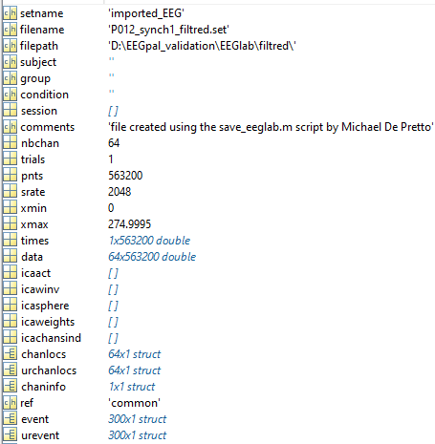
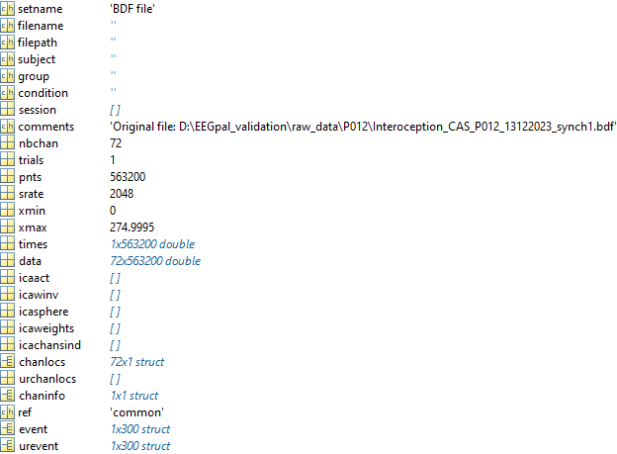
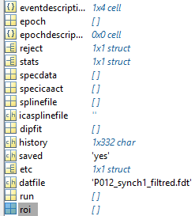
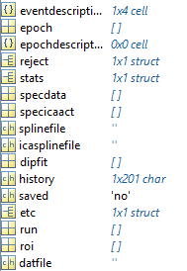
Comparaison of .set structure between eeglab and scipt from MichaelBP
Fichier Interoception_CAS_P012_13122023_synch1_filtered.sef
Use of eeglab_datastruct from MichaelDP
Import bdf with biosig in eeglab interface
Both structure are identical. No compatibility problem

Slide 5
Modification of module Filtering+
The default option of Filtering implemented by MichaelDP use of the filtfilt function which is a commercial product (Signal Processing toolbox of Matlab)
I have add the option to use the the function pop_eegfiltnew used un EEGlab and developed by Arnaud Delorme.
Decision on the implementation:
- Filter order, the filter order value are not comparable between the two algo. I decided to stick to the automatic way of eeglab to determine the order (diminution of 6 dB at 0.5 of the lower bound). For exemple with a high pass frequency at 0.3 Hz, the decrease of 6 dB will be mesure at 0.3-(0.3/2)= 0.15 Hz. When you use bandpass (include high and low pass filter), it is the sharper parameter which will be applied. If you perform the high-pass and low-pass filter successively, then the order will be smaller (less sharp) for the low pass filter than the high pass. It is why it is better to perform a band pass with the two cut-off frequency at the same time to benefit of a sharper frequency cut in both boundaries.
Filter sucession: perform a pass band instead of a high pass, low pass successively like MichaelDP. Justification at previous point.
The module has been adapted in order that the other function (resampling, cleanLine, artefact correction) can be used as well. Instead of use open a .set as done in ICA module, I used the function eeglab_datastruct from MichaelDP to create a EEG struct as eeglab expect to have

Slide 6
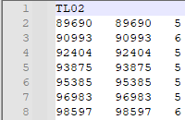
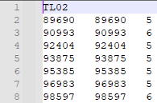
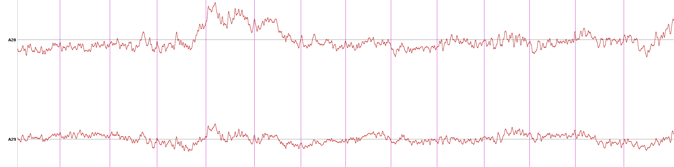
Validation of Filtering for a single file
Fichier Interoception_CAS_P012_13122023_synch1_filtered.sef
Test 1: Position of the event
New eeglab version
Original filtfilt version
Validated, position are identical and correct when you look the raw bdf file
Black = EEGpal 1.2 call eeglab filter
Red = filter done in eeglab interface
Test 2: Comparison of the filtering result
Perfect match
validated
Notes:
It has also been tested on P061_synch4_filtred_exported.sef and the results is the same between eeglab interface and EEGpal 1.2 with eeglab filtering option activated.

Slide 7
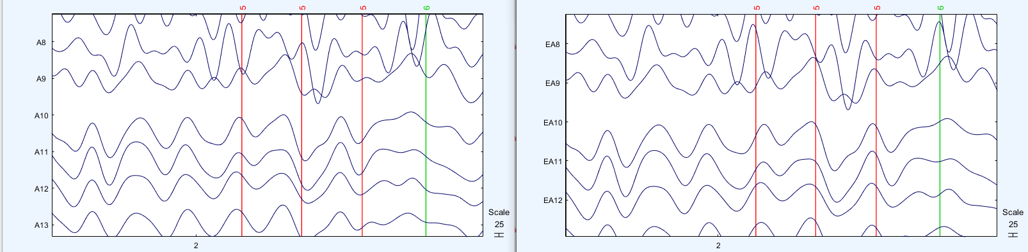
Validation of Filtering for a single file
Fichier Interoception_CAS_P012_13122023_synch1_filtered.sef
Test 2: Comparison of the filtering result in eeglab environement display (.set)
EEGpal call eeglab filter
filter done in eeglab interface
Comparison of data matrix in Excel (file: comparaison_EEGpal_call_eeglab.xlsx)
Difference between very small <0.00184. So can be considered as negligible. There is a bite variability (difference are not constant).

Slide 8
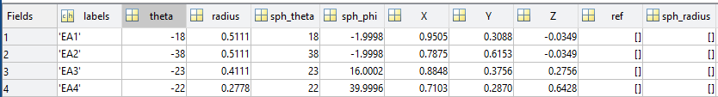
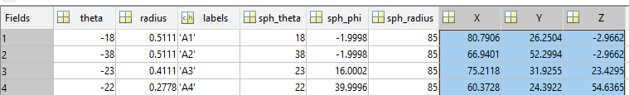
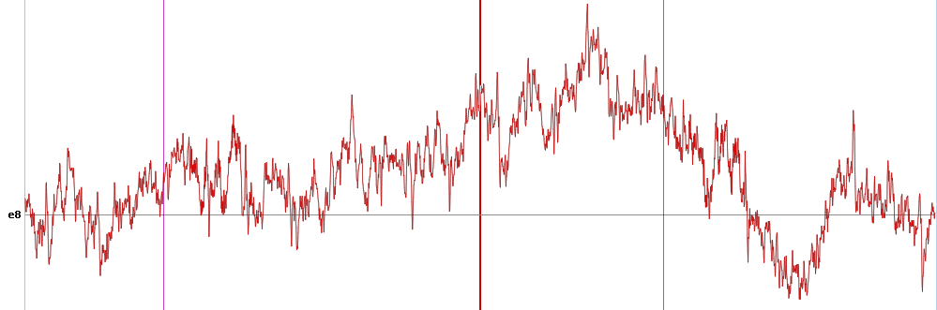
Interpolation: Stratégie eeglab vs. eeglab_datastruct de MichaelDP
La question se pose essentiellement au niveau des coordonné spatiales des électrodes. Il y a une difference dans le structure après import des .locs dans eeglab et celle créé par eeglab_datastruct .
EEG.chanlocs
Créé par eeglab_datastruct de MichaelDP sur la base du fichier de coordonné .locs
Après importation du fichier .locs depuis l’interface eeglab
Les coordonné theat, radius, sph_theta, sph_phi sont identique mais pas sph_radius, X, Y, Z. Est-ce que ça impact l’interpolation ?
Electrode 8 interpole. En noir fichier avec import .locs depuis interface eeglab et en rouge l’import du .locs depuis EEGpal.
Les deux ont exactement le même résultat. On peut donc utiliser l’import du .locs de EEGpal sans avoir à écrire des fichier intermédaire par commande eeglab.
Cependant par sécurité, je demande à l’utilisateur de loader le fichier .locs qui sera utilizer pour modifier les coordonnés dans les fichier .set avant interpolation (comme ça je pend aucun risque).

Slide 9
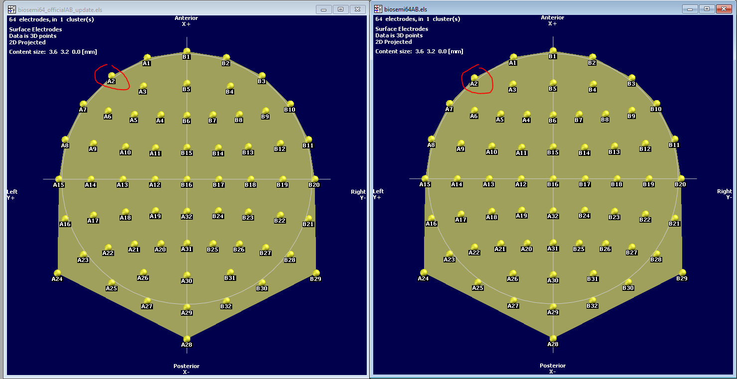
Correction fichier de coordonné biosemi64AB.locs
En utilisant l’outil de conversion dans eeglab, j’ai remarque que les coordonnées de ceraines électrodes (environ 6) étaient incorrect par rapport au fichier de coordonné official fourni par Biosemi (Cap_coords_all.xls). J’ai corriger le fichier de en biosemi64_officialAB_update.locs
biosemi64_officialAB_update.locs (new)
biosemi64AB.locs (previous)
Dans cet exemple, l’electrode A2 était un peu décallé dans le fichier biosemi64AB.locs par rapport au biosemi64_officialAB_update.locs

Slide 10
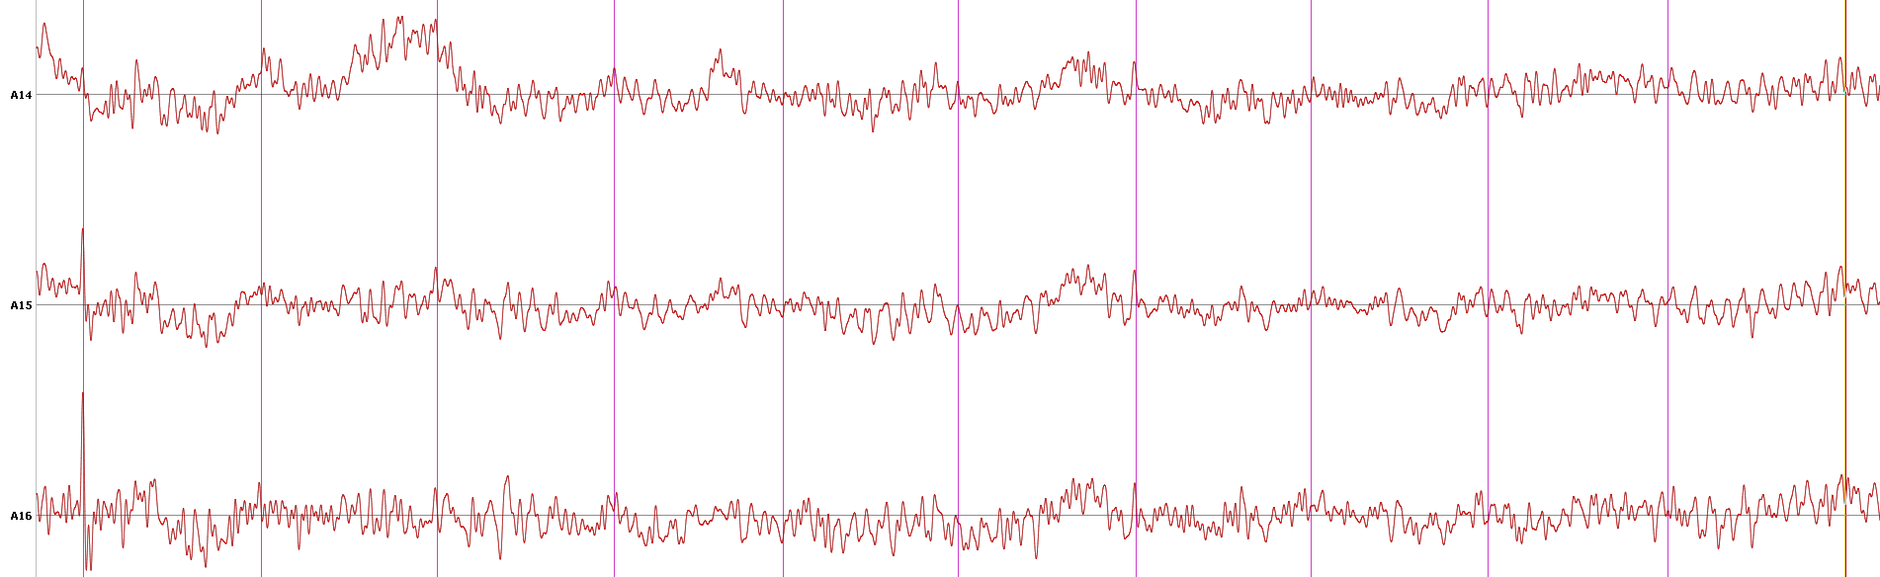
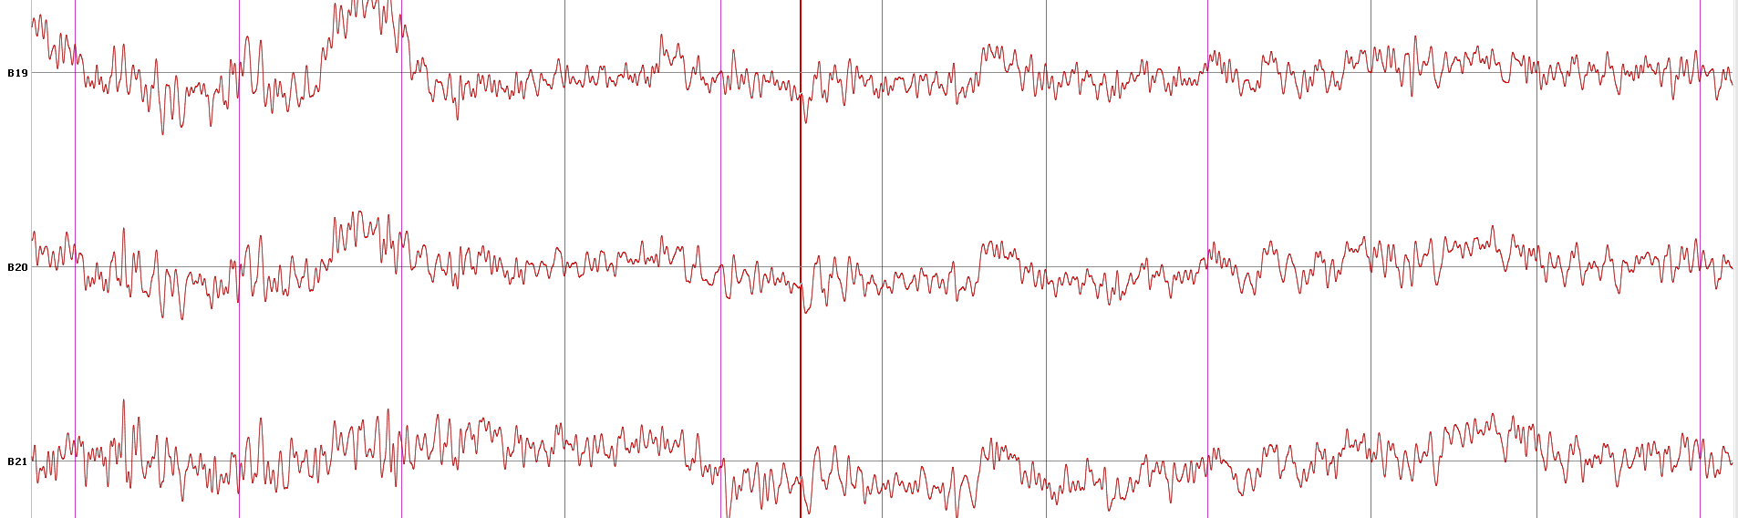
Validation of Interpolation EEGpal 1.2 (spherical) for a single file
To compare the efficiency of the interpolation methods, I interpolate the same electrode A15 B20 with the same cap coordinate on the same original file P016_synch1_filtred_inter_exported (coming from the eeglab interpolation).
Black = eeglab
Red = EEGpal 1.2 with Spherical interpolation
Interpolated channel
Interpolated channel
Conclusion: The new module Interplation of EEGpal 1.2 using spherical interpolation algo from eeglab is working. The result are the same as it was run inside of eeglab.
Notes:
Vérifier aussi sur le fichier Interoception_CAS_P034_28022024_synch1_filtered_interpolated.sef; Le résultats de l’electrode B11 interpole et les autres sont identique entre l’analyse de l’interface dans eeglab et dans l’interface EEGpal.

Slide 11
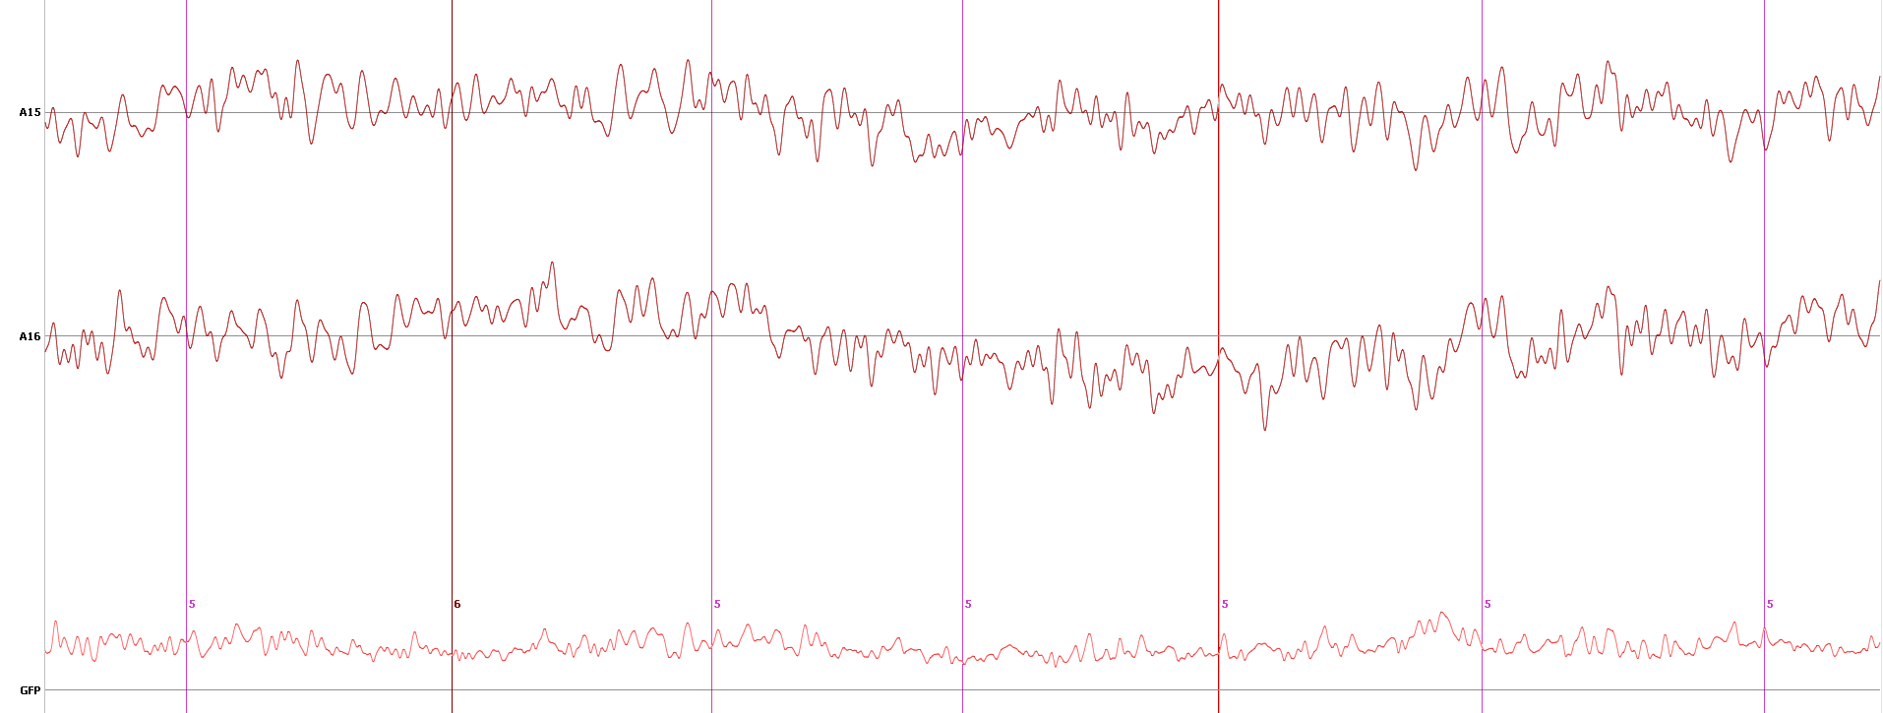
Validation of average Re-ref for a single file
To compare the efficiency of the average re-ref methods. I use the file P012_synch1_filtred_inter.set (coming from the eeglab filtering).
Black = eeglab
Red = EEGpal 1.2
Perfect overlap
The reref algo of MichaelDP give exactly the same results as the re-ref from eeglab

Slide 12
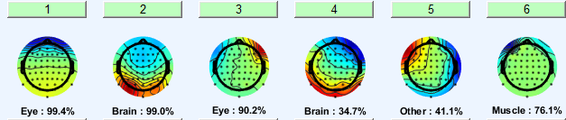
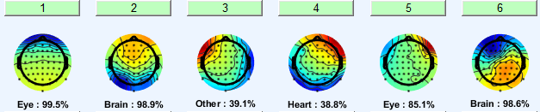
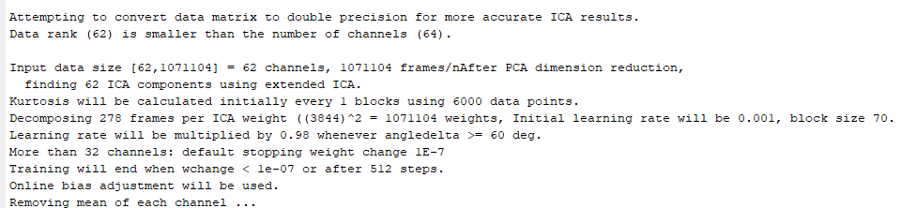
Validation ICA
Based on file Interoception_CAS_P012_13122023_synch1
eeglab
EEGpal 1.2
eeglab modify the number of compound because it detect a rank matrix of 62 probably due to re-ref. It was the same at the analysis fully perform in eeglab interface.

Slide 13
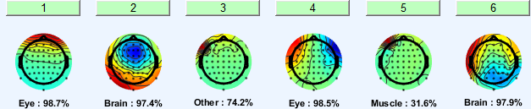
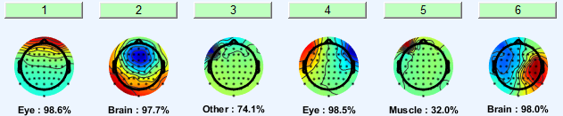
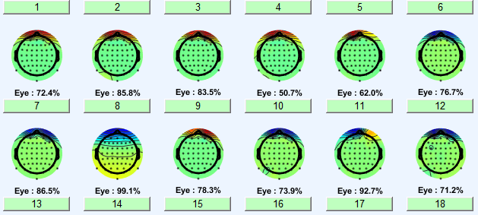
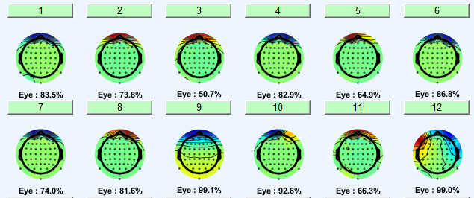
Validation ICA
Based on file Interoception_CAS_P016_19122023_synch1
eeglab
EEGpal 1.2
With this participant, almost the same ICA decomposition has been found
Based on file Interoception_CAS_P018
It is not a problem of the new version EEGpal1.2; this strange decomposition was also observed with the full eeglab processing

Slide 14
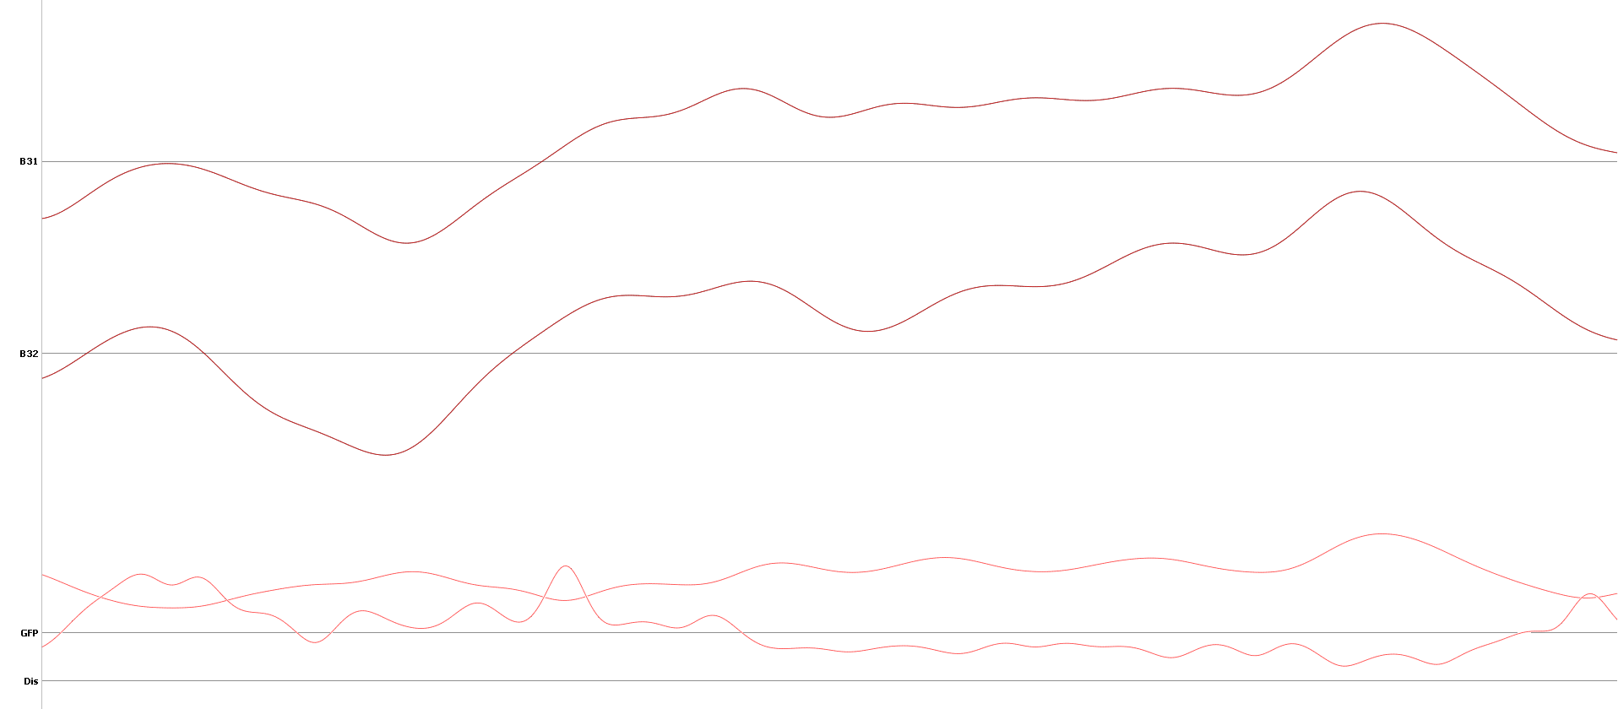
Comparaison between EEGpal Epoching module dans Cartool averaging
Grand average difference 5-6 = MMN
Black = EEGpal 1.2
Red = Cartool
Perfect Match !!
This validate the Epoching module of EEGpal ! The result of grand average over two conditions across 6 participant give exactly the same results between Cartool and EEGpal. It means that the individual means will also fit.
We can trust the Epoching module of EEGpal
Notes:
Parameters: rejection Epochs >100 microV.
Previous result was not exactly the same because I directly averages all the participants. Here, I make individuals means and then the mean of these means (the means of means give never exactly the same results as the direct mean across participant).

Slide 15
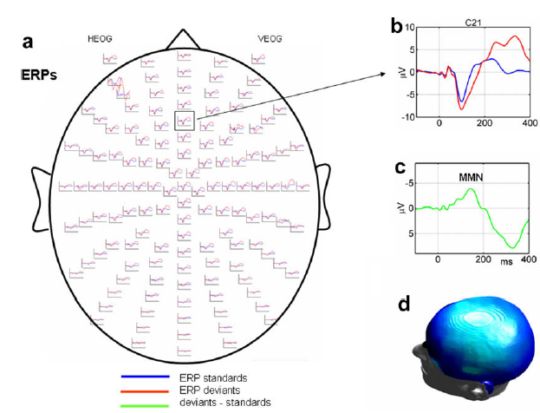
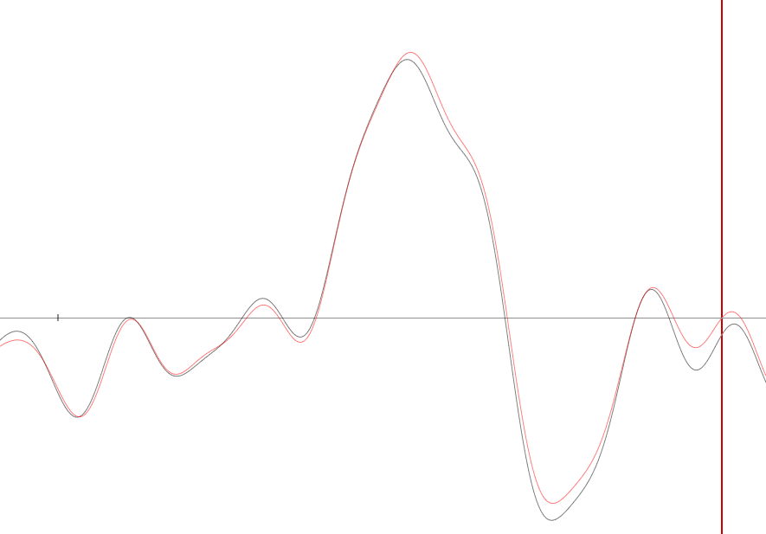
Missmatch Negativity (MMN) Comparison with litterature
Black = eeglab
Red = EEGpal 1.2
0 ms
200ms
Garrido MI, Kilner JM, Stephan KE, Friston KJ. The mismatch negativity: a review of underlying mechanisms. Clin Neurophysiol. 2009 Mar;120(3):453-63. doi: 10.1016/j.clinph.2008.11.029. Epub 2009 Jan 31. PMID: 19181570; PMCID: PMC2671031.
Similar results
Notes:
https://www.sciencedirect.com/science/article/pii/S1388245708012686?via%3Dihub

Slide 16
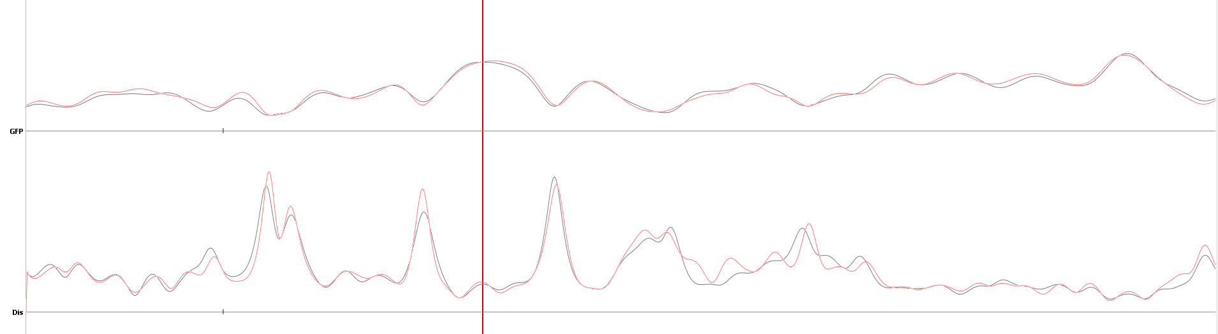
Comparison of the Grant Mean for Missmach Negativity (MMN)
Substraction : Sound-noSound (MMN for cardio synch condition over 6 patients)
Black = eeglab
Red = EEGpal 1.2
Remarks:
Similar but not identical due to the variability in the ICA decomposition. I am sure because all the other steps provide exactly the same results between eeglab and EEGpal 1.2 (with the option eeglab)

Slide 17
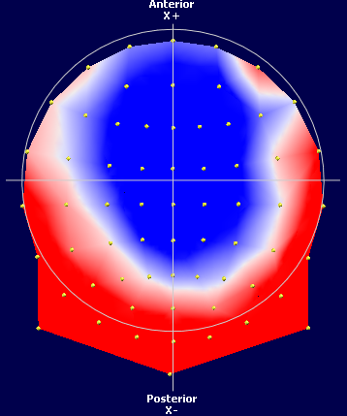
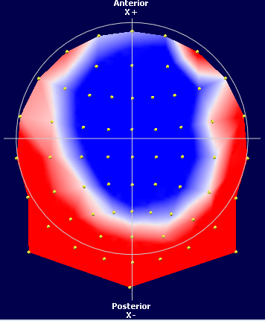
Comparison of the Grant Mean for Missmach Negativity (MMN)
TF: 481 = 135 ms post stim (MMN peak position)
eeglab
EEGpal 1.2
Topo of EEGpal 1.2 with eeglab option and full eeglab are identical

Slide 18
General Conclusion
The MMN results are quite similar between the different analysis methods (the final result will not depend on the toolbox choice)
The worst performance is provided by BrainVision (I don’t recommend the use of this software)
The two matlab softwares (eeglab and EEGpal) give the cleanest results (better than a pure Cartool pipeline)
The EEGpal version 1.1 is totally correct and validated for ERPs study. Each processing steps give a correct result in comparison of other EEG processing software.

Slide 19
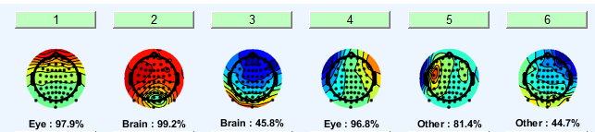
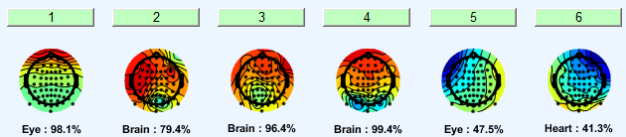
ICA
Fichier Interoception_CAS_P012_13122023_synch1_filtered.sef
Test de la suppression de l’electrode A8 et regader le résultat
Résultat precedent après interpolation
Output with 63 electodes au lieu de 64
Test de ICA si on decide d’ignorer l’electrodes A8
La comparaison visuel du résultat des électrodes frontales entre ces deux ICA sont bon. On a plus de blink.
On garde les 64 electrodes donc c’est bigo
Je peux implementer ça dans mon module ICA pour ignorer certain channel mais il seront conserver à l’output.

Slide 20
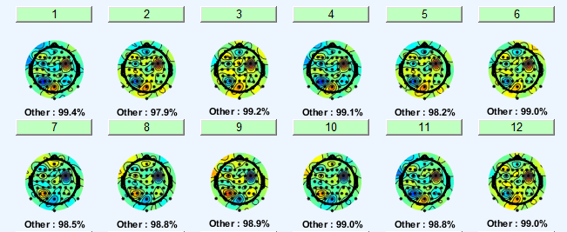
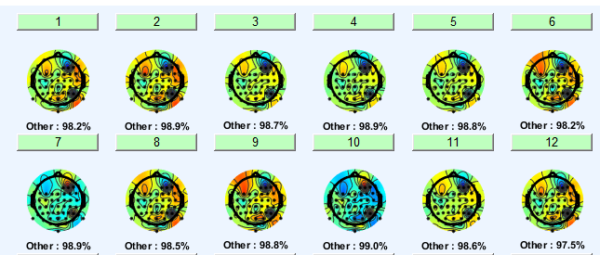
Test avec P022 et P023 non filtré (bdf)
P022
P023 avec suppression des électrodes frontales (1-6 + 33-38)
On voit rien au niveau oeil
On voit rien au niveau oeil
Le test à permit de verifier que la recomposiaiton et save marche avec la nouvelle option dans le module ICA.

Slide 21
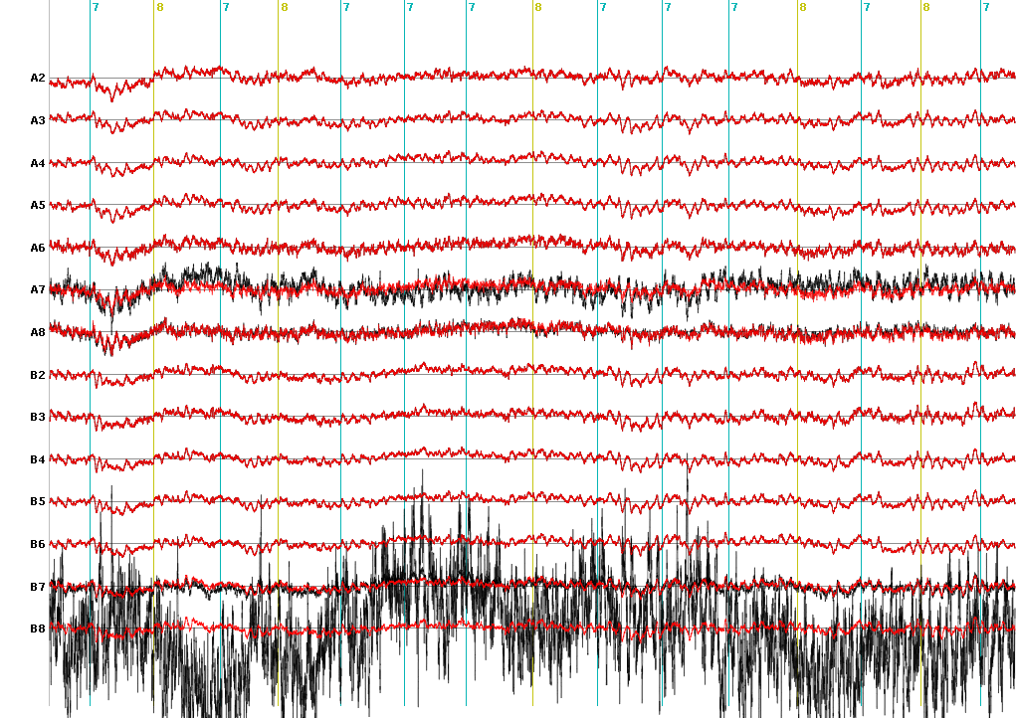
Vérification de la consequence d’ignorer une électrodes dans la decomposition ICA
Fichier Interoception_CAS_P023_asynch1.sef
Les électrodes 1-6 (A1-A6) + 33-38 (B1-B6) ont été ignorer à la decomposition ICA.
En noir le signal reconstruit (ICApruned) après avoir supprimer deux composantes et en rouge c’est le signal brute.
On observe que le signal pour les électrodes ignorer est identique au signal brute. Cela veut dire que eeglab remet le signal original pour les channel ignorer. C’est exactement ce que je voulais. C’est la meilleures stratégie ! Bien mieux que de supprimer des électrodes du dataset comme précosisé dans le tuto eeglab.
Ce résultat permet de prouver que eeglab fait bien ce que j’attendait de lui et que ma modification du module ICA fonctionne.

